Slide 1
WELCOME
Honorable Chairman & Respected Members
of
Expert Appraisal Committee, (Industry - I)
Ministry of Environment, Forests & Climate Change
New Delhi
Environmental Clearance Presentation
OF
Proposed Expansion of Integrated Steel Plant
At
Village Borjhara, Urla Guma Road, Urla Growth Center
Raipur (C.G.)
PROJECT PROPONENT
M/s. Shri Bajrang Power and Ispat Limited
Raipur (C.G.)

Slide 2
BRIEF BACKGROUND OF THE PROJECT
On 30th April 2021, proposal for expansion project of Shri Bajrang Power and Ispat Limited Borjhara was appraised by Honorable EAC (Industry-I).
In view of the observation of the EAC (Industry- I) and orders of Government of Chhattisgarh banning certain Coal based projects, SBPIL has partially withdraw its proposal of expansion of Sponge Iron Plant and Change in fuel mix in existing Captive Power Plant.
In compliance of the above mentioned meeting , we make this presentation before the Honorable EAC (Industry- I) for grant of Environment Clearance on the basis of ADS.
The PP has changed the previous consultant and appointed PECS, Nagpur as new consultant

Slide 3
OBSERVATION No. 1 | Proposed steel plant is located in a Urla Industrial area wherein the State Government of Chhattisgarh imposed ban on establishment of new sponge iron plant and coal-based power plant (Ref: 783/205/07 dated 16/03/2007) and ban on diversification (involving use of coal as fuel or raw material) of the existing industries [Ref: 3529/205/05/11/(E) dated 12/12/2007]. The provisions contained in the said notification neither considered by the proponent nor reflected in the EIA report.
COMPLIANCE | The proposal was considered in 35th meeting of REAC (Industry I) held on 30th April 2021 and returned in present form. In the view of the observation of the Honorable EAC during the meeting and orders dated 16.03.2007, 12.12.2007 and 15.05.2012 by Industry & Commerce Dept. Government of Chhattisgarh, the company has decided to withdraw the proposal of expansion of Sponge Iron Plant and Change in fuel mix in existing Captive Power Plant. The quality and quantity of coal will remain same in the present proposal.

Slide 4
OBSERVATION No. 2 | 18 trucks per hour of 20 T capacity shall be added to present traffic after expansion. Incremental SO₂ and NOx due to traffic has not been considered in AAQ modelling
COMPLIANCE | After completion of expansion including operational plant maximum 110 to 120 trucks per day (9 to 11 trucks per hour) will move in and out for material transportation and for finished product and other allied work. AAQ Modelling for Incremental PM, SO₂ and NOx due to traffic within plant boundary of proposed expansion is given in slide nos. 5-8.
The model simulations are done for the air pollutant arising due to the transportation. Ground Level Concentration (GLC) have been computed using hourly meteorological data. PM, SOx and NOx will be generated due to the transportation. Based on the number of trucks per hour, the expected emission rate due to various movement of trucks in this project is calculated. Prediction has been assessed based on 2007 standards of CPCB for trucks. Two way movement of truck for raw material and finished product transportation are considered.

Slide 5
EMISSION RATE FOR TRAFFIC MODELLING
CPCB Norm | PM | NOx | SO₂
Year | g/km | g/km | g/km
2007 | 0.28 | 6.3 | 1.42
Emission Rates
 |  | PM | NOx | SO₂
Max No of vehicles/hr | Distance (km) | Emission
11 | 0.9 Km
 | g | 2.772 g | 62.37g | 14.058g
 | g/s | 0.000004375 g/s | 9.84E-05 g/s | 2.21875E-05 g/s
GLC due to the Movement of Trucks inside the plant premises
Maximum Incremental Levels (μg/m³)
 | PM₁₀ | SOx | NOx
Incremental GLC | 0.0038 | 0.0008 | 0.002
Distance/Direction | 30m/NE | 30m/NE | 30m/NE

Slide 6
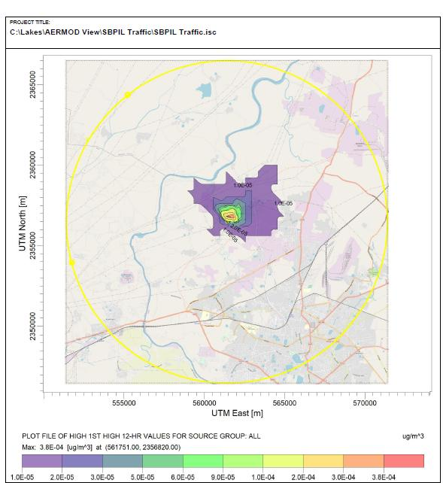
PREDICTED GLCS OF PM DUE TO TRANSPORTATION

Slide 7
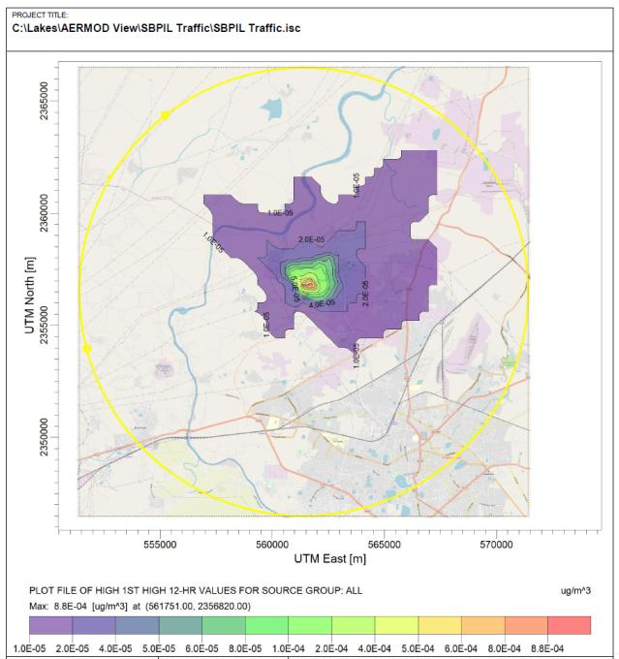
PREDICTED GLCS OF SOx DUE TO TRANSPORTATION

Slide 8
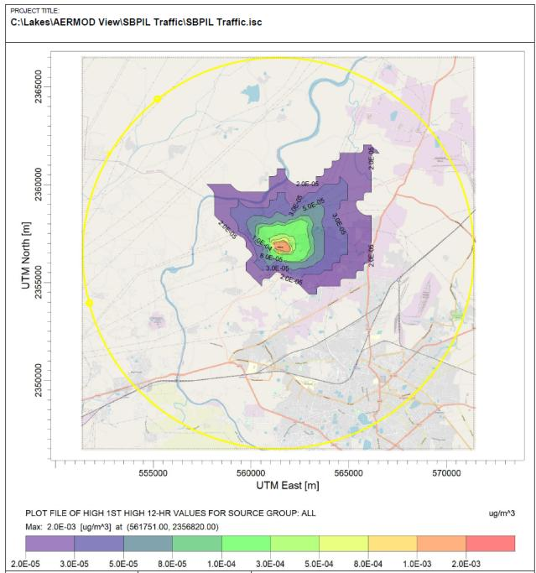
PREDICTED GLCS OF NOx DUE TO TRANSPORTATION

Slide 9
Capacity of Road as per IRC73:1980
Type of Carriage way | Total Design Service volume PCU/day in both direction
Road of intermediate width having carriageway of 7.0 metres | 10000
Road of intermediate width having carriageway of 5.5 metres | 5000
Total existing volume PCU/day in both direction and Level of Service at different road. Date of traffic survey:28/07/2021
Location | Existing Volume capacity PCU | Existing Volume/Capacity ratio | Level of Service
Bendri Birgaon Road | 1794.5 | 0.17 | A-Very Good
Bemdri Guna Village Road | 1544.5 | 0.31 | B-Good
Guna Village Road | 985 | 0.195 | A-Very Good
After expansion total 20 to 22 truck per day and 990 PCU/day will be added in existing road network on both direction. and Level of Service at different road is calculated.
Location | Volume capacity PCU | Volume/Capacity ratio | Level of Service
Bendri Birgaon Road | 2784.5 | 0.28 | B-Good
Bemdri Guna Village Road | 2534.5 | 0.50 | C-Fair
Guna Village Road | 1975 | 0.39 | B-Good

Slide 10
OBSERVATION No 3 | Details of Ferro Alloys to be manufactured is not clear.
It is proposed to expand the manufacturing capacity of Existing furnaces 2 nos. of 4 MVA with replacement higher capacity transformer of 1x5 MVA and 1x6 MVA. After this modification the manufacturing of ferro alloys will be enhanced from 0.0144 MTPA (14,400 TPA) to 0.0198 MTPA (19800 TPA). The Manufacturing products of ferro alloys will be either Ferro Manganese or Silico Manganese. Details are given in the next slide.

Slide 11
OBSERVATION No 3 | Details of Ferro Alloys to be manufactured is not clear.
SILICO MANGANESE – AFTER EXPANSION
S. No | INPUT |  |  | OUTPUT
 |  | TPA | T/T |  | TPA | T/T
1. | Manganese Ore | 35640 | 1.8 | Silico Manganese | 19800 | 1
2. | Coke | 3960 | 0.2 | Silico Manganese Slag | 23760 | 1.2
3. | Coal | 8640 | 0.436 | Gases & Fumes | 26460 | 1.336
4. | Dolomite | 1980 | 0.1
5. | Ferro Manganese Slag | 19800 | 1
Total |  | 70020 | 3.536 | Total | 70020 | 3.536

Slide 12
OR
FERRO MANGANESE– AFTER EXPANSION
S. No | INPUT |  |  | OUTPUT
 |  | TPA | T/T |  | TPA | T/T
1. | Manganese Ore | 39600 | 2 | Ferro Manganese | 19800 | 1
2. | Coke | 7425 | 0.375 | Ferro Manganese Slag | 17820 | 0.9
3. | Coal | 4356 | 0.22 | Gases & Fumes | 17721 | 0.895
4. | Dolomite | 3960 | 0.2
Total |  | 70020 | 55341 | 2.795 | Total | 55341

Slide 13
OBSERVATION No .4 | Action plan for dolochar utilization has not been furnished.
COMPLIANCE | 66,000 TPA of Dolachar is being generated from the existing Sponge Iron Plant, about 47850 TPA is being utilised in 8 MW operational Biomass based power plant in same premises and balance about 18150 TPA is being supplied to 16 MW AFBC power plant at Gondwara plant of M/s. SBPIL unit at a distance of 4 km by tarpaulin covered truck of 20 T.
OBSERVATION No . 5 | The proposed additional use of coal fines to be examined in view of the biomass status of the power plant and to ensure that complete utilization of dolochar.
COMPLIANCE | In the view of the observation of the Honorable EAC during the meeting and orders dated 16.03.2007, 12.12.2007 and 15.05.2012 by Industry & Commerce Dept. Government of Chhattisgarh, the company has decided to withdraw the proposal of expansion of Sponge Iron Plant and Change in fuel mix in existing Captive Power Plant. 100% utilization of Dolachar is being carried in the existing facility in same premises and sister concern situated at 4 km from the proposed site.

Slide 14
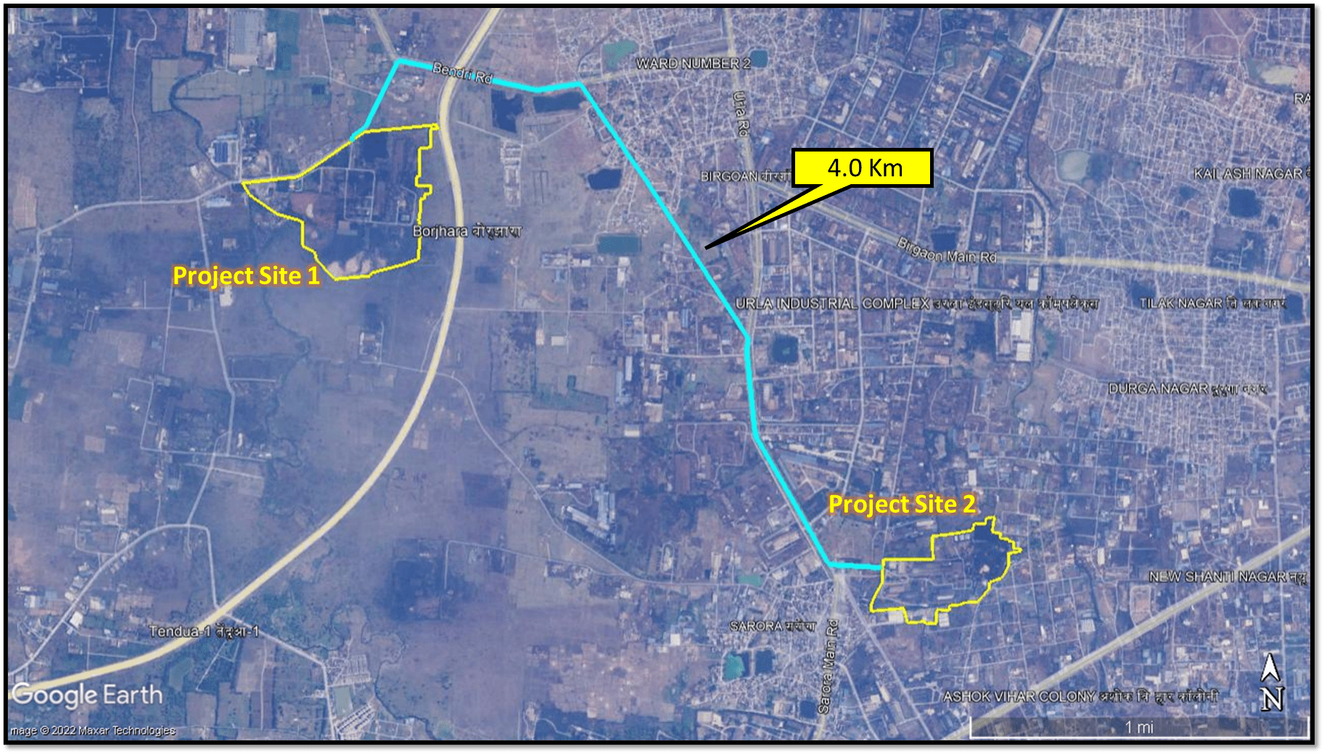
TRANSPORT ROUTE FOR DOLOCHAR
*Project site 1: Proposed project site at Village – Borjhara, Urla - Guma Road, Urla Growth Centre, District Raipur (C.G.).
Project site 2 : Power plant (Gondwara unit).

Slide 15
OBSERVATION NO. 6 | Iron ore slimes @ 35-40 % moisture from U/F of thickener shall be dumped in tailing dump yard for sun drying. No filter press is proposed.
COMPLIANCE | No tailing pond for handling of slimes is proposed. The slimes will be dewatered in the thickener and thickened tailings sludge will be dewatered in horizontal filter press. The overflow from the thickener will be collected into a process water tank and will be reused as make up water. Tailing sludge contains 30 to 40 % moisture which gets reduced to around 15 to 20 % by installing the filter press. The dewatered Tailings will be send to cement plant.
OBSERVATION NO. 7 | Iron Ore slimes shall be sent to cement plant. There is no letter of comfort to this extent, available with PP.
COMPLIANCE | The MOU with Ultratech Cement is given in next slide.

Slide 16
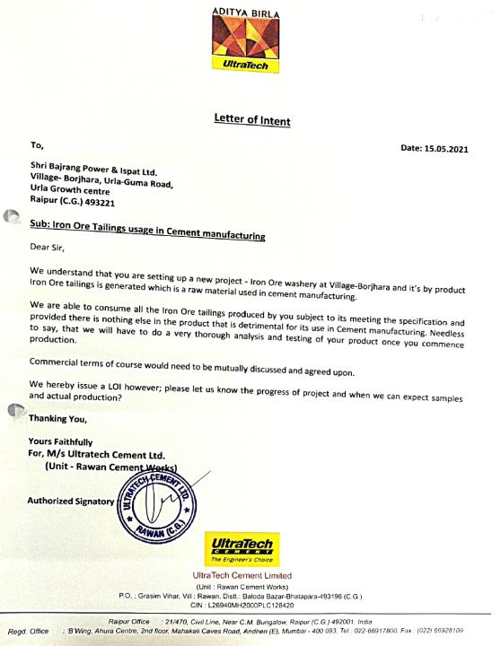
MOU WITH ULTRATECH CEMENT FOR UTILISATION OF TAILINGS

Slide 17
OBSERVATION No. 8 | Several non-compliances are observed in RO compliance letter of 23.3.2020. ATR has been sent after more than one year on 15.4.2021. ATR has not been verified by RO. Major NCs are related to poor housekeeping, incomplete green belt, inadequate RWH and environment laboratory.
COMPLIANCE | RO report is fully complied vide letter No. 5-23/2008(ENV)/-1057 dated 23rd November 2022.

Slide 18
COMPLIANCE STATUS OF CONDITIONS OF EC OF EXISTING UNIT
Certified report issued on 23rd November 2022.

Slide 19
OBSERVATION No. 9 | Incremental concentration of SO₂ is 12.8. μg/Nm³ which indicates almost 100 % increase in SO₂ levels in the study area. No details to minimize SO₂ emissions have been given.
OBSERVATION NO. 10 | There could be net increase in SO₂ emission due to high sulphur in imported coal. The chimney height shall be calculated considering the highest value of sulphur content in coal. No details are provided
COMPLIANCE | In the previous proposal imported coal was considered with high sulphur content. The quality and quantity of coal will remain same in the present proposal, so there will not be any increase in the sulphur content for sponge iron plant and captive power plant. In the view of the observation of the Honorable EAC during the meeting and orders dated 16.03.2007, 12.12.2007 and 15.05.2012 by Industry & Commerce Dept. Government of Chhattisgarh, the company has decided to withdraw the proposal of expansion of Sponge Iron Plant and Change in fuel mix in existing Captive Power Plant. No high sulphur content imported coal will be used. For Proposed Pellet Plant as per calculation and considering 0.5% maximum sulphur content in coal used, the stack height comes to 40 m. The stack of 50 m. will be constructed. The air impact assessment model AERMOD has been re-run for the revised proposal and incremental concentration of SO2 is 4.28 µg/m³.

Slide 20
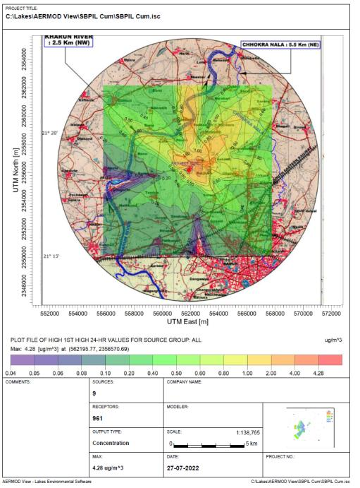
MAP SHOWING GLCS FOR SO₂ (PROPOSED + EXISTING)
Particular | Proposed (µg /m³) | Cumulative (µg /m³)
GLC SOx | 2.43 | 4.28
Distance/ Direction | 900 m NE | 1 Km NE

Slide 21
STACK HEIGHT CALCULATION FOR PELLET PLANT
Fuel | Feed Rate |  |  | Sulphur % | SO₂ Emission% | SO₂ Emission
 | TPA | TPH | Kg/Hr
Coal | 26,400 | 3.33 | 3330 | 0.5 | 1 | 33.3
Total SO₂ Emission In Kg/Hr. (Q) |  |  |  |  |  | 33.3
Stack Height (14xQ (0.3)) in Meter |  |  |  |  |  | 40.09
Proposed Stack Height in Meter |  |  |  |  |  | 50 m

Slide 22
OBSERVATION NO. 11 | Scheme to treat phenolic water and tar sludge from coal gasifiers has not been given.
COMPLIANCE : Action plan for collection and disposal of the generated Phenolic waste water from proposed coal gasifier plant as per SOP prescribed by CPCB in January 2017. Construction of a leak proof storage tank of capacity 30 KL with acid proof liner above the ground, contained with low raise bund wall & floor with slope to collect spillage, if any, into collection pit, for storage of phenolic water in a safe manner. This storage tank shall be provided shed to avoid mixing of rain water during monsoon season. Generation of phenolic water shall not be exceed 4KLD. The maximum generation upto 8 KLD as per SOP prescribed by CPCB. Arrangement will be made for transfer of phenolic water from the storage tank to ABC of sponge iron kiln through closed pipeline and inject in to ABC through Nozzles. Installation of water meters to measure quantity and feed rate of phenolic waste water to be inject into ABC. We shall provide proper protective personal equipment like face mask, safety goggles, hand gloves, safety shoes etc. to concerned employees, those will involve in the same plant operation. This is a natural resource conservation technology, wherein phenolic waste water will be used in place of fresh water in the ABC of DRI Kiln of sponge iron plant for quenching and to regulate the temperature of Hot flue gas in accordance with inlet requirement waste heat recovery boiler. Tar generated ( 4 Tons per day) will be used as supplementary fuel in pellet plant.

Slide 23
OBSERVATION NO. 12 | Additional TOR point No 3 to have 40 % green belt has not been complied with. Proposed green belt is only 33 %.
COMPLIANCE | About 33% is already developed as green belt. 10.49 ha. has been already developed under greenbelt & plantation. An additional area of 2.5 ha will be developed under greenbelt & plantation. Total green belt will cover about 12.99 ha. (Including outside plantation) more than 40% of total plant area of 31.8 ha. We have Obtained a permission from Gram Panchayat Bendri for plantation on land around 2.5 ha. At a distance of 1.9 Km from plant vide letter no. GP 2021-22 dated 01.06.2021 and plantation of 3750 No.s of Trees already planted and balance 1850 plantation is in progress. In addition to this SBPIL is developing a Garden named as (Krishna Kunj" near proposed plant area in 3 acres under CSR as per public hearing commitment where about 1200 trees of 22 species will be planted.

Slide 24
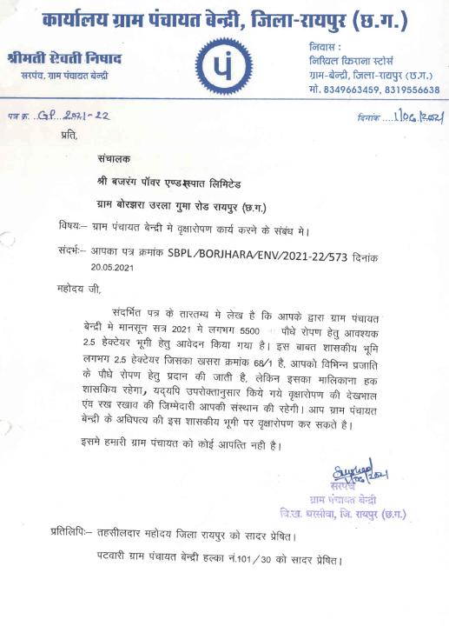

Slide 25
OBSERVATION NO. 13 | Cyclones are proposed for dedusting in coal gasifier unit which may not meet PM emissions less than 30 mg/Nm³
COMPLIANCE | Bag filters are proposed for the dedusting in coal gasifier unit which will meet PM emissions less than 30 mg/Nm³.
Technical Data Requirement
 | Gas volume to handed (cubic meter) | 20,000 m³/hr
 | Nature of dust | Coal
 | Air to cloth ratio (air passes through the square ft of filter media) | 1.6 m³/min/m²
 | Size of bag ( Dia x Length) | 150 x 3660 mm (D x L)
 | No. of Bag Filter | 120
 | Max particulate emission rate – gm./M³ | 50 mg/Nm³
 | Max velocity in duct | 16.5 m/sec
 | Interstitial Velocity (Upward movement of Air inside the filter bags) | 33.3 m/sec
 | Bag filter unit size RAV (L x W x H) | 2400mm x 3000mm x 4000mm
 | Capacity of huminity to with stand Pr.
 | Fan Capacity in m³/hr | 20,000 m³/hr
 | Motor – make/HP/RPM | Siemens-40hp-1450 RPM
 | Fan inlet pressure | 300 mmWG
 | Dust level indicator in hopper
 | RAV size, make, model, no. of gears | 200NB-Gearmotor 2.2kw-output=45(screw conveyor)
 | Filter- type | Non-woven, silicon treated, collar type Polyester
 | Type and size of purging valve | Pulse jet double diaphragm-40 NB
 | Stack height | 30 mtr
 | Stack inner/outer dia | ID – 1000mm, OD – 1016mm
 | Inlet dia of duct | 600 mm
 | Outlet dia of duct | 500 mm
 | Designated capacity

Slide 26
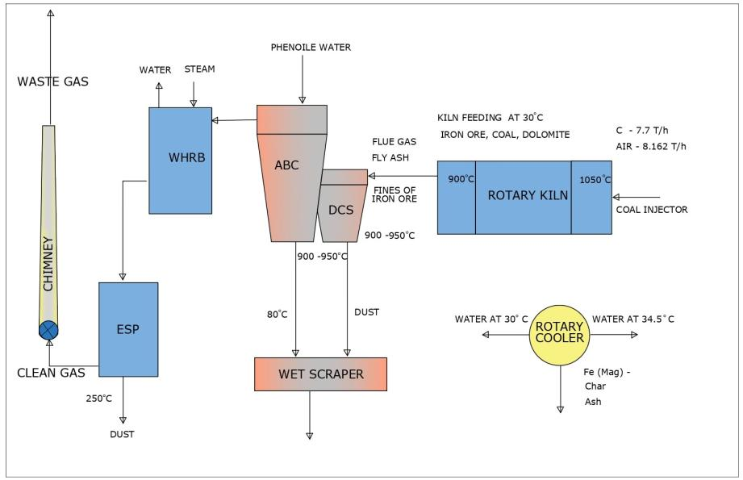
OBSERVATION NO.14 | Process flow sheets have not been given for any product manufacturing in the EIA report.
COMPLIANCE :All Process flow sheets has been included in revised EIA report.

Slide 27
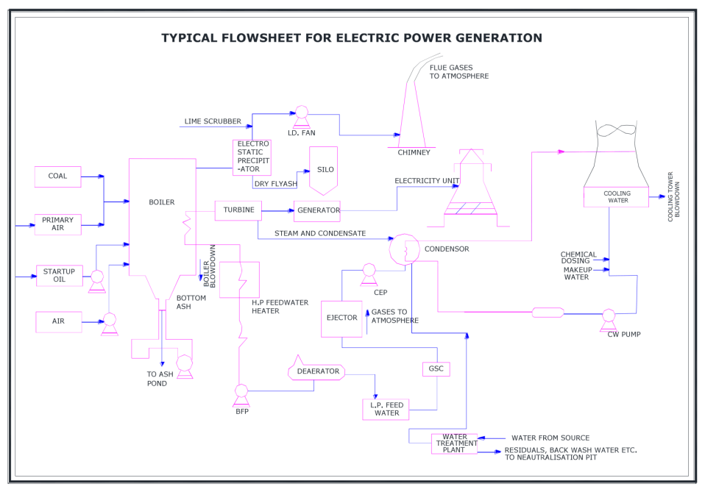
PROCESS FLOW DIAGRAM OF POWER GENERATION

Slide 28
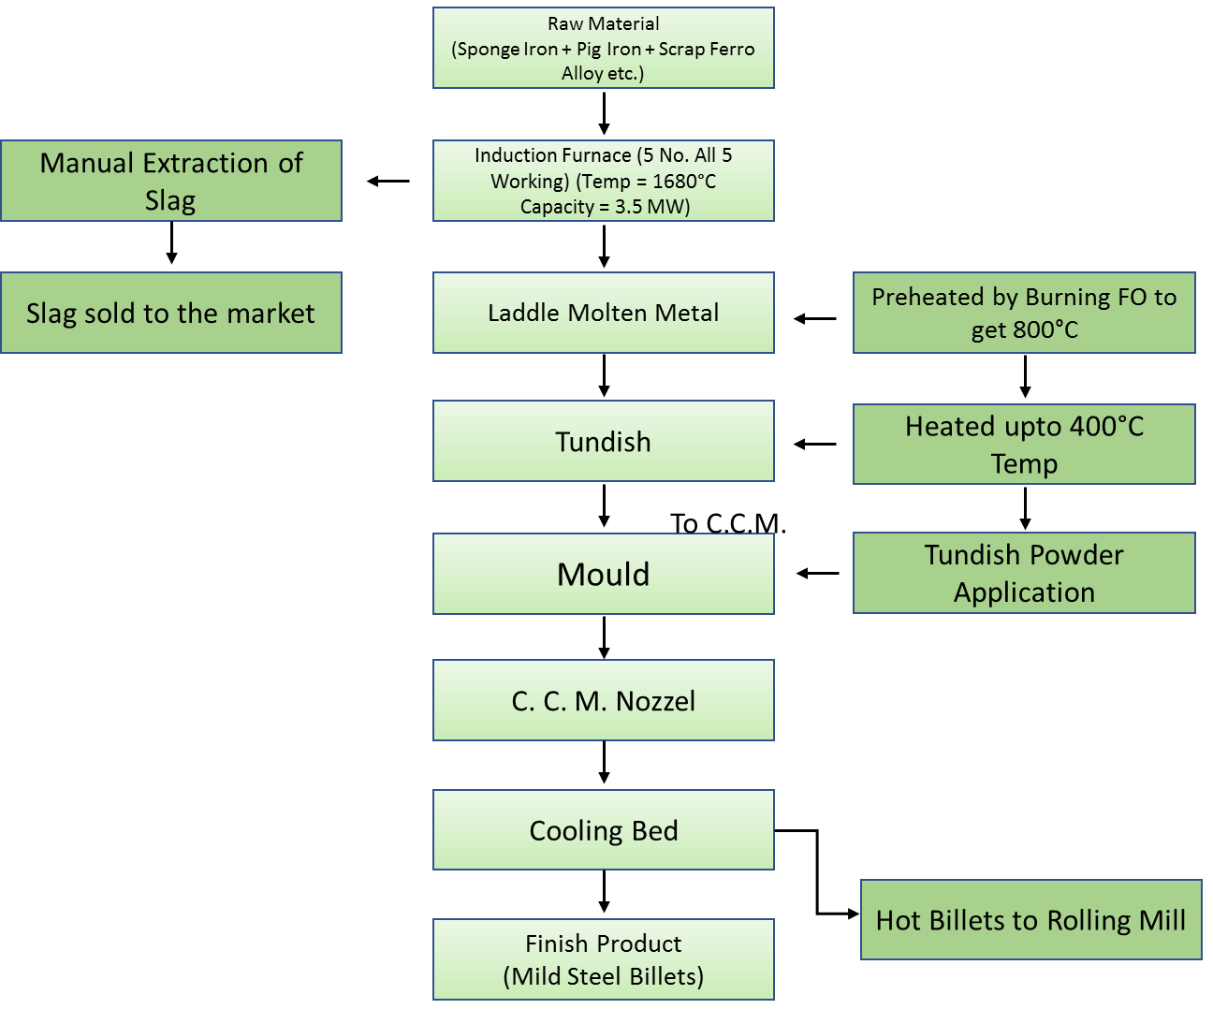
PROCESS FLOW DIAGRAM OF SMS

Slide 29
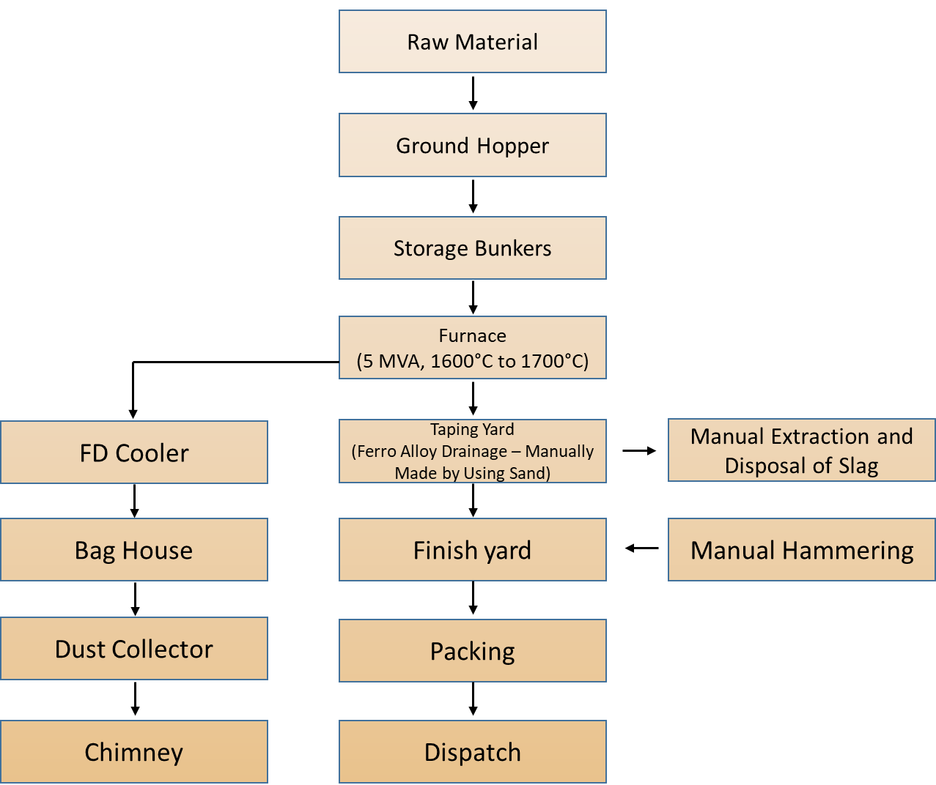
PROCESS FLOW DIAGRAM OF FERRO ALLOYS

Slide 30
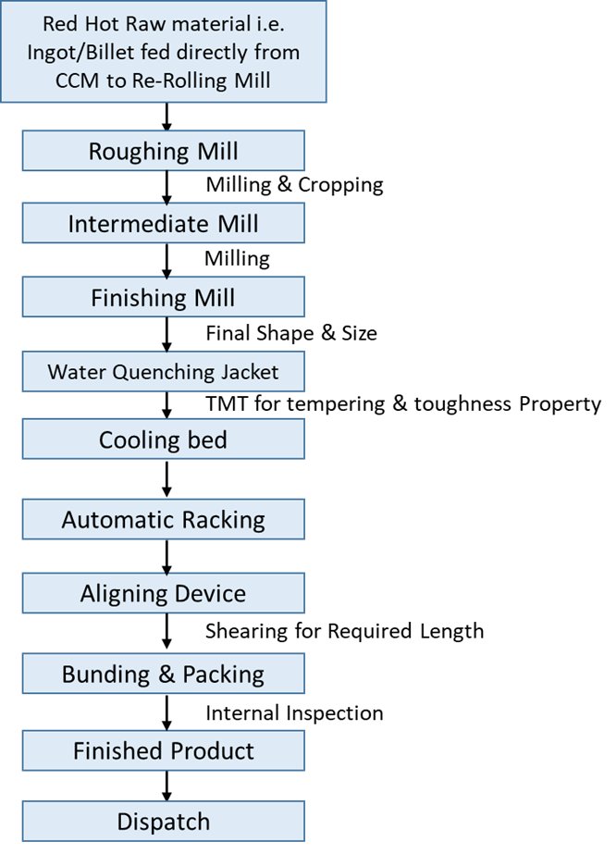
ROLLING MILL FLOW CHART

Slide 31
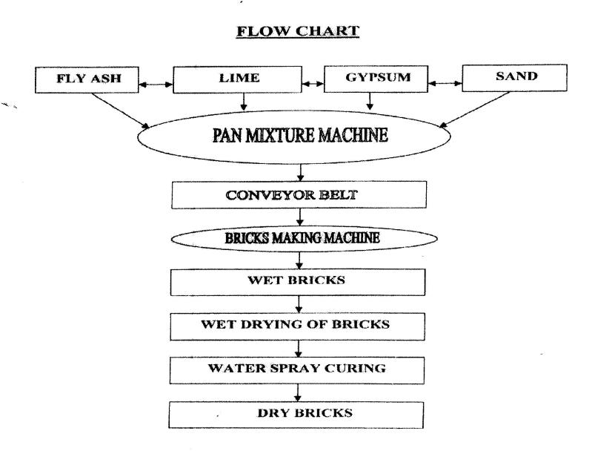
PROCESS FLOW DIAGRM OF BRICK PLANT

Slide 32
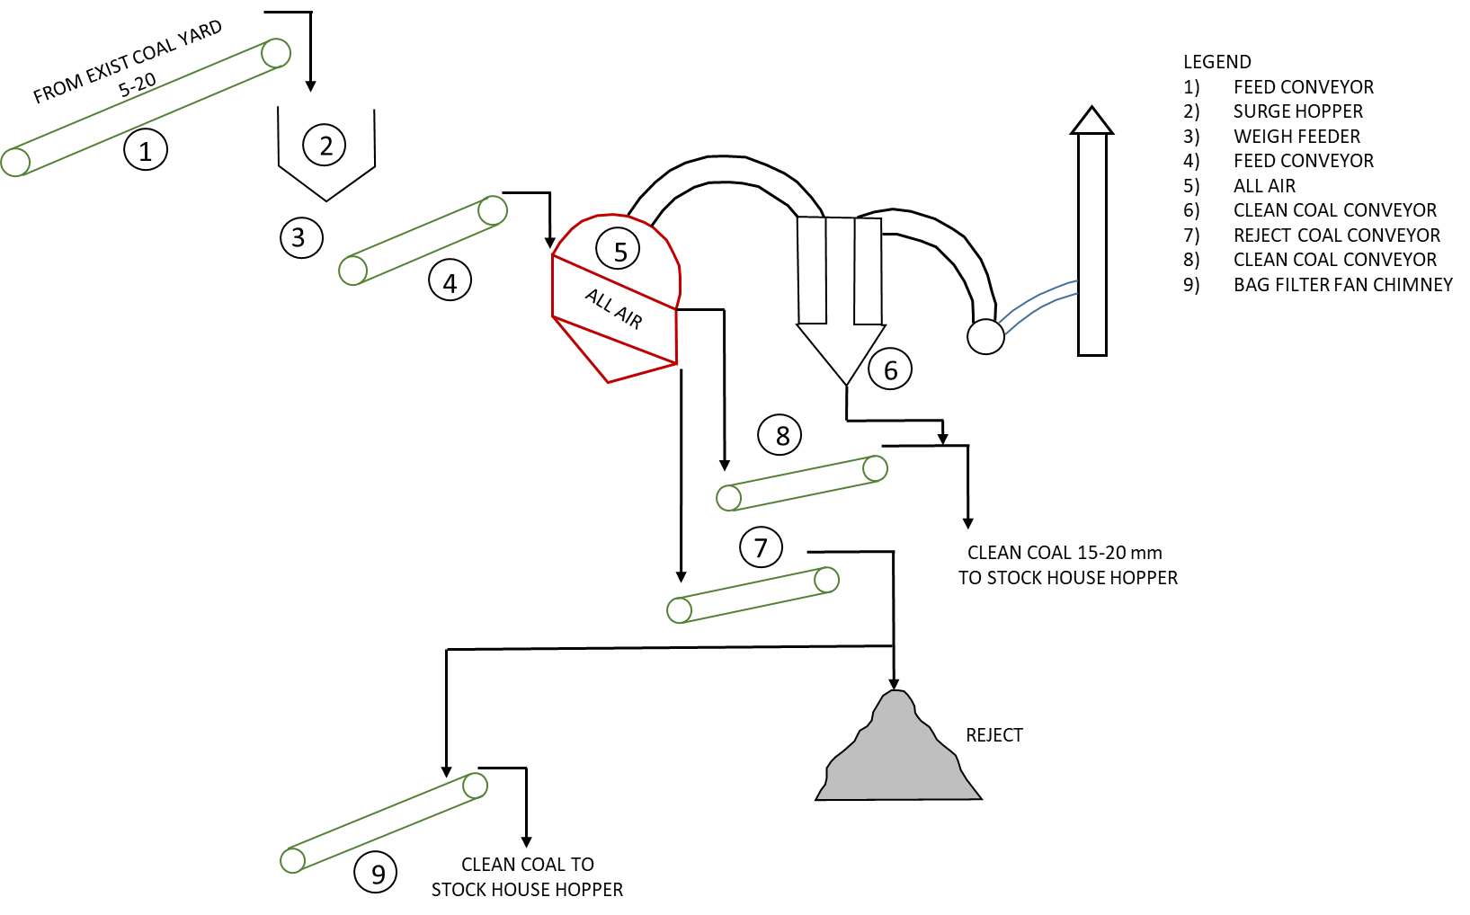
PROCESS FLOW DIAGRAM OF COAL WASHERY

Slide 33
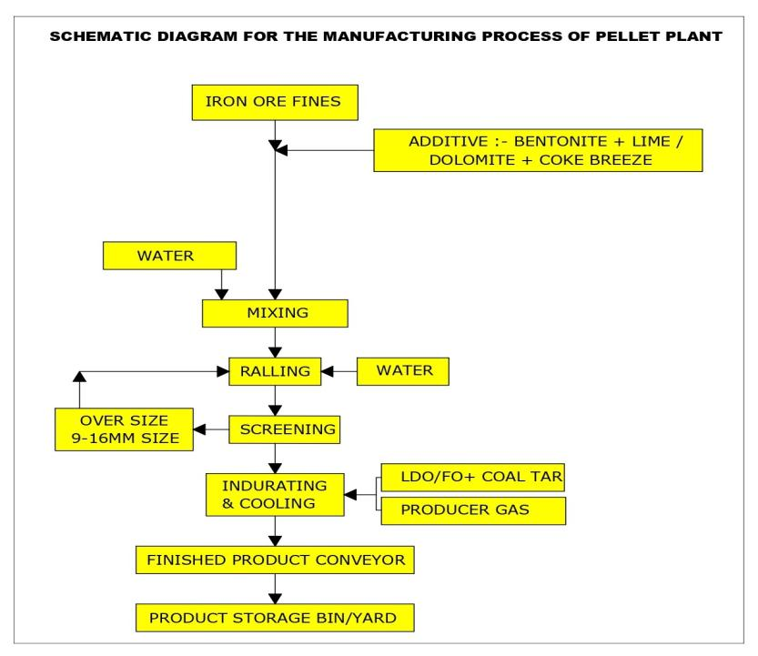

Slide 34
FLOW DIAGRAM FOR COAL GASIFIER 9000 NM³/HR
Coal
3.33 TPH
Tar 0.167 TPH
Used in Pellet Plant as Fuel
Coal Gasifier
Air
Phenolic Water 0.167 KLPH
ABC Chamber
Of DRI Kiln
Producer Gas
9000 NM³/HR
Pelletization Plant
0.6 MTPA

Slide 35
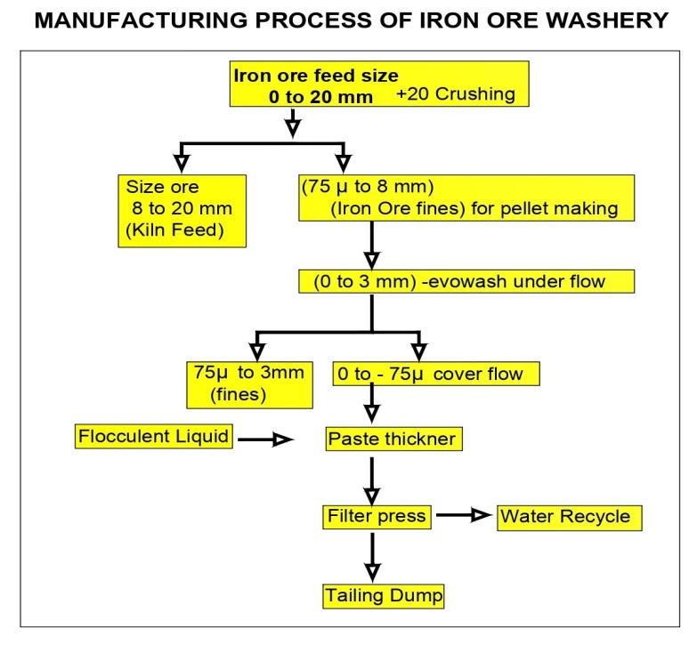

Slide 36
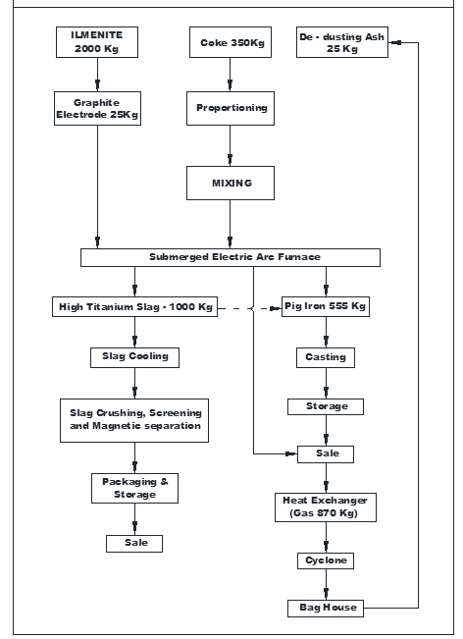
PROCESS FLOW DIAGRAM FOR TITANIUM SLAG

Slide 37
OBSERVATION NO. 15 | Criteria for selection of AAQ stations has not been given in EIA (page 142 of EIA report).
Compliance | Criteria for selection of AAQ stations has been given in revised EIA (page no.95 ).
Sample code | Monitored locations | Latitude | Longitude | Distance | Direction | Site Selection Criteria
A1 | Project Site | 21˚19'12.13"N | 81˚35'04.61"E | ---- |  | Represents project Site
A2 | Urla | 21˚18'55.89"N | 81˚36'31.59"E | 1.0 Km | ENE | Industrial area within 2 km in upwind direction
A3 | Tendua | 21˚17'25.85"N | 81˚34'13.89"E | 2.5 Km | SW | Village within 5km in downwind direction
A4 | Guma | 21˚18'16.96"N | 81˚34'10.98"E | 2.5 Km | WSW | Village within 5km in downwind direction
A5 | Kara | 21˚19'48.95"N | 81˚34'39.03"E | 2.5 Km | NW | Village in crosswind direction within 5 Km
A6 | Nawadih | 21˚19'56.88"N | 81˚36'05.01"E | 2.5 Km | NNE | Location near the road within 5 km
A7 | Bendri | 21˚19'42.18"N | 81˚35'04.07"E | 2.5 Km | NNW | Major village in cross wind direction within 5 km
A8 | Borjhara | 21˚18'30.45"N | 81˚36'12.00"E | 0.5 Km | E | Village in 500 m in upwind direction

Slide 38
OBSERVATION NO. 16 | Surface water analysis does not indicate BOD, COD, Heavy Metals, Coliform in Table 3.11 Page 147 of EIA report.
COMPLAINCE | Surface water analysis does not indicate BOD, COD, Heavy Metals, Coliform has been given in revised EIA report.
  Biochemical Oxygen Demand (BOD)
The Surface water samples have BOD values ranging from <3 to 4.2 mg/l. These results indicate very low organic pollution load.
C. Chemical Oxygen Demand (COD)
The surface water samples have COD values ranging from 8 to 34 mg/l.
B. Heavy Metals
Heavy metals, Boron and other trace elements in all water samples are either absent or wherever present were below their respective permissible limits.
C. Coliform
Surface water samples have Coliforms 70 to 300 MPN/100 ml. Thus, the surface water samples are contaminated.

Slide 39
OBSERVATION NO. 17 | Action plan to address the issues raised during public hearing as per the MoEF&CC O.M. dated 30/09/2020 has not been furnished.
COMPLIANCE : Action plan to address the issues raised during public hearing has been given in revised EIA report.
S.No | ISSUE | RESPONSE | ACTION PLAN | BUDGET
1 | Employment to locals | At present 750 peoples are employed in company out of which more than 80% are local people. In future after Installation of proposed expansion units 200 people will be employed and preference will be given to local people subject to the skill & qualification of the candidate. | After Installation of proposed expansion units manpower will be employed as per requirement time to time and subject to skill and qualification of candidate. However, preference will be given to local people. | The wages will be paid as per the state government policy.
2 | To develop local school as Smart School | The Existing local school will be developed as a smart School. | Company will develop a smart school in village Bendri with in a period of 1 Year. | Rs. 5.0 Lakhs for smart school
3 | To provide Vocational Training Institute | Vocational training center in this area will be constructed where all the local people will be associated with technical education. | within a period of one year upon allocation of suitable land from State Government | Rs. 75.0 Lakhs as capital cost and Rs.25.0 lakhs as recurring cost for vocational training institute
4 | To Develop a public garden | Company will develop a garden in nearby village. | SBPIL is developing a Garden named as (Krishna Kunj" near proposed plant area in 3 acres where about 1200 trees of 22 species will be planted. | Rs.20.0 lakhs for developing public garden

Slide 40
OBSERVATION NO. 18 | Certified compliance reports attached against point No 9 of Form 2 are not legible. One cannot make out anything from most of the pages of this large document of 205 pages.
COMPLIANCE | Legible Certified compliance reports attached against point No. 9 of Form has been uploaded and enclosed in revised EIA report and attached as additional document also

Slide 41
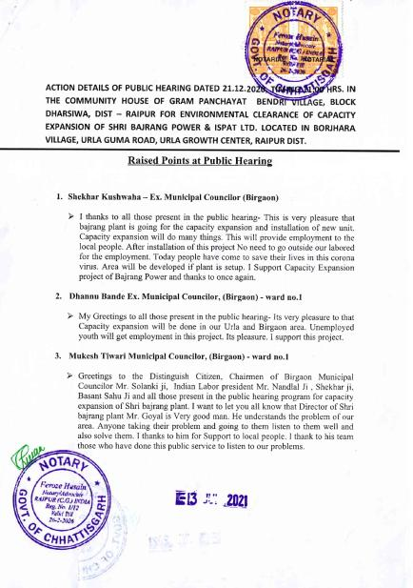
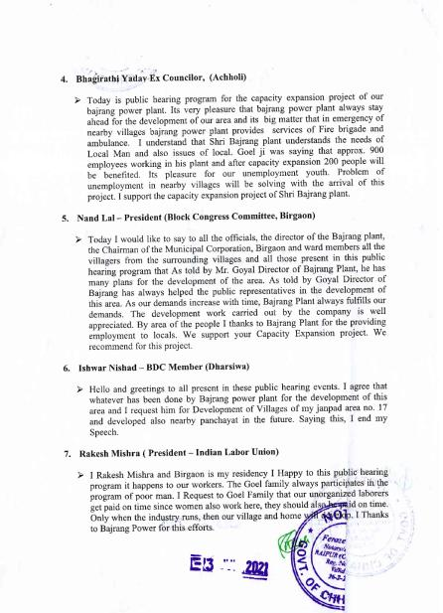
OBSERVATION NO. 19 | Copy of the PH proceedings given under section 7.1(1) of Form 2 is in Hindi. English translation of PH is not available.
COMPLIANCE | English translation of PH proceeding is attached

Slide 42
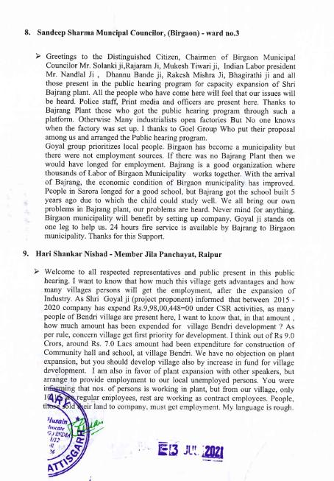
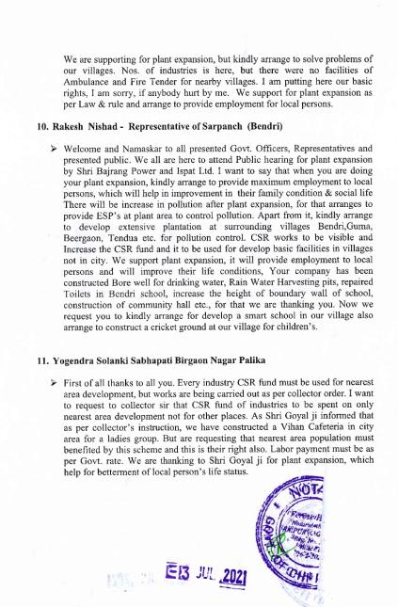

Slide 43
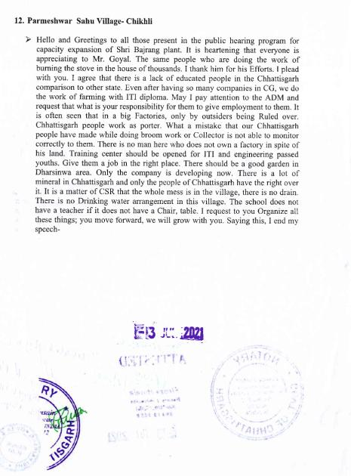
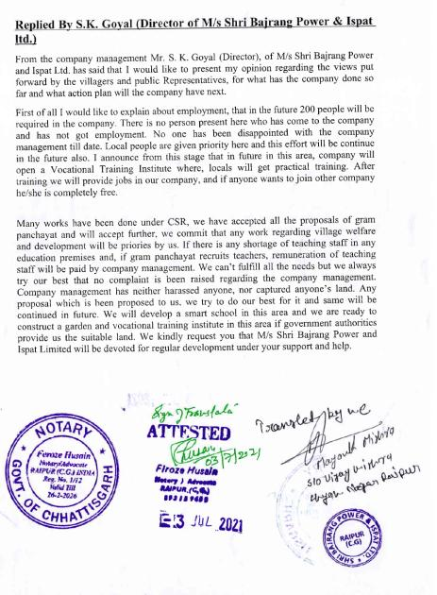

Slide 44
OBSERVATION NO. 20 | Details about titanium slag emission from furnace and radiation effects if any, by using ilmenite may be furnished.
COMPLIANCE | Details about titanium slag emission from furnace and radiation effects are as follows
Dust Produced:
Radio activity material content
U : 6ppm
Th : 43 ppm
The radioactivity levels at this level will be less than 0.3 Bq /gm which is very low
Dedusting
Flue gas from Arc Furnace
Temp of flue gas | 600-800 degC
Dust content | 23 g/m3
Flow of gas | 89000 m3/h
Composition waste flue gas (Vol%)
CO2 | 9.24
N2 | 76.28
O2 | 13.43
H2O | 0.97
SO2 | 0.05
CO | 0.03
Composition of collected dust (Vol%)
TiO2 | 38.6
Fe2O3 | 6.3
FeO | 8.3
MgO | 8.7
SiO2 | 12.12
Al2O3 | 7.42
MnO | 4.26
C | 9.86
Others | 4.44

Slide 45
 | Bulk density of collected gas | 2.3 g/cm3
 | Size of collected dust (mm) | %
 | >0.5 | 0.23
 | 0.5-0.315 | 4.43
 | 0.315-0.2 | 5.82
 | 0.2-0.16 | 3.27
 | 0.16-0.1 | 2.29
 | 0.1-0.05 | 21.11
 | 0.05-0.045 | 30.25
 | <0.045 | 32.6
B | Waste gas during slag tapping
 | Temp of flue gas | 300 DegC
 | Dust content | 0.22 g/m3
 | Flow of gas | 35000 Nm3/h
 | slag out time | 20 min
V | Composition of waste flue gas same around atmosphere
vi | Composition of dust exhausted (%)
 | TiO2 | 74
 | FeO | 6
 | Others | 20
C | Bag Filter | 2 Sets
 | Flue gas flow | 89000+35000 m3/h
 | Filtering area | 1696 m2
 | Gas speed | 0.9m/min
 | Material | Glass fiber needle felt coated with Teflon (PTFE)
 | working temp | 180 degC
 | Dedusting efficiency | 99%
D | Centrifugal fan
 | Capacity | 100000 m3/h
 | Power of Motor | 160 KW

Slide 46
OBSERVATION NO. 21 | Most of the sections in Form 2 have not been filled in properly and needs to revised in light of the aforesaid observations.
COMPLIANCE | Revised Form 2 has been filled properly.

Slide 47
BRIEF INFORMATION
SL. NO. | PARTICULARS | DETAILS
1. | DATE OF GRANT OF ToR AMENDMENT OF TOR | 20th October 2017 9th April 2020
2. | BASELINE STUDY PERIOD Additional One Month Data (As per the direction of Honorable EAC (Industry­ I) meeting held during 30th April 2021 ) | October’ 18 to December’ 18 Additional one month:5th May to 5th June 2021
3. | DATE OF PUBLIC HEARING | 21st December 2020
4. | PROJECT COST | Expansion cost : Rs. 186 Crores Existing Cost : Rs. 350 Crore Total Cost : Rs. 536 Crore
5. | EMP COST (CAPITAL AND RECURRING) | Proposed Capital : Rs1674.3 Lakhs Recurring: Rs 61.75 Lakhs per annum
6. | MANPOWER DETAILS | Admin Staff : 100 person Production Staff : 650 person Existing manpower is 750 person Proposed Man Power : 200 person Total Man power `: 950 person.

Slide 48
7. | DETAILS IF PROJECT FALLS UNDER THE PURVIEW OF A) FCA,1980 B) WLPA,1972 C) CRZ, 2011 | None
8. | CPA/SPA/ESA/ESZ, IF ANY | The Project site is located in Borjhara extension of Urla Industrial Area which was declared as Critically Polluted Area vide NGT order dated 10.07.2019 and lifting of abeyance of ministry’s OM is published on 5th July 2022
9. | INTERLINKED PROJECT, IF ANY, WITH STATUS | None

Slide 49
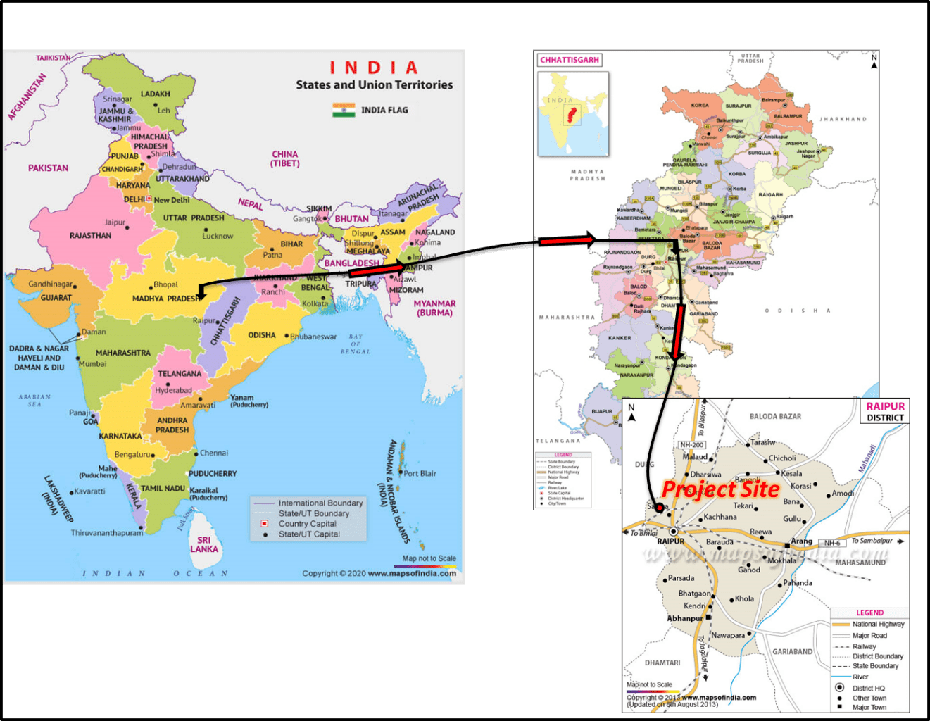
LOCATION MAP
:

Slide 50
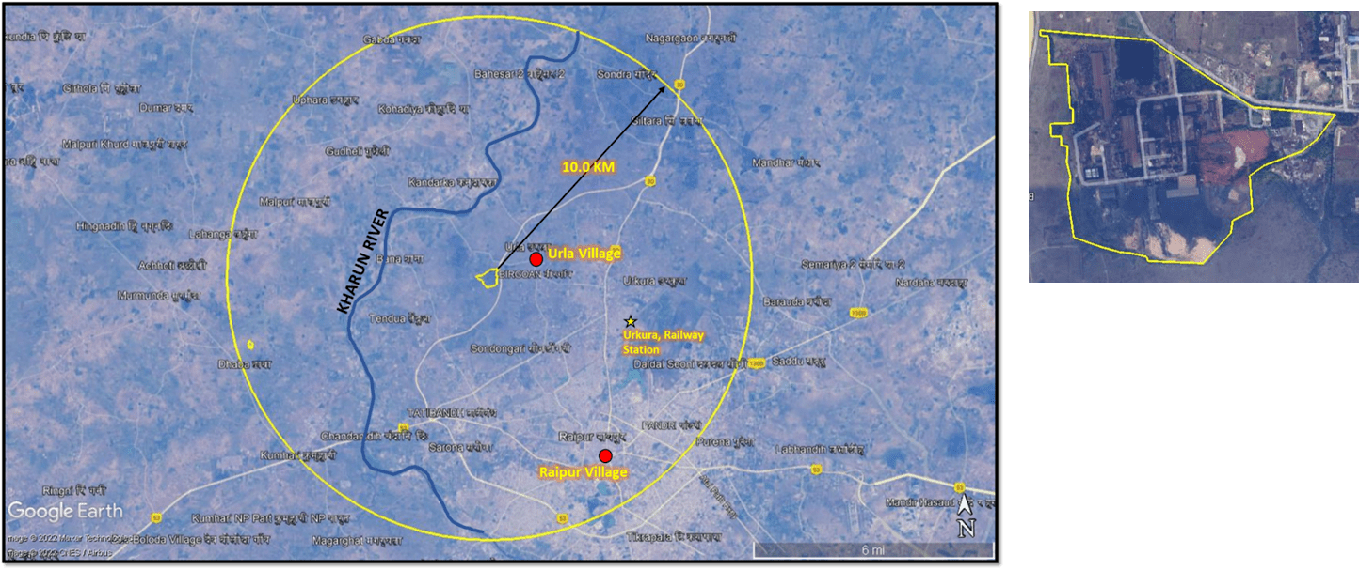
LINK FOR KML FILE & GOOGLE EARTH IMAGE

Slide 51
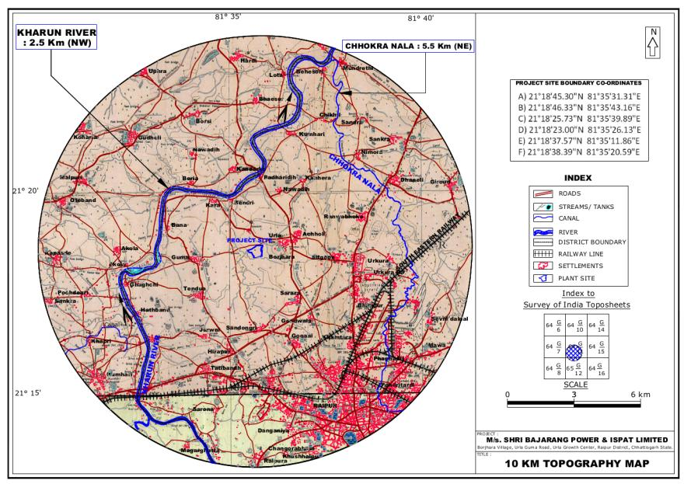
TOPOGRAPHICAL MAP
Source: Survey of India Toposheet

Slide 52
LAND ALLOTTED/ACQUISTION STATUS
Proposed expansion will be done within the existing plant premises and additional area with in the plant site.
Present activities are covered under 21.0 Ha and for expansion additional area of 10.80 Ha available within the project site will be used.
The total area is 31.8 ha in which 12.465 ha allotment is done by Chhattisgarh State Industrial Development Corporation (CSIDCL) and the balance 19.335 ha area is Private Purchased diverted for Industrial use.
Already about 10.49 ha i.e. ~33% of the total plant area (31.80 ha) is developed as green belt.. An additional area of 2.5 ha. will be developed under greenbelt & plantation.
Total proposed green belt will cover about 12.99 ha (including outside plantation) more than 40% of total plant area of 31.8 ha.

Slide 53
PLANT AREA BREAK-UP
1. | Existing Plant Built Area | 6.48
2. | Total Green Belt Area | 10.49
3. | Area Under Road and Parking | 3.10
4. | Proposed Area | 5.29
5. | Open Area | 6.44
 | Total Plant Area | 31.80

Slide 54
PREVIOUS EC DETAILS
Particulars | Establishment Year | Statutory Clearances obtained | Consent from CECB
2x350 TPD Sponge Iron Plants with 18 MW WHRB Power Plant | 2005 | Consent for Establishment From Chhattisgarh Environment Conservation Board (CECB) | Latest Renewal of Consent to Operate (for Both Air & Water) is granted on vide letter no. 8545/TS/CECB/2023 dated 07.03.2023 for SID (0.21 MTPA ) and WHRB based Power Plant (18 MW) valid from 07.03.2023 to 31.03.2024.
5 No.x 8 T Induction Furnace (CTE for change in configuration from 6 X 8 T to 3 X 15 T has been granted by CECB) | 2006 | Establishment done in year 2006 From Chhattisgarh Environment Conservation Board (CECB) | Latest Renewal of Consent to Operate (for both air & water) is granted vide letter No. 4283/TS/CECB/2021dated 17/09/2021 for for Steel Melting Shop 0.1296 MTPA valid from 01.09.2021 to 31.08.2022. Applied for further renewal on 25.07.2022.
 | 2018 | Amendment in CTE was obtained for change in configuration to 3 X 15 MT From Chhattisgarh Environment Conservation Board (CECB)

Slide 55
2 x 4 MVA Ferro Alloys plant (SAF) | 2008 | Environmental Clearance from MOEF & CC vide J-11011/531/2007-IA.II (I) dated 17-01-2008 | Latest Renewal of Consent to operate (for both air & water) is granted vide letter No. 1041/TS/CECB/2022 dated 04.06.2021 for Ferro alloys 14,400 MTPA and Biomass based Power Plant 8 MW valid from 31.05.2021 to 30.05.2023.
Captive Power Plant (8 MW biomass based ) | 2008
0.6 MTPA Coal Washery | 2012 | J-11015/159/2009-IA.II (M) dated 28.1.2010 | Latest Renewal of Consent to Operate (for air and water) is granted vide letter No. 6991/TS/CECB/2023 dated 03.01.2023 for Coal washery 0.6 MTPA and Hot Re-rolling Mill Plant 0.12 MTPA valid from 01.01.2022 to 31.12.2023.
0.12 MTPA Rolling Mill (EC granted for 0.15 MTPA) | 2012 | J-11015/159/2009- IA.II (M) dated 26.8.2013

Slide 56
ENVIRONMENTAL SITE SETTINGS
SL. NO. | PARAMETERS | DETAILS
a. | Water body | Kharun River - 2.5 km - NNW Distributary Nala - Adjacent W
b. | Highway | NH-6 - Raipur – Bhilai Durg – 8.0 km – SW SH-2-connecting Raipur Road – 4.3 km – E,
c. | Habitation | Urla – 1.0 km – E
d. | National Park/Wildlife Sanctuary/Bio-sphere Reserve/Elephant corridor/ Tiger reserve/Eco-sensitive Zone/Eco sensitive Area | None within 10 Km
e. | Nearest Industries | Shri Bajrang Alliance Limited (Agro Division) - 1.2 KM - NW Sarthak Ispat Pvt. Ltd –1.4 km –SE Mahamaya Steel Industries Ltd – 1.8 km – SE Satyarth Steel & Power Pvt. Ltd – 1.3 km –NW M/s. Real Ispat & Power Ltd – 1.7 km –NW Prime Ispat Ltd – 3.3 km – WNW

Slide 57
EXISTING & PROPOSED UNIT CONFIGURATION WITH CAPACITY IN TPA
 | Present Capacity | Proposed expansion / new unit in Production Capacity | Capacity After Expansion | Proposed activities of Expansion
Sponge Iron Pant | 2,10,000 TPA | NIL | 2,10,000 TPA | No change
Captive Power Plant, MW | 26 MW 18 WHRB + 8 MW Biomass & Dolachar based CPP | - | 26 MW 18 WHRB + 8 MW Biomass & Dolachar based CPP | No change in capacity & No change in Fuel Mix.
Steel Melting Shop(SMS) | 1,29,600 TPA 5x 8T CTE for change in configuration from 6 X 8 T to 3 X 15 T has been granted by CECB) | 81,600 TPA 2X15 T IF | 2,11,200 TPA 5X15T IF | 5 Nos. IF of 8T will be replaced by 3No.x15T and Two more induction furnaces of 15 T each along with continuous casting machine and LRF will be installed. Already permission obtained for establishment of 3 No.x15T.

Slide 58
Ferro Alloy Plant | 14,400 TPA | 5400 TPA | 19,800 TPA | Existing Submerged Arc Furnace of 4 MVA – 2 Nos. will be replaced by higher capacity transformer 1X5 MVA and 1X6 MVA
Rolling Mill | 1,50,000 TPA | 60,000 TPA | 2,10,000 TPA | Optimization of production capacity of Rolling Mill by curtailing Idle running hours.
Coal Washery | 6,00,000 TPA | NIL | 6,00,000 TPA | No change in capacity.
Pellet plant with coal gasifier | Nil | 6,00,000 TPA | 6,00,000 TPA | Pellet Plant will be installed with coal gasifier of 9000 Nm³/hr
Iron Ore Washery Plant | Nil | 4,00,000 TPA | 4,00,000 TPA | New unit Ground Hopper. Prograde Triple Deck screen – Tailings Thickener followed by Horizontal filter press.
Titanium Slag Plant & Pig Iron Plant | Nil | 36,000 TPA & 20,000 TPA | 36,000 TPA & 20,000 TPA | New unit 4 X 4.5 MVA Capacity. Submerged Arc Furnaces will be installed to produce Titanium slag @36000 TPA Along with installation of Pig Iron caster of 20,000 TPA capacity attached to Titanium Slag Plant.

Slide 59
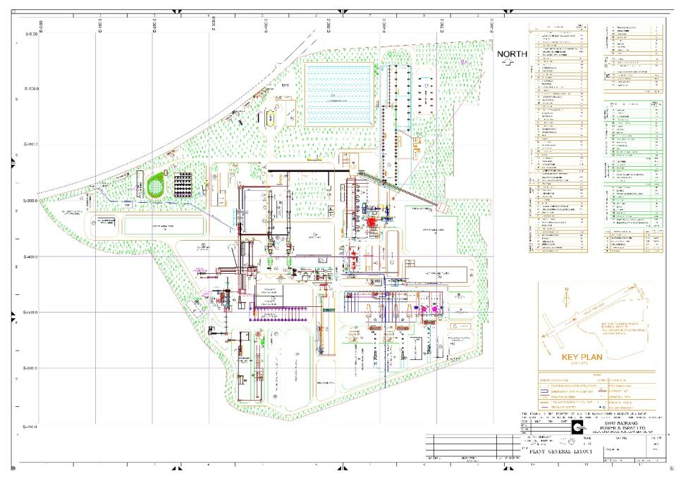
PLANT LAY OUT

Slide 60
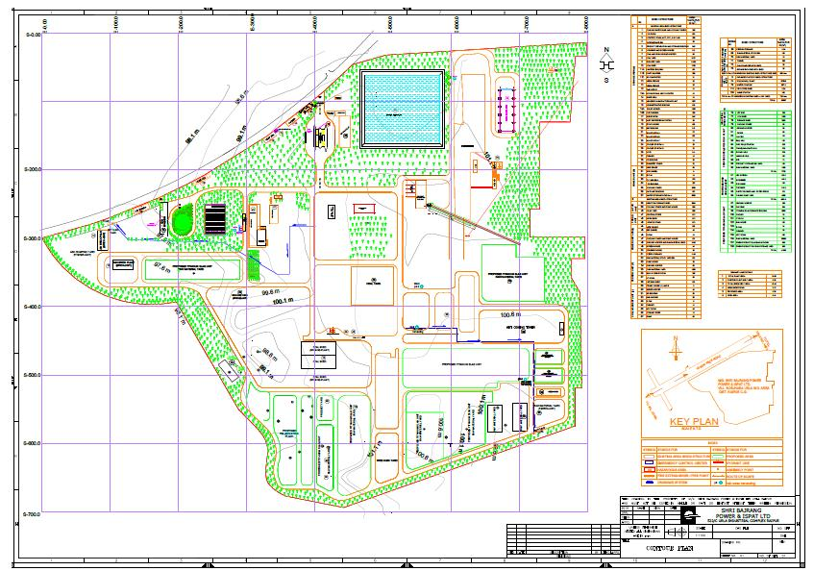
CONTOUR PLAN

Slide 61
RAW MATERIAL CONSUMPTION
SL. NO. | RAW MATERIAL | QUANTITY (TPA) | SOURCE | DISTANCE (W.R.T. PLANT) | MODE OF TRANSPORT | REMARKS
1. | Iron Ore | 315000 | Mines- Hahaladd, NMDC, Bailadila | 190 Km 420 Km | Rail/Road | **
2. | Coal | 260440 | SECL | 250 Km | Rail/Road | ***
3. | Dolomite | 10380 | Mines-Mandla, Katni | 200 Km 450 Km | Road | **
4. | Rice Husk | 125004 | Local Rice Mill | 50 Km | Road | ****
** Expansion of capacity of SID has been dropped as per the orders dated 16.03.2007, 12.12.2007 and 15.05.2012 of Industry & Commerce Dept. Government of Chhattisgarh
*** No Change in coal quantity & Quality in SID .Expansion is dropped in SID unit as per above mentioned orders.
****Addition of coal fines is dropped in Biomass power plant as per the above mentioned orders.

Slide 62
SL. NO. | RAW MATERIAL | QUANTITY (TPA) | SOURCE | DISTANCE (W.R.T. PLANT) | MODE OF TRANSPORT | REMARKS
5. | Dolochar | 66000 | Captive | - | - | -
6. | Sponge Iron | 215388 | Captive | - | - | -
7. | Pig Iron | 8784 | External procurement will not be there. 20,000 TPA will be produced of which 8784 TPA will be consumed and balance will be sold as product | - | - | -
8. | Scrap | 22176 | Local Market | 40-50 Km | Road | -
9. | Ferro & Non Ferro Alloys | 2112 | Captive | - | - | -

Slide 63
SL. NO. | RAW MATERIAL | QUANTITY (TPA) | SOURCE | DISTANCE (W.R.T. PLANT) | MODE OF TRANSPORT | REMARKS
10. | Ferro Manganese Slag | 19800 | Captive | - | - | -
11. | Coke | 21000 | Nagpur & Jharkhand | 290 Km 644 Km | Rail/Road | -
12. | Iron Ore Fine/ Concentrate | 612000 | Mines- Hahaladdi, Orissa Own Plant at Tilda | 190 Km 600 Km 30 Km | Rail/Road | -
13. | Limestone | 9000 | Katni | 450 Km | Road | -
14. | Bentonite | 4800 | Bhuj and local market | 1450 Km | Rail/Road | -
15. | Coal for Gasifier | 27000 | SECL | 250 Km | Rail/Road | -

Slide 64
SL. NO. | RAW MATERIAL | QUANTITY (TPA) | SOURCE | DISTANCE (W.R.T. PLANT) | MODE OF TRANSPORT | REMARKS
16. | Ilmenite | 72,900 | IREL & Other Suppliers | 600 | Rail/Road | -
17. | Graphite | 900 | Imported/ Indigenous | 500 | Road | -
18. | Coke Titanium Slag | 12600 | Nagpur & Jharkhand | 290 644 | Road | -

Slide 65
Power Requirement
Presently the electric Power requirement is met from captive power plant having capacity of 26MW capacity in which 18MW power generated through WHRB and rest of 8MW generated through captive bio mass power plant.
The additional power requirement after expansion shall be met by wheeling of power from other unit and/or purchase from state electricity board.
Water Requirement
Present water consumption of the plant is 2442 m³/day. The total water requirement after expansion will be about 3507 m³/day.
This requirement will be met from River Kharun at intake point 21̊ 20’ 3.71” N Latitude and 81̊ 35’ 6.81” E Longitude.
For Domestic consumption 75 KLD ground water permission granted by CGWA.

Slide 66
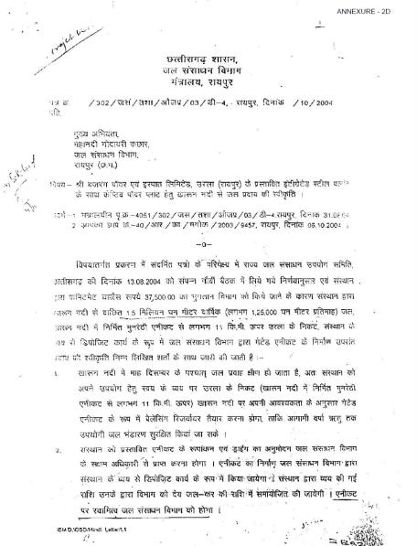
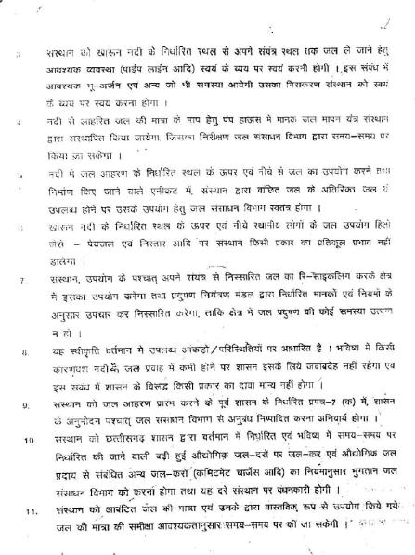
WATER AGREEMENT

Slide 67
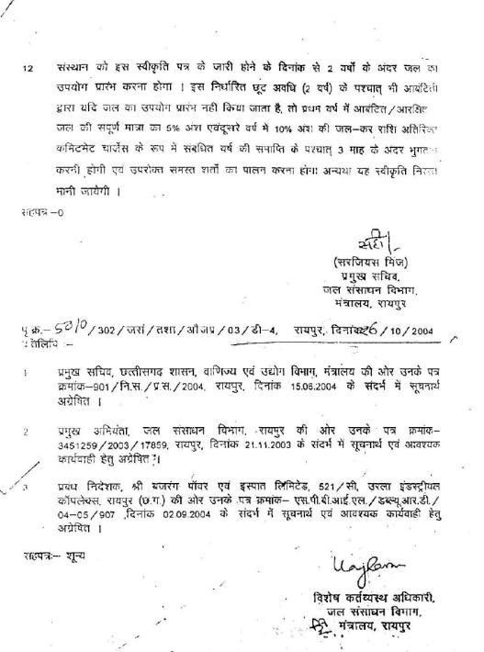

Slide 68
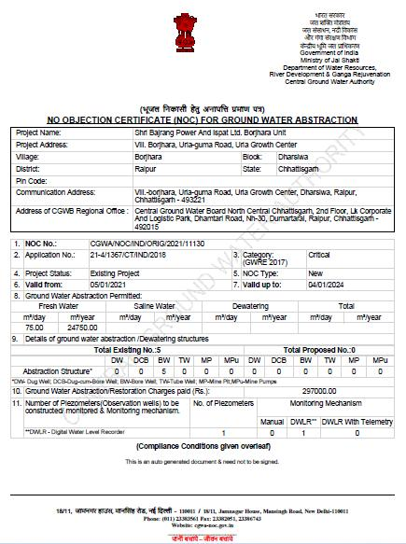

Slide 69
TOTAL WATER REQUIREMENT AFTER EXPANSION
 | Existing |  | After Expansion | After Expansion
 | Require-ment | Loss | Waste water | Require-ment | Loss | Waste Water
Existing Plant
Sponge Iron Plant (Make up water) | 200 | 200 | - | 200 | 200 | -
Power plant make up water | 1863 | 1796 | 67 | 1863 | 1796 | 67
De-mineralized water for boiler | 100 | 94 | 06 | 100 | 94 | 06
SMS makeup water | 80 | 80 | - | 130 | 130 | -
Ferro Alloys make up water | 32 | 32 | - | 44 | 44 | -
Rolling mill | 45 | 45 | - | 79 | 79 | -
Coal washery | 02 | 02 | - | 02 | 02 | -
Fly Ash bricks | 50 | 50 | - | 50 | 50 | -
Domestic | 70 | 50 | 20 | 75 | 53 | 22

Slide 70
Proposed Plant
 | Require-ment | Loss | Waste water | Require-ment | Loss | Waste Water
Pellet plant | Nil | - | - | 218 | 218 | -
Coal gasifier | Nil | - | - | 32 | 28 | 4
Iron Ore Washery Plant | Nil | - | - | 150 | 90 | 60
Titanium Slag Plant (Cooling Tower) | Nil | - | - | 540 | 540 | -
Pig Iron Plant (Quenching) | Nil | - | - | 24 | 24 | -
Total | 2442 | 2349 | 93 | 3507 | 3348 | 159-
Water Requirement for Plantation
Plantation | 150 KLD | - | - | - | - | -
*Generated waste water after Treatment will be used in Plantation.

Slide 71
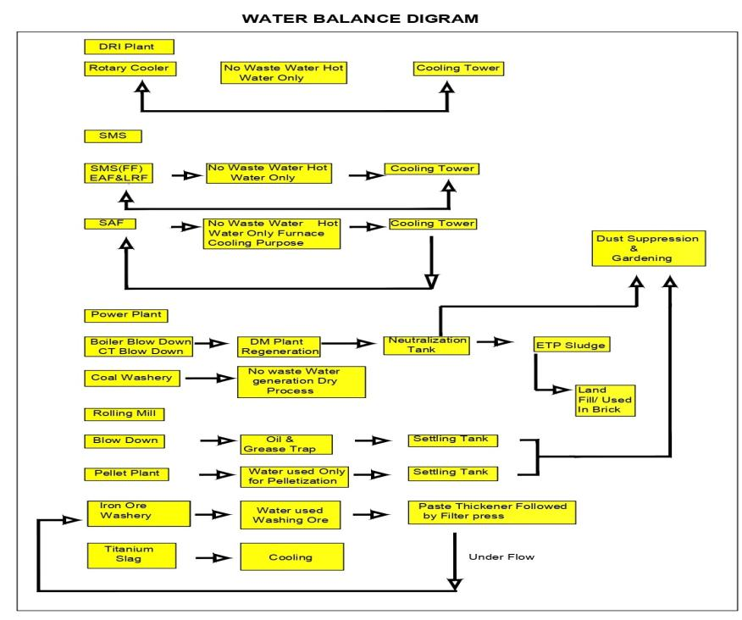

Slide 72
MATERIALS BALANCE DIAGRAM

Slide 74
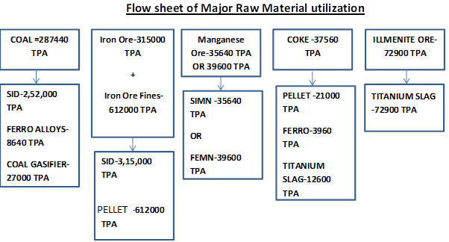

Slide 75
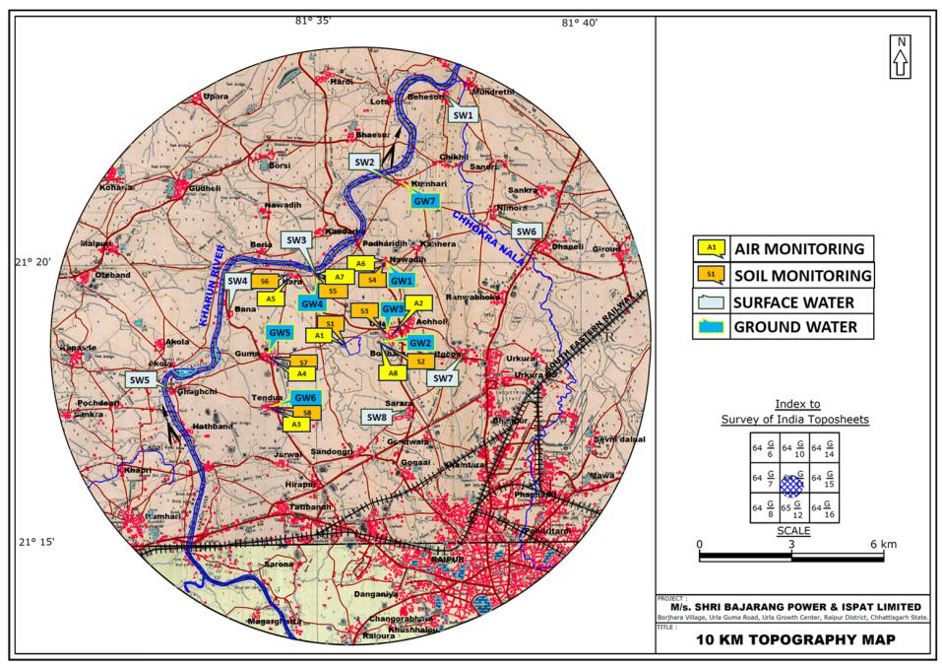
BASE LINE STUDY AREA MAP WITH LOCATIONS

Slide 76
WIND ROSE DIAGRAM (May to June 2021)

Slide 77
BASE LINE STUDY REPORTS
PERIOD
AAQ PARAMETERS AT 8 LOCATIONS | PM_{2.5} = 17.9 - 38.5 μg/m³ PM₁₀= 43.5 - 88.0 μg/m³ SO₂= 10.5 – 16.3 μg/m³ NO₂ = 11.3 – 30.8 μg/m³ CO = <1mg/m³
AAQ MODELLING* (Incremental GLCs) AERMOD | PM₁₀ = 3.8 μg/m³ (750 m in NE) SOx= 3.20 μg/m³ (1 Km in NE) NO_{x} = 0.990 μg/m³(1 Km in NE)
GROUND WATER QUALITY AT 7 LOCATIONS | pH: 7.14 – 7.33 , Total Hardness: 146 – 196 mg/l, Chlorides: 18.9 – 56.9 mg/l, Fluoride: 0.08- 1.14 mg/l. Heavy metals: ND
SURFACE WATER QUALITY AT 8 LOCATIONS | pH: 6.89 – 7.51 , DO: 3.8 -5.2 mg/l, BOD: < 3 -4.2 mg/l & COD: 14-34 mg/l.
NOISE LEVELS AT 8 LOCATIONS | 30 to72 dBA for day time and 30 to 68 dBA for night time.

Slide 78
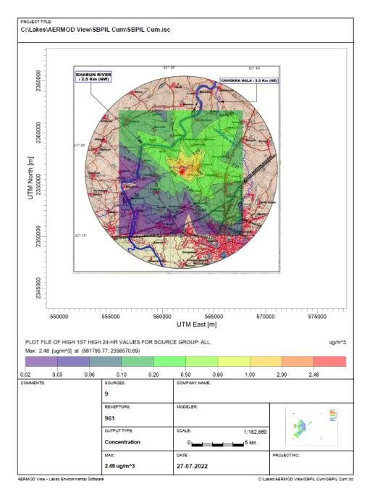
MAP SHOWING GLCS OF PLANT OPERATION FOR PM₁₀ (PROPOSED +EXISTING)

Slide 79
MAP SHOWING GLCS FOR SO₂ (PROPOSED +EXISTING)

Slide 80
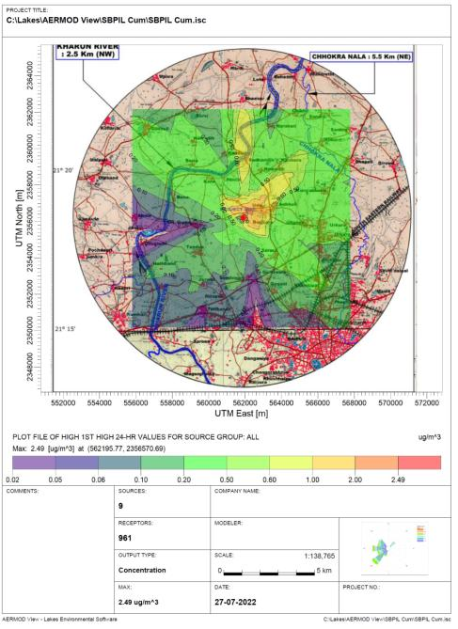
MAP SHOWING GLCS FOR NOx (PROPOSED +EXISTING)

Slide 81
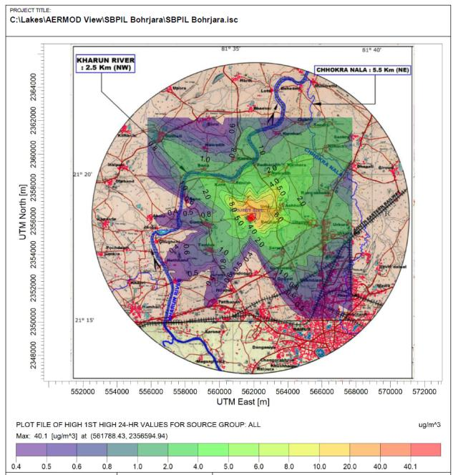
MAP SHOWING GLCS FOR PM₁₀ (Accidental)

Slide 82
OVER ALL SCENARIO
Monitoring Period | Proposed | Cumulative | Accidental
(PM µg/m³)
GLC PM | 1.34 | 2.48 | 40.1
Distance/Direction | 750m/ NE | 600m/ NE | Within Plant Boundary
(SOx µg/m³)
GLC SOx | 2.43 | 4.28 | -
Distance/Direction | 900 m NE | 1 Km NE | -
(NOx µg/m³)
GLC NOx | 0.430 | 2.49 | -
Distance/Direction | 1Km NE | 850 m NE

Slide 83
PUBLIC CONSULTATION
Public hearing advertisement for the expansion proposal was published on 20.11.2020 in “Dainik Bhaskar” (Hindi News Paper) and “Hindustan Times” (English News Paper).
Conducted on 21.12.2020 at 11:00 am (Time) in Saamudayik Building,Gram Panchayat Naya Bendri Village – Borjhara, Urla - Guma Road, Urla Growth Center, Raipur (C.G.) by ublic Hearing was conducted on 21.12.2020 by Chhattisgarh Environment Conservation Board.
Attended by 200 local people
• Issues are already given in the previous slide

Slide 84
PUBLIC CONSULTATION
Public Hearing was conducted on 21.12.2020 by Chhattisgarh Environment Conservation Board at Saamudayik Building,Gram Panchayat Naya Bendri which is 0.5 km from the plant.
SUMMARY OF PUBLIC ISSUES AND ACTION PLAN
S.No | ISSUE | RESPONSE | ACTION PLAN | BUDGET
1 | Employment to locals | At present 750 peoples are employed in company out of which more than 80% are local people. In future after Installation of proposed expansion units 200 people will be employed and preference will be given to local people subject to the skill & qualification of the candidate. | After Installation of proposed expansion units manpower will be employed as per requirement time to time and subject to skill and qualification of candidate. However, preference will be given to local people. | 25 Lakhs Per Month (Recurring Expenditure)
2 | To develop local school as Smart School | The Existing local school will be developed as a smart School. | Company will develop a smart school in village Bendri with in a period of 1 Year. | Rs. 5.0 Lakhs for smart school

Slide 85
3 | To provide Vocational Training Institute | Vocational training center in this area will be constructed where all the local people will be associated with technical education. | within a period of one year upon allocation of suitable land from State Government | Rs. 75.0 Lakhs as capital cost and Rs.25.0 lakhs as recurring cost for vocational training institute
4. | To Develop a public garden | Company will develop a garden in nearby village. | SBPIL is developing a Garden named as (Krishna Kunj" near proposed plant area in 3 acres where about 1200 trees of 22 species will be planted. | Rs.20.0 lakhs for developing public garden

Slide 86
EMP – AIR
Construction Phase
Dust will be the main pollutant affecting the ambient air quality of the area during the construction phase.
Dust will be generated during excavation, back filling and hauling operations and vehicular movement of trucks, dumpers and construction machinery.
Further, concentration of NOx and CO may also slightly increase due to increased vehicular traffic.
Air Pollution Control Measures
Regular sprinkling of water will reduce the dust generation.
Aggregates and sand will be stockpiled at suitable places (after stabilizing the surface), near the boundary wall so that the wall acts as windshield.
Necessary water sprinkling arrangement will be provided around the stockpiles and used whenever necessary to make them moist. Cement and steel will be stocked inside covered sheds.

Slide 87
EMP
Operation Phase
SOURCES, TYPE OF AIR POLLUTION & MITIGATION MEASURES
Sl. | Name of Process | Operation | Emission released waste generated | Types of pollution | Pollution Control Measures
Existing
1. | Sponge Iron plant with WHRB & AFBC power plant | DRI Kiln reduction of iron at 900-1100⁰C Generation of Steam from biomass & waste heat from DRI | PM,CO, SO₂, NO_{X} & Dust & generation of fly and bottom ash | Air Pollution & Thermal Pollution & Land pollution | Electrostatic precipitator for Sponge Iron plant with WHRB (to reduce thermal pollution and to capture heat) in order to restrict the particulate matter less than 30 mg/Nm³ Dolochar is used in the biomass based power plant.
2. | Coal Washery | unloading point, conveying transfer points, hoppers, crushers, screens | Particulate matter & Fugitve emission | Air and Noise pollution | Bag filters & Stack Water sprinkling
3. | Coal storage yard/ shed/ | Storage of raw and finished coal | Fugitive dust emission | Air pollution & noise pollution and fire risk | Water sprinkling System 90% of the dust controlled by these methods. Remaining 10% dust should not travel longer distance due to weight

Slide 88
4. | Fly Ash delivery point | - | - | - | Mist Water Spray System
5. | Ferro Alloys Plant | Ferro and silico Manganese | PM and SO₂ | Air Pollution & Thermal Pollution | Heat exchanger followed by bag filter & Stack
6 | SMS (Induction furnace) (existing as well as proposed) Hot Steel Rolling Mill | Melting of DRI in IF at 1600⁰C, Hot metal, Casting of refined liquid steel inmoulds of billet. Direct rolling technology based hence reheating furnace is not required | Water vapour, waste water containing iron scales Oil & Grease from Scrap, IF, EAF, LF slag Water, noise pollution | Air, Thermal, Water, Noise & Soil pollution No air pollution however solid waste such as Endcuts and misrolls shall be used in SMS | Bag filters with sparks arrester and swivel hood No air pollution control equipment is required , water is recirculating system hence only make up water is required noise pollution will be controlled by thick plantation

Slide 89
Proposed
7. | Pellet Plant with coal gasifier | Pellets formation from Iron Ore Fines Preheating - 1000⁰C Preheating pellets further heated and roasted upto 1250⁰C to 1350⁰C | Particulate matter, SO₂ and NOx & Fugitive emission | Air Pollution & Thermal Pollution | ESP & Stack
8 | Iron Ore Washery Plant | washing raw material | Particulate matter & Fugitive emission | Air and Noise pollution | Being Wet Screening there will be no Air Pollution
9. | Titanium Slag Plant &Pig Iron Plant | Batching of raw materials and feeding to electric smelting furnace with tapping of slag and Pig Iron metal at regular intervals. | PM and SO₂ | Air Pollution & Thermal Pollution | Heat exchanger followed by bag filter & Stack

Slide 90
POLLUTION CONTROL SYSTEM PROPOSED PLANT
S.N. | Stack No. | No. of Stacks | Particulars | Stack Height | Stack Attached
1. | Stack 1 | 1 | SMS Induction Furnace (15TX2) I &II | 30M | Bag Filter with suction hood
2. | Stack 2 | 2 | SMS Induction Furnace (15TX3) III. IV & V | 30m | Bag Filter with suction hood
3. | Stack 3 | 1 | Pellet Plant | 50m | ESP
4. | Stack 4 | 2 | Titanium Slag | 36m | Bag Filter

Slide 91
TOTAL STACK AFTER EXPANSION
S.N. | Stack No. | No. of Stacks | Particulars | Stack Height | Stack Attached
1. | Stack 1 (Replaced existing stack) | 1 | SMS Induction Furnace (15Tx2) I & II | 30m | Bag Filter with suction hood
2. | Stack 2 | 1 | SMS Induction Furnace (15Tx3) III IV & V | 30m | Bag Filter with suction hood
3. | Stack 3 | 1 | Pellet Plant | 50m | ESP
4. | Stack 4 | 2 | Titanium Slag | 36 m | Bag filter
5. | Stack 5 | 1 | Combined sponge iron +WHRB+ biomass power plant | 80m | ESP
6. | Stack 6 | 1 | Ferro Alloys Plant (Furnace 1) | 32 m | Bag Filter
7. | Stack 7 | 1 | Ferro Alloys Plant (Furnace 2) | 30 m | Bag Filter
8. | Stack 8 | 1 | Coal Washery | 30m | Bag Filter

Slide 92
EMP – WATER
WATER AND WASTE WATER INVENTORY (In m³/day)
S. No. | Facilities | Make-up Water requirement in m³/day | Wastewater Generated in m³/day | End use
1. | Sponge Iron Plant | 200 | Nil | -
2. | CPP | 1863 | 67 | Dust suppression & green belt after treatment
3. | Demineralized water for boiler | 100 | 06
4 | SMS | 130 | Nil | -
5. | Ferro Alloys | 44 | Nil | -
6. | Rolling Mill | 79 | Nil | -
7 | Coal Washery | 02 | Nil | -
8 | Fly Ash Bricks Plant |  | Nil | -
7. | Pellet Plant | 218 | Nil | -
 | Coal Gasifier | 32 | 4 | Phenolic water will be sent to ABC of Sponge Iron Kiln SOP attached as Annexure XVII in EIA report
8. | Domestic | 75 | 22 | Green belt after treatment
9. | Iron Ore Washery Plant | 150 | 60 | Recycled back as fresh water.
 | Titanium Slag Plant (Cooling Tower) | 540 | Nil | -
11. | Pig Iron Plant (Quenching) | 24 | Nil | -

Slide 93
EMP - SOLID & HAZARDOUS WASTE
MANAGEMENT & DISPOSAL
Source and type of solid waste | Qty. T/Year Existing | Qty.T/Year (Total Capacity after expansion) | Utilization /disposal method
Fly ash (Power Plant) | 58680 | No change | Bricks manufacturing unit & Cement Plant
Fly ash (SID) | 69300 | No change
Slag from SMS unit | 17000 | 25344 | Slag from SMS is being/will be sold to brick manufacturers in open market/Used in making man made sand
Slag from Ferro Alloys unit | 17280 | 23760 | Backfilling of low-lying area/land leveling/Sold in local market
Dolochar from SID | 66000 | No Change | Used in our AFBC based power plant as a Raw material.
Rejects From Coal Washery | 2,40,000 | No Change | Used in our AFBC based power plant (Gondwara unit) as a Raw material..

Slide 94
Coal Gasifier | Coal ash | - | 7920 | Disposal to Red bricks manufacturing unit.
 | Tar | - | 1320 | Used in pellet plant
Iron Ore Washery Plant -Reject (Fines) |  | - | 40,000 | No tailing pond for handling of slimes is proposed. The slimes will be dewatered in the thickener and thickened tailings sludge will be dewatered in proposed filter press. The overflow from the thickener will be collected into a process water tank and will be reused as fresh water. Slimes will be given to cement plants, Mou is attached as Annexure XVI.
Titanium Slag Plant capacity &Pig Iron Plant |  | Zero Solid Waste Generation Plant. |  | Note: The detail of sources from where solid waste and Hazardous Waste is being generated / anticipated are described as here under: The major Solid wastes generated from Smelting Furnace in the plant will be flue dust (@ 25 kg/ t of Titanium Slag). The flue dust will be recycled back to the furnace after being collected from Dust Collector Bag Filter house and fully reutilized.

Slide 95
PROPOSED BUDGET ALLOCATION FOR ENVIRONMENTAL MANAGEMENT PLAN (Rs. In Lakhs)
S.NO. | ACTIVITIES | Capital Cost | Recurring Cost per annum
1 | Air Pollution Control measures ESPs, Bag Filters, dust extraction systems, stack etc. | 500 | 10
2 | Fugitive dust control measures – Vacuum Cleaner | 64 | 2
3 | Wastewater Management and Effluent Treatment Plant | 190 | 8
4 | Sewage Treatment Plant | 50 | 2
5 | Environmental Monitoring Program and Occupational Health Survey | 200 | 23.75
6 | Solid Waste Management | 200 | 5
7 | Noise Reduction Systems | 10 | 1
8 | Greenbelt Development in Plant | 28 | 7
9 | Greenbelt development at Urla-Bendri-Guma Road in 2.5 ha
10 | Rain Water Harvesting | 50 | 3
11 | Public Hearing Commitments (Activities given below in table) | 156
 | Need based activities of villages | 226.3 | -
A. TOTAL |  | 1674.3 | 61.75

Slide 96
S.NO. | ACTIVITIES | Capital Cost | Recurring Cost
1. | Water for plantation | NIL | NIL
 | B. Total | 0 | 0
 | Grand Total (A+B) | 1674.3 | 61.75
*Recycled water will be used for the plantation so, cost will be nil for water for plantation.

Slide 97
EMP – GREEN BELT
The Green belt of 33% has been developed in the existing land and further plantation will be developed in the additionally in the 2.5 ha. of land provided by Gram Panchayat in Bendri village.
SBPIL has already planted about 29000 numbers of trees in the premises out of which 27000 tress are survived and proposed to plant additional 5600 no. of saplings in the additionally in the 2.5 ha. of land provided by Gram Panchayat in Bendri village within 5 km radius of the premises of SBPIL. Plantation of 3750 No.s of Trees already planted and Balance 1850 plantation is in progress.
An amount of Rs. 28.00 Lakhs is budgeted as capital cost along with recurring cost of Rs 7.00 lakhs.
In addition to this SBPIL is developing a Garden named as (Krishna Kunj" near proposed plant area in 3 acres under CSR as per the Public Hearing Commitment where about 1200 trees will be planted.

Slide 98
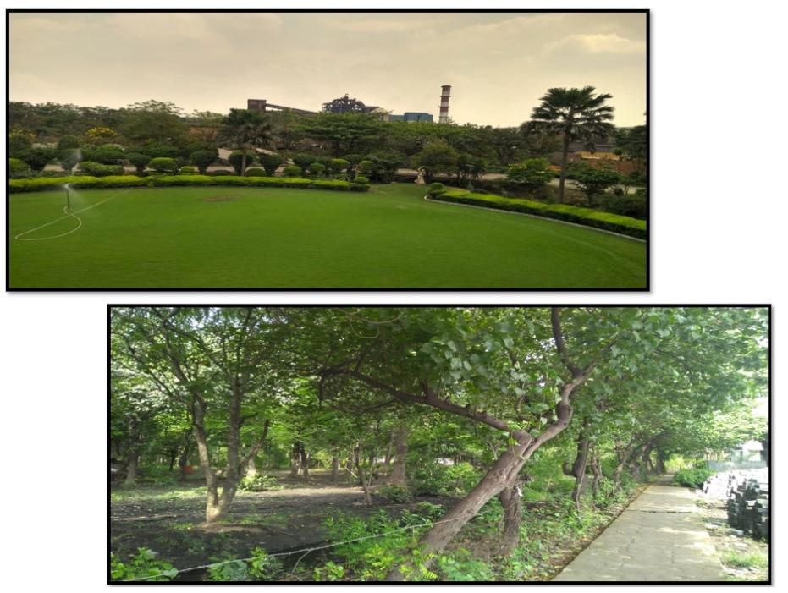
EXISTING GREEN BELT PHOTOGRAPHS

Slide 99
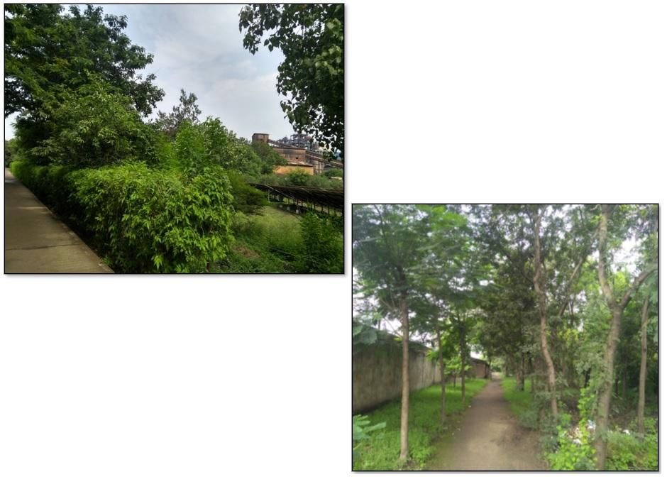

Slide 100
POST PROJECT MONITORING
S. No. | Monitoring Particulars | Parameters to be Monitored | Sampling Frequency
1 | Stack Monitoring (Main Stack) | Temp., Velocity, Flow rate, Particulate matter, SO₂, NOx | Online
2 | Performance analysis of Air Pollution Control Devices | Temp., Velocity, Flow rate, PM₁₀, SO₂,NOx | Quarterly
3 | CEMS PM analyser validation | Temp., Velocity, Flow rate, Particulate matter | Annual
4 | Continuous Ambient Air Monitoring four manual AAQ monitoring station will be replaced with Continuous Ambient Air Quality Monitoring Stations (CAAQMS) CAAQ1: Near Admin Building CAAQ2: Near Main Gate CAAQ3: Near Raw Material Yard CAAQ4: Near Rolling mill Two Locations will be outside the plant: for Manual Continuous Ambient Air Monitoring A1: Urla Village A2: Nawadih Village | PM10, PM2.5, SO2, NOx, CO | Online (One AAQMS Installed) Twice in a week
5 | Fugitive Emissions / Work zone monitoring | SPM, SO₂, NOx, CO | Twice in a month (8 Hourly)
6 | Waste Water Quality (Influent & effluent) | pH, BOD, COD, TSS, O & G | Quarterly

Slide 101
7 | Ground Water (1 Location in the plant and 7 locations around the plant) Surface Water 1 location SW1: Kharun River | As per IS 10500 | Quarterly
8 | Ambient Noise Monitoring (In and around the Plant) | Noise levels in dB(A) 24 hr continuous with one hr interval | Quarterly
9 | Soil Quality (4 Location in and around the plant) | Physico-chemical parameters and metals | Pre and Post Monsoon
10 | Sludge | As per Hazardous Waste Rules 2016 | Half Yearly
11 | Char from Sponge Iron Plant |  | Half Yearly
12 | Slag from SMS |  | Half Yearly
13 | Ash from Power Plant |  | Half Yearly
14 | Dust from Bag Filters |  | Half Yearly
15 | Phenolic Water |  | Half Yearly
16 | Tar |  | Half Yearly
17 | Spent Oil and Lubricants (From all units of the plant) |  | Half Yearly
18 | Used Batteries (Vehicles and computers) |  | Half Yearly

Slide 102
RISK ASSESSMENT FINDINGS AND ITS MITIGATION
SL NO | ACTIVITY CREATING HAZARD | Rank
 |  | Likelihood of occurrence (A) | RANK | Likelihood of detection (B) | RANK | Severity of consequence ( C ) | RANK | Risk potential = (A+B)XC | Preventive Measures
Pellet Plant
1 | Cleaning of kiln cooler cleaning/inspection | MODERATE | 3 | MODERATE | 3 | LOW | 6 | 12 | Heat proof jacket are being used
2 | ESP Cleaning Electrode Changing & Ash Handling | LOW | 2 | LOW | 4 | LOW | 6 | 36 | Use of PPE like safety shoes, Boiler suit, helmets, gloves, aprons and goggles
SID
1 | Cleaning of cooler transfer chute | HIGH | 4 | VERY LOW | 5 | MODERATE | 8 | 72 | Heat proof jacket being used
2 | Cleaning of dust settling chamber | HIGH | 4 | VERY LOW | 5 | MODERATE | 8 | 72 | Use of PPE like safety shoes, helmets, gloves, aprons and goggles
2 | Wet Scrapper Slurry Cleaning | HIGH | 4 | LOW | 4 | MODERATE | 8 | 64 | Follow SOP Use of PPE
3 | ABC & DSC Cleaning | VERY LOW | 1 | MODERATE | 3 | HIGH | 10 | 40 | Work permit SOP for process Use of PPE

Slide 103
SMS
1 | Burn injury due to overflow of hot material | LOW | 2 | VERY LOW | 5 | HIGH | 10 | 70 | Use of PPE like safety shoes, helmets, gloves, aprons and goggles
2 | Burn injury due to broken of wire rope | LOW | 2 | VERY LOW | 5 | HIGH | 10 | 70 | Cordening of area with hooter arrangement during transportation
3 | Fall of ladle due to broken of hanger | LOW | 2 | VERY LOW | 5 | HIGH | 10 | 70 | Cordening of area with hooter arrangement during transportation Regular checkup of wire rope by competent person
4 | Slip and fall due to accumulation of sponge iron on shop floor | MODERATE | 3 | MODERATE | 3 | LOW | 6 | 36 | Use of PPE like safety shoes, helmets, gloves, aprons and goggles
5 | Falling of scrap due to mishandling of scrap during charging of scrap to SMS | MODERATE | 3 | MODERATE | 3 | MODERATE | 8 | 48 | Use of helmets and safety shoes
6 | SLIPING OF PERSONS DUE TO Spillage of material on the shop floor during charging of raw material through mobile equipment | MODERATE | 3 | MODERATE | 3 | MODERATE | 8 | 48 | Use of PPE like safety shoes, helmets, gloves, aprons and goggles
7 | Electrical Flashing / shock during Air cleaning of furnace capacitors and switch gear | LOW | 2 | LOW | 4 | HIGH | 10 | 60 | Electrical isolation, tagging, spot earthing Provide Rubber Sheet
8 | Electrical Shock during Checking of Capacitor bank | VERY LOW | 1 | MODERATE | 3 | MODERATE | 8 | 32 | Rubber hand gloves and insulator tools Provide Rubber Sheet
9 | Occurrence of static electricity/electric spark in the Mill Cellar Room | VERY LOW | 1 | VERY LOW | 5 | HIGH | 10 | 60 | Proper earthing to be ensured
10 | Splashing of molten metal and slag | Low | 2 | VERY HIGH | 1 | HIGH | 10 | 30 | Face shield, helmet, asbestos appron

Slide 104
CAPTIVE POWER PLANT
1 | Furnace oil transfer from tanker to storage tank 1. Slip & Fall 2. Fire | LOW | 2 | HIGH | 2 | MODERATE | 8 | 32 | To be transferred Mechanically and Use of PPE
2 | Operation of Boiler 1.EXPLOSION 2.TUBE LEAKAGE 3. BACKFIRE | LOW | 2 | LOW | 4 | HIGH | 10 | 60 | Periodic NDT to know the thickness of pipe and replacement with thinned down pipes. Interlocking of ID fan running with LDO firing.
3 | Oil leakage from bearings & oil line on main steam line | LOW | 2 | LOW | 4 | LOW | 6 | 36 | Shrouding of evaporator coil
4 | Chemical handling 1. ACID / ALKALI SPILLAGE | MODERATE | 3 | LOW | 4 | MODERATE | 8 | 56 | Use of PPE like safety shoes, helmets, gloves, aprons and goggles
5 | Generation of dust during ash unloading on trucks | VERY HIGH | 5 | VERY HIGH | 1 | LOW | 6 | 36 | Use of Dusk Mask & PPE
6 | Fall from height while working in the height | LOW | 2 | LOW | 4 | HIGH | 10 | 60 | Use of safety belt
7 | Oil wastes/oil sludge handling | Low | 2 | High | 2 | Mode rate | 8 | 32 | Use of PPE like safety shoes, helmets, gloves, aprons and goggles
8 | Collapsing of acid/ alkali storage tanks | Very low | 1 | High | 2 | High | 10 | 30 | Use of vacuum breaker
9 | Leakages of steam line | LOW | 2 | HIGH | 2 | MODERATE | 8 | 32 | NDT of steam line at regular intervals specially at bends and thermal insulation of pipeline
ROLLING MILL
1 | Fall of material during hot slab handling | LOW | 2 | VERY LOW | 5 | HIGH | 10 | 70 | Sling to be checked from time to time, Use of PPE
2 | BODY PART in between slab/chain | LOW | 2 | VERY LOW | 5 | MODERATE | 8 | 56 | Use of Hand gloves, Stopper switch at short intervals
6 | Collision of hot wire during Shifting | LOW | 2 | very low | 5 | low | 6 | 42 | To be mechanically handled
7 | Falling of objects from top | MODERATE | 3 | VERY LOW | 5 | MODERATE | 8 | 64 | Use of helmet & Safety Shoe
8 | Un safe disposal of oily wastes of Rolling Mills | High | 4 | Low | 4 | Moderate | 8 | 64 | To be collected in drums and capped

Slide 105
GASIFIER
1 | contact with fire Coal dust explosion due to loading unloading | LOW | 2 | HIGH | 2 | HIGH | 10 | 40 | Firefighting equipment’s will be kept ready like extinguishers sand, buckets and fire hydrant ,Fire tender etc.
2 | Exposure to CO and PM from manual feeding. | LOW | 2 | HIGH | 2 | Moderate | 8 | 32 | PPE will be provide to the worker and operator. Portable CO level monitoring instrument will be made available at site.
3 | Gasifier Reactor Pressure buildups Flames through the gasifier reactor nozzles. Gas leakages, air leakages into system | LOW | 2 | HIGH | 2 | HIGH | 10 | 40 | All the operation will be followed as per SOP Fire fighting equipment’s are in place.
GENERAL HAZARDS OF PLANT
1 | Electrical shock during maintenance / routine check up of MCC | MODERATE | 3 | LOW | 4 | HIGH | 10 | 70 | Isolation & preventive measures with use of PPE
2 | Short circuit & flash over due to faulty insulation | LOW | 2 | LOW | 4 | MODERATE | 8 | 48 | Isolation & preventive measures with use of ppe
3 | Shock during maintenance of EOT cranes leading to fall from height | LOW | 2 | LOW | 4 | HIGH | 10 | 60 | Isolation & preventive measures with use of PPE
4 | Spillage of oil during maintenance of transformers | MODERATE | 3 | HIGH | 2 | MODERATE | 8 | 40 | Immediate removal of oil from floor
5 | Use of defective tools | LOW | 2 | MODERATE | 3 | MODERATE | 8 | 40 | Proper check list before use
6 | Movement of faulty vehicles inside plant | MODERATE | 3 | HIGH | 2 | LOW | 6 | 30 | Entry of vehicles with certificate
7 | Movement of CRANES under High tension line | LOW | 2 | HIGH | 2 | HIGH | 10 | 40 | Proper supervision

Slide 106
ENERGY CONSERVATION MEASURES
Details of energy efficiency improvement measures implemented, investment made and savings in energy achieved and progress made in implementation of other recommendations
A. | Implemented: 2020-21
SI. No. | Description of energy efficiency improvement measures | Category¹ | Investment (Rupees Crores) | Verified savings² (Lakh Rupees) | Verified energy savings (In Lakhs) | Units | Fuel | Remarks
1 | VFD Installed at CWP - 2 Nos x 250 KW in Power Plant | 20. Electric Motors and Drives | 0.07 | 31.81 | 5.84 | Lakh KWh | Electricity | NA
2 | VFD Installed at Cooler Discharge Belt - 2 Nos. x 30 KW in SID Plant | 20. Electric Motors and Drives | 0.03 | 3.77 | 0.69 | Lakh KWh | Electricity | NA
3 | Eliminated the use (Switched off) two nos of shell air fan each from both the kilns -1 & 2 (of capacity 11 KW x 2 Nos. + 22 KW x 2 Nos.) thorough process optimisation and modification . | 17. Fans | NIL | 1.55 | 0.29 | Lakh KWh | Electricity | NA
TOTAL |  |  | 0.10 | 37.13 | 6.81 | Lakh KWh
TOTAL MTOE SAVING |  |  |  |  | 58.59 | MTOE

Slide 107
Compliance to OM of MOEF&CC F.No. 22-23/2018-IA. II (PT) dated 31.10.2019 (as per Hon'ble NGT order dated 19.08.2019 (published on 23.08.2019) in O.A. No. 1038 2018)
Environment | Stipulated Conditions/Recommendations | Measures to comply Recommendation
Air
i. | Stack emission levels should be stringent than the existing standards in terms of the identified critical pollutants. | Stack emission from all the stacks will be maintained within 30 mg/Nm³. Sponge Iron Pant: 2 No. of ESPs (Existing 3 fields ESP) attached with common stack of height 80m. Steel Melting Shop: Pulse jet type Bag filter (2 No.) (SMS Induction Furnace (15Tx2) I & II: Stack height 30m and SMS Induction Furnace (15Tx3) III IV & V: Stack height 30m) Ferro Alloy Plant: Pulse jet type Bag Filter (2 no) with fourth hole fume extraction attached with stack of height 32m and 30m in furnace 1 and 2 respectively. Power Plant: ESP (3 fields ESP) attached with stack of height 80m. Coal Washery: Pulse jet type Bag filters (1 No.) attached with stack of height 30m. Pellet Plant: The flue gases from the induration furnace of pellet plant will pass through ESP (4 fields ESP) and outlet dust emission will be less than 30 mg/Nm³. The height of the stack will be 50m. Titanium Slag Plant: Pulse jet type Bag Filter (2 nos) with two stacks of height 36m each.

Slide 108
Environment | Stipulated Conditions/Recommendations | Measures to comply Recommendation
ii. | CEMS may be installed in all large/medium red category industries (air polluting) and connected to SPCB and CPCB server. | CEMS has already been installed with following stacks in the existing Plant and proposed for the proposed project: Existing: - Sponge Iron Plant: Kiln 1 and Kiln 2 : Common RCC Stack and Separate ESP with each kiln. AFBC (Biomass Based): Common RCC Stack with Kiln and Separate ESP SMS:Stack connected with bagfilter Ferro Alloy Plant: Stack connected with bagfilter Proposed:- SMS: Stack connected with bagfilter Pellet Plant: Stack connected with ESP Titanium Slag: Stack connected with bagfilter After expansion there will be total 8 Nos. Opacity meters as OCEMS (4 Nos. existing + 4 No. proposed). All the CEMS are being/will be connected with CECB server.

Slide 109
Environment | Stipulated Conditions/Recommendations | Measures to comply Recommendation
iii. | Effective fugitive emission control measures should be imposed in the process, transportation, packing etc. | All material transfer points are connected with Dust Extraction system attached with Bag filter. Dust extraction measures with swivel hood, ID fan are provided at different loading, unloading and transfer points in the raw material handling section. Fumes and gases in DRI, IF, SAF and other sections are removed by Fume extraction system with bag house followed by stack. Adequate dust suppression system in the form of water sprinklers are provided at raw material yard, solid waste dump site and along the vehicular roads. Sufficient no. of movable as well as fixed water sprinklers have been installed at various locations of the plant area especially in Raw Material & solid waste storage yard for dust suppression. Fugitive emissions are/will be suppressed by water sprinkling in dust prone areas. No. of sprinkler at present – 170 Proposed addition –80 Sprinklers Total no. of sprinklers after expansion- 250 Dedusting Stack details:
Stack Attached | Existing Height of Stack (in mts) | No. of Bag Filter
Stack 1 [SID (Bin Area)] | 30 meters | 02
Stack 2 (RMP Area) | 30 meters | 01
Stack 3 (Coal Handling Plant) | 30 meters | 01
Stack 4 (PSB Area) | 30 meters | 03
Stack 5 (Sponge Iron Loading Point ) | 30 meters | 01

Slide 110
Environment | Stipulated Conditions/Recommendations | Measures to comply Recommendation
iv. | Transportation of materials by rail/ conveyor belt, wherever feasible. | Transportation of Raw materials, fuel and finished products, solid waste like Fly Ash etc. are being transported in covered vehicles by Roads (Covered with Tarpaulin). Fly Ash is being transported in closed bulker also to cement plants. Dust extraction measures with swivel hood, ID fan are provided at different loading, unloading and transfer points in the raw material handling section. All the conveyor belts provided cover system to control fugitive emission. Dedicated roads for vehicles carrying raw materials and products are existing. 1 No. of Mechanical Sweeping Machines has been deployed to clean the roads regularly to keep fugitive dust emission under control. Two No. of water tankers has also been deployed.
v. | Encourage use of cleaner fuels (pet coke/ furnace oil/ LSHS may be avoided). | Not Applicable
vi. | Best Available Technology may be used. For example; usage of EAF/SAF/ IF in place of Cupola furnace. Usage of Supercritical technology in place of sub-critical technology. | Induction Furnaces are being operated in our SMS Plant Submerged Arc Furnaces are being operated in our Ferro Alloys Plant. Induction Furnace is being used for Billet production and Submerged Arc Furnace is being used for Ferro Alloys production which is best available proven technology.

Slide 111
Environment | Stipulated Conditions/Recommendations | Measures to comply Recommendation
vii. | Increase of green belt cover by 40% of the total land area beyond the permissible requirement of 33%, Wherever feasible. | SBPIL has already developed 33% of total land as green belt. 10.49 ha. has been already developed under greenbelt & plantation. An additional area of 2.5 ha will be developed under greenbelt & plantation. Total green belt will cover about 12.99 ha. (Including outside plantation) more than 40% of total plant area of 31.8 ha. We have Obtained a permission from Gram Panchayat Bendri for plantation on land around 2.5 ha. At a distance of 1.9 Km from plant vide letter no. GP 2021-22 dated 01.06.2021 and plantation of 3750 No.s of Trees already planted and balance 1850 plantation is in progress. In addition to this SBPIL is developing a Garden named as (Krishna Kunj" near proposed plant area in 3 acres under CSR as per public hearing commitment where about 1200 trees of 22 species will be planted. An amount of Rs. 28.00 Lakhs is budgeted as capital cost along with recurring cost of Rs 7.00 lakhs.
viii. | Stipulation of greenbelt outside the project premises such as avenue plantation, plantation in vacant areas, social forestry, etc. | Under greenbelt development program we have carried out plantation on outside roads, schools & Gram Panchayat buildings and Muktidham of nearby villages. SBPIL is developing a Garden named as (Krishna Kunj" near proposed plant area in 3 acres where 1200 trees will be planted.
ix. | Assessment of carrying capacity of transportation load on roads inside the industrial premises. If the roads required to be widened, shall be prescribed as a condition. | Adequate Roads of proper size are present inside the plant premises further strengthening and widening of roads is in progress. Roads with their sizes are given in Plant layout.

Slide 112
Environment | Stipulated Conditions/Recommendations | Measures to comply Recommendation
Water Environment
i. | Reuse/recycle of treated wastewater, wherever feasible. | Water is being used only for cooling purpose in re-circulating manner. No any treated / untreated effluent is being discharged outside the factory premises. Plant discharge water after treatment is being used for plantation and dust suppression purposes. Cooling Tower discharge water is being used for dust suppression purpose, inside the plant premises. 4 KL/ day Phenolic water from coal gasifier will be sent to ABC of Sponge Iron Kiln Domestic waste water is being treated in STP of capacity 30 KLD. Outside discharge of sewage is not envisaged. There will be zero discharge from the plant. Treated effluent will be utilized in greenbelt development.
ii. | Continuous monitoring of effluent quality/quantity in large and medium Red Category Industries (water polluting). | The project will be based on Zero Liquid Discharge. Continuous monitoring of effluent will be carried out to ensure no discharge outside the factory premises.
iii. | A detailed water harvesting plan may be submitted by the project proponent | Rain water harvesting has been already developed in the existing plant to harvest the rain water to reduce the water consumption. At present 5 Nos of Rain Harvesting systems are installed in Plant premises.
iv. | Zero liquid discharge wherever techno - economically feasible. | The project will be based on Zero Liquid Discharge. Continuous monitoring of effluent will be carried out to ensure no discharge outside the factory premises.
v. | In case, domestic waste water generation is more than 10 KLD, the industry may install STP. | The domestic water will be treated in STP of 30 KLD and reused for green belt development.

Slide 113
Environment | Stipulated Conditions/Recommendations | Measures to comply Recommendation
Land
i. | Increase of green belt cover by 40% of the total land area beyond the permissible requirement of 33%, wherever, feasible for new projects. | SBPIL has already developed 33% of total land as green belt. 10.49 ha. has been already developed under greenbelt & plantation. An additional area of 2.5 ha will be developed under greenbelt & plantation. Total green belt will cover about 12.99 ha. (Including outside plantation) more than 40% of total plant area of 31.8 ha. We have Obtained a permission from Gram Panchayat Bendri for plantation on land around 2.5 ha. At a distance of 1.9 Km from plant vide letter no. GP 2021-22 dated 01.06.2021 and plantation of 3750 No.s of Trees already planted and balance 1850 plantation is in progress. In addition to this SBPIL is developing a Garden named as (Krishna Kunj" near proposed plant area in 3 acres under CSR as per public hearing commitment where about 1200 trees of 22 species will be planted. An amount of Rs. 28.00 Lakhs is budgeted as capital cost along with recurring cost of Rs 7.00 lakhs.
ii. | Stipulation of greenbelt outside the project premises such as avenue plantation, plantation in vacant areas, social forestry, etc. | Under greenbelt development program we have carried out plantation on outside roads, schools & Gram Panchayat buildings and Muktidham of nearby villages. SBPIL is developing a Garden named as (Krishna Kunj" near proposed plant area in 3 acres where about 1200 trees will be planted.

Slide 114
Environment | Stipulated Conditions/Recommendations | Measures to comply Recommendation
iii. | Dumping of waste (fly ash, slag, red mud, etc.) may be permitted only at designated locations approved by SPCBs/ PCCs. | 58,680 TPA of ash from power and 69,300 TPA of ash from SID is being sold to brick manufacturers/ Cement Plant. 66,000 TPA of generated Char/ Dolochar is used in 8 MW Biomass power plant and surplus supplied to 16 MW AFBC power plant at Gondwara plant of M/s. SBPIL unit. 25,344 TPA of slag from SMS is being/will be sold to brick manufacturers in open market/Used in making man made sand. 17,820 TPA slag generated from ferro manganese plant will be used in production of SiMn and 23,760 of silico manganese slag will be used for backfilling of low-lying area/land leveling 2,40,000 TPA of reject coal generated from coal washery (100%) is used for captive consumption in 16 MW AFBC power plant at Gondwara plant of M/s. SBPIL unit. 100% Mill scale is used for captive consumption in Ferro Alloys Plant as raw material. Miss-Roll and End Cuts (100%) are used in captive consumption in Steel Melting Shop as raw materials. The liquid steel produced is used to produce hot billet suitable for rerolling, thus online hot rerolling practice has been adopted. Generated waste heat is used in WHRB for generation of power. 1,320 TPA of Tar generated from Coal Gasifier will be be used as supplementary fuel in pellet plant. 40,000 TPA pf Iron ore fines/slimes will be sold to Cement plants The Titanium Slag though produced in the form of slag is a marketable product raw material to Pig Iron Plant. Pig iron which is a by-product of the plant also will be sold out

Slide 115
Environment | Stipulated Conditions/Recommendations | Measures to comply Recommendation
iv. | More stringent norms for management of hazardous waste. The waste generated should be preferably utilized in co-processing. | Storage and handling of hazardous waste will be done as per provisions of Hazardous Waste Rules, 2016.
Other Condition (Additional)
i. | Monitoring of compliance of EC conditions may be submitted with third party audit every year. | Six Monthly Compliances are being sent to Regional office MOEFCC, Raipur every six months and are verified timely by officials. The third-party audit will be conducted every year.
ii. | The % of the CER may be at least 1.5 times the slabs given in the OM dated 01.05.2018 for SPA and 2 times for CPA in case of Environmental Clearance. | Corporate Environment Responsibility Budget towards capital expenditure in accordance to the MOEFCC's office Memorandum # F.No. 22-65/2017-IA-III dated 01.05.2018 is estimated to be about Rs. 1.64 Crores. Due to location of the project in Critically polluted areas, in compliance to OM of MOEFCC F. No. 22-23/2018-IA.II(PT) dated 31.10.2019, CER allocated is 2 x i.e., 2 times of estimated CER which is about Rs. 3.28 Crores. Further based on need of the villages in study area again the CER has been further increased to Rs. 3.82 Crores.

Slide 116
ASSESSMENT OF ECOLOGICAL DAMAGE, REMEDIATION PLAN, NATURAL AND COMMUNITY RESOURCE AUGMENTATION PLAN
M/s. Shri Bajrang Power & Ispat Limited constructed Iron ore washery and observed to be operational during the visit of Regional Officer, IRO Chhattisgarh on request of M/s. Shri Bajrang Power and Ispat Ltd, Village Borjhara, Urla Industrial Area, Raipur, Chhattisgarh vide letter no. SBPIL/Borjhara/Env/2022-23/725 dated 21/07/2022 and mentioned in the certified copy of compliance status report of EC stipulations vide letter no. EC-635/RON/2017-NGP/898 dated 26/08/2022 in accordance with MoEF&CC, New Delhi circular No. F.no. IA-3-22/10/2022-IA.III (E177258) dated 08.06.2022.
This construction of Iron Ore washery and its operation on trial basis for a period of 30 days without prior Environmental Clearance is under violation of MoEF&CC’s EIA Notification 2006.

Slide 117
DETAILS REGARDING CONSTRUCTION WORK CARRIED OUT AND ITS OPERATION PRIOR EC
1 | Company Name | Shri Bajrang Power and Ispat Limited
2 | Location | Khasara no. 173,174,175,176,177 and 178 at village Borjhara in Urla Industrial Complex, Raipur, Chhattisgarh
3 | Total Plant Area Land area for existing Project Land area for expansion Land area for Iron ore washery | 31.8 Ha. 21.0 Ha. 10.8 Ha 0.38 Ha
4 | Construction made (Prior EC) | Iron Ore Washery 0.4 MTPA
5 | Construction Period Date of start construction Date of completion of construction No. of days of operation | 01.04.2022 30.06.2022 30 days (July 2022)
6 | Actual working days Construction of Iron ore washery Trail operation : | 90 days 30 days
7 | Number of workers engaged for construction Number of workers engaged during operation | 40 (civil + Engineering ) 10

Slide 118
8 | Water Required during construction and Domestic use (drinking) Drinking water during trial operation of Iron Ore washery (30 days) Make up water during operation | Surface water for 90 days -150 m³ Drinking water – 25 KL 12 KL 750 KL
9 | Materials used for construction Steel Cement Sand Gitti | 90 MT (with equipment) 30 MT (600 bags) 50 MT 150 MT
10 | Production details from Iron Ore washery during operation period (30 days) | Iron Ore Feed – 6000 MT Product – 5000 MT
11 | Construction cost (Iron Ore washery) | Rs. 2,64,16,273/ as per CA certificate
12 | Turnover due to project | Rs. 3 Crore for 5000 MT @ Rs. 6000 per Tone
13 | Energy (operation + construction) Operation Construction | 51000 units 24000 units (Captive Power) 27000 units (Captive Power)

Slide 119
Total Damage and Remediation cost for Construction Activities carried out under Violation
Sr. No. | Environmental Component | Total Damage Cost (Rs.) | Total Remediation Plan Cost (Rs.)
1 | Air Environment | No damage cost as water sprinkling was there to suppress emitted dust during excavation for construction. Damage cost during operation phase due to fugitive emission = Rs. 52/- | Rs. 1,06,000/- for sprinklers and baricates
2 | Noise Environment | Non-availability of PPEs Damage cost = Rs. 50,000/- | Rs. 50,000/-
3 | Water Environment | Rs. 1088718/- for water consumed during construction and operation phase | Rs. 290 lakhs, provisions made in EMP (240 lakhs) for STP/ETP and rainwater harvesting (50 lakhs +Rs.15000/-
4 | Land Environment | Rs. 2520/- | Rs. 30,000/-
5 | Solid & Hazardous waste | Rs. 17800/- | Rs. 70,000/-
6 | Biological Environment | Deficiate plantation and greenbelt in and around the plant ( 800 trees) Rs. 4,00,000/- | Rs. 28,00,000 (28.0 lakhs) for plantation and green belt in and around the plant (provision in EMP)
7 | Socio-economic Environment (occupational health) | 25,000/- | Rs. 35,000/-
8 | Energy Consumption | Rs. 1,53,000/- | Rs. 2,50,000/- solar system
 | Total | Rs. 1737090/- Rs. 17.37 lakhs. | Rs. 556000 +318 lakhs (provision for STP, ETP, RWH and plantation and greenbelt in and around plant site (290+28=318 lakhs)

Slide 120
Remediation Plan and Budgetory Provisions for 3 year
Sr. No. | Environmental component | Activities Proposed | Budgetary provision |  |  | Total (in Rs.)
 |  |  | 1st Year | 2nd Year | 3rd Year
1. | Air Environment a) Ambient Air b) Air Pollution | Dust Suppression and water sprinkling. Provision of Barricates | 40,000 | 40,000 | 26,000 | 1,06,000
2 | Noise Environment | Supply of personnel projective equipments | 20,000 | 20,000 | 10,000 | 50,000
3 | Water Environment | STP and ETP Rain water harvesting structure Provision in EMP for Rs. 290 lakhs + 15000 for toilets | 10,00,0000 15000 | 10,00,0000 | 90,00,000 | 2,90,00,000 (Provision in EMP) 15000
4 | Land Environment | Leachate proof storage facility for productive soil and waste material | 20,000 | 10,000 | - | 30,000
5 | Ecology | G.B. and plantation in and around plant site Provision made in EMP for Rs. 28 lakhs | 10,00,000 | 10,00,000 | 800000 | 28,00,000 (Provision in EMP)
6 | Solid and hazardous waste | Provision of coloured bins Provision of storage facility | 25,000 | 25,000 | 20,000 | 70,000
7 | Socio-economic (occupational health) | First aid kit and health check up | 20,000 | 10,000 | 5,000 | 35,000
8 | Energy consumption | Construction of Solar panels | 1,00,000 | 1,00,000 | 50,000 | 2,50,000
 |  | TOTAL | 11000000 2,40,000 | 11000000 205000 | 9800000 111000 | 31800000 (Provision in EMP) 556000

Slide 121
Natural Resources Augmentation Plan
Sr. No. | Activities Proposed | Yearwise Implementation and Budgetary provision in Rs. |  |  | Total cost (Rs.)
 |  | 1st Year | 2nd Year | 3rd Year
1. | Development of Greenery in the surrounding area and road side plantation (along the state highway abutting the project side (100 trees in the surrounding area and 100 trees roadside Total 200 trees with maintenance @ 500/- per tree, total cost Rs. 1,00,000/-) | 50,000 | 25,000 | 25,000 | 1,00,000
2 | Provision of drinking water facilities through hand pumps/ dugwells/ tubewells (hand pump/ well per year in the nearby villages each year with maintenance) i.e. 3 tubewells per village in 2 villages | 30,000 | 30,000 | 30,000 | 90,000
3 | Repair and maintenance of roads in the nearby 3 villages with the help of gram panchayat considering one village each year | 25,000 | 25,000 | 25,000 | 75,000
4 | Development of plantation in two villages along road side @100 trees in each villages. Total number of trees 200@ Rs 300/- per tree. Total cost Rs. 60,000/- | 30,000 | 15,000 | 15,000 | 60,000
5 | Provision of solar system with solar pan, poles, wiring and lamps etc. in two villages (Roadside) | 1,00,000 | 1,00,000 | 1,00,000 | 3,00,000
6 | Construction of rainwater harvesting tanks 2 in each village in hospital/school for 2 villages | 4,00,000 | 4,00,000 | 4,00,000 | 12,00,000
 | TOTAL | 6,35,000 | 5,95,000 | 5,95,000 | 18,25,000

Slide 122
Community Welfare Augmentation Plan
Sr. No. | Activities Proposed | Year wise Implementation and Budgetary provision in Rs. |  |  | Total cost (Rs.)
 |  | 1st Year | 2nd Year | 3rd Year
1. | Development of drainage facilities in 2 villages one in each village with the help of Grampanchayat | 2,00,000 | 2,00,000 | 2,00,000 | 6,00,000
2 | Medical check-up camp in nearby areas for 2 villagers and supply of medicines (2 villages per year) | 50,000 | 50,000 | 50,000 | 1,50,000
3 | Assistance in providing study materials, uniforms, books to the poor students (50 students) each year | 50,000 | 50,000 | 50,000 | 1,50,000
4 | Provision of construction of package type STP in 2 Schools of nearby villages (2) with operation and maintenance training to the school staff | 2,00,000 | 2,00,000 | 2,00,000 | 6,00,000
5 | Provision mobile medical van 1 No. | 15,00,000 | - | - | 15,00,000
6 | Provision of Ambulance for PHC (one) |  | 7,00,000 | - | 7,00,000
 | TOTAL | 20,00,000 | 12,00,000 | 5,00,000 | 37,00,000

Slide 123
Summary of Remediation plan, Natural Resource and
Community Augmentation Plan
Sr. No. | Activity Proposed | Total (Rs.)
1. | Cost of damage / Remediation plan | 5,56,000 (excluding provisions of EMP cost of Rs. 318 lakhs) for STP, ETP, RWH and deficiate plantation in and around plant site
2. | Natural Resource Augmentation Plan | Rs. 18,25,000/-
3. | Community Augmentation Plan | Rs. 37,00,000/-
 | Total | Rs. 60,81,000/-

Slide 124
Request
In view of above we request Hon’ble EAC (Industry-I) Ministry of Environment, Forests & Climate Change, Government of India, New Delhi to kindly grant Environmental Clearance to M/s. Shri Bajrang Power & Ispat Limited for expansion of Integrated Steel Plant at Village-Borjhara, Urla –Guma Road, Urla Growth Center, Raipur District, Chhattisgarh State.
Thank You

