Slide 1
PRESENTATION FOR ENVIRONMENT CLEARANCE OF
M/s. RAMGARH SPONGE IRON PRIVATE LIMITED
BEFORE ESTEEMED MEMBERS OF EAC, NEW DELHI
enhancement the production capacity of sponge iron plant from 90,000 TPA (3x100 TPD) to 2,25,000 TPA (4x100 TPD & 1x 350 TPD DRI Unit), Proposed MS Billet of 1,76,400 TPA by installation of 4 x 15 TPH Induction Furnace, Rolling Mill having capacity 1,50,000 TPA & Captive Power Plant having capacity 30 MW (14 MW afbc & 16 MW whrb)
AT: Village: HOSSIR, P.O: DARI, District: HAZARIBAGH, JHARKHAND
CATEGORY OF PROJECT: A
PROPOSAL NO: IA/JH/IND/114277/2019
BASELINE MONITORING PERIOD: OCTOBER TO DECEMBER 2019
LABORATORY USED: KALYANI LABORATORIES PRIVATE LIMITED, BHUBANESWAR
NABL: Certificate No.TC -7043 validity 10.05.2022
MoEF: File No: Q-15018/46/2018-CPW Validity 24.10.2024
ENVIRONMENT CONSULTANT
Kalyani Laboratories Pvt. Ltd.
Plot No: 78/944, Pahala, Bhubaneswar, Odisha. (NABET Cert. No: NABET/EIA/1922/RA0154 valid till 28.04. 2022)

Slide 2
BRIEF INFORMTION
Sl. No | Particulars | Details
01 | Date of Grant of ToR | 22.11.2019
02 | Baseline study period | October – December 2019
03 | Date of Public hearing | 31.10.2020
04 | Project Cost | 346 crores
05 | EMP Cost (Capital and Recurring) | Capital cost – 38 crores Recurring cost – 2.2 Crores
06 | Manpower Details | 1860 (Existing 130; Proposed 1730)
07 | Details of the project falls under the purview of A) FCA,1980, B) WPA, 1972 C) ESZ if any | Not applicable
08 | CPA/SPA/ESA/ESZ, if any | No
09 | Interlinked project if any with status | No
10 | Any other relevant information | No

Slide 3
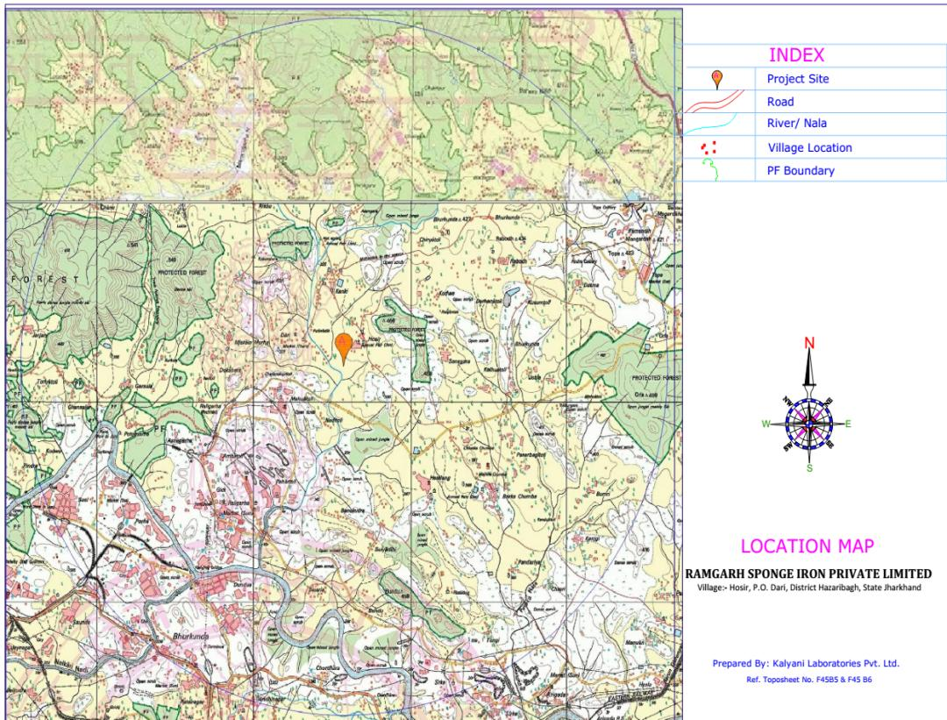
Protected Forest
Protected Forest
Major Infrastructure | Distance in kms
Ranchi-Ramgarh Road | 8.5Km
Kuju –Giddi Road | 1 Km
Kuju Railway station | 12 Km
Damodar River | 5 Km
Protected Forest
Protected Forest
Dari
Project Site
Protected Forest
Protected Forest
Kuju-Giddi Rd
Damodar River
8.5 Km
Ranchi-Ramgarh Rd
3

Slide 4
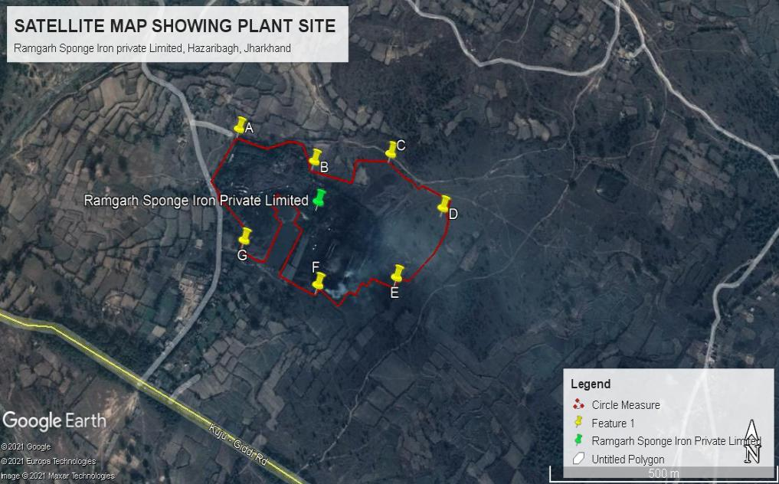
SATELITE MAP SHOWING PROJECT SITE
Coordinate | A | B | C | D | E | F | G
Latitude | 23˚42’40.47”N | 23˚42’38.56”N | 23˚42’38.06”N | 23˚42’33.26”N | 23˚42’30.93”N | 23˚42’29.86”N | 23˚42’33.14”N
Longitude | 85˚24’5.69”E | 85˚24’11.46”E | 85˚24’19.61”E | 85˚24’22.84”E | 85˚24’18.21”E | 85˚24’11.54”E | 85˚24’5.60”E
4
4

Slide 5
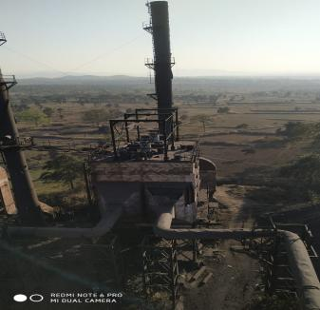
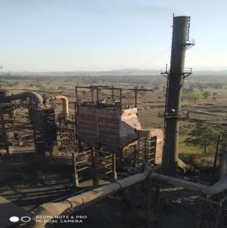
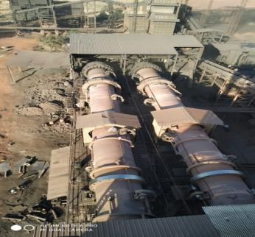
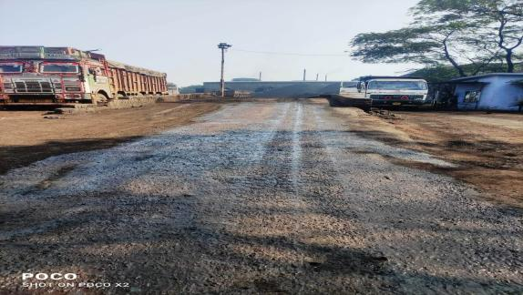
PHOTOGRAPH OF PLANT SITE

Slide 6
LAND ALLOCATED/ ACQUISITION STATUS
KHATA NO. | PLOT NO. | AREA ( IN ACREs)
75 | 1442 | 0.02
75/2 | 1475/1 | 1.04
75/2 | 1393/1 | 0.91
75/2 | 1442/1 | 0.20
75/2 | 1376/1 | 0.16
75/2 | 1476/1 | 0.60
12 | 1379 | 0.34^{2/3}
31 | 1473 | 0.19
31 | 1472 | 0.21^{1/3}
12 | 1379 | 0.17^{1/3}
31 | 1473 | 0.095
31 | 1472 | 0.10^{2/3}
12 | 1379 | 0.34^{2/3}
31 | 1473 | 0.19
31 | 1472 | 0.21^{1/3}
31 | 1394 | 1.54
31 | 1374 | 0.61
31 | 1474 | 0.47
12 | 1379 | 0.17^{1/3}
31 | 1473 | 0.095
31 | 1472 | 0.10^{2/3}
12 | 1382 | 2.11
12 | 1380 | 0.58
12 | 1383 | 0.80
12 | 1375 | 0.32
31 | 1383 | 0.90
75 | 1393 | 0.63
75 | 1477 | 0.36
31 | 1383 | 1.10
75 | 1477 | 0.11
31 | 1384 | 0.08
12 | 1375 | 0.32
76 | 1393 | 0.24
76 | 1393 | 0.23
75 | 1393 | 0.15
55 | 1381 | 0.21
55 | 1381 | 0.105
55 | 1381 | 0.105
55 | 1381 | 0.105
75 | 1376 | 0.20
75 | 1477 | 0.05
55 | 1381 | 0.21
75 | 1393 | 0.045
75 | 1393 | 0.015
40 | 1470 | 0.65
75 | 1477 | 0.64
25 | 1469 | 1.54
25 | 1469 | 1.03
25 | 1471 | 0.21
75 | 1477 | 0.64
25 | 1471 | 0.32
25 | 1469 | 0.06
25 | 1457 | 0.8^{2/3}
25 | 1458 | 0.03
25 | 1459 | 0.02^{1/2}
25 | 1460 | 0.25^{1/2}
25 | 1461 | 0.21^{2/3}
25 | 1462 | 0.01^{1/2}
25 | 1463 | 0.01^{1/3}
25 | 1464 | 0.06^{1/3}
25 | 1466 | 0.05^{1/3}
25 | 1467 | 0.07
25 | 1501 | 0.06
25 | 1469 | 1.23
 | Total | 22.2157 (Already acquired)

Slide 7
PREVIOUS CLEARANCES
Facilities Envisaged | Consent Status | Implementation Status | Remarks
400 TPD sponge Iron Iron plant | CTE vide JSPCB letter no. N-292, 09.04.2005 | Partially implemented | 3x 100 TPD constructed and operated 1x100 TPD constructed but not operated due to not obtaining CTO
3x100 TPD sponge Iron Plant | CTO vide Letter no. JSPCB/HO/RNC/CTO-5505181/2019/2028 dated 30.09.2019 valid till 31.12.2021 | Implemented | 3x100 TPD sponge Iron Conditions implemented and verified by Regional officer JSPCB.
All the CTO conditions has been complied and verified by Regional Officer, State Pollution Control Board, Jharkhand. Copy of the certified report attached

Slide 8
ENVIRONMENTAL SITE SETTING
Sl. No | Parameters | Details
a. | Water body | Naikari River – 1.5 Km, SW Damodar River- 5. Km, S
b. | Highway | Ranchi-Ramgarh Road – 8.5 Km Kuju- Giddi Road – 1 Km
c. | Railway line | Kuju Railway station – 12 Km
d. | Habitation | Dari – 2.5 Km Hossir – 1 Km
e. | National Park/ Wildlife Sanctuary/ Bio-sphere reserve/ Elephant Corridor/Tiger Reserve/ Eco-sensitive zone/ Eco-sensitive area | No national / Wildlife Sanctuary/ Bio-sphere reserve/ Elephant Corridor/Tiger Reserve/ Eco-sensitive zone/ Eco-sensitive area within 10 Km of the project site.
f. | Any other | Nil

Slide 9
FINAL PLANT CONFIGURATION
Sl. No | Name of the Unit | Configuration |  |  | Capacity | Product
 |  | Existing | Proposed | Final
1 | DRI | 3 x 100 TPD (under operation) | 1 x 100 (Constructed) + 1x350 TPD (additional) | 4x100TPD +1x350TPD | 2,25,000 TPA | Sponge Iron
2 | Induction Furnace (Steel Melting) | **** | 4x15 TPH | 4x15 TPH | 1,80,000 TPA (10 heat/day) | Molten Metal
3 | Continuous Caster (for Billet making) | **** | 3x6/11 m Radius | 3x6/11 m Radius | 1,76,400 TPA | MS Billet
4 | Rolling Mill | **** | 1,50,000 TPA | 1,50,000 TPA | 1,50,000 TPA | TMT Bar
5 | Slag Grinding Unit | **** | 40,000 TPA | 40,000 TPA | 40,000 TPA | Iron recovery
6 | Captive Power Plant | **** | WHRB-16MW AFBC-14 MW | WHRB-16MW AFBC-14 MW | 30 MW | Power

Slide 10
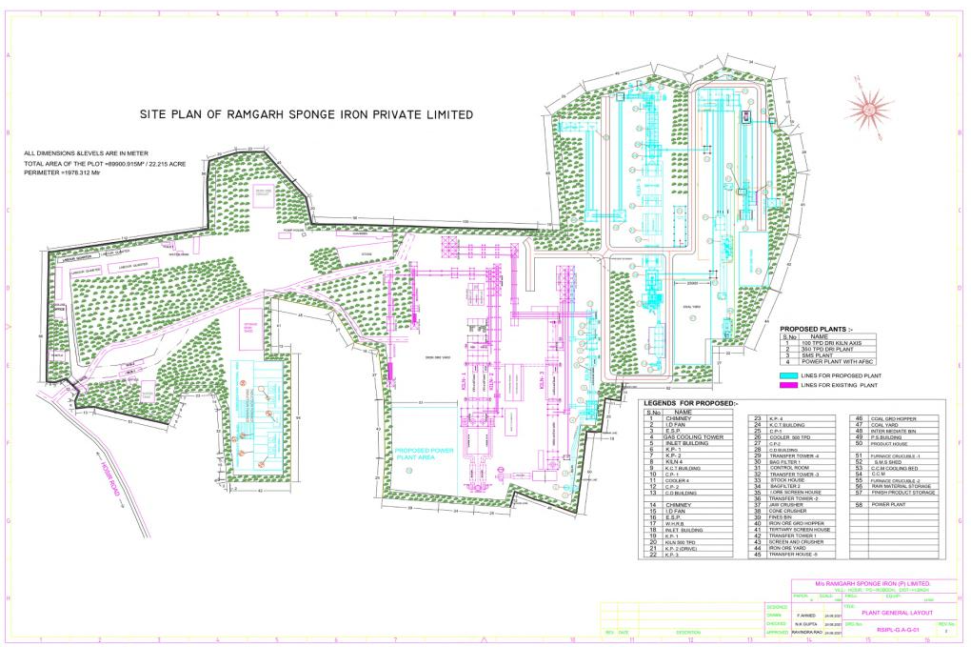
PLANT LAYOUT

Slide 11
RAW MATERIAL CONSUMPTION
Sl. No. | Name Of The Raw Materials | Quantity (TPA) | Source |  |  | Mode Of Transportation
DRI Unit
1 | Iron Ore | 3,60,000 | Mines of Odisha and Jharkhand |  |  | by rail rake and by road
2 | Non Coking coal | 2,92,500 | CCL |  |  | by Rail rake and by Road
3 | Dolomite /Limestone | 6750 | Chattishgarh |  |  | by Road
Power Plant (WHRB)
4 | Hot Flue gas | 4 x 25000 Nm³/hr from ABC of DRI Kilns (4x100T) and 1 x 100000 Nm³/hr from ABC of DRI kiln of 1 x 350 T
Power Plant (AFBC)
 | Item | Composition per unit of Fuel | Requirement Mt per Year |  |  | Source
5 | Char (CV -1500 Kcal/ Kg ) | 0.60 | 58050 |  |  | Captive Production
4 | Coal(CV -5000 Kcal/ Kg ) | 0.40 | 38400 |  |  | CCL mines
Steel Melting Shop
 | Name of Raw material | Qty. Required per metric ton of production (MT) |  | Total qty Required per annum |  | Source
7 | Sponge Iron | 1.0 |  | 1,80,000 TPA |  | Captive production
8 | Scrap | 0.24 |  | 43,200 TPA |  | Open market
Rolling Mill
9 | Billet | 1.03 |  |  | 1,54,500 | Captive production

Slide 12
FUEL, POWER & WATER CONSUMPTION
Sl. No | Particulars | Quantity | Source | Mode
01 | Water requirement | Existing Project 233 KLD | Drinking – 6 KLD (Tanker water); Plantation: 2 KLD; Process requirement – 225 KLD (RWH ponds 2 nos (40x40x5m) and nearby quarry of CCL during summer for 3 months). | Pipeline and Tanker
 |  | Proposed Expansion 2488 KLD | 2488 KLD (Damodar Valley Corporation, Additional one RWH pond (40x5x5) and CCL quarry) Application has been made and under process. | Pipeline
02 | Power Requirement | 30 MW | Initially from JSEB for construction activities and after operation power sourced from Captive power plant
03 | Fuel | Non Coking Coal- 292500 | CCL mines, Jharkhand | Truck

Slide 13
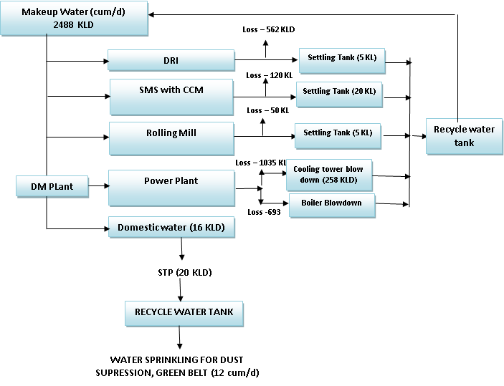
WATER BALANCE
Units | Final Installed Capacity | Water requirement Existing m³/ day | Water requirement Expansion (m³/day) | Total Water requirement m³/day
DRI Plant | 750 TPD | 225.00 | 337.00 | 562.00
SMS with CCM | 600 TPD | -- | 120.00 | 120.00
Power Plant | 30 MW | -- | 1728.00 | 1728.00
Rolling Mill | 500 TPD | -- | 50.00 | 50.00
Drinking & Domestic |  | 6.00 | 10.00 | 16.00
Plantation and Dust suppression |  | 2.00 | 10.00 | 12.00 (Recycled Water)
Total |  | 233.00 | 2255 | 2488

Slide 14
MATERIAL BALANCE
DRI
Input |  |  | Output
Input | Quantity T/T | Quantity (TPA) | Output | Quantity T/T | Quantity (TPA)
Iron ore | 1.6 | 360000 | Sponge Iron | 1 | 225000
Non Coking coal | 1.30 | 292500 | Dolo Char | 0.258 | 58050
Dolomite/Limestone | 0.03 | 6750 | ESP Dust | 0.165 | 37125
 |  |  | Wet Scrapper Sludge | 0.06 | 13500
 |  |  | Bag Filter Dust | 0.09 | 20250
 |  |  | Accretion | 0.009 | 2025
 |  |  | Gases | 1.348 | 303300
Total |  | 6,59,250 |  |  | 6,59,250
STEEL MELTING SHOP
Name of the Input Materials | Quantity input in (TPA) | Name of the output Materials | Quantity output in (TPA)
Sponge Iron | 1,80,000 | Liquid Steel | 1,80,000
Scraps/Pig Iron | 43,200 | End cut/Mill Scale | 3900
 |  | Bagfilter Dust | 10800
 |  | Salg | 18000
 |  | Gases | 10500
Total | 2,23,200 |  | 2,23,200

Slide 15
MATERIAL BALANCE
ROLLING MILL
Sl. No. | Input | Input Quantity (TPA) | Source | Mode of Transportation | Output Qty/Annum
1. | Billets / Slab | 1,54,500 | In House | Through Crane/ conveying System | Product- 1,50,000 TPA TMT Bar
CAPTIVE POWER PLANT (AFBC)
Input | Quantity, TPA | Output | Quantity, TPA
Coal | 38400 (40% Ash) | Ash | 15360
Dolo-Char | 58050 (80% Ash) | Ash | 46440
Total: | 96450 |  | 61800 [49440 TPA Fly Ash +12360 TPA BottomAsh]

Slide 16
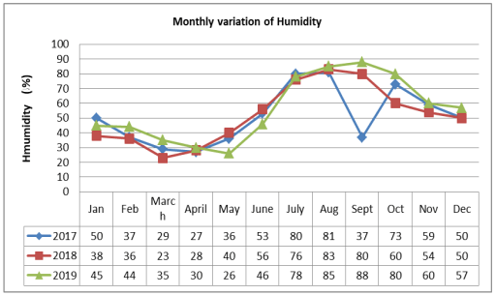
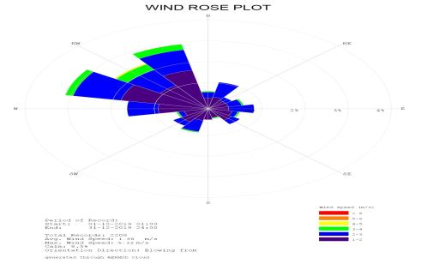
METEOROLOGICAL DETAILS WITH WINDROSE DIAGRAM
Maximum Temp: 42 deg.C
Minimum Temp. 10 deg.C
High relative humidity during the month of September i.e. 80 - 88%
Low during the month of April i.e. 28-30 %.
Average rainfall during monsoon is 1169 mm and average annual rainfall is 1414 mm.

Slide 17
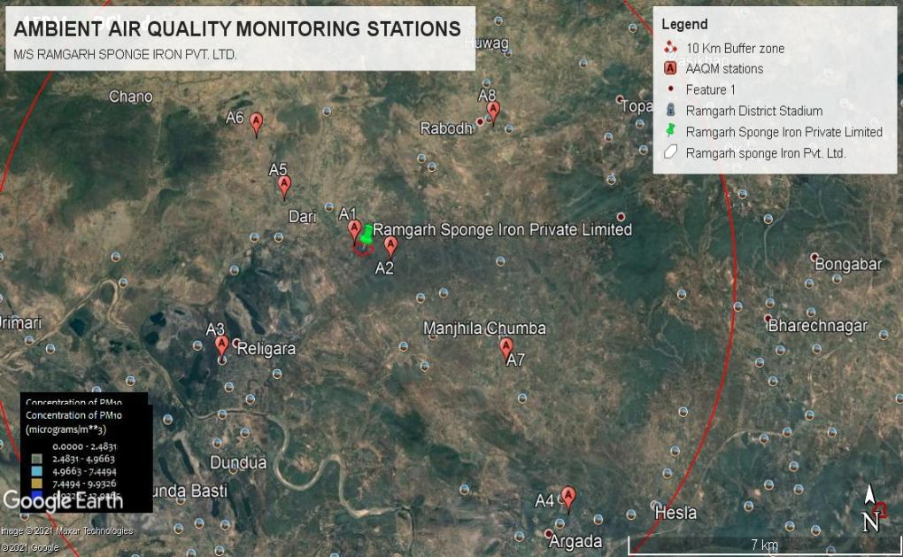
BASELINE STUDY AREA WITH LOCATION (Ambient Air Quality)
S.l. No | Locations | Distance in km | Direction | Ambient Air | Wind Direction
1. | Project Site | -- | -- | A1 | --
2. | Husir | 0.63 | SE | A2 | Predominant Down wind Direction
3. | Giddi | 4.60 | SW | A3 | Cross wind Direction
4. | Sirka | 8.37 | SE | A4 | Predominant Downwind direction
5. | Dari | 5.57 | NW | A5 | Up Wind direction
6. | Chano | 4.28 | NW | A6 | Up Wind direction
7. | Majhila Chumba | 4.88 | SE | A7 | Predominant down wind direction
8. | Rabodh | 4.8 | NE | A8 | Cross wind Direction

Slide 18
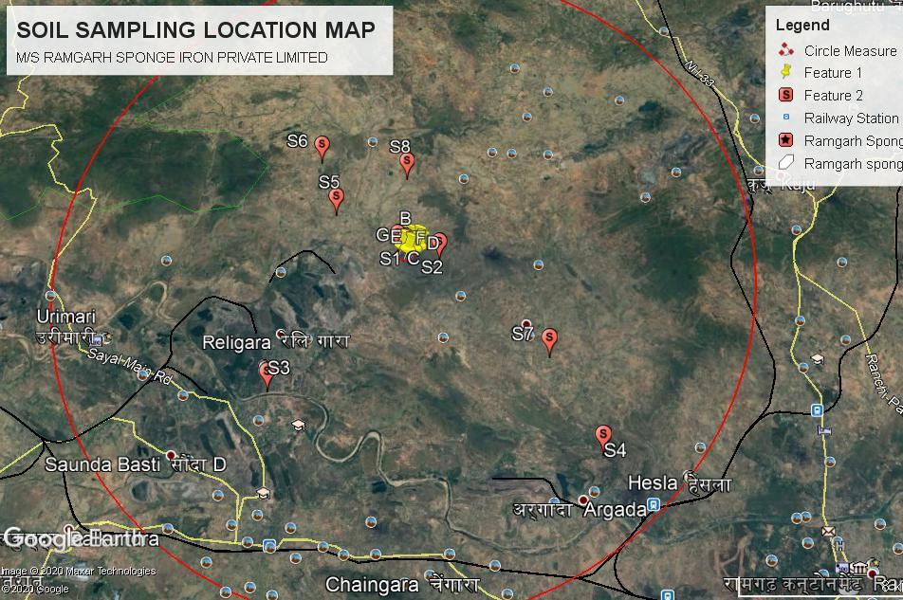
BASELINE STUDY AREA WITH LOCATION (Soil Quality)
S.l. no | Locations | Distance in km | Direction | Station No.
1. | Project Site | -- | -- | S1
2. | Husir | 0.75 | E | S2
3. | Giddi | 5.22 | SW | S3
4. | Sirka | 7.68 | SE | S4
5. | Dari | 2.43 | NW | S5
6. | Chano | 3.97 | NW | S6
7. | Majhila Chumba | 5.09 | SE | S7
8. | Rabodh | 4.42 | N | S8

Slide 19
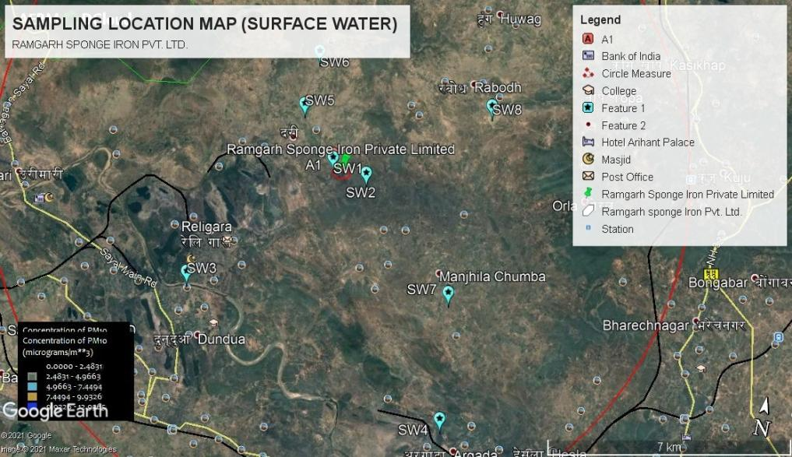
BASELINE STUDY AREA WITH LOCATION (Surface water)
Locations | Distance in km | Direction | Station No. | Source
Project Site | -- | -- | SW1 | RWH
Husir | 0.63 | E | SW2 | Pond
Giddi | 5.43 | SW | SW3 | Damodar river (U/s)
Sirka | 7.76 | SE | SW4 | Damodar river (D/s)
Dari | 1.92 | NW | SW5 | Kamala River (U/s)
Chano | 3.20 | NW | SW6 | Kamala River (D/s)
Majhila Chumba | 4.96 | SE | SW7 | Nala
Rabodh | 2.62 | N | SW8 | Pond

Slide 20
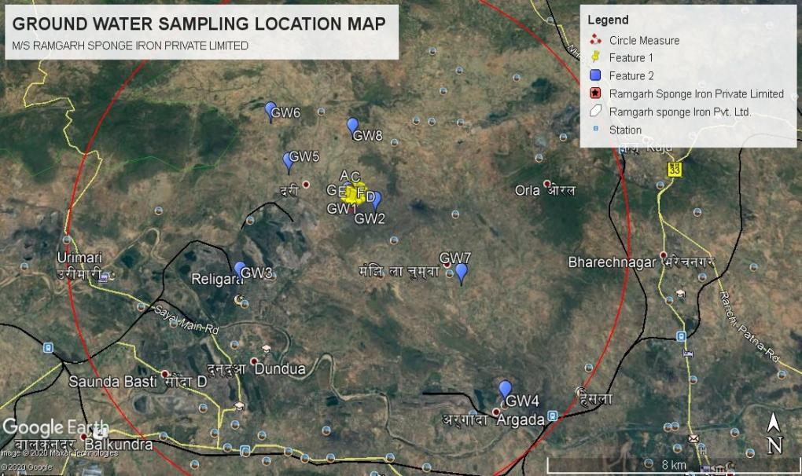
BASELINE STUDY AREA WITH LOCATION (Ground water)
Locations | Distance in km | Direction | Station No.
Project Site | -- | -- | GW1
Husir | 0.74 | NE | GW2
Giddi | 4.60 | N | GW3
Sirka | 8.39 | SE | GW4
Dari | 2.54 | SW | GW5
Chano | 4.41 | NW | GW6
Majhila Chumba | 4.83 | NW | GW7
Rabodh | 4.4 | NNE | GW8

Slide 21
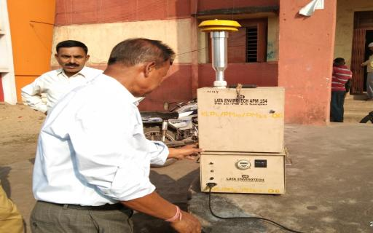
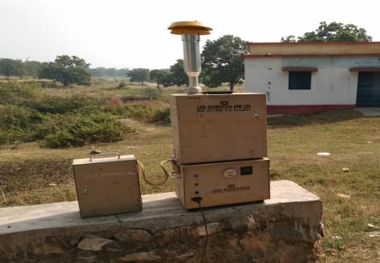
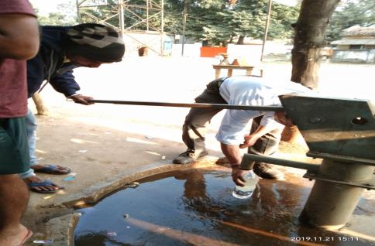
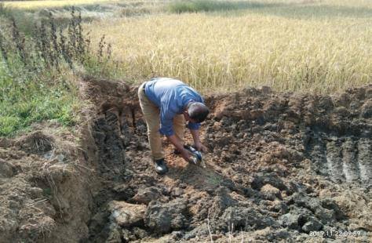
BASELINE STUDY PHOTOGRAPHS

Slide 22
BASELINE STUDY REPORTS
PERIOD | OCTOBER – DECEMBER 2019
AAQ PARAMETERS AT 8 LOCATIONS | PM2.5 – 29.2 to 48.7 µg/cu.m PM10 - 46.4 to 89.3 µg/cu.m SO2 -4.1 to 16.3 µg/cu.m NO2 -12.4 to 38.7 µg/cu.m CO – 0.21 to 0.60 mg/cu.m
AAQ Modeling (Incremental GLCs) AERMOD Cloud remote version | PM - 0.44 µg/m³ (with pollution control measure) at 2400m towards South East direction from the Stack PM- 18.84 µg/m³ (without pollution control measure) at 2400m towards south East direction from the Stack. SO2- 1.7834 µg/m³ at 3700m towards South East from the Stack NOx- 1.0067 µg/m³ at 4000m towards South East from the Stack.
Surface water at 8 locations | pH- 6.5 to 7.7 Total Hardness – 58- 428 mg/l , Chloride – 14- 58 mg/l , Fluorides – 0.28 – 1.67 , Heavy metals (Cd, Hg, As)- BDL
Ground water Quality at 8 Location | pH – 7.1 to 7.9, DO- 6.1 to 7.4 mg/l, BOD- 1-7 mg/l COD- 5-34 mg/l, Heavy metals (Cd, Hg, As)- BDL
Noise level at 8 locations | 40 – 72 dBA for day time and 30 to 68 dBA during night time

Slide 23
TRANSPORTATION PLAN – VEHICULAR TRAFFIC LOAD STUDY
Particulars | Details | Remarks
Traffic Load study period | 25.11.2019 (11.30-12.30 & 4.15 to 5.15)
Traffic Load Baseline | 218 PCU/hr
Additional Traffic load during operation of the expansion project (PCU/day) | 32 PCU/hr
Total Traffic load during operation of the existing and proposed expansion project (PCU/day) | 250 PCU/hr
Traffic capacity as per the IRC 106: 1990n for highways (PCU/day) | Kuju – Giddi Road (2 lane two way) | 1500 PCU/hr

Slide 24
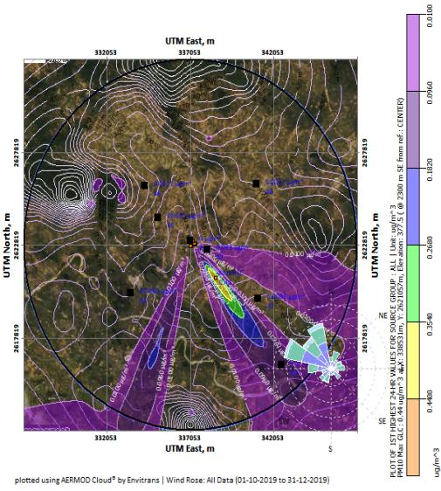
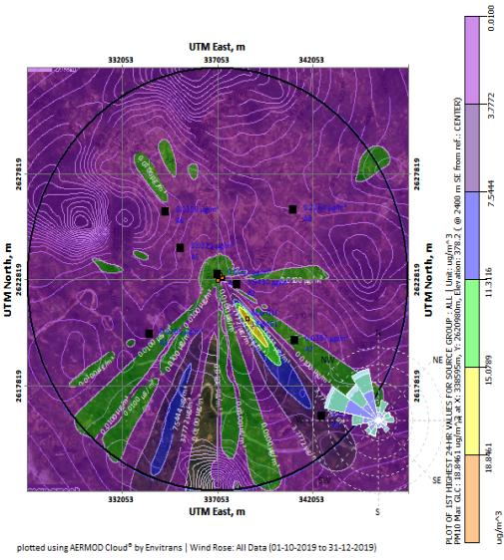
ISOPLETHS (Particulate Matter)
With Pollution Control measures
Without Pollution Control measures

Slide 25
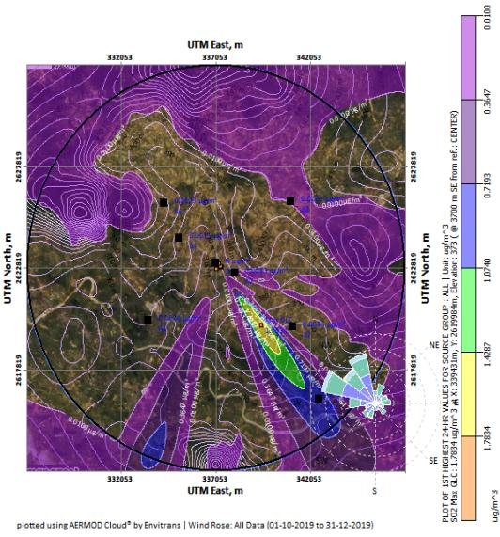
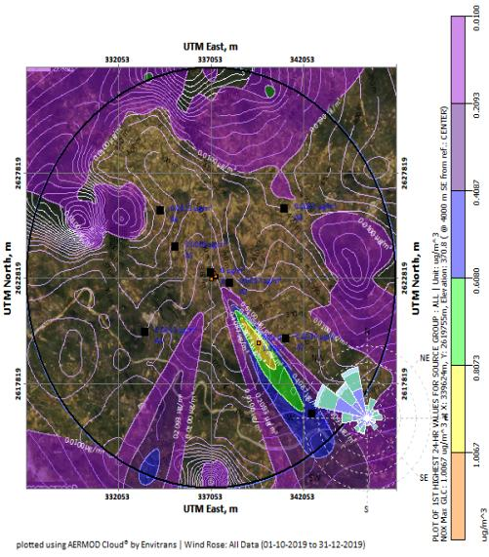
ISOPLETHS (SO2 & NOx)
SO2
NOx

Slide 26
MAXIMUM INCREMENTAL CONCENTRATION DUE TO PROPOSED PROJECT
Sl. No. | Discrete Cartesian Receptors | Incremental GLC in µg/m³
 |  | Baseline Conc | PM WMM | Cumulative Conc. WMM |  | PM WOMM | Cumulative Conc. WOMM |  | Baseline Conc. | SO₂ WOMM | Cumulative Conc. |  | Baseline Conc. | NO₂ WOMM | Cumulative Conc.
 | A1 – Project Site | 88.76 | 0.15 | 88.91 |  | 6.63 | 95.39 |  | 16.25 | 0.92 | 17.17 |  | 37.84 | 0.54 | 38.38
 | A2 – Husir | 76.88 | 0.09 | 76.97 |  | 1.94 | 78.82 |  | 13.78 | 0.01 | 13.79 |  | 20.18 | 0.01 | 20.19
 | A3 – Giddi | 63.61 | 0.01 | 63.62 |  | 0.22 | 63.83 |  | 7.91 | 0 | 7.91 |  | 17.31 | 0.01 | 17.32
 | A4 – Sirka | 65.24 | 0.11 | 65.35 |  | 0.04 | 65.28 |  | 8.43 | 0.64 | 9.07 |  | 19.12 | 0.37 | 19.49
 | A5 – Dari | 65.85 | 0.002 | 65.852 |  | 0.04 | 65.89 |  | 8.32 | 0.002 | 8.322 |  | 18.94 | 0.001 | 18.941
 | A6 – Chano | 65.4 | 0.042 | 65.442 |  | 0.02 | 65.42 |  | 6.98 | 0.003 | 6.983 |  | 18.41 | 0.003 | 18.413
 | A7 – Majhila Chumba | 76.81 | 0.01 | 76.82 |  | 0.02 | 76.83 |  | 9.34 | 0.005 | 9.345 |  | 17.34 | 0.005 | 17.345
 | A8 – Rabodh | 78.27 | 0.004 | 78.274 |  | 0.005 | 78.275 |  | 10.58 | 0.01 | 10.59 |  | 19.23 | 0.001 | 19.231
Maximum Incremental GLC in µg /m³ |  |  | 0.44 µg/m³ at 2400m towards South East from the Stack. |  |  | 18.84 µg/m³ at 2400m towards South East from the Stack. |  |  |  | 1.7834 µg/m³ at 3700m towards South East from the Stack. |  |  |  | 1.0067 µg/m³ at 4000 m towards South East from the Stack.
Maximum GLC with Maximum Baseline Conc |  | 88.76 | 0.44 |  | 89.2 | 18.84 |  | 107.6 | 16.25 | 1.78 |  | 18.03 | 37.84 | 1.0067 |  | 38.846
WOMM – Without Mitigation Measure; WMM – With Mitigation Measures

Slide 27
PUBLIC CONSULTATION
Notice made through advertisement in the newspapers The Hindustan on 01.10.2020 and Prabhat Khabar 30.09.2020.
Conducted on 31.10.2020 at 11.30 AM at Community Hall, Giddi, Jharkhand under chairmanship of Sri Abhay Kumar Sinnha, Deputy Development Commissioner, Hazaribah.
Attended by: 46 persons; Issues raised by 15 persons

Slide 28
ISSUES RAISED DURING PUBLIC HEARING
Area of intrest | Issues raised during PH | Response by project proponent (after PH)
Employment | Employment for local people | Employment will be provided to the local people based on the requirement and skill.
Health | Provision for medical facility for local people and workers. | Medical facility will be provided to the local people and workers.
Infrastructire development | Formation of village Committee | Village Committee will be formed with consultation with village Panchayat.
 | Provision of paved road and repair of damaged road connecting plant site and village. | Paved Road will be constructed in the locality.
 | Utilization plan for CSR fund | CSR fund will be utilized as per recommendation of the management in consultation with village committee.
Education | Infrastructure development of educational institutions. | Company will support in development of Primary school in Giddi,Dari area and Hosir College.
Drinking Water supply | Supply of drinking water facility to nearby people and villagers. | Drinking water is being supplied to the nearby villagers with water tankers.
Electricity Supply | Provision of electricity to nearby villages. | Since, the power generated will be captive for the project needs, hence will not be feasible to extend to the villagers.
 | Time bound Plantation programme | Plantation is continuous process. Being carried out on regular basis.
Pollution Control | Adoption of Pollution Control measure techniques to avoid pollution. | The existing unit has all the equipments such as Bag filters, ESPs, Silos, and Sprinklers etc to ensure a pollution free environment. All possible measures will continue to be adopted for a pollution free environment in future also.
Peripheral Development | Peripheral developmental plan | We will ensure comprehensive development of the people in particular and society at large by facilitely employment and investment opportunity.

Slide 29
ACTION PLAN TO ADDRESS PH ISSUES
Proposed social development activities | Monitorable Physical Targets |  |  |  | Total Budget proposed in Lakhs
 | Year 1 | Year 2 | Year 3 | Year 4
Employment generation for local people | Out of the contractual workers (Unskilled and semiskilled) required for construction 80% will be hired from the local villages | Out of the contractual workers (Unskilled and semiskilled) required for construction 80% will be hired from the local villages | During the operational phase 80% of the local people will be employed in the plant (Un skilled) | -- | --
 | Promotion and scholarship for 10 nos for ITI study and give employment in the plant from 3rd years onwards (Rs. 2,00,000 per annum) | Promotion and scholarship for 10 nos for ITI study and give employment in the plant from 3rd years onwards (Rs. 2,00,000 per annum) | Promotion and scholarship for 10 nos for ITI study and give employment in the plant from 3rd years onwards (Rs. 2,00,000 per annum) | Promotion and scholarship for 10 nos for ITI study and give employment in the plant from 3rd years onwards (Rs. 2,00,000 per annum) | 8.0
Medical Facility | Quaterly health camp for Dari, Hossir and Napo village for 100 people (Rs.2,00,000) | Quaterly health camp for Dari, Hossir and Napo village for 100 people (Rs.2,00,000) | Quaterly health camp for Dari, Hossir and Napo village for 100 people (Rs.2,00,000) | Quaterly health camp for Dari, Hossir and Napo village for 100 people (Rs.2,00,000) | 8.0
 |  |  | Dedicated vehicle to be used for medical emergency for local people (Rs.16,00,000.00) | Maintenance (Rs.3,00,000.00) | 19.0

Slide 30
ACTION PLAN TO ADDRESS PH ISSUES
Repair and maintenance of the road | Repair and maintenance of the road connecting Plant site – Kuju – Giddi Road (600m) Rs,20,00,000.00) | Repair and maintenance of the road connecting Hossir village- Plant site – Kuju – Giddi Road (800m) Rs,30,00,000.00) | Regular maintenance of the 1400m road (Rs,10,000,00.00) | Regular maintenance of the 1400m road (Rs,10,000,00.00) | 50.0
Plantation | Plantation of 600 nos of saplings along the village road connecting Plant site to Kuju- Giddi Road (600m) @Rs.200/- per saplings with tree guard (Rs. 120000) | Plantation of 800 nos of saplings along the village road connecting Plant site to Kuju- Giddi Road (800m) @Rs.200/- per saplings with tree guard (Rs. 180000) |  |  | 3.00
Formation of village committee | Village comitte will be formed | -- |  |  | --
Pollution control | Pollution control measures to be installed as per statutory requirement and design criteria | To be monitored by village comittee | To be monitored by village comittee | To be monitored by village comittee
Reduce in soil fertility | Monitoring of soil quality and Water quality on quarterly basis ( 4 locations) (Rs.1,00,000.00) | Monitoring of soil quality and Water quality on quarterly basis ( 4 locations) (Rs.1,00,000.00) | Monitoring of soil quality and Water quality on quarterly basis ( 4 locations) (Rs.1,00,000.00) | Monitoring of soil quality and Water quality on quarterly basis ( 4 locations) (Rs.1,00,000.00) | 4.0

Slide 31
ACTION PLAN TO ADDRESS PH ISSUES
Supply of Fertilizers | Fertilizer supply to 20 farmers @20,000 per farmer per year (Rs.4,00,000.00) | Fertilizer supply to 20 farmers @20,000 per farmer per year (Rs.4,00,000.00) | Fertilizer supply to 20 farmers @20,000 per farmer per year (Rs.4,00,000.00) | Fertilizer supply to 20 farmers @20,000 per farmer per year (Rs.4,00,000.00) | 16.0
Drinking water facility | One solar water system with pump and pipe supply in Hossir village) Place as decided by village committee) Rs.5,00,000.00) | One solar water system with pump and pipe supply in Hossir village) Place as decided by village committee) Rs.5,00,000.00) | One solar water system with pump and pipe supply in Dari village) Place as decided by village committee) Rs.5,00,000.00) | One solar water system with pump and pipe supply in Dari village) Place as decided by village committee) Rs.5,00,000.00) | 20.0
Education facility | Support to Hossir and Dari Primary school for developmental activities (RWH, Maintainace of furniture, Toilet water supply etc as per requirement of school) Rs.3,00,000.00 | Support to Hossir and Dari Primary school for developmental activities (RWH, Maintainace of furniture, Toilet water supply etc as per requirement of school) Rs.3,00,000.00 | Support to Hossir and Dari Primary school for developmental activities (RWH, Maintainace of furniture, Toilet water supply etc as per requirement of school) Rs.3,00,000.00 | Support to Hossir and Dari Primary school for developmental activities (RWH, Maintainace of furniture, Toilet water supply etc as per requirement of school) Rs.3,00,000.00 | 12.0
Electricity Supply |  |  | Installation of solar street light in Hossir village (20 nos) Rs. 8,00,000.00 | Installation of solar street light in Dari village (20 nos) Rs. 8,00,000.00 | 16.00
Total Budget |  |  |  | 176.00 Lakhs

Slide 32
EMP – AIR ENVIRONMENT
Source | Proposed mitigation Measures
Captive Power Plant | Bag filter capacity 40000Nm3 ESP will be provided to control to dust emission through flue gases from AFBC. Stack height will be as per the regulatory norms
Stock House | Bag filter capacity 12000Nm³
Kiln | ESP with pneumatic ash handling system (Silo)
Other dust generating area | 30 nos of fixed water sprinklers and 2 nos of moveable sprinklers with 2 nos of water tankers for water sprinklers
Sponge Iron Unit | Stack of 35 m height with two nos of ESPs a to control dust emission through flue gases from DRI kilns after WHRB. Conveyors covers and stack height will be increase to meet the emission norms. Bag filters installed at stock house, crusher house, coal injection control fugitive dust emission.
Induction furnace | Fume extraction system followed by bag filters for cleaning of gases solid waste (slag) will be used for recovery of metal and supplied for construction filling and other uses.
Raw material and Product Handling | Bagfilters will be used at coal handling section, Iron ore handling section, stock house and product house section to control fugitive dust pollution. Water sprinkling will be done during unloading and loading of raw material an product. Raw material and products will be kept in covered sheds and conveyors will be covered
Other Environmental management activities | Two RWH structures has been constructed within the project site. Green belt has been developed over an area of 7.5 acres with about 1500 saplings. Pucca road construction within the plant premises has been initiated.

Slide 33
EMP – AIR ENVIRONMENT (Fugitive dust control)
Sl. No | Name of Unit/ Process | APCD & Stack height | Design Efficiency | PM Emission
1 | Cooler discharge area and transfer points of DRI Plant | Bag Filters, common stack | 99% | < 100 mg/Nm³
2 | Product Hopper of DRI Plant (intermediate stock bins, crusher and screening plant and magnetic separator) | Bag Filters, common stack | 99% | < 100 mg/Nm³
3 | Day Bins of DRI Plant (feeder area, mixing area, transfer and junction points) | Bag Filters, common stack | 99% | < 100 mg/Nm³

Slide 34
EMP – NOISE ENVIRONMENT
Use of suitable muffler systems/enclosures/sound-proof glass panelling on heavy equipment/pumps/blowers, the same should be ordered with the equipment supplier.
Pumps and blowers mounted on rubber pads to absorb maximum noise during operation.
Proper scheduling of high noise generating activities to minimize noise impacts
Placement of equipment emitting high noise in an orientation that directs the noise away from work place/ sub floor personnels.
Periodic maintenance of equipment/replacing whenever necessary/ lubrication of rotating parts, etc.
Performance specifications for noise represent a way to insure the procured item is controlled.
Use of ear protective devices.
Implementation of greenbelt for noise attenuation may be taken up

Slide 35
EMP – WATER ENVIRONMENT
Sl. No | Source | Proposed mitigation Measures
1 | DRI Plant | Only water requirement will be for cooling purpose. The cooling water will be recirculated in the process through cooling tower
2 | Steel Melting Shop | Only non-contact cooling water is required to maintain the desired temperature of furnace shell, casting shell and moulds. Make-up water is added to cooling tower to compensate for evaporation loss. The cooling water is recirculated in the process.
4 | Rolling Mill | Direct circulating cooling water used in rolling mill is contaminated with scales and traces of oil. Mill scales from Rolling Mill are carried away with the flowing water to the settling tank. The water is allowed to return to ambient temperature and reused for cooling purpose. Only make-up water is added.
6 | CPP | Water requirement for CPP is for condenser cooling, cooling other plant equipment, ash handling and DM feed water making. Wastewater is generated in the form of cooling tower blow down, boiler blow down, DM plant regeneration and ash sump overflow. The effluents will be taken to guard pond and then reused for dust suppression, ash handling and disposal.

Slide 36
EMP – WATER ENVIRONMENT
WASTE WATER TREATENT FOR DIFFERENT UNITS
Units | Waste water treatment method
DRI | Settling Pond and recirculation
DM Plant | Neutralization Plant
Canteen/Shop/ Units | Drains, catch pits, storm water drains
Power Plant Blow down Water | Settling Pond and recirculation
Rolling Mill | Settling Pond and recirculation
RAIN WATER HARVESTING DETAILS
Sl. No | Rain water harvesting area | Area in Sq.m | Recharge co-efficient | Rainfall (m) | Volume of harvestable quantity of rain water per annum (Cu.m)
01 | Roof Top (Corrugated) | 35208 | 0.8 | 1.42 | 39996
02 | Roof Top (Concrete) | 2024 | 0.8 | 1.42 | 2299
03 | Road and Paved area | 6070 | 0.6 | 1.42 | 5172
Total harvested Rain water |  |  |  |  | 47467
Two rain water storage tanks of dimension 40 x 40 x 5 m has been constructed within the plant premises to store the harvested quantity of rain water and for use. Total storage capacity of the tank will be 16000 Cu.m. Further additional one RWH pond with capacity 8000 cu.m (40x40x5m) is being proposed for the proposed expansion .

Slide 37
EMP – WATER ENVIRONMENT
Storm water drainage system to collect surface runoff is separately connected to rain water harvesting tank.
All effluents containing acid/alkali/organic/toxic wastes/sanitary waste is being separately stored and treated separately.
Dewatering of sludge and appropriate disposal of solids
Treated wastewater (such as sewage, industrial wastes, or stored surface runoffs) can be used as cooling water makeup .
Fuel storage areas is bounded.
Handling, storing, and disposal of hazardous materials will be done as per rules.
Emergency response plan will be strictly followed for accidental spills if any.

Slide 38
EMP – GREEN BELT (EXISTING)
Sr. No. | No of Saplings planted | Area | Survival Rate (Avg.) | Area covered Under green belt in Acres
1 | 320 | Along NW Plant Boundary and open space near |  | 1.45
2 | 480 | Along SW Boundary and open space near office building, Product Storage Yard, Car & Truck Parking area |  | 1.82
3 | 350 | Along southern boundary of the lease area |  | 1.19
4 | 380 | Along SE Boundary |  | 1.15
 | 1530 |  | 70% | 5.6

Slide 39
EMP – GREEN BELT (PROPOSED)
Proposed plantation in the existing Plantation area (1st Year)
Sr. No. | No of Saplings planted | Area | Survival Rate (Avg.) | Existing Plantation area | Proposed Saplings
1 | 1130 | Along NW Plant Boundary and open space near | 70% | 1.45 | Mango, Sisoo, Teak, Deodar, Neem, Alstonia, Kachnar, Gulmohr, Mahagoni, Bot, Champa, Sirisa, Bakul, Kadam, Radhachura, Nyctanthes, Nerium, Mesuaferra, Lagerostromea, Ceaslpineapulcherima, Cassia fistula, Aegle marmelos, Pongamia pinnatta etc
2 | 1370 | Along SW Boundary and open space near office building, Product Storage Yard, Car & Truck Parking area |  | 1.82
3 | 850 | Along southern boundary of the lease area |  | 1.19
4 | 770 | Along SE Boundary |  | 1.15
 | 4120 |  |  | 5.6
Proposed Plantation in additional area (2nd Year)
 | 950 | Near Proposed SMS and rolling mill, Coal unloading, stacking and handling area, | 70% | 0.95
 | 950 | Plantation along NE and North boundary of the proposed DRI |  | 0.95
 | 1900 |  |  | 1.9

Slide 40
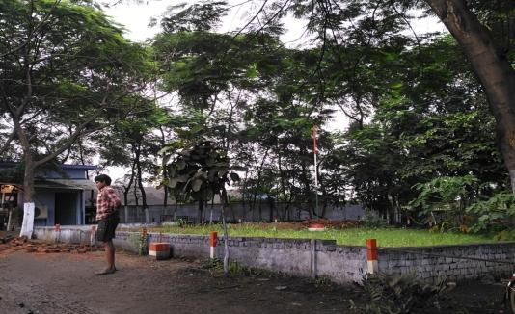
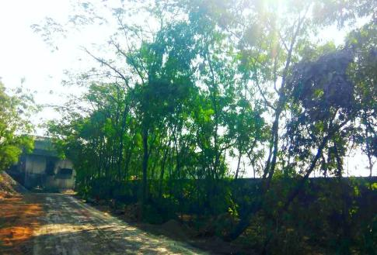
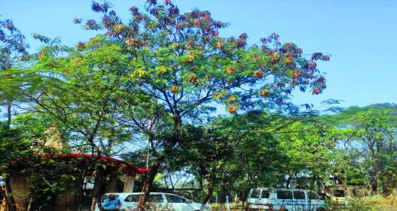
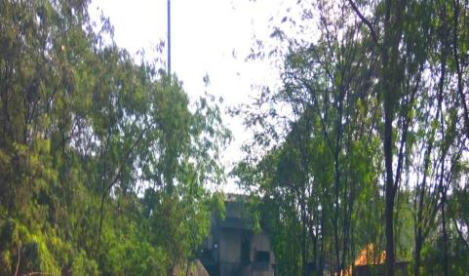
GREEN BELT PHOTOGRAPHS

Slide 41
EMP – SOLID AND HAZARDOUS WASTE MANAGEMENT
Type of waste | Source | Existing | Proposed | Total | Utilization/ Disposal | Agreement Details for Disposal
 |  | Quantity in TPA
Dolochar | DRI | 23220 | 34830 | 58050 | This expansion project envisages 100% utilization of Dolochar by installing AFBC boilers. The dolochar produced from the existing unit is being sold to the nearby power plants | Captive use
ESP Dust | DRI | 14850 | 22275 | 37125 | Utilized in AFBC Boiler for Power generation | Sold to brick manufacturer
Wet Scrapper sludge |  | 5400 | 8100 | 13500 | Sale to brick manufacturers
Bag filter dust | DRI | 8100 | 12150 | 20250 | Saleable material as fines | --
Acceration Dust | DRI | 810 | 1215 | 2025 | Non magnetic dust Utilized for Brick manufacturing Magnetic dust utilized in SMS | Captive use
IF Bag filter dust | IF | -- | 10800 | 10800 |  | Captive use
End Cut | Rolling mill | Nil | 3900 | 3900 | Utilized in IF | Captive use
Fly ash | AFBC | Nil | 49400 | 49400 | Utilized for Brick manufacturing | Fly ash to be sold to MAA enterprisers
Bottom Ash | AFBC | Nil | 12360 | 12360 | Saleable
Non Magnetic slag | IF | Nil | 16200 | 16200 | Utilized for Brick manufacturing | Grounded slag used as a substitute of sand used for road making
Magnetic Slag | IF | Nil | 1800 | 1800 | Reused in SMS

Slide 42
POST PROJECT MONITORING
Sl. No | Environmental/ Social Control Measures | Capital Cost (Rs. Crores) | Environmental/ Social Control Measures | Recurring cost in Rs. Lakhs
 | Cost of Air Pollution Control Devices/ System | 28.0 | Air Pollution Control Systems | 50.0
 | Cost of Water conservation & Pollution Control | 3.0 | Water conservation & Pollution Control | 50.0
 | Cost of Solid Waste Management System | 2.0 | Solid Waste Management System | 30.0
 | Green belt development | 0.5 | Green belt development | 10.0
 | Noise Reduction Systems | 2.0 | Online/ Manual Monitoring Surveillance System | 20.0
 | Occupational Health and safety Management | 1.0 | Noise Reduction Systems | 10.0
 | Implementation of Controlling measures to minimize impacts due to transportation and traffic | 0.5 | Occupational Health Management | 10.0
 | Setting/ Modification Environmental Laboratory | 1.0 | Risk Mitigation & Safety Plan | 20.0
 |  |  | Environmental Management Department | 20.0
 | GRAND TOTAL | 38.0 | GRAND TOTAL | 220 Lakhs
 | Social development cost in compliance to Public hearing | 176.0 | Expenditure within 4 year of operation of the project

Slide 43
RISK ASSESSMENT FINDINGS AND MITIGATION
Components / Process | Failure Mode | Failure Effect | Failure Cause |  | Existing Control | S | O | D |  |  | RPN | Additional Control
DRI (SPONGE IRON PLANT)
Conveyor feed belt to DRI | Friction | Corrosion | Improper Maintenance | Belt Sway Switch |  | 8 | 2 | 2 | 32 | Lubricating the rotating parts regularly and maintaining the cover sheet to avoid corrosion
Reducing Gas injection | Duct rupture | Process Failure in DRI Kiln | Over Pressure | Duct Inspection |  | 7 | 3 | 3 | 63 | Regular inspection and Periodic maintenance, proper insulation
Cooler Discharged Gas | duct rupture | Failure in After Burning Chamber | Excess Pressure | Duct Inspection |  | 5 | 3 | 2 | 30 | Regular inspection, replacement of safety item (hook, rope, belt etc.) before cut-off date, periodic maintenance and proper insulation
Moving Machinery, onsite transport, forklifts & crane | Mechanical Failure | Conveying System Failure | Improper Monitoring | Inspection |  | 5 | 3 | 3 | 45 | Periodic Maintenance& Mechanical Strength testing
Conveyor Belt to storage Bins | Friction | Waste Storage System Failure | Improper Maintenance& overloading | Belt Sway Switch |  | 4 | 2 | 2 | 16 | Lubricating the rotating parts regularly and maintaining the cover sheet to avoid corrosion. Avoiding overload by providing weigh feeder.
Inhale agents from ABC & Kiln | Mechanical Failure | Failure in After Burning Chamber& cooler Discharge causing gases, dust and fumes | Improper Maintenance &Excess Pressure | Inspection |  | 4 | 3 | 2 | 24 | Regular inspection and Periodic maintenance. Provision of Alarm

Slide 44
RISK ASSESSMENT FINDINGS AND MITIGATION
STEEL MELTING SHOP
Flow monitoring switch | Failure to operate | Rupture in Current Flow | Switch broken | Reliable Supplier |  | 7 | 2 | 3 | 42 | Regular Inspection
DC Choke | Failure to operate | Rise of current to dangerous level | Electric Failure | Reliable Supplier |  | 7 | 3 | 3 | 63 | Regular Inspection& use of ISI certified brand product
DM Water circulating unit | Failure to circulate de ionized water | Excessive Heat generation in solid state power supply unit | Electric Failure& Short circuit | Inspection |  | 4 | 3 | 3 | 24 | Regular inspection, monitoring conductivity test, Periodic maintenance and use of ISI certified brand product
Direction Control Valve | Failure to operate | furnace tilting control failure | Corrosion | Reliable Supplier |  | 7 | 2 | 3 | 42 | Periodic Maintenance and replacement before cut-off date
Furnace lamination packet | Electric/magnetic failure | Failure to provide a return path to the flux | Overheating of the structure | Inspection |  | 7 | 3 | 2 | 42 | Regular inspection, Periodic maintenance and use of ISI certified brand product
Flow regulating valves in furnace | Failed to Operate | Excessive Temperature | Improper Maintenance | Indicator |  | 8 | 3 | 4 | 96 | Periodic Maintenance and replacement before cut-off date
Hot metal lifting by crane | Rope breakage | Hot Metal down | Overloading | Safe working load are marked |  | 9 | 3 | 2 | 54 | Interlocks with alarm and replacement of safety item (hook, rope, belt etc.) before cut-off date. Avoid overloading.
Hot metal transfer by trolley | Mechanical Failure (Gearbox, Axial, Wheel) | Spillage of hot metal | Improper Maintenance | ROW (3 m) marked, loading within Granted permissible limit |  | 9 | 3 | 2 | 54 | Regular inspection, periodic maintenance and replacement of movable item before cut-off date. Avoid overloading
CONTINUOUS CASTING MACHINE
Transfer car | Friction | Fire | Improper Maintenance | Belt Sway Switch | 8 |  | 2 |  |  |  | 2 | 32 | Lubricating the rotating parts regularly
Stopper | Mechanical Failure | Fire & Explosion | Improper Maintenance | Indicator | 7 |  | 2 |  |  |  | 2 | 28 | Regular Inspection
Tundish | Failed to Operate | Spillage of Hot liquid metal | Mechanical Failure | Line inspection | 7 |  | 2 |  |  |  | 2 | 28 | Regular inspection and Periodic maintenance

Slide 45
RISK ASSESSMENT FINDINGS AND MITIGATION
ROLLING MILL
Conveyor rollers to feed | Friction | Fire | Improper Maintenance | Belt Sway Switch | 8 | 2 | 2 | 32 | Lubricating the rotating parts regularly
Water cooling pump | Pump failure | Explosion | No power supply | Redundant power supply | 10 | 3 | 2 | 60 | Check the fuel level of diesel generator
DOLOCHAR COAL MIX BASED CPP
Air Supply Fluidized Bed | Flow Air Fuel Ratio | Operation Failure | Air Flow Below 30 % | Line inspection | 5 | 3 | 5 | 75 | Provide detectors with alarm system
Boiler | Corrosion Effect | Cooling of tube & High TDS | Creep Failure | Line inspection | 4 | 4 | 5 | 80 | Regular inspection by IBR department and use only IBR specified materials.
Boiler | Boiler Tube | Damage inside & outside the tube | Extremely combustion | Monitors | 6 | 2 | 5 | 60 | Periodic Maintenance and use only IBR specified materials.
Boiler | Tube Alignment & Setting | Deformation of vibration Arrestor | Vibration increases | Inspection | 6 | 2 | 4 | 48 | Periodic Maintenance and use only IBR specified materials.
Boiler | Incomplete Combustion | Air Fuel Losses | Insufficient air supply to Furnace | Line inspection | 5 | 2 | 5 | 50 | Regular inspection by IBR department and use only IBR specified materials.
Turbine/Steam Generator | Temp of Super Heater & Reheater | Failure of turbine blades | Changing the plant load | Line inspection | 5 | 2 | 6 | 60 | Periodic Maintenance and steam load to be kept within threshold limit.
Turbine/Steam Generator | Loss of fuel | Abnormal Combustion | Improper air fuel mixture | Monitors | 4 | 3 | 4 | 48 | Check the level for every 5 minutes
Water Tank (Boiler Drum) | Water Level of Drum | Excess Steam Pressure | Failure of Indicators | Monitor | 6 | 3 | 2 | 36 | Regular inspection and installation of additional auxiliary alarm/ indicator

Slide 46
ENERGY AND WATER CONSERVATION MEASURES
Energy efficient motors will be used (Efficiency above 90%)
Generation of captive power by use of hot gas from Kils @2 MW per 100 TPD DRI
100% utilization of char produced from DRI for power generation
Use of variable frequency drives (VDFs) will reduce energy consumption by 15-20%.
Damper control in fans.
Kiln Shell painting with heat resistant paint to reduce radiation of temperature and can reduce thermal radiation loss upto 17% with surface emission of 0.9 to 0.65.

Slide 47
THANK YOU

