Slide 1






WELCOME
Expert Appraisal Committee Members, MoEFCC; New Delhi
Environmental Clearance (EC) Presentation
On
Expansion of Molasses based Distillery from 75 to 110 KLPD for Ethanol production by using C / B Heavy Molasses/ Cane Syrup with 3 MW Captive Power Plant (CPP) including expansion of cane crusshing from 10,000 to 12,000 TCD alongwith Co-genertion Plant from 20 to 30 MW.
(In Project Complex of 10,000 TCD Sugar Factory, 20 MW Cogeneration Plant & 75 KLPD Distillery)
(Cat. B2 Project as per MoEFCC Notification No. 980 (E) dt.02.03.2021)
By
Shri Dudhganga Vedganga Sahakari Sakhar Karkhana Ltd.
Bidri (Mouninagar), Tal.: Kagal, Dist.: Kolhapur, Maharashtra.
Prepared By
Equinox Environments (I) Pvt. Ltd.
Environmental; Civil & Chemical Engineers, Consultants and Analysts, Kolhapur (MS)
QCI- NABET & ISO 9001 : 2015 Accredited Organization
Email : eia@equinoxenvi.com, projects@equinoxenvi.com

Slide 2
Shri Dudhganga Vedganga Sahakari Sakhar Karkhana Ltd. Located at Bidri (Mouninagar), Tal.: Kagal, Dist.: Kolhapur, Expansion of Molasses based Distillery from 75 to 110 KLPD for Ethanol production by using C / B Heavy Molasses/ Cane Syrup with 3 MW CPP including expansion of cane crusshing from 10,000 to 12,000 TCD alongwith Co-genertion Plant from 20 to 30 MW.
1 | New Project / Expansion Project | Expansion Project
2 | Product Mix or Change in Technology | Not Applicable
4 | Proposed Capacity | 110 KLPD for Ethanol production by using C / B Heavy Molasses/ Cane Syrup with 3 MW CPP, 12,000 TCD Sugar Factory & 30 MW CO-gen Plant
5 | Forest Area/ Wildlife/ ESZ if any | Protected forest is about 1.15 Km from the project site.
6 | Name of EIA Coordinator | Dr. Sangram Ghugare
7 | Consultant, NABET Registration No. & Validity | Equinox Environments (I) Pvt. Ltd., NABET/EIA/1821/RA 0135, 21.10.2021
8 | Monitoring Period | Not Applicable. Project to be appraised as B2 as per Notification S.O. 980 (E) 02.03.2021 under EBP program
9 | Date of Public Hearing (P.H.) conducted
10 | Status of FC; CRZ & CPA | Not Applicable
11 | Certified Compliance submitted | Certified Compliance of EC Conditions for 20 MW Bagasse based Co-gen Plant (EC dt. 05.08.2009)
12 | Visit of Ro; MoEFCC, Nagpur | 15.10.2020
13 | RO; MoEFCC, Nagpur Report Received | 21.12.2020
14 | Whether there is any Court Cases pending against the project and/or land in which the project is proposed to be set up ? | No

Slide 3
Report by RO; MoEFCC; Nagpur (Visit dt.: 15.10.2020 & Compliance Observed vide Report dt. 21.12.2020)
Out of 27 General Conditions; 22 were Fully Complied, 2 were Partly Complied & only 3 was Not Complied
No | Comments in RO Report | Comment / Compliance done by PA | Latest Status
A | Condition was not Complied
1 | Condition No. IX Rain water harvesting system is yet to be implemented. | Rainwater harvesting to be implemented soon before next monsoon season. Rain water harvesting plan : 1. Total Plot Area: 7, 26, 219 Sq. M 2. Open land area in the industrial premises: 4, 14,434 Sq. M. 3. Total water available after Rooftop & Surface harvesting: 2,51,464.38 M³ i.e. 251.46 ML. 4. Groundwater recharge through infiltration & percolation shall have Positive Impact on Water Table in premises, Reuse of Harvested Water shall save Fresh Water for Domestic and Gardening purposes. On the open land in the premises counter bunding, terracing and dressing will be done so as to divert the rainwater as per natural slopes to various tranches excavated on the plot in a decentralized manner. Further, the recharge points will be located as per geometry of zones. | The rain water harvesting will be implemented soon before next monsoon season.
2 | Condition No. X Ground water quality is not being monitored. PP shall monitor the ground water quality at 2-3 locations in and around the plant. | The condition is being followed. Regular Monitoring reports of ground water analyzed to study change in the quality of water. The Monitoring reports of ground water is enclosed at Annexure –I. | The condition is being followed. Regular Monitoring reports of ground water has been attached .
3 | Condition No. XXII & XXV PP did not submit the six monthly compliance report regularly since the grant of EC. | Latest Six monthly report for period October 2020 to March 2021 is submitted to Regional Office of MoEFCC Nagpur. Henceforth, reports shall be submitted regularly to your office. Acknowledgment of six monthly compliance for period October 2020 to March 2021 is Enclosed at Annexure -II. | Status report of the same have been submitted to Regional Office of MoEFCC Nagpur.

Slide 4
Report by RO; MoEFCC; Nagpur (Visit dt. : 15.10.2020 & Compliance Observed vide Report dt. 21.12.2020)
No | Comments in RO Report | Comment / Compliance done by PA | Latest Status
B | Conditions Partly Complied
1 | Condition No. XXI Advertisement has been made, however the clause of seven day was not followed. | Advertisement in newspaper within seven days w.r.t. grant of EC delayed. This happed inadvertently. The advertisement regarding grant of EC of 20 MW Cogen plant was published on 05.11.2009 in two local newspapers i.e., Dainik Lokamat and Times of India. Photo of Advertisement enclosed at Annexure-III. | Advt. given in News papers on 05.11.2009.
2 | Condition No. XXIII & XXVI PP did not upload the copies of environmental clearance, six monthly compliance report and environment statement to project website. | The condition will be complied. Work of industrial website is under process. In next six-monthly compliance report, screenshots shall be provided. | Industrial website will be submitted to MoEFCC in next six Monthly report.

Slide 5
Introduction
1 | Project Description | Shri Dudhganga Vedganga S.S.K.Ltd., Bidri, Kolhapur. Expansion of Distillery (75 to 110 KLPD) with 3 MW CPP, Sugar Factory (5,000 - 10,000 TCD) & Co-gen Plant (20 – 30 MW); Cat.: A, Item :5(g), 5(j), 1(d)
2 | Plot (Ha) | Plot : 72.62 [Built Up :6.13(Existing) + 0.26 (Proposed), Parking: 5.4, Under Road: 3.6, Open Space : 33.25]
3 | GB (Ha) | Green Belt Existing: 9.44 (13 % of TPA), Expansion : 14.52 (20 % of TPA), Total: 23.96 (33% of TPA) after Expansion
4 | LU change | Present Land use is Industrial only
5 | Air & Noise Pollution Sources | Sugar & Cogen :– 60 TPH proposed boiler (APC:ESP; 80 M Stack) Existing boiler: 120 TPH (APC : ESP; 80 M Stack), 250 KVA & 1500 KVA (2 Nos.) D.G. Sets, Existing - Distillery Incineration Boiler - 30 TPH (APC : ESP ; 71 M Stack); Process Emissions : CO_{2,} Fugitive Emissions: Mills, Sugar Bagging, Bagasse; Pressmud & Ash Storage Yards, Bagasse Conveyor.
6 | Project Cost | Existing : Rs. 425.97 Cr., Expansion : Rs. 50 Cr., Total after Expansion : Rs. 475.97Cr.
7 | EMP Cost | Rs. 61.3 Cr. (Existing) & Rs.4.3 Cr. (Proposed); Total: Rs.65.6 Cr. (After Distillery Expansion)
8 | CSR Cost | Rs.3.67 Cr.(Exist.). Rs. 0.55Cr. (Prop.); Manpower– Existing: 569, Under Distillery Expansion : 34
9 | EMC Details | 8 Members, M.E. (Env.), M.Sc. (Env. Sc.), B.Sc. (Chem.), PGDISHE. MD, Environment Consultant, Chief Chemist, Chief Engineer, Civil Engineer, Co-gen Plant Incharge, Labour Officer, Environmental Officer
1 | Water Use | Sugar, Co-gen: 6637 (95 Fresh + 725 ETP & STP Treated + 5817 Excess Cane Condensate) Distillery: 1131 (212 Fresh + 919 CPU Treated Effluent ); 96% Recycle Overall
2 | Source | Dudhganga River (Permission granted from Irrigation Dept.; Maharashtra)
3 | Energy | Power requirement – 13 MW
4 | Fuels (TPD) | Sugar & Co-gen Expansion: 60 TPH Bagasse (720) Existing 30 TPH Incineration Boiler: Bagasse (225) / Coal (102) + Conc. Spentwash (238), Sugar Factory & Co-gen 120 TPH Boiler Bagasse (1284)
5 | Effluent; CMD | Sugar, Co-gen: 713 CMD; Distillery: Raw Sp.wash: 880 (Conc. Sp.wash: 176); Other Effluents (MEE Cond., Cooling & Boiler B/d , Washing) : 902
6 | Treatment & Disposal | Existing ETP : 713 CMD, Sugar CPU: 3240 Concentrated Spentwash (MEE) : Incineration ; CPU Treated Effluent : 100% Recycled in Process- ZLD.

Slide 6
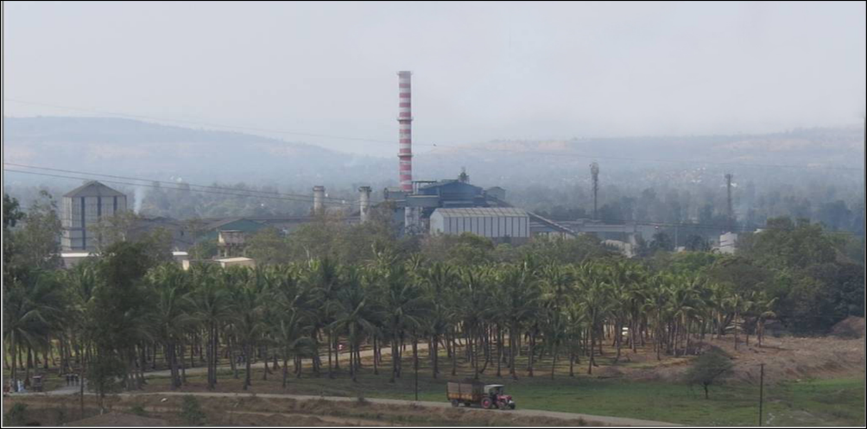
About the Project & Allied Developments
Year 1956 : Industry Registration as - Shri Dudhganga Vedganga S.S.K. Ltd.
Year 1963-64 : First Crushing Season with 1250 TCD Capacity
Year 2004 : Expansion of Sugar Factory from 1250 to 5000 TCD
Year 2009 : Cogeneration Plant (20 MW) implementation (EC Procured)
Year 2021 : Expansion (5,000 to 10,000 TCD) & Estab. of 75 KLPD Distillery
Year 2021 : Expansion Distillery (75 to 110 KLPD), Sugar Factory (5,000 to 10,000 TCD) & Co-gen Plant (20 to 30 MW)
Project Proponents
No. | Name | Designation
1 | Mr. K. P. Patil | Chairman
2 | Mr. V. S. Khorate | Vice Chairman
3 | Mr. K.S. Chaugale | Managing Director

Slide 7
Salient Features of Integrated Project Complex
Distillery -
100% Biofuel Ethanol Manufacturing and Participation in National Bio-Fuel Program.
100% Fresh Water Saving for Cane Juice Distillery (Requirement : 0 KL/KL, Norm : 10 KL/KL)
98% Less Water for Molasses Distillery (Norm : 10 KL/KL; Requirement : 1.8 KL/KL)
90% (Cane Juice) Lesser Spentwash to Disposal (Generation : 0.8 KL/KL, Norm : 8 KL/KL)
80% (Molasses) Lesser Spentwash to Disposal (Norm : 8 KL/KL, Generation : 1.6 KL/KL)
30 TPH Existing Incineration Boiler in Distillery (ESP & 71 M stack as APC)
ZLD tho’, Spentwash Concentration (MEE) & Incineration .
Spentwash Ash Brick Making Proposed.
CO₂ from Fermenters to be Cleaned, Compressed & Bottled.
Substantial Investment in EMP Infrastructure : Existing Rs. 61.30 Cr; Proposed: Rs. 4.30 Cr.
Handsome Provisions for CSR: Existing Rs. 3.67 Cr; Proposed: Rs. 0.55 Cr.
Rs. 0.44 Cr / Yr. to be spent on O & M of ETP, APC & Other Infrastructure.
20% More Green Belt to Make up 33% of TPA (Existing GB: 13%)
Sugar Factory -
100 % Saving in Process Fresh Water.
72% Reduction in Effluent w.r.t. Norm (Generation: 94 Lit/MT; Norm:200 Lit/M)
Complete Revamping of Sugar Factory ETP by investing Rs.1.75 Cr.: Primary Treatment-Secondary Anaerobic Treatment- Secondary Aerobic Treatment (2 Stage Aeration)-Tertiary Treatment (DMF & ACF)
40% Increase in ETP Efficiency (Exist. BOD : 100 mg/lit; Prop. BOD : 60 mg/lit)
ZLD for Sugar Factory tho’ Reduce- Reuse- Recycle
ESP & 80 M Stack as APC to Cogen Boiler (ESP Efficiency : 99.5%); OCMS Provided.
10% Less Steam Consumption – 46% Steam on Cane to 36% (Less Steam –Less Fuel-Less Pollution)
Installation of O₂ plant under COVID-19 Scenario wroth 80 Lakh

Slide 8
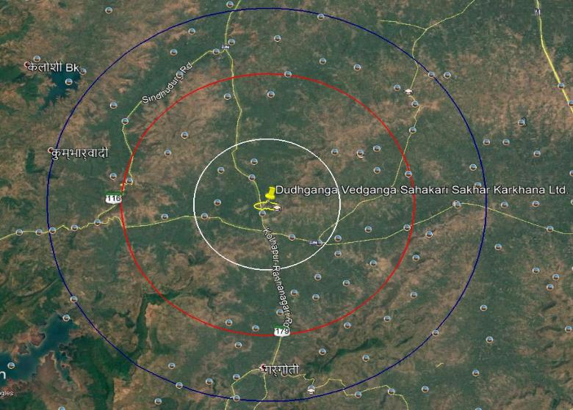
Location of Project & its Connectivity
15 Km
10 Km
5 Km
Accessibility | Connectivity
Highway / Road | NH-4 (23.8 Km) & SH- 179 (0.1 Km )
Railway Station | Kolhapur (32 Km)
Airport | Kolhapur (30 Km)
Latitude | 16°25'42.18"N
Longitude | 74° 8'28.36“E
Elevation | 568 M above MSL

Slide 9
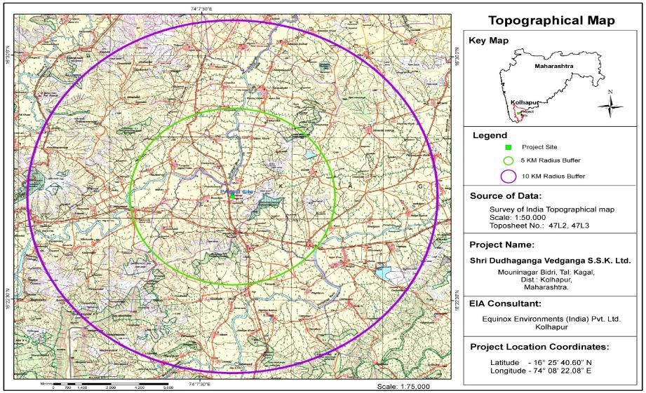
Topographical Map
Particulars | Distance & Directions
Water Bodies | Dudhganga River at 0.7 Km (NW) & Vedganga River at 5.8 Km (SE)
Forest | Protected Forest at 1.15 Km from Project Site
Nearest Habitation | Bidri Village (1 Km)

Slide 10
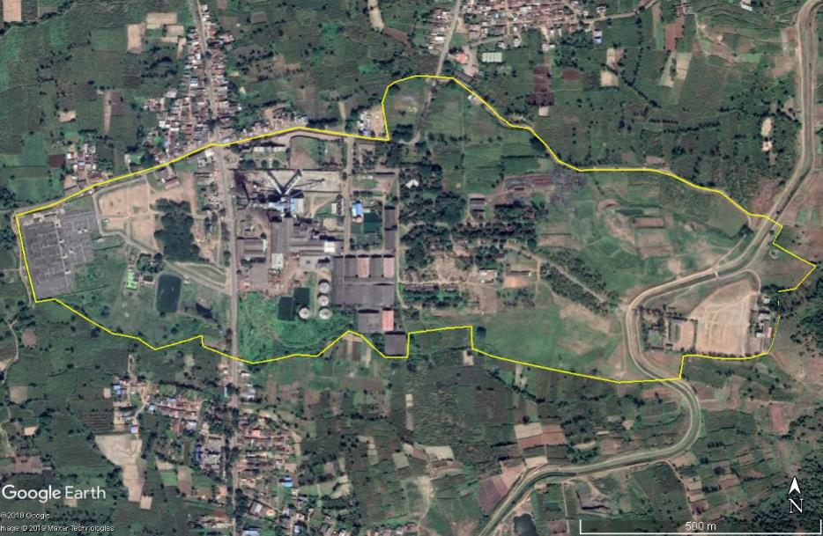
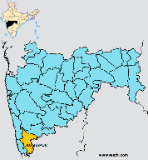
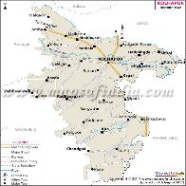
Project Site
Location - Industrial Site is at 32 Km on North West of Kolhapur City & at 321 Km on South East of Mumbai
Co-Generation Plant
mauMba[-
Sugar Factory
Proposed Distillery Site
The Maps are Purely Graphical & not to Scale.
Latitude ¹ 16°25'42.18"N,Longitude ¹ 74 8'28.36“E.

Slide 11
Integrated Project Complex Process Flow Diagram
Sugar Factory
Weighment & Cane Preparation
Cogeneration Plant
To Grid
Cane Milling/ Crushing
Bagasse
30%
Boiler
Turbines
Steam
Power
To Factory
Juice Extraction & Clarification
Press Mud
4%
Sale
Distillery Unit
Juice Sulphitation
Ash
Brick / Cement Industry
Coal
Incineration
Syrup Boiling
Conc. Spent Wash
MEE
Condensate to Recycle
Molasses (4%)
Raw Spentwash
Centrifuging
Alcohol Storage
Fermentation
Distillation
Alcohol
Storage of Sugar

Slide 12
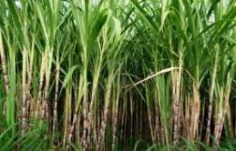
Products, By-products & Value Addition
Sugarcane in Farm
Sugar Factory
2500 TCD
Sugar
(10-12% on Cane Crushed)
Manure
Bagasses
(30%)
Ash
Brick / Cement Industry
Pressmud
(4%)
Molasses
(4%)
Low Pressure Steam
Cogen Boiler
Incineration Boiler
Steam
High Pressure Steam
Coal / Bagasse
Conc.
Spentwash
Spentwash
Distillery
45 KLPD
Turbine
Multiple Effect Evaporator (MEE)
CO₂
Alcohol
CO₂ Bottling Plant
Electricity

Slide 13
Product & Raw Materials
A. Products: Expansion: Distillery (75 to 110 KLPD), Sugar Factory (10000 to 12000 TCD), Co-gen Plant (20 to 30 MW)
Industrial unit | Product & By-product | Quantity (MT/M)
 |  | Existing | Expansion | Total
Sugar Factory | Products
 | Sugar (12%) | 36,000 | 7,200 | 43,200
 | By-products
 | Molasses (4.%) | 12,000 | 2,400 | 14,400
 | Bagasse (30%) | 90,000 | 18,000 | 1,08,000
 | Press Mud (4%) | 12,000 | 2,400 | 14,400
Co-Gen | Electricity (MW) | 20 | 10 | 30
Distillery | Products
 | RS/ ENA (B & C Heavy Molasses) | 75 | 0 | 75
 | Ethanol (B & C Heavy Molasses) | 75 | 35 | 110
 | Ethanol (Sugarcane Syrup) | 0 | 110 | 110
 | By-Products
 | Carbon Di-oxide | 1,680 | 1,050 | 2,730
 | Electric Power from Incineration Boiler | 0 | 3 | 3
B. Raw Materials: Expansion: Distillery (75 to 110 KLPD), Sugar Factory (10000 to 12000 TCD), Co-gen Plant (20 to 30 MW)
Industrial unit | Name of Raw Material | Quantity (MT/M) |  |  | Source
 |  | Existing | Expansion | Total
Sugar Factory | Sugarcane | 3,00,000 | 60,000 | 3,60,000 | Near By Farms
 | Lime | 540 | 120 | 660 | Nearby Market
 | Sulphur | 180 | 36 | 216
 | Lubricants | 42 | 8.4 | 50.4
Co-gen | Bagasse | 38,520 | 21,600 | 60,120 | Own Sugar Factory
Distillery | Molasses | 8,340 | 3,870 | 12,210 | Own Sugar Factory/ Outside Purchase
 | Sugarcane for juice | 0 | 47130 | 47130
 | Yeast | 10 | 4.67 | 14.67 | Local Vendor
 | Urea | 2.5 | 1.17 | 3.67
 | De-foaming Oil | 7 | 3.27 | 10.27

Slide 14
Molasses & Cane Juice / Syrup based Operations for 110 KLPD Distillery
No. | Description | Quantity
1 | Sugar cane crushing capacity | 12,000 TCD
2 | Sugar factory operating days | 180 Days
3 | Total Cane Crushing | 21,60,000 MT/Season
4 | Cane Juice / Syrup based Operations (Crushing Season); 180 Days | 2,82,780 MT Cane
5 | Molasses based Operations (Non-Crushing Season); 150 Days | 61,050 MT Molasses
Sugarcane Transportation Details
No. | Type of Vehicle | Avg. wt. (MT) / Vehicle | Daily No. of Vehicles | Quantity of Cane (MT) | %
1 | Bullock Carts | 2.5 | 260 | 650 | 5
2 | Mini Tractor | 15 | 492 | 7,380 | 62
3 | Tractor Trolleys | 13 | 90 | 1,170 | 10
4 | Trucks | 20 | 140 | 2,800 | 23
Total |  | 50.5 | 982 | 12,000 | 100
Product & By-product Transportation Details (After Expansion)
No. | Product | Type of Vehicles | Daily Frequency of Vehicle | Average Capacity of Vehicle | Quantity of Final Product Transported
1 | Sugar | Trucks | 70-75 | 20 MT | 2,59,200 MT / Season
2 | Pressmud [Season] | Trolleys | 130-140 | 3.5 MT | 86,310 MT/ Season
3 | Alcohol | Tankers | 4-5 | 25 KL | 33,000 KL/Season

Slide 15
Sugar Factory Process Flow Chart - 12,000 TCD
Imbibition - 2760 MT
Sugar Cane 12,000 MT
Milling Section
Bagasse; 3600 MT
Lime 22 MT
Juice 11902 MT
Condensate 1200 MT
Heat Exchanger
Clarification
Sediment 1200 MT
Filtrate
720 MT
Steam 5040 MT
10702 MT
1st Effect Vapours 1200 MT
Condensate 2040 MT
Vacuum Filter
2nd effect
4th effect
1st effect
3rd effect
3162 MT Vapours to Pan
Steam condensate;
5040 MT
Pressmud 480 MT
Vacuum Pan; 4300 MT
Evaporation Loss
3162 MT
Pan Condensate 2760 MT
Crystallizer; 1540 MT
Condensate;
380 MT
Molasses ; 480 MT
Centrifuge 1920 MT
Sugar 1,440 MT
Condensate
3240 MT
Condensate for Recycling
3240 Cu.M
Washing
12 CMD
Vacuum Pump
Sealing
180 CMD
Brushing
180 CMD
Mill Bearing
60 CMD
Ash Quenching
5 CMD
Turbine Cooling
540 CMD
Mill Turbine
480 CMD
Boiler Makeup
650 CMD
DM Backwash
86 CMD
Green Belt
407 CMD
Excess Cane
Condensate
260 CMD

Slide 16
Existing Distillery Process Flow Chart - 75 KLPD (Molasses)
Sugar Factory
Molasses
Weighing of Molasses
Molasses (198 KL; 278 MT)
Ash (28 MT/D)
To Brick Making /
Cement Industry
(95% Solids)
Molasses Dilution
Water 596 KL (From CPU Recycle)
Diluted Wash (794 KL)
Pre-Fermentation
Yeast Culture
Incineration Boiler
Fermentation
CO₂ (57 MT)
Bottling
Section
Yeast Sludge
(12 KL)
Fermented Wash (782 KL)
Conc. Spentwash
(120 KL, 162 MT)
Distillation
Alcohol (75 KL)
Storage
Section
Coal 70 MT
(55-60 % Solids)
Raw Spentwash
(600 KL)
10-12% Solids
Spent Lees
(107 KL)
Spentwash
Tank
CPU
(637 KL)
Spent Wash (600 KL)
Other Effluents (50 KL); (Lab .,Washings, Cool B/d)
MEE
Condensate (480 KL) Vol.80%
Treated CPU Effluent 596 KL for Process

Slide 17
Proposed Distillery Process Flow Chart - 110 KLPD (Molasses)
Sugar Factory
Molasses
Weighing of Molasses
Molasses (290 KL; 407 MT)
Ash (51 MT/D)
To Brick Making /
Cement Industry
(95% Solids)
Molasses Dilution
Water 870 KL (From CPU Recycle)
Diluted Wash (1160 KL)
Pre-Fermentation
Yeast Culture
Incineration Boiler
Fermentation
CO₂ (91 MT)
Bottling
Section
Yeast Sludge
(23 KL)
Fermented Wash (1137 KL)
Conc. Spentwash
(176 KL, 238 MT)
Distillation
Alcohol (110 KL)
Storage
Section
Coal 102 MT
(55-60 % Solids)
Raw Spentwash
(880 KL)
10-12% Solids
Spent Lees
(147 KL)
Spentwash
Tank
CPU
(902 KL)
Spent Wash (880 KL)
Other Effluents (51 KL); (Lab .,Washings, Cool B/d)
MEE
Condensate (704 KL) Vol.80%
884 KL; 100% Recycle
(870 KL for process + 14 KL for cooling makeup water)

Slide 18
Proposed Distillery Process Flow Chart - 110 KLPD (Sugarcane Juice)
Sugar Crushing : 1571 TCD
Bagasse; 30% (471 MT)
Cane Juice; 70% (1100 KL)
Juice Boiling; Concentration & Syrup
Sugar Factory Condensate (440 KL)
Cane Juice Syrup (660 KL)
Weighing of Syrup
Ash (95% Solids)
(29 MT/D)
Juice Syrup (660 KL)
Pre-Fermentation
Yeast Culture
Incineration Boiler
Yeast Sludge
(13 KL)
Fermentation
CO₂
(91 MT)
Bottling Section
Conc. Spentwash
(88 KL; 119 MT)
Fermented Wash (647 KL)
Coal 51 MT/ Bagasse 128 MT
Distillation
Alcohol (110 KL)
Storage Section
Spent Leese
(97 KL)
6-8% Solids
Spentwash
(440 KL)
Spentwash
Tank
CPU
(500 KL)
Other Effluents (51 KL);
(Lab .,Washings, Cool & Boiler B/d)
MEE
55-60 % Solids
Condensate
(352 KL) 75%
Treated CPU Effluent
for Reuse 490 KL

Slide 19
Environmental Aspects
A. Water Consumption in Sugar Factory & Co-gen Plant (M³/Day) :
No | Description | Existing (Sugar 10000 TCD & Co-gen 20 MW) | Total After Expansion (Sugar 12,000 TCD & Co-gen 30 MW)
1 | Domestic | #31 | #31
2 | Industrial
 | a. Process | *3066 | *3560
 | b. Cooling Makeup | *760 | *1020
 | c. Boiler Makeup | *435 | *650
 | d. DM Plant | *60 | *86
 | e. Lab & Washing | *10 | *12
 | f.Ash Quenching | *4 | *5
 | Industrial Use | *4335 100% Recycle | *5333 100% Recycle
3 | Green Belt | $655 | 1209 ($725+*484)
 | Grand Total (1+2+3) | 5085 (*4335 +#95 + $655) | 6637 (*5817 + #95 + $725)
 | Water Norm : 100 Lit / MT of Cane | 0 Lit / MT of Cane | 0 Lit / MT of Cane
Note : # - Fresh water from Dudhganga River, *- Excess Cane Condensate, $- Treated Effluent from Sugar Factory ETP & STP.
B. Effluent Generation in Sugar Factory & Co-gen Plant (M³/Day)
No | Description | Existing | After Expansion | Treatment
1 | Domestic | 24 | 24 | Proposed STP under Distillery
2 | Industrial |  |  | Treated in ETP which will be updated under expansion and Recycle in Process Operations and Green Belt to Achieve ZLD.
 | a. Process | 368 | 427
 | b. Cooling Makeup | 76 | 102
 | c. Boiler Makeup | 60 | 86
 | d. Lab & Washing | 10 | 12
 | e. DM Plant | 60 | 86
 | Total Industrial | 574 | 713
 | Effluent Generation Rate | 57 | 59 | Norm: 200 Lit/ MT of Cane Crushed

Slide 20
Environmental Aspects
A. Water Consumption in Distillery (M³/Day) :
No | Description | Existing (75 KLPD) | Total after Expansion (110 KLPD)
 |  |  | Molasses Based
 |  |  | During Crushing | During Non-Crushing | Sugarcane Juice
1 | Domestic | #2 | #2 | #2 | #2
2 | Industrial
 | Process (Fermentation & Dilution) | ♣596 | ♣870 | ♣870 | -
 | b. Cooling Make up | 105 (♣24+ #81) | 155 (♣14+*87+#54) | 155 (♣14+ #141) | ^{Ø} 155
 | c. Boiler Make up | #72 | *72 | #72 | ^{Ø}72
 | d. DM Plant | # 15 | *15 | # 15 | ^{Ø}15
 | e. Lab & Washing | #5 | *6 | #6 | ^{Ø}6
 | f. Ash Quenching | #2 | *3 | #3 | ^{Ø}3
 | Industrial Use Fresh Water 10 KL /KL | 795 (#175+♣620) 78% Recycle 2.3 KL/KL | 1121 (*183+♣884+#54) 95% Recycle 0.4 KL/KL | 1121 (#237+♣884) 79% Recycle 2.0 KL/KL | ^{Ø}251 (100% Recycle) 1.8 KL/KL
 | Grand Total (1+2+3) | 805 (#185+♣620) | 1123 (#56*183+♣884) | 1123 (#239+♣884) | 261 (#10+^{Ø}251)
Note: # - Fresh water from Dudhganga River, *- Excess Cane Condensate, $- Treated Effluent from Sugar Factory ETP & STP, ♣ - Distillery CPU Treated Effluent Recycle during Molasses based operations, Ø – Distillery CPU Treated Effluent Recycle during Sugarcane Syrup based operations

Slide 21
Environmental Aspects
B. Effluent Generation in Distillery (M³/Day)
No | Description | Existing | After Expansion (150 KLPD) |  | Treatment
 |  |  | Molasses | Cane Syrup
1 | Domestic | 1.5 | 1.5 | 1.5 | Proposed STP
2 | Process (Fermentation & Dilution) | Raw Spentwash : 600 Conc. Spentwash : 120 | Raw Spentwash : 880 Conc. Spentwash : 176 | Raw Sp. Wash- 440 Conc. Spentwash- 88 | 110 KLPD: Raw Sp.wash –MEE – Conc. Spentwash - Incineration
 |  | MEE Condensate - 480; Spent Leese – 107 | MEE Condensate - 704; Spent Leese – 147 | Sp. Lees- 97 MEE Condensate- 352 | Treatment : In proposed Distillery CPU Treated Effluent : 100% Recycle. Total ZLD Project Spentwash Storage Tank Capacity : 5 Days
 | Cooling Make up | 11 | 15 | 15
 | Boiler Make up | 15 | 15 | 15
 | DM Plant | 15 | 15 | 15
 | Lab & Washing | 5 | 6 | 6
 | Spentwash Norm 8 KL / KL of Alcohol | Conc. Sp wash: 120 Other Effluent: 637 Spentwash 1.6 KL/ KL | Conc. Sp wash: 176 Other Effluent: 902 Spentwash 1.6 KL/ KL | Conc. Sp wash: 88 Other Effluent : 535 Spentwash 0.6 KL/ KL

Slide 22
Sugar Factory, co-gen Plant & Distillery Integrated Project ZLD Plan
1 | Daily Sugarcane Crushing | 12,000TCD
2 | Water Content of Cane Crop @ 68% by weight | 8160 MT
3 | Actual Cane Condensate for reuse is to the tune of 50 % on Cane Wt. after losses as - (1) Moisture in Pressmud (70%) (2) Bagasse (50%), (3) Sugar (5%), (4) Molasses (60%) as well as (5) Losses during juice heating, concentration in pans etc. | 6000 CMD
4 | Sugar & Cogen ETP Treated Effluent for Recycle 713 CMD after Primary & Sec. | 700 CMD
5 | Treated STP Effluent for Recycle; Sewage @ 25.5 CMD | 25 CMD
 | Total Recycle Availability (3+4+5) | 6725 CMD
Water Consumption in Sugar Factory (12000TCD) & Cogen Plant (30 MW) (M³/Day):
No | Sugar Factory | Water Quantity | Effluent Generation | Remarks
A | Domestic | #31 | 24 | Treated in STP
B | a. Process | *3560 | 427 | Industrial Effluent is being treated In recently upgraded existing ETP Fresh Water Norm : 100 Lit/ MT of Cane crushed- 0 Lit/ MT Note: Note : # - Fresh water from Dudhganga River, *- Excess Cane Condensate, $- Treated Effluent from Sugar Factory ETP & STP.
 | b. Cooling Makeup | *1020 | 102
 | c. Boiler Makeup | *650 | 86
 | d. DM Backwash | *86 | 12
 | e. Lab & Washing | *12 | 86
 | f. Ash Quanching | *5 | 713
C | Total | *5333 100% Recycle | 427
D | Gardening | 1209 ($725+*484) | --
 | Grand Total (A+B+C+D) | 6637 (*5817 + #95 + $725) | --

Slide 23
Inlet
713 M³/D
Existing Sugar Factory Recently Upgraded ETP (Capacity: 1200 M³/Day)
Surge Tank
(23 X 15 X 3M)
Equalization Tank
(14 X 12 X 3.5 M)
Buffer Tank
(11 X 7 X 3 M)
Screen Chamber
(3 X 2.5 X 2 M)
O & G Tank
(8.5X2.5X1.5M)
Pri. Clarifier
(9Ø X 3 M)
Neutralization Tank
(3 X 3 X 2.5 M)
Sludge
RAS
To SDB
Aeration Tank - 1
(41 X 25 X 3 M)
Lamella Clarifier
(5 X 5 X 3 M)
Aeration Tank-2
20 X 12.5 X 3M
Sec. Clarifier - 1
(10 Ø X M)
UASBR
(16 Ø X 12.5 M)
RAS
Excess
Sludge
To SDB
Filter Feed Tank
(9 X 4.5 X 3 M)
Filter Feed Tank
(18 X 10 X 3 M)
Sec. Clarifier - 1
(10 Ø X M)
DMF
ACF
Treated Effluent
40 M³/Hr.
40 M³/Hr.
Excess
Sludge
No | Parameters | Unit | Inlet | Outlet
1. | pH | --- | 5 - 6 | 7 – 8
2. | COD | mg/lit | 2000 - 2500 | < 250
3. | BOD | mg/lit | 1000 - 1500 | < 100
4. | TDS | mg/lit | 1800 - 2100 | < 2100
5. | SS | mg/lit | 250 - 300 | < 100
Note:
PSF: Pressure Sand Filter
ACF : Activated carbon Filter
RAS : Return Activated Sludge
SDB: Sludge Drying Bed
SDB (10 Nos.)
(5 X 2.8 X 1.5 M

Slide 24
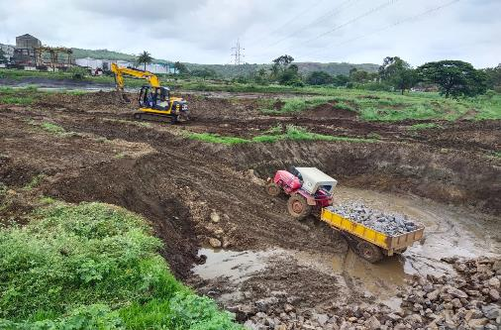
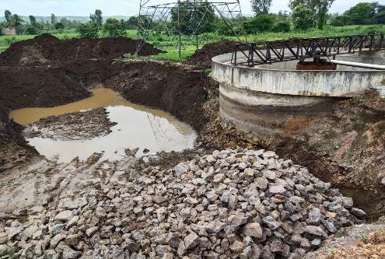
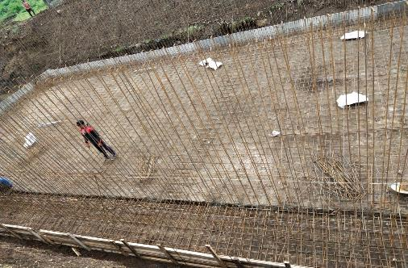
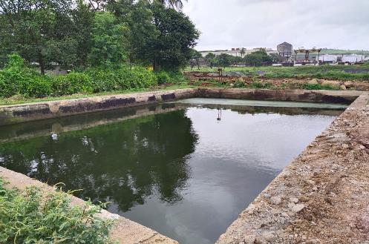
Sugar Factory ETP Revamping

Slide 25
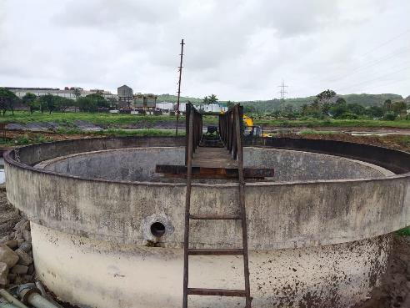
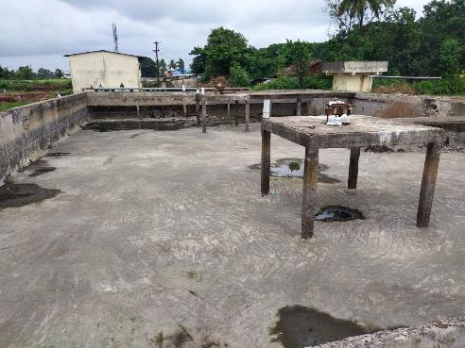
Sugar Factory ETP Revamping

Slide 26
Proposed Sugar Factory CPU (Capacity: 3500 M³/Day)
Filtrate from SDB
Cane Condensate
3240 M³/ Day
PST
(10 Ø X 3 M)
Equalization Tank
(18 X 18 X 4 M)
Flash Mixer
(1.5 X 1.5 X 2 M)
MBBR Reactor
(24 X 20 X 4 M)
Flocculator
(2 X 2 X 2.5 M)
Sludge To SDB
RAS
Sludge to SDB
SST
(12 Ø X 3 M)
Treated Condensate for Reuse in Process
Pump
ACF (2 Nos.)
(60 Cu.M / Hr) Each
PSF (2 Nos.)
(60 Cu.M / Hr) Each
Treated Effluent Tank
(15 X 15 X 4 M)
Excess Sludge
No | Para. | Inlet | Outlet
1 | pH | 5-6 | 7 – 8
2 | COD | 700-800 | < 200
3 | BOD | 300-400 | < 30
4 | TSS | 200-300 | < 10
SDB
Sludge to Disposal
Note:
PSF: Pressure Sand Filter
RAS : Return Activated sludge
ACF : Activated carbon Filter
SST: Secondary Settling Tank
SDB: Sludge Drying Beds
Filtrate to
Equalization Tank
All values are in mg/L except pH.

Slide 27
Proposed Distillery CPU
Condensate &
Other Effluents
902 CMD
Reaction
Tank
Tube Settler
(2 X 2 X 2.5 M)
MBBR
(24 X 18 X 4.5 M)
Equalization Tank
(18 X 16 M X 3.5 M)
UASBR
(16 Ø X 6 M Ht.)
Pump
Buffer Tank
(3 X 3 M X3 M)
Sludge
To SDW Unit
RAS
Reject
Sludge To SDB
Sec. Clarifier
(6 M Ø x 3 M SWD)
Tube Settler
(2 X 2 X 2.5 M)
Pump
RO
Plant
Treated Sump
(4 X 4 X 2.5 M)
ACF
30 Cu.M / Hr
PSF
30 Cu.M / Hr
Flocculator
Flash Mixer
Intermediate Tank
(4 X4 X 2.5 M)
Sludge
Sludge
Permeate for Reuse
Sludge to Disposal
Excess Sludge
Sludge Dewatering Unit
Filtrate to Equalization Tank
No | Para. | Inlet | Outlet
1 | pH | 5-6 | 7 – 8
2 | BOD | 2000-2500 | < 50
3 | COD | 3500-4000 | < 100
4 | TDS | 2000-3000 | < 100
Note:
PSF: Pressure Sand Filter
ACF : Activated carbon Filter
SST: Secondary Settling Tank
SDW Unit: Sludge Dewatering Unit

Slide 28
Proposed STP (Capacity: 25 M³/Day)
Inlet
25 M³/Day
Equalization Tank
(20 M³)
Anaerobic Contact Media Chamber
(6.450 M³)
Bar Screen Chamber
(2.5 M³)
O & G
Chamber
(2.5 M³)
Pump
Sedimentation & Separation Chamber
(3.135 M³)
Recirculation Line
Treated Water Tank
(10 M³)
Moving Bed Chamber
(6.293 M³)
Disinfection Chamber
(0.380 M³)
Sedimentation Chamber
(2.247 M³)
To Reuse
No. | Parameter | Unit | Inlet | Outlet
1 | pH | --- | 6.0 – 8.5 | 6.0 – 8.5
2 | COD | mg/lit | 400 – 500 | < 50
3 | BOD | mg/lit | 250 – 300 | < 20
4 | TSS | mg/lit | 150 - 250 | < 30
5 | O & G | mg/lit | 20 - 30 | < 10

Slide 29
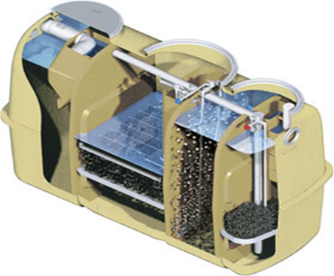
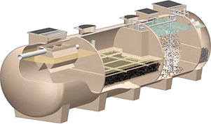

Daiki Axis Johkasou Technology – Packaged STP
Expeditious treatment; easy maintenance
Energy-saving
Most updated automated manufacturing technology
Stable high-quality FRP material
Capacities:
1 KLD to 50 KLD models
(further capacities can be increased in parallel arrangement)

Slide 30
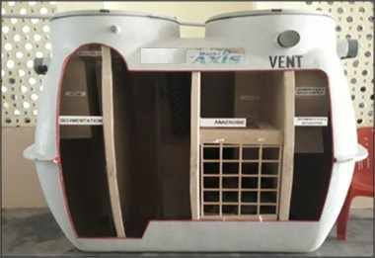
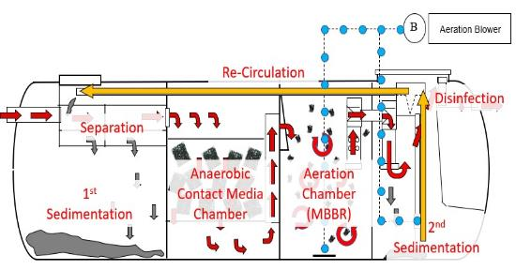
Johkasou STP Treatment Process
Unit | MOC | Process Description
Separation & Sedimentation Chamber | FRP | Suspended Solids (SS) are separated.
Anaerobic Chamber | FRP | Organic matters are anaerobically decomposed.
Moving Bed Chamber | FRP | BOD content reduced by continuous aeration.
Sedimentation Chamber | FRP | SS are settled and clear treated water is obtained.
Disinfection Chamber | FRP | Treated Water is disinfected by Disinfection agent.
Sludge Re-circulation Arrangement | - | Sludge from 2nd Sedimentation Chamber is recirculated to the 1st Sedimentation Chamber.
Technological Frame Work
Technology approved by National Jal Jeevan Mission.
Technology Approved by CII (Confederation of Indian Industry)
No COVID-19 Trace observed in outlet water

Slide 31
Online Continuous Monitoring System (OCMS)

Slide 32
Environmental Aspects
Air Pollution Control
No | Description | Proposed Boiler | Existing Boilers & DG Set |  |  |  | Remarks
1 | Source | Boiler | Boiler | Incineration boiler | DG Set | DG Set | D.G. Set only in power failure. OCMS Installed to Cogen Boiler OCMS to be installed to Incineration Boiler.
2 | Capacity (TPH) | 60 | 120 | 30 | 1500 KVA (2 Nos) | 250 KVA
3 | Fuel | Bagasse | Bagasse | Spwash+Coal | Diesel | Diesel
4 | Quantity (MT/D) | 720 | 1284 | 238+102 | 100 Lit./Hr. | 30 lit/Hr
5 | Stack Height | 80 M | 80 M | 71 | 200 mm | 150 mm
6 | APC Equi. | ESP | ESP | ESP | --
Hazardous Waste
No | Industrial Unit | Category | Quantity (MT/M) |  | Storage & Disposal Method
 |  |  | Existing | After Expansion
1 | Sugar Factory & Co-gen Plant | 5.1 Used Oil | 6.5 | 7.8 | Burnt in Boiler
Solid Waste
No | Unit | Type | Quantity (MT/M) |  | Disposal
 |  |  | Existing | After Expansion
1 | Sugar Factory & Co-gen Plant | ETP Sludge | 18 | 21 | Used as Manure
 |  | Boiler Ash (Bagasse) | 960 | 1500
2 | Distillery (Proposed) | Boiler Ash (Coal + Sp. Wash) | 840 | 1530 | Brick Making
 |  | Yeast Sludge | 360 | 690 | Burnt in incineration Boiler
 |  | CPU Sludge | 18.9 | 28

Slide 33
Environmental Aspects
Noise
Unit | Source | Control Measures
Distillery | Fermentation & Distillation Section | Isolation, Separation and Insulation techniques adopted PPE as Earmuffs, Earplugs provided to staff & workers.
Sugar Factory | Mills, Pumps Compressors & D. G Boiler Section & Turbine
Dust
Unit | Source | Control Measures
Sugar Factory | Mills, Sugar Bagging, Bagasse & Pressmud Storage Areas | Efficient Exhaust & Ventilation Systems, Efficiency Monitoring of APC & Dust Control Equipments, Regular Self Monitoring of Work Zone Dust Levels, PPE, Adequate Density & Type Green Belt Development, Proper Surfacing of Internal Roads, Yards, Water Sprays & Mist Arrangements.
Odour
Unit | Source | Control Measures
Distillery | Molasses Tanks, Fermentation Section, Yeast Sludge & Spentwash Storage Tanks | Proper House Keeping, Prompt Sludge Management in Biological Treatment units, GMPs Efficient handling, prompt & proper disposal of Pressmud, Yeast Sludge & Spentwash. Close Fermentation & Molasses Handling.
Sugar Factory | ETP, Molasses Tanks, Pressmud Yard, Bagasse Conveyor; Feeding Section, Ash Storage

Slide 34
Baseline Environmental Details
Risk Studies & Disaster Management
Project | Risk Area | Hazard | Mitigation Measures
Distillery | Molasses Storage Tanks | Rupture & Toxic Liquid Leakage | Dyke walls is constructed around the tank. In case of temp. beyond 30⁰C; external cooling system Mechanical Seals to Pump Gland to avoid leakages Hot work permit for maintenance to avoid direct contact with pressurized gases in tank.
 | Alcohol Storage | Fire (Worst case scenario) | All tanks in Dyke Walls (Std. design & construction norms). Guidelines in OISD 117 Std. is followed for fire fighting around alcohol storage area. Pump Motors & Electrical Fittings to be Flame Proof. On Site Emergency Control Plan : RA & DMP is implemented.
Sugar Factory | Bagasse Storage | Fire | Self & Auto-mode Fire Fighting System around Bagasse Yard. Hot Work, Welding, Gas Cutting avoided near Bagasse Storage Training of all Staff in Normal & Emergency Conditions. High Voltage Transmission Lines above Bagasse Yard Avoided. Firefighting Plan & Lightning Arrestors Provided
 | Sulphur Storage | Dust Explosion & Fire | Shed with Min. Horizontal Surfaces to avoid Dust Accumulation, All sources of Ignition excluded. Formation & Suspensions of Sulphur Dust in air avoided, Chemical Foam Fire Extinguishers provided. Bag Opening Device, PPE (mask, hand gloves) provided.
 | SO₂ Prod. | Toxic Gas Leakage | Installation of SO₂ Leak Detectors & Alarm Systems. Pressure & Thickness Tests of equipment & piping carrying SO₂ to avoid leakage.
Occupational Health & Safety Measures
Occupational Health Center., 24 X 7 Ambulance Facility available
Regular Medical Checkup of Employees & Records Keeping is followed .
SO₂ Production procedure has been prepared.
Workmen Compensation Policy, Mediclaim Health Policy (Temporary & Permanent)
Good Management Practices (GMPs) being followed.
Well Managed Process Operations, Automation of Production with Pollution Control Equipments done.
Health & Safety Awareness camps arranged. Posters & Boards displayed in Industry.
PPEs such as Shoes, Helmets, Goggles, Earmuffs, Ear Plugs are provided.
Housekeeping & Waste Handling : Training & Education to Workers, Good O & M Practices
Sanitary Facilities & Other Measures – Adequate Toilets, Changing Rooms, Rest Rooms Provided. Good Aesthetics maintained and BMPs adopted.

Slide 35
Photographs of Fire Fighting Arrangements

Slide 36
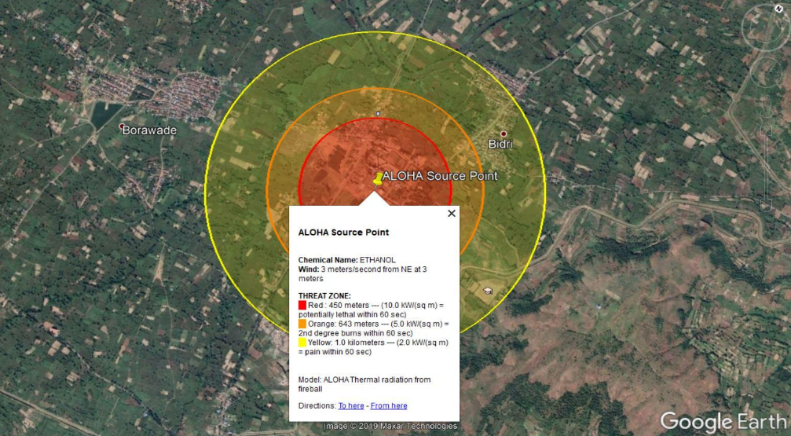
Aloha – Ethanol
Scenario - I : BLEVE of flammable liquid in horizontal cylindrical tank
Tank Dia.: 9 M; Tank Length : 13.5 M;
Tank Volume : 859 Cu.M, Mass in Fireball: 15%
Threat Zone :
Red : 450 M (10.0 kW/(sq m) = potentially lethal within 60 sec)
Orange: 643 M (5.0 kW/(sq m) = 2nd degree burns within 60 sec)
Yellow: 1.0 Km (2.0 kW/(sq m) = pain within 60 sec)

Slide 37
Green Belt Development Plan
Total Land Acquired for SDVSSKL Complex : 72.62 Ha
Existing Green Belt (13% of TPA) : 9.44 Ha; No. of Trees : 34,735
Proposed Green Belt Augumentation (20% of TPA) : 14.52 Ha; No. of Trees : 25,178 Nos.
Total GB after Expansion (33% of TPA) : 23.97 Ha; No of Trees : 59,913 Nos. (Say 48,000) @ 2000 Nos./Ha
Features of the GB Development Program:
Avenue Plantation : Internal Roads to various Units, Bagasse; Pressmud; Ash Yards
Shelter Belt Plantation: A thick barrier of trees to be created along periphery / fence.
Mass Plantation : Vicinity of Ash & Bagasse Storage, Trees controlling dust planted.
Plantation of Peculiar Tree Species - Noise Attenuation, Dust Suppression, Indigenous, Ever Green.
Rain Water Harvesting Details
Surface Harvesting : Runoff from Industrial Plot 72.62 Ha. to be harvested & stored in tanks excavated at suitable locations as per the Contour Levels.
Roof Top Harvesting Yield : 50,169.73 M³ (From Area : 63,992 M²)
Surface Harvesting Yield : 1,85,874.74 M³ (From Area: 6,08,286 M²)
Total RWH : 2,36,044 M³, 236.04 ML.
Provision of 7 Tanks (38,970 M³) : 8,460 M³, 2,250 M³, 10,800 M³, 3,240 M³, 11,520 M³, 360 M³ & 2,340 M³.
Utilization for Green Belt, Fugitive Dust control, Firefighting Demand Makeup, Washing & Cleaning
Excess rain water will be diverted offsite the plot through storage tanks outlets
Description | Area (M²) | Total Area (M²) | Rainfall (M) | Runoff Coeff. | Yield (M³)
Roof Top Harvesting | 63992 | 63992 | 0.98 | 0.8 | 50169
Surface Harvesting
Green Belt | 239652.30 | 239652.30 | 0.98 | 0.3 | 70457
Road | 36000 | 36000 | 0.98 | 0.5 | 17640
Open space | 332574.7 | 332574.7 | 0.98 | 0.3 | 97776
Total |  |  |  |  | 1,85,874.74

Slide 38
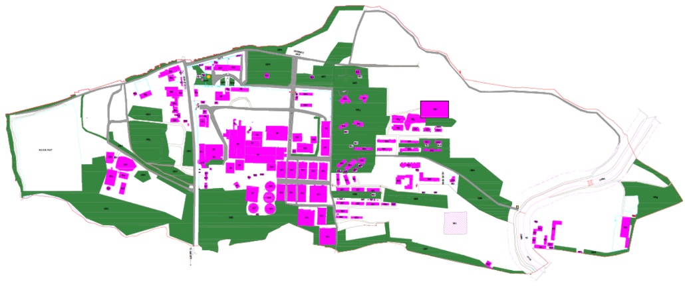
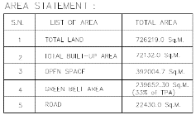
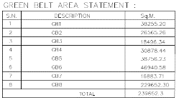
Green Belt Plan

Slide 39
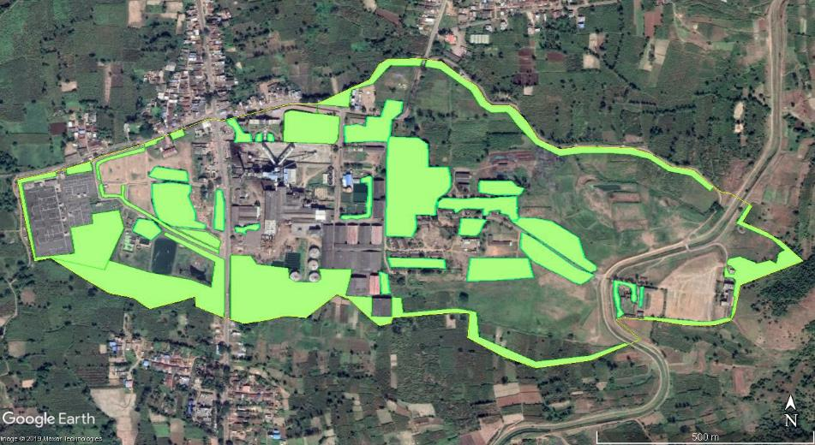
Green Belt Plan

Slide 40
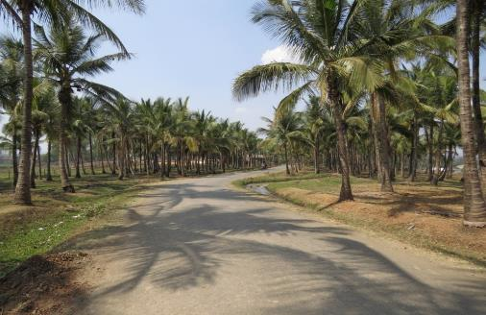
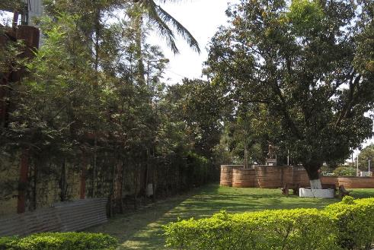
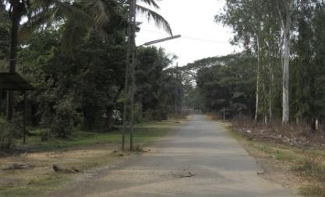
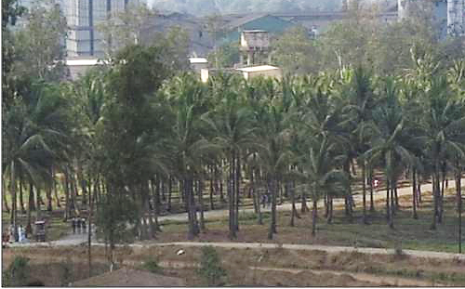
Photographs of Green Belt

Slide 41
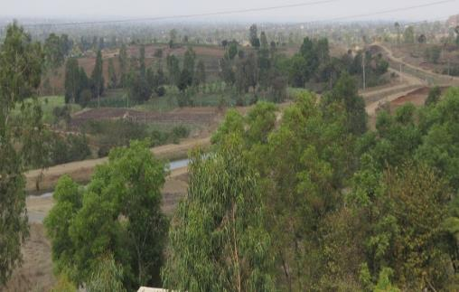
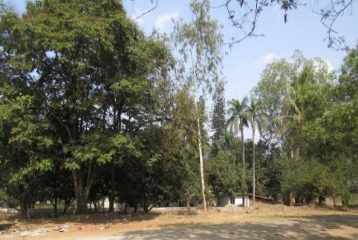
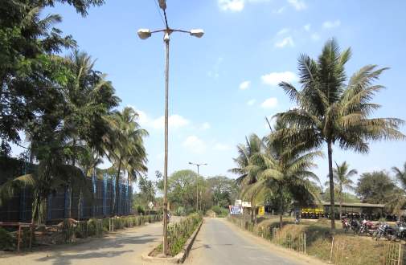
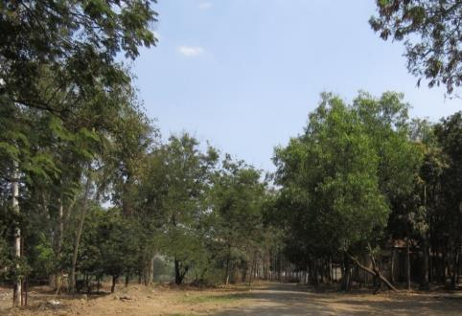
Photographs of Green Belt

Slide 42
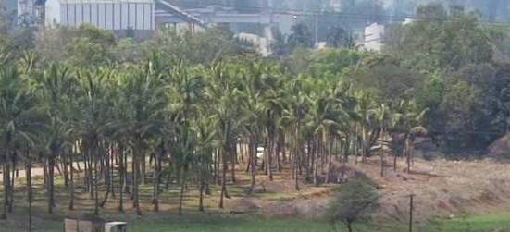
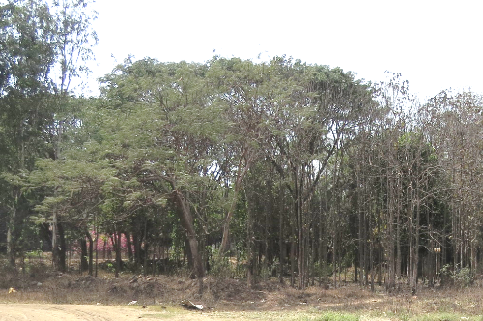
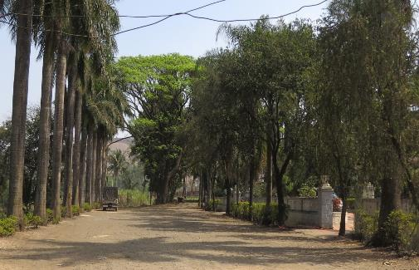
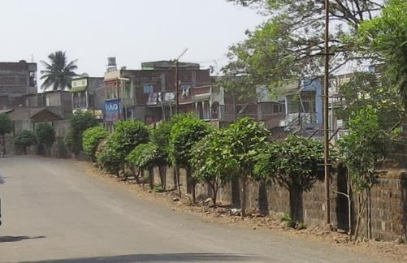
Photographs of Green Belt

Slide 43
Green Belt (GB) Design Details
Type of Plantation | Location on Plot | GB Length (M) | GB Width (M) | GB Area (Sq. M) | No. of Tree Rows | Trees / Row | Total Trees | Trees | Characteristics
 |  | A | B | C = A*B | D = B/2 (2 = Dist. Bet. 2 Rows) | E = A/2 (2= Dist. Bet. 2 trees) | F = D*E
Shelter Belt along Compound Wall | North | 1476 | 10 | 14760 | 5 | 738 | 3690 | Neem, Shisav, Karanj, Umbar, Wilayati Chinch, Saptaparni, Apta, Mahogani, Bel, Ran Bibba, Nandruk, Kadamb, Limbara | Trees with round & oblong canopy, native, evergreen, pollution resistant, fast growing, high dust settling index
 | East | 448 | 10 | 4480 | 5 | 224 | 1120
 | South | 1841 | 10 | 18410 | 5 | 920.5 | 4602.5
 | West | 200 | 10 | 2000 | 5 | 100 | 500
Mass Plantation | Open Areas | Areas with uneven shapes |  | 190722 | 4 sqm area for each tree species |  | 47681 | Khair, Saag, Bel, Bahava, Shivan, Nandruk, Umbar, Limbara, Kadamb | Tree with round & oblong canopy, native, evergreen, pollution resistance
Avenue Plantation | Along Roadside | 4640 | 2 | 9280 | 1 | 2320 | 2320 | Bakul, Bahava, Tamhan, Ashoka, Saptaparni | Tree species with conical, columnar canopy, ornamental, fast growing, pollution resistance will be planted as avenue plantation
Total |  |  |  | 2,39,652 |  |  | 59,913
 |  |  |  |  |  | Existing | 34,735
 |  |  |  |  |  | Proposed | 25,178

Slide 44
Proposed Tree List
Names; Numbers & Types of Trees in Green Belt
Sr. No. | Name of the plant | Common Name | Quantity | Characteristics & Ecological Importance
1 | Azadirachta indica | Neem | 3400 | Native, evergreen, fast growing, tolerant
2 | Dalbergia sissoo | Shisav, Shisham | 900 | Native, evergreen, tolerant
3 | Mimusops elengi | Bakul | 300 | Native, ornamental, host plant for bees and butterflies.
4 | Pongamia pinnata | Karanj | 1000 | Pollution tolerant
5 | Acacia Catechu | Khair | 2500 | Native and pollution resistant
6 | Tectona grandis | Saag | 2000 | Native and pollution resistant
7 | Neolamarckia cadamba | Kadamb | 1000 | Native, evergreen, fast growing, pollution tolerant
8 | Cassia fistula | Bahava | 300 | Native, ornamental, host plant for bees and butterflies.
9 | Gmelina arborea | Shivan | 2500 | Native and pollution resistant
10 | Pithecellobium dulce | Wilayati Chinch | 700 | Native, ornamental, host plant for bees and butterflies.
11 | Alstonia scholaris | Saptaparni | 250 | Native, evergreen, higher dust settling index
12 | Swietenia mahogani | Mahogani | 1000 | Native, evergreen, higher dust settling index
13 | Aegle marmelos | Bel | 2000 | Native and pollution resistant
14 | Holigarna grahamii | Ran Bibba | 702 | Native and pollution resistant
15 | Ficus macrocarpa | Nandruk | 2000 | Native and pollution resistant
16 | Melia azedarach | Limbara | 1107 | Native and pollution resistant
17 | Bauhinia racemosa | Apta | 900 | Native and pollution resistant
18 | Butea monosperma | Palas | 2000 | Native, Evergreen tree,
19 | Lagerstroemia speciosa | Tamhan | 581 | Native, State flower of Maharashtra
20 | Polyalthia longifolia | Ashoka | 250 | Air pollution absorbing species
Total |  |  | 25,178

Slide 45
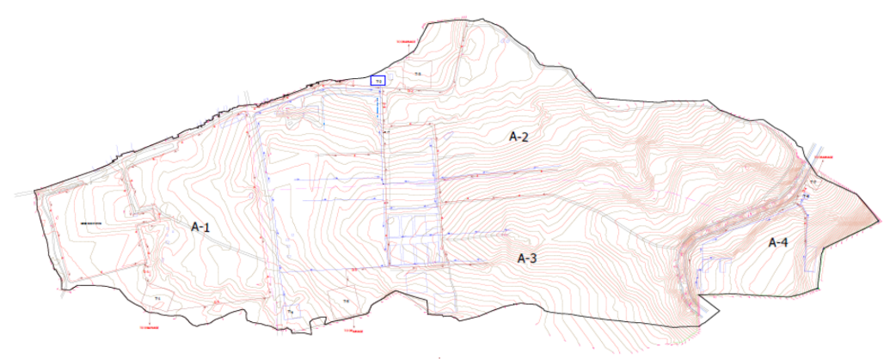
Contour Map with RWH Design

Slide 46
Evaluation of Runoff & Carrying Capacity of Drains for Precipitation Condition (125 mm/Hr)
Ref: Manning's Formula for Runoff Velocity through drains; V = 1/N x R^{2/3} x √S, and Runoff Discharge; Q = A x V
B/W | Bed Width of Drain; M | a | Cross Sectional Area of Water; Sq.M.
H | Ht. of Water in Drain; M | P | Wetted Perimeter of Drain; M
N | Manning's Coefficient 0.024 for Concrete | S | Bed Slope in Vertical : Horizontal
Q | Discharge Capacity of Drain in Cu.M. /Sec | V | Velocity in Drain : M / Sec
Drains | Values |  | a | P | a/p = R | 1/N | R^2/3 | 1/ √S | V m/sec | Q (Cu.M./Sec)
D1 | N | 0.024 | 1.2 | 3.4 | 0.353 | 41.667 | 0.4994 | 0.1 | 2.081 | 2.497
 | B/w | 1
 | H | 1.2
 | Slope | 1
 | is to | 100
D2 | N | 0.024 | 1.8 | 4.2 | 0.429 | 41.667 | 0.4994 | 0.1 | 2.081 | 3.746
 | B/w | 1.2
 | H | 1.5
 | Slope | 1
 | is to | 100
D3 | N | 0.024 | 1.95 | 4.3 | 0.453 | 41.667 | 0.4994 | 0.1 | 2.081 | 4.058
 | B/w | 1.3
 | H | 1.5
 | Slope | 1
 | is to | 100
D4 | N | 0.024 | 0.4 | 2.1 | 0.19 | 41.667 | 0.4994 | 0.1 | 2.081 | 0.832
 | B/w | 0.5
 | H | 0.8
 | Slope | 1
 | is to | 100
Drains | Gross Plot Area (Sq.M.) | Surface Area Contributing Runoff (w/o Rooftop) | Rainfall (mm) | Runoff Factor (Coefficient) | Yield (Cu.M./Hr.) | Inflow Discharge (Cu.M./Sec.) | Designed Discharge (Q) (Cu.M./Sec.) | Remarks
1 | 2 | 3 | 4 | 5 | 6 =3X4X5 | 7 = 6/3600 | 8 | 9
D1 | 1,66,389 (A1) | 166389 | 125 | 0.5 | 8319.5 | 2.31 (Q1) | 2.5 | Q1 < Q
D2 | 2,45,355 (A2) | 217813 | 125 | 0.5 | 10890.7 | 3.02 (Q2) | 3.7 | Q2 < Q
D3 | 2,64,320 (A3) | 224645 | 125 | 0.5 | 11232.3 | 3.12 (Q3) | 4.0 | Q3 < Q
D4 | 50,155 (A4) | 45240 | 125 | 0.5 | 2262.0 | 0.63 (Q4) | 0.8 | Q4 < Q

Slide 47
Proposed CSR Details
No | CER Activities | Rs. Lakh
1 | Arrangement of Drinking Water Supply Infrastructure: Total 5 Nos. of Safe Drinking Water Units with Filtration, RO Module & Storage Tank, Piping, Electrical Control Panel etc. with dispensing & metering systems. Capacity of 500 Lit/Hr each. 5 Nos. X Rs. 2.50 Lakhs / No = Rs. 12,50,000/- | 12.50
2 | Solar Street Lights: Provision of Solar Street Lights with gadget comprising of – 1 MS Pole, 18-20 W LED Lamp, Battery, Solar Panel, Wiring etc. complete. 6 Villages X 10 Nos/Village = 60 Solar Street Lights X Rs.30,000/- per No. = Rs. 18,00,000/- | 18.00
3 | Solar Photovoltaic Electricity Generation Systems: Provision of 1 Solar Photovoltaic Electricity Generation Systems (10 KW) at Grampanchyat / School Building. 2 Nos. X 10 KW X Rs.1 Lakh / KW = Rs. 20 Lakhs | 20.00
 | Total Amount | Rs. 50.5 Lakhs
CSR Implementation Schedule
No | CER Activities | Year 2022 | Year 2023 | Year 2024 | Year 2025 | Year 2026 | Total | Year of Completion
 |  | Amount in Rs. Lakh
1 | Arrangement of Drinking Water Supply Infrastructure | 3 | 2 | 5 | 1 | 1.5 | 12.50 | 2024
2 | Solar Street Lights | 3 | 3 | 6 | 3 | 3 | 18 | 2024
3 | Solar Photovoltaic Electricity Generation Systems | 2 | 5 | 5 | 3 | 5 | 20 | 2025

Slide 48
Existing CSR Details
No | Name of Activity | Cost by industry (Rs. Lakh)
1 | Distribution of Educational material & Scholarships | 14
2 | Mobile Ambulance Van | 15
3 | Fire Brigade Van | 16
4 | Drip Irrigation awarness program | 10
5 | RO Drinking Water Units in Village Bidri & Borawade | 15
6 | Road Construction in Village Bidri & Borawade | 95
7 | Agricultural Training Program | 10
8 | Distribution of Bio-fertilizers to Farmers | 40
9 | Distribution of saplings in nearby villages | 10
10 | Sanitation facility to nearby villages | 32
11 | Promotion of Govt. Programs | 30
12 | O₂ Plant as per Covid Senario | 80
 | Total | 367

Slide 49
Environment Management Plan (EMP)
EMC of 8 Members, Qualification : Qualification : M.E. (Env.), M.Sc. (Env. Sc.), B.Sc. (Chem.), PGDISHE.
MD, ETP Chemist, Bio-Gas Operator, Sugar ETP Supervisor
The Capital as well as O & M Costs towards Environmental Management -
No. | Description | Cost Component (Rs. Lakhs)
 |  | Capital | Annual O & M
A | Existing Unit
1 | APC system (ESP + Stack (Height 80 M) for Co-gen Boiler, Incineration Boiler, ESP & Stack (Height 71M) & OCMS | 4400 | 450
2 | Existing Sugar Factory & Co-gen ETP & its upgradation, Spent wash storage tank, MEE, CPU, Piezometers | 1625 | 130
3 | Noise Pollution Control | 10 | 2
4 | Environmental Monitoring & Management | 25 | 5
5 | Occupational Health & Safety | 20 | 2
6 | Green Belt Development & Rain Water Harvesting | 50 | 5
 | Total (14% of Capital Investment of Rs. 425.5 Cr) | 6130 | 594
B | After Expansion
1 | APC system (ESP + Stack (Height 80 M) for Co-gen Boiler & OCMS | 325 | 30
2 | Noise Pollution Control | 10 | 2
3 | Environmental Monitoring & Management | 25 | 5
4 | Occupational Health & Safety | 20 | 2
5 | Green Belt Development & Rain Water Harvesting | 50 | 5
 | Total 8.6% of Capital Investment of Rs. 50 Cr) | 430 | 44
 | Grand Total (A + B) | 6560 | 638

Slide 50

THANK YOU

