Slide 1

Presentation to
The Hon’ble Chairman & Members of the Expert Appraisal Committee,
Ministry of Environment, Forests & Climate Change, New Delhi
on
Final Environmental Impact Assessment (EIA) Report
Prepared for obtaining Environmental Clearance for
Establishment of 180 KLPD Distillery Unit &
8 MW Co-generation Power Plant
At
Survey No. 349/3, 350/3, 370, 385/2 & others of Kambagi Village,
Bableshwar Taluk, Vijayapura Dist. Karnataka State.
(Proposal No. IA/KA/IND2/195873/2021;File NoIA-J-11011/42/2021-IA-II(I))
by
M/s. SOMESHWAR SUGARS LIMITED
Presented by: M/s EHSC Pvt Ltd., Bengaluru, QCI-NABET Accreditation NABET/EIA/1821/SA0123; Validity 18.01.2022
Date:
New Delhi

Slide 2
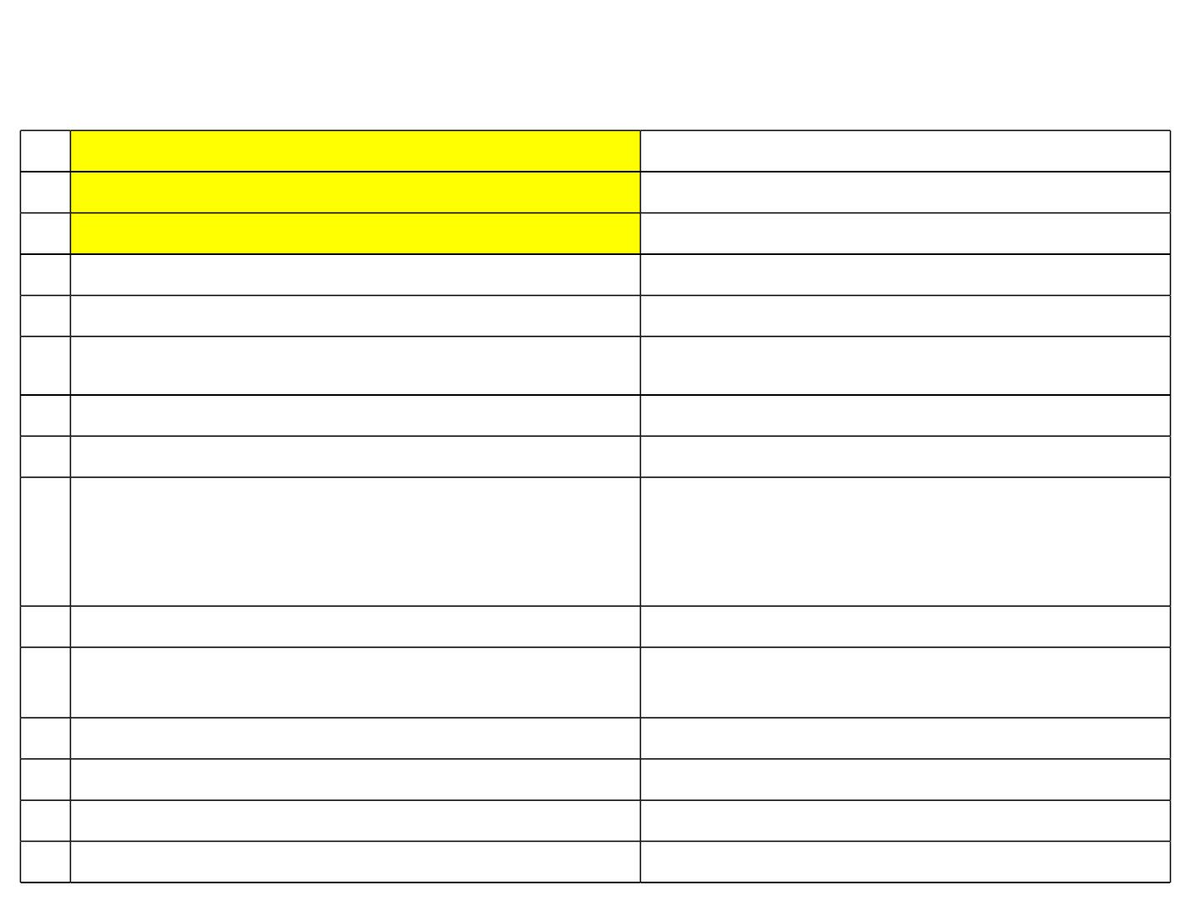
AgendaꢀNo.ꢀꢀꢀꢀꢀꢀꢀꢀꢀꢀꢀꢀ
Nameꢀ ofꢀ theꢀ Projectꢀ :ꢀEstablishmentꢀ ofꢀ 180ꢀ KLPDꢀ Distilleryꢀ Unitꢀ &ꢀ 8ꢀ MWꢀ Co-generationꢀ Powerꢀ
PlantꢀByꢀM/s.ꢀSomeshwarꢀSugarsꢀLimited
1
2
3
4
5
DateꢀofꢀApplicationꢀSubmission
ADSꢀifꢀanyꢀincludingꢀdateꢀofꢀreplyꢀ
DateꢀofꢀAcceptance
NewꢀProject/ExpansionꢀProject
ProductꢀMixꢀorꢀChangeꢀinꢀTechnologyꢀ
NewꢀProject
NA
6 Existingꢀ&ꢀProposedꢀCapacity
ProposedꢀDistilleryꢀunitꢀ–ꢀ180ꢀKLPDꢀ&ꢀ8MWꢀ
Co-generationꢀPowerꢀPlant
7
8
ForestꢀArea/Wildlife/ESZꢀifꢀanyꢀ
NameꢀofꢀEIAꢀCoordinator
NA
Shri.ꢀShivanandꢀM.ꢀDambal
Consultant:
Nameꢀ
NABETꢀRegistrationꢀNo.ꢀ
Validity
EnvironmentalꢀHealthꢀ&ꢀSafetyꢀConsultantsꢀ
Pvt.ꢀLtd.,ꢀBengaluruꢀ–ꢀ560010
NABET/EIA/1821/SAꢀ0123
Up-to18.01.2022
9
10 DateꢀofꢀPublicꢀHearingꢀ(P.H.)ꢀConductedꢀ
11 LevelꢀofꢀOfficerꢀconductedꢀP.H.ꢀ
12 StatusꢀofꢀForestꢀClearanceꢀ(FC)ꢀ
10.11.2021
Additionalꢀ Deputyꢀ Commissionerꢀ &ꢀ Chairmanꢀ
EPHꢀCommitteeꢀ,ꢀVijayapura
NA
13 ApplicabilityꢀofꢀCoastalꢀRegulatoryꢀZoneꢀ(CRZ)ꢀifꢀanyꢀꢀ NA
14 WhetherꢀlocatedꢀinꢀCriticallyꢀPollutedꢀAreaꢀ(CPA)
CertifiedꢀComplianceꢀsubmitted
NA
NA
15
2

Slide 3

DetailsꢀofꢀEarlierꢀECꢀ&ꢀCTEꢀ&ꢀCTO
• M/s.ꢀSomeshwarꢀꢀSugarsꢀLimitedꢀisꢀincorporatedꢀonꢀ13thꢀSeptemberꢀ2006ꢀandꢀ
registeredꢀunderꢀCompaniesꢀAct,ꢀBangalore.ꢀ
• M/s.ꢀ Someshwarꢀ Sugarsꢀ Limitedꢀ (M/s.ꢀ SSL)ꢀ earlierꢀ obtainedꢀ theꢀ CFEꢀ fromꢀ
KSPCBꢀ forꢀ Establishmentꢀ ofꢀ 2500ꢀ TCDꢀ ofꢀ Sugarcaneꢀ andꢀ 15ꢀ MWꢀ
CogenerationꢀpowerꢀplantꢀvideꢀNo.ꢀPCB/253/HPI/2015/5682ꢀDtd.ꢀ20.02.2015.ꢀ
• Detailsꢀ ofꢀ ECꢀ &ꢀ CTE:-ꢀM/s.ꢀ SSLꢀ hasꢀ appliedꢀ &ꢀ obtainedꢀ ECꢀ forꢀ increaseꢀ inꢀ
capacityꢀ ofꢀ theꢀ sugarcaneꢀ crushingꢀ fromꢀ 2500ꢀ TCDꢀ toꢀ 15000ꢀ TCDꢀ andꢀ Co-
generationꢀpowerꢀplantꢀfromꢀ15ꢀMWꢀtoꢀ70ꢀMWꢀvideꢀLetterꢀNo.ꢀSEIAAꢀ5ꢀINDꢀ
2015ꢀ Dtdꢀ 29.07.2016ꢀ andꢀ similarlyꢀ obtainedꢀ CFE-Exp.ꢀ videꢀ letterꢀ No.ꢀ CTEꢀ
304499ꢀDtdꢀ07.12.2017ꢀfromꢀKSPCB.ꢀ
• Theꢀ Sugarꢀ unitꢀ andꢀ theꢀ Co-generationꢀ powerꢀ plantꢀ forꢀ whichꢀ theꢀ ECꢀ andꢀ theꢀ
CFEꢀisꢀobtainedꢀisꢀnotꢀyetꢀimplementedꢀdueꢀtoꢀadministrativeꢀreasons.
• Now,ꢀ M/s.ꢀ Someshwarꢀ Sugarsꢀ Limitedꢀ hasꢀ proposedꢀ toꢀ Establishꢀ Distilleryꢀ ofꢀ
180ꢀKLPDꢀandꢀ8ꢀMWꢀCo-generationꢀPowerꢀPlantꢀatꢀtheꢀsameꢀpremisesꢀatꢀSy.ꢀ
No.ꢀ349/3,ꢀ350/3,ꢀ370,ꢀ385/2ꢀ&ꢀothersꢀofꢀKambagiꢀVillage,ꢀBableshwarꢀTaluk,ꢀ
Vijayapuraꢀ District,ꢀ Karnataka,ꢀ withꢀ totalꢀ landꢀ areaꢀ ofꢀ 36ꢀ Acresꢀ (1,45,687ꢀ
SQM)
3

Slide 4
IntroductionꢀofꢀtheꢀProjectꢀ
• BriefꢀDescriptionꢀofꢀtheꢀProject:ꢀM/s.ꢀSomeshwarꢀSugarsꢀLimitedꢀearlierꢀobtainedꢀtheꢀ
ECꢀ andꢀ CFE-Expꢀ forꢀ 15000ꢀ TCDꢀ Sugarcaneꢀ Crushingꢀ andꢀ 70ꢀ MWꢀ Co-generationꢀ
powerꢀplantꢀwhichꢀisꢀnotꢀyetꢀimplementedꢀdueꢀtoꢀadministrativeꢀreasons.
• Nowꢀtheꢀmanagementꢀhasꢀproposedꢀtoꢀestablishꢀ180ꢀKLPDꢀDuelꢀfeedꢀDistilleryꢀandꢀ8ꢀ
MWꢀ Co-generationꢀ unitꢀ atꢀ Sy.ꢀ Noꢀ 349/3,ꢀ 350/3,ꢀ 370,ꢀ 385/2ꢀ &ꢀ othersꢀ ofꢀ Kambagiꢀ
Village,ꢀBableshwarꢀTaluk,ꢀVijayapuraꢀDistrict,ꢀKarnataka.ꢀ
• Plotꢀarea:ꢀTheꢀtotalꢀplotꢀareaꢀofꢀtheꢀprojectꢀisꢀ36ꢀAcresꢀ(145687ꢀSQM).
• %ꢀofꢀGreenbeltꢀProposedꢀ:ꢀTheꢀgreenbeltꢀdevelopmentꢀareaꢀofꢀtheꢀprojectꢀisꢀ12ꢀacresꢀ
(33.33ꢀ%ꢀofꢀtotalꢀareaꢀofꢀ36ꢀacres).ꢀ
• Landꢀ Useꢀ :ꢀ Theꢀ distilleryꢀ unitꢀ isꢀ comingꢀ upꢀ inꢀ theꢀ existingꢀ ECꢀ obtainedꢀ Sugarꢀ
Industrialꢀlandꢀpremises,ꢀtheꢀlandꢀisꢀalreadyꢀconvertedꢀtoꢀindustrialꢀuse.
• EstimatedꢀProjectꢀCostꢀ:ꢀTotalꢀcostꢀofꢀtheꢀprojectꢀisꢀRs.ꢀ281.73ꢀcrores.
• EMPꢀCostꢀ :ꢀTheꢀ EMPꢀcostꢀofꢀ theꢀ projectꢀ isꢀ Rs.ꢀ 471.97ꢀ Lakhsꢀ (1.67ꢀ %ꢀ ofꢀ theꢀ totalꢀ
cost).
• CERꢀCostꢀ:ꢀCERꢀcostꢀofꢀtheꢀprojectꢀisꢀRs.ꢀ4.42ꢀcrores@ꢀ1.5ꢀ%ꢀofꢀtotalꢀinvestment.
• Manpowerꢀ:ꢀTotalꢀManpowerꢀrequiredꢀisꢀ190ꢀNos.
4

Slide 5
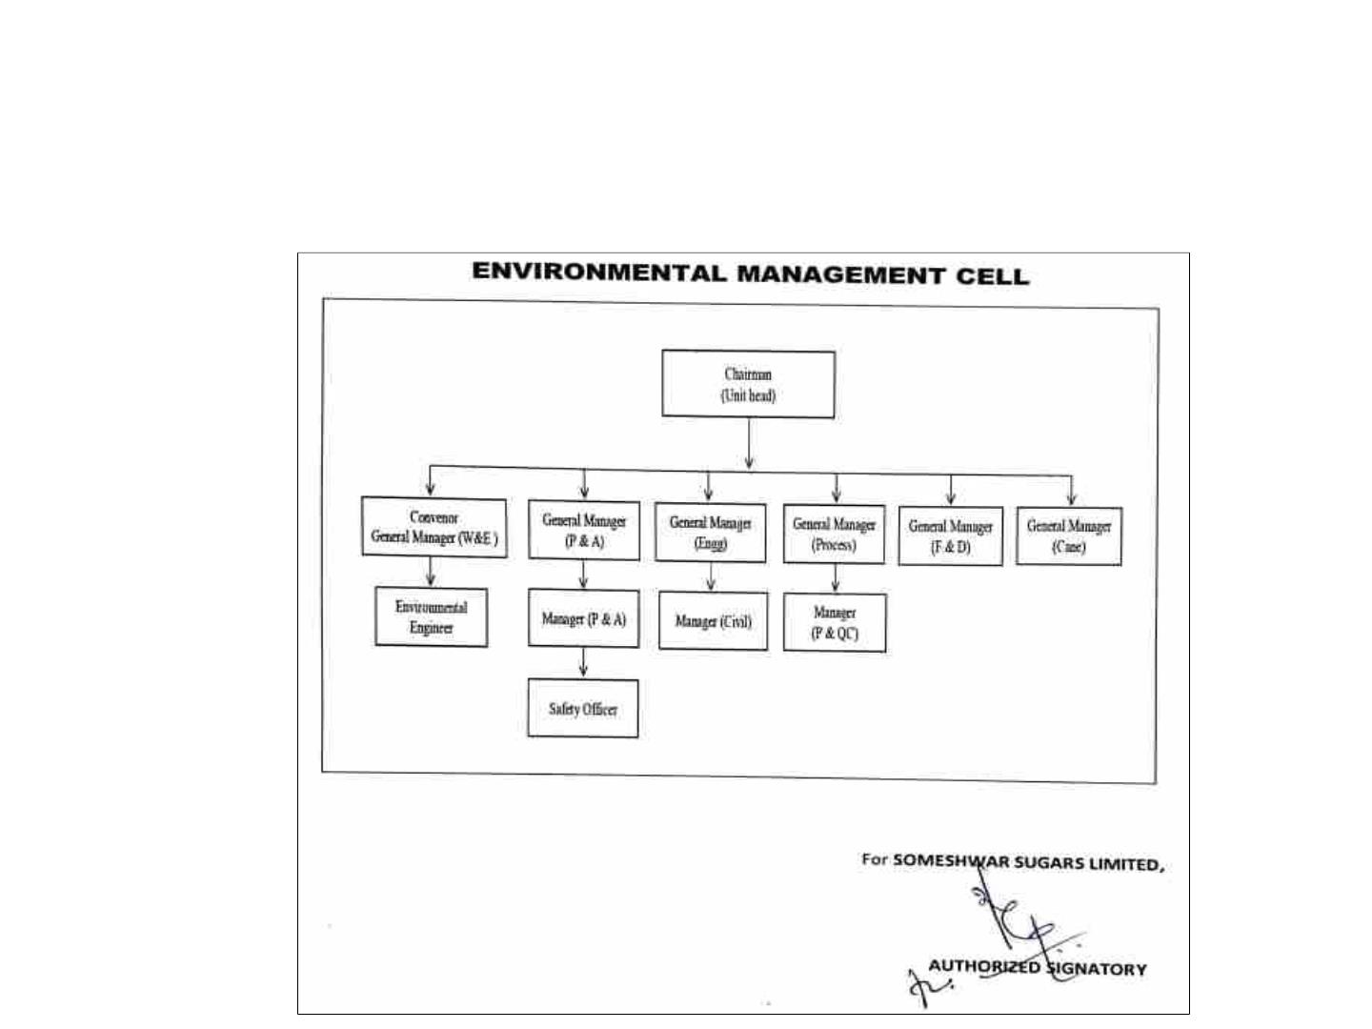
AirꢀandꢀNoiseꢀPollutionꢀSources
Ø Airꢀpollutionꢀsourcesꢀareꢀ60ꢀTPHꢀBoiler,ꢀ1250ꢀKVAꢀDGꢀset,ꢀVehicularꢀmovement.
Noiseꢀ pollutionꢀ sourcesꢀareꢀ 60ꢀ TPHꢀ Boiler,ꢀ Turbine,ꢀ Electrostaticꢀ Precipitatorꢀ (ESP),ꢀ
DGꢀSetꢀ&ꢀVehicularꢀmovement.
DetailsꢀofꢀEnvironmentꢀOfficersꢀwithꢀQualifications
5

Slide 6
WaterꢀConsumption,ꢀSourceꢀ&ꢀPermissionꢀObtained
Ø WaterꢀSource:ꢀꢀKrishnaꢀRiverꢀ:ꢀ4000ꢀKLD
Ø Waterꢀwillꢀ beꢀ sourcedꢀ fromꢀ Krishnaꢀ Riverꢀ forꢀ whichꢀ WaterꢀPermissionꢀ isꢀ obtainedꢀ fromꢀ
Krishnaꢀ Bhagyaꢀ Jalaꢀ Nigamꢀ Limited,ꢀ Damꢀ Divisionꢀ Alamattiꢀ (KBJNL)ꢀ @4000ꢀ KLDꢀ ofꢀ
waterꢀforꢀSugarꢀunitꢀandꢀtheꢀsameꢀshallꢀbeꢀutilizedꢀforꢀtheꢀDistilleryꢀunitꢀalso.
Ø Totalꢀwaterꢀavailabilityꢀisꢀ1116000ꢀKLꢀ(FromꢀKrishnaꢀRiverꢀ@ꢀ4000ꢀKLDꢀforꢀperiodꢀfromꢀ
Juneꢀ toꢀ Novemberꢀ andꢀ Condensateꢀ Waterꢀavailableꢀ fromꢀ Sugarꢀ Industryꢀ afterꢀ treatingꢀ inꢀ
CondensateꢀPolishingꢀUnitꢀ@ꢀ4200ꢀKLDꢀconsideringꢀ120ꢀdaysꢀofꢀSeasonꢀoperation).
Ø TotalꢀWaterꢀRequirementꢀꢀforꢀbothꢀProposedꢀSugarꢀunitꢀandꢀDistilleryꢀunitꢀisꢀ1076100ꢀKL.
FreshꢀWaterꢀRequirementꢀforꢀ180ꢀKLDꢀENAꢀProduction;
CaneꢀJuice/SyrupꢀasꢀFeed:ꢀꢀꢀ1012ꢀKLDꢀ@ꢀ5.62ꢀKL/KL
B-HeavyꢀMolassesꢀasꢀFeed:ꢀ1294ꢀKLDꢀ@ꢀ7.19ꢀKL/KL
C-MolassesꢀasꢀFeed:ꢀꢀꢀꢀꢀꢀꢀꢀꢀꢀꢀꢀ1440ꢀKLDꢀ@ꢀ8.00ꢀKL/KL
FreshꢀWaterꢀRequirementꢀforꢀ180ꢀKLDꢀEthanolꢀProduction;
CaneꢀJuice/SyrupꢀasꢀFeed:ꢀꢀꢀ922ꢀKLDꢀ@ꢀ5.12ꢀKL/KL
B-HeavyꢀMolassesꢀasꢀFeed:ꢀ1210ꢀKLDꢀ@ꢀ6.72ꢀKL/KL
C-MolassesꢀasꢀFeed:ꢀꢀꢀꢀꢀꢀꢀꢀꢀꢀꢀꢀ1374ꢀKLDꢀ@ꢀ7.63ꢀKL/KL
6

Slide 7

EnergyꢀConsumption
Ø DuringꢀConstructionꢀPhaseꢀ–ꢀ500ꢀkWhꢀ(FromꢀtemporaryꢀDGꢀSet)
Ø DuringꢀOperationꢀPhaseꢀisꢀ4030ꢀkWhꢀwillꢀbeꢀmetꢀfromꢀownꢀ8ꢀMWꢀCo-generationꢀUnit.
Ø DGꢀ ofꢀ capacityꢀ 1ꢀ xꢀ 1250ꢀ KVAꢀwillꢀ beꢀ usedꢀ asꢀ back-upꢀ powerꢀ failureꢀ forꢀ bothꢀ Sugarꢀ andꢀ
DistilleryꢀUnit.ꢀ
KindꢀandꢀQuantityꢀofꢀFuelꢀUsed
Sl.ꢀNo.
RawꢀMaterial
Quantity
Modeꢀofꢀ
Transport
Source
Storage
FuelꢀforꢀBoiler
1
2
Bagasse
BioꢀGasꢀ
501ꢀTPD ByꢀBeltꢀConveyor
Throughꢀpipelineꢀ
In-house
In-house
Storageꢀyard
GasꢀHolder
48ꢀTPD
fromꢀGasꢀHolder
3
Indianꢀ/ꢀImportedꢀCoal
64.80ꢀ
TPD
ByꢀBeltꢀConveyor FromꢀMarket Storageꢀyard
FuelꢀUsedꢀforꢀDGꢀset
HSDꢀwithꢀsulfurꢀ
contentꢀlessꢀthanꢀ
0.005%
FromꢀLocalꢀ
Market
Storedꢀinꢀ
Leakꢀproofꢀ
barrels
1
200ꢀL/A
Road
7

Slide 8
WastewaterꢀGenerationꢀ&ꢀTreatmentꢀFacilityꢀ
• DuringꢀConstructionꢀPhase
• TheꢀwastewaterꢀgeneratedꢀfromꢀlaborꢀcampsꢀwillꢀbeꢀtreatedꢀinꢀmobileꢀSTP.
• DuringꢀOperationalꢀPhase
• Theꢀ generatedꢀ Domesticꢀ sewageꢀ ofꢀ 9.72ꢀ KLDꢀ willꢀ treatedꢀ inꢀ STPꢀ ofꢀ 10ꢀ KLDꢀ capacityꢀ
withꢀSBRꢀtechnologyꢀandꢀtreatedꢀwaterꢀwillꢀbeꢀusedꢀforꢀgreenbeltꢀdevelopment.
• Theꢀgeneratedꢀspentꢀwashꢀofꢀ715ꢀtoꢀ1378ꢀKLDꢀfromꢀtheꢀproposedꢀprojectꢀwillꢀbeꢀpassedꢀ
throughꢀ digesterꢀ followedꢀ byꢀ concentrationꢀ inꢀ MEE,ꢀ andꢀ driedꢀ throughꢀ sprayꢀ driersꢀ toꢀ
removeꢀaboutꢀ92ꢀ–ꢀ95ꢀ%ꢀmoistureꢀcontentꢀ&ꢀthenꢀpackedꢀandꢀsoldꢀoutꢀinꢀlocalꢀmarketꢀasꢀaꢀ
potashꢀpowder.ꢀ
• Spentꢀ lees,ꢀ boilerꢀ andꢀ coolingꢀ towerꢀ blowꢀ down,ꢀ DMꢀ water,ꢀ softenerꢀ regenerationꢀ andꢀ ꢀ
processꢀcondensate,ꢀfloorꢀwashingꢀꢀshallꢀbeꢀcollectedꢀtogetherꢀandꢀtreatedꢀinꢀCondensateꢀ
polishingꢀunitꢀ(CPU)ꢀofꢀcapacityꢀ1400ꢀKLDꢀandꢀitꢀwillꢀbeꢀreusedꢀforꢀprocess.
8

Slide 9
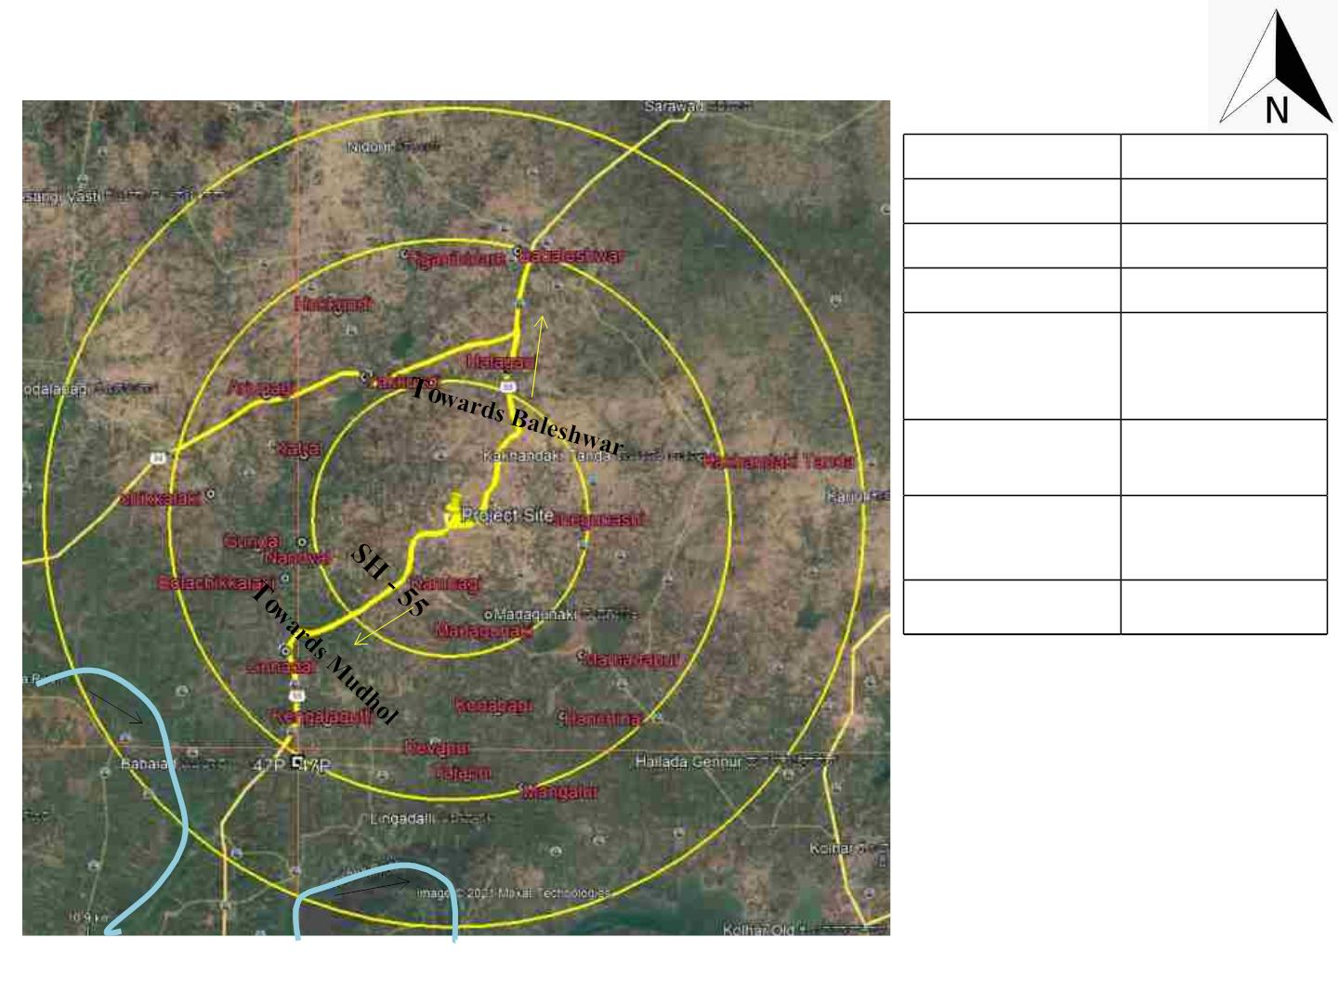
LocationꢀofꢀtheꢀProjectꢀandꢀitsꢀConnectivity
Latitude
16ºꢀ34’ꢀ47.7”Nꢀ
75ºꢀ33’ꢀ13.5”E
606ꢀm
Longitude
Elevationꢀ
Accessibilityꢀ
Connectivityꢀ
(Mudhol-
Vijayapura)
SHꢀ55ꢀ–ꢀ
Adjacentꢀtoꢀ
projectꢀsiteꢀ(S)
(GulbargaꢀBijapurꢀ NHꢀ218ꢀ-ꢀ15.40ꢀ
-HubliꢀHighway) Kmꢀ(E)ꢀ
MulvadꢀRailwayꢀ
Station
21.06ꢀKmsꢀ(E)
BelgaumꢀAirportꢀ 126.7ꢀKmsꢀ(SE)
KrishnaꢀRiver
9

Slide 10
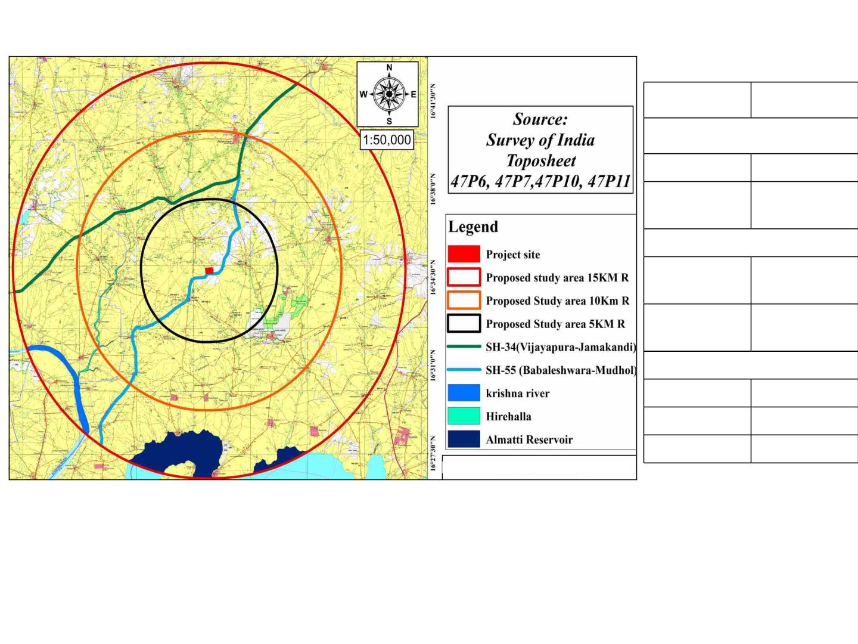
TopographicalꢀMap
Particularsꢀ
Distanceꢀ
WaterꢀBodiesꢀ
HireꢀHalla
6.6ꢀKm(W)
Krishnaꢀ
River
12.95ꢀKmsꢀ
(SW)
Forestꢀ
RFꢀ
Mamadapurꢀ
nearꢀ
5.1ꢀKmsꢀ(SE)
RFꢀnearꢀ
Tadalabagiꢀ
13.8ꢀKmsꢀ
(NW)
Denselyꢀpopulatedꢀarea
Kambagiꢀ
2.6ꢀKmꢀ(SW)
Shegunshi
Bableshwara
3ꢀKmꢀ(SE)
9.7ꢀKmꢀ(N)
10

Slide 11
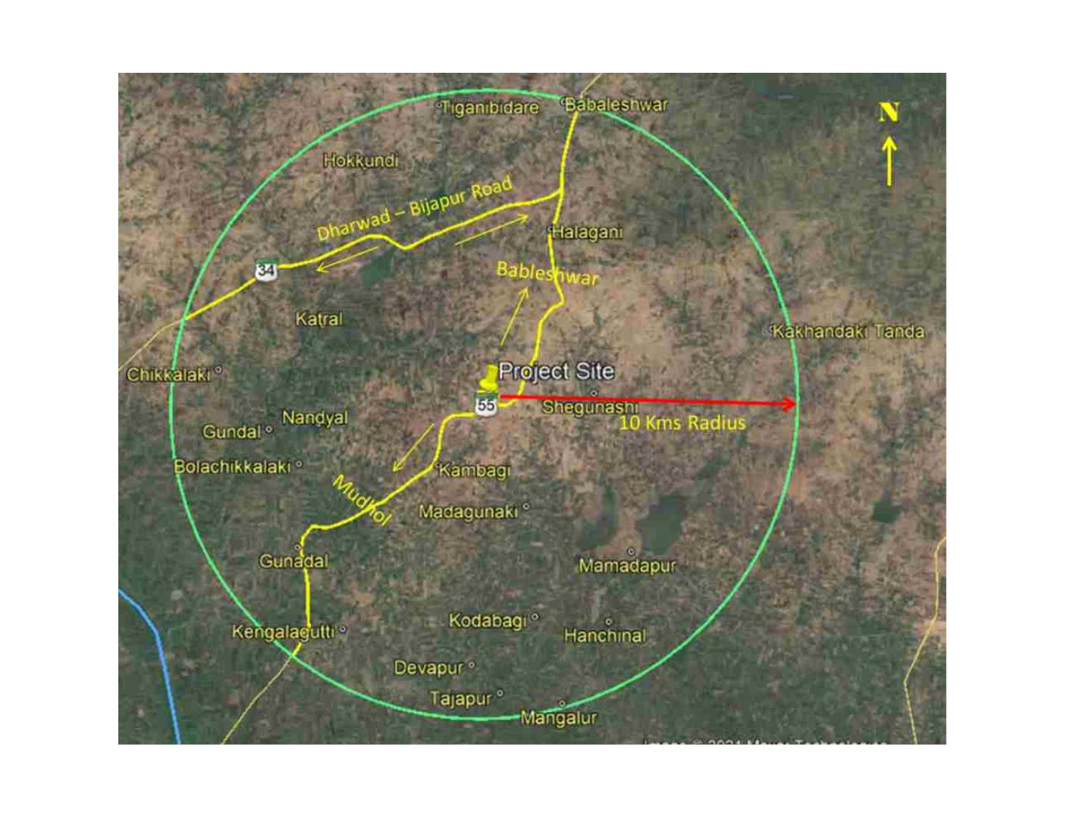
ProjectꢀSiteꢀonꢀGoogleꢀEarthꢀImage
11

Slide 12
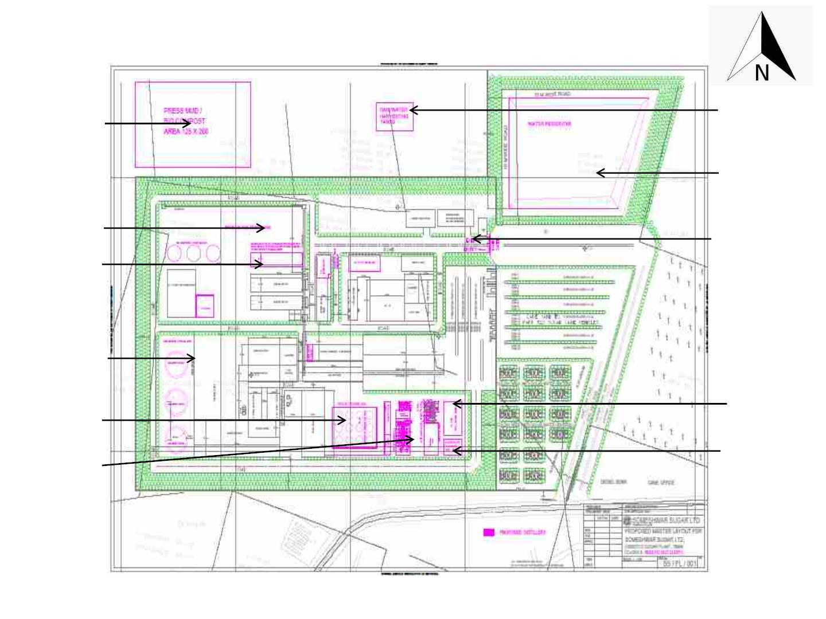
LayoutꢀplanꢀofꢀtheꢀproposedꢀProjectꢀSite
PressꢀMud/ꢀ
Bioꢀ
Compostꢀ
Area
Rainꢀwaterꢀ
Harvestingꢀ
Tanks
WaterꢀStorageꢀ
Reservoir
Bagasse/ꢀ Fuelꢀ
StorageꢀYard
Entryꢀandꢀ
ExitꢀGates
Boiler
ꢀ
ꢀ
ꢀ
ꢀ
ꢀꢀꢀꢀꢀꢀꢀ
Rawꢀ materialꢀ
storageꢀarea
Productꢀ
StorageꢀYard
SpentꢀWashꢀ
Tank
Fermentationꢀ
+ꢀDistillationꢀ
+ꢀEvaporationꢀ
Section
Condensateꢀ
Polishingꢀ
Unitꢀ(CPU)

Slide 13

BaselineꢀEnvironmentꢀDetails
1)ꢀAirꢀQuality
PeriodꢀofꢀMonitoring
Marchꢀ2021ꢀtoꢀMayꢀ2021
AAQꢀMonitoredꢀparametersꢀatꢀ8ꢀ Particulateꢀ Matterꢀ (PM ) Particulateꢀ Matterꢀ (PM
Sulphurꢀ
2.5),
10
,
Locations
Dioxideꢀ(SO ), NitrogenꢀDioxideꢀ(NO ), Leadꢀ(Pb), Nickelꢀ(Ni),
2
2
Arsenicꢀ (As), Carbonꢀ Monoxideꢀ (CO), Ozoneꢀ (O₃), Ammoniaꢀ
(NH ) Benzeneꢀ(C H ), Benzoꢀ(a)ꢀpyreneꢀ(BaP)
3
6
6
ComparisonꢀofꢀAAQMꢀdataꢀ
fromꢀupwindꢀtoꢀdownwindꢀ
station
A2ꢀ-ShegunshiꢀVillageꢀ
(UpstreamꢀStation)
A7ꢀ-ꢀGundalꢀVillage
(DownstreamꢀStation)
PMꢀ_{10,ꢀ}g/m³
PM_{2.5,ꢀ}g/m³
SO_{2,ꢀ}g/m³
NO_{2,ꢀ}g/m³
CO,ꢀmg/m³
69.09
23.96
7.44
68.32
23.61
7.47
19.41
0.84
17.79
0.84
NH_{3,ꢀ}g/m³
O_{3,ꢀ}g/m3
8.28
0.64
7.83
2.43
\
AAQꢀModelling
Proposedꢀ60ꢀTPHꢀBoilersꢀforꢀDistilleryꢀUnit
(IncrementalꢀGLCs)
AERMODꢀCLOUD
CALINEꢀPRO
PMꢀ=ꢀ0.37ꢀµg/m3ꢀatꢀaꢀdistanceꢀofꢀ1000ꢀmꢀtowardsꢀEꢀdirection.ꢀ
SO₂ꢀ=ꢀ0.15ꢀµg/m3ꢀatꢀaꢀdistanceꢀofꢀ1000ꢀmꢀtowardsꢀEꢀdirectionꢀ.ꢀ
NO₂ꢀ=ꢀ0.24ꢀµg/m3ꢀatꢀaꢀdistanceꢀofꢀ1000ꢀmꢀtowardsꢀEꢀdirection
NoiseꢀLevelsꢀatꢀ8ꢀLocations
46.04ꢀtoꢀ53.8ꢀdB(A)ꢀforꢀdayꢀtime;ꢀ36.40ꢀtoꢀ48.91ꢀdB(A)ꢀforꢀnightꢀ
time.
13

Slide 14
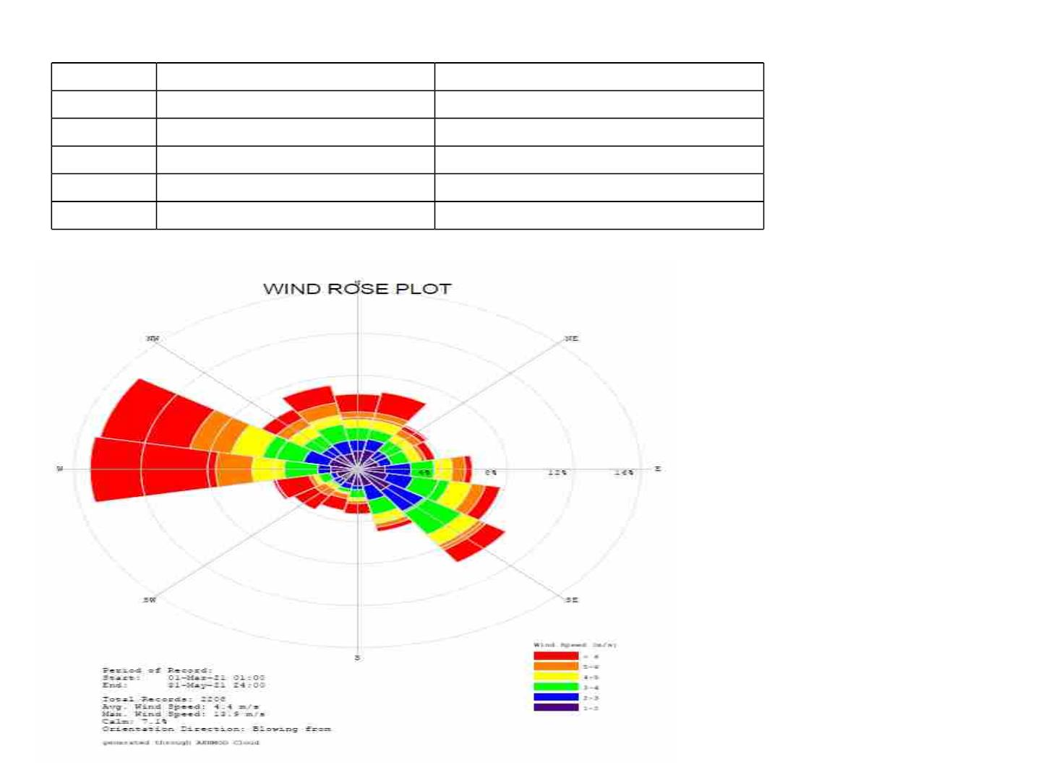
MinimumꢀDetectableꢀLimitsꢀofꢀAAQM
SL.NO
Parameter
MinimumꢀDetectableꢀLimit
<1ꢀng/m³
1.
2.
3.
4.
5.
Arsenicꢀ
Benzeneꢀ
Benzoꢀ(a)ꢀpyreneꢀ
Nickel
<5µg/m³
<1ꢀng/m³
<1ꢀng/m³
Lead
<0.005ꢀµg/m³
WindꢀRoseꢀDiagram
Windꢀdirectionꢀduringꢀstudyꢀ
periodꢀisꢀBlowingꢀFromꢀW,ꢀ
NWꢀdirection
14

Slide 15
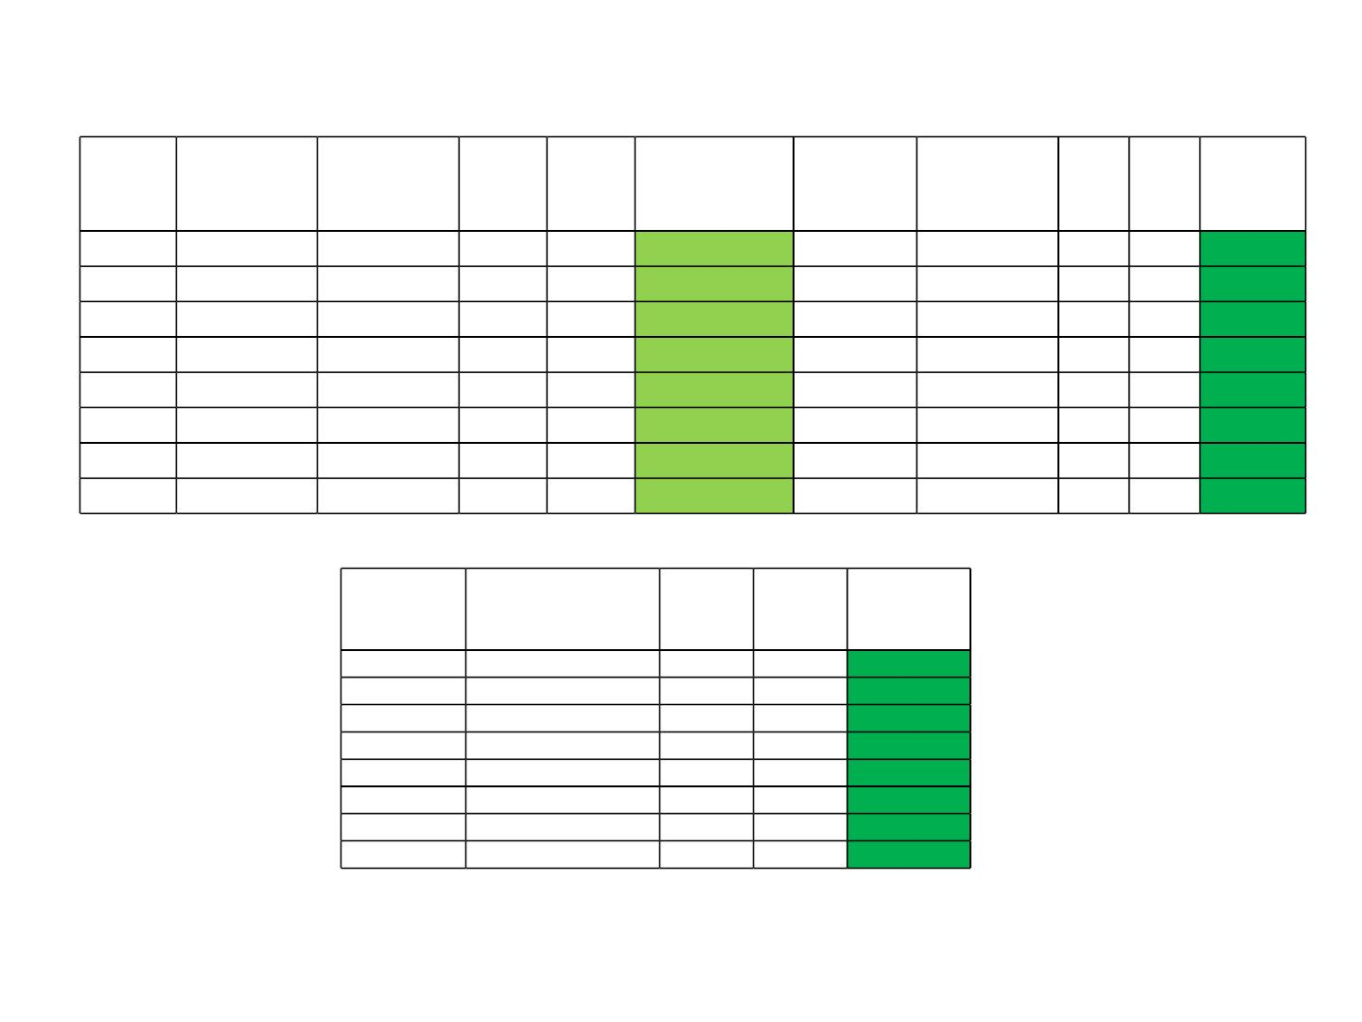
IncrementalꢀPollutionꢀLoadꢀ–ꢀAQIꢀIndexꢀwithꢀmitigationꢀmeasuresꢀforꢀ60TPHꢀBoilerꢀ
Marchꢀ2021ꢀtoꢀMayꢀ2021
PM_{10,ꢀ}g/m³
Percentile
PM_{10,ꢀ}g/m³
Modellingꢀ
Values
SO_{2,ꢀ}g/m3
Percentile
SO_{2,ꢀ}g/m³
Modellingꢀ Total AQI Remarks
Location
Total
AQI
Remarks
Values
A1
A2
A3
A4
A5
A6
A7
A8
65.30
69.09
64.87
61.73
64.01
69.90
68.32
69.48
0.12
65.42
65.42
Satisfactory
Satisfactory
Satisfactory
Satisfactory
Satisfactory
Satisfactory
Satisfactory
Satisfactory
6.99
7.44
6.58
6.08
6.70
7.60
7.47
7.15
0.05
0.06
0.01
0.0
7.04 8.80
7.5 9.38
Good
Good
Good
Good
Good
Good
Good
Good
0.15
0.03
0.0
69.24
64.9
69.24
64.9
6.59 8.24
6.08 6.08
61.73
61.73
0.0
64.01
70
64.01
70
0.0
6.70 6.70
7.61 9.51
0.1
0.01
0.0
0.0
68.32
69.48
68.32
69.48
7.47 7.47
7.15 7.15
0.0
0.0
NO
^{NO}2,ꢀ^{g/m3}
2,ꢀ
g/m³
Percentile
17.26
Modellingꢀvalues
Total
AQI
Remarks
0.08
0.1
17.34
19.43
16.33
13.90
15.33
18.8
21.68
24.29
20.41
13.90
15.33
23.50
17.79
18.53
Good
Good
Good
Good
Good
Good
Good
Good
19.41
16.31
13.90
15.33
18.74
17.79
18.53
0.02
0.0
0.0
0.06
0.0
0.0
17.79
18.53
15

Slide 16
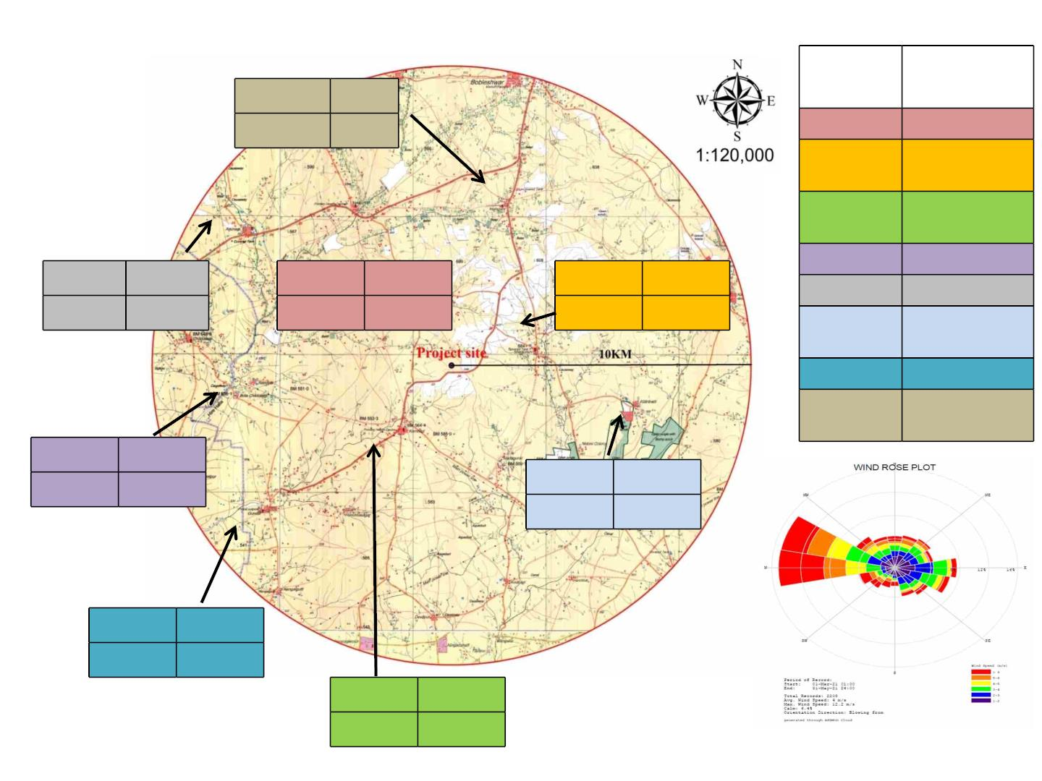
Map of AQM Station be given superimposed with respective monitored value &
wind rose
Station
no
Station
name
PM 10
69.48
23.78
PM 2.5
A1
A2
Project site
Shegunshi
Village
A8
A5
A3
Kambagi
Village
A4
A5
Nandyal Village
Arjunagi Village
PM 10 64.01
PM 2.5 19.80
PM 10
65.30
PM 10
69.09
PM 2.5, 21.00
PM 2.5, 23.96
Kilarihatti
Village
A2
A6
A7
A8
A4
A1
Gundal Village
A6
Halagani
Village
A3
PM 10
61.73
PM 2.5, 16.65
PM 10
69.90
A7
PM 2.5, 25.28
PM 10
68.32
PM 2.5, 23.61
PM 10
64.87
PM 2.5, 19.01
PeriodꢀofꢀRecord:ꢀMarchꢀtoꢀMayꢀ2021
Orientation:ꢀBlowingꢀFromꢀW,NW

Slide 17
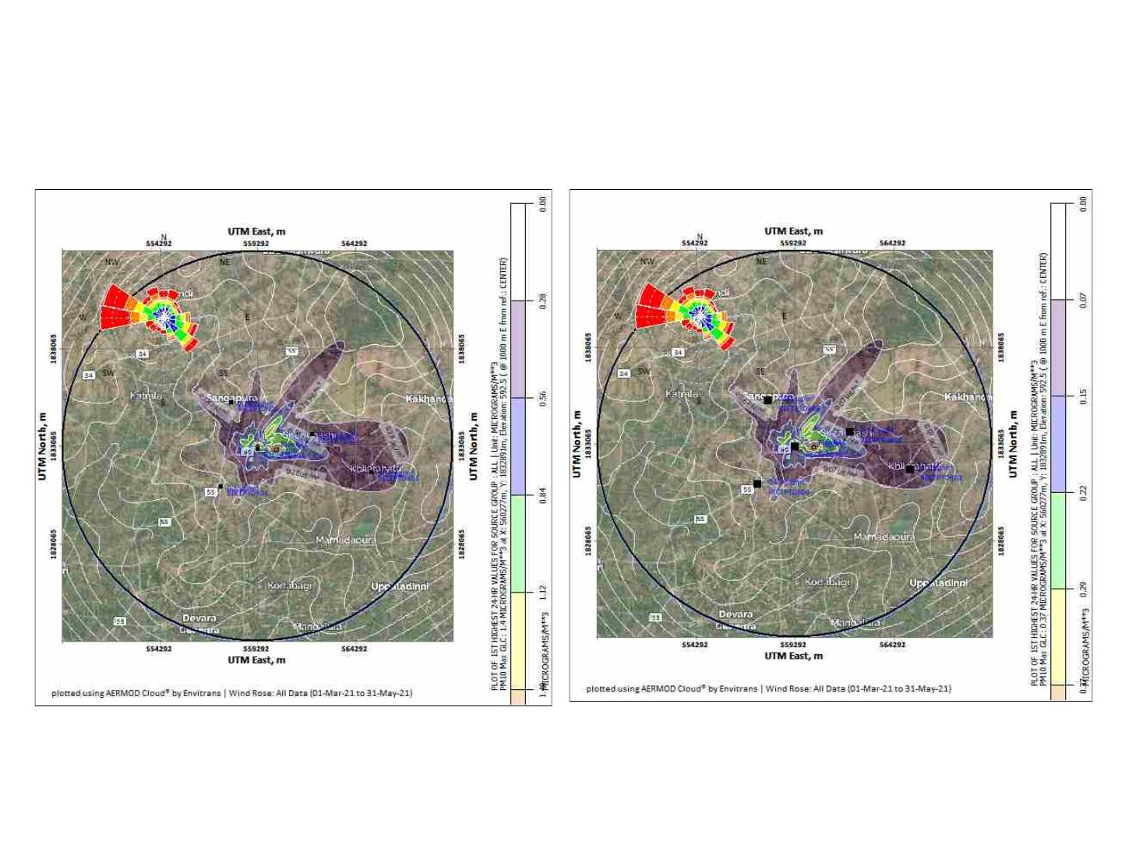
PredictionꢀofꢀMaxꢀGLC
Model Used : AERMOD Cloud
Isopleths
IsoplethsꢀdrawnꢀforꢀPMꢀwithoutꢀmitigationꢀ
measuresꢀforꢀproposedꢀ60ꢀTPHꢀBoiler
IsoplethsꢀdrawnꢀforꢀPMꢀwithꢀmitigationꢀ
measuresꢀforꢀproposedꢀ60ꢀTPHꢀBoiler
Maximumꢀconcentrationꢀpredictedꢀisꢀ1.4ꢀµg/m3ꢀ
atꢀaꢀdistanceꢀofꢀ1000ꢀmꢀtowardsꢀE.
Maximumꢀconcentrationꢀpredictedꢀisꢀ0.37ꢀµg/m³ꢀ
atꢀaꢀdistanceꢀofꢀ1000ꢀmꢀtowardsꢀE
17

Slide 18
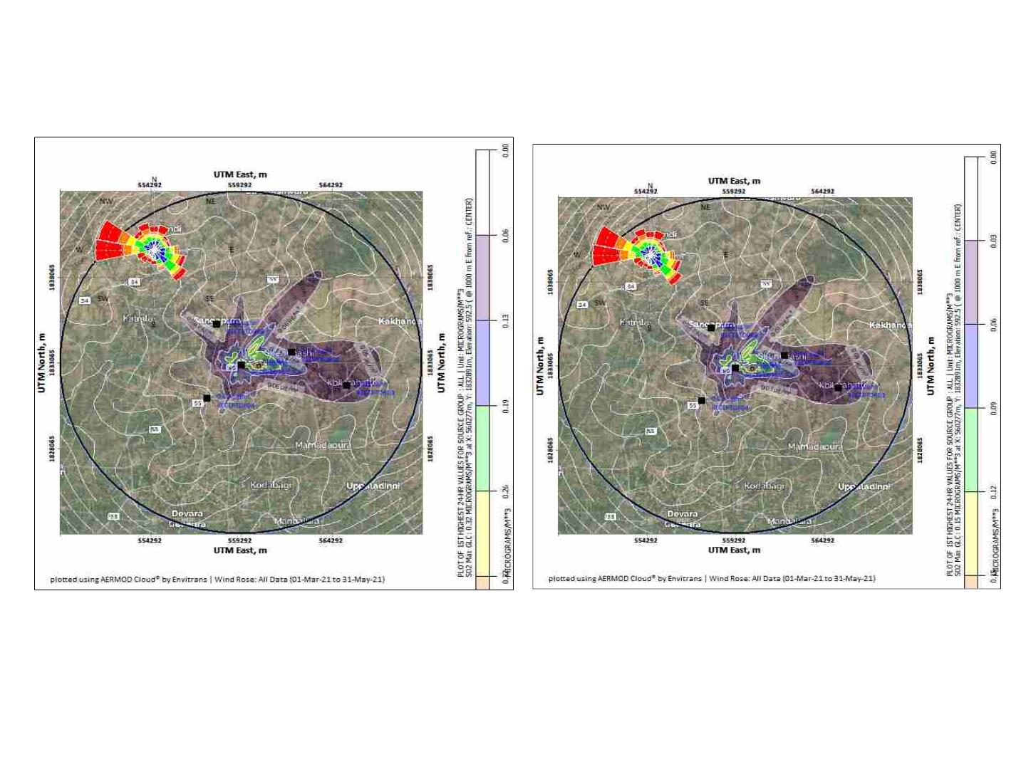
PredictionꢀofꢀMaxꢀGLC
Model Used : AERMOD Cloud
IsoplethsꢀdrawnꢀforꢀSO2ꢀwithoutꢀmitigationꢀ
measuresꢀforꢀproposedꢀ60ꢀTPHꢀBoiler
IsoplethsꢀdrawnꢀforꢀSO2ꢀwithꢀmitigationꢀ
measuresꢀforꢀproposedꢀ60ꢀTPHꢀBoiler
Maximumꢀconcentrationꢀpredictedꢀisꢀ0.32ꢀµg/m³ꢀ
atꢀaꢀdistanceꢀofꢀ1000ꢀmꢀtowardsꢀE
Maximumꢀconcentrationꢀpredictedꢀisꢀ0.15ꢀ
µg/m3ꢀatꢀaꢀdistanceꢀofꢀ1000ꢀmꢀtowardsꢀE
18

Slide 19
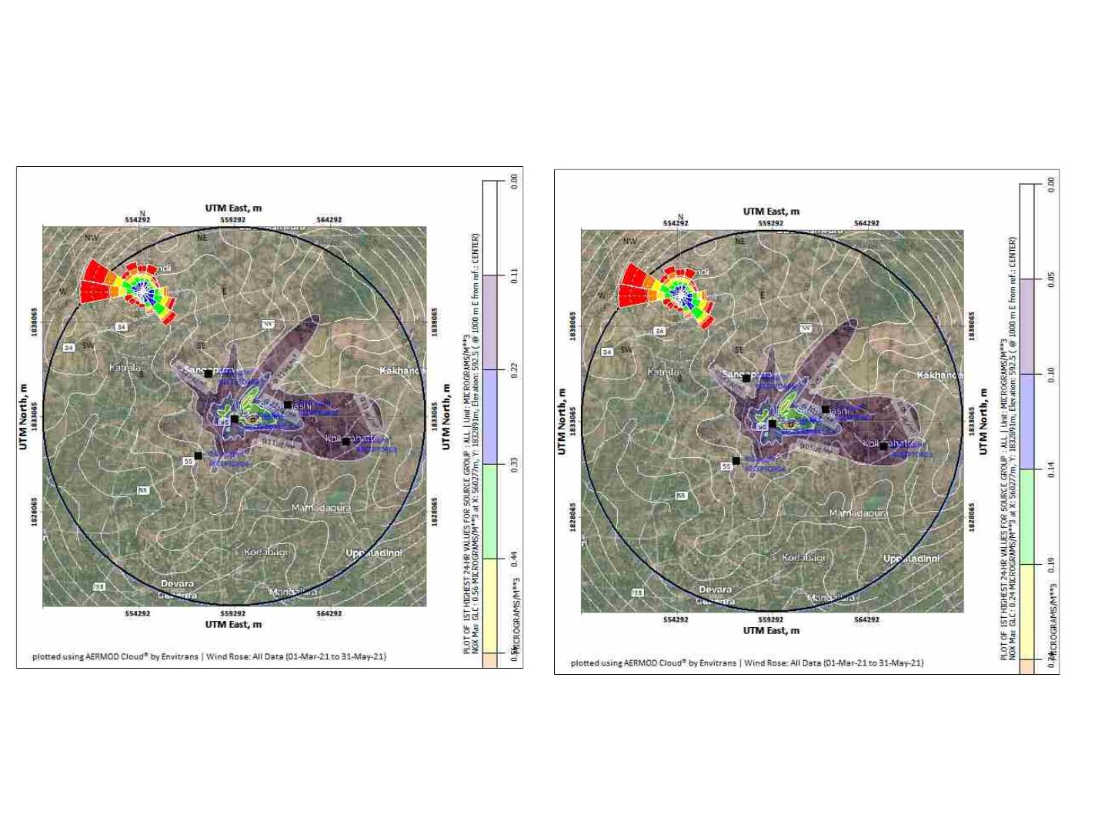
PredictionꢀofꢀMaxꢀGLC
Model Used : AERMOD Cloud
IsoplethsꢀdrawnꢀforꢀNO2ꢀwithoutꢀmitigationꢀ
measuresꢀforꢀproposedꢀ60ꢀTPHꢀBoiler
IsoplethsꢀdrawnꢀforꢀNO2ꢀwithꢀmitigationꢀ
measuresꢀforꢀproposedꢀ60ꢀTPHꢀBoilerꢀ
Maximumꢀconcentrationꢀpredictedꢀisꢀ0.56ꢀ
µg/m³ꢀatꢀaꢀdistanceꢀofꢀ1000ꢀmꢀtowardsꢀE
Maximumꢀconcentrationꢀpredictedꢀisꢀ0.24ꢀ
µg/m3ꢀatꢀaꢀdistanceꢀofꢀ1000ꢀmꢀtowardsꢀE
19

Slide 20
ImpactsꢀofꢀꢀDust,ꢀSmoke,ꢀgas,ꢀfumesꢀ&ꢀOdor
DuringꢀConstructionꢀPhase
• Theꢀmajorꢀsourcesꢀofꢀairꢀpollutionꢀduringꢀconstructionꢀphaseꢀwillꢀbeꢀfugitiveꢀemissionsꢀ
dueꢀ toꢀ transportationꢀ activity.ꢀ Dustꢀ mayꢀ ariseꢀ dueꢀ toꢀ movementꢀ ofꢀ dumpꢀ trucks,ꢀ
constructionꢀequipmentꢀandꢀotherꢀvehiclesꢀonꢀunpavedꢀroadsꢀandꢀmixingꢀandꢀbatchingꢀ
ofꢀaggregateꢀforꢀconcreteꢀpreparation.
DuringꢀOperationalꢀPhase
• TheꢀmainꢀsourcesꢀofꢀAirꢀPollutionꢀinꢀtheꢀexistingꢀprojectꢀareꢀtheꢀBoiler.ꢀHoweverꢀthereꢀ
isꢀnoꢀadditionalꢀsourceꢀofꢀairꢀpollution.ꢀ
• Odorꢀisꢀtheꢀmostꢀcommonꢀissueꢀinꢀdistilleryꢀindustries,ꢀtoꢀeliminateꢀtheꢀodorꢀproblemꢀinꢀ
theꢀinꢀtheꢀproposedꢀprojectꢀtheꢀfollowingꢀmeasuresꢀwillꢀbeꢀadopted;
• Spentꢀ washꢀ generatedꢀ fromꢀ theꢀ proposedꢀ dualꢀ feedꢀ distilleryꢀ shallꢀ beꢀ carriedꢀ throughꢀ
closedꢀpipelineꢀandꢀfirstꢀitꢀwillꢀbeꢀpassedꢀthroughꢀdigesterꢀfollowedꢀbyꢀconcentrationꢀinꢀ
MEE,ꢀ andꢀ driedꢀ throughꢀ sprayꢀ driersꢀ toꢀ removeꢀ aboutꢀ 92ꢀ –ꢀ 95ꢀ %ꢀ moistureꢀ contentꢀ &ꢀ
thenꢀpackedꢀandꢀsoldꢀoutꢀinꢀlocalꢀmarketꢀspentꢀwashꢀpowder.ꢀ
• Properꢀmaintenanceꢀaroundꢀtheꢀmolassesꢀstorageꢀtanks.
• Properꢀ stepsꢀ willꢀ beꢀ takenꢀ toꢀ reduceꢀ odorꢀ issuesꢀ towardsꢀ handing,ꢀ conveyance,ꢀ usage,ꢀ
housekeeping,ꢀoperationꢀandꢀmaintenance.ꢀ
• Greenꢀbeltꢀdevelopmentꢀinꢀandꢀaroundꢀtheꢀindustryꢀtoꢀreduceꢀodorꢀproblems
20

Slide 21

BaselineꢀEnvironmentꢀDetails
2)ꢀWaterꢀ(Surfaceꢀ+ꢀGroundꢀ)ꢀEnvironmentꢀ
Dateꢀofꢀmonitoringꢀ
SWꢀ–ꢀ15.06.2021
GWꢀ–ꢀ22.04.2021
Groundꢀ Waterꢀ Qualityꢀ Color,ꢀ Temperature,ꢀ Turbidity,ꢀ pH,ꢀ Electricalꢀ conductivityꢀ (EC),ꢀ ꢀ
Parametersꢀ monitoredꢀ atꢀ Totalꢀ Dissolvedꢀ Solids,ꢀ Totalꢀ Hardness,ꢀ Totalꢀ Suspendedꢀ Solids,ꢀ
8ꢀlocations
Chloride,ꢀ Sulphate,ꢀ Phosphates,ꢀ Nitrate,ꢀ TKN,ꢀ Fluoride,ꢀ Calcium,ꢀ
Magnesium,ꢀ Copper,ꢀ Iron,ꢀ Manganese,ꢀ ꢀ Salinity,ꢀ Alkalinity,ꢀ
Sodiumꢀ Absorptionꢀ Ratioꢀ (SAR),ꢀ Residualꢀ Sodiumꢀ Carbonateꢀ
(RSC),ꢀ Ammonicalꢀ Nitrogen,ꢀ Zinc,ꢀ Silver,ꢀ Arsenic,ꢀ Lead,ꢀ
Cadmium,ꢀ Chromiumꢀ Hexavalent,ꢀ Totalꢀ Pesticide,ꢀ MBAS,ꢀ Totalꢀ
Nitrogen,ꢀ Potassium,ꢀ Anionicꢀ Detergents,ꢀ Nitrite,ꢀ Carbonate,ꢀ
Bicarbonate,ꢀUranium,ꢀMercury,ꢀSodiumꢀTotalꢀPesticides
Surfaceꢀ Waterꢀ Qualityꢀ Turbidity,ꢀ pH,ꢀ Electricalꢀ conductivity,ꢀ Dissolvedꢀ Oxygen,ꢀ
Parametersꢀ monitoredꢀ atꢀ BiochemicalꢀOxygenꢀDemandꢀ(3ꢀdaysꢀ@ꢀ27⁰C),ꢀChemicalꢀOxygenꢀ
4ꢀlocations
Demand,ꢀ Totalꢀdissolvedꢀ solids,ꢀ ꢀ Totalꢀsuspendedꢀ solids,ꢀ Oilꢀ andꢀ
grease,ꢀAmmonicalꢀNitrogen,ꢀTKN,ꢀNitrate,ꢀNitrite,ꢀFluoride,ꢀTotalꢀ
Hardness,ꢀ Chloride,ꢀ Sulphate,ꢀ Calcium,ꢀ Magnesium,ꢀ Alkalinity,ꢀ
Iron,ꢀ Manganese,ꢀ Totalꢀ Coliformꢀ andꢀ Fecalꢀ Coliform,ꢀ Phenol,ꢀ
Copper,ꢀ Zinc,ꢀ Silver,ꢀ Arsenic,ꢀ Lead,ꢀ Cadmium,ꢀ Chromiumꢀ
Hexavalent,ꢀ Anionicꢀ detergent,ꢀ PAH,ꢀ Totalꢀ Pesticides,ꢀ Sodium,ꢀ
Sodiumꢀ Absorptionꢀ Ratio,ꢀ ,ꢀ Residualꢀ Freeꢀ Chlorine,ꢀ Salinity,ꢀ E-
Coli,ꢀ Mercury,ꢀ Uranium,ꢀ Carbonate,ꢀ Bicarbonate,ꢀ Phenolicꢀ
CompoundꢀTotalꢀNitrogen,ꢀTotalꢀPhosphate&ꢀPotassium
21

Slide 22
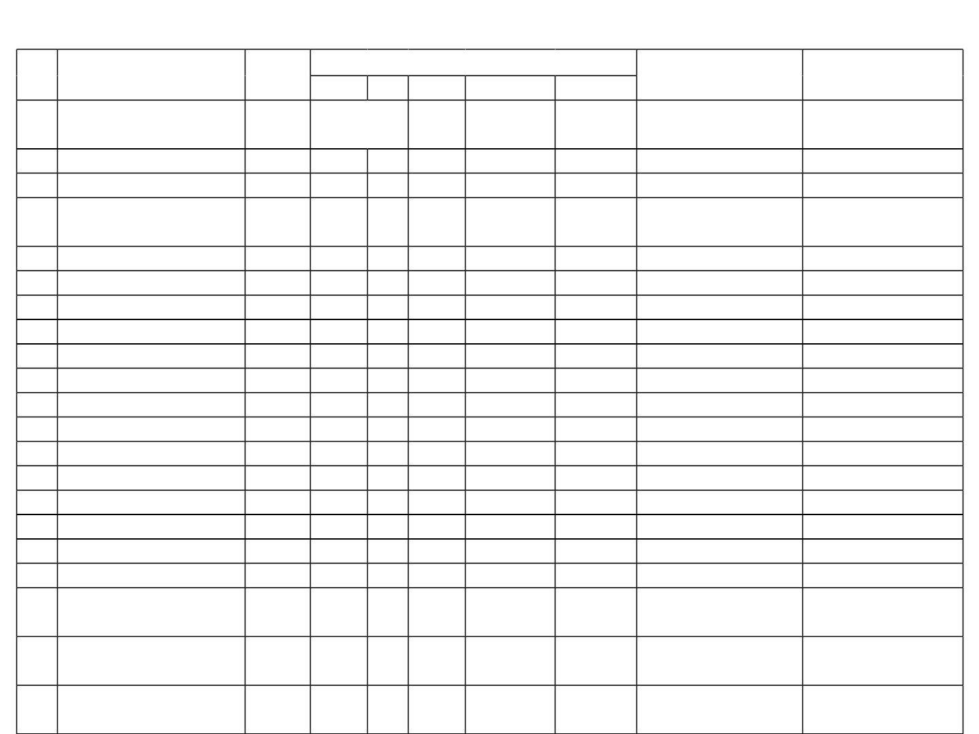
Comparisonꢀofꢀꢀdataꢀfromꢀupstreamꢀtoꢀdownstreamꢀsamplingꢀlocation
Sl.
Parameters
Unit
WaterꢀQualityꢀCriteria
LakeꢀnearꢀYakkundiꢀ HireꢀKereꢀ-ꢀSW3
No
A
B
C
D
E
–ꢀSW2ꢀ(Upstream)
(Downstream)
1
pH
-
6.5ꢀ&ꢀ8.5
6-9
6.5ꢀtoꢀ8.5 6.0ꢀtoꢀ8.5
7
8.41
.78
4.7
32
2
3
DissolvedꢀOxygen
BOD(3ꢀDays@27˚C)
ChemicalꢀOxygenꢀ
Demand
mg/L
mg/L
6
2
5
3
4
3
4
-
-
-
4.3
18
4
mg/L
-
-
-
-
-
108
64
5
6
7
8
9
ElectricalꢀConductivity
TotalꢀSuspendedꢀSolids
TotalꢀDissolvedꢀSolids
TotalꢀHardness
µs/cm
mg/L
mg/L
mg/L
mg/L
mg/L
mg/L
mg/L
mg/L
mg/L
mg/L
mg/L
mg/L
mg/L
MPN/
100ml
MPN/
100ml
MPN/
100ml
-
-
-
-
-
-
-
-
-
-
-
-
-
-
-
-
-
-
-
-
-
-
-
-
-
-
-
-
-
-
-
-
-
-
-
-
-
-
-
-
-
-
-
-
-
-
-
-
-
-
-
-
-
-
-
-
2250
2700
52
2050
4.0
-
-
-
-
-
-
-
-
-
-
-
-
-
1813
660
1156
450
NitrateꢀasꢀNO3
5.44
471.10
205.82
7.4
3.09
349.68
128.13
7.2
10 ChlorideꢀasꢀCl-
11 SulphateꢀasꢀSO4
12 TotalꢀNitrogen
13 PotassiumꢀasꢀK
14 CalciumꢀasꢀCa
15 MagnesiumꢀasꢀMg
16 FluorideꢀasꢀF
17 LeadꢀasꢀPb
5.2
5.6
140
112
75.33
0.55
0.03
0.32
41.31
0.65
0.03
1.57
18 IronꢀasꢀFeꢀ
19 TotalꢀColiform
20 FecalꢀColiform
21 E-coli
50
-
500 5000
-
-
-
-
-
-
350
32
210
<1.8
<1.8
-
-
-
-
-
17
22

Slide 23

MinimumꢀDetectableꢀLimitsꢀofꢀGroundꢀWaterꢀꢀ&ꢀSurfaceꢀWater
SL.No
1.
Parameter
ResidualꢀSodiumꢀCarbonateꢀ(RSC)
AnionicꢀDetergents
Silverꢀ
MinimumꢀDetectableꢀLimit
<0.1meq/L
2.
<0.2mg/L
3.
<0.005ꢀmg/L
<0.005ꢀmg/L
<0.003ꢀmg/L
<0.2ꢀmg/L
4.
Leadꢀ
5.
Cadmiumꢀ
6.
ChromiumꢀHexavalentꢀ
Mercuryꢀ
7.
<0.001ꢀmg/L
<1ꢀmg/L
8.
Oilꢀ&ꢀGrease
10.
11.
12.
13.
14.
15.
16.
17.
18.
PhenolicꢀCompounds
ManganeseꢀasꢀMn
ResidualꢀFreeꢀChlorine
CarbonateꢀasꢀCO₃
PolyꢀAromaticꢀHydrocarbonꢀ(PAH)
CopperꢀasꢀCu
<0.005ꢀmg/L
<0.005ꢀmg/L
<0.1ꢀmg/L
<1ꢀmg/L
<0.001ꢀmg/L
<0.005ꢀmg/L
<0.005ꢀmg/L
<0.005ꢀmg/L
<0.005ꢀmg/L
ZincꢀasꢀZn
IronꢀasꢀFe
CopperꢀasꢀCu
23

Slide 24
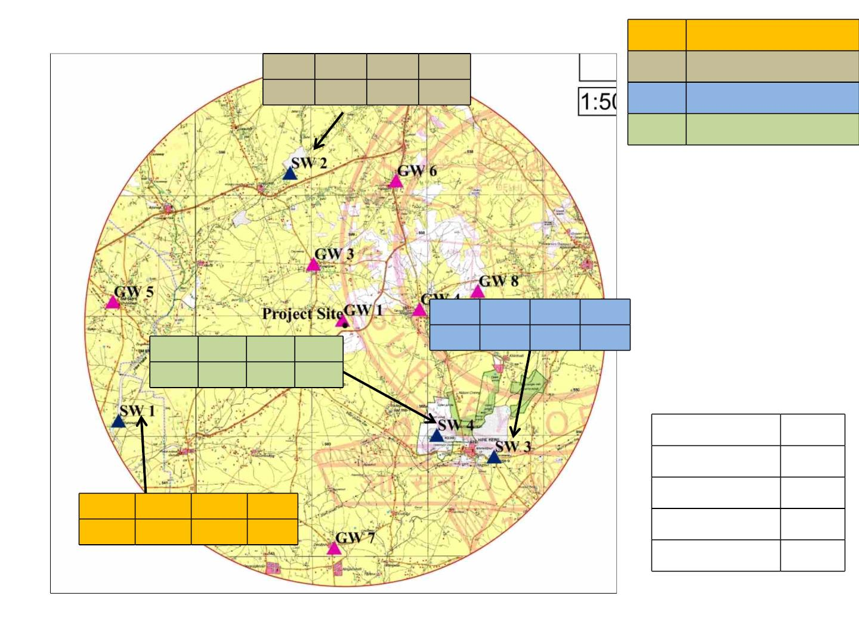
ResultsꢀofꢀSurfaceꢀWaterꢀQualityꢀ
SW1
SW2
SW3
SW4
Hire Halla
pH
DO
4.7
BOD
32
COD
108
Lake near Yakkundi
Hire Kere
7.78
Chikka Kere
CPCBꢀCriteria
Fromꢀ theꢀ laboratoryꢀ
analysisꢀ ofꢀ ꢀ waterꢀ
quality,ꢀ itꢀ wasꢀ
confirmedꢀ thatꢀ theꢀ
samplesꢀ belongꢀ toꢀ
criteriaꢀ'D'ꢀandꢀ‘E’ꢀ
pH
DO
4.3
BOD COD
18 64
pH
DO
5.3
BOD COD
8.41
8.17
4.1
12
Parameters
pH
Units
-
DO
mg/l
mg/l
mg/l
pH
DO
4.8
BOD
12
COD
80
7.89
BOD
COD
24

Slide 25
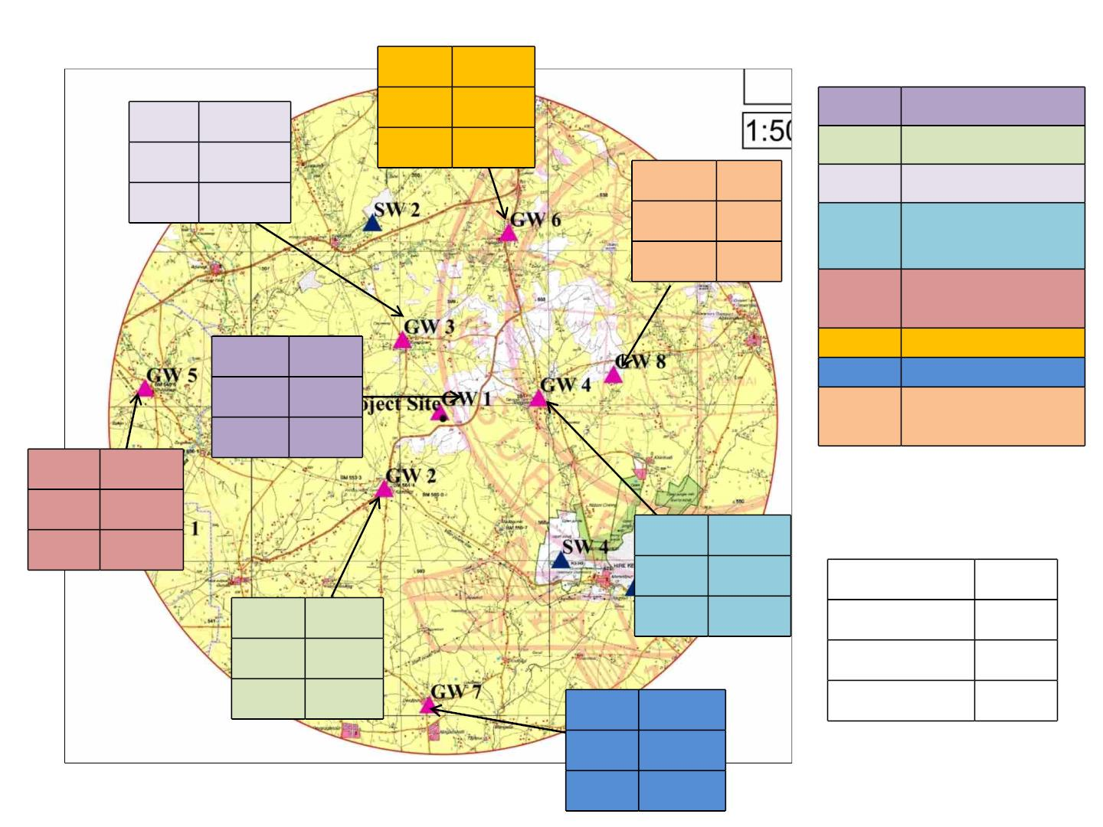
ResultsꢀofꢀGroundꢀWaterꢀQuality
pH
7.43
TDS 578
TH 216
GW-1
GW-2 Kambagi Village
pH
7.31
Project Location
TDS 1256
TH 580
pH
7.34
662
296
GW-3
Sangapur Village
TDS
TH
GW-4
Shegunshi
Village
GW-5
Ckikkalakkiꢀ
Village
pH
7.23
370
128
GW-6 HalaganiꢀVillage
GW-7 Devapura
Haralayyaꢀ
TDS
TH
GW-8
Temple
pH
7.21
TDS 396
TH 200
pH
7.07
TDS 852
Parameters Units
pH
TDS 572
TH 228
TH
380
7.46
pH
-
TDS
TH
mg/l
mg/l
pH
7.31
TDS 678
TH 304
25

Slide 26
InterferenceꢀofꢀAnalysisꢀReportsꢀ
SurfaceꢀWater
• SurfaceꢀWaterꢀsamplingꢀ&ꢀanalysisꢀisꢀcarriedꢀoutꢀatꢀ6ꢀlocationsꢀinꢀtheꢀstudyꢀarea.ꢀ
• Analysisꢀreportsꢀrevealsꢀthat,ꢀtheꢀsurfaceꢀwaterꢀqualityꢀinꢀtheꢀstudyꢀareaꢀareꢀofꢀ
Goodꢀqualityꢀ(SW-1,ꢀSW-2,ꢀSW-4ꢀ&ꢀSW-6),ꢀPoorꢀqualityꢀ(SW-3ꢀ&ꢀSW-5).ꢀ
GroundꢀWater
§ Groundꢀwaterꢀ(Boreꢀwell)ꢀsamplesꢀwereꢀcollectedꢀatꢀ8ꢀlocationsꢀandꢀanalyzedꢀtoꢀ
knowꢀtheꢀbaselineꢀgroundꢀwaterꢀquality.ꢀ
§ Theꢀ Potassiumꢀ valuesꢀ rangesꢀ fromꢀ 3.2ꢀ mg/Lꢀ (GW-5)ꢀtoꢀ 18ꢀ mg/Lꢀ (GW-3)ꢀwithꢀ
meanꢀ valueꢀ ofꢀ 9.1ꢀ mg/L,ꢀ Calciumꢀ valuesꢀ rangesꢀ fromꢀ 46.4ꢀ mg/Lꢀ (GW-5)ꢀ toꢀ
126.4ꢀmg/Lꢀ(GW-2)ꢀwithꢀmeanꢀvalueꢀofꢀ78mg/L.ꢀ
§ Magnesiumꢀvaluesꢀrangesꢀfromꢀ24.3ꢀmg/Lꢀ(GW-5)ꢀtoꢀ68.04ꢀmg/Lꢀ(GW-1)ꢀwithꢀ
meanꢀvalueꢀofꢀ41.67ꢀmg/LꢀandꢀSodiumꢀvaluesꢀrangesꢀfromꢀ58.4ꢀmg/Lꢀ(GW-8)ꢀtoꢀ
98ꢀ mg/Lꢀ (GW-3)ꢀ withꢀ meanꢀ valueꢀ ofꢀ 72.92ꢀ mg/L.ꢀ Asꢀ perꢀ theꢀ ISꢀ 10500:2012ꢀ
Standardsꢀ(Secondꢀrevision).
§ Allꢀtheꢀvaluesꢀareꢀwellꢀwithinꢀtheꢀstandards.
26

Slide 27
FreshꢀWaterꢀReductionꢀdueꢀtoꢀrecycling/reuseꢀofꢀwastewater
§ Totalꢀ waterꢀ availabilityꢀ -ꢀ 1116000ꢀ KLDꢀ (Fromꢀ Krishnaꢀ Riverꢀ @ꢀ 4000ꢀ KLDꢀ forꢀ
periodꢀfromꢀJuneꢀtoꢀNovemberꢀandꢀCondensateꢀWaterꢀavailableꢀfromꢀSugarꢀIndustryꢀ
afterꢀ treatingꢀ inꢀ Condensateꢀ Polishingꢀ Unitꢀ @ꢀ 4200ꢀ KLDꢀ consideringꢀ 120ꢀ daysꢀ ofꢀ
Seasonꢀ operation).ꢀ TotalꢀWaterꢀRequirementꢀ ꢀ -ꢀ 1076100ꢀ KLDꢀ (Proposedꢀ Distilleryꢀ
Unit).ꢀ
§ ꢀDistilleryꢀ effluentꢀ suchꢀ asꢀ condensate,ꢀ spentꢀ leesꢀ andꢀ otherꢀ wasteꢀ waterꢀ fromꢀ
processingꢀwillꢀbeꢀtreatedꢀinꢀCondensateꢀpolishingꢀunitꢀ(CPUꢀcapacityꢀ1400ꢀKLD)ꢀ&ꢀ
reusedꢀforꢀprocess.ꢀ
§ Effluentꢀ generatedꢀ fromꢀ Sugarꢀ Industryꢀ willꢀ beꢀ treatedꢀ inꢀ Effluentꢀ Treatmentꢀ Plantꢀ
(ETPꢀ ofꢀ capacityꢀ 1800ꢀ KLD)ꢀ andꢀ reusedꢀ forꢀ greenbeltꢀ development.ꢀ Generatedꢀ
Sewageꢀ willꢀ beꢀ treatedꢀ inꢀ sewageꢀ treatmentꢀ plantꢀ ofꢀ capacityꢀ 10ꢀ KLDꢀ (SBRꢀ
Technology).
§ Rainwaterꢀharvestingꢀplanꢀwillꢀbeꢀimplementedꢀscientifically.ꢀRoofꢀrunoffꢀ&ꢀsurfaceꢀ
runoffꢀwillꢀbeꢀsegregatedꢀ&ꢀcollectedꢀinꢀseparateꢀsumps.ꢀRoofꢀrunoffꢀwillꢀbeꢀusedꢀforꢀ
non-potableꢀ purposesꢀ &ꢀ surfaceꢀ runoffꢀ willꢀ beꢀ connectedꢀ toꢀ groundꢀ waterꢀ rechargeꢀ
pits.
27

Slide 28
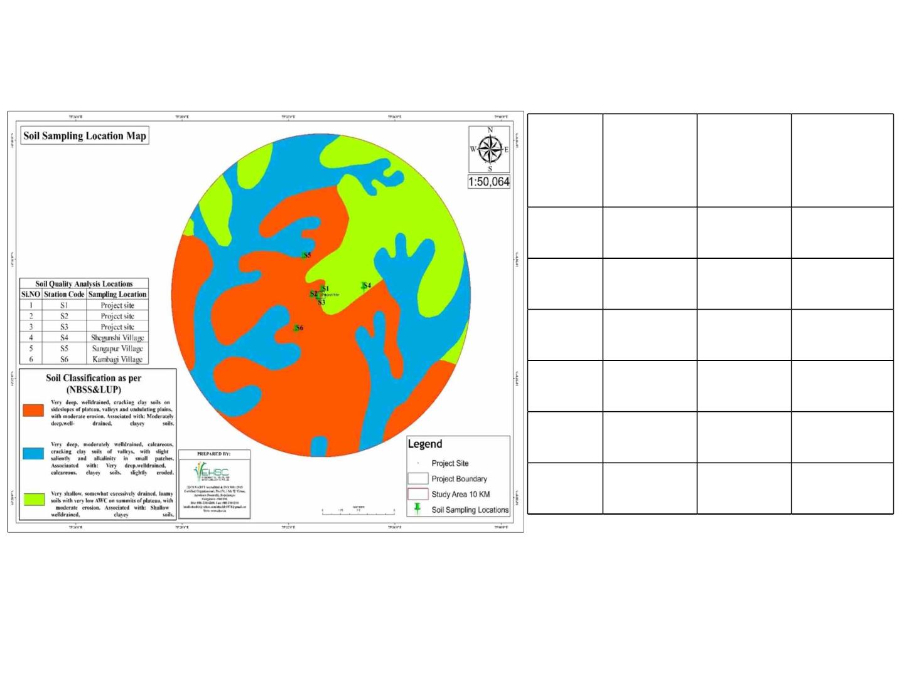
SoilꢀandꢀBiologicalꢀEnvironment
3)ꢀSoilꢀSamplingꢀꢀlocationsꢀ
Distanceꢀ
(km)ꢀandꢀ
direction
Criteriaꢀ
forꢀ
selection
Stationꢀ
no
Stationꢀ
name
S1
S2
S3
S4
S5
S6
Projectꢀ
siteꢀ(N)
-
Industrialꢀ
premisesꢀ
Projectꢀ
siteꢀ(W)
-
Projectꢀ
siteꢀ(S)
-
Shegunshi
Sangapur
Kambagiꢀ
3,ꢀNE
4.1,ꢀNW
2.65ꢀ,ꢀSW
Nearestꢀ
village
Nearestꢀ
village
Nearestꢀ
village
28

Slide 29

SoilꢀSamplingꢀResults
ꢀ
ꢀ
ꢀ
Locations
Sl.ꢀ
No
ꢀ
ꢀ
Units
-
Projectꢀsite Projectꢀsiteꢀ Projectꢀsiteꢀ Shegunshiꢀ Sangapurꢀ Kambagiꢀ
Parameters
North
West
South
Village
Loamyꢀ
Sand
Villageꢀ
Sandyꢀ
Loam
Village
1
2
Texture
Colour
Sandyꢀloamꢀ Sandyꢀloam
Clay
ClayꢀLoam
-
Brown
Greyishꢀ
Greyishꢀ
yellowꢀ
1.22
Brown
Greyꢀ
Brown
Yellow
1.31
9.6
3
4
5
6
7
8
9
BulkꢀDensity
g/cc
percent
-
1.20
13.4
8.45
216
1.34
8.64
8.12
184
1.26
11.2
8.36
216
1.18
13.4
6.74
224
MoistureꢀContent
pH
16.4
8.64
194
8.54
ElectricalꢀConductivity
MagnesiumꢀasꢀMg
CalciumꢀasꢀCa
µS/cm
meq/L
meq/L
-
232
0.8
1.6
2.4
3.6
2.9
4.0
6.2
7.1
12.8
14.2
1.52
10.47
0.36
0.62
289.6
12.95
13.7
0.94
6.28
0.30
0.51
372.5
15.54
14.8
2.60
8.48
0.24
0.41
268.60
14.24
SodiumꢀAbsorptionꢀRatio
1.62
6.98
0.18
0.31
162.8
22.01
2.71
12.88
0.12
0.20
313.45
20.72
2.76
10 Sodium
mg/100gm
Percent
Percent
Kg/ha
Kg/ha
8.98
11 OrganicꢀCarbon
12 OrganicꢀMatter
13 AvailableꢀPotassiumꢀasꢀK
AvailableꢀPhosphorousꢀasꢀ
0.18
0.31
266.4
19.42
14
P₂O₅
15 Sand
Percent
Percent
Kg/ha
74.96
15.28
9.76
66.96
21.28
11.76
9.80
45.96
23.28
35.76
17.78
122.30
1.99
46.96
45.28
7.76
74.96
15.28
9.76
42.96
25.28
31.76
11.28
263.42
2.98
16 Silt
17 Clay
18 CationꢀExchangeꢀCapacity
19 AvailableꢀNitrogen
20 Sulphur
Percent
Percent
mg/100gm
us/cm
8.76
21.08
144.25
1.42
18.22
244.60
1.35
103.48
1.77
131.71
1.84
21 SoilꢀSalinity
22 Boron
195
184
210
172
194
202
mg/100gm
ug/gm
0.34
0.32
0.34
0.39
0.87
0.78
29
23 Hexavalent
BDL
BDL
BDL
BDL
BDL
BDL

Slide 30

24 Porosityꢀ
Percent
Mg/kg
Mg/kg
Mg/kgꢀ
Mg/kg
Mg/kg
Mg/kg
Mg/kg
45.45
4.44
39.81
8.44
25.92
11.05
0.06
36.19
3.18
45.21
4.87
34.44
6.54
25 IronꢀasꢀFe
26 LeadꢀasꢀPb
0.051
0.336
BDL
10.47
0.153
1.49
0.081
4.47
0.042
0.417
BDL
8.68
0.147
1.03
0.171
0.978
0.015
21.00
0.447
4.64
27 ZincꢀasꢀZn
0.405
BDL
11.09
0.216
2.77
28 TotalꢀChromium
29 MagnesiumꢀAsꢀMn
30 NickelꢀasꢀNi
31 CopperꢀasꢀCu
BDL
14.47
0.357
2.34
BDL
21.32
0.42
0.141
1.55
4.55
Fromꢀ theꢀ overallꢀ resultsꢀ ofꢀ physico-chemicalꢀ analysisꢀ ofꢀ theꢀ soilꢀ samples,ꢀ itꢀ isꢀ
noticedꢀthatꢀMaximumꢀ&ꢀminimumꢀpHꢀisꢀꢀ8.64ꢀandꢀ6.74.ꢀMaximumꢀECꢀwasꢀ232ꢀ
µS/cmꢀ andꢀ minimumꢀ isꢀ ꢀ 194ꢀ µS/cm.ꢀ Maximumꢀ andꢀ maximumꢀ ofꢀ Nꢀ isꢀ 263.42%ꢀ
andꢀ103.48.ꢀMaximumꢀvalueꢀofꢀZnꢀisꢀ1.03ꢀmg/kgꢀandꢀminimumꢀvalueꢀ0.336mg/kg.ꢀ
MaximumꢀvalueꢀofꢀMnꢀisꢀ21.32ꢀmg/kgꢀandꢀminimumꢀisꢀ8.68ꢀmg/kg.
SoilꢀTypesꢀinꢀtheꢀStudyꢀarea
• Theꢀ soilsꢀ inꢀ theꢀ studyꢀ areaꢀ rangesꢀ fromꢀ veryꢀ shallowꢀ excessivelyꢀ drainedꢀ gravellyꢀ
loamꢀ toꢀ clayeyꢀ soilsꢀ withꢀ lowꢀ moistureꢀ holdingꢀ capacityꢀ toꢀ veryꢀ deep,ꢀ wellꢀ drainedꢀ
clayꢀloamꢀtoꢀclayꢀblackꢀsoilsꢀwithꢀmoderateꢀtoꢀsevereꢀsheetꢀerosion.ꢀ
• Theꢀ upperꢀ portionꢀ ofꢀ theꢀ areaꢀ isꢀ shallowꢀ clayꢀ loamꢀ toꢀ clayꢀ andꢀ smallꢀ patchꢀ ofꢀ valleyꢀ
soilsꢀareꢀveryꢀdeepꢀblackꢀclayeyꢀwithꢀcalciumꢀconcretions.ꢀ
• Theꢀdrainageꢀpatternꢀisꢀofꢀradialꢀpatternꢀandꢀdrainsꢀinꢀallꢀdirectionsꢀandꢀmajorꢀslopeꢀisꢀ
towardsꢀEastꢀfromꢀNorthꢀWestꢀandꢀsouthꢀwest
30

Slide 31
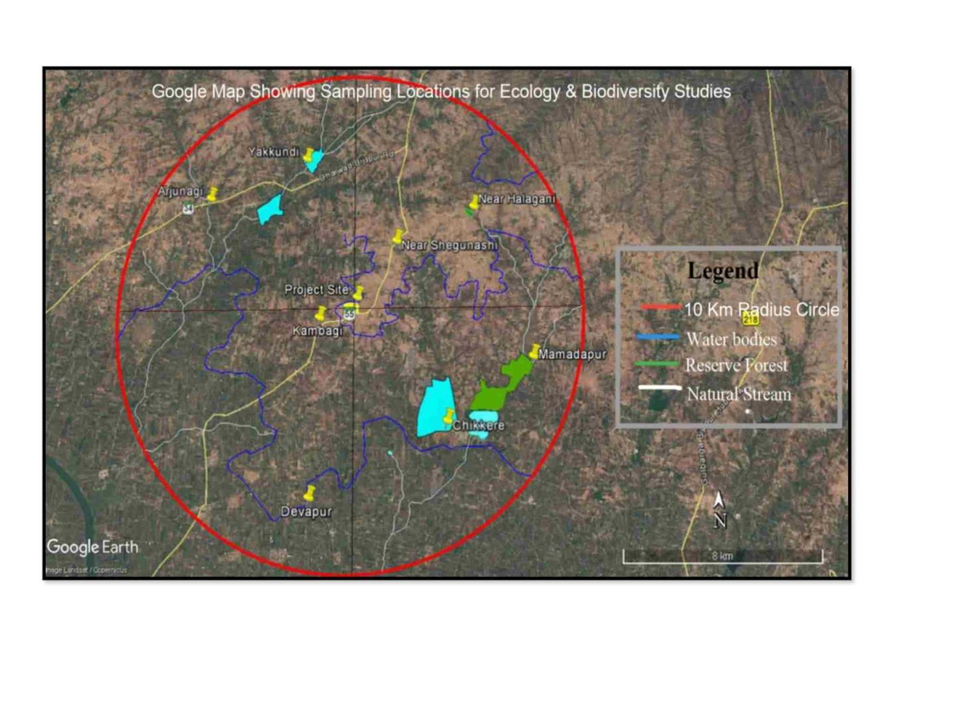
EcologyꢀandꢀBiodiversityꢀstudyꢀarea
31

Slide 32
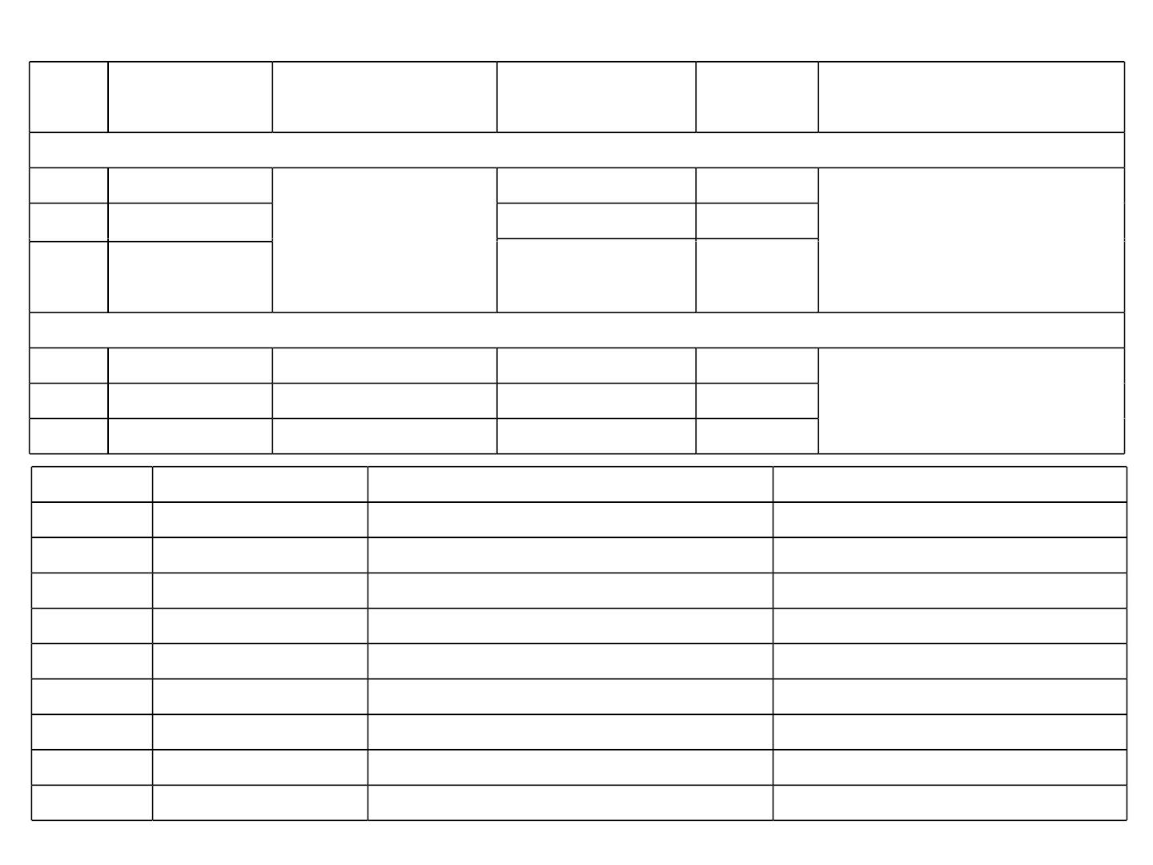
DetailsꢀofꢀEcologyꢀandꢀBiodiversityꢀStudyꢀArea
Sl.ꢀ
No.
Flora
1
Sizeꢀofꢀtheꢀ
Timeꢀandꢀdurationꢀofꢀ
sampling
Habitat
Method
Number
quadrateꢀ(m)
Trees
Shrubs
100ꢀxꢀ100
50ꢀxꢀ50
9
9
Aprilꢀ 2021ꢀ (Pre-monsoonꢀ
season-oneꢀ timeꢀ dataꢀ
collection)
2
Quadrateꢀmethod
Herbsꢀandꢀ
Grass
5ꢀxꢀ5
9
3
Fauna
1
2
3
Fauna
Transectꢀmethod
Transectꢀmethod
Pointꢀcountꢀmethod
1000
1000
--
9
9
9
Aprilꢀ 2021ꢀ ꢀ (Pre-monsoonꢀ
season-oneꢀ timeꢀ dataꢀ
collection)
Butterflies
Avi-fauna
Sl.ꢀNo.
Location
Geographicalꢀcoordinates
16°34'42.7"N,ꢀ75°33'12“ꢀE
16°36'7.4"N,ꢀ75°34'12.9"E
16°36'30.4"N,ꢀ75°36'31.6"E
16°33'35.5"N,ꢀ75°37'28.02"E
16°32'25.0"N,ꢀ75°35'34.2"E
16°37'55.2"N,ꢀ75°29'32.5"E
16°38'06.0"N,ꢀ75°31'55.2"E
16°30'40.2"Nꢀ,ꢀ75°31'52.2"E
16°34'24.5"Nꢀ,ꢀ75°32'23.5"E
Samplingꢀcriteria
1
2
3
4
5
6
7
8
9
Projectꢀsite
ImpactꢀZone
NearꢀShegunashi
HalaganiꢀVillage
Mamadapur
Chikkere
AgriculturalꢀLand
AgriculturalꢀLand
ReserveꢀForest
Waterꢀbodyꢀ(Lake)
Stream
Arjunagi
Yakkundiꢀ
Waterꢀbodyꢀ(CheckꢀDam)
Agricultureꢀland
AgriculturalꢀLand
Devapur
KambagiꢀVillage
32

Slide 33
BiologicalꢀEnvironmentꢀInterpretation
• Theꢀ projectꢀ areaꢀ isꢀ predominantlyꢀ surroundedꢀ byꢀ agriculturalꢀ landsꢀ inꢀ allꢀ directionꢀ
throughoutꢀtheꢀ10ꢀkmꢀradius.ꢀ
• Therefore,ꢀtoꢀunderstandꢀtheꢀEcologicalꢀStatusꢀofꢀtheꢀstudyꢀarea,ꢀtheꢀentireꢀstudyꢀareaꢀisꢀ
dividedꢀintoꢀfourꢀquartilesꢀi.e.,ꢀNW,ꢀNE,ꢀSEꢀandꢀSW.
• Theꢀprojectꢀsiteꢀconsistsꢀofꢀ4ꢀspeciesꢀ(n=8)ꢀandꢀallꢀtheꢀtreesꢀwillꢀbeꢀretainedꢀandꢀhenceꢀ
thereꢀwillꢀbeꢀnoꢀremovalꢀofꢀtrees.
• Prosopisꢀjulifloraꢀ(Sw.)ꢀDCꢀandꢀVachelliaꢀniloticaꢀ(Brenan)ꢀKyal.ꢀ&ꢀBoatwrꢀareꢀsomeꢀofꢀ
theꢀcommonꢀspeciesꢀrecordedꢀinꢀtheꢀprojectꢀsiteꢀandꢀstudyꢀarea.ꢀ
• Thereꢀisꢀnoꢀprotectedꢀareaꢀandꢀwildlifeꢀcorridorꢀnearꢀtheꢀprojectꢀsite.ꢀ
• Aꢀvideꢀvariantꢀbirdsꢀandꢀbutterflyꢀspeciesꢀareꢀrecordedꢀinꢀtheꢀprojectꢀsiteꢀandꢀstudyꢀandꢀ
butterfliesꢀareꢀabsentꢀinꢀtheꢀprojectꢀsite.ꢀ
• IndianꢀpeafowlꢀwasꢀrecordedꢀinꢀtheꢀprojectꢀsiteꢀandꢀBlackꢀKiteꢀ&ꢀBlack-shoulderedꢀkiteꢀ
recordedꢀinꢀstudyꢀareaꢀfallsꢀunderꢀscheduleꢀIꢀasꢀperꢀtheꢀWildlifeꢀ(Protection)ꢀAct,ꢀ1972.
• Aꢀ treeꢀ withꢀ greaterꢀ IVIꢀ valuesꢀ includesꢀ Azadirachtaꢀ indicaꢀA.Jussꢀ (IVI-ꢀ 105.743),ꢀ
Eucalyptusꢀ tereticornisꢀ L.ꢀ (IVI-ꢀ 72.455)ꢀ andꢀ Cassiaꢀ siameaꢀ Lamꢀ K.ꢀ(IVI-ꢀ 27.936)ꢀ withꢀ
theꢀleastꢀoneꢀbeingꢀDalbergiaꢀlatifoliaꢀRoxb,ꢀ(IVI-ꢀ7.306).ꢀ
• Inꢀ additionꢀ toꢀ these,ꢀ diversityꢀ indicesꢀ suchꢀ asꢀ Shannon-Weinerꢀdiversityꢀ indexꢀ wereꢀ
calculated,ꢀ whichꢀ isꢀ usedꢀ toꢀ characterizeꢀ theꢀ speciesꢀ diversityꢀ inꢀ aꢀ communityꢀ takingꢀ
intoꢀ accountꢀ bothꢀ evennessꢀ andꢀ abundanceꢀ ofꢀ theꢀ speciesꢀ present.ꢀ Shannon-Weinerꢀ
diversityꢀinꢀstudyꢀareaꢀwasꢀestimatedꢀtoꢀbeꢀ1.698.ꢀSimpson’sꢀIndexꢀofꢀdiversityꢀinꢀstudyꢀ
areaꢀwasꢀestimatedꢀtoꢀbeꢀ0.771ꢀwhichꢀshowsꢀtheꢀgreaterꢀdiversityꢀinꢀtheꢀstudyꢀarea.
33

Slide 34
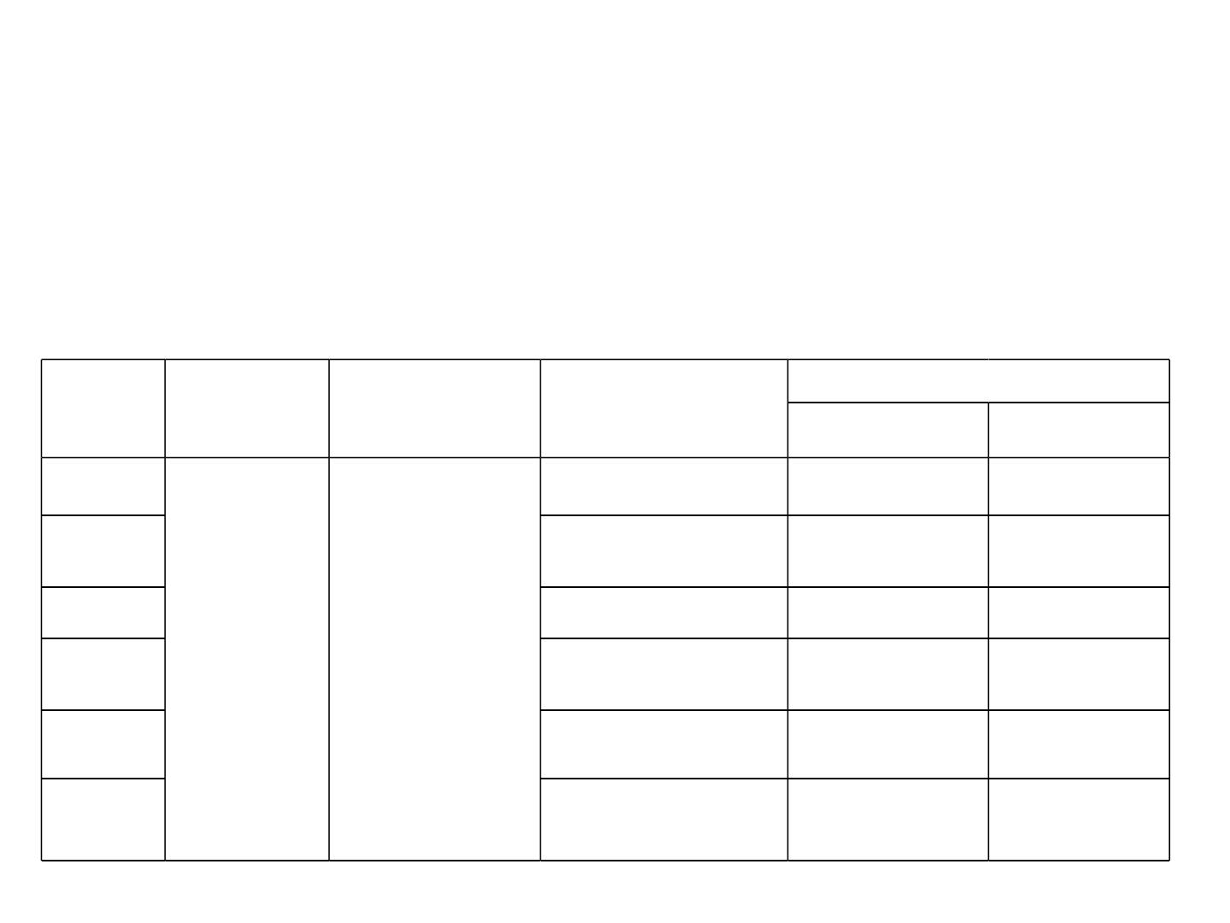
SocialꢀEnvironment
Aꢀmicroꢀlevelꢀassessmentꢀofꢀtheꢀsocio-economicꢀenvironmentꢀobtainingꢀinꢀtheꢀprojectꢀ
impactꢀ areaꢀ (comprisingꢀ villagesꢀ andꢀ habitationsꢀ withinꢀ 10ꢀ kmꢀ radialꢀ distanceꢀ fromꢀ
proposedꢀproject)ꢀwasꢀmadeꢀthroughꢀfieldꢀsurveyꢀofꢀ62ꢀhouseholdsꢀselectedꢀrandomlyꢀ
acrossꢀ6ꢀsampleꢀvillagesꢀfromꢀtheꢀ14ꢀvillagesꢀwithinꢀ10ꢀkmꢀradiusꢀconsistsꢀofꢀ42%ꢀofꢀ
studyꢀarea.ꢀ
Locationꢀfromꢀsiteꢀ
Sl.ꢀNo.
Districtꢀ
Taluk
VillageꢀName
Directions
Distance/Km
1
2
3
4
Kambagi
Madagunaki
Halagani
West
2.7ꢀKM
SouthꢀWest
East
3.5ꢀKM
5.8ꢀKM
3.0ꢀKM
Vijayapura Babaleshawra
Shegunashi
SouthꢀEast
5
Mamadapur
Nandyal
SouthꢀWest
NorthꢀWest
6.8ꢀKM
6.6ꢀKM
6
34

Slide 35
Social Environment
ReportꢀonꢀCollectionꢀofꢀPrimaryꢀ&ꢀSecondaryꢀData
• Theꢀ methodologyꢀ adoptedꢀ forꢀ theꢀ studyꢀ mainlyꢀ includesꢀ reviewꢀ ofꢀ publishedꢀ
secondaryꢀdataꢀandꢀcollectionꢀofꢀprimaryꢀdataꢀthroughꢀfieldꢀsurveys.
ꢀ
• Theꢀ macroꢀ levelꢀ baselineꢀ socio-economicꢀ environmentꢀ assessmentꢀ focusingꢀ onꢀ
demographics,ꢀ livelihoodsꢀ andꢀ infrastructureꢀ facilitiesꢀ availableꢀ inꢀ theꢀ studyꢀ regionꢀ
wasꢀmadeꢀwithꢀtheꢀhelpꢀofꢀreviewꢀofꢀsecondaryꢀdata,ꢀbothꢀpublishedꢀandꢀunpublished.ꢀ
• Aꢀmicroꢀlevelꢀassessmentꢀofꢀtheꢀsocio-economicꢀenvironmentꢀobtainingꢀinꢀtheꢀprojectꢀ
impactꢀ areaꢀ (comprisingꢀ villagesꢀ andꢀ habitationsꢀ withinꢀ 10ꢀ kmꢀ radialꢀ distanceꢀ fromꢀ
proposedꢀproject)ꢀwasꢀmadeꢀthroughꢀfieldꢀsurveyꢀofꢀ62ꢀhouseholdsꢀselectedꢀrandomlyꢀ
acrossꢀ6ꢀsampleꢀvillagesꢀfromꢀtheꢀ14ꢀvillagesꢀwithinꢀ10ꢀkmꢀradiusꢀconsistsꢀofꢀ42%ꢀofꢀ
studyꢀarea.ꢀ
• Theꢀ focusꢀ ofꢀ microꢀ levelꢀ assessmentꢀ wasꢀ onꢀ understandingꢀ theꢀ socio-economicꢀ
conditionsꢀ ofꢀ theꢀ respondentsꢀ inꢀ termsꢀ ofꢀ familyꢀ size,ꢀ livelihoodsꢀ pursued,ꢀ incomeꢀ
andꢀexpenditureꢀpatterns,ꢀhousingꢀconditions,ꢀeducationꢀandꢀhealthꢀstatus.ꢀ
• Inꢀ addition,ꢀ perceivedꢀ impactsꢀ ofꢀ theꢀ project,ꢀ bothꢀ positiveꢀ andꢀ negative,ꢀ wereꢀ
gatheredꢀduringꢀhouseholdꢀsurveysꢀandꢀin-depthꢀdiscussionsꢀwithꢀkeyꢀinformants
35

Slide 36
IdentificationꢀofꢀꢀSocialꢀRequirementꢀbasedꢀonꢀinterviewꢀ&ꢀdiscussionsꢀwithꢀtheꢀ
residentꢀofꢀtheꢀstudyꢀareaꢀ
Duringꢀ theꢀ focusꢀ groupꢀ discussions,ꢀ itꢀ wasꢀ revealedꢀ thatꢀ nearlyꢀ 95%ꢀ ofꢀ theꢀ respondentsꢀ
areꢀ awareꢀ ofꢀ theꢀ proposedꢀ projectꢀ andꢀ feelꢀ thatꢀ industrialꢀ developmentꢀ isꢀ necessaryꢀ forꢀ
employmentꢀ generation,ꢀ especiallyꢀ forꢀ theꢀ currentꢀ andꢀ futureꢀ generationsꢀ inꢀ theꢀ area.ꢀ
Developmentꢀ plannedꢀ projectsꢀ areꢀ necessaryꢀ toꢀ upliftꢀ standardꢀ ofꢀ livingꢀ ofꢀ theꢀ people,ꢀ
revivesꢀeconomiesꢀandꢀalleviateꢀpoverty.ꢀꢀWithꢀrisingꢀliteracyꢀlevelsꢀandꢀawarenessꢀaboutꢀ
growingꢀ opportunities,ꢀ theꢀ youthꢀ inꢀ theꢀ areaꢀ areꢀ focusedꢀ moreꢀ onꢀ non-farmꢀ sectorꢀ andꢀ
serviceꢀsectorꢀemployment.ꢀThereꢀareꢀhoweverꢀapprehensiveꢀaboutꢀtheꢀnegativeꢀimpactsꢀ
ofꢀindustrialꢀdevelopment.ꢀꢀTheꢀperceptionsꢀofꢀtheꢀrespondentsꢀinꢀsurroundingꢀareasꢀareꢀ
summarizedꢀasꢀfollows:
• Industrialꢀgrowthꢀinꢀtheꢀregionꢀhasꢀsignificantlyꢀsupportedꢀtheꢀsustainableꢀlivelihoodsꢀ
inꢀtheꢀareaꢀespeciallyꢀforꢀskilledꢀandꢀsemi-skilledꢀpersons.
• Developmentꢀofꢀtheꢀsecondaryꢀsectorꢀinꢀtheꢀareaꢀhasꢀpositivelyꢀcontributedꢀtoꢀinducedꢀ
developmentꢀ leadingꢀ toꢀ creationꢀ ofꢀ multiplierꢀ selfꢀ andꢀ wageꢀ employmentꢀ
opportunities.
• Itꢀwouldꢀhelpꢀfurtherꢀstrengthenꢀinfrastructureꢀdevelopmentꢀinꢀtheꢀarea.
• Itꢀmayꢀaggravateꢀairꢀpollutionꢀthroughꢀreleaseꢀofꢀobnoxiousꢀgasesꢀandꢀodors.
36

Slide 37

Risk Studies & Disaster Management
HazardousꢀSubstances
ListꢀofꢀHazardousꢀsubstancesꢀandꢀquantityꢀstoredꢀareꢀasꢀfollows;
Storageꢀ
quantityꢀ
/month
Explosiveꢀ
NFPA
Sl.ꢀno
Nameꢀofꢀtheꢀ
Typeꢀofꢀ
State
Hazardꢀ
category
Flashꢀ
limit
Acuteꢀtoxicity
Exposureꢀlimit
chemicalꢀused
container
pointꢀ°C LELꢀ UELꢀ
H
F
R
SH
%
%
1
2
Urea
15000ꢀKgs
2500ꢀKgs
Bags
Bags
Solid
Solid
NIL
NA
NA
NA
NA
LD50ꢀOralꢀ-ꢀ
8,471mg/kgꢀ
-
-
-
-
-
Sodiumꢀ
Corrosive,ꢀ
irritant
TWA:ꢀ2ꢀ
(mg/m3)ꢀfromꢀ
OSHAꢀ(PEL)
TWA:ꢀ5ꢀ
hydroxide
NA
NA
NA
NA
NA
NA
NA
NA
NA
NA
3
2
3
2
0
1
0
2
-
-
0
-
Calciumꢀ
Bags,ꢀ25ꢀ
kg
ORALꢀLDꢀ50,ꢀꢀ
7340ꢀmg/kg
3
4
5
6
hydroxide
7500ꢀKgs
2000ꢀlitres
5400
Solid
Liquid
Solids
Liquid
Irritant
NA
NA
NA
NA
(mg/m3)ꢀfromꢀ
ACGIH(TLV)
TWA:ꢀ2ꢀ
0
0
-
Sulphuricꢀ
acid
Barrel
Bags
Corrosive,ꢀ
irritant
NA
(mg/m3)ꢀfromꢀ
OSHAꢀ(PEL)
Diꢀ-
LD50ꢀꢀ=ꢀ6500ꢀ TWA-10mg/m^{3ꢀ}
mg/kgꢀꢀ fromꢀACGIH
Ammoniumꢀ
phoshphate
Irritant
-
Hydrochloricꢀ
acid
Irritant,ꢀ
LD50:ꢀ 900ꢀ 5ꢀ(ppm)ꢀfromꢀ
1500ꢀLtr
Barrel
corrosive
NA mg/kg;ꢀꢀLC50:ꢀ OSHAꢀ(PEL)
1108ꢀppm,ꢀꢀꢀ
3
3
0
-
1
1
0
-
7
8
Causticꢀlye
Yeastꢀculture
Antifoam
15000ꢀKg
2000ꢀkgs
Bags
Solid
Liquid
Liquid
Irritant
Irritant
Irritant
NA
NA
NA
16.6
NA
NA
NA
3.3
NA
NA
NA
19
LD50ꢀ=ꢀ6600ꢀ
2ꢀmg/m3ꢀTWA
Notꢀestablished -
mg/kg
Notꢀ
Barrel
-
-
-
-
established
LD50-1700ꢀ
mg/kg
9
1000ꢀkg
Containe
r/Barrel
Storageꢀ
tank
-
-
-
-
10
Ethanol/ENA
/RS
9000ꢀKLꢀx9
Liquid Flammable
LD50ꢀ=ꢀ>90ꢀ
mL/kg;
1000ꢀppmꢀ
TWA
2
3
-
-₃₇

Slide 38
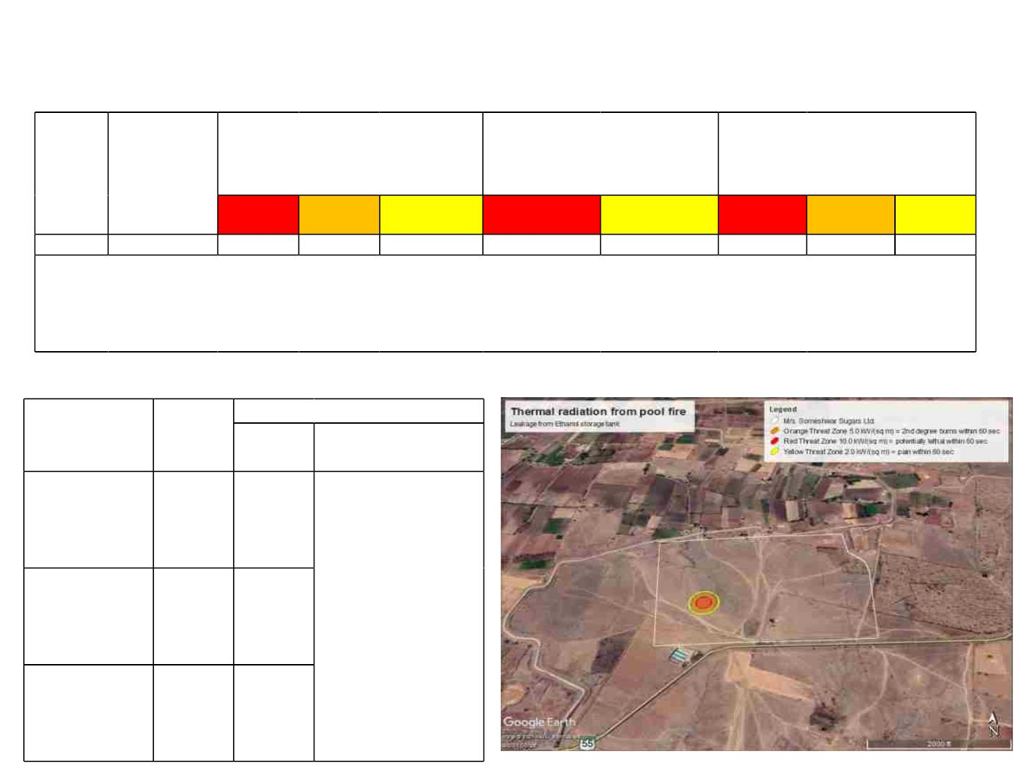
AssumptionꢀofꢀWorstꢀcaseꢀscenarioꢀ
Summaryꢀofꢀdifferentꢀcredibleꢀaccidentꢀscenariosꢀforꢀpredictionꢀofꢀriskꢀ
*SCENARIOꢀB
SCENARIOꢀA
ToxicꢀThreatꢀZone,ꢀm
Flammableꢀareaꢀofꢀvaporꢀ
cloud
*SCENARIOꢀC
ThermalꢀRadiationꢀfrom
Poolꢀfire,ꢀm
Sl.No
Hazardous
Chemicals
poolꢀfire,ꢀm
Red
Orange Yellow
Red
Yellow
Red
Orange Yellow
1
Ethanol
<10
51
70
44
72
30
37
50
*THERMALꢀRADIATIONꢀINTENSITY
Red:ꢀ10ꢀkW/sq.m.ꢀ(Potentiallyꢀlethalꢀwithinꢀ60ꢀsec)
Orange:ꢀ5.0ꢀkW/sq.ꢀm.ꢀ(2ndꢀDegreeꢀburnꢀwithinꢀ60ꢀsec)
Yellow:ꢀ2.0ꢀkW/sq.ꢀm.ꢀ(Painꢀwithinꢀ60ꢀsec)
Modelꢀoutputꢀofꢀtheꢀthreatꢀzoneꢀofꢀthermalꢀradiationꢀfromꢀpoolꢀfireꢀ
Flammableꢀ
threatꢀzone
LOC,ꢀ
kW/sq.ꢀ Distanc
ModelꢀOutcome
m.
eꢀ(m)
remarks
Maximumꢀ
distanceꢀ
Redꢀ
(Potentiallyꢀ
Lethalꢀwithinꢀ
60ꢀsec.)
10
30
ofꢀ
thermalꢀ radiationꢀ
@10kW/sq.mꢀ
Orangeꢀ(2ndꢀ
Degreeꢀburnꢀ
withinꢀ60ꢀ
sec.)
fromꢀ poolꢀ fireꢀ isꢀ
30m,ꢀ whereꢀ theꢀ
personnelꢀ exposeꢀ ꢀ
toꢀ thisꢀ radiationꢀ atꢀ
5
2
37
50
Yellowꢀ(Painꢀ
withinꢀ60ꢀ
sec.)
10ꢀ
kW/sq.mꢀ
withinꢀtheꢀdistanceꢀ
ofꢀ 30ꢀ mꢀ couldꢀ beꢀ
potentialꢀlethal.ꢀ
38

Slide 39

RiskꢀAssessmentꢀandꢀMitigationꢀMeasures
Activityꢀ
Hazardꢀdescription
Controlꢀmeasures
Vehicleꢀ
Speedꢀlimitꢀshallꢀbeꢀmaintained.
Authorizedꢀpersonsꢀwithꢀvalidꢀdrivingꢀlicenseꢀshallꢀbeꢀallowedꢀtoꢀdrive.
Cautionꢀsignagesꢀshallꢀbeꢀdisplayed
movementsꢀforꢀ
rawꢀmaterialꢀ
transportation
Hitꢀhazardꢀbyꢀvehicles
Millingꢀprocess
Injuryꢀtoꢀbodyꢀpartsꢀdueꢀtoꢀ
rotatingꢀpartsꢀofꢀtheꢀmachine
Noiseꢀemission
Respiratoryꢀorgansꢀdamageꢀ
dueꢀtoꢀexposureꢀtoꢀdust
Injuryꢀtoꢀbodyꢀpartsꢀdueꢀtoꢀ
nipꢀpoints
Provisionꢀofꢀmachineꢀguarding,ꢀtrainedꢀpersonꢀdeployment
Useꢀofꢀearꢀmuffs
Useꢀofꢀmask
Crushingꢀ
machineꢀ
operation
Machineꢀguarding,ꢀtrainedꢀoperatorꢀdeployment
Injuryꢀtoꢀbodyꢀpartsꢀdueꢀtoꢀ
contactꢀwithꢀmovingꢀ
conveyerꢀbelt
Fallꢀfromꢀtheꢀheightꢀduringꢀ
workꢀonꢀconveyerꢀbelt,
Conveyorꢀ
operation
Safetyꢀguardꢀshallꢀbeꢀprovidedꢀonꢀallꢀmovingꢀandꢀrotatingꢀpartsꢀofꢀtheꢀconveyor
Safetyꢀbelt,ꢀꢀdeployingꢀtrainedꢀperson
Fermentationꢀ
processꢀinꢀ
fermenterꢀvessel
ExplosionꢀdueꢀtoꢀExothermicꢀ
reactions
ProperꢀVentilationꢀshallꢀbeꢀensuredꢀinꢀarea,ꢀꢀProvisionꢀofꢀpressureꢀindicatorsꢀinꢀ
theꢀvessels,ꢀꢀUseꢀofꢀPPE,ꢀInspectionꢀ&ꢀregularꢀmonitoring,ꢀTrainingꢀtoꢀworkersꢀ
onꢀsafeꢀprocedureꢀofꢀvesselꢀoperationsꢀshallꢀbeꢀprovided
^{Co}2^{ꢀliberationꢀ}
Gasꢀdetectionꢀandꢀmonitoringꢀequipmentꢀwillꢀbeꢀinstalled.ꢀPeriodicꢀmaintenanceꢀ
willꢀbeꢀdoneꢀforꢀleakꢀpreventionꢀandꢀdetection.ꢀSCBAꢀ(Self-containedꢀBreathingꢀ
apparatus)ꢀwillꢀbeꢀusedꢀduringꢀemergency.
duringꢀtheꢀ
Asphyxiationꢀhazards
processꢀofꢀꢀ
Fermentation
Addingꢀyeast,ꢀ
enzymesꢀforꢀ
Fermentation
Respiratoryꢀillnessꢀandꢀ
allergicꢀreactionsꢀdueꢀ
Exposureꢀtoꢀenzymes
Damageꢀtoꢀskinꢀdueꢀtoꢀuseꢀifꢀ
corrosiveꢀchemicals
Respiratoryꢀmaskꢀwillꢀbeꢀprovided.
Safetyꢀgloves,ꢀgoggles,ꢀapronsꢀwillꢀbeꢀused
Handlingꢀofꢀ
molassesꢀinꢀ
storageꢀtank
Spillages/ꢀ
molassesꢀ dueꢀ toꢀ breakageꢀ ofꢀ stabilityꢀshallꢀbeꢀcarriedꢀout.
vessels. Dykeꢀwallsꢀshallꢀbeꢀprovided.
leakagesꢀ
ofꢀ Properꢀ maintenanceꢀ ofꢀ storageꢀ tank,ꢀ ꢀ periodicallyꢀ inspectionꢀ andꢀ structuralꢀ
39

Slide 40

Activityꢀ
Operationꢀofꢀblowers
Hazardꢀdescription
Noiseꢀemission
Controlꢀmeasures
Useꢀofꢀearꢀmuffs
Handlingꢀofꢀchemicalsꢀinꢀ ChemicalꢀburnꢀbyꢀSpillageꢀofꢀsulphuricꢀacidꢀandꢀ Safetyꢀgloves,ꢀgoggles,ꢀAprons,ꢀSafetyꢀshowerꢀ
process
causticꢀsodaꢀlyeꢀduringꢀhandling
shallꢀbeꢀensured
Useꢀofꢀchemicalsꢀinꢀ
qualityꢀtestingꢀlaboratoriesꢀ
andꢀETPꢀlab
IrritantꢀinꢀcaseꢀofꢀinhalationꢀCorrosiveꢀtoꢀskinꢀandꢀ
eyesꢀonꢀcontact
Splashꢀproofꢀꢀgoggles,ꢀaprons,ꢀorganicꢀvapourꢀ
respirator,ꢀsafetyꢀshoesꢀandꢀglovesꢀshallꢀꢀbeꢀ
provided
Distillationꢀarea
Facilityꢀ shallꢀ beꢀ designedꢀ consideringꢀ theꢀ ꢀ
Fireꢀ hazardꢀ dueꢀ toꢀ Uncontrolledꢀ ignitionꢀ source,ꢀ Electricalꢀratingꢀforꢀhazardousꢀarea,
Columnꢀfailure,
Fireꢀ detectionꢀ system,ꢀ Fireꢀ suppression,ꢀ
.Pipelineꢀfailure,
ꢀ
sprinklerꢀsystem.
Operatorsꢀ presentꢀ onsite,ꢀ Controlꢀ ofꢀ ignitionꢀ
sources,ꢀAbilityꢀtoꢀisolateꢀtheꢀfeed.
Explosionꢀhazardꢀdueꢀtoꢀoverꢀpressure
Pressureꢀreliefꢀvalveꢀshallꢀꢀbeꢀprovided
Fireꢀ hazardꢀ fromꢀ theꢀ releaseꢀ ofꢀ ethanolꢀ vapourꢀ
fromꢀtheꢀlines
Preventiveꢀmaintenanceꢀofꢀtheꢀpipeꢀlineꢀwillꢀbeꢀ
carriedꢀ out.ꢀ Leakꢀ detectionꢀ measuresꢀ shallꢀ beꢀ
carriedꢀoutꢀperiodically.
Handlingꢀofꢀreceiverꢀ
tanksꢀꢀtoꢀcollectꢀdistilledꢀ
spirit
Transferringꢀ operationꢀ isꢀ doneꢀ underꢀ
supervisionꢀofꢀtrainedꢀoperator
Adequateꢀ sizeꢀ ofꢀ receiverꢀ tankꢀ shallꢀ beꢀ
ensuringꢀ theꢀ spillagesꢀ withꢀ containmentꢀ
measuresꢀinꢀplace.
Spillageꢀofꢀdistilledꢀspirit
Transferringꢀ pumpsꢀ shallꢀ beꢀ interlockedꢀ withꢀ
receiverꢀtankꢀlevel.
Spillꢀabsorbentꢀpadsꢀshallꢀbeꢀprovided.
Properꢀ earthingꢀ andꢀ bondingꢀ systemꢀ shallꢀ beꢀ
doneꢀtoꢀpreventꢀstaticꢀelectricityꢀbuild-up.
Flameproofꢀelectricꢀequipmentꢀshallꢀbeꢀusedꢀinꢀ
theꢀ areaꢀ drocarbonꢀ sensors/detectorsꢀ shallꢀ beꢀ
installedꢀ asꢀ perꢀ needꢀ toꢀ warnꢀ inꢀ caseꢀ ofꢀ
leakages.
Fireꢀhazard
40

Slide 41

Activityꢀ
Hazardꢀdescription
Controlꢀmeasures
Boilerꢀoperation
Level/Temperatureꢀ Indicatorsꢀ areꢀ checkedꢀ andꢀ
loggedꢀregularlyꢀforꢀproperꢀfunctioning.
Explosionꢀdueꢀtoꢀexceedꢀinꢀsteamꢀpressureꢀ Pressureꢀ gaugesꢀ shallꢀ calibratedꢀ periodically,ꢀ
andꢀ temperature;ꢀ failureꢀ inꢀ waterꢀ levelꢀ Pressureꢀ reliefꢀ valveꢀ shallꢀ beꢀ providedꢀ andꢀ
controller
maintained.
Periodicalꢀcheckingꢀ&ꢀinspectionꢀshallꢀbeꢀcarriedꢀ
outꢀfromꢀtheꢀcompetentꢀperson.
Burnꢀinjuryꢀdueꢀtoꢀhotꢀwaterꢀandꢀhotꢀsteamꢀ Periodicꢀ inspectionꢀ ofꢀ pipelineꢀ forꢀ leakꢀ test,ꢀ useꢀ
pipelineꢀleakage
ofꢀpersonalꢀprotectionꢀequipment
Housekeepingꢀpracticeꢀshallꢀbeꢀstrictlyꢀfollowed,ꢀ
conveyorsꢀ andꢀ transferꢀ points,ꢀ shallꢀ beꢀ covered,ꢀ
Adequateꢀventilationꢀshallꢀbeꢀensured,ꢀprovisionꢀ
ofꢀ personalꢀ protectiveꢀ equipmentꢀ suchꢀ asꢀ faceꢀ
maskꢀandꢀgogglesꢀshallꢀbeꢀmade.
Exposureꢀtoꢀbagasseꢀdust
Exposureꢀ toꢀ warmꢀ temperatureꢀ inꢀ boilerꢀ Heatꢀresistantꢀglovesꢀandꢀprotectiveꢀsuitsꢀshallꢀbeꢀ
area used.
Fallꢀ fromꢀ heightꢀ areasꢀ stairsꢀ ꢀ andꢀ elevatedꢀ Handrailꢀprovisionꢀshallꢀbeꢀmadeꢀtoꢀallꢀtheꢀstairsꢀ
platforms
andꢀelevatedꢀplatforms.
Exposureꢀtoꢀnoiseꢀlevel
Earꢀmuffꢀshallꢀbeꢀprovidedꢀtoꢀtheꢀboilerꢀoperators
Generatorꢀ andꢀ turbineꢀ
operation
Highꢀnoiseꢀlevel
Useꢀofꢀearꢀplugs
Automaticꢀfireꢀsuppressionꢀsystemꢀshallꢀbeꢀmadeꢀ
available,ꢀ regularꢀ inspection,ꢀ maintenanceꢀ
authorizedꢀ entryꢀ access,ꢀ sandꢀ buckets,ꢀ andꢀ fireꢀ
extinguishersꢀ shallꢀ beꢀ providingꢀ inꢀ appropriateꢀ
place.
Fireꢀinꢀtransformerꢀyard
Electricꢀshockꢀandꢀburnꢀhazard
Trainedꢀ personꢀ deploymentꢀ andꢀ electricalꢀ safetyꢀ
PPEꢀwillꢀbeꢀprovided
Slipꢀ ,ꢀ tripꢀ andꢀ fromꢀ theꢀ heightꢀ duringꢀ Safetyꢀbelt,ꢀsafetyꢀharnessꢀwillꢀbeꢀprovided,
routineꢀwork,ꢀmaintenanceꢀonꢀswitchꢀyard Training
41

Slide 42
DetailsꢀofꢀOnsiteꢀꢀMitigationꢀMeasures/DMP
• Whenꢀ theꢀ incidentꢀ isꢀ observedꢀ byꢀ anyꢀ personꢀ inꢀ theꢀ plant,ꢀ shiftꢀ in-chargeꢀ willꢀ beꢀ informedꢀ
immediatelyꢀtoꢀtakeꢀtheꢀcontrolꢀofꢀtheꢀsituation.ꢀIfꢀtheꢀsituationꢀgoꢀbeyondꢀtheꢀcontrol,ꢀthenꢀ
theꢀshiftꢀin-chargeꢀisꢀresponsibleꢀtoꢀinformꢀtheꢀcrisisꢀmanagementꢀresponsibleꢀpersonsꢀwhichꢀ
consistsꢀ ofꢀ Incidentꢀ Controllerꢀ (IC),ꢀ Siteꢀ Controllerꢀ (SC)ꢀ andꢀ supportingꢀ teamsꢀ suchꢀ asꢀ fireꢀ
fighters,ꢀ firstꢀ aiders,ꢀ rescueꢀ team,ꢀ electriciansꢀ etc.ꢀ Inꢀ caseꢀ ofꢀ minorꢀ incident,ꢀ theꢀ shift-
inchargeꢀcanꢀcontinueꢀwithꢀtheꢀoperations.
• Essentialꢀworkersꢀwillꢀbeꢀcalledꢀatꢀtheꢀsiteꢀofꢀeventꢀtoꢀfollowꢀtheꢀemergencyꢀactionꢀasꢀperꢀtheꢀ
guidanceꢀofꢀIncidentꢀControllerꢀtoꢀdealꢀwithꢀtheꢀemergency.
• Consideringꢀ theꢀ extentꢀ ofꢀ emergencyꢀ theꢀ incidentꢀ controllerꢀ willꢀ takeꢀ theꢀ chargeꢀ ofꢀ siteꢀ
Controllerꢀtillꢀtheꢀsiteꢀcontrollerꢀarrives.
• Theꢀ declarerꢀ ofꢀ emergencyꢀ afterꢀ ascertainingꢀ theꢀ gravityꢀ ofꢀ theꢀ situationꢀ andꢀ analysingꢀ theꢀ
requirementꢀforꢀannouncementꢀofꢀemergencyꢀwillꢀgiveꢀdirectionsꢀtoꢀblowꢀtheꢀsiren.ꢀ
• Operatingꢀtheꢀelectricalꢀsirenꢀwaxingꢀ&ꢀwaning,ꢀforꢀtwoꢀminutesꢀcontinuouslyꢀwillꢀmeanꢀtheꢀ
declarationꢀ ofꢀ emergencyꢀ atꢀ theꢀ site.ꢀ Theꢀ incidentꢀ controllerꢀ willꢀ orderꢀ forꢀ shutdownꢀ andꢀ
evacuationꢀofꢀworkersꢀandꢀstaffsꢀfromꢀaffectedꢀarea.ꢀIncidentꢀcontrollerꢀwillꢀinformꢀallꢀKeyꢀ
Personnelꢀandꢀallꢀoutsideꢀagencyꢀforꢀhelp.
• HeꢀwillꢀinformꢀsecurityꢀandꢀfireꢀofficersꢀandꢀStateꢀFireꢀServices.ꢀICꢀwillꢀensureꢀthatꢀallꢀnon-
essentialꢀworkers/staffꢀareꢀevacuatedꢀtoꢀassemblyꢀpointꢀandꢀareasꢀsearchedꢀforꢀcasualties.
42

Slide 43

DetailsꢀofꢀNationalꢀPark/Sanctuary/ForestꢀLand/Schedule-IꢀSpecies/ESZꢀNotification/Noꢀ
DevelopmentꢀZoneꢀIfꢀanyꢀ
Sl.ꢀNo. Particulars
DistanceꢀinꢀKms
Nearestꢀ Nationalꢀ Park/ꢀ
1
2
Nil
WildlifeꢀSanctuary
ForestꢀLand
Nil
HireꢀHalla-ꢀ6.6ꢀKmꢀ(W)
KrishnaꢀRiver–ꢀLocatedꢀatꢀaꢀdistanceꢀofꢀabout
12.95ꢀKmsꢀfromꢀtheꢀproposedꢀprojectꢀsiteꢀinꢀthe
Southwestꢀdirection
• RFꢀnearꢀMamadapurꢀ–ꢀ5.1ꢀKmsꢀ(SE)
• RFꢀnearꢀTadalabagiꢀꢀ-ꢀ13.8ꢀKmsꢀ(NW)
• IndianꢀPeafowlꢀ
3
NearestꢀWaterꢀBody
NearestꢀForest
4
5
6
Scheduleꢀ–ꢀIꢀSpecies • BlackꢀKiteꢀ
• Brahminyꢀkiteꢀ
NearestꢀWildꢀLifeꢀ
YedahallaiꢀChinkaraꢀWildꢀLifeꢀSantuaryꢀ–ꢀ23ꢀKmꢀ(SW)
Santuary
7
ESZꢀNotification
Nil
8
NoꢀDevelopmentꢀZone Nil
43

Slide 44
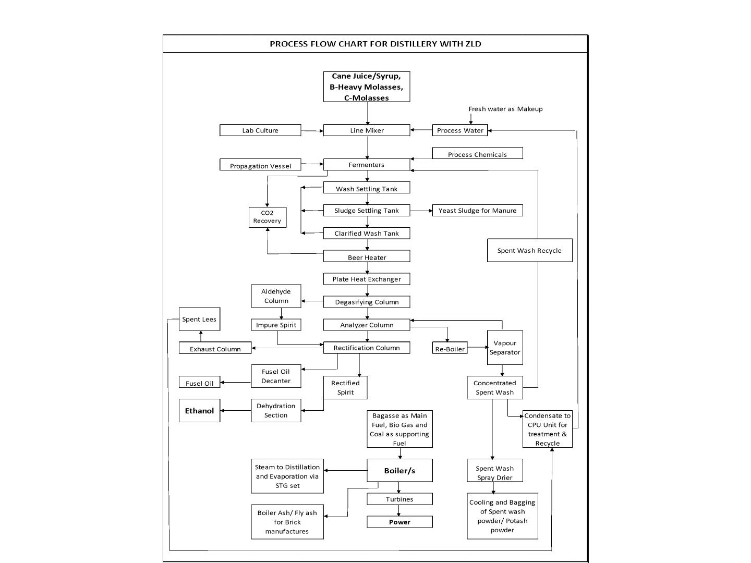
Process Flow Chart for RS/Ethanol/ENA & Co-generation Power Plant
44

Slide 45
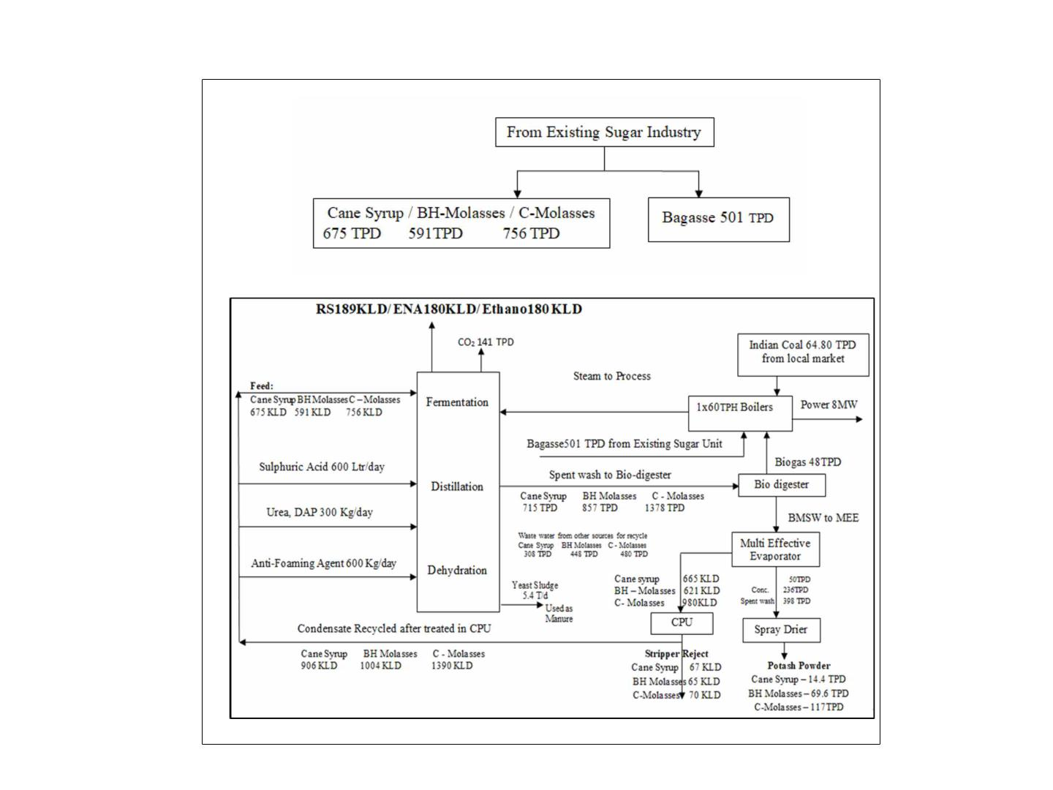
MassꢀbalanceꢀDiagramꢀ
45

Slide 46

WaterꢀRequirementꢀꢀ
Sl.ꢀNo.
Quantity
Source
1
Totalꢀ waterꢀ availabilityꢀ -ꢀ 1116000ꢀKLꢀ (Fromꢀ Krishnaꢀ Riverꢀ @ꢀ 4000ꢀ Waterꢀ willꢀ beꢀ
KLDꢀ forꢀ periodꢀ fromꢀ Juneꢀ toꢀ Novemberꢀ andꢀ Condensateꢀ Waterꢀ sourcedꢀ fromꢀ
availableꢀ fromꢀ Sugarꢀ Industryꢀ afterꢀ treatingꢀ inꢀ Condensateꢀ Polishingꢀ Krishnaꢀ Riverꢀ forꢀ
Unitꢀ @ꢀ 4200ꢀ KLDꢀ consideringꢀ 120ꢀ daysꢀ ofꢀ Seasonꢀ operation).Totalꢀ whichꢀ
Waterꢀ
isꢀ
fromꢀ
WaterꢀRequirementꢀꢀ-ꢀ1076100ꢀKLꢀ(ProposedꢀDistilleryꢀUnit).
FreshꢀWaterꢀRequirementꢀforꢀ180ꢀKLDꢀENAꢀProduction;
CaneꢀJuice/SyrupꢀasꢀFeed:ꢀꢀꢀ1012ꢀKLDꢀ@ꢀ5.62ꢀKL/KL
B-HeavyꢀMolassesꢀasꢀFeed:ꢀ1294ꢀKLDꢀ@ꢀ7.19ꢀKL/KL
C-MolassesꢀasꢀFeed:ꢀꢀꢀꢀꢀꢀꢀꢀꢀꢀꢀꢀ1440ꢀKLDꢀ@ꢀ8.00ꢀKL/KL
ꢀ
Permissionꢀ
obtainedꢀ
Krishnaꢀ Bhagyaꢀ
Jalaꢀ
Limited,ꢀ
Divisionꢀ Almattiꢀ
(KBJNL)ꢀ ofꢀ 4000ꢀ
KLDꢀ ofꢀ waterꢀ forꢀ
Distilleryꢀunit.ꢀ
Nigamꢀ
Damꢀ
FreshꢀWaterꢀRequirementꢀforꢀ180ꢀKLDꢀEthanolꢀProduction;
CaneꢀJuice/SyrupꢀasꢀFeed:ꢀꢀꢀ922ꢀKLDꢀ@ꢀ5.12ꢀKL/KL
B-HeavyꢀMolassesꢀasꢀFeed:ꢀ1210ꢀKLDꢀ@ꢀ6.72ꢀKL/KL
C-MolassesꢀasꢀFeed:ꢀꢀꢀꢀꢀꢀꢀꢀꢀꢀꢀꢀ1374ꢀKLDꢀ@ꢀ7.63ꢀKL/KLꢀ
46

Slide 47
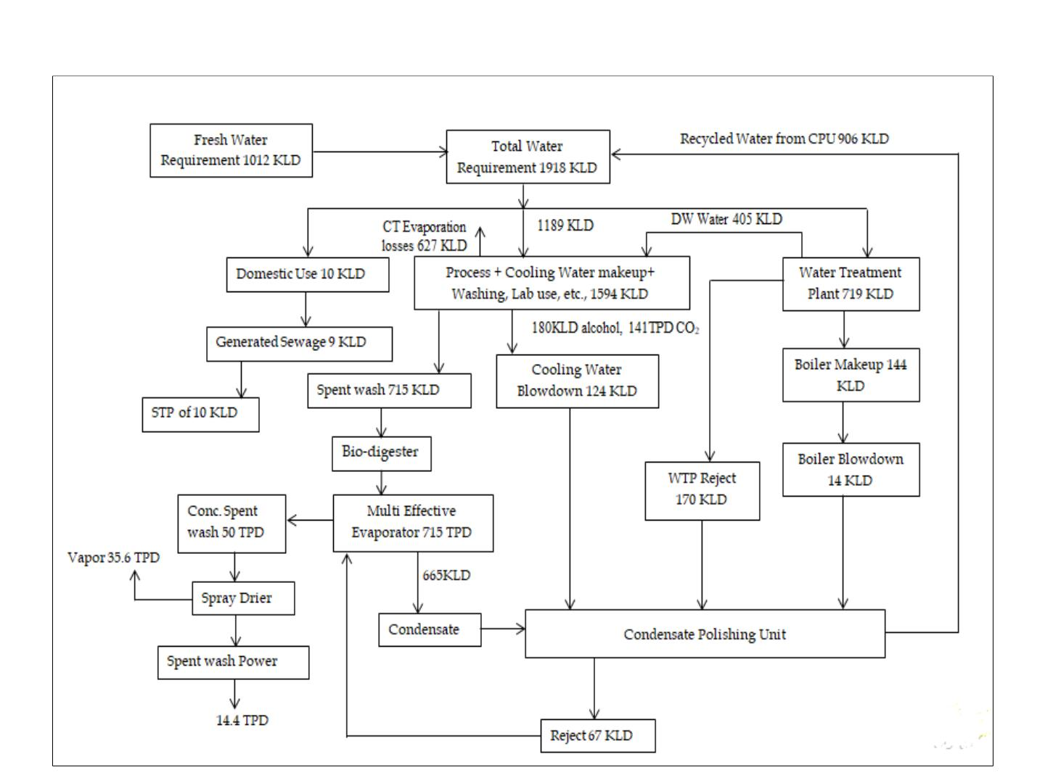
WaterꢀBalanceꢀChartꢀforꢀENAꢀ–ꢀCaneꢀjuiceꢀasꢀaꢀFeedꢀ
47

Slide 48
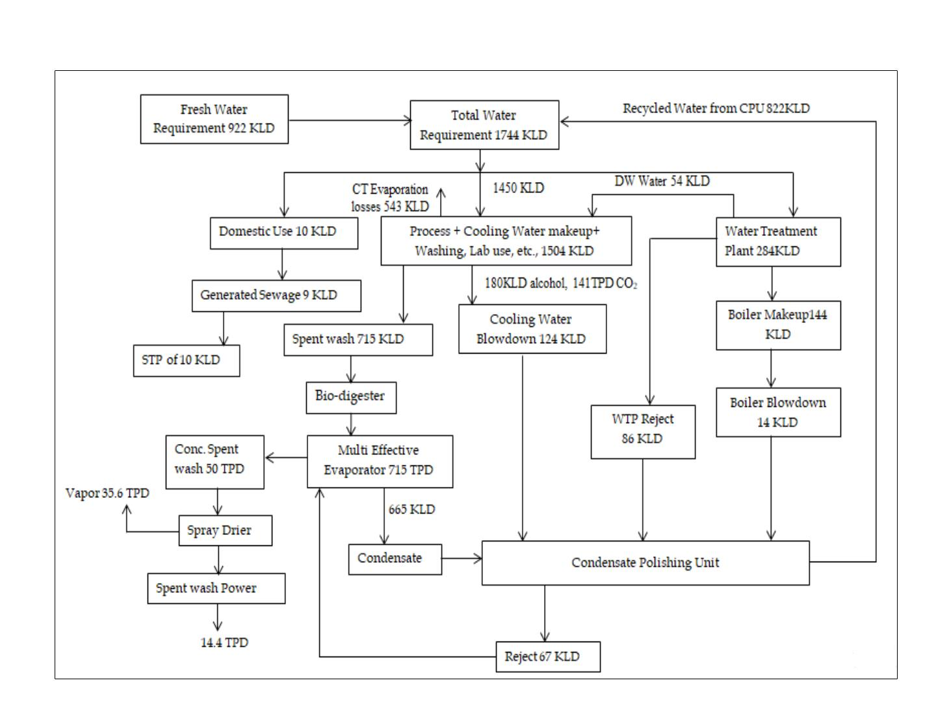
WaterꢀBalanceꢀChartꢀforꢀEthanolꢀ–ꢀCaneꢀjuiceꢀasꢀaꢀFeed
48

Slide 49
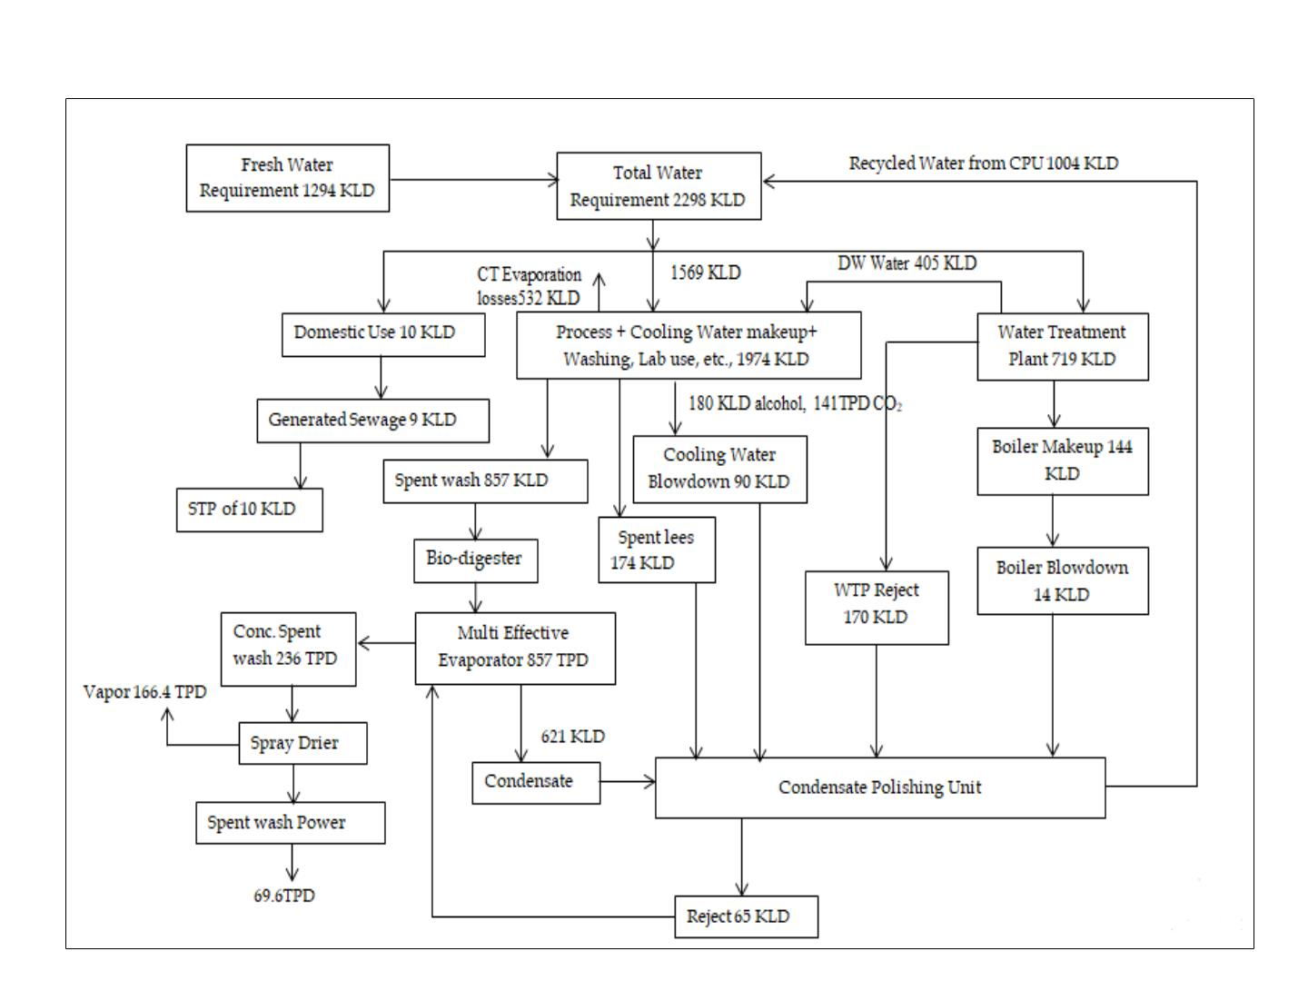
WaterꢀBalanceꢀChartꢀforꢀENAꢀ–ꢀBHꢀMolassesꢀasꢀaꢀFeed
49

Slide 50
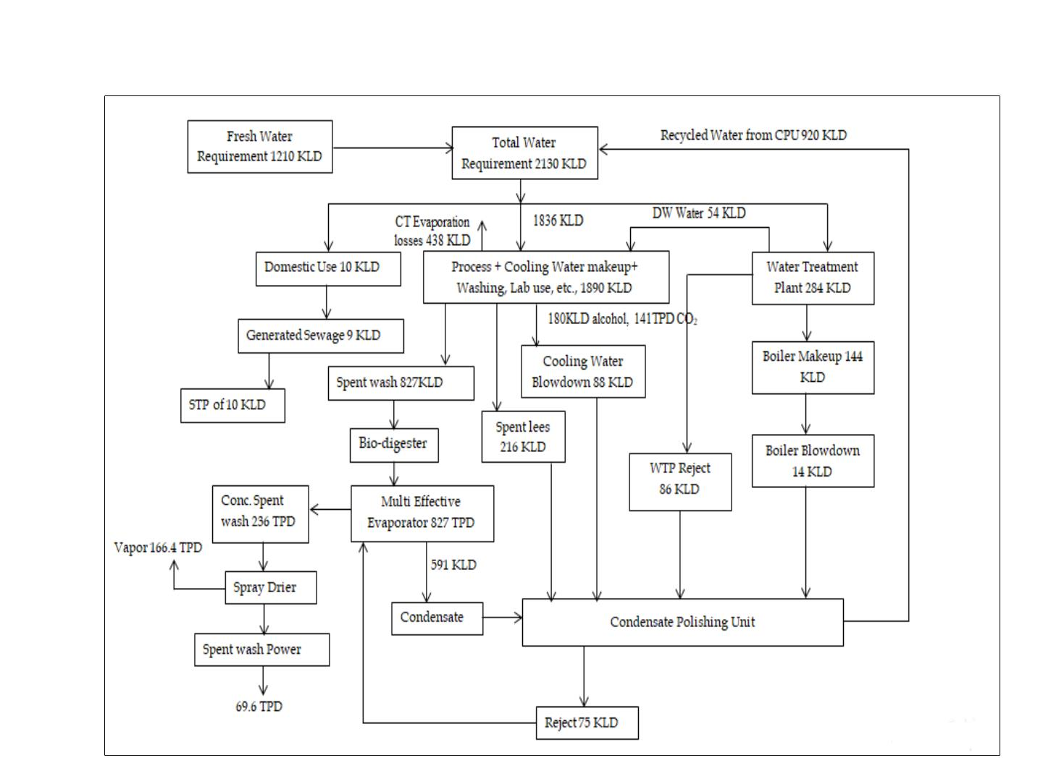
WaterꢀBalanceꢀChartꢀforꢀEthanolꢀ–ꢀBHꢀMolassesꢀasꢀaꢀFeed
50

Slide 51
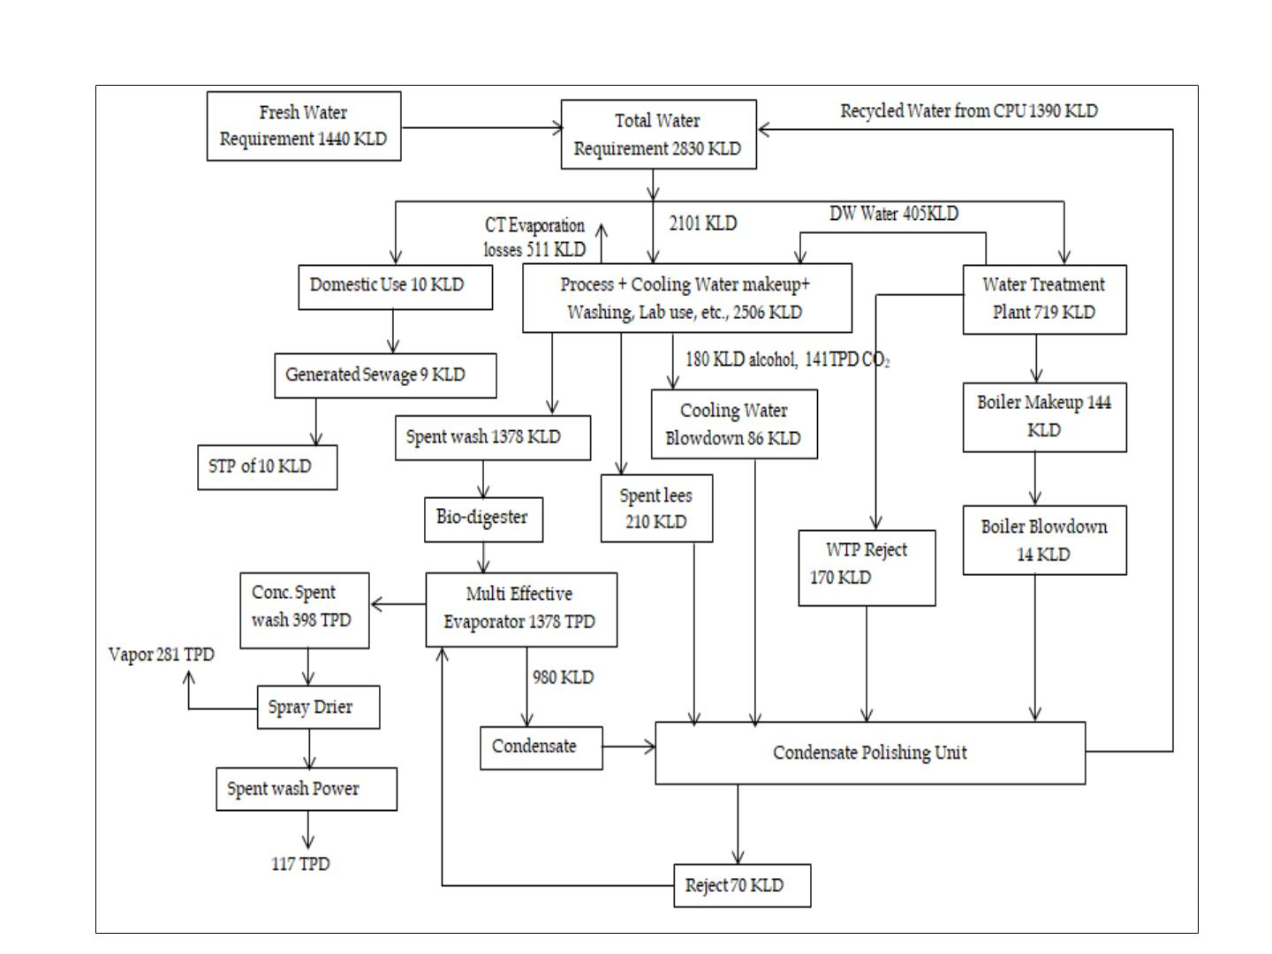
WaterꢀBalanceꢀChartꢀforꢀENAꢀ–ꢀCꢀMolassesꢀasꢀaꢀFeedꢀ
51

Slide 52
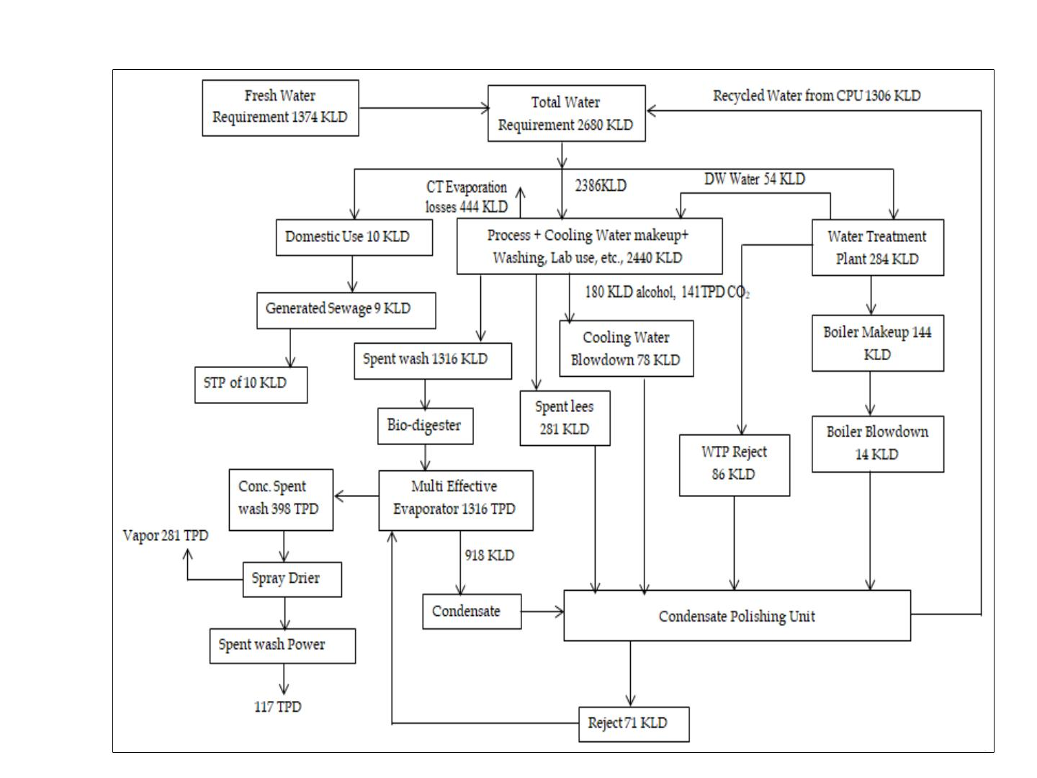
WaterꢀBalanceꢀChartꢀforꢀEthanolꢀ–ꢀCꢀMolassesꢀasꢀaꢀFeedꢀ
52

Slide 53
WastewaterꢀTreatmentꢀTechnologyꢀ
• Theꢀ generatedꢀ domesticꢀ sewageꢀ willꢀ beꢀ treatedꢀ inꢀ proposedꢀ STPꢀ ofꢀ 10ꢀ KLDꢀ
capacityꢀusingꢀSBRꢀTechnology.ꢀ
• Theꢀgeneratedꢀrawꢀspentꢀwashꢀofꢀquantityꢀ715ꢀKLDꢀusingꢀCaneꢀJuice/Syrupꢀ
asꢀFeed,ꢀ857ꢀKLDꢀusingꢀB-ꢀheavyꢀMolassesꢀasꢀFeedꢀandꢀ1378ꢀKLDꢀusingꢀC-
Molassesꢀ asꢀ aꢀ feed,ꢀ willꢀ beꢀ passedꢀ throughꢀ Bio-digesterꢀ toꢀ produceꢀ Biogasꢀ
followedꢀ byꢀ concentrationꢀ inꢀ MEE,ꢀ andꢀ driedꢀ usingꢀ sprayꢀ driersꢀ &ꢀ thenꢀ
packedꢀandꢀsoldꢀoutꢀinꢀlocalꢀmarketꢀasꢀaꢀPotashꢀpowder.
• Condensateꢀ&ꢀSpentꢀLeesꢀfromꢀprocessꢀareꢀtreatedꢀinꢀCPUꢀofꢀCapacityꢀ1400ꢀ
KLD,ꢀandꢀthenꢀitꢀwillꢀbeꢀreusedꢀinꢀProcess.
• Effluentꢀ generatedꢀ fromꢀ Sugarꢀ Plantꢀ willꢀ beꢀ treatedꢀ inꢀ Effluentꢀ Treatmentꢀ
Plantꢀ(ETPꢀofꢀcapacityꢀ1800ꢀKLD)ꢀandꢀreusedꢀforꢀgreenbeltꢀdevelopment.
53

Slide 54

RawꢀMaterialꢀConsumption
Sl.ꢀ
No
RawꢀMaterial
Quantity
Transportation
Source
Storage
2700ꢀTPDꢀorꢀ
675ꢀTPDꢀ@ꢀ
60ꢀBrix
Pipelineꢀforꢀ
Internal/Tankersꢀ
forꢀshiftingꢀfromꢀ
ICPL
OwnꢀProductionꢀ/ꢀ
Shiftingꢀfromꢀ
ICPLꢀUnit
1
CaneꢀJuiceꢀ/ꢀ
Syrup
MildꢀSteelꢀTanks
Pipelineꢀforꢀ
Internal/Tankersꢀ
forꢀshiftingꢀfromꢀ
ICPL
OwnꢀProductionꢀ/ꢀ
Shiftingꢀfromꢀ
ICPLꢀUnit
2
3
B-Heavyꢀ
Molasses
591ꢀTPD
756ꢀTPD
MildꢀSteelꢀTanks
MildꢀSteelꢀtanks
Ownꢀproductionꢀ
C-ꢀMolasses
Pipelineꢀ/Tankers plusꢀotherꢀsugarꢀ
factories.
Chemicalsꢀ/ꢀNutrients
MꢀSꢀTankꢀwithꢀ
Fumeꢀabsorbingꢀ
facility
4
SulphuricꢀAcid
360ꢀlit
Lorryꢀtanker
Mumbai
5
6
DAP
Urea
180ꢀKg
660ꢀKg
Lorry
Lorry
Local
Local
50ꢀKgꢀBags
50ꢀKgꢀBags
Antifoam
HCL
Causticꢀlye
360ꢀkg
660ꢀkg
660ꢀkg
Lorry
Tanker
Lorry
50ꢀKgꢀBags
AcidꢀproofꢀMSꢀtank
SSꢀStorageꢀtank
7
8
Local
Yeastꢀcultureꢀ
/Enzyme
330ꢀkg
Lorry
Fromꢀ
Manufacturers
10ꢀkgꢀdrum
54

Slide 55
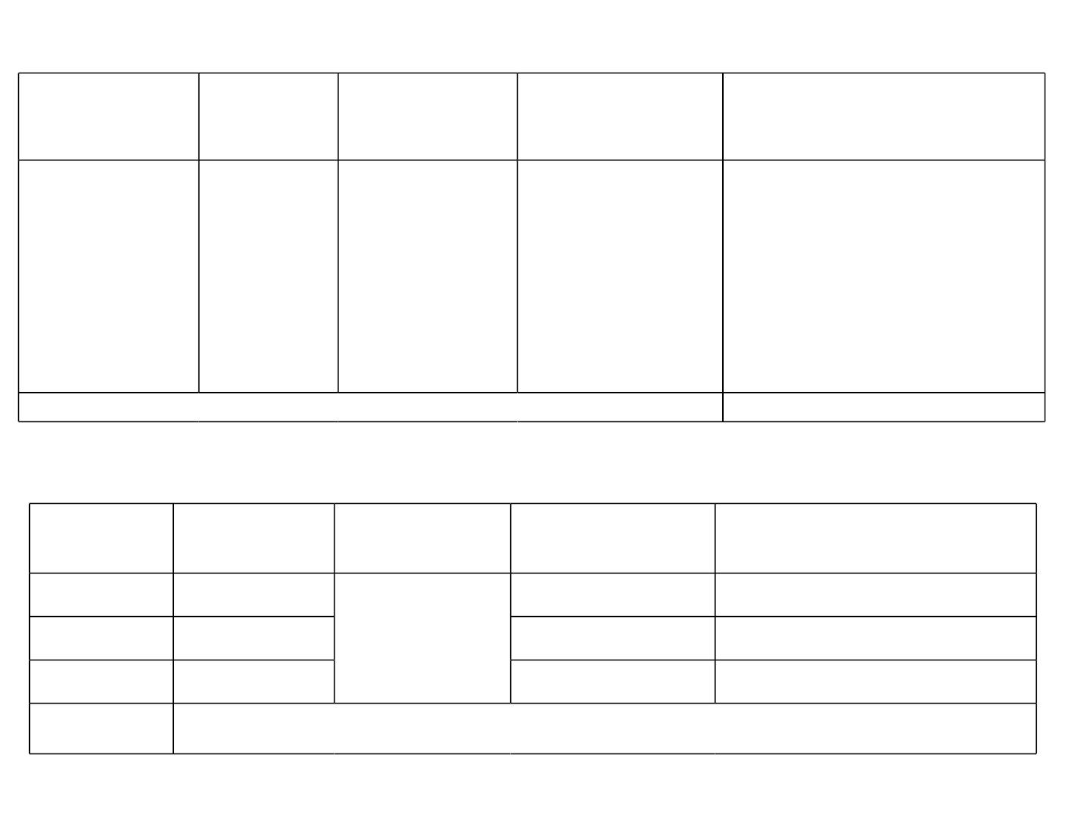
DetailsꢀofꢀGreenꢀBeltꢀDevelopmentꢀPlan
Proposedꢀareaꢀ
forꢀgreenꢀbelt
Procureme Responsibilityꢀ
No.ꢀofꢀseedlingsꢀ
forꢀplantation
ntꢀofꢀ
&ꢀMonitoringꢀ
Agency
CostꢀinꢀRs.
seedlings
Proposed:ꢀ12ꢀ
Acresꢀ(33%)
Vijayapura,ꢀ M/s.ꢀ
400/acreꢀxꢀ12ꢀacresꢀ • 100/-ꢀperꢀsaplingsꢀxꢀ4800ꢀ
Forestꢀ
Someshwarꢀ
=ꢀ4800ꢀsaplings
saplingsꢀ=ꢀRs.ꢀ4,80,000/-
• Watchꢀ&ꢀwardꢀforꢀ3ꢀyearsꢀ
(Lumpꢀsum)ꢀ=ꢀRs.ꢀ
departmentꢀ SugarsꢀLimited
andꢀNGOs
10,95,000/-
• MaintenanceꢀofꢀGreenꢀbeltꢀ
perꢀyearꢀ(fourthꢀyearꢀ
onwards)ꢀ=ꢀ1,82,500/-
17,57,500/-
Total
GreenꢀBeltꢀDevelopmentꢀplanningꢀandꢀtimeꢀframeꢀwithinꢀIndustrialꢀPremises
Years
No.ꢀofꢀrows
Area
No.ꢀofꢀsaplings
Costꢀofꢀsaplingsꢀ(Rs./-)
2022-2023
2023-2024
2024-2025
Total
1
1
1
4800
4800
4800
4,80,000/-
4,80,000/-
4,80,000/-
Allꢀalongꢀtheꢀ
periphery
14,40,000/-
55

Slide 56
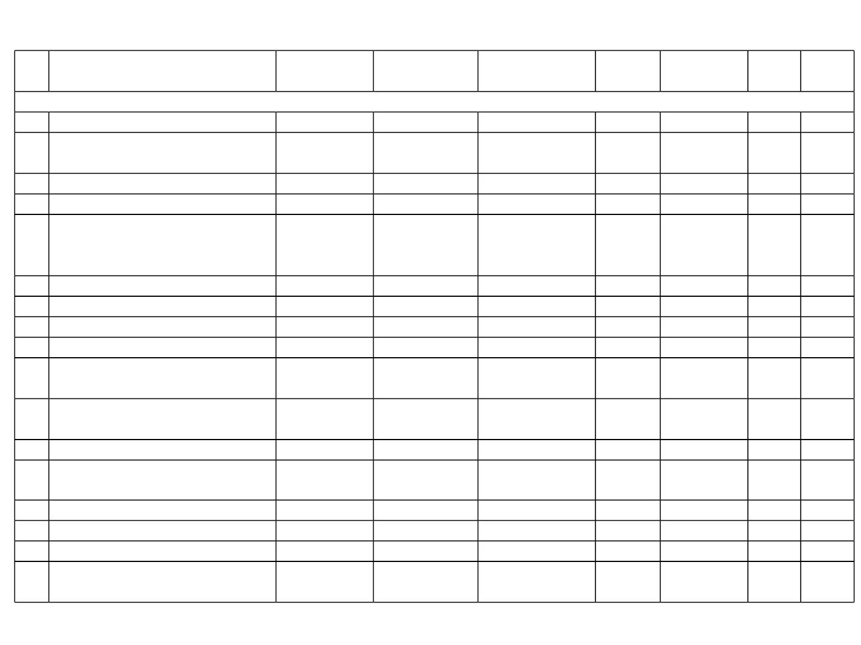
ListꢀofꢀtreeꢀspeciesꢀrecommendedꢀforꢀGreenꢀBeltꢀDevelopmentꢀ
Slꢀ
No
Scientificꢀname
Commonꢀ
Name
Family
Uses
Heightꢀ
(m)
Crownꢀ
shape^
APTI
Broadꢀ
leaved
Trees
1
Alstoniaꢀscholarisꢀ(L.)ꢀR.Br.
AzadirachtaꢀindicaꢀA.Juss.
Boothaꢀmara
Bevinaꢀmara
Apocynaceae
Meliaceae
Ornamental
Medicinalꢀandꢀ
Traditional
Fruiting
40
15
Round
6.6&
✓
2
Spreading
19.01
ꢀ
3
4
Buteaꢀmonospermaꢀ(lam.)ꢀTaub.
CassiaꢀfistulaꢀL
Mutuga
Fabaceae
Fabaceae
10
15
Round
18.42
12.13
✓
Araginaꢀmara
Medicinal
Timber,ꢀ
Spreading
-
5
ChloroxylonꢀswieteniaꢀDC.
Hurugalu
Rutaceae
medicinal,ꢀfuelꢀ
wood
20
Spreading
-
-
6
7
8
9
DalbergiaꢀlatifoliaꢀRoxb.
GmelinaꢀarboreaꢀL.
beete
Shivane
Anjan
Leguminosae
Lamiaceae
Fabaceae
Timber
15
15
25
15
Spreading
Round
32.5+
13.62
-
-
Timber
✓
-
HardwickiaꢀbinataꢀRoxb.
LagerstroemiaꢀlanceolataꢀL.
Timber,ꢀmedicinal
Timber
Spreading
Round
Nandiꢀmara
Lythraceae
7.71
✓
10 Madhucaꢀlatifoliaꢀ(Roxb)
Mahua
Sapotaceae
Edible,ꢀmedicinal
15
Oblong/roun
d
34.6+
✓
11 Madhucaꢀlongifoliaꢀvar.ꢀlatifolia
12 MangiferaꢀindicaꢀL.
Mahua
Mavu
Sapotaceae
Anacardiaceae
Phyllanthaceae
Edible,ꢀmedicinal
Fruiting
15
12
10
Oblong/roun
d
34.6+
9.85*
✓
-
Round
13 PhyllanthusꢀemblicaꢀL.
Nelliꢀkai
Fruit
Round
12.82$
-
14 Pongamiaꢀpinnataꢀ(L.)
Pongamia
Jambunerale
Tega
Fabaceae
Myrtaceae
Verbenaceae
Shade
Edible,ꢀMedicinal
Timber
15
30
12
Round
Spreading
Round
32.4+
11.93!
8.92^
-
-
15 Syzygiumꢀcuminiꢀ(L.)ꢀSkeels
16 TectonaꢀgrandisꢀL.
✓
17
Terminaliaꢀ arjunaꢀ (Roxb.)ꢀ Wightꢀ &ꢀ
Arjunaꢀmara
Combretaceae
Medicinal
20
Crown
9.03+
-
Arn.
56

Slide 57

TransportationꢀPlanꢀ-ꢀVehicularꢀTrafficꢀLoadꢀstudyꢀasꢀperꢀIRCꢀGuidelines
• TheꢀprojectꢀisꢀlocatedꢀalongꢀSH-55,ꢀwhichꢀconnectsꢀoneꢀsideꢀtoꢀVijayapuraꢀandꢀanotherꢀ
sideꢀtoꢀMudhol.
• Theꢀ existingꢀ RoWꢀ isꢀ ofꢀ 10ꢀ mꢀ andꢀ outꢀ ofꢀ whichꢀ CWꢀ measuresꢀ 6ꢀ mꢀ shouldersꢀ isꢀ
Bituminousꢀ concreteꢀ pavedꢀ road.ꢀ Theꢀ balanceꢀ widthꢀ isꢀ sharedꢀ byꢀ shouldersꢀ ofꢀ 2ꢀ mꢀ onꢀ
eitherꢀside.
• Theꢀroadꢀisꢀmarkedꢀwithꢀcentralꢀlineꢀbutꢀessentiallyꢀtheꢀedgeꢀlinesꢀmustꢀbeꢀmarkedꢀwithꢀ
thermoplasticꢀreflectiveꢀpaintsꢀandꢀinstallꢀwithꢀtheꢀredꢀroadꢀstuds.ꢀThereꢀareꢀnoꢀsignageꢀ
andꢀsignꢀboardsꢀtoꢀindicateꢀspeedꢀlimits,ꢀdriveꢀslowlyꢀandꢀinformativeꢀsignꢀboardsꢀetc.ꢀ
• Thereꢀ isꢀ noꢀ roadꢀ sideꢀ drainꢀ andꢀ willꢀ haveꢀ toꢀ beꢀ constructedꢀ toꢀ takeꢀ stormꢀ water.ꢀ Theꢀ
pavementꢀ conditionꢀ ofꢀ theꢀ existingꢀ bituminousꢀ roadꢀ isꢀ inꢀ fairꢀ condition.ꢀ Informaratoryꢀ
boardsꢀonꢀeitherꢀsideꢀofꢀtheꢀroadꢀaboutꢀtheꢀcomingꢀupꢀindustry,ꢀnoꢀparkingꢀboardsꢀonꢀtheꢀ
pavements,ꢀroadꢀhumpsꢀandꢀitsꢀsignꢀboardꢀshouldꢀbeꢀdone.ꢀꢀ
• Aꢀ highꢀ mastꢀ lightꢀ isꢀ alsoꢀ necessaryꢀ inꢀ frontꢀ theꢀ buildingꢀ andꢀ onꢀ theꢀ roadꢀ forꢀ betterꢀ
elimination
Particulars
TrafficꢀLoadꢀStudyꢀPeriod
TrafficꢀLoadꢀ(Baseline)
Details
Marchꢀ2021ꢀ–ꢀMayꢀ2021
3903ꢀPCU/dayꢀforꢀSHꢀ–ꢀ55
AdditionalꢀTrafficꢀLoadꢀduringꢀoperationꢀofꢀtheꢀProject 4046ꢀPCU/dayꢀforꢀSHꢀ–ꢀ55
TotalꢀTrafficꢀLoad
4162ꢀPCU/dayꢀforꢀSHꢀ–ꢀ55
15,000ꢀPCU/Day
TrafficꢀCapacityꢀasꢀperꢀIRCꢀ64:1990ꢀforꢀHighways
57

Slide 58

BudgetꢀforꢀCERꢀꢀasꢀperꢀMoEF&CCꢀOMꢀDt:ꢀ30.09.2020
Theꢀ Corporateꢀ Environmentalꢀ Responsibilityꢀ Planꢀ isꢀ workedꢀ outꢀ asꢀ perꢀ MoEFꢀ
Notificationꢀvideꢀno.ꢀF.No.22ꢀ-65/2017-IA.IIIꢀdatedꢀonꢀ1.05.2018,ꢀtheꢀtotalꢀCERꢀcostꢀ
ofꢀ theꢀ projectꢀ isꢀ 4.22ꢀ Crores@ꢀ 1.5ꢀ %ꢀ ofꢀ theꢀ totalꢀ investmentꢀ ofꢀ theꢀ projectꢀ (281.73ꢀ
Crores).
Sl.
No.
YearꢀwiseꢀPlan
Costꢀinꢀ
Cores 2022-23 2023-24 2024-25 2025-26 2026-27
PhysicalꢀActivity
Infrastructureꢀ developmentꢀ
atꢀ
1. Governmentꢀ schoolsꢀ inꢀ theꢀ nearbyꢀ 1.477
Villagesꢀ
Providingꢀ teachingꢀ aids/booksꢀ toꢀ
2. primaryꢀ andꢀ highꢀ schoolsꢀ toꢀ nearbyꢀ 1.055
Villages.ꢀ
29.54
21.1
29.54
21.1
29.54
21.1
29.54
21.1
29.54
21.1
Healthꢀ check-upꢀ campsꢀ toꢀ nearbyꢀ
Villages
4. PlantationꢀProgramꢀatꢀnearbyꢀVillages 0.633
Providingꢀ safeꢀ drinkingꢀ waterꢀ
3.
0.422
8.44
12.66
12.66
8.44
12.66
12.66
8.44
12.66
12.66
8.44
12.66
12.66
8.44
12.66
12.66
5.
facilitiesꢀtoꢀnearbyꢀVillagesꢀ
ꢀꢀꢀꢀꢀꢀꢀꢀꢀꢀꢀꢀꢀꢀꢀꢀꢀꢀꢀꢀꢀꢀꢀꢀꢀꢀꢀꢀꢀTotal
0.633
ꢀ
4.22
0.844ꢀ
Cr
0.844ꢀ
Cr
0.844ꢀCr
0.844ꢀ
Cr
0.844ꢀ
Cr
58

Slide 59
EMPꢀofꢀAir
Constructionꢀphase
• Regularꢀwaterꢀsprinklingꢀwillꢀbeꢀcarriedꢀoutꢀtoꢀsuppressꢀtheꢀdust.
• Theꢀ DGꢀ setꢀ willꢀ beꢀ usedꢀ onlyꢀ duringꢀ powerꢀ failure.ꢀ Sufficientꢀ stackꢀ heightꢀ ofꢀ 10ꢀ
mꢀAGLꢀwillꢀbeꢀprovidedꢀtoꢀDGꢀset.ꢀRegularꢀstackꢀmonitoringꢀwillꢀbeꢀcarriedꢀoutꢀ
&ꢀgoodꢀqualityꢀHSDꢀwillꢀbeꢀusedꢀtoꢀensureꢀthatꢀtheꢀemissionsꢀareꢀwellꢀwithinꢀtheꢀ
norms.
• AirꢀpollutionꢀMitigationꢀmeasuresꢀduringꢀconstructionꢀphaseꢀisꢀ1.25ꢀLakhs.
Operationꢀphase
• Theꢀ efficiencyꢀ ofꢀ ESPꢀ isꢀ 99.8ꢀ %.ꢀ Cleanꢀ airꢀ willꢀ beꢀ letꢀ outꢀ fromꢀ theꢀ chimneyꢀ ofꢀ
heightꢀ80ꢀMꢀAGL.
• Greenꢀ beltꢀ willꢀ beꢀ developedꢀ allꢀ alongꢀ theꢀ peripheryꢀ ofꢀ theꢀ industryꢀ toꢀ mitigateꢀ
air/Noiseꢀpollution.
• Allꢀtheꢀinternalꢀroadsꢀwillꢀbeꢀasphaltedꢀtoꢀcontrolꢀparticulateꢀemissions.
• Regularꢀ maintenanceꢀ ofꢀ airꢀ pollutionꢀ controlꢀ equipmentꢀ willꢀ beꢀ carriedꢀ outꢀ toꢀ
ensureꢀproperꢀ&ꢀeffectiveꢀperformance.
• AirꢀPollutionꢀMitigationꢀduringꢀoperationalꢀphaseꢀinstallationꢀofꢀAPCꢀEquipmentꢀ
suchꢀasꢀESPꢀandꢀinstallationꢀofꢀstackꢀtoꢀBoilerꢀisꢀ153ꢀLakhsꢀasꢀcapitalꢀcost.
59

Slide 60
EMPꢀ-ꢀNoise
Constructionꢀphase
• Periodicꢀ maintenanceꢀ willꢀ beꢀ carriedꢀ outꢀ forꢀ allꢀ highꢀ noiseꢀ generatingꢀ machineryꢀ /ꢀ
equipment.ꢀ Itꢀ willꢀ beꢀ alsoꢀ ensuredꢀ thatꢀ allꢀ suchꢀ machineriesꢀ /ꢀ equipmentꢀ areꢀ ofꢀ
recentꢀvintageꢀandꢀinstalledꢀonꢀanti-vibratingꢀmountingsꢀ&ꢀwithꢀacousticꢀenclosures.
• Theꢀ workersꢀ operatingꢀ onꢀ allꢀ suchꢀ machineriesꢀ willꢀ beꢀ providedꢀ withꢀ PPEsꢀ likeꢀ
earmuffs/ꢀearplugsꢀetc.,
Operationalꢀphaseꢀ
• Theꢀ workersꢀ inꢀ theꢀ plantꢀ premisesꢀ willꢀ beꢀ providedꢀ withꢀ properꢀ PPEsꢀ whichꢀ
includeꢀearmuffsꢀ/ꢀearplugs.
• Noiseꢀ generatingꢀ equipmentꢀ willꢀ beꢀ installedꢀ onꢀ anti-vibratingꢀ mountingsꢀ &ꢀ withꢀ
acousticꢀenclosures.
• Noiseꢀ Levelꢀ Mitigationꢀ Measuresꢀ capitalꢀ costꢀ includingꢀ provisionꢀ ofꢀ PPE’sꢀ isꢀ 12ꢀ
lakhs.
60

Slide 61
EMPꢀ-ꢀWater
Constructionꢀphase
• Temporaryꢀ garlandꢀ drainageꢀ arrangementsꢀ willꢀ beꢀ madeꢀ aroundꢀ constructionꢀ
siteꢀ&ꢀinꢀLabourꢀcampꢀtoꢀavoidꢀstagnationꢀofꢀwater.ꢀTheꢀchannelizedꢀwaterꢀwillꢀ
beꢀ collectedꢀ inꢀ catchꢀ pitꢀ &ꢀ willꢀ beꢀ usedꢀ forꢀ dustꢀ suppressionꢀ withinꢀ theꢀ
constructionꢀsite
Operationalꢀphaseꢀ
• Theꢀ condensateꢀ generatedꢀ willꢀ beꢀ treatedꢀ inꢀ CPUꢀ ofꢀ capacityꢀ 1400ꢀ KLD.ꢀ Theꢀ
treatedꢀwaterꢀwillꢀbeꢀreusedꢀinꢀtheꢀprocess.ꢀ
• Spentꢀ washꢀ generatedꢀ duringꢀ theꢀ processꢀ ofꢀ distillationꢀ willꢀ beꢀ digestedꢀ inꢀ
Anaerobicꢀ digesterꢀ andꢀ concentrateꢀ willꢀ beꢀ furtherꢀ evaporatedꢀ inꢀ multipleꢀ
effectiveꢀevaporatorsꢀandꢀthenꢀitꢀwillꢀbeꢀpowderedꢀandꢀsoldꢀasꢀfertilizer.
• Stormꢀ waterꢀ drainsꢀ willꢀ beꢀ providedꢀ toꢀ avoidꢀ floodingꢀ inꢀ theꢀ proposedꢀ site.ꢀ
Stormꢀwaterꢀgutters/drainsꢀwillꢀbeꢀconstructedꢀinꢀtheꢀpremisesꢀonꢀeitherꢀsideꢀofꢀ
theꢀhaulꢀroads.
• TheꢀgeneratedꢀdomesticꢀsewageꢀisꢀtreatedꢀinꢀSTPꢀofꢀcapacityꢀ10ꢀKLD.
• Capitalꢀ costꢀ forꢀ constructionꢀ ofꢀ garlandꢀ drainsꢀ forꢀ stormꢀ waterꢀ managementꢀ &ꢀ
implementationꢀ ofꢀ rainwaterꢀ harvestingꢀ planꢀ andꢀ installationꢀ ofꢀ rechargeꢀ pitsꢀ
willꢀbeꢀ40ꢀLakhs.
• ProvisionꢀofꢀCPUꢀandꢀSTPꢀwillꢀbeꢀ160ꢀlakhs.
61

Slide 62
SpecificꢀTermsꢀofꢀReferenceꢀforꢀEIAꢀStudiesꢀforꢀDistilleries
1.ꢀListꢀofꢀexistingꢀdistilleryꢀunitsꢀinꢀtheꢀstudyꢀareaꢀalongꢀwithꢀtheirꢀcapacityꢀandꢀsourcingꢀ
ofꢀrawꢀmaterial.ꢀ
Thereꢀisꢀnoꢀdistilleryꢀwithinꢀ10ꢀKmꢀradiusꢀofꢀtheꢀstudyꢀarea.ꢀTheꢀnearestꢀexistingꢀdistilleryꢀ
isꢀ 60ꢀ KLPDꢀ Jamkhandiꢀ Sugarsꢀ Limited,ꢀ Sugarꢀ andꢀ Distilleryꢀ alongꢀ withꢀ Co-genꢀ ꢀ atꢀ aꢀ
distanceꢀofꢀ15.88ꢀKmꢀ(NW).
2.Numberꢀofꢀworkingꢀdaysꢀofꢀtheꢀdistilleryꢀunit
330ꢀdays
3.ꢀDetailsꢀofꢀrawꢀmaterialsꢀsuchꢀasꢀmolasses/grains,ꢀtheirꢀsourceꢀwithꢀavailability
Rawꢀ materialsꢀ suchꢀ asꢀ Bagasse,ꢀ Caneꢀ Juice,ꢀ B-Heavyꢀ molassesꢀ andꢀ C-ꢀ Molassesꢀ forꢀ theꢀ
proposedꢀ distilleryꢀ willꢀ beꢀ readilyꢀ availableꢀ fromꢀ theꢀ sugarꢀ complexꢀ ofꢀ M/s.ꢀ Someshwarꢀ
SugarsꢀLimited.ꢀCaneꢀJuice,ꢀB-HeavyꢀMolassesꢀandꢀCꢀ-ꢀMolassesꢀwillꢀmeetꢀtheꢀdemandꢀofꢀ
rawꢀmaterialꢀrequiredꢀforꢀtheꢀDistilleryꢀofꢀcapacityꢀ180ꢀKLPD.
4.ꢀDetailsꢀofꢀtheꢀuseꢀofꢀsteamꢀfromꢀtheꢀboiler.
Theꢀ steamꢀ requirementꢀ forꢀ theꢀ proposedꢀ Distilleryꢀ willꢀ beꢀ metꢀ fromꢀ theꢀ 60TPHꢀ Boilerꢀ
withꢀBagasseꢀasꢀmainꢀfuelꢀandꢀCoalꢀ&ꢀBiogasꢀasꢀsupportingꢀfuels.
5.ꢀ Surfaceꢀ andꢀ Groundꢀ waterꢀ qualityꢀ aroundꢀ proposedꢀ spentꢀ washꢀ storageꢀ lagoon,ꢀ andꢀ
compostꢀyard.ꢀ
Thereꢀ isꢀ noꢀ Surfaceꢀ waterꢀ bodyꢀ inꢀ theꢀ surroundingsꢀ ofꢀ theꢀ industryꢀ henceꢀ noꢀ issueꢀ ofꢀ
impactꢀ onꢀ surfaceꢀ waterꢀ quality.ꢀSimilarlyꢀ industryꢀ doesn’tꢀ haveꢀ boreꢀ wellꢀ &ꢀ noꢀ groundꢀ
waterꢀ isꢀ usedꢀ forꢀ process,ꢀ howeverꢀ toꢀ checkꢀ theꢀ impactꢀ ofꢀ spentꢀ washꢀ storageꢀ tanksꢀ &ꢀ
compostꢀ yardꢀ piezometersꢀ willꢀ beꢀ installedꢀ toꢀ checkꢀ theꢀ groundꢀ waterꢀ qualityꢀ nearꢀ suchꢀ
storageꢀtanksꢀ&ꢀcompostingꢀyards.ꢀꢀ
62

Slide 63
6.Planꢀtoꢀreduceꢀspentꢀwashꢀgenerationꢀwithinꢀ6-8ꢀKL/KLꢀofꢀalcoholꢀproduced.
Itꢀmayꢀbeꢀnotedꢀthatꢀspentꢀwashꢀgenerationꢀvariesꢀwithꢀtypeꢀofꢀfeedꢀi.e.ꢀwithꢀSugarcaneꢀjuiceꢀ
itꢀisꢀ4ꢀKLꢀ&ꢀwithꢀB-ꢀHeavyꢀMolassesꢀitꢀisꢀ4.8ꢀKLꢀ&ꢀwithꢀC-ꢀMolassesꢀitꢀisꢀ7.7ꢀKL/ꢀKLꢀofꢀ
alcohol.ꢀ
7.ꢀProposedꢀeffluentꢀtreatmentꢀsystemꢀforꢀmolasses/grainꢀbasedꢀdistilleryꢀ(spentꢀwash,ꢀspentꢀ
lees,ꢀ condensateꢀ andꢀ utilities)ꢀ asꢀ wellꢀ asꢀ domesticꢀ sewageꢀ andꢀ schemeꢀ forꢀ achievingꢀ zeroꢀ
effluentꢀ dischargeꢀ (ZLD).ꢀ Proposedꢀ actionꢀ toꢀ restrictꢀ freshꢀ waterꢀ consumptionꢀ withinꢀ 10ꢀ
KL/KLꢀofꢀalcoholꢀproduction.
TheꢀgeneratedꢀwasteꢀwaterꢀwillꢀbeꢀtreatedꢀinꢀinꢀCondensateꢀpolishingꢀunitꢀ(CPU)ꢀofꢀcapacityꢀ
1400ꢀ KLDꢀ andꢀ willꢀ beꢀ reusedꢀ forꢀ processꢀ &ꢀ coolingꢀ towerꢀ makeupꢀ etc.ꢀ Generatedꢀ Sewageꢀ
ofꢀwillꢀbeꢀtreatedꢀinꢀtheꢀSTPꢀofꢀ10ꢀKLDꢀcapacityꢀ(SBRꢀTechnology)ꢀandꢀtreatedꢀwaterꢀwillꢀ
beꢀreusedꢀforꢀgreenbeltꢀdevelopment.
8.ꢀ Proposedꢀ actionꢀ toꢀ restrictꢀ freshꢀ waterꢀ consumptionꢀ withinꢀ 10KL/KLꢀ ofꢀ alcoholꢀ
production.
Itꢀ mayꢀ beꢀ notedꢀ thatꢀ freshꢀ waterꢀ requirementꢀ variesꢀ withꢀ typeꢀ ofꢀ feedꢀ i.e.ꢀ withꢀ Sugarcaneꢀ
juiceꢀitꢀisꢀ5.62ꢀKLꢀ&ꢀwithꢀB-ꢀHeavyꢀMolassesꢀitꢀisꢀ7.19ꢀKLꢀ&ꢀwithꢀC-ꢀMolassesꢀitꢀisꢀ7.9ꢀKL/ꢀ
KLꢀofꢀalcohol.ꢀ
9.ꢀDetailsꢀaboutꢀcapacityꢀofꢀspentꢀwashꢀholdingꢀtank,ꢀmaterialꢀused,ꢀdesignꢀconsideration.ꢀ
No.ꢀofꢀpeizometersꢀtoꢀbeꢀproposedꢀaroundꢀspentꢀwashꢀholdingꢀtank.
TheꢀgeneratedꢀspentꢀwashꢀwillꢀbeꢀstoredꢀinꢀRCCꢀTanksꢀhavingꢀcapacityꢀforꢀ5ꢀdaysꢀstorageꢀasꢀ
perꢀnorms.ꢀ
63

Slide 64
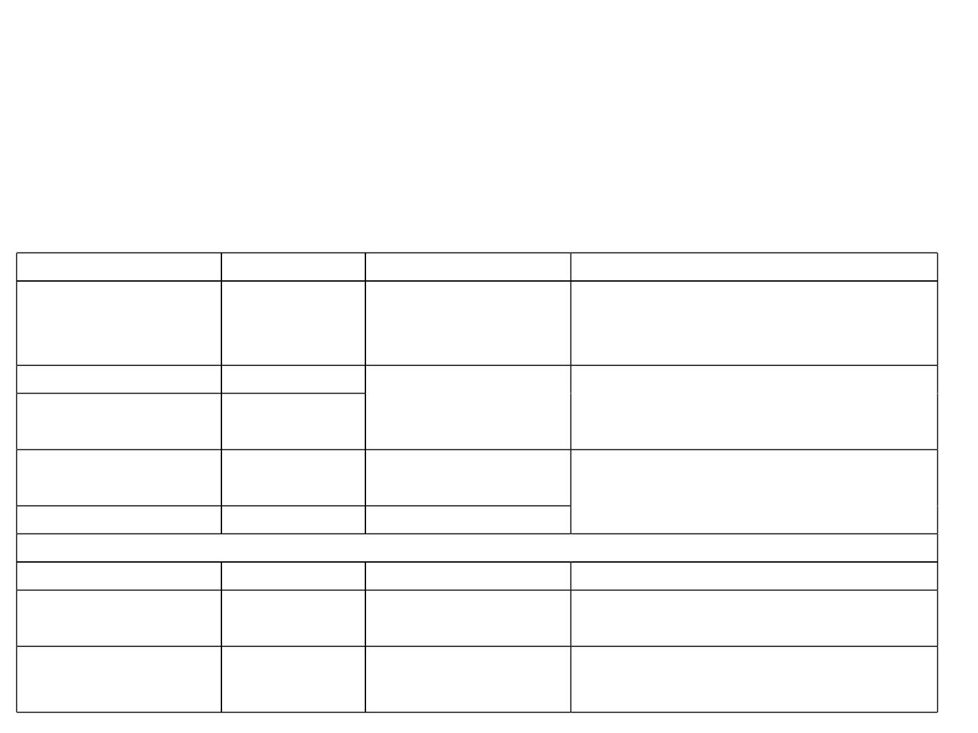
10.ꢀActionꢀplanꢀtoꢀcontrolꢀgroundꢀwaterꢀpollution
AꢀscientificallyꢀdesignedꢀCPUꢀwillꢀbeꢀinꢀplaceꢀtoꢀtreatꢀwastewaterꢀSimilarlyꢀindustryꢀ
doesn’tꢀhaveꢀboreꢀwellꢀ&ꢀnoꢀgroundꢀwaterꢀisꢀusedꢀforꢀprocess,ꢀhoweverꢀtoꢀcheckꢀtheꢀ
impactꢀofꢀspentꢀwashꢀstorageꢀtanksꢀ&ꢀcompostꢀyardꢀpiezometersꢀwillꢀbeꢀinstalledꢀtoꢀ
checkꢀtheꢀgroundꢀwaterꢀqualityꢀnearꢀsuchꢀareas.
11.ꢀ Detailsꢀ ofꢀ solidꢀ wasteꢀ managementꢀ includingꢀ managementꢀ ofꢀ boilerꢀ ash,ꢀ yeast,ꢀ
etc.ꢀDetailsꢀofꢀincineratedꢀspentꢀwashꢀashꢀgenerationꢀandꢀitsꢀdisposal
Descriptionꢀofꢀwaste
Quantity
Methodꢀofꢀcollection
Modeꢀofꢀdisposal
Segregatedꢀ intoꢀ Organicꢀ andꢀ Inorganicꢀ
solidꢀ wasteꢀ andꢀ handedꢀ overꢀ toꢀ nearbyꢀ
municipality/GramꢀPanchayat
Domesticꢀsolidꢀwasteꢀ 47.5Kg/day
Collectedꢀinꢀbines
BottomꢀAsh
FlyꢀAsh
18ꢀMT/Day
08ꢀMT/Day
Mechanicalꢀ conveyorꢀ
intoꢀ siloꢀ forꢀ furtherꢀ
disposal
Soldꢀ toꢀ brickꢀ manufacturers.ꢀ Excessꢀ willꢀ
beꢀusedꢀinꢀlandꢀfilling.
Yeastꢀ sludgeꢀ fromꢀ
fermenterꢀandꢀdigester
SludgeꢀfromꢀCPU
5.4ꢀTPD
Mechanicalꢀconveyorꢀ Usedꢀ inꢀ compostꢀ plantꢀ andꢀ usedꢀ asꢀ bioꢀ
manure
0.045ꢀTPD
Sludgeꢀdryingꢀbed
HazardousꢀWasteꢀꢀGenerationꢀDetails
UsedꢀOil
0.5ꢀKL/A
LeakꢀProofꢀContainers DisposedꢀtoꢀauthorizedꢀKSPCBꢀagency.
Usedꢀ forꢀ lightꢀ up/ꢀ Startꢀ upꢀ ofꢀ Incinerationꢀ
Oilꢀ Soakedꢀ Cottonꢀ
waste
100ꢀKg/A
StorageꢀYard
Boiler
Emptyꢀ
Barrelsꢀ
30-50ꢀno’s
StorageꢀYard
DisposedꢀtoꢀLocalꢀfarmersꢀandꢀEmployeesꢀ
forꢀhouseꢀholdꢀusage.
/Containers
64

Slide 65
12.ꢀDetailsꢀofꢀbio-compostingꢀyardꢀ(ifꢀapplicable)
Bio-Compostingꢀ Unitꢀ shallꢀ beꢀ plannedꢀ asꢀ anꢀ optionꢀ toꢀ produceꢀ Bio-Compostꢀ
usingꢀ availableꢀ Pressꢀ mudꢀ ofꢀ Sugarꢀ Plantꢀ &ꢀ yeastꢀ sludgeꢀ /ꢀ CPUꢀ Sludgeꢀ fromꢀ
Distillery.ꢀ
13.ꢀActionꢀplanꢀtoꢀcontrolꢀodourꢀpollution.
• Spentꢀ washꢀ generatedꢀ fromꢀ theꢀ proposedꢀ dualꢀ feedꢀ distilleryꢀ shallꢀ beꢀ carriedꢀ
throughꢀ closedꢀ pipelineꢀ andꢀ firstꢀ itꢀ willꢀ beꢀ passedꢀ throughꢀ anaerobicꢀ digesterꢀ
followedꢀ byꢀ concentrationꢀ inꢀ MEE,ꢀ andꢀ driedꢀ usingꢀ sprayꢀ driersꢀ toꢀ removeꢀ
aboutꢀ92ꢀ–ꢀ95ꢀ%ꢀmoistureꢀcontentꢀ&ꢀthenꢀpackedꢀandꢀsoldꢀoutꢀinꢀlocalꢀmarketꢀ
asꢀPotashꢀpowder.ꢀ
• Properꢀmaintenanceꢀaroundꢀtheꢀmolassesꢀstorageꢀtanks.
• Properꢀ stepsꢀ willꢀ beꢀ takenꢀ toꢀ reduceꢀ odourꢀ issuesꢀ towardsꢀ handing,ꢀ
conveyance,ꢀusage,ꢀhousekeeping,ꢀoperationꢀandꢀmaintenance.ꢀ
• Greenꢀbeltꢀdevelopmentꢀinꢀandꢀaroundꢀtheꢀindustryꢀtoꢀreduceꢀodour.
14.ꢀ Arrangementsꢀ forꢀ installationꢀ ofꢀ continuousꢀ onlineꢀ monitoringꢀ systemꢀ (24x7ꢀ
monitoringꢀdevice).
Onlineꢀ Monitoringꢀ systemꢀ willꢀ beꢀ installedꢀ duringꢀ operationalꢀ phaseꢀ forꢀ
continuousꢀonlineꢀmonitoringꢀofꢀemissionsꢀ&ꢀeffluents.
65

Slide 66

EMPꢀCost
Sl.ꢀNo.
Particulars
CostꢀinꢀLakhꢀRs.
A.ꢀCapitalꢀCost
1
AirꢀPollutionꢀMitigationꢀduringꢀConstructionꢀPhase
InstallationꢀofꢀAirꢀPollutionꢀControlꢀEquipmentꢀ(APCE)ꢀsuchꢀasꢀESPꢀ
InstallationꢀofꢀStackꢀforꢀboilerꢀ&ꢀDGꢀSet
1.25
120.00
33.00
2.
3.
Noiseꢀ Levelꢀ Mitigationꢀ Measuresꢀ –ꢀ installationsꢀ onꢀ anti-vibratingꢀ
pads,ꢀprovisionꢀofꢀacousticꢀenclosuresꢀ&ꢀPPEꢀtoꢀworkers
Constructionꢀ ofꢀ garlandꢀ drainsꢀ forꢀ stormꢀ waterꢀ managementꢀ &ꢀ
implementationꢀ ofꢀ Rainwaterꢀ harvestingꢀ planꢀ &ꢀ installationꢀ ofꢀ
rechargeꢀpits
4.
5.
6.
12.00
40.00
4.30
Useꢀ ofꢀ excavatedꢀ earthꢀ forꢀ levellingꢀ ofꢀ lowꢀ lyingꢀ areaꢀ andꢀ plantationꢀ
ofꢀsaplingꢀforꢀdevelopmentꢀofꢀGreenꢀbelt
7.
8.
SocioꢀEconomicꢀ–ꢀawarenessꢀprogrammes
6.00
160
ProvisionꢀofꢀCPUꢀandꢀSTPꢀ
9.
OCEMS-ꢀOnlineꢀContinuousꢀEmission/EffluentꢀMonitoringꢀSystem
Trafficꢀmanagementꢀandꢀasphaltingꢀofꢀinternalꢀroads
Solidꢀ&ꢀhazardousꢀwasteꢀmanagement
22.00
18.00
10.50
20.50
4.00
10.
11.
12.
13.
14.
15.
ꢀ
RiskꢀandꢀHazardsꢀManagement
EnergyꢀConservationꢀmeasuresꢀ
EnvironmentalꢀMonitoringꢀduringꢀconstructionꢀphase
GreenbeltꢀDevelopment
2.85
17.57
471.97
Total
66

Slide 67

Conti..
B.ꢀRecurringꢀCostꢀperꢀAnnum
1
2
3
EnvironmentalꢀMonitoringꢀduringꢀOperationꢀphase
Solidꢀ&ꢀhazardousꢀwasteꢀmanagement
4.88
2.50
OccupationalꢀHealthꢀandꢀSafety
10.00
4
Socio-economicꢀimprovementꢀactivitiesꢀalongꢀwithꢀandꢀFinancialꢀ
assistanceꢀtoꢀschools
8.00
5
6
7
8
9
Preparationꢀofꢀsocialꢀneedꢀassessmentꢀreport
Operationꢀ&ꢀMaintenanceꢀofꢀAirꢀPollutionꢀControlꢀEquipmentꢀ(APCE)
Operationꢀ&ꢀMaintenanceꢀofꢀCPUꢀ&ꢀSTP
Operationꢀ&ꢀMaintenanceꢀofꢀonlineꢀmonitoring
MaintenanceꢀofꢀGreenꢀarea.ꢀ
3.00
17.00
15.00
1.20
1.83
10 DGꢀSetꢀmaintenance
1.50
11 Maintenanceꢀofꢀgarlandꢀdrains,ꢀinternalꢀroadsꢀetc.
MaintenanceꢀofꢀRainwaterꢀHarvestingꢀtanks,ꢀrechargeꢀpitsꢀandꢀgarlandꢀ
1.20
12
3.00
drainsꢀ
13 Maintenanceꢀofꢀsolarꢀlights
1.00
8.00
14 Operationꢀ&ꢀMaintenanceꢀofꢀBoilerꢀatꢀCo-genꢀunit
Total
82.64
67

Slide 68
PublicꢀConsultationꢀ
• Publicꢀ Consultationꢀ forꢀ theꢀ M/s.ꢀ Someshwarꢀ Sugarsꢀ Ltdꢀ projectꢀ wasꢀ conductedꢀ onꢀ
10.11.2021ꢀ atꢀ 11.00ꢀ A.M.ꢀ atꢀ Projectꢀ siteꢀ premisesꢀ ofꢀ M/s.ꢀ Someshwaraꢀ Sugars,ꢀ
Kambagiꢀ Village,ꢀ Bableshwarꢀ Taluk,ꢀ Vijayapuraꢀ ꢀ District,ꢀ Karnatakaꢀ Stateꢀ whichꢀ
wasꢀ presidedꢀ overꢀ byꢀ theꢀ Shri.ꢀ Environmentalꢀ Officer,ꢀKSPCB,ꢀ Regionalꢀ Office,ꢀ
Vijayapura.
• Theꢀ publicꢀ hearingꢀ wasꢀ attendedꢀ byꢀ Shri.ꢀ Rameshꢀ Kalsad,ꢀ K.A.S,ꢀ Additionalꢀ
Deputyꢀ Commissionerꢀ andꢀ Chairman,ꢀ District,ꢀ Vijayapuraꢀ Districtꢀ andꢀ Shri.ꢀ Mꢀ Aꢀ
Maniyar,ꢀEnvironmentalꢀOffice,ꢀKSPCB,ꢀVijayanagarꢀDistrict.
• Requisiteꢀ publicityꢀ throughꢀ advertisementꢀ inꢀ localꢀ &ꢀ Nationalꢀ newspapersꢀ i.e.ꢀ
Kannadaꢀ &ꢀ English.ꢀ Kannadaꢀ advertisementꢀ wasꢀ givenꢀ inꢀ Samyukthaꢀ Karnatakaꢀ
andꢀinꢀEnglishꢀNewsꢀpaperꢀTimesꢀofꢀIndiaꢀDatedꢀ09.10.2021,ꢀwasꢀgivenꢀ30ꢀdaysꢀinꢀ
advanceꢀofꢀtheꢀdateꢀofꢀꢀPublicꢀConsultation.
• Aboutꢀ70ꢀpublicsꢀattendꢀtheꢀPublicꢀHearing.
• Theꢀprojectꢀproponentꢀhasꢀgivenꢀcommitmentꢀtoꢀfulfillꢀtheꢀenvironmentalꢀandꢀsocialꢀ
responsibilityꢀforꢀdevelopmentꢀofꢀcommunityꢀofꢀnearbyꢀvillages
68

Slide 69

Publicꢀ Hearingꢀ Minutesꢀ Itsꢀ Actionꢀ Planꢀ Withꢀ Budget,Timelineꢀ Includingꢀ
DisplayꢀofꢀꢀPHꢀVideo
Sl.
No
Name
ObservationꢀRaisedꢀ/
InformationꢀSoughtꢀduringꢀPublicꢀHearing
Compliance
ActionꢀPlan
Heꢀbeganꢀbyꢀexpressingꢀhisꢀapprehensionꢀregardingꢀoccurrenceꢀ
ofꢀ lossꢀ ofꢀ cropsꢀ toꢀ theꢀ farmersꢀ ofꢀ theꢀ villageꢀ dueꢀ toꢀ vehicularꢀ
emissions.ꢀ Theꢀ assurancesꢀ ofꢀ factoryꢀ authoritiesꢀ providingꢀ
adequateꢀ waterꢀ sprinklingꢀ systemꢀ areꢀ bleakꢀ inꢀ nature.ꢀ Theseꢀ
assurancesꢀareꢀjustꢀforꢀnamesakeꢀ&ꢀtheyꢀareꢀseldomꢀfulfilled,ꢀheꢀ
opined.
Waterꢀ
sprinklingꢀ
provisionꢀ willꢀ beꢀ madeꢀ
withinꢀ theꢀ factoryꢀ
premisesꢀ toꢀ reduceꢀ dustꢀ
pollutionꢀfromꢀvehicularꢀ
movement.
Sri.Qutubuddinꢀ
Syedsaab,
Heꢀsaid,ꢀtheꢀpreferenceꢀshouldꢀbeꢀgivenꢀforꢀlocalꢀemploymentꢀasꢀ
Positiveꢀ
1
theyꢀ areꢀ inꢀ needꢀ ofꢀ suchꢀ opportunitiesꢀ toꢀ battleꢀ theꢀ currentꢀ Response
unemploymentꢀ rate.ꢀ Considerationꢀ ofꢀ outsidersꢀ forꢀ theꢀ jobꢀ isꢀ
unwelcomedꢀ&ꢀifꢀitꢀisꢀavoidedꢀitꢀeventuallyꢀhelpsꢀinꢀmitigatingꢀ
theꢀmenaceꢀofꢀpoverty,ꢀstarvation,ꢀunemploymentꢀtoꢀatꢀleastꢀfewꢀ
familiesꢀofꢀtheꢀvillage.
Kambagi.
Employmentꢀ
Opportunitiesꢀ willꢀ beꢀ
providedꢀ toꢀ nearbyꢀ
villagers.
Heꢀconcludedꢀbyꢀsayingꢀthatꢀonlyꢀifꢀtheꢀaboveꢀpromisesꢀareꢀkept,ꢀ
theꢀprojectꢀwillꢀbeꢀwelcomed.
Heꢀ beganꢀ byꢀ requestingꢀ theꢀ factoryꢀ authoritiesꢀ toꢀ assureꢀ themꢀ
thatꢀ beforeꢀ proceedingꢀ withꢀ operationalꢀ activitiesꢀ ofꢀ theꢀ unitꢀ
adequateꢀ environmentalꢀ pollutionꢀ controlꢀ measuresꢀ willꢀ beꢀ
implementedꢀ adheringꢀ toꢀ theꢀ Air,ꢀ Waterꢀ&ꢀ SWMꢀ Actꢀ toꢀ attainꢀ
theꢀ prescribedꢀ standardsꢀ stipulatedꢀ byꢀ law,ꢀ soꢀ thatꢀ theꢀ
surroundingꢀfieldsꢀandꢀenvironmentꢀwillꢀhaveꢀnoꢀadverseꢀeffects.ꢀ
Thisꢀassuranceꢀwouldꢀmakeꢀtheꢀvillagersꢀtoꢀcompletelyꢀsupportꢀ
theꢀprojectꢀwithoutꢀcreatingꢀanyꢀobstacles.ꢀHeꢀfurtherꢀquestionedꢀ
aboutꢀtheꢀemployment,ꢀtheꢀ190ꢀjobsꢀthatꢀhasꢀtoꢀbeꢀfilledꢀ,needsꢀ
someꢀ clarityꢀ .Whetherꢀ theꢀ industry,ꢀ recruitsꢀ onlyꢀ fromꢀ theꢀ
surroundingꢀvillagesꢀorꢀwillꢀtheyꢀhireꢀtheꢀcandidatesꢀfromꢀotherꢀ
industriesꢀandꢀplacesꢀtoo?
APCEꢀwillꢀbeꢀprovidedꢀ
toꢀboilerꢀandꢀDGꢀsets,ꢀ
Wasteꢀwaterꢀgeneratedꢀ
willꢀbeꢀtreatedꢀinꢀCPU,ꢀ
ETPꢀ&ꢀSTP,ꢀandꢀtheꢀ
SolidꢀWasteꢀwillꢀbeꢀ
segregatedꢀandꢀstoredꢀ
scientifically.
Sri.Mahantesh.D.Mallann
Positiveꢀ
Response
2
avor,
Kambagi.
Fundꢀallocatedꢀ:ꢀ324.75ꢀ
Lakhsꢀ
Employmentꢀ
Heꢀ concludedꢀ byꢀ requestingꢀ theꢀ factoryꢀ authoritiesꢀ toꢀ atꢀ leastꢀ
reserveꢀ60ꢀjobsꢀforꢀtheꢀlocalꢀpeopleꢀasꢀtheꢀunemploymentꢀrateꢀisꢀ
tooꢀhigh,ꢀandꢀthatꢀheꢀspecificallyꢀrequestedꢀthemꢀtoꢀconsiderꢀtheꢀ
peopleꢀfromꢀpovertyꢀstrickenꢀorꢀaffectedꢀvillages.ꢀ
Opportunitiesꢀwillꢀbeꢀ
providedꢀtoꢀnearbyꢀ
villagers.
69

Slide 70

Conti…
Sl.
No
Name
ObservationꢀRaisedꢀ/
Compliance
ActionꢀPlan
InformationꢀSoughtꢀduringꢀPublicꢀHearing
Heꢀinformedꢀthat,ꢀtheꢀproposedꢀprojectꢀisꢀaꢀmatterꢀofꢀrejoiceꢀandꢀ
withꢀnoꢀobjectionꢀatꢀall,ꢀasꢀitꢀcanꢀleadꢀtoꢀmanyꢀadvantagesꢀtoꢀtheꢀ
peopleꢀofꢀtheꢀvillage.
Heꢀfurtherꢀrequestedꢀauthoritiesꢀtoꢀbeꢀvigilant,ꢀasꢀtheꢀstandardsꢀorꢀ
rulesꢀprescribedꢀbyꢀtheꢀlawꢀseemsꢀstringentꢀonꢀpapers,ꢀandꢀpaperꢀ
alone.ꢀ Theꢀ factoryꢀ authoritiesꢀ shouldꢀ beꢀ responsibleꢀ toꢀ followꢀ
themꢀreligiously,ꢀmereꢀquotingꢀthemꢀreapsꢀnoꢀbenefits,ꢀheꢀadded.ꢀ
Thusꢀitꢀisꢀveryꢀmuchꢀessentialꢀforꢀtheꢀfactoryꢀunitꢀtoꢀadhereꢀtoꢀtheꢀ
Air,ꢀWaterꢀ&ꢀSWMꢀActꢀbyꢀimplementingꢀallꢀtheꢀenvironmentalꢀ
pollutionꢀ controlꢀ measuresꢀ toꢀ attainꢀ theꢀ prescribedꢀ standardsꢀ
stipulatedꢀ byꢀ law,ꢀ soꢀ thatꢀ thereꢀ willꢀ beꢀ noꢀ adverseꢀ effectsꢀ onꢀ
healthꢀofꢀtheꢀpeople.
APCEꢀwillꢀbeꢀ
providedꢀtoꢀboilerꢀandꢀ
DGꢀsets,ꢀWasteꢀwaterꢀ
generatedꢀwillꢀbeꢀ
treatedꢀinꢀCPU,ꢀETPꢀ
&ꢀSTP,ꢀandꢀtheꢀSolidꢀ
Wasteꢀwillꢀbeꢀ
segregatedꢀandꢀstoredꢀ
scientifically.
Fundꢀallocatedꢀ:ꢀRs.ꢀ
324.75ꢀLakhsꢀ
Sri.Shastri
Hosamani,
Kambagi.
ꢀ
3
Positiveꢀ
Response
Heꢀconcludedꢀbyꢀrequestingꢀtheꢀauthoritiesꢀtoꢀgiveꢀpreferenceꢀforꢀ
theꢀ familiesꢀ whoꢀ lostꢀ theirꢀ landsꢀ whileꢀ consideringꢀ aboutꢀ theꢀ
employmentꢀandꢀbyꢀsuggestingꢀtheꢀfactoryꢀauthoritiesꢀtoꢀconsiderꢀ
theꢀ changingꢀ ofꢀ theꢀ nameꢀ ofꢀ theꢀ unitꢀ fromꢀ M/s.ꢀ Someshwaraꢀ
Sugarꢀ Limitedꢀ toꢀ Kambageshwaraꢀ Sugarꢀ Limited,ꢀ asꢀ itꢀ wouldꢀ
giveꢀ lotꢀ ofꢀ prideꢀ lotꢀ ofꢀ prideꢀ toꢀ theꢀ villagers,ꢀ ifꢀ theyꢀ nameꢀ afterꢀ
theꢀ godꢀ theyꢀ worship.ꢀ Theyꢀ wouldꢀ giveꢀ lotꢀ ofꢀ prideꢀ toꢀ theꢀ
villagers,ꢀ ifꢀ theyꢀ nameꢀ afterꢀ theꢀ godꢀ theyꢀ worship.ꢀ Theyꢀ wouldꢀ
notꢀhesitateꢀtoꢀco-operateꢀifꢀtheꢀpromisesꢀareꢀmet.ꢀ
Employmentꢀ
Opportunitiesꢀwillꢀbeꢀ
providedꢀtoꢀnearbyꢀ
villagers.
Heꢀ beganꢀ byꢀ opposingꢀ theꢀ ideaꢀ proposedꢀ byꢀ theꢀ factoryꢀ
authoritiesꢀregardingꢀtheꢀpossibleꢀhelpꢀcouldꢀofferꢀforꢀtheꢀschoolsꢀ
ofꢀtheꢀvillage.ꢀHeꢀsaid,ꢀgovernmentꢀisꢀatꢀitsꢀbestꢀwithꢀprovidingꢀ
benefitsꢀtoꢀtheꢀschoolsꢀandꢀtheyꢀrequireꢀnoꢀhelpꢀfromꢀtheꢀfactoryꢀ
authorities.
Infrastructureꢀ
developmentꢀforꢀ
Govt.ꢀSchoolsꢀinꢀ
nearbyꢀVillagesꢀwillꢀ
beꢀprovided.
Sri.Sunilꢀ
Dayappa,
Kambagi.
Positiveꢀ
Response
4
Heꢀ concludedꢀ byꢀ requestingꢀ theꢀ authoritiesꢀ toꢀ notꢀ createꢀ aꢀ
scenarioꢀ likeꢀ thatꢀ ofꢀ NTPCꢀ project,ꢀ whereꢀ theꢀ villagersꢀ wereꢀ
totallyꢀdisappointed.
FundꢀAllocatedꢀ:ꢀRs.ꢀ
1.477ꢀCroresꢀ
70

Slide 71

Sl.
No
Name
ObservationꢀRaisedꢀ/
InformationꢀSoughtꢀduringꢀPublicꢀHearing
Compliance
ActionꢀPlan
Heꢀ beganꢀ byꢀthankingꢀ theꢀ authoritiesꢀ andꢀexpressedꢀ hisꢀ joyꢀ overꢀ endꢀ ofꢀ theꢀ
waitingꢀasꢀlongꢀasꢀ12ꢀyearsꢀforꢀestablishmentꢀofꢀaꢀfactoryꢀinꢀthisꢀregion,ꢀwhichꢀ
tillꢀthisꢀday,ꢀresidedꢀinꢀaꢀcloudꢀofꢀdoubt.
Heꢀexpressedꢀhisꢀsatisfactionꢀoverꢀbeingꢀenlightenedꢀbyꢀtheꢀconcernedꢀpeopleꢀ
ofꢀtheꢀdistilleryꢀunitꢀregardingꢀtheꢀmeasuresꢀadoptedꢀtoꢀsafeguardꢀenvironmentꢀ
andꢀtheꢀpossibleꢀhazardsꢀthatꢀcanꢀtakeꢀplaceꢀinꢀabsenceꢀofꢀsuchꢀmeasures.ꢀHeꢀ
furtherꢀ requestedꢀ theꢀ factoryꢀ authoritiesꢀ toꢀ notꢀ divertꢀ fromꢀ theꢀ standardsꢀ
prescribedꢀbyꢀtheꢀlawsꢀofꢀland.ꢀTheꢀfactoryꢀauthoritiesꢀshouldꢀbeꢀboundꢀbyꢀtheꢀ
rulesꢀ andꢀ procedures,&ꢀ shouldꢀ utilizeꢀ theꢀ advancementꢀ ofꢀ scienceꢀ toꢀ operateꢀ
onlyꢀinꢀtheꢀextentꢀofꢀgivenꢀfreedom,ꢀsoꢀthatꢀtheꢀwelfareꢀofꢀtheꢀenvironmentꢀandꢀ
peopleꢀisꢀneverꢀcompromised.
Heꢀagreedꢀwithꢀhisꢀcolleaguesꢀopinionsꢀ&ꢀtheꢀway,ꢀtheyꢀrightlyꢀquestionedꢀtheꢀ
concernedꢀ peopleꢀ regardingꢀ theꢀ employmentꢀ opportunitiesꢀ andꢀ requestedꢀ
authoritiesꢀ toꢀ ensureꢀ employmentꢀ toꢀ theꢀ eligibleꢀ candidatesꢀ fromꢀ village,ꢀ
especiallyꢀeducatedꢀyouth,ꢀforꢀaꢀbetterꢀlifeꢀahead.ꢀHeꢀsaidꢀtheꢀmostꢀsignificantꢀ
conditionꢀ heꢀ hadꢀ atꢀ theꢀ timeꢀ ofꢀ hisꢀ involvementꢀ forꢀ 6ꢀ yearsꢀ orꢀ so,ꢀ whileꢀ theꢀ
APCEꢀwillꢀbeꢀ
providedꢀtoꢀboilerꢀ
andꢀDGꢀsets,ꢀ
Wasteꢀwaterꢀ
generatedꢀwillꢀbeꢀ
treatedꢀinꢀCPU,ꢀ
ETPꢀ&ꢀSTP,ꢀandꢀ
theꢀSolidꢀWasteꢀ
willꢀbeꢀsegregatedꢀ
andꢀstoredꢀ
5
Sri.Dr.K.H.Mumbar factoryꢀauthoritiesꢀwereꢀnegotiatingꢀaꢀdealꢀwithꢀtheꢀfarmersꢀforꢀprocurementꢀofꢀ Positiveꢀ
addi,ꢀShegunshi. landꢀforꢀtheꢀprojectꢀwasꢀthat,ꢀtoꢀprovideꢀemploymentꢀforꢀeducatedꢀyouthꢀofꢀthisꢀ Response
villageꢀonlyꢀandꢀthenꢀtoꢀlookꢀforꢀtheꢀeligibleꢀcandidatesꢀelsewhere.
Heꢀ saidꢀ theꢀ distilleryꢀ unitꢀ thatꢀ isꢀ goingꢀ toꢀ beꢀ setupꢀ hereꢀ mayꢀ notꢀ beingꢀ greatꢀ
benefitsꢀ toꢀ theꢀ villagersꢀ asꢀ theyꢀ sugarꢀ juiceꢀ orꢀrequisiteꢀ productsꢀareꢀ boughtꢀ
fromꢀ elsewhereꢀ andꢀ processedꢀ here.ꢀ Theꢀ planningꢀ forꢀ establishmentꢀ ofꢀ sugarꢀ
factoryꢀ inꢀ thisꢀ regionꢀ hasꢀ toꢀ beꢀ hurriedꢀ byꢀ factoryꢀ authorities.ꢀ Theꢀ
establishmentꢀofꢀsugarꢀfactoryꢀwillꢀgreatlyꢀbenefitꢀtheꢀvillagesꢀnearby.ꢀAsꢀthereꢀ
isꢀnoꢀscarceꢀofꢀsugarcaneꢀinꢀtheꢀregionꢀandꢀtheꢀsufficientꢀamountꢀofꢀsugarcaneꢀ
isꢀ grown.ꢀ Theꢀ establishmentꢀ ofꢀ thisꢀ kindꢀ willꢀ ensureꢀ theꢀ costꢀ cutꢀ ofꢀ bothꢀ theꢀ
parties.ꢀ Asꢀvillagersꢀ wouldꢀ noꢀ longꢀ waitꢀ forꢀ theirꢀ turnꢀ inꢀ queueꢀ toꢀ sellꢀ theirꢀ
shareꢀofꢀsugarcaneꢀcropꢀandꢀtheꢀtransportationꢀcostsꢀcanꢀbeꢀdrasticallyꢀlowered,ꢀ
helpingꢀtheꢀvillagersꢀtoꢀtheꢀgreatꢀextent.
scientifically.
Fundꢀallocatedꢀ:ꢀ
Rs.ꢀ324.75ꢀLakhsꢀ
Employmentꢀ
Opportunitiesꢀwillꢀ
beꢀprovidedꢀtoꢀ
nearbyꢀvillagers.
Heꢀconcludedꢀbyꢀsayingꢀthatꢀtheꢀvillagersꢀshouldꢀnotꢀbeꢀprovokedꢀatꢀanyꢀcostꢀ
toꢀcallꢀaꢀstrikeꢀbyꢀfactoryꢀauthorities,ꢀbyꢀfailingꢀtoꢀkeepꢀupꢀtheꢀpromisesꢀmadeꢀ
andꢀ byꢀ failingꢀ toꢀ adhereꢀ toꢀ theꢀ prescribedꢀ standardsꢀ stipulatedꢀ byꢀ laws.ꢀ Noꢀ
compromiseꢀshouldꢀbeꢀmadeꢀwhenꢀitꢀcomesꢀtoꢀprotectionꢀofꢀtheꢀenvironmentꢀ
andꢀhealthꢀofꢀtheꢀpeople.ꢀꢀ
71

Slide 72
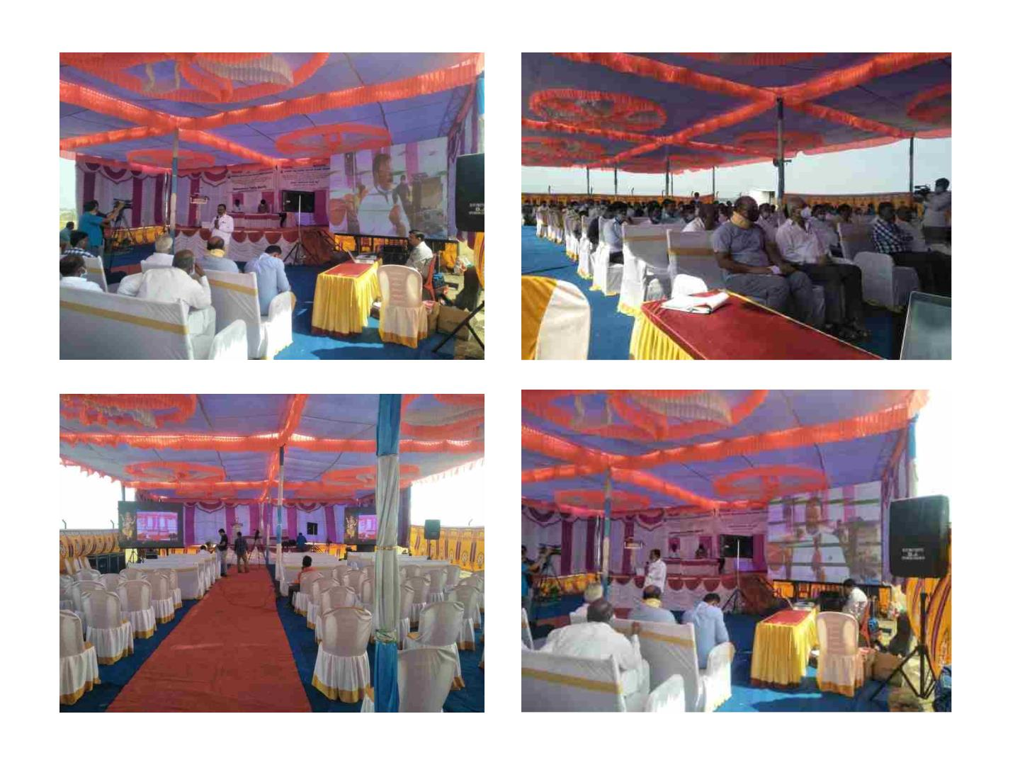
PublicꢀConsultationꢀPhotographs
72

Slide 73

THANK YOU
73

