Slide 1


PRESENTATION FOR GRANT OF EVIRONMENTAL CLEARANCE for
Proposed Greenfield Project-3.85 MTPA throughput Iron Ore Beneficiation and 2.0 MTPA Pellet Plant with Producer Gas Plant (5 x 15000 Nm3/hr) at
Palaspanga, Block – Kendujhar Town, District – Keonjhar, Odisha
Cat. ‘A’; ToR Granted: 24.10.2019;
Baseline Study Period: 1st Study Period- 1st March 2019 – 31st May 2019 (Summer Season)
2nd Study Period- 1st March 2021 – 31st May 2021 (Summer Season)
WARM WELCOME TO HON’BLE CHAIRMAN & MEMBERS OF THE RECONSTITUTED EXPERT APPRAISAL COMMITTEE (INDUSTRY-1), MoEF&CC, NEW DELHI
Project Proponent: Orissa Sponge Iron and Steel Limited
VISIONTEK CONSULTANCY SERVICES PVT. LTD., BHUBANESWAR
NABET Certificate No.- NABET/EIA/2023/RA 0209,Valid Up to: 16th Dec. 2023

Slide 2
BRIEF INFORMATION
S. No. | Particulars | Details
1 | Date of Grant of ToR | 24th October, 2019 (F. No. J-11011/275/2019-IA.II (I))
2 | Baseline Study Period | 1st Baseline Study: 2019 (March-May) (Summer Season) 2nd Baseline Study: 2021 (March-May) (Summer Season)
3 | Date of Public Hearing | 15.04.2021 at Village Murusuan Khata No. 13 (Rakhit), Plot no. 986) of Palaspanga Gram Panchayat of Keonjhar District
4 | Proposed Configuration | Product | Proposed Capacity | (Final Production)
 |  | Iron Ore Beneficiation Plant | 3.85 MTPA Throughput | Beneficiated ore - 2.5 MTPA
 |  | Iron Ore Pellet Plant | 2.0 MTPA | 2.0 MTPA
 |  | Producer Gas Plant | (5X15000 Nm3/hr) | 75,000 Nm3/hr
5 | Project Cost | Rs. 500 Crores |  | 5
6 | EMP Cost (Capital And Recurring) | EMP Capital Cost: Rs. 12 Crores, Recurring Cost: Rs. 1.11 Crores/Annum |  | 6
7 | Interlinked Project, If Any, With Status | No Interlinked Project |  | 7

Slide 3
BRIEF INFORMATION
S. No. | Particulars | Details
8 | Manpower Details | 350 Nos.
9 | Water requirement | Total Water requirement: 2345.29 m3/day |  |  | Source- Ardei River
10 | Fuel requirement | FO/LDO: 25,000 KL/year PGP: 5 x 15,000 Nm3/hr Coal for PGP: 2,00,000 TPA
11 | Power requirement | Total: 32 MW |  | Source: 15 MW- GRIDCO ltd. 17 MW- Existing plant of M/s OSISL | Source: 15 MW- GRIDCO ltd. 17 MW- Existing plant of M/s OSISL
12 | Land details | Total Area = 158.59 Acre (64.18 Ha) [Industrial Land]
13 | Land Acquisition & R&R Issue | Total land of 158.59 Acres (64.18 Ha) already in possession. No acquisition proposed. There is no existence of habitants identified within the plant boundary. Hence no R&R issues
14 | Land Details as per Land records | Lease Deed No./Date | Land Area |  |  | Village/Mouza
 |  | Lease Deed No.-30764 Dated-27.09.1993 | 158.59 Acres |  |  | Palaspanga

Slide 4
BRIEF INFORMATION
Plot/khasra No. | 17-46 52-56
Geographical Coordinates | Latitude-21°47'19.89"N to 21°48'8.49"N Longitude- 85°34'9.67"E to 85°34'41.67"E
Village, Tehsil, District & State | Village – Palaspanga, Block – Kendujhar Town, District – Keonjhar, Odisha
Survey of India (SOI) Topo-sheet No | F45N5 & F45N6, F45N9 & F45N10
Height above MSL | 428 m - 457 m
Topography of project site | The topography of the land is generally flat and well suited for development of industrial projects.

Slide 5
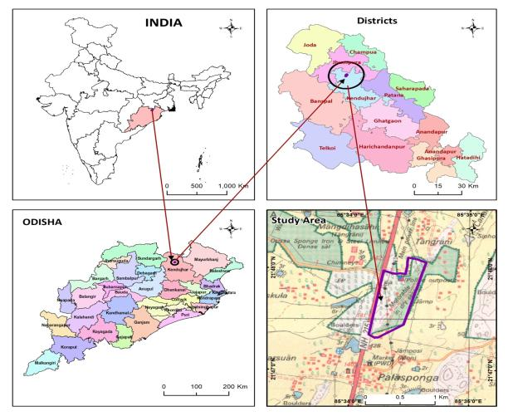
LOCATION MAP
Location of the project site
Village:- Palaspanga,
Tehsil – Kendujhar Town,
District – Keonjhar,
State- Odisha.
Latitude:
21°47'19.89"N to 21°48'8.49"N
Longitude:
85°34'9.67"E to 85°34'41.67"E

Slide 6
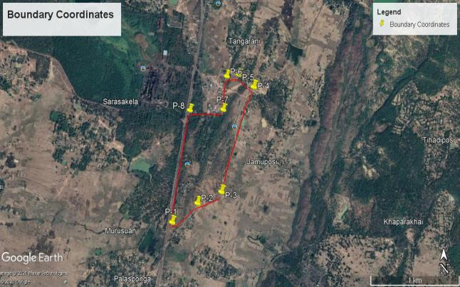
GOOGLE EARTH IMAGERY
Corner Index | Latitude (N) | Longitude (E)
1 | 21°47'19.89"N | 85°34'9.67"E
2 | 21°47'26.18"N | 85°34'19.62"E
3 | 21°47'29.96"N | 85°34'29.04"E
4 | 21°48'4.78"N | 85°34'41.76"E
5 | 21°48'9.07"N | 85°34'35.94"E
6 | 21°48'8.51"N | 85°34'31.23"E
7 | 21°47'57.43"N | 85°34'29.82"E
8 | 21°47'57.22"N | 85°34'16.68"E
Source: Google Earth

Slide 7
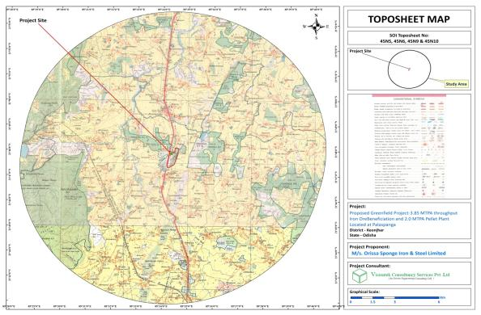
TOPOGRAPHICAL MAP

Slide 8
LAND ACQUISITION DETAILS
Land Acquisition Status | Total land of 158.59 Acres (64.18 Ha) already in possession which is is Industrial Land. The land is allotted by IDCO. There is no existence of habitants identified within the plant boundary. Hence no R&R issues

Slide 9
ENVIRONMENTAL SETTINGS OF PROJECT SITE
Nearest State/ National Highway | NH-215- Adjacent to west boundary of Plant site
Nearest Railway Station | Parjanpur Railway Station , approx. 4.75KM (W).
Nearest Commercial Airport | Biju Patnaik International Airport, Bhubaneswar – 230 km
Ecologically sensitive areas (Wild Life Sanctuary / National Park / Biosphere Reserve etc.) | Nil
RF / PF in Project Site | No forest land within the Project Site.
RF / PF In Study Area | Tangrani RF-0.60 Km, W Raikala RF- 1.28 Km, E Nayagarh RF- 6.0 Km, E Patabila RF- 8.80 Km, N Jodipada RF-6.0 Km, SE Lakshmiposi RF- 8.30 Km, NE
Nearest River / Dam & Distance of nearest Highest Flood Level (HFL) from the Project Boundary | Ardei River-2.1 Km, SW Jokdara River- 3.56 Km, W Tangrani Dam- 1.66 Km, NE Water reservoir, Jhumpura 1.65 Km, N Jagadala Reservoir- 9.63 Km, W Distance of nearest Highest Flood Level (HFL) from the Project Boundary- 1.95 km
Seismic Zone | Zone – II; (Low Damage Risk Zone) {as per IS 1893 (Part-I): 2002}
Nearest Densely populated or built-up area; Village Panchayat/Municipal Corporation | Murusuan-0.5 KM, S Saraskela- 0.75 KM, W Balisuan- 3.30 Km, SE Jhumpura – 2.06 Km, N

Slide 10
PROPOSED UNIT CONFIGURATION WITH CAPACITY IN TPA
Particulars | Proposed Capacity in MTPA
Iron Ore Beneficiation Plant | 3.85 MTPA Throughput (Beneficiated ore - 2.5 MTPA)
Iron Ore Pellet Plant | 2.0 MTPA
Producer Gas Plant | (5X15000 Nm3/hr)

Slide 11
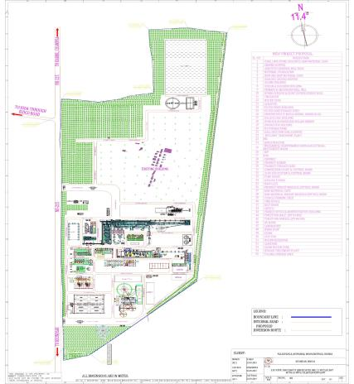
PLANT LAYOUT
PLANT LAYOUT

Slide 12
RAW MATERIAL CONSUMPTION
Sr. No | Proposed Facility | Raw material | Quantity | Source | Distance /Mode of Transportation
1. | Beneficiation Plant (3.85 MTPA) | Iron Ore Fines | 3.85 MTPA | Nearby Iron Ore Mines of Keonjhar, Joda & Barbil areas. | By Rail & Road, Up to 120 Km (Nearest Railway Siding Parjanpur Railway Station , approx. 4.75KM (W).)
2. | Pellet Plant (2.0 MTPA) | Coke Breeze | 37,500 Tons/year | Open market/ JSL/ Visa Steel in Jajpur Area | By Road 150 Km
 |  | Bentonite | 12,500 Tons/year | Rajasthan | By Road 1750 Km
 |  | Limestone/ Dolomite fines | 25,000 Tons/year | Rourkela | By Road 200 KM
 |  |  |  | Rourkela | By Road 200 KM
 |  | FO/LDO | 25,000 KL/year | Nearest Oil depot | By Road 15 Km
 | PG Plant (5 x 15000 Nm3/hr) | Coal | 200000 Tons/year | Open Auction MCL, SECL etc. having mines in Talcher & Sambalpur areas. | By Road 120 KM

Slide 13
FUEL, POWER / ENERGY & WATER REQUIREMENT WITH REQUISITE PERMISSION DETAILS
Sl. No. | Type | Requirement | Remark
1 | FO/LDO | 25,000 KL/Annum | Source: Nearest Oil depot (15 km)
2 | Power/ Energy | Total: 32 MW Backup: 2x500 KVA | Source: 15 MW- GRIDCO ltd. Balance 17MW power demand will be fulfilled by importing from OTPCL/TPNDO by enhancing the power important agreement to match the total plant electrical load prior to commissioning of plant.
3 | Water Requirement | Total: 2345.29 KLD | Source: from Ardei river (through pipeline 2- 3 Km

Slide 14
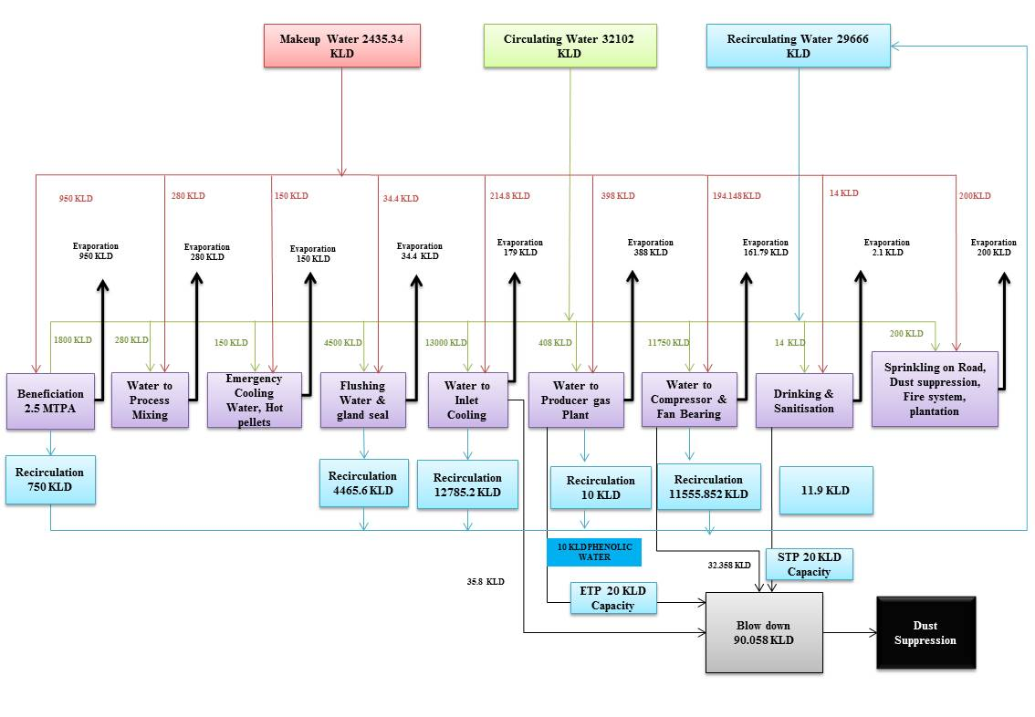
WATER BALANCE

Slide 15
MATERIAL BALANCE
Material Balance for Beneficiation Plant (TPA throughput)
Input |  | Output
Raw Material | Quantity in TPA | Product | Quantity in TPA
Iron ore fines | 38,50,000 | Beneficiated Iron ore (Fe%: >63) | 25,00,000
(Fe%: - 55 - 60; size < 10 mm )
- | - | Tailings | 13,50,000
Total Input | 38,50,000 | Total Output | 38,50,000
Material Balance for Pellet Plant (2.0 MTPA)
Input |  |  | Output
Item | Quantity kg/T | T/Yr | Item | Quantity kg/T | T/Yr
Beneficiated ore | 1118 | 2,236,000 | Pellet | 1000 | 2,000,000
Bentonite | 6.25 | 12,500 | Return Fines | 51.24 | 102,480
 |  |  | (Pellet fines& ESP dust)
Lime Stone/Dolomite | 12.5 | 25,000 | LOI & Moisture | 201.55 | 403,100
Green Ball Moisture | 46.05 | 92,100 | - | - | -
Coke (Dry) | 18.75 | 37,500 | - | - | -
Return Fines (DRY) | 51.24 | 102,480 | - | - | -
Total | 1252.8 | 2,505,580 | Total | 1252.79 | 2,505,580

Slide 16
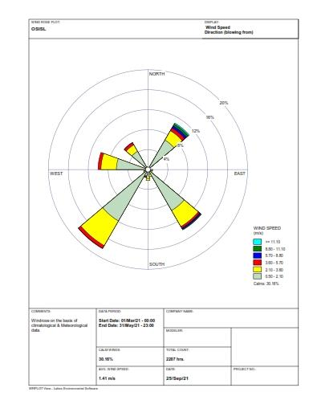
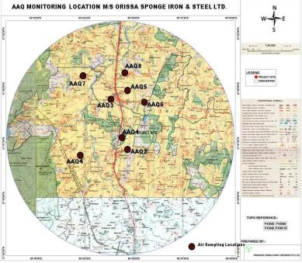
BASE LINE STUDY AREA MAP WITH LOCATIONS
Ambient Air Quality (AAQ) Monitoring Stations (March-May 2019)
Sr. No. | Locations | Station Code | Aerial Distance from plant site (Km) | Direction from plant site | Co-ordinate | Type of Area
1. | Project Site | A1 | -- | -- | 21°47′53.92″ N 85°34′20.45″ E | Industrial Area
2. | Jamuposi | A2 | 1.03 | SE | 21°47'52.70"N 85°34'56.35"E | Settlement Area
3. | Jumpura | A3 | 2.94 | NNW | 21°49'29.12"N 85°34'7.83"E | Settlement Area
4. | Patung | A4 | 4.09 | SWS | 21°46'54.06"N 85°32'13.36"E | Settlement Area
5. | Bhaluka | A5 | 3.1 | NE | 21°49'34.92"N 85°34'25.44"E | Settlement Area
6. | Shrinampur | A6 | 2.63 | NNE | 21°49'5.84"N 85°35'10.47"E | Settlement Area
7. | Silisuan | A7 | 5.93 | WNW | 21°50'24.00"N 85°32'11.09"E | Settlement Area
8. | Arsala | A8 | 4.66 | NE | 21°50'25.33"N 85°34'11.09"E | Settlement Area
Ambient Air Quality Monitoring
Locations Map & Result

Slide 17
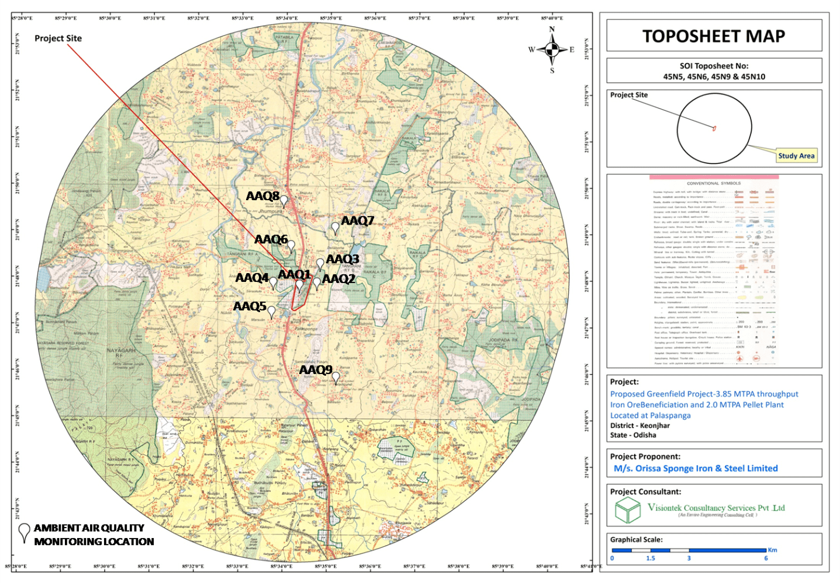
BASE LINE STUDY AREA MAP WITH LOCATIONS
Ambient Air Quality (AAQ) Monitoring Stations (March-May 2021)
Station | Location Name | Distance | Direction | Justification | Latitude | Longitude
AAQ1 | At Project Site |  |  | Core Zone | 21°47'40.38"N | 85°34'18.28"E
AAQ2 | Jamuposi village | 0.35 km | E | Nearest habitation from project site | 21°47'43.94"N | 85°34'44.55"E
AAQ3 | Tangarani village | 0.40 km | NE | 1st predominant Downwind direction / Nearest village to the project site | 21°48'9.56"N | 85°34'50.97"E
AAQ4 | Sarasakela village | 0.80 km | W | Crosswind / Habitation near the project site | 21°47'47.14"N | 85°33'45.84"E
AAQ5 | Palasponga village | 0.90 km | SW | 1st predominant Upwind direction / Village nearby project site | 21°47'6.67"N | 85°33'45.04"E
AAQ6 | Nuagaon village | 1.10 km | NW | 2nd predominant Downwind direction / Village nearby project site | 21°48'34.39"N | 85°34'5.08"E
AAQ7 | Srirampur village | 2.0 km | NNE | Habitation in 1st downwind direction | 21°48'59.75"N | 85°35'8.39"E
AAQ8 | Jhumpura village | 2.70 km | NW | 2nd pre-dominant Downwind direction / Dense habitation along transport road | 21°49'27.93"N | 85°33'59.18"E
AAQ9 | Balisuan village | 3.40 km | SE | 2nd predominant Upwind direction | 21°45'42.64"N | 85°35'12.33"E
Ambient Air Quality Monitoring
Locations Map & Result

Slide 18
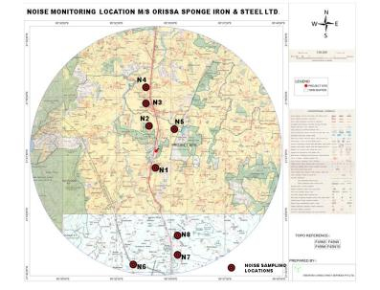
BASE LINE STUDY AREA MAP WITH LOCATIONS
Ambient Noise Level Monitoring Locations (March-May 2019)
Station Code | Location | Direction w.r.t. Plant Site | Distance from Plant Site (Km) | Co-ordinate | Type of Area
N1 | Palasponga | 1.76 | S | 21°47'2.99"N 85°33'52.37"E | Settlement Area
N2 | Luhagudi | 1.87 | NW | 21°48'54.59"N 85°34'20.50"E | Settlement Area
N3 | Jhumpura | 2.92 | NW | 21°49'28.44"N 85°34'9.61"E | Settlement Area
N4 | Bishnupur | 3.74 | NW | 21°49'51.37"N 85°33'45.91"E | Settlement Area
N5 | Spongepatana | 1.18 | NNE | 21°48'28.26"N 85°34'38.84"E | Settlement Area
N6 | Badabil | 9.68 | SW | 21°42'43.68"N 85°33'24.43"E | Settlement Area
N7 | Banajodi | 9.22 | SE | 21°42'59.50"N 85°35'21.91"E | Settlement Area
N8 | Putulia | 7.23 | SE | 21°44'2.07"N 85°35'2.20"E | Settlement Area
Ambient Noise monitoring locations, Results & Noise Modeling

Slide 19
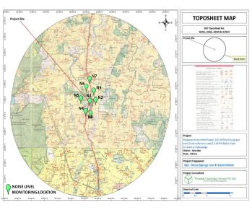
BASE LINE STUDY AREA MAP WITH LOCATIONS
Ambient Noise Level Monitoring Locations (March-May2021)
Station | Location Name | Distance | Direction | Justification | Latitude | Longitude
N1 | At Project Site |  |  | Core zone | 21°47'40.29"N | 85°34'18.28"E
N2 | Jamuposi village | 0.35 km | E | Nearest habitation | 21°47'43.03"N | 85°34'45.96"E
N3 | Tangarani village | 0.40 km | N | village near to the project site | 21°48'17.39"N | 85°34'39.44"E
N4 | Nodal UP School, Palasponga | 0.70km | SSW | Near school area / Nearby village area | 21°46'59.77"N | 85°34'1.32"E
N5 | Sarasakela | 1.00 km | W | Village area close to the project site / Other nearby industry | 21°47'51.62"N | 85°33'40.27"E
N6 | Nuagaon village near Grid Sub-station, Odisha Power Transmission Corporation Ltd. | 1.10 km | NW | Habitat nearby/ Adjacent to Indusrty | 21°48'33.81"N | 85°34'3.52"E
N7 | Misbaah English Medium School, Jhumpura | 1.50 km | N | School building | 21°48'55.35"N | 85°34'20.14"E
N8 | Near Payal Variety Store, Palaspanga | 0.63 km | SE | Habitation nearby project site | 21°47'7.29"N | 85°34'28.76"E
Ambient Noise monitoring locations, Results & Noise Modeling

Slide 20
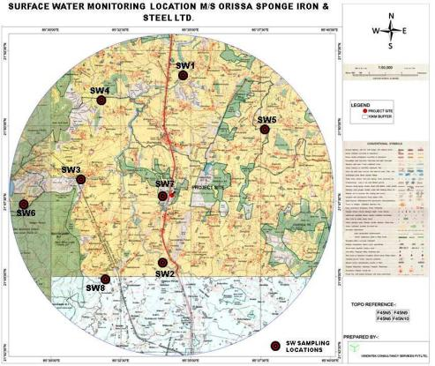
BASE LINE STUDY AREA MAP WITH LOCATIONS
Surface water monitoring locations (March- May 2019)
Surface Water Sampling
Location Map & Results
Code | Location | Distance from Plant Site (km) | Direction w.r.t. Plant Site | Coordinate
Surface Water Quality
River Water
SW1 | Ardei River Up-stream | 7.61 | N | 21°51'59.89"N 85°34'46.79"E
SW2 | Ardei River Down-stream | 4.36 | S | 21°45'34.42"N 85°33'52.90"E
SW3 | Jokdara River | 5.78 | WNW | 21°48'9.55"N 85°31'0.12"E
SW4 | Tamajor Nalla | 7.53 | NW | 21°51'6.51"N 85°31'39.25"E
SW5 | Amunijora River | 7.03 | NE | 21°49'55.06"N 85°37'48.07"E
SW6 | Barhgarhia Nala | 9.33 | W | 21°47'19.80"N 85°28'57.63"E
SW7 | Pond near Sarasakula | 0.82 | W | 21°47'41.79"N 85°33'55.16"E
SW8 | Kadal Nala | 6.66 | SW | 21°45'1.49"N 85°31'59.91"E

Slide 21
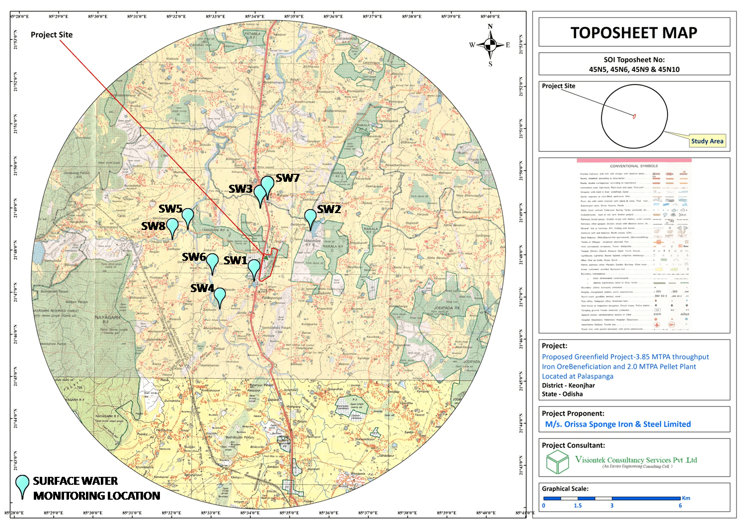
BASE LINE STUDY AREA MAP WITH LOCATIONS
Surface water monitoring locations (March- May 2021)
Surface Water Sampling
Location Map & Results
Station | Location Name | Distance | Direction | Justification | Latitude | Longitude
SW1 | Pond nearby plant in Sarsakela Village. | 0.18 km | W | Nearest water body adjacent to Plant boundary/ Slope towards the pond from plant site | 21°47'20.07"N | 85°34'3.64"E
SW2 | Tangarani Dam | 1.70 km | NE | Dam (water used for agricultural purpose) near the project site | 21°48'32.42"N | 85°35'28.62"E
SW3 | Canal near NH-215 | 1.80 km | NW | Canal (water used for irrigation purpose) /Slope towards the canal | 21°49'0.68"N | 85°34'6.16"E
SW4 | Aradei River, Near M/s. Brand Steel and Power Pvt. Ltd. | 2.14 km | SW | Upstream of river / Adjacent to M/s. Brand Steel and Power Pvt. Ltd. | 21°46'37.12"N | 85°33'11.65"E
SW5 | Confluence point of Jokdara River and Aradei River | 3.52 km | WNW | Downstream of river / Nearby Joda-Bamebari-Palasponga Road | 21°48'32.56"N | 85°32'19.95"E
SW6 | Aradei River, Nuadih village | 2.14 km | W | Confluence point of Aradei River & water from SW7/ Water used in irrigation by Nuadih Villagers | 21°47'25.82"N | 85°32'55.43"E
SW7 | Water Reservoir, Jhumpura | 2.02 KM | N | Water used for itrrigation by Jhumpura Villagers/Near to Dense Habitat | 21°49'13.68"N | 85°34'20.82"E
SW8 | Jokdara River near Satikudar | 4.02 km | W | Water used for irrigation purpose by nearby village | 21°48'16.57"N | 85°31'58.13"E

Slide 22
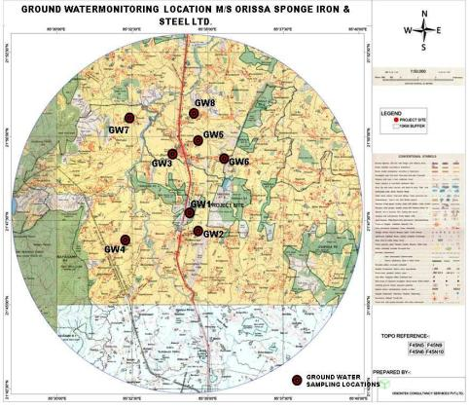
BASE LINE STUDY AREA MAP WITH LOCATIONS
Ground water monitoring locations (March- May 2019)
Ground Water Sampling
Location Map, Results
Code | Location |  | Distance from Plant Site (km) | Direction w.r.t. Plant Site |  | Coordinate
GW1 | Project Site | -- |  | -- | 21°47′53.92″ N 85°34′20.45″ E
GW2 | Jamuposi | 1.03 |  | SE | 21°47'52.70"N 85°34'56.35"E
GW3 | Jumpura | 2.94 |  | NNW | 21°49'29.12"N 85°34'7.83"E
GW4 | Patung | 4.09 |  | SWS | 21°46'54.06"N 85°32'13.36"E
GW5 | Bhaluka | 3.1 |  | NE | 21°49'34.92"N 85°34'25.44"E
GW6 | Shrinampur | 2.63 |  | NNE | 21°49'5.84"N 85°35'10.47"E
GW7 | Silisuan | 5.93 |  | WNW | 21°50'24.00"N 85°32'11.09"E
GW8 | Arsala | 4.66 |  | NE | 21°50'25.33"N 85°34'11.09"E

Slide 23
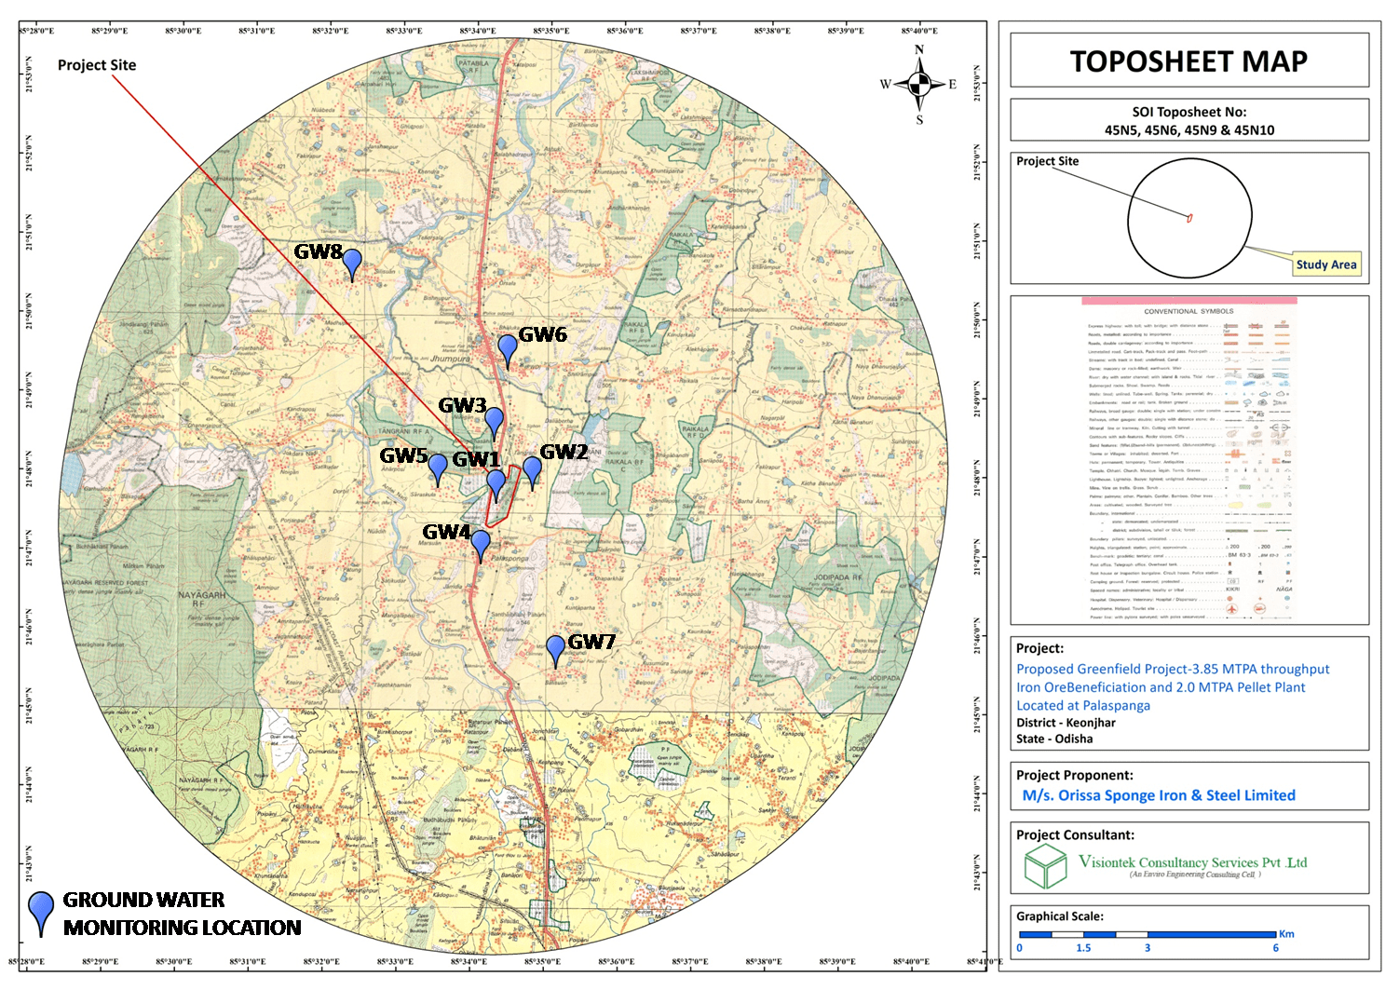
BASE LINE STUDY AREA MAP WITH LOCATIONS
Ground water sampling locations (2021)
Ground Water Sampling
Location Map, Results
Station | Location Name | Distance | Direction | Justification | Latitude | Longitude
GW1 | At Project Site |  |  | Core zone | 21°47'34.34"N | 85°34'14.72"E
GW2 | Jamuposi village | 0.35 km | E | Borewell (used for drinking purpose)/ Nearest habitation from project site | 21°47'43.55"N | 85°34'45.71"E
GW3 | Near Corporateoffice of Odisha Power Transmission Corporation Limited, Palaspanga | 0.70 km | NW | Borewell (used for drinking purpose) / Habitat nearby Industrial Plant | 21°48'23.29"N | 85°34'15.14"E
GW4 | Shiva Temple, Near Palasponga bus stop | 1.00 km | S | Dense Habitat/ Borewell (used for drinking purpose) / Nearby village area / Nearby public place | 21°46'50.17"N | 85°34'3.87"E
GW5 | Sarasakela | 1.25 km | W | Borewell (used for drinking purpose) / Village area nearby project site | 21°47'47.20"N | 85°33'30.73"E
GW6 | PS Girls High School, Jhumpura | 2.20 km | N | Densly populated area/ Borewell (used for drinking purpose) | 21°49'17.71"N | 85°34'27.91"E
GW7 | Balisuan Village | 3.67 km | SE | Borewell (used for drinking purpose)/Village Nearby MSP Sponge Iron Plant | 21°45'31.13"N | 85°35'9.13"E
GW8 | Silisuan Village | 5.80 KM | NW | Borewell (used for drinking purpose) | 21°50'24.00"N | 85°32'11.09"E

Slide 24
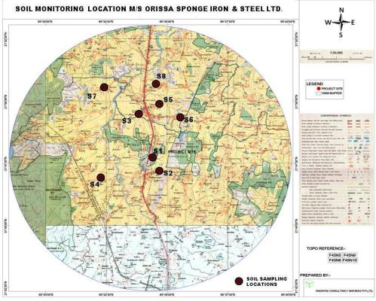
BASE LINE STUDY AREA MAP WITH LOCATIONS
Sampling Locations for Soil (March-May 2019)
Soil Sampling
Location Map and Results
Station Code | Location | Distance from Plant Site (Km) | Direction w.r.t. Plant Site | Co-ordinate
S1 | Project Site | -- | -- | 21°47′53.92″ N 85°34′20.45″ E
S2 | Jamuposi | 1.03 | SE | 21°47'52.70"N 85°34'56.35"E
S3 | Jumpura | 2.94 | NNW | 21°49'29.12"N 85°34'7.83"E
S4 | Patung | 4.09 | SWS | 21°46'54.06"N 85°32'13.36"E
S5 | Bhaluka | 3.1 | NE | 21°49'34.92"N 85°34'25.44"E
S6 | Shrinampur | 2.63 | NNE | 21°49'5.84"N 85°35'10.47"E
S7 | Silisuan | 5.93 | WNW | 21°50'24.00"N 85°32'11.09"E
S8 | Arsala | 4.66 | NE | 21°50'25.33"N 85°34'11.09"E

Slide 25
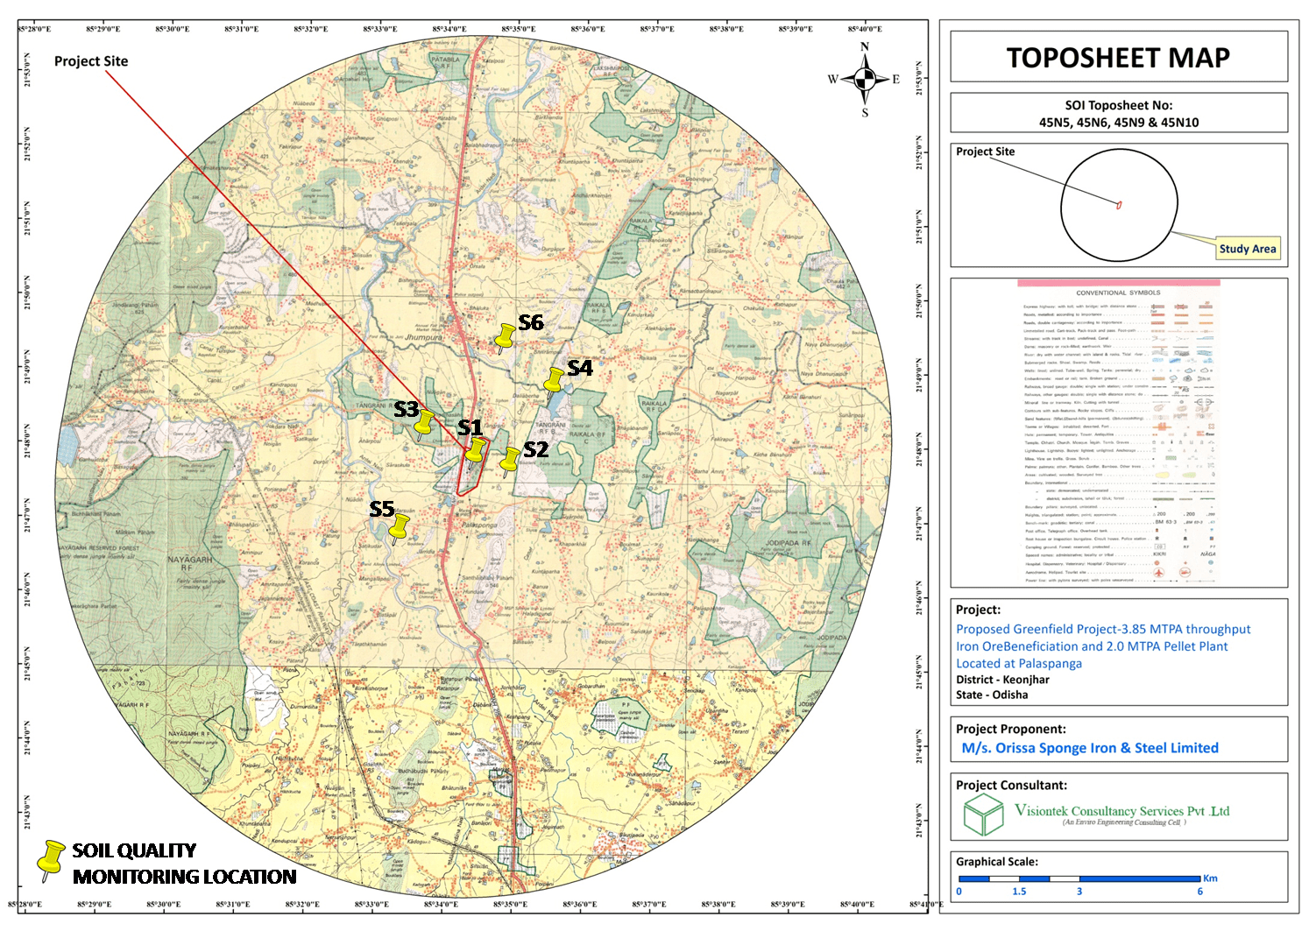
BASE LINE STUDY AREA MAP WITH LOCATIONS
Sampling Locations for Soil (March-May 2021)
Soil Sampling
Location Map and Results
Station | Location Name | Distance | Direction | Justification | Latitude | Longitude
S1 | At Project Site |  |  | On -Site Location / Scrubland | 21°47'39.88"N | 85°34'18.37"E
S2 | Hundula Village | 0.55 km | E | Agriculture land near plant site | 21°47'32.16"N | 85°34'49.23"E
S3 | Near KIDKO Toll Plaza, Sarasakela | 1.13 km | W | Mixed Deciduous Forest land / Close to industry | 21°48'2.24"N | 85°33'37.96"E
S4 | Daliaberha village (near Tangarani Dam) | 1.88 km | NE | Barren land/ Near to Tangarani Dam | 21°48'40.01"N | 85°35'28.14"E
S5 | Murusuan village | 2.00 km | SW | Cropland near Industrial plant/ Adjacent to Ardei River | 21°46'39.57"N | 85°33'16.24"E
S6 | Near Block Office, Jhumpura | 2.09 km | N | Built-up land / Nearby densely populated area | 21°49'12.96"N | 85°34'41.42"E

Slide 26
METEOROLOGICAL DETAILS WITH WIND ROSE DIAGRAM (2019)
Sl. No. | Parameters |  | Mar-19 | Apr-19 | May-19
1 | Temperature (0C) | Minimum | 20.4 | 20.7 | 21.6
 |  | Maximum | 39.1 | 41.2 | 42.2
 |  | Average | 28.5 | 29.7 | 31.6
2 | Relative Humidity (%) | Minimum | 37.0 | 41.0 | 38.0
 |  | Maximum | 92.0 | 87.0 | 91.0
 |  | Average | 63.1 | 58.0 | 63.4
3 | Wind Speed (m/Sec) | Average | 1.24 | 1.22 | 2.0
4 | Wind Direction (%) | E | 1.2 | 1.3 | 2.4
 |  | ENE | 0.4 | 0.3 | 0.7
 |  | ESE | 0.8 | 1.8 | 3.0
 |  | N | 0.4 | 0.1 | 0.9
 |  | NE | 7.7 | 12.2 | 12.8
 |  | NNE | 0.7 | 1.0 | 0.7
 |  | NNW | 1.1 | 0.3 | 0.9
 |  | NW | 9.4 | 5.3 | 2.4
 |  | S | 3.4 | 1.0 | 2.4
 |  | SE | 4.2 | 13.6 | 20.2
 |  | SSE | 1.2 | 1.8 | 2.7
 |  | SSW | 2.4 | 0.8 | 1.3
 |  | SW | 16.9 | 18.8 | 15.2
 |  | W | 12.4 | 6.8 | 7.1
 |  | WNW | 0.9 | 1.0 | 0.7
 |  | WSW | 1.3 | 0.6 | 0.9
 |  | CALM | 35.6 | 33.5 | 25.7
5 | Cloud Cover (%) | Minimum | 0 | 0 | 0
 |  | Maximum | 4 | 3 | 7
6 | Rainfall (mm) | Monthly Total | 5.5 | 4.5 | 72.5

Slide 27
METEOROLOGICAL DETAILS WITH WIND ROSE DIAGRAM (2021)
Sl. No. | Parameters |  | Mar-21 | Apr-21 | May-21
1 | Temperature (0C) | Minimum | 20.3 | 21.5 | 18.5
 |  | Maximum | 43.5 | 43.9 | 39.9
 |  | Average | 31.4 | 32.4 | 30.0
2 | Relative Humidity (%) | Minimum | 42.0 | 41 | 43
 |  | Maximum | 76.0 | 94 | 97
 |  | Average | 62.0 | 62.2 | 68.4
3 | Wind Speed (m/Sec) | Average | 1.3 | 1.3 | 1.9
4 | Wind Direction (%) | E | 0.5 | 1.4 | 0.9
 |  | ENE | 0.0 | 0.4 | 0.4
 |  | ESE | 0.5 | 0.7 | 1.3
 |  | N | 0.1 | 0.3 | 0.9
 |  | NE | 7.7 | 11.4 | 13.2
 |  | NNE | 0.4 | 0.7 | 0.4
 |  | NNW | 0.7 | 0.4 | 0.5
 |  | NW | 10.5 | 6.4 | 1.9
 |  | S | 3.6 | 1.1 | 1.9
 |  | SE | 5.0 | 14.7 | 22.2
 |  | SSE | 0.7 | 1.8 | 2.0
 |  | SSW | 2.3 | 1.3 | 1.5
 |  | SW | 18.0 | 19.7 | 17.2
 |  | W | 13.7 | 7.8 | 8.6
 |  | WNW | 1.1 | 0.6 | 0.3
 |  | WSW | 1.1 | 0.6 | 1.2
 |  | CALM | 34.1 | 30.8 | 25.5
5 | Cloud Cover (%) | Minimum | 0 | 0 | 0
 |  | Maximum | 4 | 4 | 6
6 | Rainfall (mm) | Monthly Total | 0 | 5.5 | 277.4

Slide 28
BASE LINE STUDY REPORTS (2019)
Period | 1st March 2019 to 31st May 2019
AAQ parameters at 8 Locations | Parameter | Maximum | Minimum | 98th Percentile
 | PM2.5 | 46.6 μg/m3 | 22.9 μg/m3 | 27.6 to 46.3 μg/m3
 | PM10 | 81.6 μg/m³ | 40.8μg/m³ | 49.2 to 81.4 μg/m^{3.}
 | SO₂ | 21.6 μg/m3 | 7.6 μg/m3 | 11.2 to 21.4 μg/m3
 | NO₂ | 30.6 μg/m3 | 14.6μg/m3 | 19.4 to 29.0 μg/m3
 | CO | 0.62 mg/m3 | 0.1 mg/m3 | 0.16 to 0.62 mg/m3
Ground water quality at 8 locations | Parameter | Unit | Maximum | Minimum
 | pH | NA | 7.2 | 5.9
 | Hardness | mg/l | 491 | 129
 | Fluoride | mg/l | < 0.1
 | Chloride | mg/l | 186.0 | 38.0
 | Zinc | mg/l | 3.65 | BDL <0.03
 | TDS | mg/l | 599.0 | 215.0

Slide 29
BASE LINE STUDY REPORTS
Surface water quality at 8 locations | Parameter | Unit | Maximum | Minimum
 | pH | NA | 7.65 | 6.2
 | DO | mg/l | 6.4 | 5.7
 | BOD | mg/l | 3.2 | 2.0
 | COD | mg/l | 28.0 | 10.0
Soil Quality at 8 Locations | Parameter | Unit | Maximum | Minimum
 | pH | NA | 7.74 | 5.72
 | Nitrogen | mg/kg | 54 | 32
 | Phosphorous | mg/kg | 45 | 18
 | Potassium | mg/kg | 63.4 | 20
 | Electrical conductivity | mS/cm | 84.7 | 16.5
Noise Levels at 8 locations | Ambient noise reaches 49.2 to 57.3 dB(A) during day time and 39.4 to 43.4 dB(A) during night time.

Slide 30
BASE LINE STUDY REPORTS
Period | 1st March 2021 to 31st May 2021
AAQ parameters at 9 Locations | Parameter | Maximum | Minimum | 98th Percentile
 | PM2.5 | 49.0 μg/m³ | 23.1μg/m³ | 31.9 to 48.9 μg/m³
 | PM10 | 88.7 μg/m³ | 42.6 μg/m³ | 57.8 to 88.2 μg/m³
 | SO₂ | 21.4 μg/m³ | 9.1 μg/m³ | 12 to 21.4 μg/m³
 | NO₂ | 30.7 μg/m³ | 15.7 μg/m³ | 20.4 to 30.5 μg/m³
 | CO | 0.63 mg/m3 | 0.16 mg/m3 | 0.27 to 0.61 mg/m3
AAQ Modelling (AERMOD version 9.9.0 ) Maximum Incremental | Parameter | Incremental | Distance | Direction
 | PM2.5 | 0.984 µg/m³ | 0.4 km | Northwest
 | PM10 | 1.47 µg/m³ | 0.4 km | Northwest
 | SO₂ | 1.56 µg/m³ | 0.4 km | Northwest
 | NO₂ | 2.31 µg/m³ | 0.4 km | Northwest
Ground water quality at 8 locations | Parameter | Unit | Maximum | Minimum
 | pH | NA | 7.5 | 6.4
 | Hardness | mg/l | 379 | 92
 | Fluoride | mg/l | 0.5 | 0.1
 | Chloride | mg/l | 120 | 13

Slide 31
BASE LINE STUDY REPORTS
Ground water quality at 8 locations | Parameter | Unit | Maximum | Minimum
 | Zinc | mg/l | 0.93 | BDL <0.03
 | TDS | mg/l | 506 | 160
 | Iron | Mg/l | 0.86 | 0.15
Surface water quality at 8 locations | Parameter | Unit | Maximum | Minimum
 | pH | NA | 8.0 | 7.2
 | DO | mg/l | 5.8 | 4.6
 | BOD | mg/l | 2.8 | 2.0
 | COD | mg/l | 32.0 | 12.0
Soil Quality at 6 Locations | Parameter | Unit | Maximum | Minimum
 | pH | NA | 8.1 | 6.2
 | Nitrogen | mg/kg | 60.0 | 23.8
 | Phosphorous | mg/kg | 50.0 | 15.0
 | Potassium | mg/kg | 493.2 | BDL
 | Electrical conductivity | microS/cm | 159 | 45
Noise Levels at 8 locations | Ambient noise reaches 47.9 to 53.7 dB(A) during day time and 37.0 to 42.3 dB(A) during night time.

Slide 32
TRANSPORTATION PLAN - VEHICULAR TRAFFIC LOAD STUDY AS PER IRC GUIDELINE
(a) Monitored Cumulative Traffic per day, Dt. 20.04.2021
(b) Monitored Cumulative Traffic per day, Dt. 22.04.2021
Sl No. | Study Location | Details | Volume (PCU/hr) | *Capacity (PCU/hr) | Existing V/C ratio | **Level of Service (LOS)
1. | Near entry gate of project site | Average Hour Load | 1189 | 3600 | 0.33 | B
 |  | Peak Hourly Load | 1605 | 3600 | 0.44 | C
2. | Near OSISL plant road | Average Hour Load | 715 | 1500 | 0.47 | C
 |  | Peak Hourly Load | 990 | 1500 | 0.66 | D
3 | Jhumpura Chakk | Average Hour Load | 1191 | 3600 | 0.33 | B
 |  | Peak Hourly Load | 1774 | 3600 | 0.49 | C
Sl No. | Study Location | Details | Volume (PCU/hr) | *Capacity (PCU/hr) | Existing V/C ratio | **Level of Service (LOS)
1. | Near entry gate of project site | Average Hour Load | 1198 | 3600 | 0.33 | B
 |  | Peak Hourly Load | 1662 | 3600 | 0.46 | C
2. | Near OSISL plant road | Average Hour Load | 734 | 1500 | 0.48 | C
 |  | Peak Hourly Load | 918 | 1500 | 0.61 | D
3 | Jhumpura Chakk | Average Hour Load | 1205 | 3600 | 0.33 | B
 |  | Peak Hourly Load | 1790 | 3600 | 0.49 | C

Slide 33
STACK EMISSION DETAILS: AFTER APCD WITH CONTROL MEASURES
Stack No | Stack Attached To | Qty. | Height, m | Flue Gas Temp. C | Stack Dia., |  | Max. Velocity in Stack, m/s | Mass flow rate (Kg/s) | *Flue Gas Qty., Nm³/sec | Controlled Concentration
 |  |  |  |  | Bottom | Top |  |  |  | PM |  |  |  | SO₂ |  | NOx
 |  |  |  |  | (m) | (m)
 |  |  |  |  |  |  |  |  |  | mg/Nm3 | Emission g/s | PM10 | PM2.5 | mg/Nm3 | Emission g/s | mg/Nm3 | Emission g/s
Stack 1 | Induration Furnace Exhaust ESP | 1 | 65 | 135 | 6.8 | 4.5 | 14 | 211.53 | 223 | <30 | 6.5 | 3.9 | 2.6 | 45 | 10.0 | 25 | 5.57
Stack 2 | Indurance feed end bag filter | 1 | 35 | 50 | 2 | 1.3 | 13 | 19.3 | 17 | <30 | 0.50 | 0.3 | 0.2 | 22 | 0.40 | 14 | 0.42
Stack 3 | Indurance discharge end bag filter | 1 | 35 | 75 | 2 | 1.3 | 13 | 18.98 | 17 | <30 | 0.50 | 0.3 | 0.2 | 21 | 0.36 | 12 | 0.20
Stack 4 | Coke stone Grinding Bag Filter | 1 | 30 | 40 | 0.6 | 0.5 | 15.35 | 3.37 | 3 | <30 | 0.09 | 0.05 | 0.04
Stack 5 | lime stone Grinding Bag Filter | 1 | 30 | 40 | 0.6 | 0.5 | 15.35 | 3.37 | 3 | <30 | 0.09 | 0.05 | 0.04
Stack 6 | Proportioning system Bag Filter | 1 | 30 | 40 | 0.6 | 0.5 | 15.58 | 3.42 | 3 | <30 | 0.09 | 0.05 | 0.04
Stack 7 | Hearth Layer Separation Building | 1 | 35 | 70 | 2 | 1.3 | 14 | 3.08 | 19 | <30 | 0.55 | 0.33 | 0.22

Slide 34
PREDICTED GLC AT AMBIENT AIR QUALITY MONITORING STATIONS IN CONTROLLED CONDITION
Location ID | Locations | PM10 in µg/m3 |  |  | SO2 in µg/m3 |  |  | NOx in µg/m3 |  |  | PM 2.5
 |  | Background | Incremental | Resultant | Background | Incremental | Resultant | Background | Incremental | Resultant | Background | Incremental | Resultant
 |  | (Max) |  |  | (Max) |  |  | (Max) |  |  | (Max)
AAQ1 | At Project Site | 67.3 | 0.3 | 67.6 | 14.6 | 0.5 | 15.1 | 24.2 | 0.5 | 24.7 | 36.6 | 0.1 | 36.7
AAQ2 | Jamuposi village | 58 | 0.3 | 58.3 | 12.7 | 0.5 | 13.2 | 21.2 | 0.6 | 21.8 | 32 | 0.3 | 32.3
AAQ3 | Tangarani village | 62.1 | 0.5 | 62.6 | 12.3 | 0.6 | 12.9 | 20.6 | 0.5 | 21.1 | 33.6 | 0.3 | 33.9
AAQ4 | Sarasakela village | 68.2 | 0.5 | 68.7 | 14.4 | 0.4 | 14.8 | 25.1 | 0.5 | 25.6 | 39.2 | 0.3 | 39.5
AAQ5 | Palasponga village | 88.7 | 0.3 | 89.0 | 19.4 | 0.2 | 19.6 | 30.7 | 0.2 | 30.9 | 49.0 | 0.1 | 49.1
AAQ6 | Nuagaon village | 73.1 | 0.8 | 73.9 | 14.5 | 0.8 | 15.3 | 24.2 | 1.0 | 25.2 | 41.6 | 0.3 | 41.9
AAQ7 | Srirampur village | 61.7 | 0.5 | 62.2 | 13.4 | 0.7 | 14.1 | 22.6 | 0.6 | 23.2 | 33.5 | 0.5 | 34.0
AAQ8 | Jhumpura village | 84.1 | 0.3 | 84.4 | 21.4 | 0.7 | 22.1 | 29.2 | 0.5 | 29.7 | 49.2 | 0.3 | 49.5
AAQ9 | Balisuan village | 82.2 | 0.1 | 82.3 | 16.7 | 0.2 | 16.9 | 28 | 0.2 | 28.2 | 48.2 | 0.07 | 48.27

Slide 35
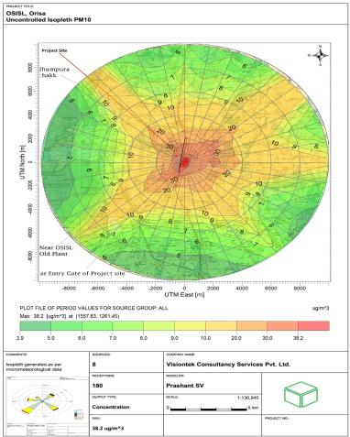
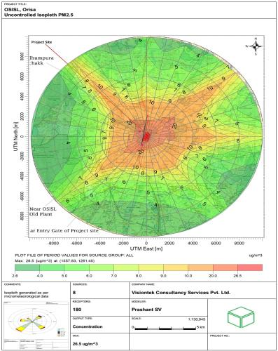
ISOPLETHS
Isopleths for 24 Hr. Incremental Conc. (μg/m³) for PM10 (worst case)
Isopleths for 24 Hr. Incremental Conc. (μg/m³) for PM2.5 (worst case)

Slide 36
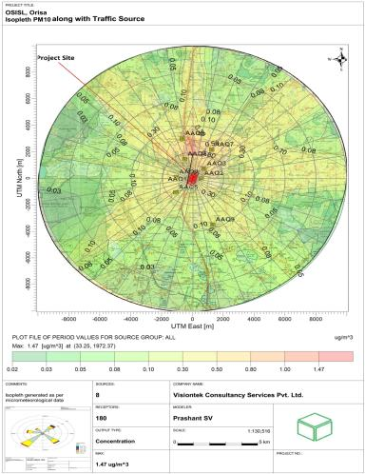
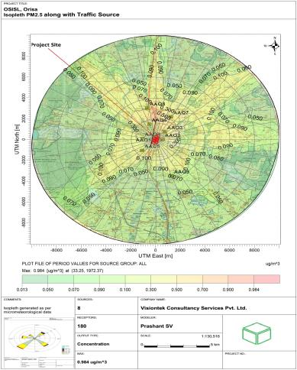
ISOPLETHS
Isopleths for 24 Hr. Incremental Conc. (μg/m³) for PM10 (Controlled)
Isopleths for 24 Hr. Incremental Conc. (μg/m³) for PM2.5 (Controlled)

Slide 37
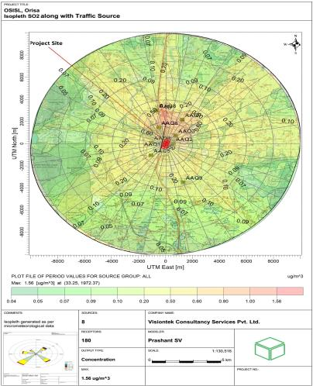
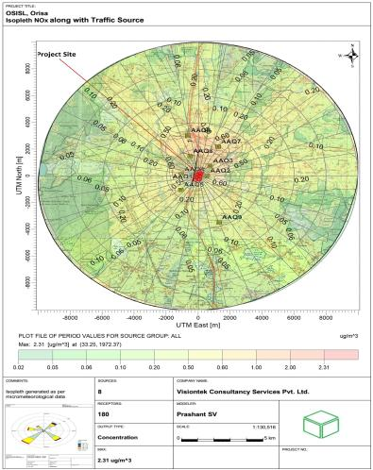
ISOPLETHS
Isopleths for 24 Hr. Incremental Conc. (μg/m³) for SO2 (Controlled)
Isopleths for 24 Hr. Incremental Conc. (μg/m³) for NOx (Controlled)

Slide 38
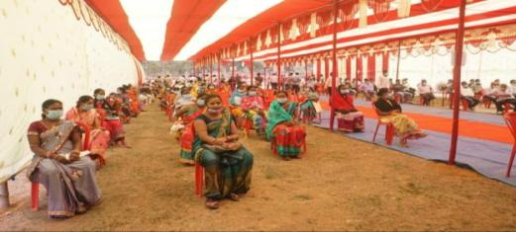
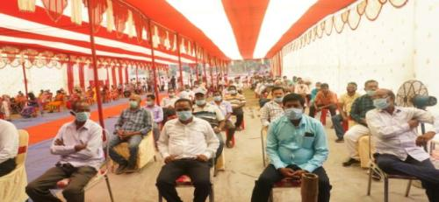
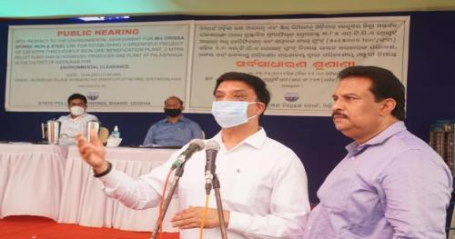
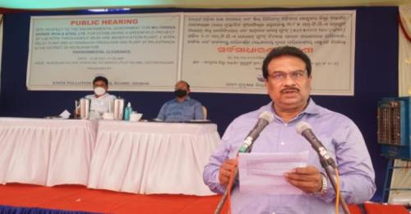
PUBLIC CONSULTATION PHOTOGRAPHS

Slide 39
PUBLIC CONSULTATION
The Public hearing was held on the scheduled date i.e. 15.04.2021 at Village Murusuan Khata No. 13 (Rakhit), Plot no. 986) of Palaspanga Gram Panchayat of Keonjhar District.
The Notice for conducting the public discussion was published in the daily Newspapers –Dhariti (Local newspaper mandate) and Times of India on 5th March, 2021.
The committee facilitating the Public hearing consisted of Shri Santosh Kumar Nayak, Additional District Magistrate, Keonjhar and Shri Puskar Chandra Behera, Regional Officer, Odisha State Pollution Control Board, Keonjhar Odisha. Shri Behera elaborated the need for public hearing with views, comments, objections along with opinions is mandate for availing Environmental Clearance.
The panel received 22 nos. of written representation of local people demanding different facilities in the locality during public hearing, which is enclosed. Mr. Mahapatra also mentioned that No direct Project Affected Families are identified as land losing families as Land Acquisition is not involved. No PAF would be losing home or land or both under the project.
The overall views and opinions of the Public during this meeting was in favour of Odisha Sponge Iron and Steel Limited (OSISL) without any agitation. Moreover, OSISL assured of adequate support and addressing the aspiration of the local community appropriately as laid in the deliberation.

Slide 40
Issues raised and Action plan in Public Hearing
Sl. No | Name and Address of the Representative | Public/Member Topic or Demand(s) Discussed based on needs | Response to the Public |  |  | Remarks
 |  |  | Commitment | Timeframe | Budget
1 | Sri Sanjay Kumar Naik, Sarpanch, Palaspanga Gram Panchayat. | Acknowledged the Greenfield Project. Demanded for Educational Institute Environmental protection measure, Employment, and Support to the cultural activities. | EMP has been formulated for controlling pollution. However, CER Budget has been for Development Activities within the peripheral villages | EMP have planned and CER has been planned for 3 years. | Apart from EMP Budget, 340 Lakh is assigned under CER. | Refer Chapter-10 of EIA Report for EMP Budget.
2 | Sri Srikanta Mahanta, Ex-Sarpanch, Palaspanga GP | Accredited OSISL’s initiatives of Greenfield project. Demanded for: Employment and Health Care Facilities for local villagers. | Approximately 350 nos of manpower is required (105 skilled; 160 unskilled and 85 Managerial) and considering the suitability, and requirement of OSISL employment to the local shall be provided. OSISL shall establish a Dispensary within the premises and it shall cater the requirement of the local villagers. Health Camps shall also be organized by OSISL. | Budget has been allocated under Occupational Health and Safety – EMP for establishing Dispensary for 3 years. 12 Health Camp shall be organized within a period of 3 years. | Out of Rs. 340 Lakhs CER Budget, Rs. 89 lakhs for Education, Rs. 90.5 Lakhs for Health, Rs. 63 Lakhs for Drinking Water, Rs. 42.5 lakhs for Environment and Rs. 55 Lakhs for Livelihood has been assigned. | Budget with Physical Targets is prepared..

Slide 41
Issues raised and Action plan in Public Hearing … Cont…
3 | Sri Anadi Charan Pradhan, Saraskola Village | Appreciated OSISL’s project with the following demand(s): Adequate Environment Protection measures Free medical facility with Ambulance due to potential dust pollution Support Farmers with seeds and fertilizer | OSISL’s EMP Budget (Capital & Recurring) has been allocated for Environment Protection measures. However, setting up a Dispensary with appropriate functioning along with an ambulance will be taken-up. Health camps shall be regularly organized | The Dispensary shall be established on the commencement of the project and shall function for next 3 years. Similarly, 12 nos. of Health camps will be organized within next 3 years | Out of Rs. 340 Lakhs CER Budget, Rs. 90.5 Lakhs for Health, Rs. 42.5 lakhs for Environment and Rs. 55 Lakhs for Livelihood has been assigned. The above mentioned is apart from EMP | Refer Chapter-10 of EIA Report for EMP Budget. CER budget along with physical targets are mentioned below.
4 | Sri Purna Chandra Sahani Village, PS member | Expressed his gladness for the 3 nos. of Public Hearing for OSISL and expressed that sudden closure of the plant have adverse impact on the community with loss of employment etc. The demands are: Massive plantation drive along with adequate pollution control measures Safety measures within the Plant Employment | OSISL has planned for Environment Management Cell with Safety, Occupational health division will take care of the Environment Protection measures and Occupational Safety. Apart from Greenbelt development, budget has been allocated for Plantation drive and rain water harvesting. As committed to Shri Mahanta, employment to the local shall be provided considering the suitability and requirement of OSISL. | CER Budget for Socio-Economic Development along with Physical targets has been planned for 3 years. | Out of Rs. 340 Lakhs CER Budget, Rs. 42.5 lakhs for Environment been assigned for rain Water Harvesting and Plantation Drive. | Budget with Physical Targets is attached below.

Slide 42
Issues raised and Action plan in Public Hearing … Cont…
5 | Sri Ratha Munda, Zila Parishad Member, Gobardhan Village | Supported the project. Requested the following: Massive Plantation drive with immediate effect Pollution Control Measures Moreover, the OSISL’s commitment for community development and Plantation with Pollution control should get implemented rather than getting limited to pen and paper. | Apart from Greenbelt development, budget has been allocated for Plantation drive and EMP budget has been assigned for Pollution Controlling measures. OSISL is committed for community development. | CER Initiatives have been planned for 3 years for community development. | Out of Rs. 340 Lakhs CER Budget, Rs. 42.5 lakhs for Environment been assigned for rain Water Harvesting and Plantation Drive.
6 | Sri Bharat Chandra Pradhan, Palaspanga Village | Supported and stated that the OSISL’s greenfield project shall be beneficial for the community. However, had his concerns on fulfillment of commitments by other Companies. | OSISL will follow the modalities and ensure that the plant gets operated at its earliest. OSISL’s CER & EMP budget has been planned for community development and Pollution controlling measures respectively. | For 3 years, CER funds shas been allocated. | A total of Rs. 340 Lakhs under CER has been planned for Socio-Economic Development | The budget allocated and presented under CER is for 3 years
7 | Sri Indramani Mohanta, Murusuan Village | Cherished and welcomed the project with the following mandate: Employment Education Drinking Water Pending payment pertaining with the closure of OSISL’s another plant | OSISL’s CER has been planned for strengthening Education, health care facility, drinking water. Environment and Livelihood. OSISL’s Management shall look into payment issues raised. | Presently, the support planned is for 3 years. | Out of Rs. 340 Lakhs CER Budget, Rs. 89 lakhs for Education, Rs. 90.5 Lakhs for Health, Rs. 63 Lakhs for Drinking Water, Rs. 42.5 lakhs for Environment and Rs. 55 Lakhs for Livelihood has been assigned. | The CER budget mentioned below is for 3 years

Slide 43
Issues raised and Action plan in Public Hearing … Cont…
8 | Sri Duryadhan Naik, Murusuan Village | OSISL’s greenfield project is close to Sajabeda MI project. Hence, Lift Irrigation project for Agriculture was persued by him for Farmers. | OSISL shall request the District Administration for implementation of the MI project. However, OSISL have incorporated livelihood support programme under their CER intervention. | For a period of 3 years, SHGs and farmers shall be supported. | Rs. 55 Lakhs has been assigned for livelihood | Details have been mentioned below with physical targets.
9 | Sri Gajendra Naik, Palaspanga Village | Employment with appropriate wages Health Care facilities | OSISL shall ensure that employment is provided to the locals as per requirement and their ability/suitability with appropriate wages. Health shall be important subject in the CER interventions. Setting up a Dispensary with appropriate functioning along with an ambulance will be ensured by OSISL. | Dispensary shall be immediately constructed and the health initiatives under CER shall be for 3 years. | Rs. 90.5 Lakhs has been allocated for Health under CER’s total budget of Rs. 340 Lakhs | Refer CER Budget
10 | Sri Lamodhar Mohanta, Murusuan Village | Employment Agricultural facility with inputs to farmers (Fertilizers and Seeds) | As mentioned above, OSISL shall ensure that employment is provided to the locals as per requirement and their ability/suitability with appropriate wages. Support to Farmers & SHGs with adequate inputs has been planned under CER intervention with an allocated budget of Rs. 170 Lakhs (Livelihood Support). | The Farmers and SHGs shall be trained and supported as per the CER provisional Plan for 3 years. | Rs. 55 Lakhs has been assigned for Livelihood interventions. | Refer CER Allocation and Targets

Slide 44
Issues raised and Action plan in Public Hearing … Cont…
11 | Smt. Lilabati Mahanta, Naik Sarpanch, Palaspanga GP | Past experience with the Companies was unconducive and expecting OSISL to partner with the community in a positive form for development of both parties | CER Plan has been proposed for development of the nearby villages. However, the operation of the plant can only ensure that OSISL’s proposed CER commitment won’t fail. | CER budget has been outlined for 3 years | A total of Rs. 340 Lakhs under CER has been planned and allocated. | The budget with physical targets is for 3 years.
12 | Smt. Soudamani Naik, Saraskola Village | Supported the project. Requested for the following: Pollution controlling measures. Drinking Water Roads Employment for the locals. | As mentioned earlier, OSISL shall ensure that employment as per requirement and ability/ suitability. Pollution Controlling measures has been planned under EMP. Drinking Water support shall be under CER interventions. | Presently, the CER is planned for3 years. | Rs. 55 Lakhs has been assigned for Livelihood interventions and Rs. 63 Lakhs for Drinking Water has been allocated. | The CER budget mentioned below is for 3 years
13 | Smt. Manjulata Mahata, Murusuan Village | Demanded the same as per earlier speaker | EMP and CER intervention will be for the betterment of the community. | Presently, the CER is planned for 3 years. | A total of Rs. 340 Lakhs under CER has been planned | The CER budget mentioned below is for 3 years

Slide 45
Issues raised and Action plan in Public Hearing … Cont…
14 | Smt. Sabitri Naik, Nurusuan Village | Room for SHG training Health Camps Control Dust Pollution Donation to poor girl’s marriage Massive Plantation | Construction of Community Hall shall be taken up by District Administration and liaison shall be made. Health Care initiatives and Camps have been planned under CER. However, Pollution Controlling measure have been planned under EMP. For Girl’s marriage, OSISL shall impart training and inputs to strengthen their livelihood. Apart from Greenbelt development, Plantation and rain water harvesting has also been planned under CER. | CER Initiatives for development of shall be taken up and a 3 year budget has been allocated considering the present need, situation and demand. | Rs. 10 lakhs for setting up a Community Centre-cum-Training centre and Rs. 24 Lakhs for Health camps has been allocated. | The CER budget mentioned is for 3 years. However, EMP budget will have both capital and recurring cost.
15 | Ms. Jasoda Sethy, Saraskola Village | Support SHG members specially Mothers Drinking Water Roads Health Care facilities | Under CER intervention, activities for SHGs, Drinking Water and Health care have been planned. However, on the commencement of the plant, connecting roads within the nearby villages shall be planned by District Administration. | OSISL has planned its CER initiatives for 3 years considering the Socio-Economic status. | Out of Rs. 340 Lakhs CER Budget, Rs. 89 lakhs for Education, Rs. 90.5 Lakhs for Health, Rs. 63 Lakhs for Drinking Water, Rs. 42.5 lakhs for Environment and Rs. 55 Lakhs for Livelihood has been assigned. | -

Slide 46
Issues raised and Action plan in Public Hearing … Cont…
16 | Sri. Laxmi Kanta Pradhan, Palaspanga Village | Appreciated OSISL’s greenfield intervention and emphasized on smooth operation where community/Villages along with the company need to support each other. | OSISL agreed with the statement and ensured that adequate measures for Environment protection and community development shall be executed. | Roadmap for CER intervention with targets has been laid for 3 years. | Socio-Economic Development Activities are planned as CER Initiative with Rs. 340 Lakhs
17 | Smt. Rani Nayak, Saraskola Village | Dust Collection through sprinkling Water Livelihood intervention by supporting SHGs and Employment to the locals Drinking Water | For Pollution control, EMP has been planned with capital as well as recurring Cost. CER budget has been allocated for Livelihood Support of the local community and provisions for Drinking Water has also been outlined. However, OSISL shall ensure that employment is provided to the locals as per requirement and their ability/suitability with appropriate wages. | CER Initiatives as per modalities for Greenfield project has been planned for for 3 years. | Rs. 340 Lakhs has been proposed for sustainable development of the community. | Refer EMP Budget and CER budget.
18 | Sri Subrat Kumar Pradhan, Palaspanga Village | Supported the intervention of OSISL | CER for Socio-Economic Development and EMP plan for mitigating Pollution shall be executed | NA | NA | NA
19 | Sri Bhabagrahi Mahanta, Murusuan Village | Other Companies with assurance have not fulfilled the commitment as pending work persists. Employment for qualified. | OSISL will be committed for community development in sustainable format. Henceforth, adequate financial resources have been allocated as per modalities. | CER has been planned for 3 years and EMP capital and recurring has been outlined for 1 year. | Rs. 340 Lakhs as CER has been outlined.

Slide 47
Issues raised and Action plan in Public Hearing … Cont…
20 | Smt. Samtilata Mahatanta, Nuagao Village, Palaspanga | More Compensation to land losers Education Roads | No private land acquisition as per RFCTLARR Act, 2013 prevails. Hence, no compensation is required to be paid. For education, Rs. 215.3 Lakhs has been allocated under CER. On the start of project, District Administration shall support in laying adequate communication facility. | CER has been outlined for 3 years | Rs. 340 Lakhs charted for CER | NA
21 | Sri Fakir Naik, Jamudiha Village | Employment Education Good Roads Health Care Drinking Water | CER will cater the needs of the nearby community like Education, Health Care and Drinking Water. Employment shall be on abilities and requirement. However, adequate initiatives pertaining with livelihood interventions are also planned under CER | 3 Years | Rs. 340 Lakhs | Refer CER Interventions
22 | Sri Mangal Majhi, Murusuan Village | Afforestation programme in Tangrani Areas Lift irrigation at Sajabeda Permanent employment | Apart from Greenbelt development, plantation drive has been planned under CER. However, adequate coordination with District Administration shall be done for lift irrigation project. Moreover, employment shall be provided based on abilities and requirement and hence commitment at this junction is not possible | 3 Years of CER intervention | Rs. 340 Lakhs for CER | NA

Slide 48
Public hearing demands with Action Plan and Budget as per MoEF&CC O.M. dated 30/09/2021
S. No. | Major activities | Year Wise Proposed CER Budget (Rs. In Lakhs) |  |  | Total Amount (Rs. In Lakhs) | Total Physical Targets | Physical Target
 |  | 1st Year | 2nd Year | 3rd Year
A | Education
1 | High School Transformational Project (smart class, science lab, etc.) partnering with Govt. of Odisha flagship project under Mo School Abhiyaan or Madhyamik Shikshya Abhiyan | 0.0 | 20.0 | 20.0 | 40.0 | 2 | 2 High School shall be supported
2 | Beti Padhao Campaign and Campaign against Child Labour | 4.0 | 4.0 | 4.0 | 12.0 | 12 | Each year, 4 campaigns shall be conducted with the help of Local NGOs (2 Beti Padhao and 2 Child Labour)
4 | Organizing School level competition (Quiz, Drawing, Slogan, etc. on various issues) | 2.5 | 2.5 | 2.5 | 7.5 | 15 | Each year, 4 school level & 1 GP level Competition shall be organized for a period of 3 years. In total 15 such events shall be organized
5 | Improvement in basic amenities & teaching learning materials in Anganwadi center (AWC) | 2.0 | 2.0 | 2.0 | 6.0 | 6 | Each year 02 AWCs shall be supported per year.
6 | Financial Support to Children with single parent or Orphans for Education (Death due to Covid-19 or Scholarship for Merit Students (Above Matriculation for completing Graduation) | 5.4 | 5.4 | 5.4 | 16.2 | 15 | For the period of 3 years, 15 Children will be supported
7 | Bridge Course Centre (For Drop-Out and Never Enrolled Children) | 0.0 | 3.6 | 3.6 | 7.2 | 2 | 2 Bridge Course Centre shall be operationalized to develop skill of Drop-out children to re-enroll in schools
 | Sub Total | 13.9 | 37.5 | 37.5 | 88.9

Slide 49
Public hearing demands with Action Plan and Budget as per MoEF&CC O.M. dated 30/09/2021
B | Health
1 | Setting up a Dispensary | 15.0 | - | - | 15.0 | 1 | Setting up a Dispensary serving local Community and Plant workers
2 | Operational Cost of the Dispensary (Free Doctor consultation and Generic medicine) | 12.0 | 12.0 | 12.0 | 36.0 | 3 | Operational Cost of the Dispensary for 3 years
3 | Ambulance | 10.0 | 2.8 | 2.8 | 15.5 | 1 | 1 Ambulance serving the peripheral villages
4 | Health Camps in Surrounding Villages | 8.0 | 8.0 | 8.0 | 24.0 | 12 | 4 Camps in a Year concluding the total 12 Camps
 | Sub Total | 45.0 | 22.8 | 22.8 | 90.5
C | Drinking Water
1 | Purified Drinking Water Facility at Public Places | 11.0 | 11.0 | 11.0 | 33.0 | 3 | In total 3 nos of Purified Drinking Water shall be installed at strategic public locations
2 | Community based RO Plant | 10.0 | 10.0 | 10.0 | 30.0 | 3 | Every year 3 Nos. of RO Plant shall be installed considering Contamination of Drinking Water
 | Sub Total | 21.0 | 21.0 | 21.0 | 63.0

Slide 50
Public hearing demands with Action Plan and Budget as per MoEF&CC O.M. dated 30/09/2021
D | Environment
1 | Rain Water Harvesting in Govt. Schools and Govt. Institutions | 0.0 | 13.8 | 13.8 | 27.5 | 50 | 50 Schools or Govt. offices or Govt. Institution shall be covered within 2 years i.e. 25 per year
2 | Plantation/Afforestation Drive (including sampling and protection like tree guard etc) | 5.0 | 5.0 | 5.0 | 15.0 | 60 | 60 Schools or Govt. offices or Govt. Institution shall be covered within 3 years with approximately 15000 Sampling (250 sampling per Institution)
 | Sub Total | 5.0 | 18.8 | 18.8 | 42.5
E | Livelihood
1 | Promotion of Income Generation Activities- Tailoring & embroidery etc | 0.0 | 7.5 | 7.5 | 15.0 | 100 | 100 interested women beneficiaries within 10 SHG members of neghbouring GP shall be trained within 2 years i.e. 5 Group with 10 member in each group shall be trained every year
2 | Promotion of Income Generation Activities- Mushroom Cultivation, NTFP, Kitchen Garden, Leafplate, Pickle etc. | 0.0 | 7.5 | 7.5 | 15.0 | 100 | 100 interested women beneficiaries within 10 SHG members of neghbouring GP shall be trained within 2 years i.e. 5 Group with 10 member in each group shall be trained every year
3 | Farmers input support for improving the yield for better return | 5.0 | 5.0 | 5.0 | 15.0 | 250 | 150 interested and selective farmers shall be provided with inputs for 3 years
4 | Setting up a Community Centre-cum-Training Centre | 10.0 | 0.0 | 0.0 | 10.0 |  | 1 Community Centre cum Training Centre shall be constructed
 | Sub Total | 15.0 | 20.0 | 20.0 | 55.0
 | GRAND TOTAL | 99.9 | 120.0 | 120.0 | 339.9

Slide 51
EMP AT SITE DURING CONSTRUCTION
The responsible person will be-
Head, Environment, Orissa Sponge Iron and steel Ltd, Keonjhar.
Communication protocol for any environmental issues to be communicated first to Head, Environment, subsequently the matter will be taken into knowledge of Head (Plant operation), Head (Project) and Corporate Head (Environment) for immediate action to resolve issues.
All complaint registration will be communicated to Head (Environment) and response mechanism to any environmental eventualities shall be taken on first priority basis to resolve the issues by taking necessary support of top management and local management.

Slide 52
EMP AT SITE DURING CONSTRUCTION
S n | Component | Aspect | Potential impacts | Impact evaluation | Mitigation measures | Monitoring/ Responsibility
1. | Air | Air quality | Fugitive dust emissions from construction activities like Operation of heavy vehicles, dumping of materials etc. | Temporary impacts confined to construction site. | Use of covered trucks Regular water sprinkling at vulnerable areas of construction site and roads Regular maintenance of Vehicles and machineries to conform to CPCB standards | Continuous daily monitoring and supervision by OSISL. Monitoring of pollutants on monthly basis as proposed in monitoring program.
2. | Noise | Noise levels | Increase in noise levels due to Operation of construction equipment & Vehicular traffic for carrying construction material | Increased noise levels However, no long duration exposure envisaged. | Provision of PPEs - earplugs, earmuffs etc. for construction personnel. | Monthly monitoring of Noise level during construction by OSISL
3. | Water | Surface water | Increase in suspended solids from Storm water run-offs during heavy rain & flooding situations carrying loose soil/ construction material from site | No large scale levelling & excavation is required for completion of the balance work. | Storm water drainage system with sediment traps for arresting the silt / sediment load All washable construction material will be stored under sheds or enclosed space to prevent spillage into the drainage network Clariflocculator is established to treat surface runoff. | Monitoring of pollutants on monthly basis by OSISL as proposed in environment monitoring program.
 |  | Ground water | No groundwater will be used during construction phase. Thus, no negative impact anticipated. | No negative impact anticipated. Hence mitigation measure not required. | Ground water | -
4. | Solid waste | Soil quality | Soil Contamination due to Solid wastes generated during construction | Temporary storage. construction & implementation will be managed properly. | Construction waste generated will be disposed by use for levelling of pre-identified low lying areas within the plant. | Continuous daily visual inspection by trained staff of contractor. Weekly monitoring and supervision by OSISL

Slide 53
EMP AT SITE DURING OPERATION PHASE (AIR)
SL.NO | Component | Aspect | Impacts | Mitigation measures | Monitoring / Responsibility
1. | Air | Air quality | Degradation of AAQ in the plant & vicinity due to Stack emissions (mainly PM). Vehicular traffic may result in increased air pollution in nearby habitations. Fugitive emissions from material handling, transfer, loading and unloading operations. | ESP for control of main process emissions from the stack. Bag filters in other sections to control stack emissions All APCDs designed / upgraded to meet PM emissions of < 30 mg/Nm³ Dust suppression consisting of water sprinkling facilities and De dusting systems. Control of fugitive emissions Plain water type dust suppression systems consisting of water sprinkling systems will be provided all around the raw material stockpiles to suppress fugitive dust. | Responsibility EMC, OSISL. Monitoring of process stacks (of ESPs) through OCEMS. Hourly continuous ambient air quality monitoring by Continuous Ambient Air Quality Monitoring Stations (CAAQMS) Monitoring in the plant and nearby area as proposed in environment monitoring program. EMC will use the data to analyze performance of the plant equipment. periodically.

Slide 54
EMP AT SITE DURING OPERATION PHASE ( NOISE)
SL.NO | Component | Aspect | Impacts | Mitigation measures | Monitoring / Responsibility
2. | Noise | Noise levels | Main noise generating sources are much away from the plant boundary. | Heavy noise generating equipment like – blowers/fans, crushers, compressors will be provided with acoustic barriers/ enclosures. Proper grouting of equipment to avoid rattling and vibrations. Regular monitoring and preventing maintenance to avoid pneumatic (air) leakages in lines Provision of PPEs, ear plugs/muffs provided to personnel working close to the noise generating equipment. All rotating equipment / parts lubricated and provided with enclosures as far as possible to reduce noise transmission. Isolation of equipment to the extent possible. | Work zone and ambient noise monitoring will be conducted periodically. Noise level Monitoring in the plant and nearby area as proposed in environment monitoring program.

Slide 55
EMP AT SITE DURING OPERATION PHASE ( WATER)
Sn | Component | Aspect | Impacts | Mitigation measures | Monitoring / Responsibility
3. | Water | Surface water resources | Fresh water withdrawal from Ardei River only to the tune of 2345.29 KLD for the proposed project. Decrease in flow of water in the river. | Extensive recycling & water reuse is envisaged in the present proposal, to minimize fresh water withdrawal. | Monitoring by OSISL.
 |  | Surface water quality | Contamination of surface water due to flow of effluents and surface runoff. | Process effluent from Beneficiation plant is recycled and kept in closed circuit through thickeners, so that there is no discharge of wastewater. Dedicated ETP of 20 KLD will be provided to treat Phenolic water generation. STP based on MBBR technology for treatment of domestic wastewater. ZLD systems will be implemented in the proposed plant. | Water and wastewater monitoring will be conducted periodically. Monitoring as proposed in environment monitoring program.
 |  | Ground water resources | No abstraction of groundwater is envisaged for the proposed activities. Thus, no negative impact on existing ground water regime.

Slide 56
EMP AT SITE DURING OPERATION PHASE ( SOLID WASTE AND ECOLOGY)
Sl. no | Component | Aspect | Impacts | Mitigation measures | Monitoring / Responsibility
4. | Solid waste | Soil quality/ Ground water quality | Deteriorating ground water quality & Soil quality, due to leaching of chemicals. | Tailings, 1.35 MTPA will be disposed to outside parties for use in cement plants in Jajpur area- M/s. JSW Cement/ M/s. Emami Cement/ M/s. RAMCO Cement & brick manufacturing/ landfill/ Construction fillings in nearby areas.Ash from PGP, 60000 TPA to be supplied to fly ash brick/ block manufacturers- M/s. Lucky Fly Ash Bricks & Paver Blocks/ M/s. Ramamani Ecobrick Tech in Keonjhar area.Tar generation 7000 TPA, Used Oil 6 KLA, Wastes/ Residues Containing Oil 3 KLA to be sold to Authorize Tar Processing Vendor by SPCB. Fines collected from ESP/Bag 1,02,480 TPA will be recycled in pellet plant along with concentrate. Phenolic water KLD to be treated in a ETP OF 20 KLD Capacity. | Monitoring by OSISL
5. | Ecology | Terrestrial ecology/ Aquatic ecology | Activities will take place only within the plant premise. No discharge of effluents. There are around 595 Trees which will be fallen for establishing plant facilities. Around 839 trees present along the boundary of the project site will be preserved for greenbelt in addition to 33% greenbelt/plantation area.No cutting of trees required outside plant premises. | All technological measures to minimize air emissions, generation of effluents (including contaminated storm water) and noise generation will be incorporated in the design of the proposed units. Green belt will be developed in 52.33 Acre which is 33% of total area (158.59 Acres). | Horticulture Department, OSISL.

Slide 57
EMP – GREEN BELT (OPERATION/CONSTRUCTION)
In the Proposed Project green belt and plantation area is 52.33 Acres (21.18 Ha.), (33% of total land area of 158.59 acres, 64.18 Ha.).
The estimated cost for this program is Rs 48,78,400.
Local plant species have been preferred as per the CPCB guidelines in consultation with the Local Forest Department.
A planned 5 year Afforestation scheme shall be developed over an area of 52.33 Acre. With 2500 saplings/Ha.
The maintenance such as suitable fencing, watering, replacement of dead plants etc. shall be done for better survival rate.
Dust suppression shall be done by regular water sprinkling to minimize the impact on plants.

Slide 58
EMP – GREEN BELT SCHEDULE (PROPOSED)
Sl. No. | Year | Greenbelt Area to be developed (in Acres) | No. of Saplings Proposed to be Planted | Species Name | spacing of Plantation (m x m) | Budgetary Allocation (In Rs.)
1 | 1st Year | 6.7 | 4355 | Casuarina, Neem, Radha Chuda, Chattiyana, Kadamba, Karanja, Spathodia, Patoli, Badam, Champa, Mango, Jamun, Mahagoni, Sishoo | 2 x 2 | 6,22,200
2 | 2nd Year | 8.9 | 5785 | Neem, Radha Chuda, Chattiyana, Kadamba, Karanja, Spathodia, Patoli, Bahula, Badam, Champa, Mango, Jamun, Mahagoni, Sishoo |  | 8,26,500
3 | 3rd Year | 10.62 | 6903 | Neem, Radha Chuda, Chattiyana, Kadamba, Karanja, Spathodia, Patoli, Sana Chakunda, Badam, Sishoo |  | 9,86,200
4 | 4th Year | 12.0 | 7930 | Neem, Radha Chuda, Kadamba, Spathodia, Patoli, Badam, Krishna Chuda, Jakaranda, Sunahari, Cordia Sebastina |  | 11,33,000
5 | 5th Year | 14.11 | 9172 | Neem, Radha Chuda, Kadamba, Spathodia, Patoli, Badam, Krishna Chuda, Jakaranda, Casurina, Chattiyana |  | 13,10,500
Total |  | 52.33 | 34,145 |  |  | 48,78,400

Slide 59
EMP-SOLID WASTE MANAGEMENT & DISPOSAL
Beneficiation Plant
Solid waste | MTPA | Disposal
Tailing | 1.35 | Disposed to outside parties for use in cement plants in Jajpur area- M/s. JSW Cement/ M/s. Emami Cement/ M/s. RAMCO Cement & brick manufacturing/ landfill/ Construction fillings in nearby areas.
Pellet (including PG) Plant
Solid waste | TPA | Disposal
Fines collected from ESP/Bag filters | 1,02,480 | Will be recycled in pellet plant along with concentrate
Ash from PGP | 60,000 | Supplied to fly ash bricks/blocks manufacturers M/s. Lucky Fly Ash Bricks & Paver Blocks/ M/s. Ramamani Ecobrick Tech in Keonjhar area.
Tar | 7,000 TPA | Sold to Authorize Tar Processing Vendors by SPCB

Slide 60
EMP- HAZARDOUS WASTE MANAGEMENT & DISPOSAL
Category of Hazardous Waste as per the Schedules I, II & III of these rules | Waste Description | Quantity | Mode of Disposal
Schedule- I Sl. No.- 5.1 | Used Oil | 6 KLA | Storage in containers over the concrete floor under-ventilated covered shed followed by sale to actual users/Recyclers/Re-processors having valid authorization from SPCB, Odisha or disposed to TSDF
Schedule- I Sl. No.- 5.2 | Wastes/ Residues Containing Oil | 3 KLA
Schedule- I Sl. No.- 1.4 | Phenolic water | 10 KLD | To be treated in ETP of 20 KLD Capacity

Slide 61
EMP BUDGET
The total cost of the project is Rs 500 Crores and the capital cost for environmental protection measures is proposed as Rs 12 Crores. The annual recurring cost towards the environmental protection measures is proposed as Rs 1.11 Crores. The manpower requirement is 350. The details of cost for environmental protection measures is as follows:
Estimated Cost of EMP
Sr. No. | Particulars | Estimated Capital cost in Rs. Cr. | Recurring cost in Rs. Cr./annum
1. | Air Pollution Control | 8.00 | 0.20
2. | Water Pollution Control | 1.00 | 0.10
3. | Noise Pollution Control | 0.50 | 0.015
4. | Environment Monitoring & Management | 0.50 | 0.575
5. | Occupational Health | 0.50 | 0.04
6. | EMS & Disaster Management | 1.0 | 0.10
7. | Green Belt/plantation | 0.50 | 0.08
Total |  | 12.0 | 1.11
PH Compliance Cost |  | - | 3.40

Slide 62
POST PROJECT MONITORING
Sl. No. | Particulars |  | Monitoring Frequency | Duration of Sampling | Important Monitoring Parameters
1. | Air Pollution and Meteorology
 | A | Ambient Air Quality
 |  | 4 locations (1 location in upwind side, 2 in downwind side / impact zone, 1 at other nearby receptors) 2 location within the plant boundary | Twice a week | 24 hr continuously | Parameters as per NAAQS
 | B | Stack Monitoring
 |  | All stacks & Performance evaluation of APCDs Performance evaluation of APCDs | Monthly Annually | As per CPCB norms (Continuous monitoring) | Temperature, Velocity, Particulate Matter, SO₂, & NO_{x.}
 | C | Fugitive Emissions
 |  | Transportation route Raw material & Additive Handling areas Processing area and Product handling area. | Monthly | 24 hr continuously | PM₁₀ & PM_{2.5}
 | D | Meteorology
 |  | Meteorological data to be monitored at project area | Regular | Continuous monitoring | Wind speed, direction, temperature, relative humidity and rainfall

Slide 63
POST PROJECT MONITORING … Cont…
2 | Water and Wastewater Quality
 | A | Industrial
 | 1 | Sewage treatment plant | Monthly | Grab | 10 basic parameters
 | 2 | Effluent Treatment Plant | Monthly | Grab | Oil & Grease, pH, TDS, TSS, BOD, COD,
 | 3 | Performance of WPC system/equipmemt | Annually
 | B | Water Quality in the study area
 | 1 | Ground Water - 4 locations in buffer zone. | Once in a month | Grab | As per the parameters specified under IS:10500 and as per OSPCB listed parameters
 | 2 | SurfaceWater-3 locations in buffer zone. | Once in a month | Grab | Parameters specified under Class – C & E and as per OSPCB
3 | Noise Levels
 | Industrial Noise
 | 1 | Major noise generating sources (Machineries) | Quarterly | 4 hr continuous with 1 hr interval | Noise level in dB(A)
 | 2 | Transportation road inside the boundary | Quarterly | 4 hr continuous with 1 hr interval | Noise level in dB(A)
 | 3 | Personal noise exposure | Monthly | 8 hour exposure | Noise level in dB(A)
 | Ambient Noise level
 |  | 4 locations within the plant boundary 4 locations in nearby villages | Monthly | 24 hr continuous with 1 hr interval | Noise level in dB(A)

Slide 64
RISK ASSESSMENT FINDINGS AND ITS MITIGATION
Sl. No. | Activity | Hazard | Risk | Risk Level | Proposed Safety system
1 | Fire/explosion hazard (General)
1.1 | A. Storage and Handling of LDO/FO B. LPG | Fire | Fire may propagate to the nearby area. | Medium | On site emergency plan is prepared based up on detailed hazard identification and risk assessment studies carried using CAMEO Software system. Fire hazard in FO Storage Tank is considered as Most credible scenario. Emergency command structure is prepared along with defined roles and responsibilities of team members. Silent hour command structure is also prepared. Activation and closing procedures are defined for onsite emergency situation.

Slide 65
RISK ASSESSMENT FINDINGS AND ITS MITIGATION
Sl. No. | Activity | Hazard | Risk | Risk Level | Proposed Safety system
1 | Material Handling (Raw Materials & Finished Products)
1.1 | Unloading of material from trucks | Dust | Respiratory problems | Medium | Preparation of SOP and SMP and Training manuals, Providing adequate training to the operators, Conducting regular safety audits and rectifying safety issue and monitor safety compliance reports, Ensure use of PPE
1.2 | Transportation of materials by truck | Collision of trucks | Injury to person | High
1.3 | Stack of of material | Dust arising during conveying of materials / Spillage | Respiratory problem Injury to personnel | Low
1.4 | Handling of Coal | Inflammable, fire/ explosion hazard | Fire and Explosion hazard in the facility can lead to fatality. | High | Inspection and Maintenance; Fire protection system; Fire/smoke detectors; Fire Hydrant system
1.5 | Finished Product Handling and Transportation | Occupational and Physical Hazard | Cuts, Falling of material | Low | Avoiding overloading, Training shall be given to operators, Ensure use of PPE

Slide 66
RISK ASSESSMENT FINDINGS AND ITS MITIGATION
Sl. No. | Activity | Hazard | Risk | Risk Level | Proposed Safety system
2 | Fire/explosion hazard (General)
2.1 | Hot Area | Fire in LDO Tank, Furnace Oil Tank, LPG | Scope of fire accidents and burns Scope of damage to skin | Medium | Proper SOPs for O&M and adequate firefighting scheme Proper safety and protective equipment Maintain collection of data on accidents with a view to take corrective, remedial and preventive action. Automatic fire detection-cum-alarm system shall be provided.
2.2 | Chemicals/Oil spillage | Corrosive | it effects people, animals, the land and the coastal waters ways | Medium | Periodical inspection and testing to identify spillage. Disaster Controller in plant
2.3 | Diesel Generator | Mechanical hazards, fire hazards in Lube oil system and Cable galleries, Short circuits | Fire / electrical accident | Medium | Inspection and Maintenance Fire protection system. Provision in electrical system described above

Slide 67
RISK ASSESSMENT FINDINGS AND ITS MITIGATION
Sl. No. | Activity | Hazard | Risk | Risk Level | Proposed Safety system
3 | Fire/explosion hazard (General)
3.1 | Used Oil Storage in the Plant Cloud burst/ lightning static electricity/electric spark | Fire hazard / Slippage | Burn injury, May be fatal if magnitude of fire is high & uncontrollable Body injury due to slippage | High | Oil storage on Concrete floor with catchment and spillage oil collection pit Firefighting system Fireproof bulb in Oil storage area Proper house keeping No smoking/any other ignition source while handling Used oil
4 | Electrical System
4.1 | Electrical System | Exposure to Electrical Shocks Scope of Fire due to Electrical Short circuits Exposure to Burns | Burns Shocks Damages to skin Neurological problems | Medium | Adequately rated and quick response circuit breakers, aided by reliable and selective digital or microprocessor based electromagnetic protective relays would be incorporated in the electrical system Powder type or CO₂ fire extinguisher Proper design of electrical equipment as per standards/HAC and proper isolation

Slide 68
RISK ASSESSMENT FINDINGS AND ITS MITIGATION
Sl. No. | Activity | Hazard | Risk | Risk Level | Proposed Safety system
5 | Occupational health
5.1 | Food poisoning/water poisoning & - Sabotage Workplace hazards like confined space, working with improper tools, poor illumination, poor ventilation, etc | Health | Common symptoms of food borne diseases are nausea, vomiting, stomach cramps, and diarrhea. | Medium | Facilities for immediate first aid. Proper workplace maintenance with respect to illumination, ventilation etc in adherence with latest norms. Strict adherence to safe work practices
6 | Contamination by hazardous waste
6.1 | improper storage of those materials might cause spills, leaks, fires, and contamination of soil and drinking water | Toxic | hazardous waste can have serious short-and-long-term effects on the body: Eye and skin irritation. Chemical burns. Difficulty breathing | Medium | Storage in containers over the concrete floor under-ventilated covered shed followed by sale to actual users having valid authorization from SPCB, Odisha

Slide 69


RISK POTENTIAL OF DIFFERENT LIKELY EVENTS
Event | Nature of Hazard | Risk Ranking |  |  | Mitigation Measures
 |  | L | S | RP
Fire in LDO Tank | Fire | 3 | 3 | 9 | • Proper implementation of fire prevention methods and an appropriate fire fighting service. • Maintain collection of data on accidents with a view to take corrective, remedial and preventive action. • Automatic fire detection- cum-alarm system shall be provided.
Fire in Furnace Oil Tank | Fire | 4 | 3 | 12
Fire in Transformer Oil Storage Tank | Fire | 3 | 3 | 9
Chemicals/Oil spillage | Corrosive | 2 | 3 | 6 | • Periodical inspection and testing to identify spillage. • Disaster Controller in plant to ensure inspection of affected areas to get first- hand knowledge of damages occurred.
Cloud burst/lightning | Fire | 2 | 4 | 8 | • Automatic fire detection- cum-alarm system shall be provided
Food poisoning | Health | 3 | 3 | 9 | • Facilities for immediate first aid.
Contamination by hazardous waste | Toxic | 2 | 3 | 6 | • Storage in containers over the concrete floor under- ventilated covered shed followed by sale to actual users having valid authorization from SPCB, Odisha
Occurrence of fire due to static | Fire | 2 | 3 | 6 | • Fire alarm & Foam based Firefighting system

Slide 70
ENERGY AND WATER CONSERVATION MEASURES
Energy Conservation Measures taken in Beneficiation & Pellet Plant are;
Low voltage and medium voltage Variable Frequency Drive (VFD) to be used for almost all motors, fans and conveyors.
99% of lights of LED category.
The power factor of plant to be maintained near to unity through harmonic filters and generators excitations.
The Centralized Energy Monitoring System to be implemented through Honeywell make Distributed Control Systems (DCS).
Water Conservation Measures to be taken in Pellet Plant are;
Enhance the wastewater recycling to the extent practicable to conserve make-up water and to aim at zero discharge of process effluent.
Due to Wet process of Iron ore grinding, the water is recycled and kept in closed circuit through thickeners .
STP (Sewerage Treatment Plant) of capacity 20 KLD of MBBR (Moving Bed Bio-film Reactor) based technology will be installed and treated water will be used for green belt.
ETP of 20 KLD capacity to treat 10 KLD Phenolic water.

Slide 71
DIRECTION/ COURT CASE/ LITIGATION
No Direction/ Court Case/ Litigation reported.

Slide 72
Thank You

