Slide 1
ENVIRONMENTAL CLEARANCE
for
Revised Configuration of Modernisation-cum-expansion (3.5 MTPA to 2.7 MTPA Gross Hot Metal)
by M/s Steel Authority of India Limited (SAIL), Durgapur Steel Plant (DSP)
located at Durgapur, Faridpur Block, District Paschim Bardhaman,
West Bengal
Project Proponent
Category: A
Sector No. 3(a): “Metallurgical Industries
(Ferrous & Non-Ferrous)”
EIA Consultant
STEEL AUTHORITY OF INDIA LIMITED
DURGAPUR STEEL PLANT (DSP)
ISPAT BHAWAN,
DURGAPUR,
WEST BENGAL, PIN – 713203
MECON Limited
(A Govt. of India Enterprise)
Vivekananda Path, PO. Doranda
Dist – Ranchi, Jharkhand - 834002
CERTIFICATE NO: NABET/EIA/2023/RA 0195
Valid Upto: 09.02.2023

Slide 2
BRIEF INFORMATION
S.N | Particulars | Details
1. | Date of grant of ToR | 23rd September, 2020 (ToR amendment on 8th February, 2021)
2. | Baseline Study Period | Summer Season, 2020 Sept-Oct. 2020 Due to nation-wide lockdown during COVID pandemic full summer season could not be monitored. MoEFCC permitted the PP for collecting additional one month monitoring data starting from 15th Sept., 2020 to 15th Oct., 2020)
3. | Date of Public Hearing | 5th January, 2022
4. | Project Cost | Rs. 3,324 Crores
5. | EMP Cost (Capital And Recurring) | Capital – Rs 435.52 Crores Recurring – Rs 0.79 Crores
6. | Manpower Details | Additional employment : 667 people (regular basis) During construction : 1350 people (temporary)
7. | Details if Project falls under the preview of FCA, 1980 | No Forest Land Involved.
8. | Project Area | 600 ha

Slide 3
Notes:
3

Slide 4
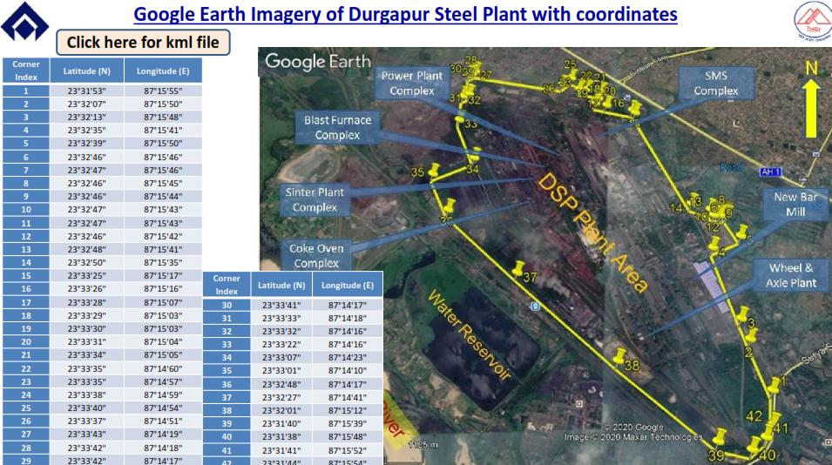

Slide 6
Land Allotted / Acquistion Status
Durgapur Steel Plant was installed in 1959.
Existing Durgapur Steel plant area: 600 ha.
Total area under possession of DSP : 5444 ha (600 ha existing plant area + 4844 ha township/other area).
Present Proposal : Within the existing Durgapur Steel plant Boundary (within 600 ha) : already under DSP’s possession.
NO ADDITIONAL LAND REQUIRED

Slide 7
Previous EC Details
EC of DSP for Modernisation-cum-Expansion plan : accorded by MoEFCC for increase in production capacity of Gross Hot Metal (GHM) from 2.088 to 3.5 MTPA (F. No. J-11011/492/2007-IA II(I) dtd. 10.09.2007).EC validity extended for 5 years (till 09.09.2017)
S.N | Date of Amend. | Particulars/ Details of Amendment
1. | 23.12.2008 | EC condition w.r.t water req. and Dust extraction system.
2. | 01.04.2011 | EC letter printed as Lime Calcinations Plant to Dolomite Calcinations Plant.
3. | 20.11.2014 | To bring back COB#5 in operation with no expansion in total production
4. | 19.02.2016 | For change in Product Mix of two units viz. Wheel & Axle Plant and Merchant Mill.
Due to recession in global market, only part of the expansion-cum-modernization plan of DSP could be executed and the proposed rebuilding of Blast Furnace#1 of 0.945 MTPA could not be undertaken. Therefore, at present DSP is operating much below the approved capacity of 3.5 MTPA.

Slide 8
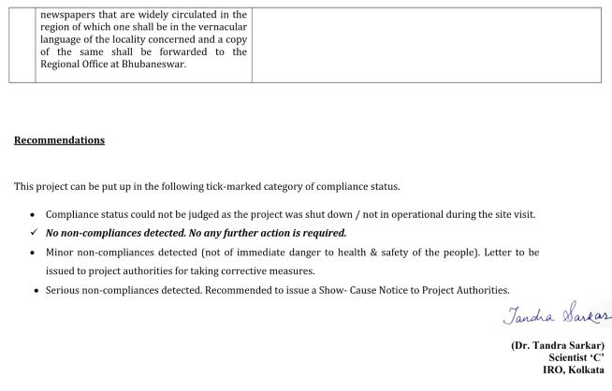
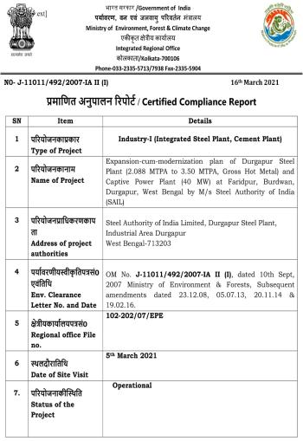
Compliance Status of Existing Units
Site visit on 5th March, 2021
RO Report No - J-11011/492/2007-IAII(I) dtd. 16th March, 2021 mentions that “No non-compliances detected. No any further action is required”.

Slide 9
Environmental Site Settings
S.No. | Parameters | Details
1. | Water Body | Project site: None Study area: Yes River: Damodar River,~1.15 km (S) Water body: Durgapur Barrage built on Damodar River, ~7.0 km (SE) Seasonal Nallah: Tamla Nala (~0.3km E), Singaran Nala (~1.5 km W), Barjora Nala (~6 km S)
2. | Highway | National Highway 19 (erstwhile NH2) (Delhi-Kolkata highway) passes close to plant boundary on North
3. | Railway Line | Durgapur (~7 km), Andal (~6 km) & Waria ~0.5 km All on Eastern Railway’s Howrah-Delhi main line
4. | Habitation | DSP Township (~3 km, NE) DTPS Township (~2 km, SE)
5. | National Park/Wildlife Sanctuary/ Bio-sphere Reserve/Elephant corridor/Tiger reserve/Eco-sensitive Zone/Eco sensitive Area |  |  | None
6. | Environmental Sensitivity |  | As per CPCB, Durgapur is a Severely Polluted Area.

Slide 10
EXISTING & PROPOSED UNIT CONFIGURATION WITH CAPACITY
Production capacity | EC Capacity (as per EC, 2007 and its amendments) | Existing installed Capacity (Status as of now) | Proposed Capacity | Remarks
Gross Hot Metal (GHM) (in MTPA) | 3.5 | 2.555 | 2.70 | Reduction in capacity from earlier accorded EC
Crude Steel Production (in MTPA) | 3.0 | 2.20 | 2.5
Finished / Saleable Steel (in MTPA) | 2.8325 | 2.29 | 2.4104
Cold Pigs Production (in TPA) | 214000 | 214000 | 214000 | No change
Due to recession in global market, only part of the expansion-cum-modernization plan of DSP could be executed and the proposed rebuilding of Blast Furnace#1 of 0.945 MTPA could not be undertaken. Therefore, at present DSP is operating much below the approved capacity of 3.5 MTPA.

Slide 11
EXISTING & PROPOSED UNIT CONFIGURATION WITH CAPACITY
Sl. No. | Plant / Unit / Facility | Plant Unit Configuration/Capacity
 |  | EC Capacity/ Config. (2007 & amend.) | Existing Capacity / Config. | Present Proposal | Final Capacity / Config.
1. | Coke Oven Complex
a. | COB # I | 78 Ovens; 4.5 m tall; Top Charge; Wet Quenching Facility | 78 Ovens; 4.5 m tall; Top Charge; Wet Quenching Facility | Existing COB # I to be replaced with New COB#I (2x44 Ovens, height 5.5m, Stamp Charge; CDCP). | COB # I (2x44 Ovens, height 5.5m; Stamp Charge; CDCP)
 | COBs # II, # III, # IV, #V, # VI | Each 78 Ovens, height 4.45m; Top Charge; Wet Quenching. | Each 78 Ovens, height 4.45m; Top Charge; Wet Quenching. | No Change | Each 78 Ovens, height 4.45m; Top Charge; Wet Quenching)
 | Gross Coke Production | 1.7 MTPA | 1.7 MTPA | No Change | 1.7 MTPA
b. | CDCP Green Power | - | - | New CDCP Extraction Turbine 12MW; Power Generation 10MW | CDCP Extraction Turbine 12MW; Power Generation 10MW

Slide 12
EXISTING & PROPOSED UNIT CONFIGURATION WITH CAPACITY
Sl. No. | Plant / Unit / Facility | Plant Unit Configuration/Capacity
 |  | EC Capacity/ Config. (2007 & amend.) | Existing Capacity / Config. | Present Proposal | Final Capacity / Config.
2. | Byproducts Plant
a. | Benzol Plant : Crude Benzol Production | 16800 TPA | 16800 TPA | No Change | 16800 TPA
b. | Ammonium Sulphate Plant | 19200 TPA | 19200 TPA | No Change | 19200 TPA
c. | Tar Plant : Crude Tar Production | 72000 TPA | 72000 TPA | No Change | 72000 TPA
3. | Sinter Plant Complex :
a. | SP # I (2X143.2 m2) | 1.299 MTPA (to be phased out after installation of SP#III) | 1.299 MTPA | 1.5 MTPA (Operational Optimisation) | 1.5 MTPA
b. | SP # II (1X180 m2) | 1.71 MTPA | 1.71 MTPA | 1.9 MTPA (Operational Optimisation) | 1.9 MTPA
c. | SP # III (1X296 m2) | 3.029 MTPA | Not Installed | Not Installed | -
 | Total Gross Sinter: | 4.739 MTPA | 3.009 MTPA | 3.4 MTPA | 3.4 MTPA

Slide 13
EXISTING & PROPOSED UNIT CONFIGURATION WITH CAPACITY
Sl. No. | Plant / Unit / Facility | Plant Unit Configuration/Capacity
 |  | EC Capacity/ Config. (2007 & amend.) | Existing Capacity / Config. | Present Proposal | Final Capacity / Config.
4. | Blast Furnace :
a. | BF# 1 : 1x1400 m3; | 0.945 MTPA GHM | Dismantled | Dismantled | -
b. | BF# 2 & BF# 3 : 2x1400 m3 | 1.61 MTPA GHM | 1.61 MTPA GHM | 1.755 MTPA (Operational Optimisation) | 1.755 MTPA
c. | BF# 4 : 1 x 1800 m3 | 0.945 MTPA | 0.945 MTPA | No Change | 0.945 MTPA
 | Total GHM Production | 3.5 MTPA | 2.555 MTPA | 2.7 MTPA | 2.7 MTPA
d. | BF Gas Cleaning Plant (GCP): | GCP: BF #2, #3 & BF #4 | GCP: BF #2, #3 & BF #4 | No Change | GCP:BF #2, #3 & BF #4
e. | Slag Granulation Plant (SGP): | 0.89 MTPA | 0.89 MTPA | No Change | 0.89 MTPA
f. | Pig Casting Machine | 214000 TPA | 214000 TPA | No Change | 214000 TPA

Slide 14
EXISTING & PROPOSED UNIT CONFIGURATION WITH CAPACITY
Sl. No. | Plant / Unit / Facility | Plant Unit Configuration/Capacity
 |  | EC Capacity/ Config. (2007 & amend.) | Existing Capacity / Config. | Present Proposal | Final Capacity / Config.
5. | Steel Melting Shop & Associated Facilities
a. | Hot Metal Mixer | 2 x 1300t | 2 x 1300t | No Change | 2 x 1300t
b. | Hot Metal De-sulphurisation Unit | 1.4 MTPA | Not installed | Not installed | -
c. | Charging Ladles | 140t | 140t | No Change | 140t
d. | Basic Oxygen Furnaces (BOFs) | 3x120t (3x110 m3): 3/3 Convertor Operation | 3x120t (3x110 m3): 3/3 Convertor Operation | No Change | 3x120t (3x110 m3): 3/3 Convertor Operation.
e. | Laddle Furnace (LF) | 2x130t (Existing) + 1x130t (New) | 3x130t | No Change | 3x130t
f. | RH de-gassing unit | 1X130t | Not installed | Not installed | -
g. | Secondary Refining : Vacuum Arc Degassing (VAD) | 1X130t | 1X130t | No Change | 1X130t
h. | Gas Cleaning Plant | 83000 Nm3/hr | 83000 Nm3/hr | No Change | 83000 Nm3/hr

Slide 15
EXISTING & PROPOSED UNIT CONFIGURATION WITH CAPACITY
Sl. No. | Plant / Unit / Facility | Plant Unit Configuration/Capacity
 |  | EC Capacity/ Config. (2007 & amend.) | Existing Capacity / Config. | Present Proposal | Final Capacity / Config.
6. | Casting Facilities
a. | Billet Caster | 2X6 strand | 2X6 strand | No Change | 2X6 strand
b. | Bloom Caster | 1X4 strand | 1X4 strand | No Change | 1X4 strand
c. | Bloom-cum-Round Caster | 1X4 Strand | 1X4 Strand | No Change | 1X4 Strand
7. | Rolling Mills
a. | Existing Merchant Mill | 0.33 MTPA | 0.33 MTPA | 0.4 MTPA | 0.4 MTPA
b. | New Bar & Rod Mill: | Wire Rod Mill: 0.5 MTPA. New Merchant Mill: 0.8 MTPA | Not installed | Not installed | -
c. | New Bar Mill | - | - | New Bar Mill proposed, Capacity : 1.0 MTPA | 1.0 MTPA

Slide 16
EXISTING & PROPOSED UNIT CONFIGURATION WITH CAPACITY
Sl. No. | Plant / Unit / Facility | Plant Unit Configuration/Capacity
 |  | EC Capacity/ Config. (2007 & amend.) | Existing Capacity / Config. | Present Proposal | Final Capacity / Config.
d. | Wheel & Axle Plant | 0.16 MTPA | 0.16 MTPA | Addition of Online Heat Treatment Facility | 0.16 MTPA (with Online Heat Treatment Facility)
e. | Skelp Mill | 0.22 MTPA | Not in Operation | Not in Operation | -
f. | Section Mill | 0.207 MTPA (Kept Out of Operation) | 0.207 MTPA (Kept Out of Operation) | Bring Back in Operation (Capacity 0.207 MTPA) till full Capacity Utilization of Medium Structural Mill. | Section Mill: Capacity 0.207 MTPA in Operation till full Capacity Utilization of Medium Structural Mill
g. | New Medium Structural Mill (MSM) | 1.0 MTPA | 1.0 MTPA | No change | 1.0 MTPA

Slide 17
EXISTING & PROPOSED UNIT CONFIGURATION WITH CAPACITY
Sl. No. | Plant / Unit / Facility | Plant Unit Configuration/Capacity
 |  | EC Capacity/ Config. (2007 & amend.) | Existing Capacity / Config. | Present Proposal | Final Capacity / Config.
h. | 20 Nos. Soaking Pits Ingot-Stripping Facilities & Blooming Mills | Phase Out | Phased Out | No change | -
i. | Billet Mill; Producing 0.23 MTPA. Phased out | Phase Out | Phased Out | No change | -
8. | Old Power Plant (OPP)
a. | Dual Fired (Coal & Gas) Boiler 1, 2, 5 & 6 (68 TPH each) | Proposed to be replaced with Dual Fired (Coal & Gas) Boiler 3X125 TPH. | Boiler replacement not undertaken | Boiler replacement not undertaken | Dual Fired (Gas & Coal) Boilers No. 1, 2, 5 & 6 (68 TPH each).
b. | Gas Fired Boiler 3, 4 & 7 (68 TPH each). | Three Gas Fired Boiler Nos. 3, 4 & 7 (68 TPH each). | Three Gas Fired Boiler Nos. 3, 4 & 7 (68 TPH each). | Replacement of Boiler 7 with 100 TPH. | Boiler 3 & 4 (68 TPH each) Boiler 7 (100 TPH).

Slide 18
EXISTING & PROPOSED UNIT CONFIGURATION WITH CAPACITY
Sl. No. | Plant / Unit / Facility | Plant Unit Configuration/Capacity
 |  | EC Capacity/ Config. (2007 & amend.) | Existing Capacity / Config. | Present Proposal | Final Capacity / Config.
9. | Associated Facilities
a. | Calcined Lime Plant (3X300 t/d) | 0.2485 MTPA | 0.2485 MTPA | No Change | 0.2485 MTPA
b. | Calcined Dolomite Plant (1X300t/d) | 0.0694 MTPA | 0.0694 MTPA | No Change | 0.0694 MTPA
c. | Oxygen Plant: Captive | 2x350 TPD | 2x350 TPD | 1x350 TPD Phasing out 1x350 TPD - Operational | 1x350 TPD
d. | Oxygen Plant : BOO basis | 1x700 TPD 1x350 TPD(new) | 1x700 1x350 TPD- Not Installed | Replacement of 1x700 TPD by 1x1250 TPD | 1x1250 TPD
e. | Foundry shop with EAF | Furnace 6t | Furnace 6t | No Change | Furnace 6t
f. | Raw material Handling Complex | 9.1138 MTPA | 7.5321 MTPA | No Change | 7.5321 MTPA

Slide 19
EXISTING & PROPOSED UNIT CONFIGURATION WITH CAPACITY
Sl. No. | Plant / Unit / Facility | Plant Unit Configuration/Capacity
 |  | EC Capacity/ Config. (2007 & amend.) | Existing Capacity / Config. | Present Proposal | Final Capacity / Config.
g. | Coke Oven Gas Holder | 56,000 m3 | 56,000 m3 | To be replaced with New Gas Holder of Capacity 70,000 m3 | 70,000 m3
h. | BF Gas Holder | 1,00,000m3 | 1,00,000m3 | No Change | 1,00,000m3
i. | Existing BOF Gas Holder | 40,000m3 | 40,000m3 | No Change | 40,000m3
j. | Liquid Oxygen Holder | 2000t | 2000t | No Change | 2000t
k. | Propane Unit (2x200t) | 2x200t = 400t | 2x200t = 400t | No Change | 2x200t = 400t
l. | LPG Storage Facility | 4X500t | Not Installed | Not Installed | -

Slide 20
SUMMARY OF PRESENT PROPOSAL
Replacement of existing COB 1 with a new 0.76 MTPA stamp charge COB along-with 120TPH (10MW) Coke Dry Cooling Plant (CDCP).
Installation of new Bar Mill of 1.0 MTPA capacity in place of Wire Rod Mill (0.5 MTPA) and Bar & Merchant Mill (0.8 MTPA) as envisaged in EC 2007.
Replacement of existing COG holder (56,000 m3) by new COG Holder (70,000 m3).
Replacement of existing 7th Boiler of 68 TPH in Old Power Plant with new 100 TPH Boiler.
Installation of new Online Heat Treatment Facility at Wheel & Axle Plant.
Increase in Gross Hot Metal (GHM) production from BF # 2 and BF # 3 from 1.61 MTPA to 1.755 MTPA by operational optimisation.
Increase in gross sinter production from SP#I from 1.299 MTPA to 1.5 MTPA and SP#II from 1.71 to 1.9 MTPA by operational optimisation.
Bringing back in operation Section Mill (0.207 MTPA) till stabilization of Medium Structural Mill (1.0 MTPA).
Increase in production capacity of Merchant Mill from 0.33 MTPA to 0.4 MTPA by operational optimisation.
Installation of new Oxygen Plant (1x1250 TPD) on BOO basis in place of two existing Oxygen Plants [1x350 TPD (Captive) and 1x700 TPD (BOO basis)].

Slide 21
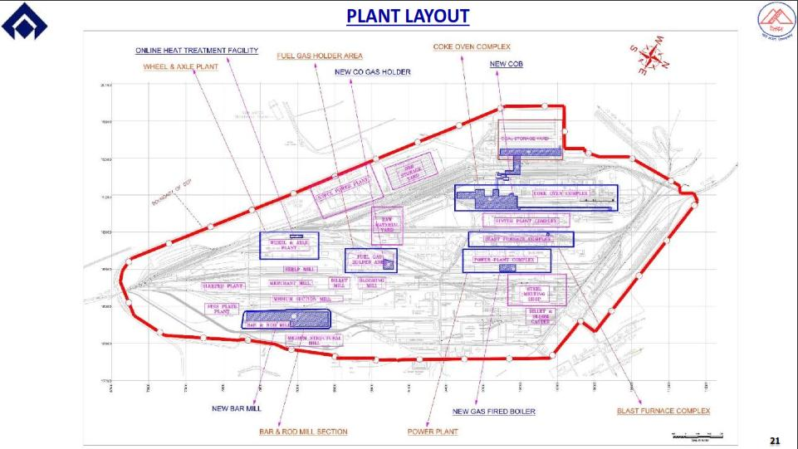

Slide 22
RAW MATERIAL CONSUMPTION
Raw Material / Fuel | Quantity per Annum | Unit | Source | Distance of Source from Project Site (in KM) | Mode of Transport
Iron Ore Lump | 1639000 | TPA | Captive EMD Mines at Bolani / Gua | 250 | Rail
Iron Ore Fines | 2680000 | TPA | Captive EMD Mines at Bolani / Gua | 250 | Rail
SMS Grade Iron Ore | 81000 | TPA | Captive EMD Mines at Bolani / Gua | 250 | Rail
Lime stone -LCP / SMS | 506688 | TPA | Jaisalmer, Rajasthan | 1600 | Rail
Dolomite (SMS grade) | 141568 | TPA | Bhutan | 600 | Rail
Lime Stone for SP (BF) | 131000 | TPA | Captive EMD Mines Kuteswar,MP | 700 | Rail
Dolomite for SP / BF | 212000 | TPA | Bhutan | 600 | Rail
Mn Ore for BF | 0 | TPA | Captive EMD Mines at Bolani / Gua | 250 | Rail
Ferro Manganese | 2500 | TPA | Private Suppliers | 500 | Rail
Ferro Silicon | 7600 | TPA | Private Suppliers | 500 | Rail
Silico Manganese | 41100 | TPA | Private Suppliers | 500 | Rail
Ferro Alloys | 0 | TPA | Private Suppliers | 500 | Rail
Quartzite for BF | 0 | TPA | Chaibasa, Ranchi | 250 | Road/Rail
Coal for CDI | 214000 | TPA | ECL / BCCL, Chasnala | 250 | Rail
Coking Coal | 2675450 | TPA | Imported / BCCL Chasnala / CCL | 250 | Rail
Coal for Power Plant | 42000 | TPA | Imported / BCCL Chasnala / CCL | 250 | Rail
 | 8373906

Slide 23
FUEL, POWER/ENREGY & WATER REQUIREMENT
S.N | Type | Requirement | Permission Details | Remark
1. | Fuel | Overall regular fuel requirement at 2.7 MTPA GHM stage is : BF + BOF/LD gas req.: 534724 Nm³/hr CO Gas: 79160 Nm³/hr CBM: 3000 Nm³/hr | In-plant Generation | Source: BF/ LD/ CO gas – Existing Blast furnace / SMS / Coke Oven complex
2. | Power / Energy | Overall power requirement at 2.7 MTPA GHM stage : 245.5 MVA | Power Agreement with NSPCL & DVC | Source: New COB#I with CDCP : 10 MW. Existing Old Power Plant – Critical Power : 20 MW and total process steam. Major power req. will be met from NSPCL & DVC (same as existing).

Slide 24
FUEL, POWER/ENREGY & WATER REQUIREMENT
S.N | Type | Requirement | Permission Details | Remark
3. | Water Requirement | Overall water drawl at 2.7 MTPA GHM stage: 5575 m3/hr. (5575 m3/hr= 4141 m3/hr. for steel plant + 1434 m3/hr for Drinking Water Treatment Plant No.1 & 2.) | Agreement with Damodar Valley Corporation (DVC) for withdrawal of 5676 m3/hr. | Source: Damodar River. No Ground water extraction No additional water allocation required for proposed project

Slide 25
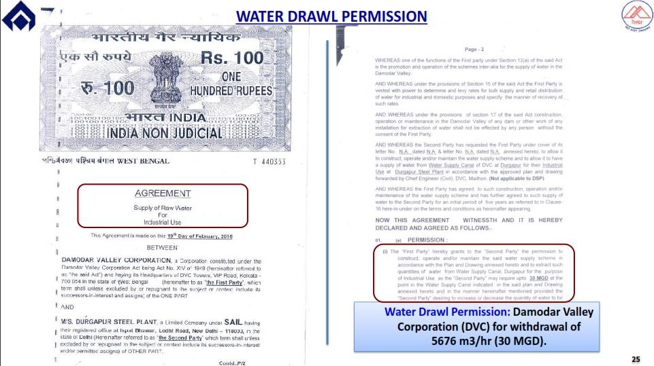

Slide 28
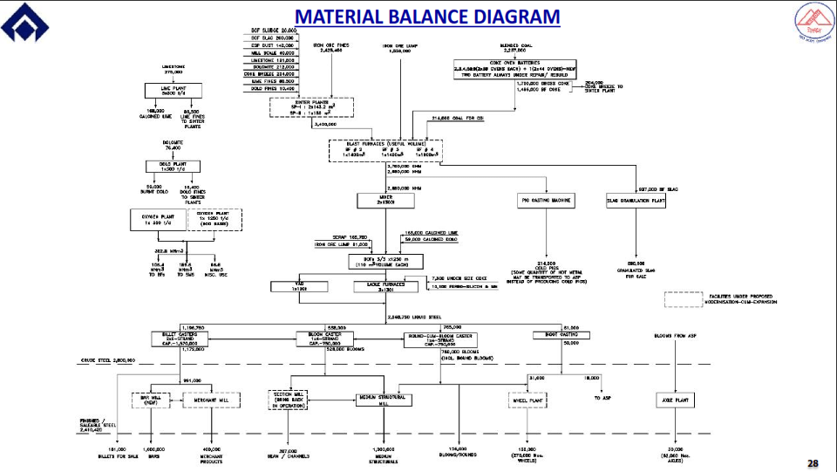

Slide 30
METEOROLOGICAL DETAILS
Met station : Ispat Bhawan (Latitude 23˚33'39.9"N, Longitude 87˚15'3.9"E) adjacent to DSP boundary.
Summarized Monitored Meteorological Data, Summer season 2020 & Sept-Oct 2020
Month | Wind Speed (m/s) |  |  | Temperature (ºC) |  |  | Relative Humidity (%) |  |  | Rainfall (mm) |  | Solar Radiation (Cal cm⁻²min⁻¹)
 | Max | Min | Avg. | Max | Min | Avg. | Max | Min. | Avg. | Total | No. of Rainy days | Max | Min | Avg.
Mar’20 | 6.72 | 0.0 | 1.31 | 36.3 | 16.3 | 25.9 | 34.4 | 10.0 | 26.2 | 56.5 | 03 | 1.6 | 0.0 | 0.12
Apr’20 | 5.33 | 0.0 | 1.61 | 42.5 | 19.6 | 29.2 | 57.6 | 10.0 | 27.8 | 27.0 | 02 | 1.6 | 0.0 | 0.097
Sept’-Oct’20 | 5.81 | 0.0 | 1.26 | 35.1 | 24.3 | 29.3 | 77.6 | 32.0 | 46.8 | 48.5 | 05 | 1.6 | 0.0 | 0.228

Slide 32
BASELINE STUDY REPORTS
Period | Summer season 2020 & Sept-Oct 2020 Due to National Lockdown, additional one month monitoring in Sept-Oct 2020 with permission from MoEFCC has been carried out.
AAQ parameters at 8 locations | PM2.5 = 37 to 63 μg/m³ PM10 = 55 to 106 μg/m³ SO2 = 13.5 to 33.1 μg/m³ NO2 = 20.1 to 39.9 μg/m³ CO = 0.3 to 2.2 mg/m³
AAQ modelling : AERMOD | PM10 = -1.5 μg/m³ ( 4.6 km, ENE) PM2.5 = -1.3 μg/m³ ( 4.6 km,ENE) SO2 = 0.8 μg/m³ ( 0.15 km, N) NOx = 0.9 μg/m³ ( 5.3 km, NW)
Ground water quality at 8 locations | pH: 7.0 to 7.3, Total Hardness: 200 to 444 mg/l, Chlorides: 40 to 114 mg/l, Fluoride: 0.42 to 0.93 mg/l. Heavy metals: within limits.

Slide 33
BASELINE STUDY REPORTS
Surface water quality at 10 locations | pH: 7.2 to 7.9; DO: 5.4 to 7.2 mg/l and BOD: 3 to 5 mg/l.
Noise levels | Day time : 38.8 to 66 Night time : 37.6 to 53.7
Traffic assessment study findings | Existing infrastructure have sufficient capacities. However, at DSP ~100% raw material is transported through railway mode.
Flora and fauna | Schedule-I fauna (Shikra, Black-winged Kite, Black Kite, Oriental Honey Buzzard, Osprey, Grey Wolf, Asian Elephant, Indian Rock Python, Golden Monitor, Purple Leaf Blue, Chestnut-streaked Sailer, Danaid Eggfly) present in Study Area. Site-specific Wildlife Conservation Plan for Schedule-I Fauna has been prepared by Durgapur Wildlife Information and Nature Guide Society and is submitted to competent authority for approval. The total budget for implementation of Wildlife conservation plan is Rs. 401.17 Lakhs for the period of 10 years.

Slide 35
TRANSPORTATION PLAN – VEHICULAR TRAFFIC LOAD STUDY AS PER IRC GUIDELINES
Baseline traffic volume along with PCU Capacity of roads in study area (PCUs/day)
Existing Roads : Sufficient PCU Capacity available (as per IRC Guidelines)
Period of Study: June, 2020
Proposed transportation : ~100% of raw material and finished products is being transported through Railway.
Traffic Monitoring Locations | Traffic Load Baseline (Max PCU/hr) | Additional load due to transportation in proposed project | Total | Carrying capacity as per: IRC:106-1990 (PCU’s per hour) | Remarks
T1 | 1035 | No additional load envisaged due to present proposal | 1035 | 3600 | 100% Raw Material transportation through Road. Safe – below carrying capacity of road.
T2 | 3896 |  | 3896 | 5400

Slide 36
AAQ MODELLING : ISOPLETHS
Baseline Concentration (A): Contribution the existing plant under operation is being reflected in the baseline air quality monitoring.
Contribution from existing units undergoing changes/re-building/expansion (B): Existing load of units proposed to be modernised/re-building/ expansion/ de-bottlenecking, the GLC’s have been predicted considering emissions from these existing units in production.
Contribution of Proposed units & Existing units undergoing changes (C): Emissions from all new units / re-building of existing units/ expansion in production due to operational optimisation & de-bottlenecking proposed under the present proposal with the proposed capacity.
Resultant Concentration =
Baseline concentrations (A) – Contribution from Existing units undergoing change (B) +
Contribution of proposed Units/existing units with new capacities (C)

Slide 37
AAQ MODELLING : ISOPLETHS
Cumulative AAQ at 2.7 MTPA Gross Hot metal Stage
Concentrations are in µg/m³ and of 24 hours averaging time
PM10
S.N. | AAQ location | Baseline Concentration (C98) | Contribution of Existing units (to be modernised/re-build/expansion) | Estimated Contribution of proposed units (new/after modernisation/expansion) | Cumulative AAQ after proposed proposal
 |  | (A) | (B) | (C) | (A-B+C)
A1 | Ispat Bhawan | 97 | 9.3 | 2.1 | 89.9
A2 | Ichchapur village | 96 | 2.8 | 1.0 | 94.2
A3 | DSP Township | 91 | 2.5 | 0.9 | 89.4
A4 | Netaji Colony | 95 | 3.3 | 1.5 | 93.1
A5 | City Centre | 99 | 2.7 | 1.2 | 97.5
A6 | DPL Colony | 92 | 1.6 | 0.8 | 91.3
A7 | Maliara Village | 86 | 1.6 | 0.6 | 85.0
A8 | Bhadhur Village | 90 | 1.7 | 0.5 | 88.8
PM_{2.5}
S.N. | AAQ location | Baseline Concentration (C₉₈) | Contribution of Existing units (to be modernised/re-build/expansion) | Estimated Contribution of proposed units (new/after modernisation/expansion) | Cumulative AAQ after proposed proposal
 |  | (A) | (B) | (C) | (A-B+C)
A1 | Ispat Bhawan | 57 | 6.7 | 1.7 | 52.0
A2 | Ichchapur village | 58 | 2.0 | 0.7 | 56.7
A3 | DSP Township | 54 | 1.9 | 0.7 | 52.9
A4 | Netaji Colony | 57 | 2.5 | 1.0 | 55.5
A5 | City Centre | 59 | 2.0 | 0.7 | 57.7
A6 | DPL Colony | 53 | 1.2 | 0.5 | 52.3
A7 | Maliara Village | 53 | 1.2 | 0.4 | 52.2
A8 | Bhadhur Village | 54 | 1.3 | 0.6 | 53.3

Slide 38
AAQ MODELLING : ISOPLETHS
Cumulative AAQ at 2.7 MTPA Gross Hot metal Stage
Concentrations are in µg/m³ and of 24 hours averaging time
SO₂
S.N. | AAQ location | Baseline Concentration (C₉₈) | Contribution of Existing units (to be modernised/re-build/expansion) | Estimated Contribution of proposed units (new/after modernisation/expansion) | Cumulative AAQ after proposed proposal
 |  | (A) | (B) | (C) | (A-B+C)
A1 | Ispat Bhawan | 31.9 | 8.7 | 9.5 | 32.66
A2 | Ichchapur village | 27.0 | 3.4 | 3.5 | 27.14
A3 | DSP Township | 28.5 | 3.1 | 3.8 | 29.18
A4 | Netaji Colony | 26.9 | 4.5 | 5.6 | 27.95
A5 | City Centre | 31.7 | 3.5 | 3.9 | 32.12
A6 | DPL Colony | 28.0 | 2.2 | 2.5 | 28.30
A7 | Maliara Village | 30.5 | 2.2 | 2.1 | 30.45
A8 | Bhadhur Village | 29.9 | 2.5 | 3.5 | 30.91
NOx
S.N. | AAQ location | Baseline Concentration (C₉₈) | Contribution of Existing units (to be modernised/re-build/expansion) | Estimated Contribution of proposed units (new/after modernisation/expansion) | Cumulative AAQ after proposed proposal
 |  | (A) | (B) | (C) | (A-B+C)
A1 | Ispat Bhawan | 32.0 | 4.7 | 5.8 | 33.08
A2 | Ichchapur village | 36.2 | 1.8 | 2.1 | 36.46
A3 | DSP Township | 34.7 | 1.7 | 2.3 | 35.33
A4 | Netaji Colony | 33.1 | 2.5 | 3.4 | 34.06
A5 | City Centre | 38.5 | 1.9 | 2.2 | 38.80
A6 | DPL Colony | 32.8 | 1.2 | 1.7 | 33.29
A7 | Maliara Village | 33.0 | 1.2 | 1.4 | 33.29
A8 | Bhadhur Village | 39.0 | 1.3 | 2.2 | 39.83

Slide 43
Proposed Air Pollution Control Measures
Air Pollution Control Measures installed in Existing Plant Units
S. N. | Unit | Details of Air Pollution Control Measures
 | Raw Material Handling System | 100% transportation of major raw material by Railways Covered conveyors Dry Fog Dust Suppression (DFDS) Systems Dust Extraction (DE) systems at material transfer points Sprinklers in Storage Yard
2. | Sinter Plant | ESP based Process Flue gas cleaning ESP based Stock House de-dusting Pneumatic dust conveying system
3. | Coke Ovens | Charging emissions control HPLA system, Hydro-jet door cleaner, Screw feeder charging car, Water sealed AP caps, Lid luting. Use of CO gas for under firing Dry Fog Dust Suppression (DFDS) Systems for coal and coke transfer points
4. | Blast Furnace | Dry Fog Dust Suppression (DFDS) Systems
5. | Steel Melting Shops | ESP based Secondary emission control / Dog Houses Ladle Furnace Bag Filter
6. | Lime & Dolo Plant | Process Flue gas cleaning Bag Filter
7. | Rolling Mills | Use of cleaned fuel gas for reheating
8. | OPP Boilers | Process Flue gas cleaning / ESP

Slide 44
Proposed Air Pollution Control Measures
Action plan for Proposed Units
S.N. | Units | Details of Proposed System
1. | Stack emission of proposed new boiler | Boiler is BF gas fired so new stack emission will be less than 30 mg/Nm3 as per design of the new project
2. | New Stamp Charge Battery | Latest environment control systems like land based pushing emission control system, CDQ, dust suppression system etc. will be provided. Stack emission will be less than 50 mg/Nm3 in line with acceptable norm.
3. | New Bar Mill | Necessary air pollution control system if any required shall be coming with new project. Stack emission will be less than 30 mg/Nm3.

Slide 45
Proposed Air Pollution Control Measures
Action Plan for Existing Units – PM Emissions <30 mg/Nm3
S.N | Title of Air Pollution Control Project | Present Status | Implementation Schedule
1. | Stack emission control for Lime Kilns of NLCP | FR and TS has been prepared by CET, SAIL, Ranchi. Order placed on M/s Eastern Metec in Dec, 2021. | Expected completion : March’2023
2. | Stack emission control for ladle Furnaces 1 & 2 of SMS | FR and TS has been prepared by CET, SAIL, Ranchi. Order placed on M/s Soil and Enviro Industries Pvt. Ltd. in Dec, 2021. | Expected completion : March’2023
3. | Stack emission control for Ladle Furnace 3 of SMS | FR & TS has been prepared to achieve emission of <30 mg/Nm³. Awaiting approval. | Expected completion : December’2023
4. | Installation of New ESP in place of multi-cellular dedusting units in Sinter Plant - 1 | Revision of FR & TS is under process to achieve emission of <30 mg/Nm³ | Expected completion : December’2023
5. | Up-gradation of ESP in Sinter Plant - 2 | FR & TS has been prepared to achieve emission of <30 mg/Nm³. Awaiting approval. | Expected completion : December’2023
6. | Old Power plant Boiler No.1,2,5 & 6 | By upgradation of ESP and operational improvisation, effective use of more clean gas, Emission of <30 mg/Nm³ will be achieved. | Expected completion : December’2023
7. | Old power plant boiler No.3, 4 & 7 | By operational improvisation and effective use of more clean gas, emission of <30 mg/Nm³ is achieved. | Within <30 mg/Nm³
8. | Stack emission control of New Dolomite Plant | FR & TS are under preparation for up-gradation of Fume Extraction system | Expected completion : December’2023
9. | Stack emission of Merchant Mill | Furnace of Merchant Mill is fired by gaseous fuel. | Within <30 mg/Nm³
10. | Stack emission of W & A Plant | Furnaces of W & A Plant is fired by gaseous fuel | Within <30 mg/Nm³
11. | Stack emission of MSM | Furnace of MSM is fired by gaseous fuel | Within <30 mg/Nm³

Slide 47
DETAILS OF PUBLIC CONSULTATION
Details of advertisement given | Notices made through advertisement - published on 01st December, 2021
Date of public consultation | 5th January, 2022
Venue | Steel Club, R.K.Avenue, A-Zone, Durgapur-713204, Dist. Paschim Bardhaman, West Bengal
Presiding Officer | Shri Sandip Tudu, WBCS (Executive), Additional District Magistrate (L&LR), Dist- Paschim Bardhaman, West Bengal
No. of people attended | 33
Major issues raised | The Project was largely welcomed by the Local Citizens. Major demands / issues were related to: Development of roads Educational facilities Employment generation Development of health infrastructure Development of greenbelt
Budget allocation for addressing PH issues | Rs. 2.01 Crores

Slide 48
Action Plan to Address PH Issue
Sl. No. | Name and Address | Public/Stakeholders Demand/ Comments /Suggestions | Project Proponent Answer | Plan & Budget | Time schedule for implementation
1. | Name : Sri Babu Dey Village : Old Court More | Welcomed proposed modernization-cum-expansion project. Requested for consideration of local employment and provide Ambulance Car at their locality for medical purposes. | Employment will be undertaken as per the Company’s law through open advertisement. Ambulance will be provided. | Rupees 15 lakhs has been budgeted for providing an Ambulance Car. The modalities will be decided after discussion with the local State Government Hospital. | 1 year
2. | Name :Rana Chattopadhyay Village : Gulf Nagar | Welcomed proposed modernization-cum-expansion project. Repairing of Road located at their locality. | SAIL management has planned for undertaking repairing of the existing roads of Gulf Nagar in consultation with local Municipality/ Panchayat. | Rupees 100 lakhs for repairing of Road (approx. 5 km) | 3 years

Slide 49
Action Plan to Address PH Issue
Sl. No. | Name and Address | Public/Stakeholders Demand/ Comments /Suggestions | Project Proponent Answer | Plan & Budget | Time schedule for implementation
3. | Name : Kalyan Adhikari Village : Amrai | Requested to set up a vocational Training Institute at their locality. He welcomed proposed modernization-cum-expansion project. | SAIL management has planned set up a vocational Training Institute near Amrai village in consultation with local Municipality/ Panchayat. | Rupees 20 lakhs to set up a Vocational Training Institute at their locality | 3 years
4. | Name : Bikash Chakraborty Village : Patsov | To organise eye testing camp at their locality To provide Ambulance Car at their locality | SAIL will organise Eye testing camp in every 6 months in the nearby villages including Patsov village. Ambulance will be provided. | Rupees 1 lakhs to organise each eye testing camp. Rupees 15 lakhs has been budgeted for providing an Ambulance Car. The modalities will be decided after discussion with the local State Government Hospital. | 6 monthly 1 year

Slide 50
Action Plan to Address PH Issue
Sl. No. | Name and Address | Public/Stakeholders Demand/ Comments /Suggestions | Project Proponent Answer | Plan & Budget | Time schedule for implementation
5. | Name : D P Bishnu Village : A-Zone, DSP Township | Welcomed proposed modernization-cum-expansion project. Appreciated the existing green belt development programme and existing various other programme under Corporate Social Responsibility of SAIL-DSP. Plantation of Fruit Trees and Ornamental Plants at the concerned area. | SAIL will undertake plantation for 50,000 saplings of fruit bearing plants and Ornamental plants in the A-Zone, Arati Gram and other nearby suitable areas. | Rupees 50 lakhs for plantation of 50,000 saplings of fruit bearing plants and Ornamental plants. | 3 years

Slide 51
Action Plan to Address PH Issue
Sl. No. | Name and Address | Public/Stakeholders Demand/ Comments /Suggestions | Project Proponent Answer | Plan & Budget | Time schedule for implementation
6. | Name : Sk. Masud Village : Arati Gram | Requested for greenbelt development at their locality. To undertake more CSR activity at their locality in the form of organizing eye testing camp etc. | SAIL will undertake plantation for 50,000 saplings of fruit bearing plants and Ornamental plants in the A-Zone, Arati Gram and other nearby suitable areas. SAIL will organise Eye testing camp in every 6 months in the nearby villages including Arati Gram and Patsov village. | Rupees 50 lakhs for plantation of 50,000 saplings of fruit bearing plants and Ornamental plants. Rupees 1 lakhs to organise each eye testing camp. | 3 years 6 monthly
7. | Name : H N Mourya Village : Palashdiha | He requested the PP for consideration of local employment Distribution of wheelchair among the concerned person at their locality. | Employment will be undertaken as per the Company’s law through open advertisement. Wheelchairs will be provided to all Differently abled person of Palashdiha Village and nearby areas. | Budget of Rupees 10 lakhs has been earmarked for distribution of Wheel Chairs among the concerned persons. | 2 years

Slide 52
EMP
S.N. | Description | Capital Cost (Rs. in Crores) | Recur. Cost/ annum (Rs. In Crores)
1. | Air, Noise, Solid/ Waste Management/ Water Conservation & Pollution Control Systems | 430.84 | 0.79
2. | Green belt development | 2.67 | -
Sub-total Cost for Environmental Protection Measures |  | 433.51 | 0.79
3. | EMP cost for addressing PH issues (formerly called CER) | 2.01 | -
Total EMP implementation cost |  | 435.52 | 0.79

Slide 53
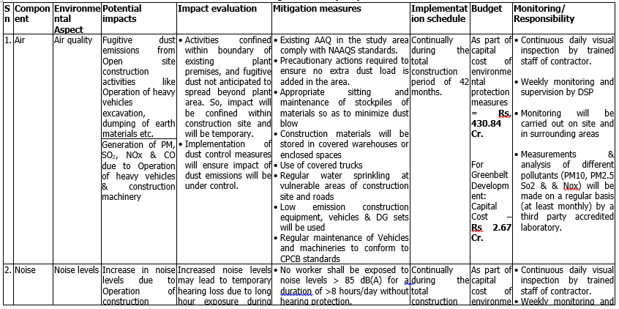
EMP (Construction)

Slide 54
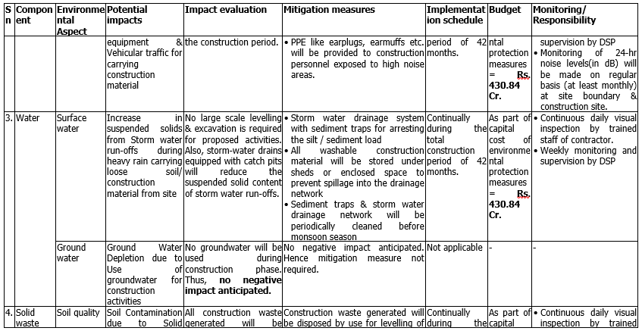
EMP (Construction)

Slide 55
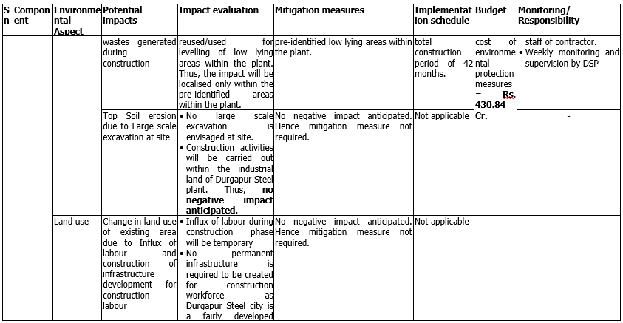
EMP (Construction)

Slide 56
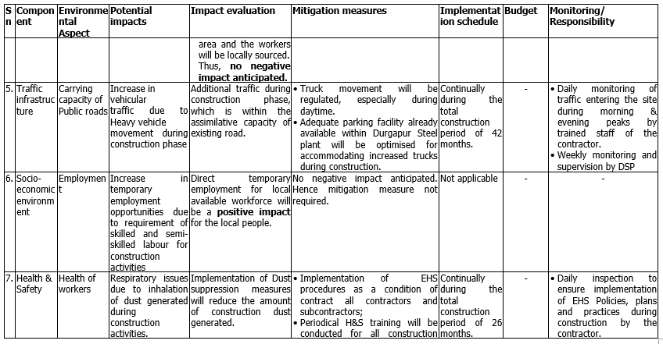
EMP (Construction)

Slide 57
EMP (Construction)

Slide 58
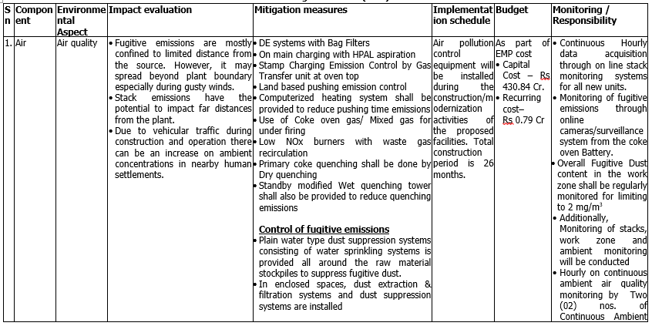
EMP (Operation)

Slide 59
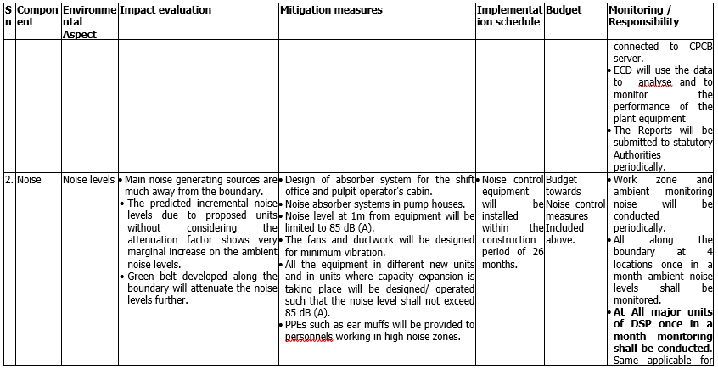
EMP (Operation)

Slide 60
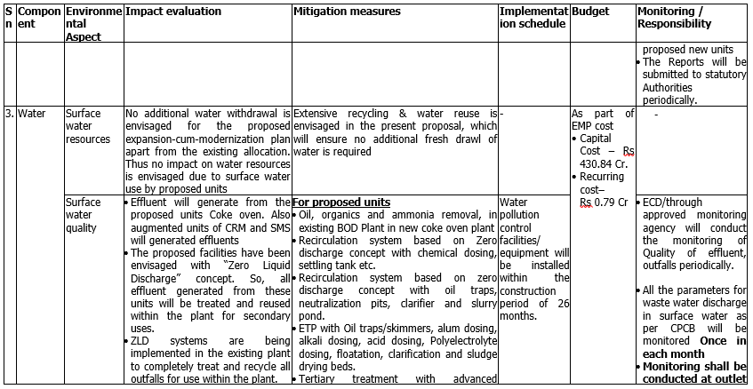
EMP (Operation)

Slide 61
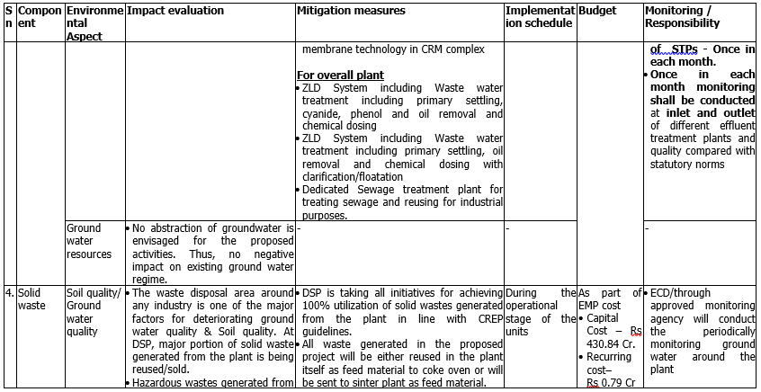
EMP (Operation)

Slide 62
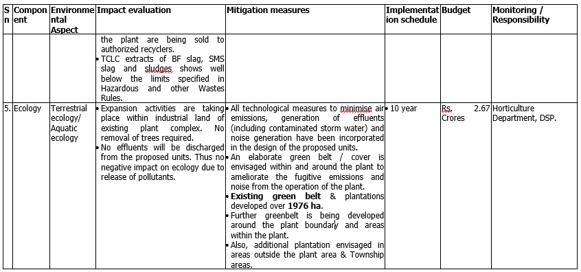
EMP (Operation)

Slide 63
EMP - GREEN BELT
Tree density for Green Belt development : 2500 trees/ha.
Description | Existing | Proposed (Additional) | Total
A. Within Plant Area (600 ha)
Plant Area | 600 ha | - | 600 ha
Green Belt Area within plant | 239.66 ha | 10.34 ha | 250 ha
Percentage of Total Plant Area | 39.94% | 1.73% | 41.67%
B. Total Area under possession of DSP (5444 ha)
Plant Area | 600 ha | - | 600 ha
Township/other area | 4844 ha | - | 4844 ha
Total Area under possession of DSP | 5444 ha | - | 5444 ha
Green Belt Area | 1976 ha | 202 ha | 2178 ha
Percentage of Total Area | 36.297% | 3.71% | 40.007%
No. of trees | 31,61,600 | 5,05,000 | 36,66,600
Tree Density | - | 2500 /ha | -
Funds Allocated (Rs.) | - | 2,67,65,000 | 2,67,65,000

Slide 66
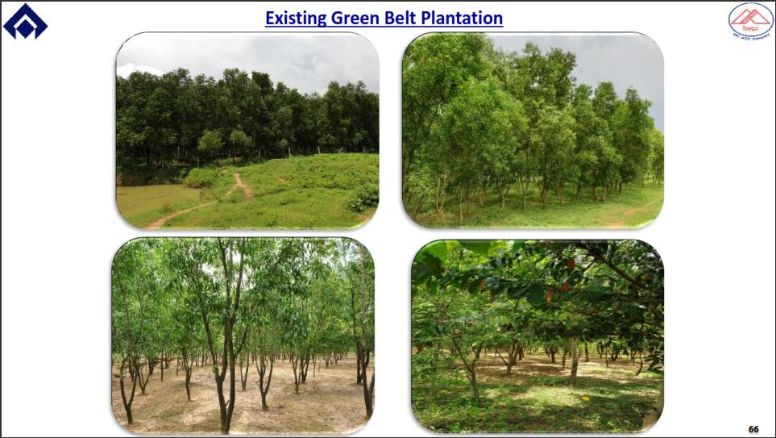

Slide 69
Solid Waste Generation & Utilization
Waste | Estimated Solid Waste Generation (T) |  |  | Mode of Utilisation / Disposal
 | 3.5 MTPA GHM (EC 2007) | 2.7 MTPA GHM (Proposed Project) | Additional
BF Slag | 1085026 | 939034 | -145992 | 100% sold for Cement making
BF Flue dust | 28004 | 17321 | -10683 | 100% reused in sinter plant/ Sold
BF Sludge | 23000 | 11588 | -11412 | 100% used in Sinter making / Will be sold in secondary market
BOF Slag | 625031 | 418298 | -206733 | 70-75 % in Sinter making, BF as substitute of lime. Rest 25-30% utilization for road making.
BOF Sludge | 51001 | 40655 | -10346 | 100% will be reused in sinter plant
Mill Scales | 37997 | 50066 | 12069 | 100% reused in sinter plant
Lime Fines | 40003 | 27094 | -12909 | 100% reused in sinter plant
Waste Refractory | 12000 | 9504 | -2496 | 100% sold in outside market
Cinder | 87004 | 26861 | -60143 | 100% Sold to Briquette manufacturers
SP ESP dust | 285040 | 198578 | -86462 | 100% reused in sinter plant
Total | 2274106 | 1738999 | -535107
NOTE: Decrease in waste generation because of Decrease in production capacity.

Slide 70
Hazardous Wastes Generation & Utilization
SN | Hazardous Waste | Maximum at EC 2007 GHM 3.5 MTPA (in t) | Total After Proposed Project GHM 2.7 MTPA (in t) | Additional from Proposed Project GHM 2.7 MTPA (in t)
1 | Tar sludge | 6383 | 950 | -5433
2 | ETP sludge | 5.9140 | 5.0 | -0.914
3 | Used oil | 109.48 | 29.07 | -80.41
4 | Lead Acid battery | 11.503 | 8.709 | -2.794
5 | Empty contaminated containers | 5984 | 4616 | -1368
All Hazardous waste : sent to authorized Recyclers / TSDF facility
No fly-ash is being generated at SAIL-DSP.
100% of the cinder generated from the power-plant is being sold to the briquette manufacturers.
Additional Power generation is done by M/s NPSCL, a separate entity which has got separate CTO from WBPCB and separate EC from MoEFCC.

Slide 71
Post-project Environmental Monitoring plan
S.N. | Description | Capital Cost (Rs. in Crores) | Recur. Cost/ annum (Rs. In Crores)
1. | Air, Noise, Solid/ Waste Management/ Water Conservation & Pollution Control Systems | 430.84 | 0.79
Sub-total Cost for Environmental Protection Measures |  | 433.51 | 0.79

Slide 72
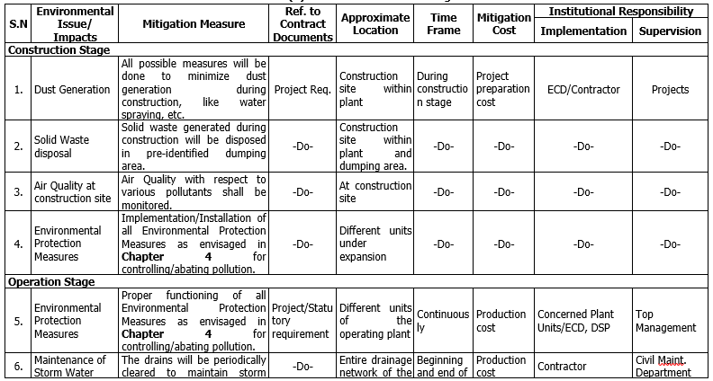
Post-project Environmental Monitoring plan

Slide 73
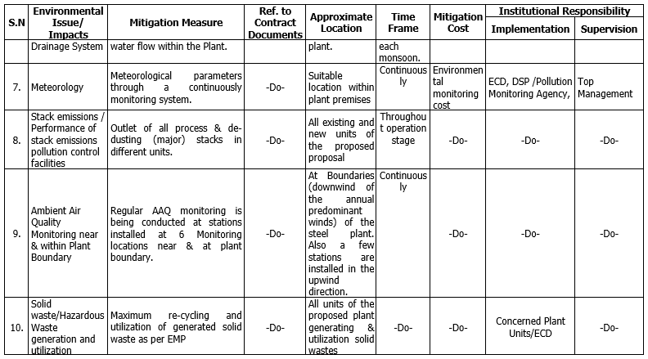
Post-project Environmental Monitoring plan

Slide 74
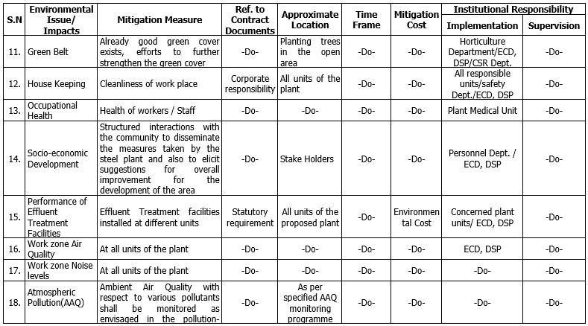
Post-project Environmental Monitoring plan

Slide 75
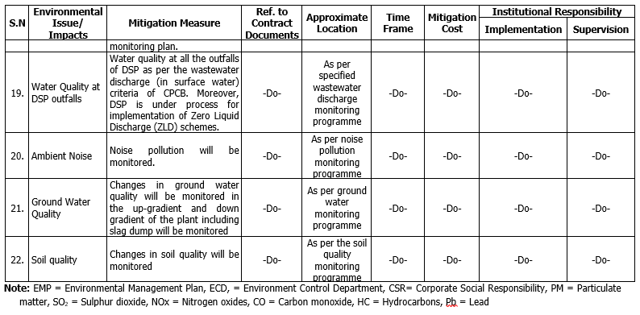
Post-project Environmental Monitoring plan

Slide 76
Risk Assessment Findings & its Mitigation
SN | Name of Hazardous substance | Physical state | Maximum Annual Quantity Stored/handled | Type of storage/ handling vessel | Size of storage vessel | Nature of hazard associated
 | BF Gas (Primarily Carbon monoxide) | Gas | Existing: 100000 m3 | Vertical Gas holder with oil seal | 100000 m3 | Flammable & Toxic gas
2. | BOF Gas (Primarily Carbon Monoxide) | Gas | Existing: 40000 m3 | Vertical Gas holder with oil seal | 40000 m3 | Flammable & Toxic gas
3. | Coke Oven Gas, COG (Primarily Hydrogen & Methane) | Gas | Existing: 25000 m3 (will be replaced with 56000 m3) | New MAN type tar sealed gas holder | 56000 m3 | Flammable & Toxic gas
 |  |  | Proposed: 66500 m3 | Vertical Gas holder with Dry Seal | 70000 m3
4. | Propane | Gas | Existing: 440 T | Mounded Bullets | 200 T | Flammable gas
 |  |  |  | Horizontal bullets | 20 T
5. | LDO | Liquid | Existing (NSPCL): 200 KL | Vertical cylindrical tanks | 100 KL | Flammable liquid
 |  |  | Proposed (NSPCL): 10 KL |  | 10 KL
OTHER CHEMICALS
 | Benzol | Liquid | 1482 KL | Vertical tanks | 310 KL | Explosive/ Flammable liquid
 |  |  |  |  | 176 KL
 |  |  |  |  | 50 KL

Slide 78
Risk Assessment Findings & its Mitigation
Zones identified from consequence modelling as affected areas due to thermal radiations greater than 12.5 kW/m2 - shall be marked as “Heat Zones” & provisions for fire fighting made available.
To provide portable gas detectors within the site in order to facilitate gas leak monitoring &checks.
All major hazardous units / equipment shall be provided with :
Smoke / fire detection and alarm system
Water supply
Fire hydrant and nozzle installation
Foam system
Water fog and sprinkler system
Mobile fire-fighting equipment
First-aid appliances
Personal Protective Equipment (PPE) shall be provided for additional protection to workers
Security of facility to prevent unauthorized access, introduction of prohibited items & control of onsite traffic.

Slide 79
Energy Conversation Measures
Energy and Water Conservation Measures
“Zero discharge” concept is under implementation.
Coke Dry Quenching Plant sensible heat recovery with steam generation.
State-of-the-art pollution control technologies have been considered to have minimum impact on the environment.
High-Efficiency Multi slit Burner in Ignition Furnace eliminates “NO FLAME” areas and supplies minimum heat input for ignition, therefore saving energy.
Exhauster VVVF drive for better control of gas suction and energy conservation.
Stage Combustion / Recirculation of Flue Gas for Energy Conservation and NOx control
Utilization of energy in off-gases
Utilization of PCI in Blast Furnace
Solar Plant - 1 MWp Roof Top Solar Plant has been installed
LED Lighting

Slide 80
Specific Consumptions & Emissions
SN. | Parameter | Values |  | Unit
 |  | Existing 2020-21 | Proposed Project (at 2.7 MTPA GHM stage)
1 | Water Consumption | 3.3 | 3.0 | m³/tcs
2 | Energy Consumption | 5.88 | 5.81 | Gcal/thm
3 | CO₂ Emissions (GHG emissions) | 2.33 | 2.3 | t/thm
4 | Solid waste generation | 0.6016 | 0.6 | t/thm
5 | Raw material Consumption | 2774.66 | 2770 | kg/thm
6 | PM emissions | 0.623 | 0.60 | Kg/thm

Slide 81
DETAILS OF COURT CASES
No Direction / Court cases/ Litigation against the project

Slide 82
THANK YOU
There is a little bit of SAIL in everybody’s life

Slide 83
Change in Total GHM (Gross Hot metal) from 3.5 MTPA (EC 2007) to 2.7 MTPA
No reconstruction of BF#1 (0.945 MTPA)
Increase in GHM production of BF # 2 & BF # 3 (1.61 to 1.755 MTPA)
No change in GHM production from BF # 4 (0.945 MTPA)
 | BF Units | Capacity as per EC 2007 | Existing Installed Capacity (as of now) | Proposed Capacity | Remarks
 | BF# 1 | Reconstruction (new) 0.945 MTPA GHM | Not Constructed | - | Change. BF# 1 is decommissioned New not reconstructed
b) | BF# 2 & BF#3 | 1.61 MTPA | 1.61 MTPA GHM | 1.755 MTPA GHM | Change Increase in GHM from 1.61 to 1.755 MTPA by Operational Optimisation
c) | BF# 4 | 0.945 MTPA | 0.945 MTPA GHM | 0.945 MTPA GHM | No Change
 | Total GHM | 3.5 MTPA | 2.555 MTPA | 2.7 MTPA

