Slide 1


Ministry of Environment, Forest & Climate Change
EC Presentation
Development of Maryada Purushottam Shriram Airport (Ayodhya Airport), Uttar Pradesh
File No: IA/UP/MIS/216087/2021
F. No: 21-67/2021-IA-III
Airports Authority of India

Slide 2
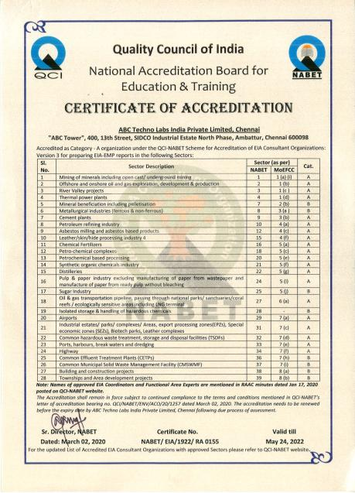
Accredited Environment Consultant
ABC Techno Labs India Private Limited
No. 400, 13th Street, SIDCO Industrial Estate (North Phase), Ambattur, Chennai – 600 098.
S. No : 04 (Sector No 28 - Airports)
As per List of Accredited EIA Consultant Organizations (as on Oct 11, 2018), MOEF&CC website.

Slide 3
Background
Maryada Purushottam Shriram Airport is an upcoming International airport in Ayodhya city that will be upgraded from the existing government airstrip,
Existing:
  Current government airstrip is spread over an area of 177.62 acres (71.88 ha).
  About 170 acres (68.79 ha) of additional land will be utilized for the proposed project which has already been handed over by the district administration.
TOR for proposed works at the Proposed Airport was finalized by MOEF&CC vide letter F. No. 21-67/2021-IA-III Dated 14 August, 2021.
Based on revised proposal Public Hearing was conducted by Uttar Pradesh Pollution Control Board on 20th September 2021.

Slide 4
2. Location of the project
The proposed project site is located at Dharampur Sahadat, Firozpur, Ganja, Janaura, Kushmaha, Nandapur, Pure Husan Khan, Sarethi villages of Faizabad Taluk and Faziabad District.
Geographical location:
  Latitude : 26°44'55.58"N to 26°45'22.25"N
  Longitude : 82° 8'35.94"E to 82° 9'39.62"E
  Altitude : 99 - 106 m above MSL

Slide 5
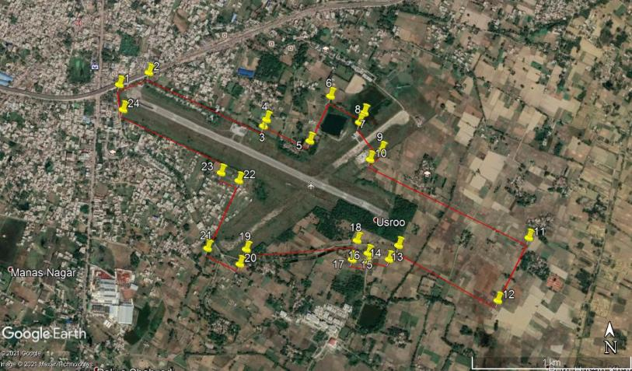
Satellite Imagery showing the Project Site
Pt | Latitude | Longitude | Pt | Latitude | Longitude | Pt | Latitude | Longitude | Pt | Latitude | Longitude
1 | 26°45'22.57"N | 82° 8'33.87"E | 7 | 26°45'16.97"N | 82° 9'29.62"E | 13 | 26°44'50.46"N | 82° 9'37.47"E | 19 | 26°44'49.69"N | 82° 9'2.77"E
2 | 26°45'24.97"N | 82° 8'40.61"E | 8 | 26°45'15.04"N | 82° 9'28.54"E | 14 | 26°44'47.68"N | 82° 9'35.31"E | 20 | 26°44'46.73"N | 82° 9'1.30"E
3 | 26°45'14.33"N | 82° 9'6.69"E | 9 | 26°45'9.52"N | 82° 9'33.56"E | 15 | 26°44'48.90"N | 82° 9'30.51"E | 21 | 26°44'49.89"N | 82° 8'53.95"E
4 | 26°45'15.60"N | 82° 9'7.38"E | 10 | 26°45'7.64"N | 82° 9'30.94"E | 16 | 26°44'47.26"N | 82° 9'30.43"E | 22 | 26°45'3.41"N | 82° 9'1.07"E
5 | 26°45'11.34"N | 82° 9'17.24"E | 11 | 26°44'52.00"N | 82°10'7.13"E | 17 | 26°44'47.65"N | 82° 9'26.90"E | 23 | 26°45'4.99"N | 82° 8'57.04"E
6 | 26°45'20.32"N | 82° 9'22.00"E | 12 | 26°44'39.46"N | 82°10'0.07"E | 18 | 26°44'51.47"N | 82° 9'28.00"E | 24 | 26°45'17.59"N | 82° 8'34.71"E

Slide 6
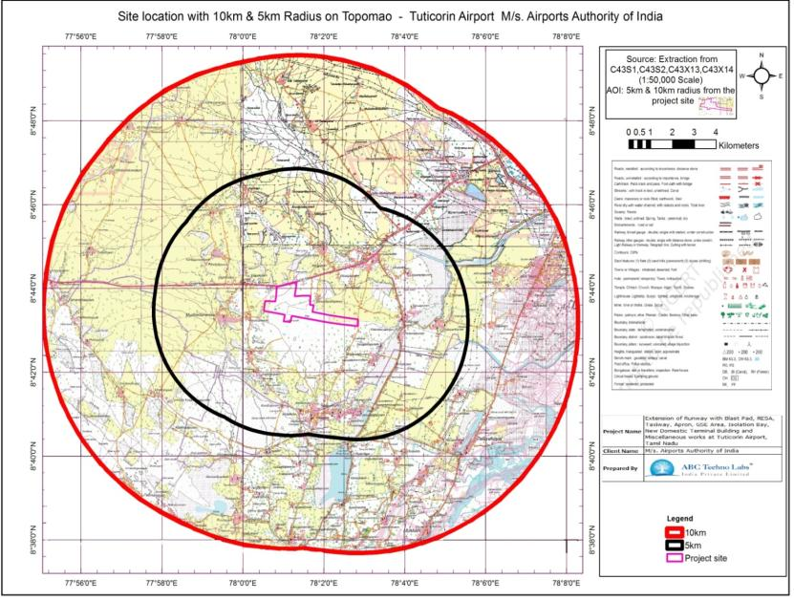
10 km Toposheet - study area

Slide 7
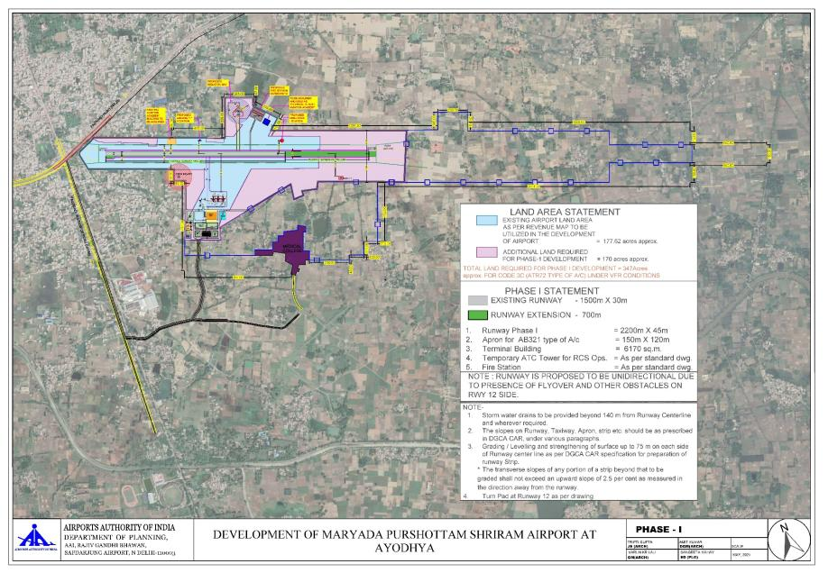
Proposed Project Site Layout

Slide 8
3. Project/ activity covered under item of Schedule to the EIA Notification, 2006 and Category
7(a) Category – A
4. In case of Category B project/activity- Reason for appraisal at the Central level
Proposed project belong to Category – A.
5. Project Brief: Nature of proposal (new/expansion,) total area- land use, project components, connectivity to the site etc:
Nature of proposal | New
Total area- land use | 140.67 ha (347.60 Acres) - Barren/ Unculturable/ Waste land
Project components | Extension of Runway, RESA, Taxiway, Apron, Isolation Bay, New Domestic Terminal Building & Miscellenious Works
Connectivity to the site | NH – 27, Basti to Lucknow - Adjacent, NW

Slide 9
Land use pattern/ Total plot area/ built up area
Land use pattern : Barren/ Unculturable/ Waste land.
Total area of the project site : 140.67 ha (347.60 Acres).
Total water requirement and its source, Ground water withdrawal approval from CGWA, if any
Total water requirement : 35 KLD
Source : Ayodhya Municipal Corporation
Waste water generation, treatment and disposal
Generation : 21 KLD of sewage
Treatment : MBBR based Sewage Treatment plant
Disposal : Used for flushing and green belt development at Maryada Purushottam Shriram Airport

Slide 10
Municipal solid waste generated disposal facility
Generation : Approx. 100 kg per day
Collection : Colour Coded Dual Waste Bins for biodegradable food wastes, paper wastes, non - biodegradable plastic wastes, metal & inert wastes will be used
Disposal : Solid waste will be collected, segregated and handed over to external agency as per Solid Waste Management Rule, 2016
Power requirement and source
Total power requirement : 500 KVA.
DG Sets : 3 Nos of capacity of 250 KVA

Slide 11
Proposed energy saving measures with estimated energy saving
Airport Terminal building have been designed and constructed for GRIHA Rating 4 star
Use of Energy Efficient building material & glass
Use of LED lamps instead of GLS lamps
Solar passive techniques for terminal building
Microprocessor based Building Management System (BMS) will be installed for minimization of energy consumption
Automatic lighting on / off control system will be provided in the airport area for optimum utilization of energy.
By adopting above measures more than 30% energy will be saved

Slide 12
Details of Rain Water Harvesting Plan
50 rainwater recharge pits will be constructed.
Parking details as per norms
City side car : 75 cars,
VIP parking : 10 cars, taxi parking and coach parking.
6. Details of earlier EC, if any and compliance thereof
In 2008, the Ayodhya Airport was handed over by the government of Uttar Pradesh to Airports Authority of India (AAI) to be developed as full-fledged airport by the approval of Uttar Pradesh cabinet.
In 2012, the Uttar Pradesh government had issued formal orders allowing the landing and parking of private aircraft on the airstrip. Therefore, environmental clearance is not available.

Slide 13
7. Whether the project is in critically Polluted area? If so, give details
The project is not situated in critically polluted areas as identified by the CPCB.
8. List of commitments as mentioned in the EIA/EMP w.r.t mitigation measures
Construction of community toilets at nearby villages
Construction of drainage channel around airport villages to avoid flooding during the rainy season.
Solid waste collection and disposal facilities in the surrounding villages located around airport premises.
Rain water Harvesting Structure at nearby villages.
Greenbelt development at nearby villages.
Desilting of Ponds at nearby villages for rain water accumulation.

Slide 14
9. Comparative analysis of existing /envisioned pollution load (in case of expansion/modernization)
The envisioned pollution load after the development of Proposed Airport
Pollutant | Baseline Levels, µg/m³ | Incremental Levels, µg/m³ | Resultant Levels, µg/m³
SO₂ | 11 | 0.322 | 11.32
NO₂ | 22 | 0.077 | 22.07
PM | 69 | 0.038 | 69.03
10. If the project is for EC under EIA Notification, 2006
a) For the first time appraisal by EAC
Date of ToR
MOEF&CC vide letter F. No. 21-67/2021-IA-III Dated 14 August, 2021.
(ii) Point-wise ToR compliance

Slide 15
Compliance of Standard Terms of Reference issued by MOEF&CC, New Delhi, MOEF&CC vide F. No. 21-67/2021-IA-III dated 14th August 2021

Slide 16
TOR Point 1: Reasons for selecting the site with details of alternate sites examined / rejected / selected on merit with comparative statement and reason / basis for selection. The examination should justify site suitability in terms of environmental angle, resources sustainability associated with selected site as compared to rejected sites. The analysis should include parameters considered along with weightage criteria for short-listing selected site.
Compliance:
As the proposed project involves extension of Runway, RESA, Taxiway, Apron, GSE Area, Isolation Bay, construction of new terminal building and Miscellaneous works within the government airstrip in Maryada Purushottam Shriram Airport.
The site for proposed development work has already been handed over by the district administration, which is located adjacent to the existing airstrip Therefore, no alternative site has been considered for this project.

Slide 17
TOR Point ii: Details of the land use break-up for the proposed project. Details of land use around 10 km radius of the project site. Examine and submit detail of land use around 10 km radius of the project site and map of the project area and 10 km area from boundary of the proposed / existing project area, delineating project areas notified under the wild life (Protection) Act, 1972 / critically polluted areas as identified by the CPCB from time to time/notified eco-sensitive areas/interstate boundaries and international boundaries. Analysis should be made based on latest satellite imagery for land use with raw images.
Compliance
The proposed site is spread over an area of 347.62 Acres. About 170 acres (68.79 ha) of additional land has already been handed over by the district administration for the proposed development activities.
The site for the proposed development activities and allied works is free from vegetation and buildings. For designing of proposed development works, AAI Circulars, National Building Code and ICAO guidelines have been followed.
There is no wildlife sanctuary, national park or any other ecological sensitive area within 10 km distance.
There is no critically polluted areas as identified by the CPCB from time to time or interstate boundaries and international boundaries within 10 km distance from the site.

Slide 18
S. No. | Activity | Area in Acres | Percentage (%)
1. | Terminal Building & Allied Buildings | 1.48 | 0.43
2. | Runway, Taxiway, Apron | 35.37 | 10.18
3. | Internal Roads | 6.84 | 1.96
4. | Parking Area | 0.8 | 0.23
5. | Gardening / Green Belt | 34.76 | 10.00
6. | Remaining open area | 268.37 | 77.20
 | Total | 347.62 | 100
There is no wildlife sanctuary, national park or any other ecological sensitive area within 10 km distance.
There is no critically polluted areas as identified by the CPCB from time to time or interstate boundaries and international boundaries within 10 km distance from the site.
Land use and Land Cover for 10 km Study Area
S. No. | Land use | Area (Sq. km.) | Percentage (%)
1 | Agriculture Crop Land | 50.54 | 13.31
2 | Agriculture Plantation | 85.71 | 22.57
3 | Agriculture Fallow Land | 139.36 | 36.70
4 | Barren / Uncultivable / Waste Lands / Scrub Lands | 27.21 | 7.17
5 | Built-up Land | 47.67 | 12.56
6 | River Sand | 16.07 | 4.23
7 | Water bodies | 13.12 | 3.46
 | Total Area | 379.68 | 100

Slide 19
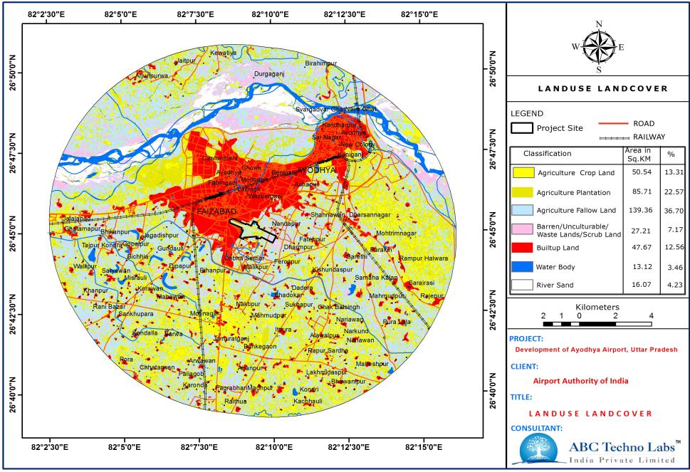
Land use & Land Cover of Study Area

Slide 20
TOR Point iii: Submit the present land use and permission required for any conversion such as forest, agriculture etc. land acquisition status, rehabilitation of communities / villages and present status of such activities
Compliance
170 Ha of additional land which has already been handed over by District Administration, is required for the extension of Runway, RESA, Taxiway, Apron, GSE Area, Isolation Bay, construction of new terminal building and Miscellaneous works in Maryada Purushottam Shriram Airport.
ToR Point iv: Examine and submit the water bodies including the seasonal ones within the corridor of impacts along with their status, volumetric capacity, quality likely impacts on them due to the project.
Compliance
No water bodies including the seasonal one are present in the Maryada Purushottam Shriram Airport campus.
ToR Point v: Submit a copy of the contour plan with slopes, drainage pattern of the site and surrounding area.
Compliance
Area of proposed development site is flat. The drainage pattern of the site is given in the following figure.

Slide 21
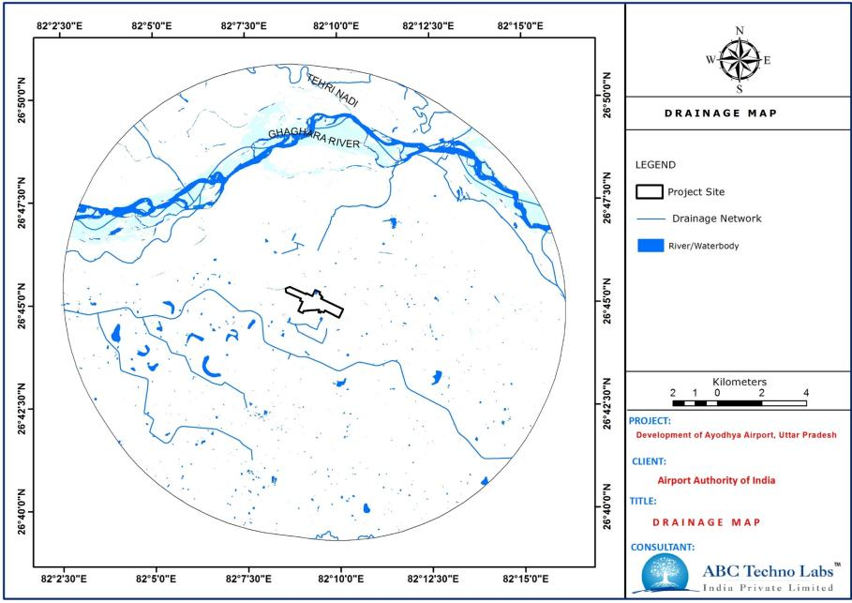
Drainage Network Map – Study Area
21

Slide 22
Point vi: Submit details of environmentally sensitive places, land acquisition status, rehabilitation of communities / villages and present status of such activities.
Compliance
There is no wildlife sanctuary, national park or other protected area within 10 km distance from the Proposed Airport.
TOR Point vii: Examine the impact of proposed project on the nearest settlements.
Impact on ambient air quality will be negligible as construction of the terminal building will be mostly through steel and glass facades. During runway extension water sprinkling will be carried.
During excavation of foundation, necessary curtain barrier around construction activities will be provided and water sprinkling will be carried out as per requirement.
Intermittent noise generated from construction activities will be confined within boundary of the site.
Workers will be deployed from local area, therefore beneficial socio-economic impacts are anticipated.

Slide 23
TOR Point viii: Examine baseline environmental quality along with projected incremental load due to the proposed project/ activities
Compliance
Baseline environmental quality was monitored during summer season (1st March 2021 to 31st May 2021).
Soil Characteristics: Soil characteristics were analyzed for 8 locations
Surface Water Quality: Surface water quality of study area meets acceptable and permissible limits as per IS: 10500.
Ground Water Quality: The results of ground water samples were compared to Indian Standard Specification of drinking water IS:10500:2012. Analyzed values meets permissible limits for drinking standards at all ground water sampling locations.
Ambient Air Quality: National ambient air quality standards for industrial, residential, rural & other areas are met for all monitored parameters at 8 AAQM locations during summer season.
Ambient Noise: Ambient noise quality was monitored during the study period and found within stipulated standards.
Base line data were collected and interpreted for meteorology, biological and socio-economic environment.

Slide 24
Ground Water Quality in the Study Area
GW1 | Project Site | GW2 | Faizabad | GW3 | Jagdishpur | GW4 | Bhikhapur
S. No. | Parameter | Unit | Limit as per IS 10500 : 2012 |  | Results
 |  |  | Acceptable limit | Permissible limit | GW1 | GW2 | GW3 | GW4
1 | Colour | Hazen | 5 | 15 | <1 | <1 | <1 | <1
2 | Odour | - | Agreeable | Agreeable | No Odour Observed | No Odour Observed | No Odour Observed | No Odour Observed
3 | Turbidity | NTU | 1 | 5 | BDL(<0.5) | BDL(<0.5) | 0.9 | BDL(<0.5)
4 | pH at 25 °C | - | 6.5-8.5 | 6.5-8.5 | 7.63 | 7.39 | 7.65 | 7.54
5 | Conductivity at 25 °C | μS/cm | Not Specified | Not Specified | 568 | 878 | 712 | 535
6 | Total dissolved solids | mg/l | 500 | 2000 | 331 | 518 | 421 | 312
7 | Total Suspended solids | mg/l | Not Specified | Not Specified | <2 | <2 | <2 | <2
8 | Total Alkalinity as CaCO₃ | mg /l | 200 | 600 | 142 | 210 | 180 | 112
9 | Total Hardness as CaCO₃ | mg/l | 200 | 600 | 170 | 260 | 230 | 148
10 | Calcium as Ca | mg/l | 75 | 200 | 46 | 68 | 65 | 41
11 | Magnesium as Mg | mg/l | 30 | 100 | 13 | 21.8 | 16 | 11
12 | Chloride as Cl⁻ | mg/l | 250 | 1000 | 97 | 156 | 114 | 86
13 | Sulphate as SO₄ | mg/l | 200 | 400 | 16 | 48 | 38 | 27
14 | Nitrate as NO₃ | mg/l | 45 | 45 | 3 | 11 | 1 | 5
15 | Iron as Fe | mg/l | 1 | 1 | 0.05 | 0.14 | 0.16 | BDL (<0.05)
16 | Manganese as Mn | mg/l | 0.10 | 0.3 | BDL(<0.01) | BDL(<0.01) | BDL(<0.01) | BDL(<0.01)
17 | Fluoride as F | mg/l | 1.00 | 1.5 | 0.16 | 0.37 | 0.21 | 0.22
18 | Sodium as Na | mg/l | Not Specified | Not Specified | 52 | 102 | 75 | 52

Slide 25
Ground Water Quality in the Study Area
GW1 | Project Site | GW2 | Faizabad | GW3 | Jagdishpur | GW4 | Bhikhapur
S. No. | Parameter | Unit | Limit as per IS 10500 : 2012 |  | Results
 |  |  | Acceptable limit | Permissible limit | GW1 | GW2 | GW3 | GW4
19 | Potassium as K | mg/l | Not Specified | Not Specified | 1.9 | 3 | 4.2 | 2.4
20 | Barium as Ba | mg/l | 0.7 | 0.7 | BDL(<0.1) | BDL(<0.1) | BDL(<0.1) | BDL(<0.1)
21 | Residual Free Chlorine | mg/l | 0.20 | 1 | BDL(<0.1) | BDL(<0.1) | BDL(<0.1) | BDL(<0.1)
22 | Aluminum as Al | mg/l | 0.03 | 0.2 | BDL(<0.03) | BDL(<0.03) | BDL(<0.03) | BDL(<0.03)
23 | Cadmium as Cd | mg/l | 0.003 | 0.003 | BDL(<0.003) | BDL(<0.003) | BDL(<0.003) | BDL(<0.003)
24 | Lead as Pb | mg/l | 0.01 | 0.01 | BDL(<0.01) | BDL(<0.01) | BDL(<0.01) | BDL(<0.01)
25 | Copper as Cu | mg/l | 0.05 | 1.5 | BDL(<0.03) | BDL(<0.03) | BDL(<0.03) | BDL(<0.03)
26 | Zinc as Zn | mg/l | 5.00 | 15 | 0.06 | 0.16 | 0.16 | 0.03
27 | Total Chromium as Cr | mg/l | 0.05 | 0.05 | BDL(<0.03) | BDL(<0.03) | BDL(<0.03) | BDL(<0.03)
28 | Arsenic as As | mg/l | 0.01 | 0.05 | BDL(<0.01) | BDL(<0.01) | BDL(<0.01) | BDL(<0.01)
29 | Cyanide as CN | mg/l | 0.05 | 0.05 | BDL(<0.02) | BDL(<0.02) | BDL(<0.02) | BDL(<0.02)
30 | Selenium as Se | mg/l | 0.01 | 0.01 | BDL(<0.01) | BDL(<0.01) | BDL(<0.01) | BDL(<0.01)
31 | Mercury as Hg | mg/l | 0.001 | 0.001 | BDL(<0.001) | BDL(<0.001) | BDL(<0.001) | BDL(<0.001)
32 | Anionic Surfactants as MBAS | mg/l | 0.20 | 1.0 | BDL(<0.025) | BDL(<0.025) | BDL(<0.025) | BDL(<0.025)
33 | Phenolic Compounds | mg/l | 0.001 | 0.002 | BDL(<0.001) | BDL(<0.001) | BDL(<0.001) | BDL(<0.001)
34 | Pesticides | mg/l | Absent | Absent | Absent | Absent | Absent | Absent
35 | Total Coliforms | MPN/ 100ml | Absent /100ml | Absent /100ml | <2 | 4 | <2 | <2
36 | E. Coli | MPN/ 100ml | Absent /100ml | Absent /100ml | <2 | <2 | <2 | <2

Slide 26
Ground Water Quality in the Study Area
GW5 | Kot Saray | GW6 | Khurdabad | GW7 | Arwawa | GW8 | Ayodhya
S. No. | Parameter | Unit | Limit as per IS 10500 : 2012 |  | Results
 |  |  | Acceptable limit | Permissible limit | GW5 | GW6 | GW7 | GW8
1 | Colour | Hazen | 5 | 15 | <1 | 1 | <1 | 1
2 | Odour | - | Agreeable | Agreeable | No Odour Observed | No Odour Observed | No Odour Observed | No Odour Observed
3 | Turbidity | NTU | 1 | 5 | 0.7 | 1 | BDL(<0.5) | 0.5
4 | pH at 25 °C | - | 6.5-8.5 | 6.5-8.5 | 7.78 | 7.71 | 7.29 | 7.51
5 | Conductivity at 25 °C | μS/cm | Not Specified | Not Specified | 794 | 1336 | 512 | 635
6 | Total dissolved solids | mg/l | 500 | 2000 | 467 | 768 | 291 | 376
7 | Total Suspended solids | mg/l | Not Specified | Not Specified | <2 | <2 | <2 | <2
8 | Total Alkalinity as CaCO₃ | mg /l | 200 | 600 | 150 | 280 | 98 | 128
9 | Total Hardness as CaCO₃ | mg/l | 200 | 600 | 196 | 360 | 132 | 152
10 | Calcium as Ca | mg/l | 75 | 200 | 56 | 96 | 38 | 44
11 | Magnesium as Mg | mg/l | 30 | 100 | 14 | 29 | 9 | 10
12 | Chloride as Cl⁻ | mg/l | 250 | 1000 | 141 | 215 | 81 | 123
13 | Sulphate as SO₄ | mg/l | 200 | 400 | 60 | 91 | 30 | 26
14 | Nitrate as NO₃ | mg/l | 45 | 45 | 1 | 7 | 6 | 3
15 | Iron as Fe | mg/l | 1 | 1 | 0.05 | 0.25 | 0.05 | 0.10
16 | Manganese as Mn | mg/l | 0.10 | 0.3 | BDL | BDL | BDL | BDL
17 | Fluoride as F | mg/l | 1.00 | 1.5 | 0.19 | 0.31 | 0.22 | 0.31
18 | Sodium as Na | mg/l | Not Specified | Not Specified | 96 | 148 | 48 | 84

Slide 27
Ground Water Quality in the Study Area
GW5 | Kot Saray | GW6 | Khurdabad | GW7 | Arwawa | GW8 | Ayodhya
S. No. | Parameter | Unit | Limit as per IS 10500 : 2012 |  | Results
 |  |  | Acceptable limit | Permissible limit | GW1 | GW2 | GW3 | GW4
19 | Potassium as K | mg/l | Not Specified | Not Specified | 2.8 | 3.9 | 2 | 1.9
20 | Barium as Ba | mg/l | 0.7 | 0.7 | BDL(<0.1) | BDL(<0.1) | BDL(<0.1) | BDL(<0.1)
21 | Residual Free Chlorine | mg/l | 0.20 | 1 | BDL(<0.1) | BDL(<0.1) | BDL(<0.1) | BDL(<0.1)
22 | Aluminum as Al | mg/l | 0.03 | 0.2 | BDL(<0.03) | BDL(<0.03) | BDL(<0.03) | BDL(<0.03)
23 | Cadmium as Cd | mg/l | 0.003 | 0.003 | BDL(<0.003) | BDL(<0.003) | BDL(<0.003) | BDL(<0.003)
24 | Lead as Pb | mg/l | 0.01 | 0.01 | BDL(<0.01) | BDL(<0.01) | BDL(<0.01) | BDL(<0.01)
25 | Copper as Cu | mg/l | 0.05 | 1.5 | BDL(<0.03) | BDL(<0.03) | BDL(<0.03) | BDL(<0.03)
26 | Zinc as Zn | mg/l | 5.00 | 15 | 0.11 | 0.11 | 0.06 | 0.08
27 | Total Chromium as Cr | mg/l | 0.05 | 0.05 | BDL(<0.03) | BDL(<0.03) | BDL(<0.03) | BDL(<0.03)
28 | Arsenic as As | mg/l | 0.01 | 0.05 | BDL(<0.01) | BDL(<0.01) | BDL(<0.01) | BDL(<0.01)
29 | Cyanide as CN | mg/l | 0.05 | 0.05 | BDL(<0.02) | BDL(<0.02) | BDL(<0.02) | BDL(<0.02)
30 | Selenium as Se | mg/l | 0.01 | 0.01 | BDL(<0.01) | BDL(<0.01) | BDL(<0.01) | BDL(<0.01)
31 | Mercury as Hg | mg/l | 0.001 | 0.001 | BDL(<0.001) | BDL(<0.001) | BDL(<0.001) | BDL(<0.001)
32 | Anionic Surfactants as MBAS | mg/l | 0.20 | 1.0 | BDL(<0.025) | BDL(<0.025) | BDL(<0.025) | BDL(<0.025)
33 | Phenolic Compounds | mg/l | 0.001 | 0.002 | BDL(<0.001) | BDL(<0.001) | BDL(<0.001) | BDL(<0.001)
34 | Pesticides | mg/l | Absent | Absent | Absent | Absent | Absent | Absent
35 | Total Coliforms | MPN/ 100ml | Absent /100ml | Absent /100ml | <2 | 4 | <2 | <2
36 | E. Coli | MPN/ 100ml | Absent /100ml | Absent /100ml | <2 | <2 | <2 | <2

Slide 28
Surface Water Quality in the Study Area
SW1 | Gaddoupur Lake | SW2 | Bhadokhar Lake | SW3 | Ghaghara River
S. No. | Parameter | Unit | Limit as per IS 10500 : 2012 |  | Results
 |  |  | Acceptable limit | Permissible limit | SW1 | SW2 | SW3
1 | Temperature | °C | - | - | 26.6 | 27 | 25.6
2 | Colour | Hazen | 5 | 15 | 3 | 10 | 1
3 | Odour | - | Agreeable | Agreeable | No Odour Observed | No Odour Observed | No Odour Observed
4 | pH at 25°C | - | 6.5-8.5 | 6.5-8.5 | 7.94 | 7.54 | 7.82
5 | Electrical Conductivity | μS/cm | Not Specified | Not Specified | 278 | 352 | 206
6 | Turbidity | NTU | 1 | 5 | 3.3 | 2.1 | 1.5
7 | Total Dissolved Solids | mg/l | 500 | 2000 | 156 | 193 | 115
8 | Total Hardness as CaCO3 | mg/l | 200 | 600 | 58 | 70 | 40
9 | Total Alkalinity as CaCO3 | mg/l | 200 | 600 | 60 | 68 | 48
10 | Chloride as Cl | mg/l | 250 | 1000 | 48 | 61 | 35
11 | Sulphate as SO₄ | mg/l | 200 | 400 | 6 | 12 | 4
12 | Fluoride as F | mg/l | 1 | 1.5 | 0.1 | 0.14 | 0.11
13 | Nitrate as NO₃ | mg/l | 45 | 45 | 4 | 6 | 1
14 | Ammonia as NH₃ | mg/l | 0.5 | 0.5 | 0.05 | 0.11 | BDL <0.05)
15 | Phosphate as PO₄ | mg/l | - | - | 0.12 | 0.16 | 0.05
16 | Sodium as Na | mg/l | Not Specified | Not Specified | 35 | 44 | 27
17 | Potassium as K | mg/l | Not Specified | Not Specified | 2.2 | 3.6 | 1.5
18 | Calcium as Ca | mg/l | 75 | 200 | 18 | 23 | 13
19 | Magnesium as Mg | mg/l | 75 | 200 | 3.1 | 3 | 2
20 | Iron as Fe | mg/l | 0.3 | 0.3 | 0.13 | 0.21 | 0.05
21 | Manganese as Mn | mg/l | 0.1 | 0.3 | BDL(<0.02) | BDL(<0.02) | BDL(<0.02)

Slide 29
Surface Water Quality in the Study Area
SW1 | Gaddoupur Lake | SW2 | Bhadokhar Lake | SW3 | Ghaghara River
S. No. | Parameter | Unit | Limit as per IS 10500 : 2012 |  | Results
 |  |  | Acceptable limit | Permissible limit | SW1 | SW2 | SW3
22 | Anionic Surfactants as MBAS | mg/l | 0.2 | 1 | BDL(<0.025) | BDL(<0.025) | BDL(<0.025)
23 | Total Suspended Solids | mg/l | - | - | 4 | 6 | 2
24 | Dissolved Oxygen as O₂ | mg/l | - | - | 6.7 | 6.1 | 6.9
25 | Chemical Oxygen Demand | mg/l | - | - | 12 | 15 | 8
26 | Bio-Chemical Oxygen Demand @ 27°C for 3 days | mg/l | - | - | <2 | <2 | <2
27 | Phenolic compounds as C₆H₅OH | mg/l | 0.001 | 0.002 | BDL(<0.001) | BDL(<0.001) | BDL(<0.001)
28 | Copper as Cu | mg/l | 0.05 | 1.5 | BDL(<0.03) | BDL(<0.03) | BDL(<0.03)
29 | Mercury as Hg | mg/l | 0.001 | 0.001 | BDL(<0.001) | BDL(<0.001) | BDL(<0.001)
30 | Cadmium as Cd | mg/l | 0.003 | 0.003 | BDL(<0.003) | BDL(<0.003) | BDL(<0.003)
31 | Selenium as Se | mg/l | 0.01 | 0.01 | BDL(<0.01) | BDL(<0.01) | BDL(<0.01)
32 | Total Arsenic as As | mg/l | 0.01 | 0.05 | BDL(<0.01) | BDL(<0.01) | BDL(<0.01)
33 | Cyanide as CN | mg/l | 0.05 | 0.05 | BDL(<0.02) | BDL(<0.02) | BDL(<0.02)
34 | Lead as Pb | mg/l | 0.01 | 0.01 | BDL(<0.01) | BDL(<0.01) | BDL(<0.01)
35 | Zinc as Zn | mg/l | 5 | 15 | 0.05 | 0.14 | 0.05
36 | Total Chromium as Cr | mg/l | 0.05 | 0.05 | BDL(<0.03) | BDL(<0.03) | BDL(<0.03)
37 | Nickel as Ni | mg/l | 0.02 | 0.02 | BDL(<0.02) | BDL(<0.02) | BDL(<0.02)
38 | Oil & Grease | mg/l | - | - | BDL(<1) | BDL(<1) | BDL(<1)
39 | Mineral oil | mg/l | - | - | BDL(<0.5) | BDL(<0.5) | BDL(<0.5)
40 | Poly Chlorinated Biphenyls (PCBs) | mg/l | 0.0005 | 0.0005 | BDL (<0.0001) | BDL (<0.0001) | BDL (<0.0001)
41 | Poly Nuclear Aromatic Hydrocarbon as PAH | mg/l | 0.0001 | 0.0001 | BDL (<0.0001) | BDL (<0.0001) | BDL (<0.0001)
42 | Total Coliform | MPN/ 100ml | Absent /100ml | Absent /100ml | 40 | 70 | 8
43 | Faecal Coliform | MPN/ 100ml | Absent /100ml | Absent /100ml | 6 | 40 | <2

Slide 30
Ambient Air Quality in the Study Area
Code | Location | PM₁₀ |  |  |  | PM_{2.5} |  |  |  | SO₂
 |  | Min | Max | Avg | 98% | Min | Max | Avg | 98% | Min | Max | Avg | 98%
AAQ1 | Project site | 47 | 66 | 58 | 65 | 23 | 32 | 27 | 32 | 7 | 9 | 8 | 9
AAQ2 | Faizabad | 53 | 69 | 62 | 69 | 25 | 34 | 29 | 34 | 8 | 11 | 9 | 11
AAQ3 | Jagdishpur | 47 | 61 | 54 | 61 | 21 | 30 | 26 | 30 | 7 | 9 | 8 | 9
AAQ4 | Bhikhapur | 45 | 57 | 50 | 57 | 21 | 27 | 24 | 27 | 5 | 8 | 7 | 8
AAQ5 | Kot Saray | 43 | 57 | 49 | 57 | 20 | 27 | 23 | 27 | 5 | 8 | 7 | 8
AAQ6 | Khurdabad | 51 | 69 | 61 | 69 | 25 | 34 | 30 | 34 | 8 | 11 | 10 | 11
AAQ7 | Arwawa | 42 | 57 | 49 | 57 | 20 | 27 | 23 | 27 | 5 | 8 | 7 | 8
AAQ8 | Ayodhya | 48 | 66 | 58 | 65 | 22 | 31 | 27 | 31 | 7 | 10 | 8 | 10
CPCB Standards |  | 100 |  |  |  | 60 |  |  |  | 80
Code | Location | NO₂ |  |  |  | CO
 |  | Min | Max | Avg | 98% | Min | Max | Avg | 98%
AAQ1 | Project site | 16 | 19 | 17 | 19 | 0.12 | 0.26 | 0.17 | 0.25
AAQ2 | Faizabad | 16 | 22 | 19 | 22 | 0.17 | 0.32 | 0.26 | 0.32
AAQ3 | Jagdishpur | 15 | 19 | 17 | 19 | 0.12 | 0.29 | 0.2 | 0.29
AAQ4 | Bhikhapur | 14 | 17 | 16 | 17 | 0.11 | 0.21 | 0.16 | 0.2
AAQ5 | Kot Saray | 14 | 17 | 15 | 17 | 0.11 | 0.19 | 0.15 | 0.19
AAQ6 | Khurdabad | 17 | 22 | 19 | 22 | 0.16 | 0.31 | 0.24 | 0.3
AAQ7 | Arwawa | 13 | 17 | 15 | 17 | 0.11 | 0.21 | 0.15 | 0.2
AAQ8 | Ayodhya | 15 | 19 | 17 | 19 | 0.14 | 0.29 | 0.22 | 0.29
CPCB Standards |  | 80 |  |  |  | 2
Concentration of NH₃, O₃, Lead, Benzene, Bap, Ar and Ni were below detection limit.

Slide 31
Ambient Noise Measurements
Locations | Day Time dB(A) | Night Time dB(A) | Prescribed Standards dB(A)
 |  |  | Day Time | Night Time
Project site | 54.1 | 46.9 | 55 | 45
Faizabad | 56.7 | 46.9 | 55 | 45
Jagdishpur | 53.9 | 44.5 | 55 | 45
Bhikhapur | 51.7 | 44 | 55 | 45
Kot Saray | 49.7 | 43.6 | 55 | 45
Khurdabad | 57.8 | 47.8 | 55 | 45
Arwawa | 52.6 | 44.8 | 55 | 45
Ayodhya | 55.6 | 46.3 | 55 | 45
Project site | 54.1 | 46.9 | 55 | 45
Faizabad | 56.7 | 46.9 | 55 | 45
Jagdishpur | 53.9 | 44.5 | 55 | 45

Slide 32
TOR Point ix: Examine and submit details of levels, quantity required for filling, source of filling material and transportation details etc. Submit details of a comprehensive Risk Assessment and Disaster Management Plan including emergency evacuation during natural and man-made disaster integrating with existing airport.
Compliance
The new terminal building and allied facilities at proposed Airport will be above ground.
For the development of all the facilities at the proposed Airport, required quantity of filling material will be procured in authorized quarries.
Hazard occurrence at the airport may result in on-site implications:
Leakage of flammable materials (HSD) followed by fire
Bomb threat at terminal building or in aircraft
Natural calamities like, earthquake, etc.
Other incidents, which can also result in a disaster at the proposed Airport:
Agitation/ forced entry by external group of people
Sabotage
Air raids
Crashing of aircraft i.e. while landing or take-off

Slide 33
TOR Point x: Examine road/rail connectivity to the project site and impact on the existing traffic network due to the proposed project/ activities. A detailed traffic and transportation study should be made for existing and projected passenger and cargo traffic.
Compliance
The proposed Airport is well connected by the National Highway 27 and State Highway 34. The construction materials and filling earth will be transported through existing road only. Earth and construction materials will be transported during non-peak hours or night time.

Slide 34
TOR Point xi: Submit Details Regarding R&R involved in the project
Compliance
No land acquisition is proposed by AAI for the proposed project and therefore, R&R is not involved in the project.
TOR Point xii: Examine the details of water requirement, use of treated waste water and prepare a water balance chart. Source of water vis-à-vis waste water to be generated along with treatment facilities to be proposed.
Total water requirement is estimated as 35 KLD, while fresh water requirement will be 15 KL per day. Fresh Water requirement will be met through Ayodhya Municipal Corporation.
Water balance chart is given below
Effluents Generation and Management
Sewage will be collected and treated in well-designed sewage treatment plant.
21 KLD sewage will be generated from the proposed Airport which will be treated in MBBR based STP of 25 KLD capacity.
After meeting stipulated standards, treated waste water will be utilized for Flushing and greenery /landscaping.
STP will be operated properly to avoid generation of odour.
Conditions imposed by UPPCB for operation of STP will be followed.

Slide 35
Water Balance Chart
Water Supply from Municipal Corporation
(15 KLD)
Consumed
(4 KLD)
Treatment Loss
(1 KLD)
Total Water Requirement
35 KLD
Water for Drinking, Hand Washing, Food, etc.
(15 KLD)
STP
(25 KLD)
11 KLD
20 KLD
Water for Toilet Flushing
(10 KLD)
10 KLD
Water for Green Belt & Landscaping
(10 KLD)
Treated Water Storage Tank
(20 KLD)

Slide 36
TOR Point xiii: Rain water harvesting proposals should be made with due safeguards for ground water quality. Maximize recycling of water and utilization of rain water.
Compliance
Total run off available for recharging the ground water = 736762.91 cu.m.
As per the CPWD rainwater harvesting calculations, the maximum volume of Rainwater derived is 17796.19 cu. m/15 min. As per soil lithology, 50 No of Recharge pits will be provided.

Slide 37
TOR Point xiv: Examine details of Solid waste generation treatment and its disposal.
Compliance
About 100 kg per day municipal solid waste will be generated during operation of the airport including waste generated from shops / eateries / office of airport premises and deplane waste generated from aircraft.
The same will be collected, segregated and managed by external agency for disposal as per Solid Waste Management Rules, 2016.
Toilet wastes and sewage collected from aircrafts will be treated in Sewage treatment plant to be installed at the proposed Airport.
Waste Source | Proposed
Trash collected in flight and disposed at the Airport. | 10
Maintenance and workshop wastes | 20
Wastes arising out of eateries and shops situated within the airport. | 25
Waste generated by passengers | 20
Waste generated by the employees | 25

Slide 38
TOR Point xv: Submit the present land use and permission required for any conversion such as forest, agriculture etc.
Compliance
No land use conversion required as no forest / agriculture land is involved in the proposed project.
TOR Point xvi: Examine separately the details for construction and operation phases both for Environmental Management Plan and Environmental Monitoring Plan with cost and parameters.
Environmental Management Plan and Environmental Monitoring Plan for construction and operation phases with cost and parameters have been prepared and are presented in Chapter 6 & Chapter 10 of EIA Report.
Total budget of Rs 1.3 Crores has been kept for implementation of environmental management plan during construction and operation phases of new terminal building and associated facilities.
Note: For recurring cost per annum for Environmental Management, fund of Rs 30.00 has been allocated.

Slide 39
Environmental Management Plan
Components | Stage | Items | Total Cost (Rs)
Air | Construction | Dust Management with Sprinkling of Water | 1000000
 |  | Covers for Vehicles Transporting, Construction Materials | 500000
 |  | Shed for de-dusting of cements bags | 50000
 | Operation | Stack to DG set | 200000
Water | Construction | Sanitary Facilities for Construction Workers | 200000
 |  | Silt Fencing | 500000
 | Operation | Oil & Grease Traps | 85000
 |  | Installation of STP | 500000
Construction Safety | Construction | Facilities to Workers | 1250000
Soil | Construction | Preservation of top soils | 400000
 |  | Cement Flooring at Fuel Storage Yard | 50000
Compensatory afforestation | Construction/Operation | Plantation of 1750 trees @ Rs 1500/- tree | 2625000
Waste Management | Construction | Bins for collection of waste from sites | 25000
 | Operation | Waste collection and segregation | 200000
Noise | Construction | Ear plugs and muff | 20000
 | Operation | Ear plugs and muff | 20000
Energy Conservations | Operation Phase | Energy conservation measures | 1000000
Occupational Health & Safety | Construction | PPEs for workers | 500000
 |  | Workers facilities as per BOCW Regulations | 1000000
Landscaping | Operation | Landscaping within Airport and Green Belt/plantation in nearby settlement | 3000000
 |  | Total | 1,31,25,000
 |  | Say | Rs 1.3 Crores

Slide 40
Environmental Monitoring Plan
Component | Stage | Parameter | Locations | Duration/ Frequency
Air | Construction Phase | PM_{2.5}, PM₁₀, SO₂, NO₂, CO | Airport site corners | Continuous 24-hourly, once in a season
 | Operation Phase | PM_{2.5}, PM₁₀, SO₂, NO₂, CO | Airport & surrounding villages | Continuous 24-hourly, once in month
Water Quality | Construction Stage | Parameters as per IS 10500:2012 | One sample at the Proposed Airport | Once in 6 months
 | Operation Phase | Parameters as per IS 10500:2012 | One sample at the Proposed Airport and 3 surrounding villages | Once in 6 months
Sewage | Operation Phase | pH, TDS, TSS, BOD, COD, Oil & Grease | One sample of treated waste water at outlet of STP | Once in month
Noise | Construction Phase | Day and Night Time Noise Level in dB (A) | 4 locations on the boundary of Proposed Airport | Once in a season
 | Operation Phase | Day and Night Time Noise Level in dB (A) | Terminal building arrival and departure, boundary of Proposed Airport | Once in a season
Soil | Construction | Composite sample from the site for Physio-chemical parameters | At Proposed Airport | Pre and Post Monsoon season
 | Operation | Composite sample from the site for Physio-chemical parameters | At Proposed Airport | Pre and Post Monsoon seasons

Slide 41
TOR Point xvii: Submit details of a comprehensive Disaster Management Plan including emergency evacuation during natural and man-made disaster.
Complied in Point No (ix)
TOR Point xviii: Examine baseline environmental quality along with projected incremental load due to the proposed project/ activities.
Compliance
Complied in TOR Point viii
TOR Point xix: The air quality monitoring should be carried out as per the notification issued on 16th November, 2009.
Compliance
Baseline environmental quality was monitored during Summer season (From 1st May 2021 to 31st May 2021)
Complied in TOR Point viii

Slide 42
TOR Point xx: Examine separately the details for construction and operation phases both for Environmental Management Plan and Environmental Monitoring Plan with cost and parameters.
Compliance
Complied in TOR Point (xvi)
TOR Point xxi: Submit details of Corporate Social Responsibilities (CSR)
Compliance
The Corporate Social Responsibility (CSR) Policy of the Airports Authority of India (AAI) is aligned with its overall commitment to maintaining the highest standards of business performance.
Under Corporate Environmental Responsibility (CER) as specified under Ministry of Environment, Forest and Climate Change (MOEFCC) Office Memorandums, AAI has allocated budget of Rs. 3.632 Crores (1.5% of additional capital investment - Greenfield Project) for surrounding villages. The proposed activities under CER will be undertaken in consultation District Collector.

Slide 43
Proposed CER Activities
Sr. No. | Activities | Target Year | Amount (Rs. Lakhs)
1. | Construction of community toilets at Bhikapur, Pure Husan Khan, Janaura, Parwa Villages | 2021-2023 | 61
2. | Desilting of Ponds in Bhikapur, Pure Husan Khan, Janaura, Parwa villages for rain water accumulation | 2022-2023 | 52
3. | Rain water Harvesting Structure at Govt Building/Schools in at Bhikapur, Pure Husan Khan, Janaura, Parwa Villages | 2023-2024 | 65
4. | Solid waste collection and disposal facilities at Bhikapur, Pure Husan Khan, Janaura, Parwa Villages | 2023-2024 | 65
5. | Construction of Drainage Channels in Bhikapur, Pure Husan Khan, Janaura, Parwa Villages | 2024-2025 | 70
6 | Plantation in Bhikapur, Pure Husan Khan, Janaura, Parwa Villages | 2024-2025 | 50
 | Total |  | 363

Slide 44
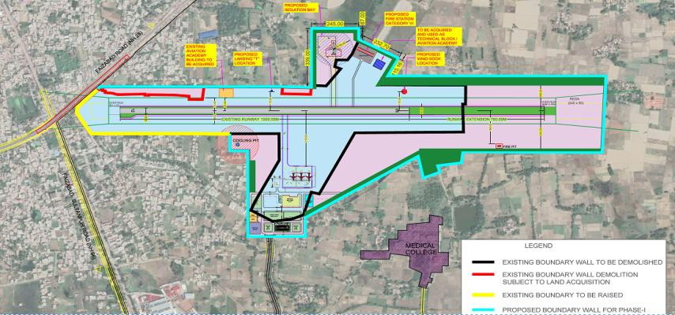
TOR Point xxii: Submit details of the trees to be cut including their species and whether it also involves any protected or endangered species. Measures taken to reduce the number of the trees to be removed should be explained in detail. Submit the details of compensatory plantation. Explore the possibilities of relocating the existing trees.
The additional land for the proposed development activities is covered with trees in partial area. A total of 2800 trees will be cut down and compensation will be met in 1:5 ratio.

Slide 45
TOR Point xxiii: Examine the details of afforestation measures indicating land and financial outlay. Landscape plan, green belts and open spaces may be described. A thick green belt should be planned all around the nearest settlement to mitigate noise and vibrations. The identification of species/ plants should be made based on the botanical studies.
Compliance
Green belt/plantation is proposed on 140668.73 sqm area at the Maryada Purushottam Shriram and open area will be covered with landscaping and grasses. It is proposed to plant 1750 trees sapling at the Ayodhya airport.
The List of Trees for Green Belt/Plantation
Sn. | Botanical Name | Common Name | Nos of Saplings
1. | Acacia catechu | Khair | 100
2. | Bauhinia acuninata | Kanchan | 95
3. | Bauhinia Semla | Semla | 120
4. | Delonix Regia | Gulmohar | 150
5. | Albizia lebbeck | Siras | 120
6. | Grevillea robusta | Silky Oak | 100
7. | Albizia procera | Kala Siras | 150
8. | Anthocephalus cadamba | Kadam | 150
9. | Cassia fistula | Amaltas | 90
10. | Melia azadarach | Bakain | 130
11. | Oreodex Regia | Bottle Palm | 50
12. | Polyalthia longifolia | Ashoka | 150
13. | Terminalia arjuna | Arjun | 85
14. | Cordia dichotoma | Lasoda | 210
15. | Holoptelea integrifolia | Papadi | 50

Slide 46
TOR Point xxiv: Public Hearing to be conducted for the project in accordance with provisions of Environmental Impact Assessment Notification 2006 and the issues raised in the public hearing should be addressed in Environmental Management Plan. The public hearing should be conducted based on the TOR letters issued by Ministry and not on the basis of Minutes of Meetings available on the web-site.
Compliance
The public hearing for the proposed extension of Runway, RESA, Taxiway, Apron, Isolation Bay, New Domestic Terminal Building & Miscellenious Works by Airports Authority of India for proposed Airport was conducted on 20th September 2021 at Primary School, Dharampur conducted by Uttar Pradesh Pollution Control Board.
TOR Point xxv: A detailed draft EIA/EMP report should be prepared in accordance with additional TOR and should be submitted to the Ministry in accordance with Notification.
Compliance
Draft EIA/EMP report has been prepared in accordance with Standard TOR and same has been submitted to MoEFCC after completion of public hearing.

Slide 47
10. a) (iii) Impact of proposed project/activity on Air, Water, Noise, Ecology and proposed mitigation measures
Impact of proposed project/activity on Air, Water, Noise, Ecology and proposed mitigation measures are given in Chapter 4 of EIA Report
(iv) Details of Public Hearing (PH)
The public hearing for the proposed proposed extension of runway RESA, taxiway, apron, isolation, new domestic terminal building and miscellaneous works by Airports Authority of India at Maryada Purushottam Shriram Airport was conducted on 20th Sep 2021 at the Primary School in Dharampur by Uttar Pradesh Pollution Control Board.

Slide 48
(v) Major issues raised during PH and response of PP in the form of implementable action plan
S. No | Name of the Participant | Issues Raised | Clarification/Action Taken
1. | Shri Ram Milan Dharampur Village, Ayodhya district | He said that on 5th August the land transfer procedure has been completed but still has not received money. | The regional officer said that the public hearing is being held from environmental point of view and the question is related to district administration of Ayodhya district.
2. | Shri Ramlot, Dharampur Village, Ayodhya district | He said that pollution is mainly caused due to dirt from roadside and asked if there are any arrangements followed for cleanliness. | The necessary actions will be taken up for the disposal of garbage by Municipal Corporation Ayodhya.
3. | Shri Ramgopal Tiwari, Dharampur Village, Ayodhya district | He asked whether the land acquisition will be continued after the airport development. | There is no near future expansion after the development and we agree not to cause any negative impacts on the livelihood of the people nearby.
4. | Shri Vishnu Prasad, Dharampur Village, Ayodhya district | He said that 9 rooms have been built on 2 Biswa land, and asked is it right to get Biswa land. | The public hearing is being held from environmental point of view and the question is related to district administration, Ayodhya District.

Slide 49
S. No | Name of the Participant | Issues Raised | Clarification/Action Taken
5. | Shri Dwarkanath, Dharampur Village, Ayodhya district | He said that noise pollution will occur due to operation of aircrafts. Other buildings will be constructed around airport which will also cause air and noise pollution. He asked to make some arrangements for the colony drainage and employment for nearby people. | We will provide rubber pads, etc for DG Sets along with acoustic enclosures to subside the noise and vibration level. STP will be set up for the purification of domestic effluent generated from the colony. Drains will be constructed around the colony for managing drainage and this project will provide employment to the nearby people.
(vi) Environmental and Socio-Economic Impacts
a. Period/ Season of baseline study and Number of Locations
Period of Baseline: 3 months (March 2021 to May 2021)
Season of Baseline: Summer
Parameter | Number of Locations
Ambient Air Quality | 8
Noise | 8
Ground water | 8
surface water | 3
Soil | 8

Slide 50
b. Key Indications: The indicates that the maximum and minimum values of PM10 are in the range of --------- to -----------, whereas the PM2.5 are in the range of ------- to ----------μg/m3. The SO2 concentrations within the study area are in the range of ------- to ---------- and the NOx are in the range of ----------- to --------------. Ozone concentrations were also monitored in the study area and are found to be in the range of ------------- to ---------------, CO are in the range of ------------ to ---------------, Benzene observed are in the range of -------------- to ------------, Ammonia observed are in the range of ------------- to --------------. The 12 observed pollutant levels were compared with CPCB National Ambient Air Quality Standards and found to be……………………….
Baseline study indicates that the maximum and minimum values of PM₁₀ are in the range of 69 to 42 μg/m³, whereas the PM_{2.5} are in the range of 34 to 20 μg/m³. The SO₂ concentrations within the study area are in the range of 11 to 5 μg/m³ and the NOx are in the range of 22 to 13 μg/m³. Ozone concentrations were also monitored in the study area and are found to be below 5.0 μg/m³, CO are in the range of 0.32 mg/m³ to 0.11 mg/m³, Benzene observed are to be below 0.1 μg/m³, Ammonia observed are be below 5.0 μg/m³. The 12 observed pollutant levels were compared with CPCB National Ambient Air Quality Standards and found to be observed well within the standards.

Slide 51
b) Second/subsequent appraisal
(i) Date of first /earlier appraisal(s)
(ii) Details of the information sought by the EAC with the responses of PP
This is first appraisal in EAC.
12. If the project is in CRZ area,
Components in CRZ area.
recommendation of Coastal Zone Management Authority
layout on CRZ map of 1: 4000 scale prepared by an authorised agency
Not applicable
13. If the project involves diversion of forest land
extent of the forest land
status of forest clearance
No forest or agricultural land is required for the extension of Runway, RESA, Taxiway, Apron, Isolation Bay, New Domestic Terminal Building & Miscellenious Works at the proposed Airport.

Slide 52
14. If the project falls within 10 km of eco- sensitive area
Name of eco- sensitive area and distance from the project site,
Status of clearance from National Board for wild life
The project does not falls within 10 km of eco- sensitive area
15. Waste Management
Water requirement, source, status of clearance
Water requirement: 35 KLD
Source: Ayodhya Municipal Corporation
Water requirement, source, status of clearance
Waste water quantity: 21 KLD
STP treatment capacity: 25 KLD
Recycling / reuse of treated water and disposal
Recycling / reuse of treated water: 20 KLD
Disposal: Flushing and Greenbelt development

Slide 53
Solid Waste Management
Complied in Point xiv
Hazardous Waste Management
Complied in Point xiv
16. Other details
Noise Modelling with noise control measures for airports
Area | Permissible Limits (Day Time) | Distance from source
Silence Zone | 50 dB (A) | 110 m
Residential | 55 dB (A) | 90 m
Commercial | 65 dB (A) | 30 m
Industrial | 75 dB (A) | 10 m
Provision of rubber padding / noise isolators to DG sets and construction machines
Preventive maintenance of the machine / equipments will be carried out;
Provision of silencers to modulate the noise generated by machines;
Provision of protective devices like ear muff / plugs to the workers; and
Monitoring of ambient noise level / source emission will be carried out as per details given in Chapter 6 or as stipulated by the CPCB/ UPPCB.

Slide 54
Details of water bodies, impact on drainage, if any
Gaddour Pur Pond – 3.2 Km, NW
Tajpur Kodara Lake – 4.7 Km, SW
Dharamdaspur Lake – 5.2 Km, SSW
Ghaghra River – 5.5 Km, NW
Green belt development and Details of tree felling/transplantation
Green belt/plantation is proposed on 18211 sqm area at the Proposed Airport and open area will be covered with landscaping and grasses. It is proposed to plant 1500 trees sapling at the Proposed airport.
Undertaking to the effect that no activity has since been taken up
No construction has started. Affidavit is enclosed.
Expected timeline for completion of the project
The proposed development activities will be completed within a period of 2 years.
Investment/Cost of the project is Rs............(in crore)
Investment/Cost of the project is Approx. Rs. 242.14 Crores.
Employment potential
Direct: 250 persons, Indirect: 180 persons.

Slide 55
Benefits of the project
• Air Connectivity to Ayodhya city and its surroundings.
• Increase in regional economy as it will boost tourism, trade and commercial activities in the region.
• Generation of more revenue to the state, hence more development of the region.
• Employment opportunity to people. More business and industrial opportunities.

Slide 56
Thank You

