Slide 1

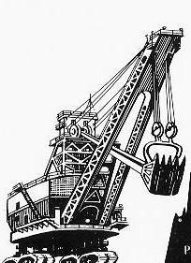

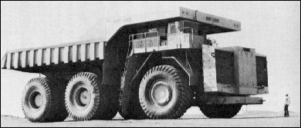
WESTERN COALFIELDS LIMITED
WELCOMES
CHAIRMAN & MEMBERS
OF
EXPERT APPRAISAL COMMITTEE (COAL MINING SECTOR)
Notes:
1

Slide 2
PRESENTATION
FOR
ENVIRONMENTAL CLEARANCE
(AS PER CLAUSE 7 (II) OF EIA NOTIFICATION, 2006 and MOEF&CC O.M. DATED 07.05.2022)
FOR
EXPANSION OF SINGHORI OC
NAGPUR AREA, WCL
Expansion in Production Capacity
from 1.12 MTPA to 1.20 MTPA within 423.91 ha
(within already sanctioned EC area of 425.04 ha)
Notes:
2

Slide 3
CONSULTANT
Central Mine Planning & Design Institute Ltd.,
Gondwana Place, Kanke Road
Ranchi – 834 031, Jharkhand
E-mail: gmenv.cmpdi@coalindia.in
Tel. no. 0651-2230055
Accredited By QCI
Accredited vide Certificate No. NABET/EIA/1720/SA 0108 valid till 22.08.2021
(Extended by QCI/NABET/EIA/ACO/22/2339 dated 09/05/2022 upto 08.08.2022)
Sectors Approved
Sl. No. | Sector No. | Name of Sector | Category
1 | 1 | Mining of Minerals | A
2 | 6 | Coal washeries | A
3 | 4 | Thermal Power Plants | A
Notes:
3
3
3
3

Slide 4
PROPOSAL
The present proposal seeks Environment Clearance for enhancement in production capacity of Singhori OC from 1.12 MTPA to 1.20 MTPA (i.e. 40% to 50% enhancement) within 423.91 ha (area covered under EC area of 425.04 ha) as per provisions of section 7(ii) of EIA Notification, 2006 and O.M. dated 07.05.2022.
There is 14.23 ha of Forest land involved in the ML area and for which Stage – II Forestry clearance has been granted vide letter dated 29.11.2018 of MoEF&CC.

Slide 5
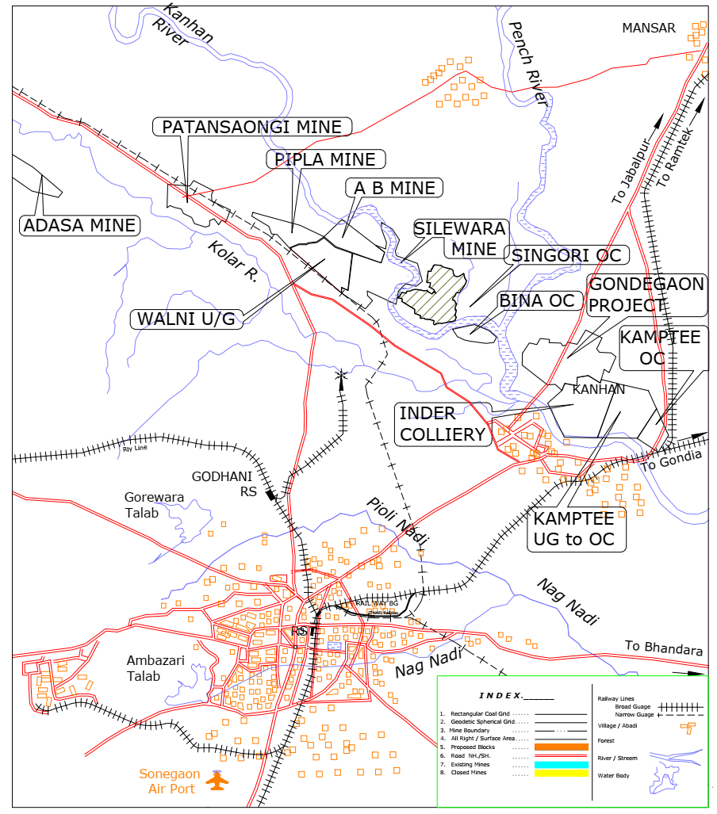
LOCATION PLAN
Location Plan of Expansion of Singhori OC
Singhori OC

Slide 6
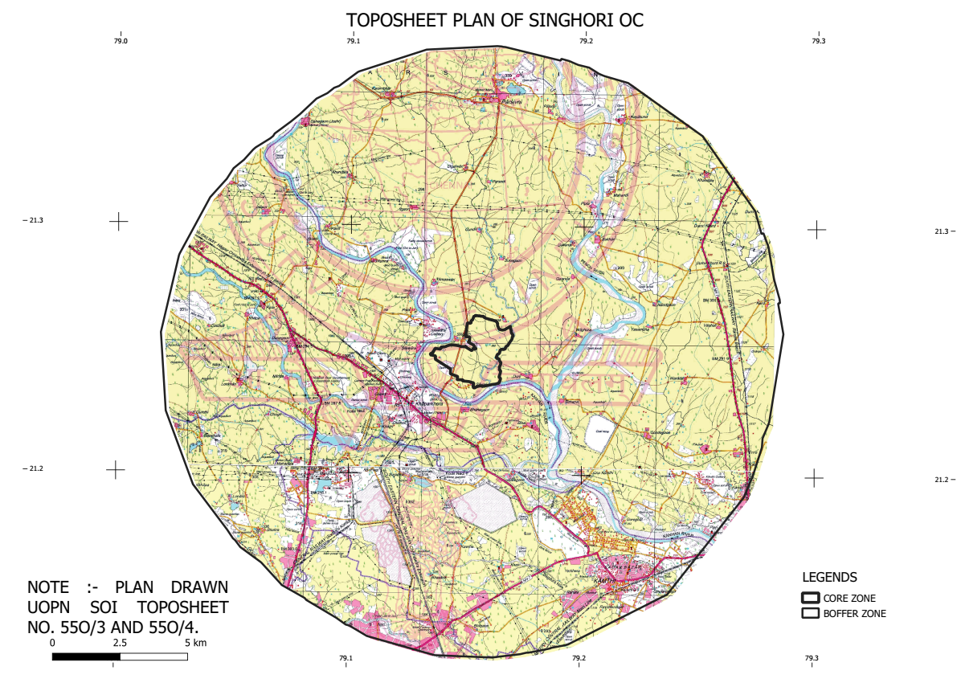
TOPOSHEET PLAN

Slide 7
BACKGROUND
MoEF&CC, New Delhi Office has issued Office Memorandum dated 11.04.2022 in respect of the grant of Environment Clearance under para 7 (ii) of EIA notification, 2006 regarding expansion up to 50%.
Further MoEF&CC, New Delhi Office has issued Office Memorandum dated 07.05.2022 regarding special dispensation for consideration of Environment Clearance (EC) for 40% to 50% expansion in coal mining projects.
As such, in WCL, Expansion of Singhori OC is proposed to avail this special dispensation.
The production capacity of Expansion of Singhori opencast coal mining project has already been enhanced by 40% from original EC of 0.80 MTPA upto 1.12 MTPA in land area of 425.04 Ha vide MOEF & CC’s EC letter no. J-11015/67/2006-IA.II (M) dated 22.08.2019.
Past performance has been given in the subsequent slide.

Slide 8
PAST PERFORMANCE
S. No. | Financial Year | Sanctioned Capacity as per EC (MTPA) | Actual Production
1. | 2017-18 | 0.80 | 0.35
2. | 2018-19 | 0.80 | 0.80
3. | 2019-20 | 1.12 | 1.119
4. | 2020-21 | 1.12 | 1.12
5. | 2021-22 | 1.12 | 1.12

Slide 9
PROPOSAL
Now, it is proposed to further enhancement of production capacity of coal for expansion from 40% to 50% (+ 10%) in-line with the provisions of O.M. dated 07.05.2022.
Based on the exigency of domestic coal supply in the country, in order to meet the demand of coal for all sectors, it is proposed to increase the production capacity upto 50% of original EC within the same mine lease area, based on the available reserves in the coal block, on the same terms and conditions of existing EC dated 22.08.2019 granted for 40% expansion of production capacity.
Original EC Capacity | 40% enhanced capacity already availed | Total EC Capacity | Proposed enhancement in production capacity | Total capacity for which EC is solicited for | Remarks
(A) | (B) = 40% of (A) | (C)= (A) + (B) | (D) = 10% of (A) | (E )= (C )+ (D) | Out of which 40% of 0.80 i.e. 0.32 has already been availed. So balance 10% of 0.80 i.e. 0.08 is now being proposed for grant.
0.80 MTPA | 0.32 MTPA | 1.12 MTPA | 0.08 MTPA | 1.20 MTPA

Slide 10
MINING DETAILS
Sl. No. | Details | Particulars
1 | Total Geological Reserves (Million Tonne) | 14.38
2 | Mineable Reserves (Million Tonne) | 12.30 (Total) , 7.786 (Balance as on 01.04.2022)
3 | Extractable Reserves(Million Tonne) | 12.30 (Total) , 7.786 (Balance as on 01.04.2022)
4 | Percent(%) of Extraction | 85%
5 | Grade of Coal /Ore /Mineral | G8
6 | Stripping Ratio | 1 : 6.23 (balance as on 01.04.2022)
7 | Average Gradient(Degree) | 1 in 3.5 to 1 in 4
8 | Mining Method | Opencast with Shovel Dumper Combination
9 | Life of Mine (Years) | 7 (balance as on 01.04.2022)

Slide 11
CALENDAR PROGRAMME
Sl. No. | Year | Coal Production
1 | 2022-23 | 1.20
2 | 2023-24 | 1.20
3 | 2024-25 | 1.20
4 | 2025-26 | 1.20
5 | 2026-27 | 1.20
6 | 2027-28 | 1.20
7 | 2028-29 | 0.586
 | Total | 7.786

Slide 12
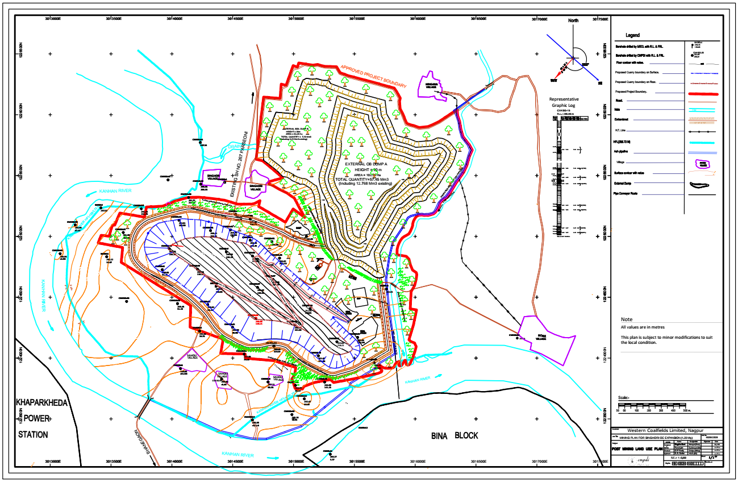
POST MINING LAND USE PLAN

Slide 13
FORESTRY CLEARANCE
Stage II Forestry clearance has been secured has been secured for the forest land of 14.23 Ha involved in the project. There is no further forest land involved in the project as well as in the proposed expansion.

Slide 14
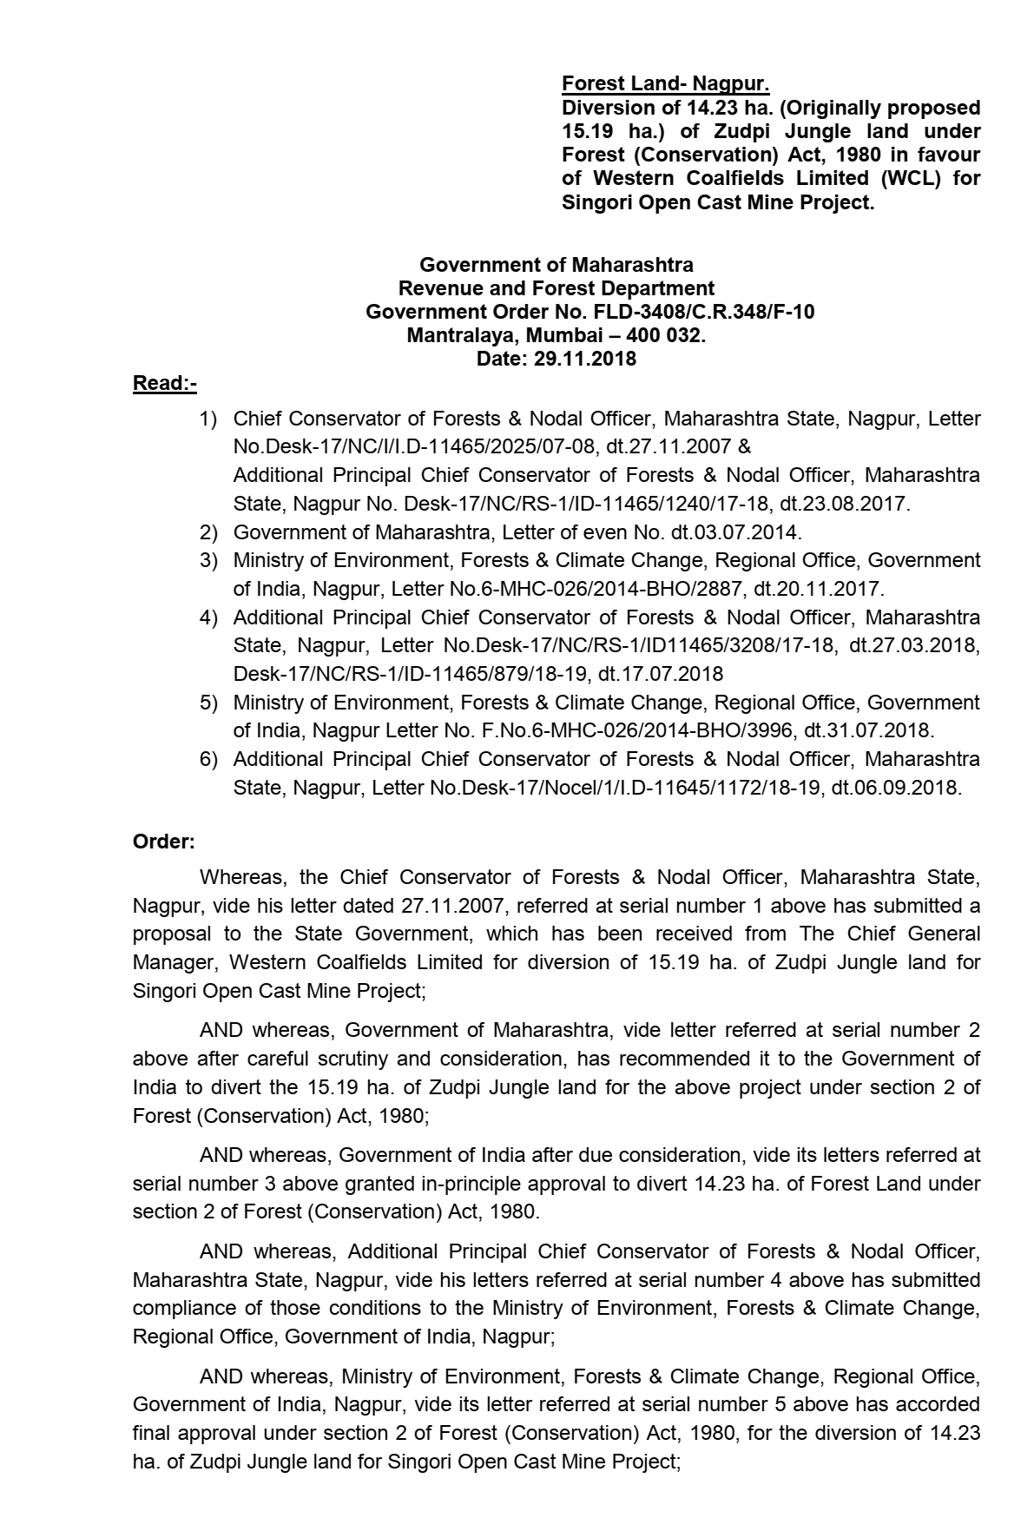
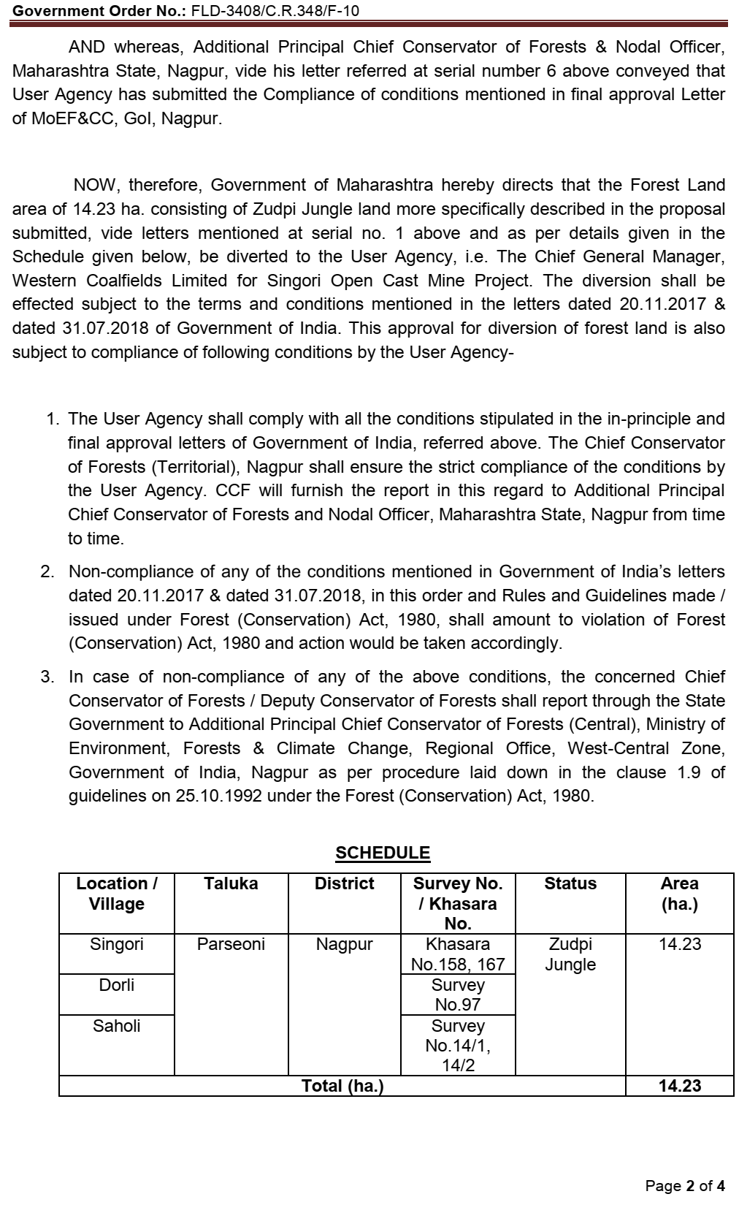
FORESTRY CLEARANCE LETTER

Slide 15
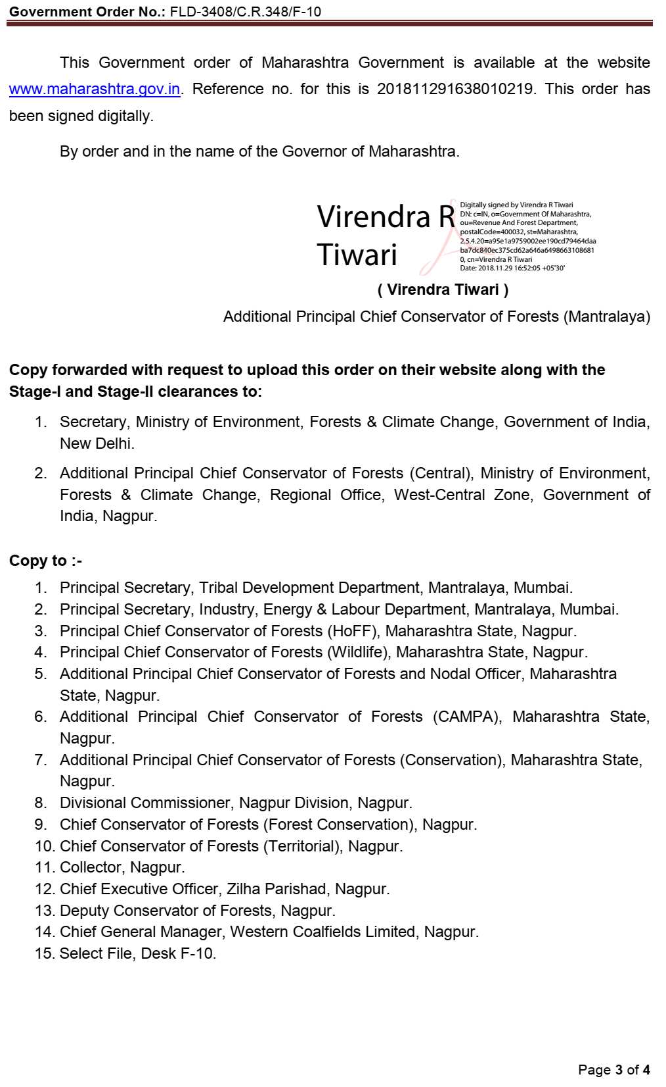
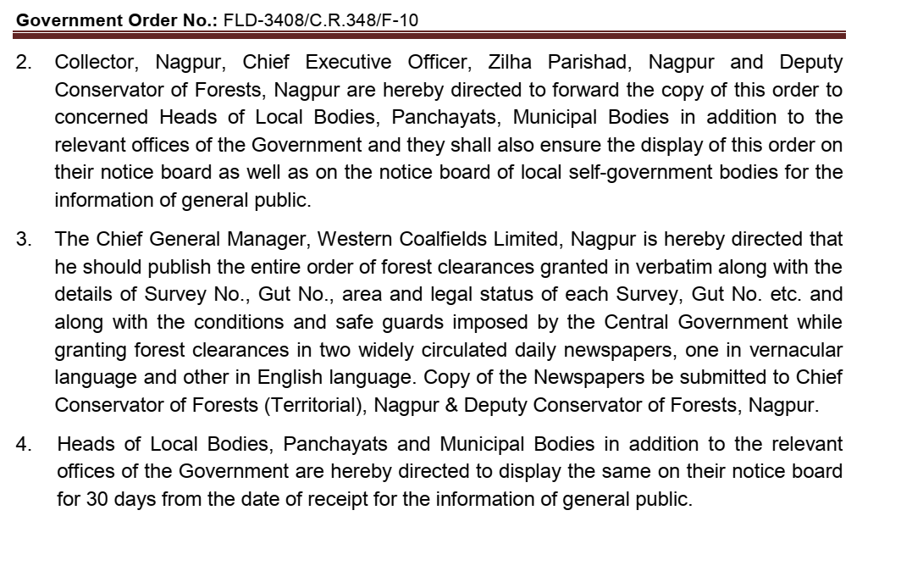
FORESTRY CLEARANCE LETTER

Slide 16
Compliance of O.M. dated 07/05/22
Further, in compliance of item no. 6 (iv) of O.M dated 07.05.2022, the certified compliance report of the EC granted for 40% expansion, along with EIA/EMP report, prepared based on standard TORs for the additional capacity of 10% will be submitted on PARIVESH portal within six months of enhancement of production beyond 40%.
Salient Pollution control measures presently deployed at Singhori OC has been given in subsequent slides.

Slide 17
COAL DISPATCH ARRANGEMENT
Presently, Coal from Singhori OC is being dispatched in following arrangement.
Part of the coal production is dispatched to Dumri Railway Siding, which is located at 34 Kms from the Mine and thereafter by rail to consumers.
Part of the Coal production is directly fed to the power plants of the MAHAGENCO namely Koradi Thermal Power Plant and Khaparkheda Thermal Power Plant (transport is arranged by TPP) which are located at 21 Kms and 10 Kms respectively.

Slide 18
COAL DISPATCH ARRANGEMENT
Now, coal transportation to TPP will be replaced by Pipe Conveyor system from the existing road transportation and rail transportation.
The commissioning of pipe conveyor system is already in progress and being carried out by MAHAGENCO.
The plan of the total system and the existing status of the work is placed in subsequent slides.

Slide 19
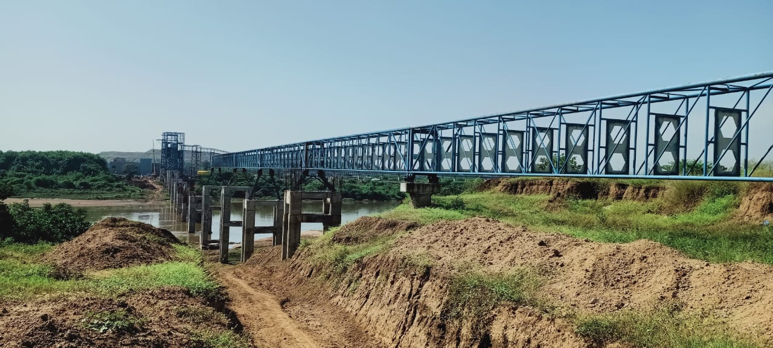
CONSTRUCTION OF PIPE CONVEYOR SYSTEM NEAR SINGHORI OC

Slide 20
POLLUTION CONTROL MEASURES
Air Pollution Control Measures/ Monitoring
Fixed Sprinklers - 18 nos. of rain guns having width 40 m throw are in operation.
Portable Sprinklers - 25 nos. in place of mobile nature & 20 nos. - Proposed
Mobile Water tankers – 2 nos. (18 KL Cap.) & 2 nos. (12 KL Cap.) in operation.
Truck Mounted Mist fogger – 01 nos. proposed
Coal transportation road - Black topping of about 3.6 km length completed
Drilling – Wet Drilling
Plantation done – 86500 nos.
1 no. of CAAQMS in operation
All Existing measures will continue to be operated and maintained. The proposed measures will also be placed into operation.

Slide 21
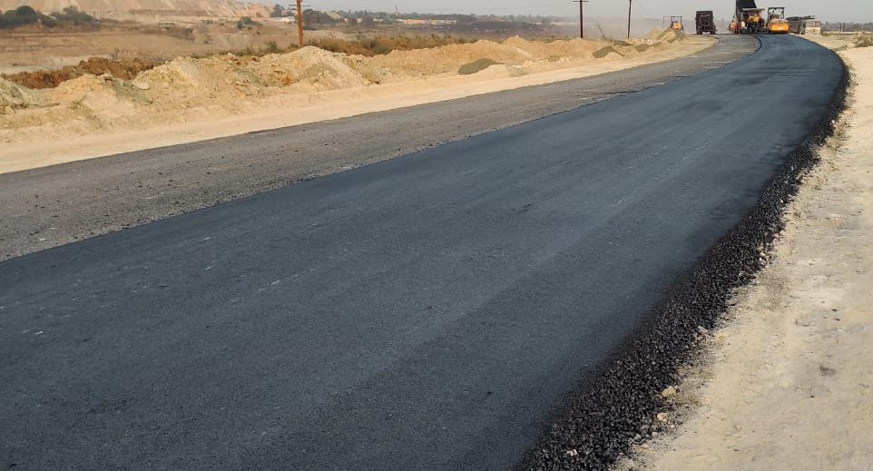
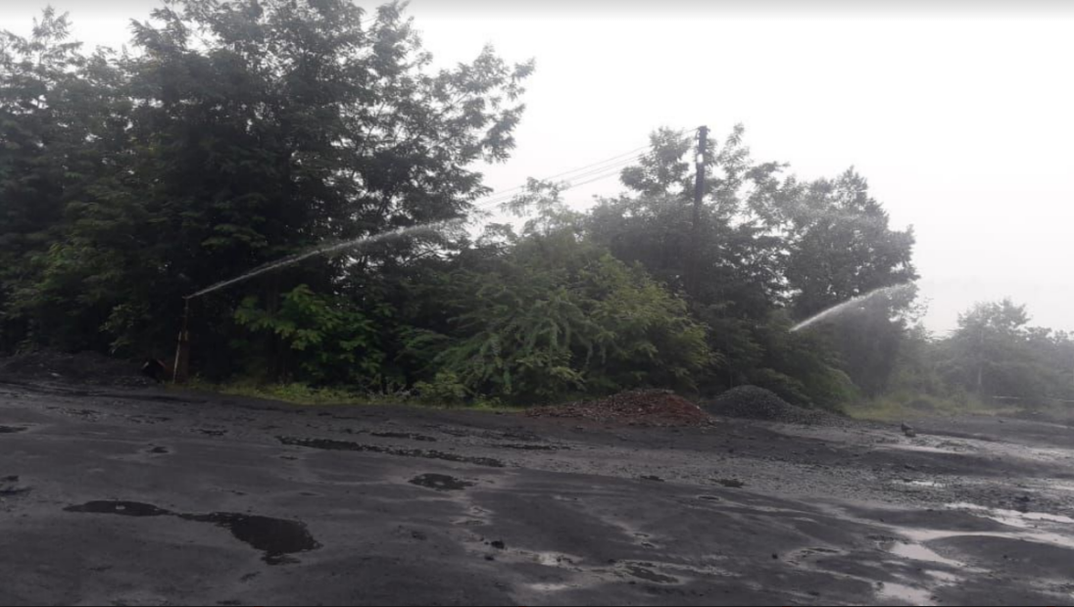
Black Topping Of Coal Transportation Road
POLLUTION CONTROL MEASURES
Fixed Rain Guns

Slide 22
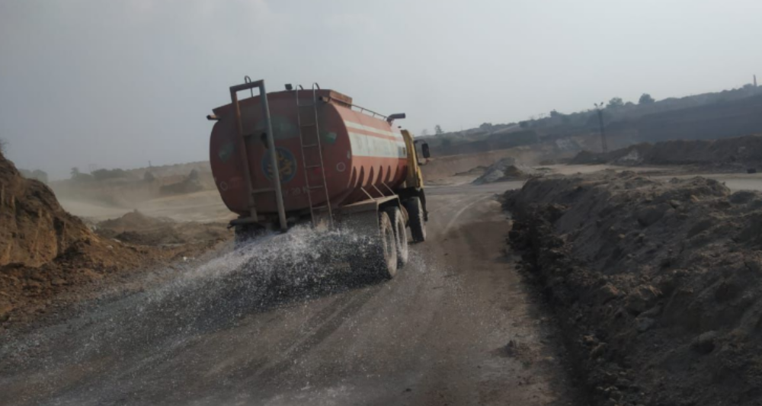
Mobile Water Tanker
POLLUTION CONTROL MEASURES

Slide 23
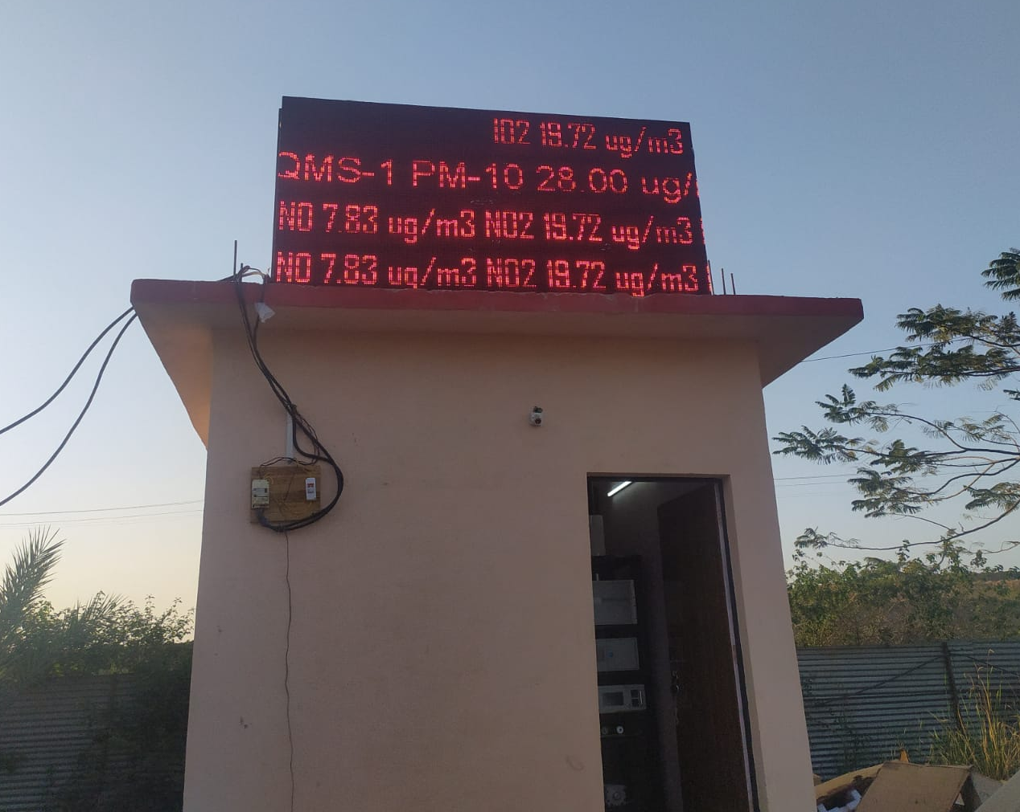
CAAQMs
Singhori OC
Nagpur Area

Slide 24
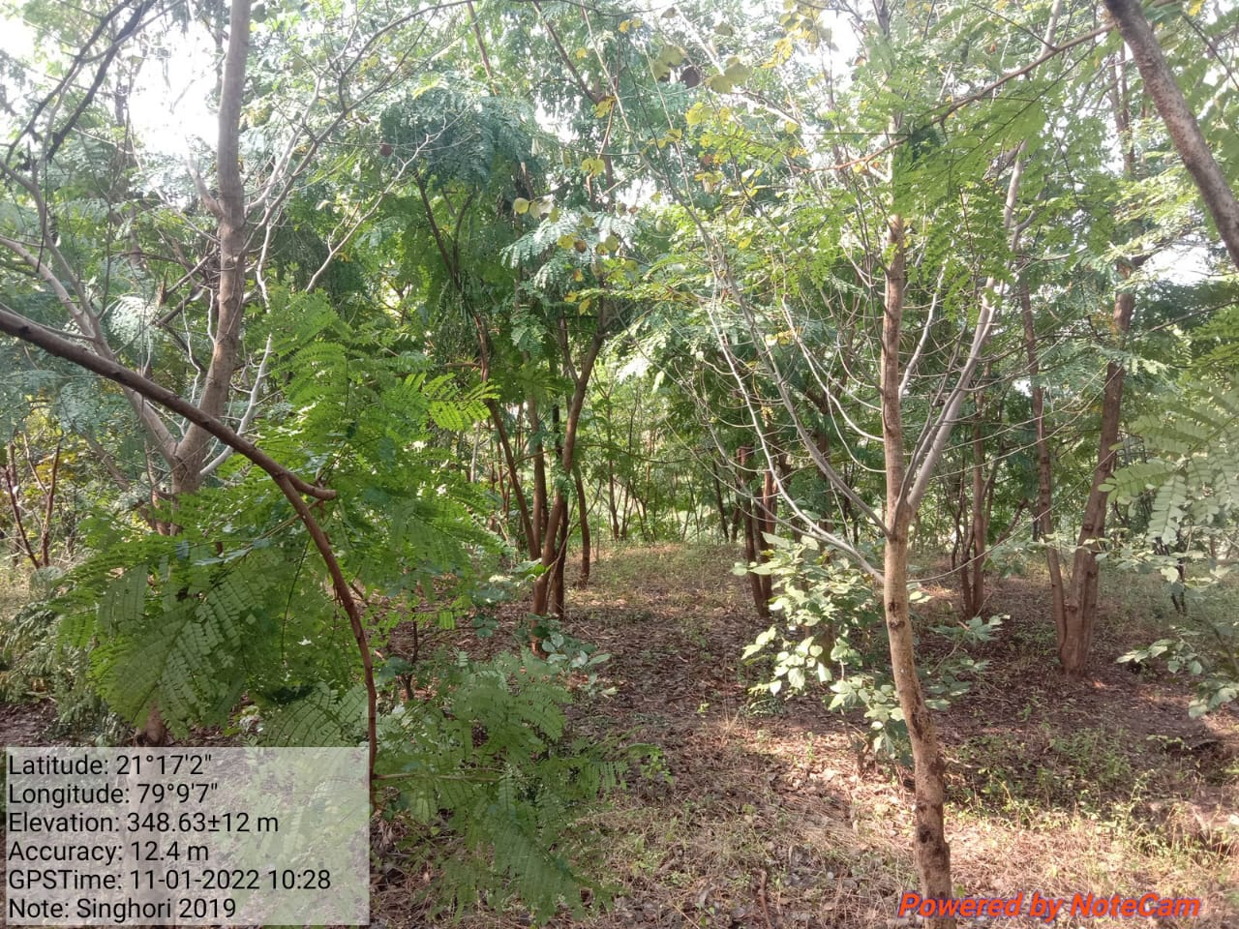
Plantation at Singhori OC, Nagpur Area (2019)

Slide 25
POLLUTION CONTROL MEASURES
Water Pollution Control Measures & Ground Water Recharge
Mine Water Treatment – Through Sedimentation tank of Capacity 2160 m³/day is in operation (60 m*30 m*1.2 m)
Domestic Effluent Treatment - There is no residential colony for the project, as such not applicable.
Ground Water Recharge – Rainwater harvesting arrangement – 2 nos. (Transit Hostel, Manager Office)

Slide 26
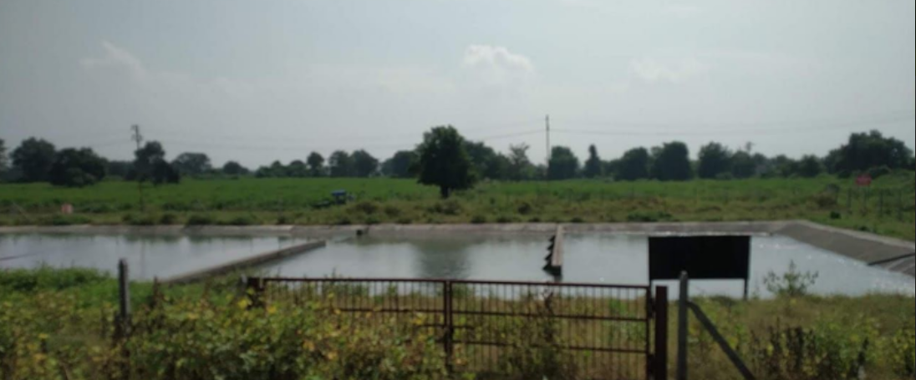
POLLUTION CONTROL MEASURES
Sedimentation Tank

Slide 27
CERTIFIED COMPLIANCE REPORT OF EARLIER EC
In compliance with the item no. 6 (iv) of the O.M dated 07.05.2022, Certified Compliance report against Compliance of EC of 1.12 MTPA dated 22.08.2019 will be submitted on PARIVESH portal within six months of enhancement of production beyond 40%.
The compliance report of existing EC has been submitted to IRO, MOEF & CC, Nagpur vide email dated 10.05.2022 and hard copy submitted on 11.05.2022. Reference email and receipt letter is placed below.

Slide 28
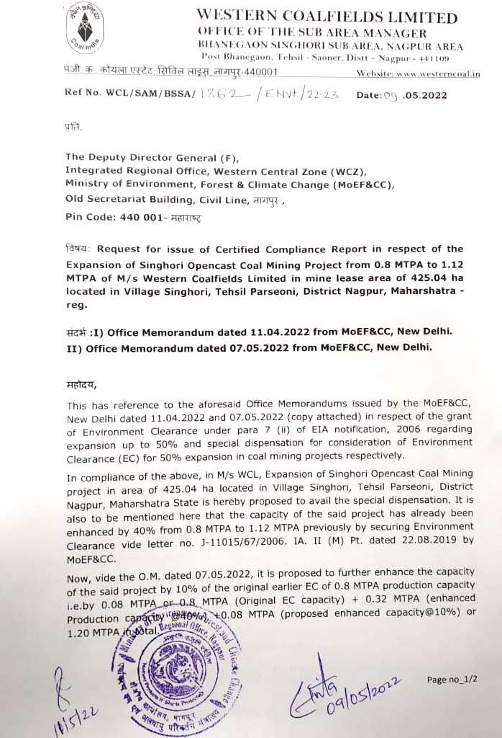

Slide 29
SUBMISSION
Grant of EC is solicited for Expansion of Singhori opencast coal mining project for increase in production capacity from 1.12 MTPA to 1.20 in land area of 423.91 Ha (within the already sanctioned EC ML area of 425.04 Ha) in-line with MoEF&CC’s Office Memorandum vide no. F. No. IA3-22/10/2022-IA.III (E 177258) dated 11.04.2022 & 07.05.2022 and as per EIA Notification, 2006.

Slide 30
THANK YOU

Slide 32
BACKGROUND
As per the para 6 iv of the O.M. dated 07.05.2022, Certified Compliance Report of the EC granted for 40 % expansion, along with EIA/ EMP report, prepared based on the Standard ToR for the additional capacity of 10 % will be submitted on PARIVESH portal within six months of enhancement of production beyond 40%.
Mining Plan for production capacity of 1.20 MTPA deliberating available reserves and calendar programme has been prepared and approved by competent authority of WCL.
Details of available reserves and calendar programme have been given in the subsequent slides.

Slide 33
BACKGROUND
Expansion of Singhori OC has secured environmental clearance for increase in production capacity from 0.80 MTPA to 1.12 MTPA (40% enhancement in production capacity) vide letter No. J-11015/67/2006-IA.II (M) Pt. dated 22.08.2019 as per section 7(ii) of EIA Notification 2006.
Considering huge pressure on domestic coal supply in the country, it has been proposed to further enhance production capacity from 40% to 50%. i.e. 1.12 MTPA to 1.20 MTPA as per O.M. dated 07.05.2022 without requiring revised EIA/EMP and public consultation.
An application has been made on PARIVESH portal on 11.05.2022.

