Slide 1

TECHNICAL PRESENTATION
FOR OBTAINING ENVIRONMENTAL CLEARANCE
FOR
“Expansion of MS Ingots from 28,800 TPA to 60,000 TPA and MS TMT Bars/Angles/Channels from 28,800 TPA to 1,00,000 TPA”
category-‘B’ under item 3(a)-Metallurgical industries (ferrous& non-ferrous)
Location : Plot No.E-154 to E-156, E-157 , RIICO Industrial Area, Bagru Extension Phase-II, Jaipur (Rajasthan)
Study Period : March, April and May ‘2021
Project cost : Total Rs. 28.83 Cr. (Existing: 15.83 Cr. and Proposed: 13.0 Cr.)
Promoter: Shri Prithvi Alloys Private Limited C/o B-190 (A) ROAD NO. 9F V.K.I. AREA JAIPUR RJ 302013 E-mail: prithvigroupg@gmail.com Project In-charge: Mr. Sudesh Sharma (Director) | Environmental Consultant: Gaurang Environmental Solutions Pvt. Ltd #102, SNG Shri Ratna Apartment, Near Tambi Petrol Pump, Peetal Factory, Jhotwara Road, Jaipur- 302016 E-mail- gaurangenviro@gmail.com NABET Accreditation No.: NABET/EIA/2023/RA0192 (rev.01) dated 16.07.2021 valid up to 19.01.2023 .
1

Slide 2
INTRODUCTION
Project Name | Expansion of MS Ingots from 28,800 TPA to 60,000 TPA and MS TMT Bars/Angles/Channels from 28,800 TPA to 1,00,000 TPA
Promoter | Shri Prithvi Alloys Private Limited
Location | Plot No.E-154 to E-156, E-157 , RIICO Industrial Area, Bagru Extension Phase-II, Jaipur (Rajasthan)
Terms of Reference | Terms of Reference (ToR) was prescribed by SEIAA, Rajasthan vide letter No. F1(4)/SEIAA/SEAC-Raj./Sectt./Project/Cat.3(a)B2(19397)/2019-20 dated 09th July’2021.
Study Period | March, April and May ‘2021

Slide 3
REGULATORY COMPLIANCE
S. No. | Regulatory compliance | Applicable
1. | Land Documents
2. | Environmental Clearance | Shri Prithvi Alloys Pvt. Ltd. is in operational since 2010. The production capacity of MS Ingots manufacturing in existing unit was less than 30,000 TPA. Therefore, no prior Environmental Clearance was required for existing unit. The existing project does not come under the purview of Environmental Clearance as existing project is for MS Ingots and Rolling mill.
3. | Consent to Establish and Consent to Operate | Existing unit has been obtained Consent to establish and consent to operate.
4. | Water | Ground Water supply
5. | Power | JVVNL supply
6 | DCF letter | DCF letter has been obtained from Deputy Conservator of Forest (Wildlife), Chidiyaghar, Jaipur vide letter no क्रमाकएफ () सर्वे/ज़ू/2020-21/3123-24 dated 06.05.2021
Plot Number | Name of the project | Area (Sq.m) | Date
E-154,155,156, Bagru (Ext.) II Phase | Lease agreement between Rajasthan State Industrial Development & Investment Corporation Limited Jaipur and Shri Prithvi Alloys Pvt. Ltd. | 13,267 | 08.02.2006
E-157 | registered in favour of Munni Devi Khetan (Director ) of M/s R.L Steel by RIICO | 4013 | 06.03.2007
E-157 | Purchase agreement registered between Munni Devi Khetan (Director ) of M/s R.L Steel and Mr. Rajesh Kumar Guarg (Director ) of M/s Shree Prithvi Alloys Pvt. Ltd.(4,013 sq.m) | -- | 23.04.2010
E-157 | Transfer of lease hold rights between R L steels and Shri Prithvi Alloys Pvt. Ltd. (4013 sq.m) | -- | 27.01.2014
Total Area |  | 17,280

Slide 4
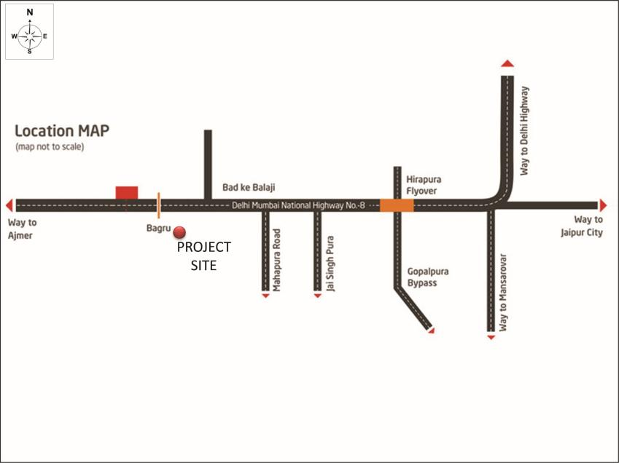
LOCATION MAP

Slide 5

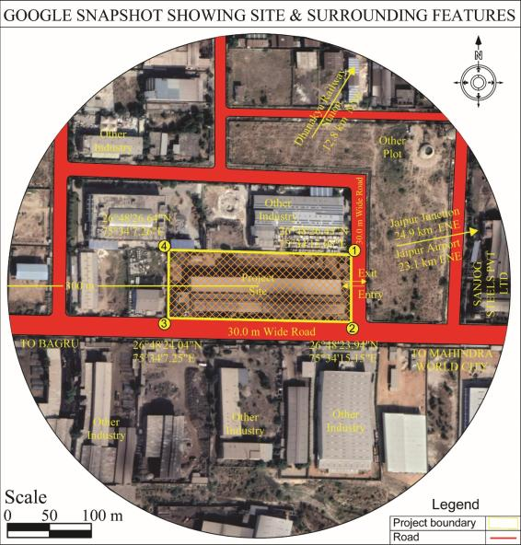
GOOGLE MAP
Project Location and Coordinates
Plot No.E-154 to E-156, E-157 , RIICO Industrial Area, Bagru extension phase-II, Jaipur, Rajasthan
S. No. | Latitude (N) | Longitude (E)
1. | 26°48'26.43" | 75°34'15.05"
2. | 26°48'23.94" | 75°34'15.15"
3. | 26°48'24.04" | 75°34'7.25"
4. | 26°48'26.64" | 75°34'7.26"

Slide 6
PROJECT SUMMARY
Items | Details
Project capacity
Total Plot Area | 17,280 sq.m. The proposed expansion is coming up within the same premises.
Green Area | 5702.4 sq.m (33%)
Power, Backup and Fuel Demand and Source
Name of Products | Production Capacity (TPA)
 | Existing | Proposed | Total
M.S. Ingots | 28,800 | 31,200 | 60,000
Induction Furnace (Capacity and Numbers) | 4 TPH x 1 8 TPH x 1 | 8 TPH x 1 12 TPH x 1 (Replace with existing 4 TPH) | 20 TPH (8 TPH x 1 and 12 TPH x 1)
Number of Hour, Number of working days | Two Shift (12-14 Hour)
No of working Days Per Year | 300 days
MS TMT Bars/Angles/Channels | 28,800 | 71,200 | 1,00,000
Reheating Furnace (Capacity and Numbers) | 12 TPH x 1 | Upgrade existing (12 TPH) Reheating furnace - 20 TPH | 20 TPH x 1
Number of Hour, Number of working days | Two Shift (17-18 Hour)
No of working Days Per Year | 310 days
Particulars | Unit | Existing | Proposed | Total | Source
Power | kVA | 5900 | 4000 | 9900 | JVVNL
DG Set (Number and capacity) | kVA | 380 – 1 no | -- | 3380– 1 no | From manufacture
HSD (for DG Set) | l/hr | 80 | -- | 80 | Local Traders
Coal (for Re-heating furnace) | T/day | 30 | 60 | 90 | Open market

Slide 7
PROJECT SUMMARY Cont....
Items | Details
Water Demand and Source
Manpower (Nos.) | Existing | Proposed
 | Construction Phase – Nil Operation phase – 50 | Construction phase – 50 (Contract basis) Operation Phase – 100
 | *Local people will be given preference.
Waste water generation
S. No. | Particulars | Existing (In KLD) | Total after expansion (In KLD)
1. | Domestic purposes | 1.0 | 8.0
2. | Industrial Process Cooling Operation Sprinkling & spraying | 4.5 | 22.0
Total |  | 5.5 | 30
Source: Ground water supply – Existing Bore well 1 no
S. No. | Waste water | Quantity | Remarks
1. | Domestic | Existing- 0.8 KLD Expansion – 4.0 KLD Total – 4.8 KLD | Existing - Septic tank followed by soak pit After Expansion – Automatic Control Airlift Crossflow MBR followed by Ozonator technology STP (6 KLD).
2. | Industrial | None | NA

Slide 8
POINT WISE COMPLIANCES OF TERM OF REFERENCES

Slide 9
POINT WISE COMPLIANCES OF TERM OF REFERENCES
TOR Point | ToR Details | Implementation/Plan
1. | Executive Summary | Shri Prithvi Alloys Pvt. Ltd. is an existing unit operational since 2010 is situated at Plot No.E-154 to E-156, E-157, RIICO Industrial Area, Bagru extension phase-II, Jaipur, Rajasthan involves production of MS Ingots to the tune of 28,800 TPA and MS TMT Bars/Angles/Channels to the tune of 28,800 TPA. Now unit undergoes expansion of MS Ingots from 28,800 TPA to 60,000 TPA and MS TMT Bars/Angles/Channels from 28,800 TPA to 1,00,000 TPA. The total plot area of existing unit is 17280 sq m. Proposed expansion is coming up within the same premises. Hence, no additional land is required for the proposed expansion. The total cost of the project after expansion will be Rs. 28.83 Cr. (Existing: 15.83 Cr. and Proposed: 13.0 Cr.).
2. | Introduction | Project introduction is mentioned in ToR Point 1.
i. | Details of the EIA Consultant including NABET accreditation | EIA Consultant-Gaurang Environmental Solutions Pvt. Ltd. Certificate Number–NABET/EIA/2023/RA0192 (Rev.01) dated 16.07.2021 valid up to 19.01.2023.
ii. | Information about the project proponet
Name of the Promoter | Shri Prithvi Alloys Private Limited
Name and Address of the Applicant | Mr. Sudesh Sharma (Director) B-190 (A) ROAD NO. 9F V.K.I. AREA JAIPUR RJ 302013
CIN No. | U27320RJ2005PTC020097
Status of Project | Brownfield Project (Freshly applied for Environmental Clearance)
E-mail Id | prithvigroupg@gmail.com
Contact Number | +91-8114413240

Slide 10
POINT WISE COMPLIANCES OF TERM OF REFERENCES
TOR Point | ToR Details | Implementation/Plan
iii. | Importance and benefits of the project | Importance of the project: Iron and steel have a vital role to play especially in a developing country like India. It is one of the most important basic requirements in almost all development activities e.g. building construction, bridges, railways, machine tools, transport vehicles. As per the latest world Steel Association Report, India is the largest steel producer in the world. The proposed expansion will result in the following benefits:- Benefits of the project: Employment to the local population Infrastructure development of surrounding area. Economic and Social upliftment of suppressed class. The proposed expansion project aims to fill the demand – supply gap through optimum allocation and production of natural resources required to meet the demand effectively Narrowing down and demand supply gap. Revenue to State and Central exchangers

Slide 11
POINT WISE COMPLIANCES OF TERM OF REFERENCES
TOR Point | ToR Details | Implementation/Plan
3. | Project Description | As given below:-
i. | Cost of project and time of completion | Time of completion: The project will be operational within a year after obtaining all the statutory clearances.
ii. | Products with capacities for the proposed project.
iii. | If expansion project, details of existing products with capacities and whether adequate land is adequate land is available for expansion, reference of earlier EC if any. | Existing product–MS Ingots-28,800 TPA and MS TMT Bars/Angles/Channels -28,800 TPA. Land-17,280 Sq.m. The proposed expansion is coming up within the same premises. Earlier EC-Shri Prithvi Alloys Pvt. Ltd. is in operational since 2010. The production capacity of MS Ingots manufacturing in existing unit was less than 30,000 TPA. Therefore, no prior Environmental Clearance was required for existing unit. The existing project does not come under the purview of Environmental Clearance as existing project is for MS Ingots and Rolling mill.
Cost of Project:
Existing | Expansion | Total
15.83 Crores | 13.0 Crores | 28.83 Crores
Particulars | Description
 | Existing | Proposed | Total
M.S. Ingots | 28,800 | 31,200 | 60,000
Induction Furnace (Capacity and Numbers) | 4 TPH x 1 8 TPH x 1 | 8 TPH x 1 12 TPH x 1 (Replace with existing 4 TPH) | 20 TPH (8 TPH x 1 and 12 TPH x 1)
MS TMT Bars/Angles/Channels | 28,800 | 71,200 | 1,00,000
Reheating Furnace (Capacity and Numbers) | 12 TPH x 1 | Upgrade existing (12 TPH) Reheating furnace - 20 TPH | 20 TPH x 1

Slide 12
POINT WISE COMPLIANCES OF TERM OF REFERENCES
TOR Point | ToR Details | Implementation/Plan
iv. | List of raw materials required and their source along with mode of transportation.
v. | Other chemicals and materials required with quantities and storage capacities. | No other chemicals and materials will be used. Hence, it is not applicable.
Name of the Product | Raw materials | Quantity (MT/Annum)
 |  | Existing | Proposed | Total
MS Ingots | Sponge Iron (78%) | 23,474.9 | 25,431.12 | 48,906.02
 | Steel Scrap (20%) | 6,019.2 | 6,520.8 | 12,540
 | Pig Iron + Ferro Alloy (2%) | 601.9 | 652.08 | 1253.98
Total |  | 30,096 | 32,604 | 62,700
MS TMT Bar/Angle/channels | M.S Ingots | 29,664 | 73,336 | 1,03,000
 | Coal for Reheating Furnace | 9.300 | 18,600 | 27,900
Raw Material | Max. Storage Capacity in MT/month |  |  | Physical State | Mode of Transport | Storage | Type of Linkage
 | Existing | Proposed | Total
Sponge Iron | 1950 | 2125 | 4075 | Solid | Road | Designated scrap yard | Local market
Steel Scrap | 500 | 550 | 1050 | Solid | Road | Designated scrap yard | Local market
Pig Iron + Ferro Alloy | 50 | 50 | 100 | Solid | Road | Designated scrap yard | Local market
MS Ingots/Billets | 2475 | 6100 | 8575 | Solid | Road | Designated Finished yard under shed | Inhouse production and local market
Coal for Reheating Furnace | 750 | 1500 | 2250 | Solid | Road | Designated coal storage yard | Local market

Slide 13
POINT WISE COMPLIANCES OF TERM OF REFERENCES
TOR Point | ToR Details | Implementation/Plan
vi. | Details of emission, effluents, hazardous waste generation and their management.
Air Emissions | To minimize & control the emission from induction furnace exhaust gases after suction hood will be passed through spark arrester along with bag house before its discharge to atmosphere through stack (30 m). From Re-Heating Furnace, gases passed through multi cyclone and bag house before its discharge to atmosphere through stack (30 m). DG sets is being fitted with adequate stack (10 m from ground level) to take care of particulate & gaseous emission. Coal is being used as raw material for Re-Heating Furnace. However, emissions from Coal Pulverize will be connected to Bag Filter.
Effluents | Approximately 0.8 KLD Domestic wastewater is being generated from the existing unit, which is disposed off into septic tank followed by soak pit. After expansion to the tune of 4.8 KLD will be generated. Which will be treated into Automatic Control Airlift Crossflow MBR followed by Ozonator technology STP (6 KLD). Treated water from STP will be reused in greenbelt/plantation purposes. Industrial Waste Water: There will be no industrial effluent generation, as the water from the cooling operation is left in the water settling tank. After cooling, the water will be re-used for the processes. Hence, there will be no any discharge of wastewater outside the company premises; thus the unit will achieving ZLD.
Hazardous/Solid Waste Generation | Hazardous waste Solid waste
Particulars | Category | Quantity |  |  | Management
 |  | Existing | Proposed | Total
Used/Spent oil | 5.1 | 0.01 KL/year | - | 0.01 KL/year | Authorized Recyclers
Slag | -- | 6 TPD | 6 TPD | 12 TPD | Used for road making
Recycle water tank sludge | -- | 0.15 TPA | 0.35 TPA | 0.5 TPA | Six monthly cleaning frequency and sold to cement unit
Particulars | Quantity |  |  | Mode of Disposal
 | Existing | Proposed | Total
Domestic solid waste | 15 Kg/day | 15 Kg/day | 30 Kg/day | Will be handled by Municipal Corporation, Jaipur
Fly ash | 11 kg/day | 28 kg/day | 39 kg/day | Sent to brick manufacturing unis
Mill scale/iron dust from Reheating furnace | 2 T/day | 4.6 T/day | 6.6 T/day | It is primarily iron waste and having market value, which is being/will be sold to steel casting unit.
Scaling from Induction furnace | 2 T/day | 2 T/day | 4 T/day | It is primarily iron waste and having market value, which is being/will be sold to steel casting unit.

Slide 14
POINT WISE COMPLIANCES OF TERM OF REFERENCES
TOR Point | ToR Details | Implementation/Plan
vii. | Requirement of water, power, with source of supply, status of approval, water balance diagram, man-power requirement (regular and contract). | Water Demand: Manpower:
S. No. | Particulars | Existing (In KLD) | Total after expansion (In KLD)
1. | Domestic purposes | 1.0 | 8.0
2. | Industrial Process Cooling Operation Sprinkling & spraying | 4.5 | 22.0
Total Fresh water demand |  | 5.5 | 30
Source: Ground water supply Borewell – 1 no.
Power Demand:
S. No. | Particulars | Unit | Existing | Proposed | Total | Source
1 | Power | kVA | 5990 | 4000 | 9,900 | JVVNL
 | Power backup – DG set | kVA | 380 | - | - | local vendors
 | Status of Approval | Copy of electricity bill from JVVNL
S. No. | Particulars | Existing | Proposed
1 | During Construction Phase | NA | 50
2 | During Operation Phase | 100 | 100
Total |  | 100 | 150
The entire workforce is/will be local and none is/will be residing within the industry. All the manpower will be regular.

Slide 15
POINT WISE COMPLIANCES OF TERM OF REFERENCES
TOR Point | ToR Details | Implementation/Plan
viii. | Process description along with major equipment and machineries, process flow sheet (Quantative) from raw material to products to be provided. | As under:-
Raw Material Scrap/Sponge Iron
Unloading by Magnet Crane
Charging in Induction Furnace
Melting at 1600-1650ºC in Crucible
Testing
Addition of Micro Alloys Components
Final Testing
Liquid Steel transfer to ladle
Purging
Casting into MS ingots/Billets
Direct Charging
Dispatch to MS ingots/Billet Yard
Prosess Flow Chart (Melting Shop)

Slide 16
MANUFACTURING PROCESS FLOW-CHART
TOR POINT-VIII Cont....
Raw Material Billets/Ingots
Unloading, Shifting and Inspection
Cutting and Charging in Re-Heating Furnace
Reheating around 1200ºC in Pusher type furnace
Discharge from furnace by ejector
Addition of Micro Alloys Components
Rolling in six stand cross country type 325 mm mill for Angle, Shape and Sections and Dimensional Inspection
Manual Shifting on cooling bed and cooling to below 100⁰c
Stacking manually on cooling side and stacking for cooling
End cutting by Shearing Machine & Cutting length as pre requirement
Manually Shifting on straitening Machine for Straitening
Testing and Inspection
Bundling and Storage
Process Flow Chart (Structural Section )
Dispatch

Slide 17
MANUFACTURING PROCESS FLOW-CHART
TOR POINT-VIII Cont....
Raw Material Billets/Ingots
Unloading
Cutting and Charging in Re-Heating Furnace
Reheating around 1200ºC in Pushertype furnace
Discharge from furnace by ejector
Rolling
Water Quenching in TMT
Cutting by Flying Shear
Shifting on cooling bed and cooling below 100⁰c
Cutting Bars into fixed length by cold shear
Shifting bars in yard
for Building
Testing and Inspection
Bundling and Storage
Dispatch
Prosess Flow Chart (Bar Mill)

Slide 18
POINT WISE COMPLIANCES OF TERM OF REFERENCES
TOR Point | ToR Details | Implementation/Plan
ix. | Hazard identification and details of proposed safety systems. | As under:-
Project Phase | Hazard Identified | Safety System/Measures
Existing and Proposed expansion phase | Material Hazards: High Speed Diesel (HSD) Risk associated with coal handling – dust explosion; Risk associated with Molten steel handling Coal storage in open yard; Process Hazards: During handling of hazardous materials or processes resulting in Heat, fire, explosion, etc. Electrical hazards: Electrocution, high voltage levels, short circuit, etc | On-Site/Off- Site Emergency Plan. Exposure Controls and Personal Protection; Personnel Protective Equipment’s; Other Safety Measures:- • Safety training to the workers is /will given. • PPE is/will provide to the workers. • The maintenance and cleaning of APCD is /will carried out regularly. • The dust removal efficiency of bag filters will check regularly. • Work place environment monitoring is carried out regularly and records are maintained. Good housekeeping is/will implement in the plant. • First aid box is/will provided. • The industry is/will providing adequate lighting facility inside the plant premises.

Slide 19
POINT WISE COMPLIANCES OF TERM OF REFERENCES
TOR Point | ToR Details | Implementation/Plan
x. | Expansion/modernization proposals: | This is an expansion of MS Ingots from 28,800 TPA to 60,000 TPA and MS TMT Bars/Angles/Channels from 28,800 TPA to 1,00,000 TPA.
a. | Copy of all the Environmental Clearance(s) including Amendments thereto obtained for the project from MoEF&CC/SEIAA shall be attached as an Annexure. A certified copy of the latest Monitoring Report of the Regional Office of the Ministry of Environment, Forest and Climate Change as per circular dated 30thMay, 2012 on the status of compliance of conditions stipulated in all the existing environmental clearances including Amendments shall be provided. In addition, status of compliance of Consent to Operate for the ongoing/existing operation of the project from SPCB/PCC shall be attached with the EIA-EMP report | Environmental Clearance: Shri Prithvi Alloys Pvt. Ltd. is in operational since 2010. The production capacity of MS Ingots manufacturing in existing unit was less than 30,000 TPA. Therefore, no prior Environmental Clearance was required for existing unit. The existing project does not come under the purview of Environmental Clearance as existing project is for MS Ingots and Rolling mill. Status of compliance of Consent to Operate: Compliance report of Consent to operate for existing unit
b. | In case the existing project has not obtained environmental clearance, reasons for not taking EC under the provisions of the EIA Notification 1994 and/or EIA Notification 2006 shall be provided. Copies of Consent to Establish/No Objection Certificate and Consent to Operate (in case of units operating prior to EIA Notification 2006, CTE and CTO of FY 2005-2006) obtained from the SPCB shall be submitted. | Environmental Clearance: Shri Prithvi Alloys Pvt. Ltd. is in operational since 2010. The production capacity of MS Ingots manufacturing in existing unit was less than 30,000 TPA. Therefore, no prior Environmental Clearance was required for existing unit. The existing project does not come under the purview of Environmental Clearance as existing project is for MS Ingots and Rolling mill. Consent to Establish and Consent to Operate: - The existing unit have Consent to establish and consent to operate under Air and water act. Compliance report of Consent to operate for existing unit

Slide 20
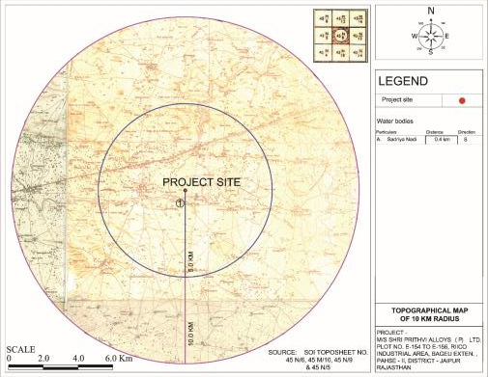
POINT WISE COMPLIANCES OF TERM OF REFERENCES
TOR Point | ToR Details | Implementation/Plan
4. | Site Details | As given below:-
i. | Location of the project site covering village, Taluka/Tehsil, District and State, Justification for selecting the site, whether other sites were considered | Location: Plot No. E-154 to E-156, E-157, RIICO Industrial Area, Bagru extension phase-II, Jaipur, Rajasthan Justification for selecting the site: - This is an existing unit and proposed expansion is coming up within the same premises.
ii. | A toposheet of the study area of radius of 10km and site location on 1:50,000/1:25,000 scale on an A3/A2 sheet.(including all eco-sensitive areas and environmentally sensitive places) | As under:-

Slide 21
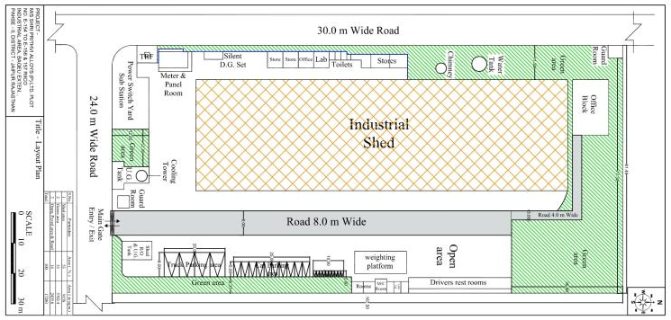
POINT WISE COMPLIANCES OF TERM OF REFERENCES
TOR Point | ToR Details | Implementation/Plan
iii. | Details w.r.t. option analysis for selection of site. | The proposed expansion is coming up within the same premises. Thus, no alternative sites were examined.
iv. | Co-ordinates (lat-long) of all four corners of the site | Co-ordinates (lat-long) of all five corners of the site is given in slide no 5.
v. | Google map-Earth downloaded of the project site | Google Map-Earth downloaded of the project site is given in slide no 5.
vi. | Layout maps indicating existing unit as well as proposed unit indicating storage area / Estate / Complex, layout of Industrial Area indicating location of unit within the Industrial area/ Estate

Slide 22
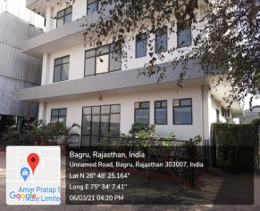
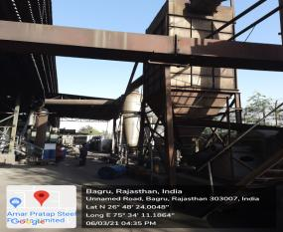
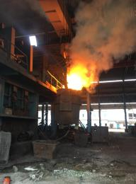
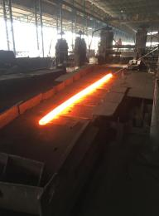
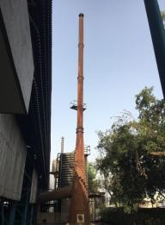
POINT WISE COMPLIANCES OF TERM OF REFERENCES
TOR Point | ToR Details | Implementation/Plan
vii. | Photographs of the proposed and existing (if applicable) plant site. If existing, show photographs of plantation/greenbelt, in particular | As under:-
Site photographs showing existing plant site

Slide 23
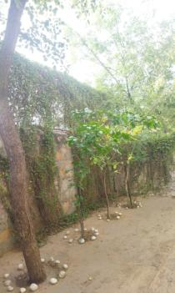
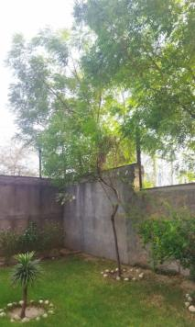
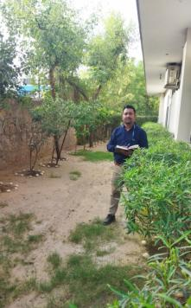
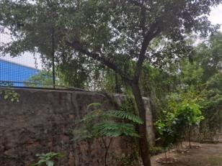
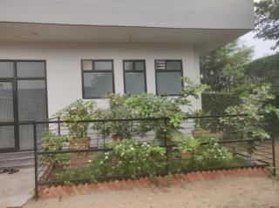
POINT WISE COMPLIANCES OF TERM OF REFERENCES
TOR POINT-VII Cont....
Site photographs showing existing green belt

Slide 24
POINT WISE COMPLIANCES OF TERM OF REFERENCES
TOR Point | ToR Details | Implementation/Plan
viii. | Land use break-up of total land of the project site (identified and acquired), government/private- agricultural, forest, wasteland, water bodies, settlements, etc. Shall be included.(not required for industrial area). | Land documents was obtained from RIICO and Rajasthan State Industrial Development & Investment Corporation Limited in favour of Shri Prithvi Alloys Pvt. Ltd. The land-use breakup is given below:-
ix. | A list of major industries with name and type within study area (10km radius) shall be incorporated. Land use details of the study area. | As under:-
S. No. | Particulars | Total | %
1 | Plant Area/Shed Area | 9158.4 | 53
2 | Green Area | 5702.4 | 33
3 | Open Area, Road and Paved Area | 2419.2 | 14
Total |  | 17,280 | 100
S. No. | Name of the industry | Type
1. | Amar Pratap Steel | Steel
2. | GRP Wood Industries | Wood
3. | Sanjog Steels | Steel
4. | Mangla Ispat Bagru | Steel
5. | Miracle Coro plast | Packaging
6. | Satyam plastfab Pvt. Ltd. | Plastic
7. | Primer TMT Bars | Steels
8. | Nirman Infra Steel | Steels

Slide 25
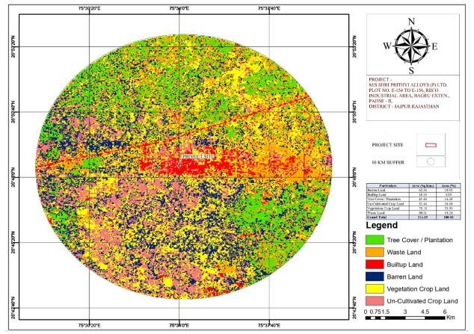
POINT WISE COMPLIANCES OF TERM OF REFERENCES
TOR POINT-ix Cont....
Details of land use (within 10 km) of the project site
Particulars | Area (Sq.km) | Area (%)
Barren Land | 62.36 | 19.85
Built-up Land | 18.38 | 5.85
Tree Cover/Plantation | 45.48 | 14.48
Un-cultivated crop land | 52.44 | 16.69
Vegetation crop land | 75.18 | 23.93
Waste Land | 60.31 | 19.20
Total | 314.15 | 100

Slide 26
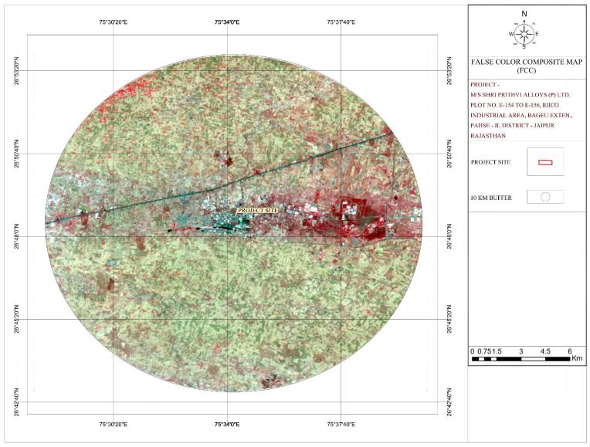
POINT WISE COMPLIANCES OF TERM OF REFERENCES
TOR POINT-ix Cont....

Slide 27
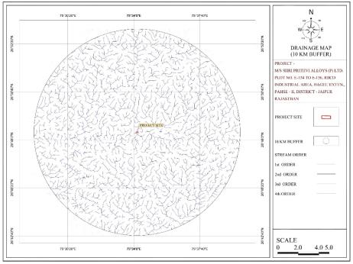
POINT WISE COMPLIANCES OF TERM OF REFERENCES
TOR Point | ToR Details | Implementation/Plan
x. | Geological features and Geo-hydrological status of the study area shall be included | No major Geological features present in study area. The area is almost flat. Highest elevation s 350 msl and lowest elevation is 348 msl.
xi. | Details of Drainage of the project up to 5km radius of study area. If the site is within 1km radius of any major river, peak and lean season river discharge as well as flood occurrence frequency based on peak rainfall data of the past 30 years. Details of Flood level of the project site and maximum Flood level of the river shall also be provided.(mega green field projects). | There is Sadriya Nadi, which is 0.5 km towards SW from the site. Which is a seasonal river. Drainage map of study area is as under:-

Slide 28
POINT WISE COMPLIANCES OF TERM OF REFERENCES
TOR Point | ToR Details | Implementation/Plan
xii. | Status of acquisition of land. If acquisition is not complete, stage of the acquisition process and expected time of complete possession of land | Not Applicable as the proposed expansion shall be executed on the existing land only. Land document was obtained from RIICO and Rajasthan State Industrial Development & Investment Corporation Limited Jaipur in favor of Shri Prithvi Alloys Pvt. Ltd.
xiii. | R&R details in respect of land in line with state Government policy | Not applicable
5. | Forest and wildlife related issues (if applicable):
i. | Permission and approval for the use of forest land (forestry clearance) if any, and recommendations of the State Forest Department, (if applicable). | No forest land is involved within the project site.
ii. | Land use map based on High Resolution satellite imagery (GPS) of the proposed site delineating of the forestland (in case of projects involving forest land more than 40ha). | Land use map based on High Resolution Satellite Imagery (GPS) of the project site delineating of the forestland is mentioned in point no. ix.
iii. | Status of Application submitted for obtaining the stage I forestry clearance along with latest status shall be submitted. | No forest land is involved within the project site. Hence, it is not applicable.
iv. | The projects to be located within 10km of the National Parks, Sanctuaries, Biosphere Reserves, Migratory Corridors of Wild Animals, the project proponent shall submit the map dully authenticated by Chief Wildlife Warden showing these features vis-a-vis the project location and the recommendations or comments of the Chief Wildlife Warden-thereon. | There is Nahargarh Wildlife Sanctuary at a distance of 27.5 km approx and Eco Sensitive zone (Nahargarh Wildlife sanctuary) at a distance of 25.4 km approx from the project site. DCF letter has been obtained from Deputy Conservator of Forest (Wildlife), Chidiyaghar, Jaipur vide letter no क्रमांकएफ () सर्वे/ज़ू/2020-21/3123-24 dated 06.05.2021.

Slide 29
POINT WISE COMPLIANCES OF TERM OF REFERENCES
TOR Point | ToR Details | Implementation/Plan
v. | Wildlife Conservation Plan duly authenticated by the Chief Wildlife Warden of the State Government for conservation of Schedule I fauna, if any exists in the study area | One no of Schedule –I species i.e. Indian Peafowl (Pavo cristatus) has been reported in the buffer zone during the study period.
vi. | Copy of application submitted for clearance under the Wildlife (Protection) Act 1972, to the standing Committee of the National Board of Wildlife | Not applicable
6. | Environmental Status
i. | Determination of atmospheric inversion level at the project site and site-specific micrometeorological data using temperature, relative humidity, hourly wind speed and direction and rainfall. | As under:-
Month | Temperature (⁰ C) |  | Relative Humidity (%) |  | Wind Speed m/ h |  | Rainfall (mm)
 | Max | Min | Max | Min | Max | Min
March’ 2021 | 41.3 | 17.7 | 52.2 | 10.0 | 9.3 | 0.0 | 0.0
April’ 2021 | 41.7 | 19.9 | 49.9 | 10.0 | 9.9 | 0.0 | 0.0
May’ 2021 | 42.7 | 21.0 | 91.9 | 10.3 | 12.2 | 0.0 | 0.0
Source: Micrometeorology at site, Indian Metrological Department

Slide 30
POINT WISE COMPLIANCES OF TERM OF REFERENCES
TOR Point | ToR Details | Implementation/Plan
ii. | AAQ data (except monsoon) at 8 locations for PM₁₀, PM_{2.5}, SO₂, NO_{X}, CO and other parameters relevant to the project shall be collected. The monitoring stations shall be based CPCB guidelines and take into account the pre-dominant wind direction, population zone and sensitive receptors including reserved forests. | One Season data i.e. Pre-Monsoon (March, April and May’2021) has been generated. AAQ data includes PM₁₀, PM_{2.5}, SO₂, NO_{X} and CO to the project were generated. The monitoring stations were selected taking into account the pre-dominant wind direction, population zone and sensitive receptors etc. The monitoring station selected represents the whole of study area is as described under: -
iii. | Raw data of all AAQ measurement for 12 weeks of all stations as per frequency given in the NAQQM Notification of Nov. 2009 along with - min., max., average and 98% values for each of the AAQ parameters from data of all AAQ stations should be provided as an annexure to the EIA Report.
Locations | PM₁₀ (µg/m³) |  |  | PM_{2.5} (µg/m³) |  |  | SO₂ (µg/m³) |  |  | No_{x} (µg/m³) |  |  | CO (mg/m3)
 | Min | Max | 98% | Min | Max | 98% | Min | Max | 98% | Min | Max | 98% | Min | Max | 98%
Project Site (AA1) | 90.13 | 111.10 | 110.17 | 46.70 | 57.56 | 57.08 | 8.32 | 12.47 | 12.47 | 17.43 | 24.80 | 24.80 | 0.53 | 0.66 | 0.65
Dahmi Khurd (AA2) | 66.28 | 76.16 | 75.84 | 34.70 | 39.88 | 39.70 | 7.28 | 9.63 | 9.49 | 5.13 | 19.67 | 19.47 | 0.40 | 0.55 | 0.55
Palri (AA3) | 60.96 | 73.64 | 73.32 | 32.42 | 39.17 | 39.00 | 6.34 | 9.75 | 9.66 | 15.93 | 20.49 | 19.92 | 0.30 | 0.51 | 0.51
Chirota (AA4) | 62.91 | 75.68 | 75.40 | 33.28 | 40.04 | 39.89 | 7.22 | 9.81 | 9.72 | 16.71 | 19.61 | 19.49 | 0.36 | 0.52 | 0.52
Lokhanda (AA5) | 62.84 | 74.32 | 74.07 | 33.25 | 39.32 | 39.19 | 6.18 | 9.51 | 9.50 | 17.24 | 20.52 | 20.46 | 0.40 | 0.63 | 0.61
Bagru (AA6) | 66.40 | 84.21 | 83.63 | 34.77 | 44.09 | 43.79 | 7.26 | 9.98 | 9.97 | 17.03 | 21.72 | 21.63 | 0.44 | 0.65 | 0.63
Bari Ka Khera (AA7) | 61.18 | 76.52 | 75.86 | 31.70 | 39.65 | 39.31 | 7.60 | 9.48 | 9.37 | 17.75 | 20.75 | 20.68 | 0.39 | 0.55 | 0.55
Bagru Industrial Area (AA8) | 89.85 | 97.50 | 97.39 | 49.64 | 53.87 | 53.80 | 8.08 | 10.73 | 10.57 | 19.81 | 22.87 | 22.87 | 0.65 | 0.45 | 0.64

Slide 31
POINT WISE COMPLIANCES OF TERM OF REFERENCES
TOR Point | ToR Details | Implementation/Plan
iv. | Surface water quality of nearby River (100m upstream and downstream of discharge point) and other surface drains at eight locations as per CPCB/MoEF&CC guidelines. | There is sadriya Nadi (seasonal river) which was dry during the study period. Hence, no surface water monitoring was carried out.
v. | Whether the site falls near to polluted stretch of river identified by the CPCB/MoEF& CC, if yes give details. | There is no polluted stretch of river identified by the CPCB/ MoEF&CC within the study area.
vi. | Ground water monitoring at minimum 8 locations shall be included | Ground water monitoring has been carried out at eight locations. Details is as given below:-

Slide 32
POINT WISE COMPLIANCES OF TERM OF REFERENCES
TOR POINT-VI Cont....
Results for analysis of Ground Water (Locations GW 1, GW 2, GW 3, GW 4)
Sl. No. | Parameter | Test Protocol | Unit | GW 1 | GW 2 | GW 3 | GW 4 | Acceptable Limit | Permissible Limit
 |  |  |  | Project site | Dahmi Khurd | Palri | Chirota
1 | pH | IS 3025(P-11):1983, RA 2017 | -- | 7.78 | 7.65 | 8.06 | 7.28 | 6.5 – 8.5 | N.R.
2 | EC | IS 3025(P-11):1983, RA 2017 | µS/cm | 1122.83 | 1173.84 | 3440.76 | 5880.24 | -- | --
3 | Temperature | IS 3025(P-03):1984, RA 2017 | °C | 34°C | 34°C | 33°C | 35°C | -- | --
4 | Color | APHA (22nd Edition) 2120 B | Hazen | <5 | <5 | <5 | <5 | 5 | 15
5 | Taste | IS 3025(P-8):2002 | Agreeable | Agreeable | Agreeable | Agreeable | Agreeable | Agreeable | Agreeable
6 | Odour | IS 3025(P-5):2002 | Agreeable | Agreeable | Agreeable | Agreeable | Agreeable | Agreeable | Agreeable
7 | Turbidity | IS 3025(P-10):1984, RA 2017 | NTU | <1 | <1 | <1 | <1 | 1 | 5
8 | Total Dissolved Solids | IS 3025(P-16):1984, RA 2017 | mg/l | 729.84 | 763 | 2236.5 | 3822.16 | 500 | 2000
9 | Total Hardness | IS 3025(P-21):2009, RA 2019 | mg/l | 111.19 | 80.87 | 111.19 | 646.97 | 200 | 600
10 | Calcium | IS 3025(P-40):1991, RA 2019 | mg/l | 20.24 | 16.19 | 16.19 | 89.05 | 75 | 200
11 | Magnesium as Mg | IS 3025(P-46):1994, RA 2019 | mg/l | 14.58 | 9.72 | 17.01 | 102.06 | 30 | 100
12 | Alkalinity | IS 3025(P-23):1986, RA 2019 | mg/l | 412.0 | 319.3 | 1421.4 | 844.6 | 200 | 600
13 | Chloride as Cl | IS 3025(P-32):1988, RA 2019 | mg/l | 72.63 | 193.69 | 435.82 | 1912.77 | 250 | 1000
14 | COD | IS 3025(P-58):2006, RA 2017 | mg/l | BDL | BDL | BDL | BDL | - | 250
15 | Fluoride as F | IS 3025(P-60):2008, RA 2019 | mg/l | 0.18 | 0.18 | 0.26 | 0.30 | 1.0 | 1.5
16 | Sulphate as SO₄ | IS 3025(P-24):1986, RA 2019 | mg/l | 29.05 | 77.47 | 130.5 | 573.6 | 200 | 400
17 | Nitrate as NO₃ | IS 3025(P-34):1988, RA 2019 | mg/l | 38.41 | 28.11 | 53.42 | 45.1 | 45 | N.R.
18 | Zinc as Zn | APHA (22nd Edition) 3111 B | mg/l | 0.05 | 0.05 | 0.03 | 0.02 | 5 | 15
19 | Lead as Pb | APHA (22nd Edition) 3111 B | mg/l | <0.01 | <0.01 | <0.01 | <0.01 | 0.01 | N.R.
20 | Manganese as Mn | APHA (22nd Edition) 3111 B | mg/l | <0.01 | <0.01 | <0.01 | <0.01 | 0.1 | 0.3
21 | Iron as Fe | IS 3025(P-53):2003, RA 2019 | mg/l | 0.05 | 0.07 | 0.17 | 0.16 | 0.3 | N.R.
22 | Cadmium as Cd | APHA (22nd Edition) 3111 B | mg/l | <0.01 | <0.01 | <0.01 | <0.01 | 0.003 | N.R.
23 | Nickel as Ni | APHA (22nd Edition) 3111 B | mg/l | <0.01 | <0.01 | <0.01 | <0.01 | 0.02 | N.R.
24 | Copper as Cu | APHA (22nd Edition) 3111 B | mg/l | <0.01 | <0.01 | <0.01 | <0.01 | 0.05 | 1.5
25 | Total Chromium as Cr | APHA (22nd Edition) 3111 B | mg/l | <0.02 | <0.01 | <0.01 | <0.01 | 0.05 | N.R.
26 | Phenolic Compound as C₆H₅OH | APHA (22nd Edition) 5530 C | mg/l | <0.001 | <0.001 | <0.001 | <0.001 | 0.001 | 0.002
27 | Mercury as Hg | APHA (22nd Edition) 3112 B | mg/l | <0.001 | <0.001 | <0.001 | <0.001 | 0.001 | N.R.
28 | Selenium as Se | APHA (22nd Edition) 3114 B | mg/l | <0.01 | <0.01 | <0.01 | <0.01 | 0.01 | N.R.
29 | Arsenic as As | APHA (22nd Edition) 3114 B | mg/l | <0.01 | <0.01 | <0.01 | <0.01 | 0.01 | 0.05
30 | Cyanide as CN | APHA (22nd Edition) 4500 B | mg/l | <0.01 | <0.01 | <0.01 | <0.01 | 0.05 | N.R.
31 | Anionic detergents as MBAS | Annex K of IS:13428 | mg/l | <0.001 | <0.001 | <0.001 | <0.001 | 0.2 | 1.0
32 | Mineral Oil | APHA (22nd Edition) 5520 B | mg/l | <0.01 | <0.01 | <0.01 | <0.01 | 0.5 | N.R.
33 | Aluminium as Al | APHA (22nd Edition) 3111 D | mg/l | <0.01 | <0.01 | <0.01 | <0.01 | 0.03 | 0.2
34 | Boron as B | APHA (22nd Edition) 4500B-B | mg/l | <0.1 | <0.1 | <0.1 | <0.1 | 0.5 | 1.0
35 | Total Coliform | APHA (22nd Edition) 9221 D | MPN/100 ml | Absent | Absent | Absent | Absent | Absent | Absent
36 | Escherichia Coli | APHA (22nd Edition) 9221 D | MPN/100 ml | Absent | Absent | Absent | Absent | Absent | Absent

Slide 33
POINT WISE COMPLIANCES OF TERM OF REFERENCES
TOR POINT-VI Cont....
Results for analysis of Ground Water (Locations GW 5, GW 6, GW 7, GW 8)
Sl. No. | Parameter | Test Protocol | Unit | GW 5 | GW 6 | GW 7 | GW 8 | Acceptable Limit | Permissible Limit
 |  |  |  | Lokhanda | Bagru | Bari ka khera | Within industrial area
1 | pH | IS 3025(P-11):1983, RA 2017 | -- | 7.34 | 7.18 | 7.2 | 7.15 | 6.5 – 8.5 | N.R.
2 | EC | IS 3025(P-11):1983, RA 2017 | µS/cm | 7527.69 | 5946.46 | 1771.53 | 3579.23 | -- | --
3 | Temperature | IS 3025(P-03):1984, RA 2017 | °C | 34°C | 34°C | 33°C | 35°C | -- | --
4 | Color | APHA (22nd Edition) 2120 B | Hazen | <5 | <5 | <5 | <5 | 5 | 15
5 | Taste | IS 3025(P-8):2002 | Agreeable | Agreeable | Agreeable | Agreeable | Agreeable | Agreeable | Agreeable
6 | Odour | IS 3025(P-5):2002 | Agreeable | Agreeable | Agreeable | Agreeable | Agreeable | Agreeable | Agreeable
7 | Turbidity | IS 3025(P-10):1984, RA 2017 | NTU | <1 | <1 | <1 | <1 | 1 | 5
8 | Total Dissolved Solids | IS 3025(P-16):1984, RA 2017 | mg/l | 4893 | 3865.2 | 1151.5 | 2326.5 | 500 | 2000
9 | Total Hardness | IS 3025(P-21):2009, RA 2019 | mg/l | 1849.94 | 1124.12 | 303.27 | 495.34 | 200 | 600
10 | Calcium | IS 3025(P-40):1991, RA 2019 | mg/l | 404.8 | 194.3 | 80.96 | 105.24 | 75 | 200
11 | Magnesium as Mg | IS 3025(P-46):1994, RA 2019 | mg/l | 201.69 | 153.57 | 24.3 | 55.89 | 30 | 100
12 | Alkalinity | IS 3025(P-23):1986, RA 2019 | mg/l | 401.70 | 300.76 | 350.2 | 813.7 | 200 | 600
13 | Chloride as Cl | IS 3025(P-32):1988, RA 2019 | mg/l | 2145.21 | 1888.56 | 387.39 | 847.43 | 250 | 1000
14 | COD | IS 3025(P-58):2006, RA 2017 | mg/l | BDL | BDL | BDL | BDL | - | 250
15 | Fluoride as F | IS 3025(P-60):2008, RA 2019 | mg/l | 0.68 | 0.32 | 0.20 | 0.28 | 1.0 | 1.5
16 | Sulphate as SO₄ | IS 3025(P-24):1986, RA 2019 | mg/l | 528.25 | 566.56 | 116.21 | 254.1 | 200 | 400
17 | Nitrate as NO₃ | IS 3025(P-34):1988, RA 2019 | mg/l | 36.10 | 32.1 | 31.28 | 42.14 | 45 | N.R.
18 | Zinc as Zn | APHA (22nd Edition) 3111 B | mg/l | 0.02 | 0.02 | 0.02 | 0.02 | 5 | 15
19 | Lead as Pb | APHA (22nd Edition) 3111 B | mg/l | <0.01 | <0.01 | <0.01 | <0.01 | 0.01 | N.R.
20 | Manganese as Mn | APHA (22nd Edition) 3111 B | mg/l | <0.01 | <0.01 | <0.01 | <0.01 | 0.1 | 0.3
21 | Iron as Fe | IS 3025(P-53):2003, RA 2019 | mg/l | 0.068 | 0.03 | 0.12 | 0.02 | 0.3 | N.R.
22 | Cadmium as Cd | APHA (22nd Edition) 3111 B | mg/l | <0.01 | <0.01 | <0.01 | <0.01 | 0.003 | N.R.
23 | Nickel as Ni | APHA (22nd Edition) 3111 B | mg/l | <0.01 | <0.01 | <0.01 | <0.01 | 0.02 | N.R.
24 | Copper as Cu | APHA (22nd Edition) 3111 B | mg/l | <0.01 | <0.01 | <0.01 | <0.01 | 0.05 | 1.5
25 | Total Chromium as Cr | APHA (22nd Edition) 3111 B | mg/l | <0.01 | <0.01 | <0.01 | <0.01 | 0.05 | N.R.
26 | Phenolic Compound as C₆H₅OH | APHA (22nd Edition) 5530 C | mg/l | <0.001 | <0.001 | <0.001 | <0.001 | 0.001 | 0.002
27 | Mercury as Hg | APHA (22nd Edition) 3112 B | mg/l | <0.001 | <0.001 | <0.001 | <0.001 | 0.001 | N.R.
28 | Selenium as Se | APHA (22nd Edition) 3114 B | mg/l | <0.01 | <0.01 | <0.01 | <0.01 | 0.01 | N.R.
29 | Arsenic as As | APHA (22nd Edition) 3114 B | mg/l | <0.01 | <0.01 | <0.01 | <0.01 | 0.01 | 0.05
30 | Cyanide as CN | APHA (22nd Edition) 4500 B | mg/l | <0.01 | <0.01 | <0.01 | <0.01 | 0.05 | N.R.
31 | Anionic detergents as MBAS | Annex K of IS:13428 | mg/l | <0.001 | <0.001 | <0.001 | <0.001 | 0.2 | 1.0
32 | Mineral Oil | APHA (22nd Edition) 5520 B | mg/l | <0.01 | <0.01 | <0.01 | <0.01 | 0.5 | N.R.
33 | Aluminium as Al | APHA (22nd Edition) 3111 D | mg/l | <0.01 | <0.01 | <0.01 | <0.01 | 0.03 | 0.2
34 | Boron as B | APHA (22nd Edition) 4500B-B | mg/l | <0.1 | <0.1 | <0.1 | <0.1 | 0.5 | 1.0
35 | Total Coliform | APHA (22nd Edition) 9221 D | MPN/100 ml | Absent | Absent | Absent | Absent | Absent | Absent
36 | Escherichia Coli | APHA (22nd Edition) 9221 D | MPN/100 ml | Absent | Absent | Absent | Absent | Absent | Absent

Slide 34
POINT WISE COMPLIANCES OF TERM OF REFERENCES
TOR Point | ToR Details | Implementation/Plan
vii. | Noise levels monitoring at 8 locations within the study area. | Noise level monitoring has been carried out at eight locations. Details is as given below:-
Time Interval | N-1 | N-2 | N-3 |  | N-4 | N-5 | N-6 | N-7 | N-8
Day Time | RESULTS
6 – 7 AM | 59.5 | 55.1 | 52.3 |  | 45.6 | 45.0 | 51.6 | 44.5 | 46.2
7 – 8 AM | 60.3 | 55.5 | 52.4 |  | 52.7 | 49.8 | 52.9 | 44.8 | 48.9
8 – 9 AM | 62.5 | 55.3 | 52.4 |  | 52.5 | 52.1 | 61.5 | 46.5 | 51.6
9 – 10 AM | 65.5 | 55.4 | 52.4 |  | 50.8 | 59.4 | 64.0 | 49.0 | 52.2
10 – 11 AM | 79.0 | 55.5 | 56.3 |  | 53.6 | 60.5 | 61.7 | 51.4 | 71.3
11 – 12 AM | 73.4 | 56.1 | 54.3 |  | 52.6 | 60.7 | 59.5 | 52.4 | 70.5
12 – 1 PM | 74.4 | 56.4 | 55.2 |  | 53.5 | 60.3 | 63.5 | 53.0 | 71.6
1 – 2 PM | 74.2 | 55.5 | 54.1 |  | 56.4 | 60.4 | 62.4 | 55.6 | 75.8
2 – 3 PM | 74.6 | 55.1 | 54.3 |  | 60.2 | 58.4 | 62.3 | 57.1 | 75.6
3 – 4 PM | 74.5 | 55.5 | 55.6 |  | 60.3 | 58.4 | 60.8 | 58.5 | 74.2
4 – 5 PM | 75.5 | 54.7 | 56.4 |  | 61.5 | 56.9 | 61.8 | 60.3 | 68.7
5 – 6 PM | 74.1 | 55.1 | 55.0 |  | 60.6 | 61.5 | 61.9 | 64.7 | 74.3
6 – 7 PM | 71.1 | 56.5 | 54.9 |  | 57.6 | 55.1 | 60.2 | 60.9 | 74.7
7 – 8 PM | 70.8 | 54.8 | 54.5 |  | 55.7 | 54.1 | 58.5 | 56.6 | 75.0
8 – 9 PM | 68.7 | 55.5 | 56.2 |  | 52.6 | 51.2 | 56.2 | 55.4 | 70.1
9 – 10 PM | 63.6 | 50.2 | 53.0 |  | 51.1 | 45.1 | 53.1 | 50.7 | 61.3
Night Time | RESULTS
10 – 11 PM | 61.1 | 47.3 |  | 50.2 | 56.5 | 56.1 | 51.0 | 50.6 | 56.6
11 – 12 PM | 55.1 | 43.7 |  | 44.8 | 50.4 | 50.8 | 51.0 | 48.7 | 52.6
12 – 1 AM | 48.9 | 36.4 |  | 42.4 | 39.7 | 41.6 | 45.7 | 45.7 | 47.8
1 – 2 AM | 46.0 | 38.5 |  | 39.5 | 41.1 | 42.2 | 45.6 | 47.1 | 50.4
2 – 3 AM | 49.6 | 37.2 |  | 39.8 | 38.7 | 41.3 | 48.7 | 47.7 | 49.1
3 – 4 AM | 49.5 | 38.8 |  | 37.3 | 43.3 | 39.1 | 48.1 | 43.5 | 51.0
4 – 5 AM | 50.1 | 36.4 |  | 39.4 | 41.4 | 41.6 | 45.1 | 42.6 | 50.7
5 – 6 AM | 58.8 | 50.5 |  | 45.2 | 45.2 | 49.6 | 45.1 | 43.1 | 61.5
Leq Day | 70.1 | 55.1 |  | 54.3 | 54.8 | 55.6 | 59.5 | 53.8 | 66.4
Leq Night | 52.4 | 41.1 |  | 42.3 | 44.5 | 45.3 | 47.6 | 46.1 | 52.5
Leq D-N | 68.7 | 54.2 |  | 53.8 | 54.7 | 55.5 | 58.9 | 54.8 | 65.4

Slide 35
POINT WISE COMPLIANCES OF TERM OF REFERENCES
TOR Point | ToR Details | Implementation/Plan
viii. | Soil Characteristic as per CPCB guidelines | Soil monitoring has been carried out at eight locations. Details is as given below:-
Results for analysis of Soil Samples (Location S1, S2, S3, S4)
S No. | Parameters | Test Protocol | Unit | S1 | S2 | S3 | S4
 |  |  |  | Project site | Dahmi khurd | Palri | Chirota
1 | pH | IS 2720 (P-26):1987 | -- | 6.79 | 6.82 | 6.90 | 6.95
2 | Electrical Conductivity | IS 14767:2000 | mS/ cm | 1404.10 | 1602.21 | 1571.31 | 1520.20
3 | Water Holding Capacity | USEPA | % | 52.1 | 57.4 | 53.4 | 49.41
4 | Porosity | USEPA | % | 32.41 | 30.41 | 25.6 | 28.54
5 | Organic Matter | IS 2720 (P-22):1972 | % | 0.54 | 0.51 | 0.48 | 0.56
6 | Cation exchange capacity | IS 2720 (P-24):1976 | meq/kg | 8.95 | 10.14 | 14.21 | 12.4
7 | Calcium | IS 2720 (P-23):1976 | mg/kg | 10.36 | 16.4 | 14.1 | 15.7
8 | Magnesium | IS 2720 (P-25):1976 | mg/kg | 8.32 | 10.14 | 7.52 | 8.14
9 | Phosphorous | USEPA | % | 0.021 | 0.023 | 0.018 | 0.022
10 | Total Kjeldahl Nitrogen | IS 14684 (RA 2014):1999 | % | 0.024 | 0.020 | 0.019 | 0.020
11 | Sodium | IS 9497:1980 | mg/kg | 2.13 | 2.40 | 2.91 | 2.87
12 | Potassium | IS 9497:1980 | mg/kg | 0.84 | 0.94 | 0.81 | 0.92
13 | Sodium Absorption Ratio | -- | mg/kg | 34.0 | 36.4 | 31.41 | 30.41
14 | Copper (as Cu) | USEPA 3050B; APHA-23rd Edition:2017 | mg/kg | 0.002 | 0.002 | 0.0015 | 0.018
15 | Cadmium (as Cd) |  | mg/kg | ND | ND | ND | ND
16 | Iron (as Fe) |  | mg/kg | 8.26 | 7.56 | 6.60 | 6.90
17 | Zinc (as Zn) |  | mg/kg | 4.23 | 3.41 | 3.68 | 3.78
18 | Lead (as Pb |  | mg/kg | ND | ND | ND | ND
19 | Nickel (as Ni) |  | mg/kg | ND | ND | ND | ND
20 | Manganese (as Mn) |  | mg/kg | 0.95 | 0.84 | 0.67 | 0.61
21 | Texture
 | Sand | USEPA | % | 67.59 | 58.20 | 61.10 | 60.14
 | Silt |  | % | 21.32 | 23.39 | 24.10 | 21.54
 | Clay |  | % | 11.09 | 18.41 | 14.8 | 18.32

Slide 36
POINT WISE COMPLIANCES OF TERM OF REFERENCES
Results for analysis of Soil Samples (Location S5, S6, S7, S8)
S. No. | Parameters | Test Protocol | Unit | S5 | S6 | S7 | S8
 |  |  |  | Lokhanda | Bagru | Bari Ka Khera | Within Industrial Area
1 | pH | IS 2720 (P-26):1987 | -- | 6.52 | 6.45 | 6.57 | 6.60
2 | Electrical Conductivity | IS 14767:2000 | mS/ cm | 1404.10 | 1371.41 | 1454.61 | 1458.41
3 | Water Holding Capacity | USEPA | % | 52.1 | 45.1 | 51.21 | 42.1
4 | Porosity | USEPA | % | 32.41 | 30.14 | 28.11 | 31.1
5 | Organic Matter | IS 2720 (P-22):1972 | % | 0.54 | 0.61 | 0.56 | 0.65
6 | Cation exchange capacity | IS 2720 (P-24):1976 | mEq/kg | 7.81 | 8.12 | 7.04 | 9.10
7 | Calcium | IS 2720 (P-23):1976 | mg/kg | 9.41 | 8.14 | 7.69 | 11.1
8 | Magnesium | IS 2720 (P-25):1976 | mg/kg | 7.21 | 7.04 | 6.02 | 7.54
9 | Phosphorous | USEPA | % | 0.02 | 0.023 | 0.018 | 0.023
10 | Total Kjeldahl Nitrogen | IS 14684 (RA 2014):1999 | % | 0.022 | 0.025 | 0.024 | 0.027
11 | Sodium | IS 9497:1980 | mg/kg | 1.41 | 2.64 | 1.63 | 3.14
12 | Potassium | IS 9497:1980 | mg/kg | 0.80 | 1.02 | 0.95 | 1.32
13 | Sodium Absorption Ratio | USEPA | mg/kg | 39.52 | 33.3 | 28.4 | 35.14
14 | Copper (as Cu) | USEPA 3050B; APHA-23rd Edition:2017 | mg/kg | 0.002 | 0.0022 | 0.0015 | 0.0018
15 | Cadmium (as Cd) |  | mg/kg | ND | ND | ND | ND
16 | Iron (as Fe) |  | mg/kg | 6.41 | 7.14 | 5.45 | 7.45
17 | Zinc (as Zn) |  | mg/kg | 3.21 | 2.91 | 3.02 | 3.14
18 | Lead (as Pb |  | mg/kg | ND | ND | ND | ND
19 | Nickel (as Ni) |  | mg/kg | ND | ND | ND | ND
20 | Manganese (as Mn) |  | mg/kg | 0.85 | 0.67 | 0.75 | 0.86
21 | Texture
 | Sand | USEPA | % | 67.1 | 60.1 | 58.4 | 64
 | Silt |  | % | 25.41 | 24.10 | 21.41 | 18.41
 | Clay |  | % | 7.49 | 15.80 | 20.19 | 17.59

Slide 37
POINT WISE COMPLIANCES OF TERM OF REFERENCES
TOR Point | ToR Details | Implementation/Plan
ix. | Traffic study of the area, type of vehicles, frequency of vehicles for transportation of materials, additional traffic due to proposed project, parking arrangement etc.
x. | Detailed description of flora and fauna (terrestrial and aquatic) existing in the study area shall be given with special reference to rare, endemic and endangered species. If schedule-I fauna are found within the study area, a Wildlife Conservation Plan shall be prepared and furnished.
xi. | Socio-economic status of the study area. | The total population in the study area has been worked out to 97776. Of this 51.6 % are male and the remaining 48.4 % are female. In the study area the total number of literate persons is 59509, which is 60.9 % of the total population. Of the total literates 60.4 % are male, and the remaining 39.6 % are female.
Particular | No. of Trucks | Capacity of Trucks (Tonne)
Type of Vehicle | Trucks | 25 MT trucks
Frequency of vehicles for transportation of material | Maximum 3 trucks per hour of 25 MT capacity
Additional Traffic due to proposed project | 20 trucks per day (day time operation only) | --
Parking arrangement | Inside the plant area proper circulation road, turning and parking (up to 5 trucks) is proposed | Truck turnaround time of maximum 2 hours is considered
Core Zone
Flora
Tree | 08 Species
Shrubs | 04 Species
Herbs and Grasses | 04 Species
Fauna
Avifauna | 05 Species
Mammalia | 02 Species
Amphibian | -
Reptiles | 01 Species
Buffer Zone
Flora
Tree | 27 Species
Shrubs | 13 Species
Herbs & Grasses | 58 Species
Fauna
Avifauna | 41 Species
Mammalia | 08 Species
Amphibian | 02 Species
Reptiles | 07 Species
Butterflies | 06 Species

Slide 38
POINT WISE COMPLIANCES OF TERM OF REFERENCES
TOR Point | ToR Details | Implementation/Plan
7. | Impact Assessment and Environment Management Plan
i. | Assessment of ground level concentration of pollutants from the stack emission based on site-specific meteorological features. In case the project is located on a hilly terrain, the AQIP Modeling shall be done using inputs of the specific terrain characteristics for determining the potential impacts of the project on the AAQ. Cumulative impact of all sources of emissions (including transportation) on the AAQ of the area shall be well assessed. Details of the model used and the input data used for modeling shall also be provided. The air quality contours shall be plotted on a location map showing the location of project site, habitation nearby, sensitive receptors, if any. | AERMOD Version 9.5 model was used to predict the changes in air quality i.e. Maximum Ground Level Concentration (GLC’s) of PM10, PM2.5, SO2, NOX and CO due to expansion activity. The GLC’s were predicted for the scenario, with EMP (80% of pollution control) in the project. Maximum ground level concentrations of particulate matter due to project activities are:-
ii. | Water Quality modeling - in case of discharge in water body | The unit is being/will be maintaining zero liquid discharge. Thus, no risk will be envisaged due to effluent discharge. No effluent is being/will be generated during process. As there is no effluent will be discharged outside the plant premises. Treated water from STP will be used for landscaping purposes.
iii. | Impact of the transport of the raw materials and end products on the surroundings environment shall be assessed and provided. In this regard, options for transport of raw materials and finished products and wastes(large quantities) by rail or rail-cum road transport or conveyor-cum-rail transport shall be examined | The transport of the raw materials is being/will be carried out in covered trucks and trailers hence negligible impact would be there with the transportation of raw materials and products.
Pollutant | Maximum Incremental Concentration (μg/m³) | Towards Direction
PM10 (µg/m³) | 11.55 | ESE
PM2.5 (µg/m³) | 4.61 | ESE
SO2 (µg/m³) | 7.69 | ESE
NOX (µg/m³) | 29.22 | ESE
CO (mg/m³) | 0.14 | Within Site

Slide 39
POINT WISE COMPLIANCES OF TERM OF REFERENCES
TOR Point | ToR Details | Implementation/Plan
iv. | A note on treatment of wastewater from different plant operations, extent recycled and reused for different purposes shall be included. Complete scheme of effluent treatment. Characteristics of untreated and treated effluent to meet the prescribed standards of discharge under E(P) rules | Industrial Waste Water: There is/will be no industrial effluent generation, as the water from quenching and cooling will be recycled. Hence, there will be no any discharge of wastewater outside the company premises; thus the unit will achieve ZLD. Domestic waste water: Approximately 0.8 KLD domestic wastewater is being generated from the existing unit, which is disposed off into septic tank followed by soak pit. After expansion to the tune of 4,8 KLD will be generated. Which will be treated into Automatic Control Airlift Crossflow MBR followed by Ozonator technology STP (6 KLD). Treated water from STP will be reused in greenbelt/plantation purposes.
v. | Details of stack emission and action plan for control of emissions to meet standards. | To minimize & control the emission from induction furnace exhaust gases after suction hood will be passed through spark arrester along with bag house before its discharge to atmosphere through stack (30 m). From Re-Heating Furnace, gases passed through multi cyclone and bag house before its discharge to atmosphere through stack (30 m). The flue gas outlets are being/will be designed to maintain the PM emission level below 30 mg/Nm³. Adequate stack height (10 m from ground level) has been provided with existing DG set (380 kVA-1 no) to take care of particulate & gaseous emission.
vi. | Measures for fugitive emission control. | Adequate stack height (10 m from ground level) has been provided with existing DG set (380 kVA-1 no) to take care of particulate & gaseous emission. Good House-keeping practices; All roads are/will be paved on which movement of raw materials or products will take place. Ambient air quality and stack emissions are/will be regularly monitored to ensure that ambient air quality standards and suggested limits of the stack emission loads are met honestly all the time. 33% of plant area will be under green cover.

Slide 40
POINT WISE COMPLIANCES OF TERM OF REFERENCES
TOR Point | ToR Details | Implementation/Plan
vii. | Details of hazardous waste generation and their storage, utilization and disposal. Copies of MOU regarding utilization of solid and hazardous waste shall also be included. EMP shall include the concept of waste-minimization, recycle/reuse/recover techniques, Energy conservation, and natural resource conservation. | Details of hazardous waste generation and their storage, utilization and disposal:-
viii. | Proper utilization of fly ash shall be ensured as per fly Ash Notification, 2009. A detailed plan of action shall be provided. | Not Applicable
ix | Action Plan for the green belt development plan in 33% area i.e., land with not less than 1,500 trees per ha. Giving details of species, width of plantation, planning schedule etc. Shall be included. The green belt shall be around the project boundary and a scheme for greening of the roads used for the project shall also be incorporated. | Total Plot area : 17280 sq. m. Total Plantation Area : 5702.4 sq. m. (33%) Tree to tree distance: 3 m Tree calculation : Trees required: 5702.4 /9 = 633.6 (Says 634) Existing Trees : 634-80=554 Trees will be provided : 560 Trees for proposed expansion= 560 tree will be planted at the existing plant site
Particulars | Category | Quantity |  |  | Management
 |  | Existing | Proposed | Total
Used/Spent oil | 5.1 | 0.01 KL/year | - | 0.01 KL/year | Authorized Recyclers
Slag | -- | 6 TPD | 6 TPD | 12 TPD | Used for road making
Recycle water tank sludge | -- | 0.15 TPA | 0.35 TPA | 0.5 TPA | Six monthly cleaning frequency and sold to cement unit

Slide 41
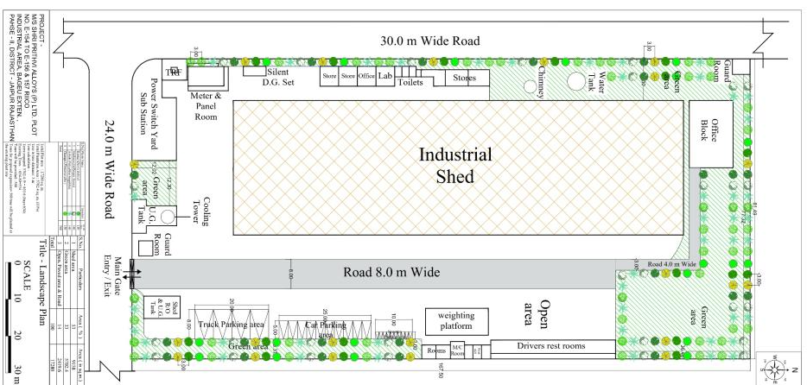
POINT WISE COMPLIANCES OF TERM OF REFERENCES
TOR POINT-ix Cont....
S. No | Scientific Name | Local Name | Number of Plant
1 | Polyalthia longifolia | Ashok | 140
2 | Pongamia Pinnata | Karanj | 130
3 | Plumeria alba | Champa | 150
4 | Dalbergia Sissoo | Shisham | 140
Total |  |  | 560

Slide 42
POINT WISE COMPLIANCES OF TERM OF REFERENCES
TOR Point | ToR Details | Implementation/Plan
x. | Action plan for rainwater harvesting measures at plant site shall be submitted to harvest rainwater from the roof tops and storm water drains to recharge the ground water and also to use for the various activities at the project site to conserve fresh water and reduce the water requirement from other sources. | Rainwater Harvesting System is the most reliable solution for augmenting groundwater level to attain self-sufficiency. Total Annual Recharge to Ground Water Regime of the area through rainwater harvesting structure would be 7,046.61 m3/ annum
xi. | Total capital cost and recurring cost/annum for environmental pollution control measures shall be submitted.
xii. | Action plan for post-project environmental monitoring shall be submitted. | As under:-
S. No. | Particulars | Capital Cost (In Rs.) | Recurring Cost (In Rs.)
1. | EMP Cost | 92.5 lac | 14.5 lac

Slide 43
POINT WISE COMPLIANCES OF TERM OF REFERENCES
TOR POINT-XII Cont....
S. No. | Potential Impact | Action to be Followed | Parameters for Monitoring | Frequency of Monitoring | Location
1 | Air Emissions | Ambient air quality monitoring | PM₁₀, PM_{2.5}, SO₂, NO_{x} CO | As per CPCB/ SPCB requirement or Twice in a week whichever is earlier | At least two locations inside project premises
 |  | Exhaust from vehicles Use of fuel efficient vehicles ¬ Maintenance of vehicles ¬ Use of only PUC certified vehicles. | Vehicle logs to be maintained |  | -
 |  | Stack Emission Monitoring ¬ Monitoring of stack attached with reheating furnace and DG set | PM | Once in a month | Plant Site
2 | Noise | Noise generated from various plant operations, vehicular to be optimized and monitored | Spot Noise Level recording; Leq(night), Leq(day), Leq(dn) | once in a month. | Noise measurement at the source & boundary of the project
 |  | Generation of vehicular noise | Maintain records of vehicles | Periodic during operation phase | -
3 | Wastewater Discharge | No untreated discharge to be made to surface water, groundwater or soil. | No discharge hoses in vicinity of watercourses. | Periodic during operation phase | -
 |  | Take care in disposal of wastewater generated such that soil and groundwater resources are protected | Discharge norms for effluents will be maintained | Periodic during operation phase | -
 |  | Compliance of treated wastewater usage | pH, TSS, TDS, BOD, COD, Oil & Grease | Periodic during operation phase | One location (Treated waste water)
4 | Drainage and effluent Management | Ensure drainage system and specific design measures are working effectively. Design to incorporate existing drainage pattern and avoid disturbing the same. | Visual inspection of drainage and records thereof | Periodic during operation phase | -
5 | Water Quality and Water Levels | Monitoring used water quality & groundwater quality and levels | Comprehensive monitoring as per IS 10500 Groundwater level bgl | Quality-twice a year Level- Monthly. | Three locations surrounding project site
6 | Energy Usage | Energy usage for air-conditioning and other activities to be minimized Conduct annual energy audit for the buildings | Energy audit report | Annual audits and periodic checks during operational phase | -

Slide 44
POINT WISE COMPLIANCES OF TERM OF REFERENCES
TOR POINT-XII Cont....
S. No. | Potential Impact | Action to be Followed | Parameters for Monitoring | Frequency of Monitoring | Location
7 | Emergency preparedness, such as fire fighting | Fire protection and safety measures to take care of fire and explosion hazards, to be assessed and steps taken for their prevention. | Mock drill records, on site emergency plan, evacuation plan | Periodic during operation phase
8 | Maintenance of flora and fauna | Vegetation, greenbelt / green cover development | No. of plants, species | Periodic during operation phase | Plant Site
9 | Solid and Hazardous Waste Management | Implement waste management plan that identifies and characterizes every waste arising associated with proposed activities and which identifies the procedures for collection, handling & disposal of each waste arising. | Records of solid waste generation, treatment and disposal | Periodic during operation phase | Plant Site
10 | Soil quality | Maintenance of good soil quality | Physico-chemical parameters and metals. | Periodical monitoring | Plantation areas
11 | Health | Employees and migrant labour health check ups | All relevant parameters mRoutine Blood Examination. Microscopic; Biochemistry. Routine Urine Examination. Lung function test. Sputum examination Audiometery X-ray, ECG | Regular check ups | All workers at the plant site

Slide 45
POINT WISE COMPLIANCES OF TERM OF REFERENCES
TOR Point | ToR Details | Implementation/Plan
xiii. | Onsite and Offsite Disaster (natural and man-made) Preparedness and Emergency Management Plan including Risk Assessment and damage control. Disaster management plan should be linked with District Disaster Management Plan. | On-Site Emergency Plan Objectives The objective of the On-site Emergency Plan should be to make maximum use of the combined resources of the plant and the outside service to:- Effect the rescue and treatment of casualties Safeguard other personnel in the premises Minimise damage to property and environment Initially contain and ultimately bring the incident under control Identify any dead Provide for the needs of relatives Provide authoritative information to the news media Secure the safe rehabilitation of affected areas Preserve relevant records and equipment for the subsequent enquiry into the cause and circumstances of emergency Action Plans The Action Plan consists of: Identification of Key Personnel Defining responsibilities of Key Personnel Designating Emergency Control Centres and Assembly Points Declaration of Emergency Sending All Clear Signal Defining action’s to be taken by non-key personnel during emergency OFF-SITE EMERGENCY PLAN Organizations involved and responsibilities and liaison arrangements between them City Fire Service Police Hospital Medical facility District Collectorate/ Administration RTO Controller of Explosives & Factory Inspectorate

Slide 46
POINT WISE COMPLIANCES OF TERM OF REFERENCES
TOR Point | ToR Details | Implementation/Plan
8 | Occupational health
i. | Plan and fund allocation to ensure the occupational health & safety of all contract and casual workers. | Necessary required budgetary allocation will be kept for to ensure safety of all Employees including contract & casual workers.
ii. | Details of exposure specific health status evaluation of worker. If the workers health is being evaluated by pre-designed format, chest X-rays, Audiometry, Spirometry, vision testing (Far & Near vision, colour vision, and any other ocular defect). ECG, during pre-placement and periodical examinations give the details of the same. Details regarding last month analysed data of abovementioned parameters as per age, sex, duration of exposure and department | Workers health is being/will be regular monitored and record for the same will be maintained.
iii. | Details of existing Occupational & Safety Hazards, What are the exposure levels of above mentioned hazards and whether they are within Permissible Exposure level (PEL). If these are not within (PEL), what measures the company has adopted to keep them within (PEL) so that health of the workers can be preserved. | All employees are being/will be trained, educated and encouraged to follow best and safe work practices. Personnel Protective Equipment’s like face mask, earmuffs, ear plugs, gloves, safety goggles and safety boots are being provided. Awareness programme regarding the use, maintenance and up-keep of respirators will be conducted on regular basis so that employees are trained to handle the equipment properly. Permissible exposure level is well within the limits.

Slide 47
POINT WISE COMPLIANCES OF TERM OF REFERENCES
TOR Point | ToR Details | Implementation/Plan
iv. | Annual report of health status of workers with special reference to occupational Health and Safety. | Annual report of health status of worker with special reference to Occupational Health and Safety will be maintained.
9 | Corporate Environment Policy
i. | Does the company have a well laid down Environment Policy approved by its Board of Director? If so, it may be detailed in the EIA report. | The industry has well defined Environmental Policy and the same is executed by EMC. The main objectives of policy are:- Adopt Environmental friendly alternatives to environmental issues; Ensure that all employees are trained to understand their environmental responsibilities and create an environment that adheres to the Company’s Policies, procedures and applicable regulations.; Waste minimization, recycling, energy conservation. Training, Education and information to employees. Compliance of provisions of applicable environmental laws. Reduce and prevent pollution. Activity participates in Social Welfare and Environmental Development activities for the locality. Effectively manage, monitor, improve and communicate the environmental performance. Take all reasonable steps to prevent pollution. Set realistic and measurable objectives and targets for continual improvement of the environmental performance

Slide 48
POINT WISE COMPLIANCES OF TERM OF REFERENCES
TOR Point | ToR Details | Implementation/Plan
ii. | Does the Environment Policy prescribe for standard operating process/procedures to bring into focus any infringement/deviation/violation of the Environment or Forest norms/conditions? If so, it may be detailed in the EIA. | Shri Prithvi Alloys Pvt. Ltd. have well defined procedures to bring into focus any infringement / deviation/ violation of the environmental and forest norms.
iii. | What is the hierarchical system of Administration order of the company to deal with the environment issues and for ensuring compliance with the environmental clearance conditions? Details of this system may be given. | Shri Prithvi Alloys Pvt. Ltd. have well defined hierarchical system to deal with the environmental issues and for ensuring compliance with the Environmental Clearance conditions. Administrative chart is mentioned in chapter-X figure-10.1 of EIA/EMP Report.
iv. | Does the company have system of reporting of non-compliances/violation of environmental norms to the Board of Directors of the company and /or shareholders or stakeholders at large? This reporting mechanism shall be detailed in the EIA report. | Director will appraise on quarterly basis regarding the performance of the Company on Environmental Measures. Details about the same is elaborated in Chapter -X of EIA/EMP Report.
v. | Details regarding infrastructure facilities such as sanitation, fuel, restroom etc. to be provided to the labour force during construction as well as to the casual workers including truck drivers during operation phase. | Other facilities such as sanitation and restroom are being/will be provided to workers. Local labor will be employed during construction phase and operational phase.

Slide 49
POINT WISE COMPLIANCES OF TERM OF REFERENCES
TOR Point | ToR Details | Implementation/Plan
11 | Enterprise Social Commitment (ESC)
i. | Adequate funds (at least 2.5 % of the project cost) shall be earmarked towards the Enterprise Social Commitment based on Public Hearing issues and item-wise details along with time bound action plan shall be included. Socio-economic development activities need to be elaborated upon. | Total Rs 28.0 lac will be earmarked towards Social Enterprise budget based on Public Hearing issues and item-wise details along with time bound action plan is given in Chapter – VII, Sub-Section 7.2 of EIA/ EMP Report. Public Hearing has been carried out as per the guidelines of MoEF&CC, New Delhi on dated 3.01.2022. Public Hearing notice was published in two regional papers.
Advertisement of Public Hearing | Dainik Bhaskar :02.12.2021 Samachar Jagat : 02.12.2021
Date/Time of Public Hearing | Date - 03-01-2022 Time - 11:00 A.M.
Venue | Government Senior Secondary School, Bagru (In front of the office of Sub-Tehsil Bagru)
Members | Shri Birbal Singh, Additional District Collector City (North), District- Jaipur Shri K.C. Gupta, Regional Officer, RSPCB (South), Jaipur Mr. Adarsh Garg (Director) Shri Prithvi Alloys Pvt. Ltd.
S. No. | EMP Activities | Year wise Expenditure in Rs (Lac)
 |  | 1stYear | 2ndYear | 3nd Year
1. | Education | 2.00 | 2.00 | 2.00
2. | Health Awareness | 4.00 | 4.00 | 4.00
3. | Development Rain Water Harvesting | 4.00 | 4.00 | 2.00
Total: Rs. 28.00 Lacs |  | 10.00 | 10.00 | 8.00
Total Amount: Rs. 28.00 Lacs will be provided under the EMP

Slide 50
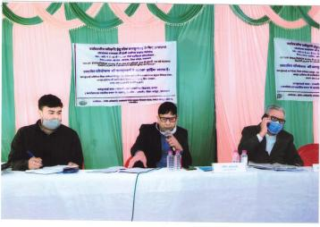
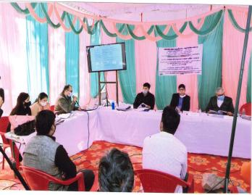
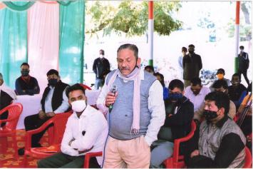
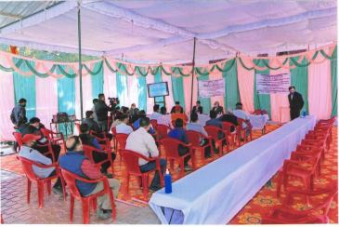
POINT WISE COMPLIANCES OF TERM OF REFERENCES
TOR POINT-I Cont....
Public Hearing Proceeding Photographs

Slide 51
POINT WISE COMPLIANCES OF TERM OF REFERENCES
Issue raised during public hearing, reply and time bound action plan
TOR POINT-I Cont....
S. No. | Name & Address | Issue/Objection Raised | Response/Reply | Budget and action Plan
1. | Shri Raghuveer, Chirota, Bagru | What are the mitigation measures taken by unit regarding control of water pollution? | Approximately 0.8 KLD Domestic wastewater is being generated from the existing unit, which is disposed off into septic tank followed by soak pit. After expansion 4.8 KLD will be generated, which will be treated into Automatic Control Airlift Crossflow MBR followed by Ozonator technology STP (6 KLD). Treated water from STP will be reused in greenbelt/plantation purposes. Industrial Waste Water There will be no industrial effluent generation, as the water from cooling will be recycled. Hence, there will be no any discharge of wastewater outside the company premises;thus the unit will achieving ZLD. | STP Capital Cost – 4.0 lac Recurring Cost – 0.5 lac
2. | Shri Manish Kumar, Bagru | How much plantation will be carried out by unit? | 33% of plant area will be under green cover after expansion. Approximately 560 trees will be planted after expansion. | Green belt development Capital Cost – 11.20 lac Recurring cost – 4.0 lac

Slide 52
POINT WISE COMPLIANCES OF TERM OF REFERENCES
Issue raised during public hearing, reply and time bound action plan
TOR POINT-I Cont....
S. No. | Name & Address | Issue/Objection Raised | Response/Reply | Budget and action Plan
3. | Shri Narendra Yadav, Bagru | What are the mitigations measures regarding air pollution control? | To minimize & control the emission from induction furnace exhaust gases after suction hood is being/will be passed through spark arrester along with bag house before its discharge to atmosphere through stack (30 m). From Re-Heating Furnace, gases passed through multi cyclone and bag house before its discharge to atmosphere through stack (30 m). The flue gas outlets are being/will be designed to maintain the PM emission level below 30 mg/Nm3. Bag filter has been provided at coal pulverizer area. DG set is being fitted with adequate stack (10 m from ground level) to take care of particulate & gaseous emission. | APCD Capital cost – 35.0 lac Recurring cost – 2.0 lac
4. | Shri Raju, Bagru | How much people will get employment by this project? | At present 50 peoples get employment in existing unit. Additional 100 peoples will get employment. Local people will get job opportunity. | NA
5. | Sh. Ramswarup Kumawat, Bagru | Question about RIICO industrial area plantation that there is no plantation, other industries put hot steel rod outside the premises which cause accident. They also asked for job opportunity and construction of toilet and bathroom for ladies. | For plantation approximately 500 tresses will be planted in schools, panchayat and other local areas. Public toilets/bathrooms for women will be constructed. | CSR Annual cost – 28.0 lac Recurring cost – NA
6. | Sh. Jugal Kishore Meena, Badikheda, Bagru | He appreciate the work done by unit and also suggest employment for local people. | At present 50 peoples get employment in existing unit. Additional 100 peoples will get employment. Local people will get job opportunity. | NA

Slide 53
POINT WISE COMPLIANCES OF TERM OF REFERENCES
TOR Point | ToR Details | Implementation/Plan
12 | Any litigation pending against the project and/or any direction/order passed by any Court of Law against the project, if so, details thereof shall also be included. Has the unit received any notice under the Section 5 of Environment (Protection) Act, 1986 or relevant Sections of Air and Water Acts? If so, details thereof and compliance/ATR to the notice(s) and present status of the case. | There is no litigation pending against project, if any, with direction/ order passed by any court of law against the Project Proponent.
13. | A tabular chart with index for point wise compliance of above ToRs. | Complied with
1. | Complete process flow diagram describing each unit, its processes and operations, along with material and energy inputs & outputs (material and energy balance). | Complete process flow diagram describing each unit, processes and operations, along with material and energy inputs & outputs (material and energy balance) is mentioned in ToR no.viii.
2. | Details on blast furnace/ open hearth furnace/ basic oxygen furnace/ladle refining, casting and rolling plants etc. | This is expansion of MS ingots and MS TMT Bars/Angles and Channels manufacturing unit. The existing unit is involved in manufacturing of MS ingots by using induction furnace (8TPH – 1 no and 4 TPH-1 no.) and MS TMT Bar/Angle/channels from Re-heating furnace (12 TPH–1 no.). Now unit is undergoes expansion from 28,800 TPA to 60,000TPA for Ms ingots and from 28,800 TPA to 1,00,000 TPA for MS TMT Bar/Angle/channels. Existing one induction furnace of capacity 4 TPH will be replace with 12 TPH and upgrade the existing Reheating furnace from 12 TPH to 20 TPH will be done after proposed expansion.

Slide 54
POINT WISE COMPLIANCES OF TERM OF REFERENCES
TOR Point | ToR Details | Implementation/Plan
3. | Details on installation/activation of opacity meters with recording with proper calibration system | Not Applicable
4. | Details on toxic metals including mercury, arsenic and fluoride emissions | Not Applicable; As no toxic metals and other toxic materials are being/will be used and manufactured.
5. | Details on stack height requirement for integrated steel | This is an expansion of existing MS Ingots and MS TMT Bars/Angles/Channels unit. Stack attached with Re-heating furnace and Induction furnace are 30 m each . the same will be maintained after expansion. 10 m stack height has been provided with existing DG set.
6. | Details on ash disposal and management -Non-ferrous metal | Coal is being/will be used as raw material in Re-Heating Furnace. Ash (39 kg/day after expansion) generated from Re-Heating Furnace will be sent to cement/brick manufacturing units.
7. | Complete process flow diagram describing production of lead/zinc/copper/ aluminium, etc | Not Applicable. As the process is based on simple secondary metallurgy using scrap, sponge iron, Fero Silicon+Ferro Alloy for making MS Ingots and MS Ingots/Billets as raw material for Re-Heating furnace. No ore is processed.
8. | Raw materials substitution or elimination | Not Applicable
9. | Details on smelting, thermal refining, melting, slag fuming, and Waelz kiln operation | Not Applicable, As the process does not involve any of the designated operations.

Slide 55
POINT WISE COMPLIANCES OF TERM OF REFERENCES
TOR Point | ToR Details | Implementation/Plan
10. | Details on Holding and de-gassing of molten metal from primary and secondary aluminum, materials pre-treatment, and from melting and smelting of secondary aluminium | Not Applicable. As no such operations are involved.
11. | Details on solvent recycling | Not Applicable
12. | Details on precious metals recovery | Not Applicable
13. | Details on composition, generation and utilization of waste/fuel gases from coke oven plant and their utilization | Not Applicable
14. | Details on toxic metal content in the waste material and its composition and end use (particularly of slag). | There will be slag generated from MS ingots manufacturing process. The same will be used from road making uses within industrial area.
15. | Trace metals Mercury, arsenic and fluoride emissions in the raw material. | Not Applicable
16. | Trace metals in waste material especially slag | Not Applicable
17. | Plan for trace metal recovery | Not Applicable
18. | Trace metals in water | Not Applicable

Slide 56

GAURANG ENVIRONMENTAL SOLUTIONS PVT .LTD.
102, SNG Shri Ratna Apartment, Near Tambi petrol pump, Peetal Factory,
Jhotwara Road, Jaipur- 302016

