Slide 1
M/s. NCL Industries Limited Proposed to establish captive coal based captive Power plant with a capacity of 30MW at Mattapalli village, Mattampalli Mandal, Nalgonda District for which they obtained Environmental Clearance from SEIAA vide order No. SEIAA/AP/NLG-35/2011/692 dated 27.04.2013.
Applied for extension of validity period of Environmental Clearance to the MoEF&CC vide proposal no IA/TG/IND/205416/2021 dated 23.03.2021.
EDS raised by MoEF&CC on 31.03.2021 i.e., “your proposal is returned due to the following: on perusal of the records, the EC was accorded by SEIAA. In view of this, application may be submitted to SEIAA and request them to transfer to MoEF&CC along with entire records due to the applicability of general condition as stated in the cover letter”

Slide 2
Based on the EDS, again applied to the Telangana SEIAA for the transfer of records from SEIAA Telangana to MoEF&CC vide proposal no: SIA/TG/THE/207358/2021 dated: 31.03.2021.
The SEAC considered the request of proponent and after detailed discussion, the SEAC recommended transfer the proposal for extension of EC. Subsequently, the proposal was examined by the state Environmental Impact Assessment Authority (SEIAA), Telangana in its meeting held on 01.05.2021. The SEIAA decided to transfer the proposal for extension of EC along with records of previous EC to the MoEF&CC and sent the Letter to the MoEF&CC vide Lr.no: SEIAA/TS/OL/SRPT-30/2021-468 dated: 05.05.2021.
Due to financial reasons we could not implement the project and now we want to go ahead with implementation of the project which may take about 3 years period.

Slide 3
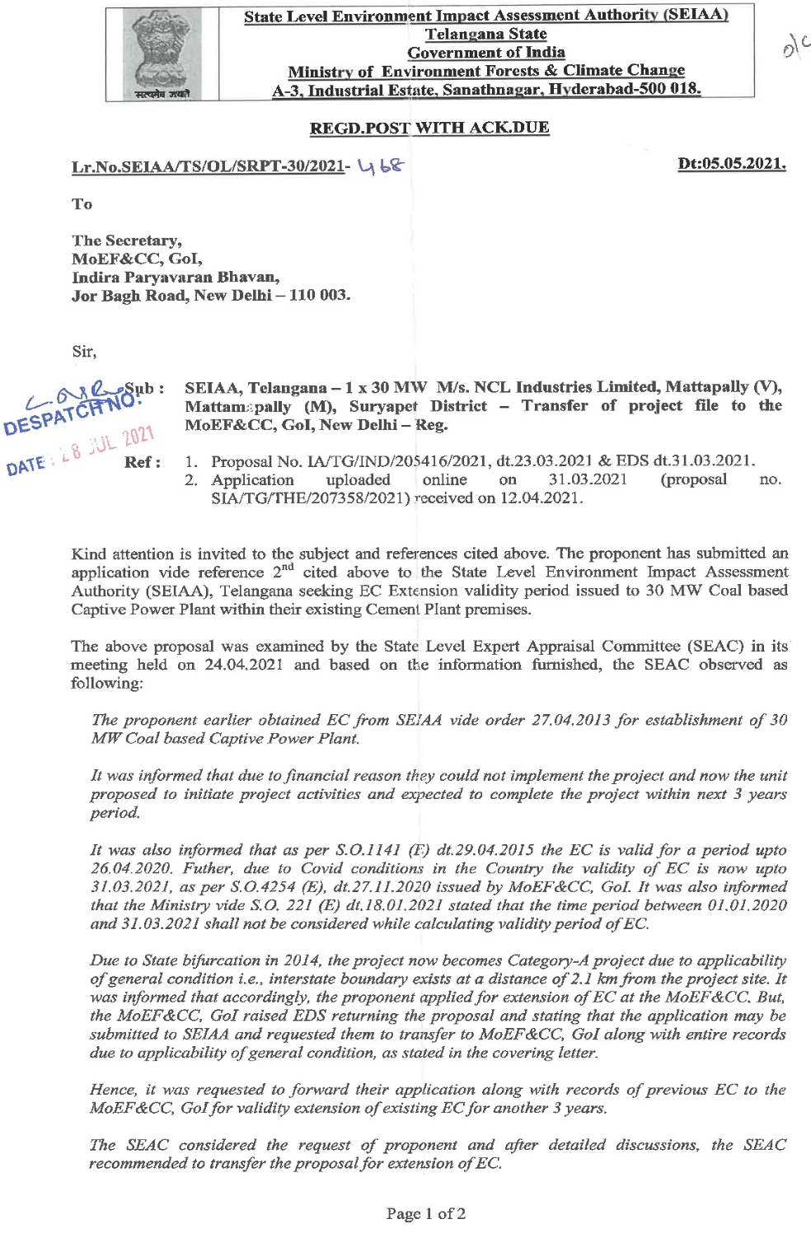
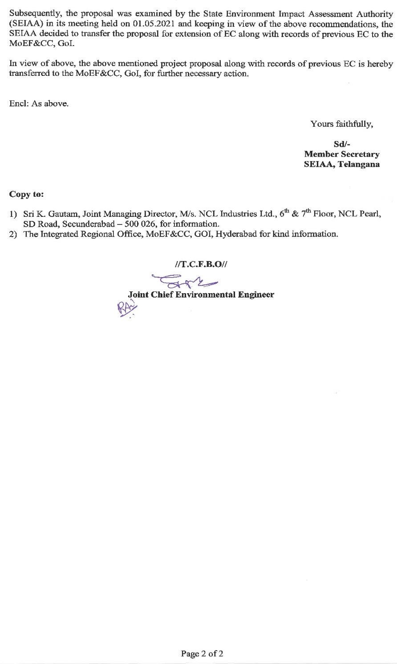

Slide 4
NCL captive power plant files transferred to MoEF&CC and we are waiting for the EAC meeting.

