Slide 1
Environmental Clearance
For
Setting up of ISP for production of 13.2 MTPA Crude Steel, 900 MW Captive Power &
10 MTPA Cement Grinding Unit
Near Paradeep, Tehsil: Ersama,
District: Jagatsinghpur , State: Odisha
By
JSW UTKAL STEEL LIMITED
Consulting Engineers:
M. N. Dastur & Co. (P) Ltd.
NABET Sl. No. – 165 (Valid till 29.03.2022)
&
WAPCOS Ltd.
NABET SI. NO. QCI/NABET/ENV/ACO/18/0797
Ref. File no: IA-J-11011/524/2017-IA-II(I)
Proposal No. IA/OR/IND/74396/2018

Slide 2
Introduction
  Project Proponent - JSW Utkal Steel Limited; wholly owned
  subsidiary of JSW Steel Ltd.
  EIA Consultant – M. N. Dastur & Co (P) Limited & WAPCOS LTD
  Details of EC Applications :
  Applied for TOR - 13 August, 2018
  Site visit by sub committee - 31 January, 2019
  TOR meeting held on - 22 February, 2019
  TOR issued on - 19 March, 2019
  Baseline data generation - Jan’18 to Apr’18, Nov’18 to
  Feb’19 and Apr’19 - May’19
  PH held on - 20 December, 2019

Slide 3
PREAMBLE
JSW Utkal Steel Ltd. Intend to set up-
13.2 MTPA Integrated Steel Plant with 52 MTPA handing capacity of Captive Jetties in Jagatsinghpur Dist.
Laying of Slurry Pipeline from Joda to ISP for transportation of 30 MTPA iron ore concentrate
Iron ore Benefication Plant at Joda in Keonjhar & Sundergarh Dist.
High Level Clearance Authority, Govt. of Odisha has accorded approval of the projects.
Total Investment of the ISP & Captive Jetties-@ Rs. 65,000 Cr.

Slide 4
Chronology of EAC Meetings
  First application for EC made in February 2021 – EDS raised and replied in March 2021 –application withdrawn
  Second application with Common EIA made in May 2021 which was considered at 36th EAC meeting on 19th May 2021
  Third application addressing ADS raised during previous meeting made in August 2021 which was considered at 44th EAC meeting on 14th September 2021
  Further queries were raised as addressed in present proposal

Slide 5
Item | Details
Project & Interlinked Project | Setting up a Greenfield ISP to produce 13.2 MTPA crude steel along with CPP of 900 MW and Cement grinding & mixing unit of 10.0 MTPA Setting up a Greenfield 52 MTPA Handling Capacity Captive Jetties adjacent to the ISP on the right bank of Jatadhar River in Odisha
Project Location | Villages - Polanga, Bayanala Kandha, Gobindapur, Dhinkia, Nuagaon, Jatadhara Tehsil - Ersama District - Jagatsinghpur State - Odisha Pin Code - 754141 Topo Sheet (OSM) Nos. - 73L/12 (F45U12) Maximum elevation above MSL - 10 m Distance of nearest HFL - 500 m Seismic Zone - III (IS-1983(Part-1):2002) Nearest Airport - Bhubaneswar (120 km by road) Nearest Port - Paradeep (12 km by road) Nearest Town - Paradeep, 12 km, NE
NO Wildlife sanctuary, National Park, Protected Area, Biosphere/Tiger/Elephant reserves, Critically & Severely Polluted Area, Eco-sensitive area, Eco-sensitive Zone, State/UT/International Boundary etc

Slide 6
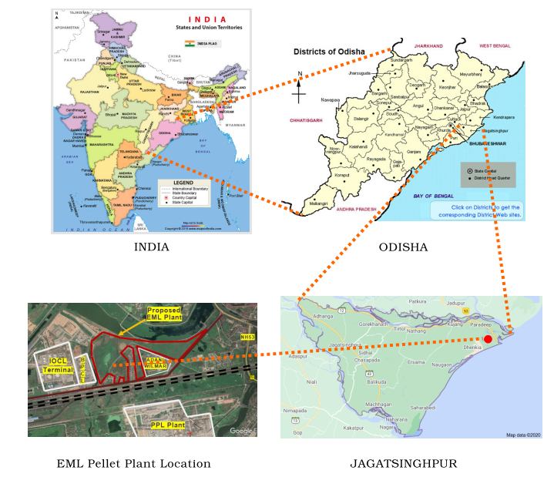
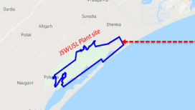
Project Location
6
India
ODISHA
JSWUSL Plant Location
Jagatsinghpur

Slide 7
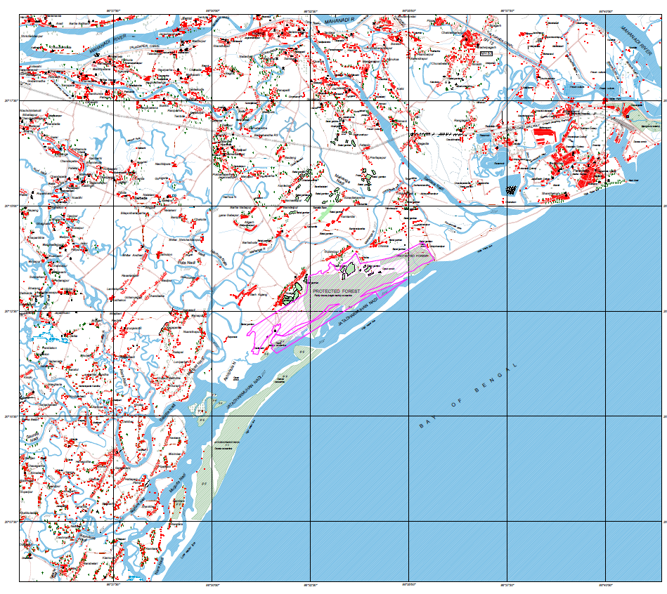
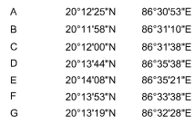
Topographic Map
Mahanadi River
OSM Nos
F45 U7
F45 U8
F45 U11
F45 U12
20°15’
F
E
G
D
Plant Boundary
20°12’30”
A
B
C
BAY OF BENGAL
86°30’
86°35’

Slide 8
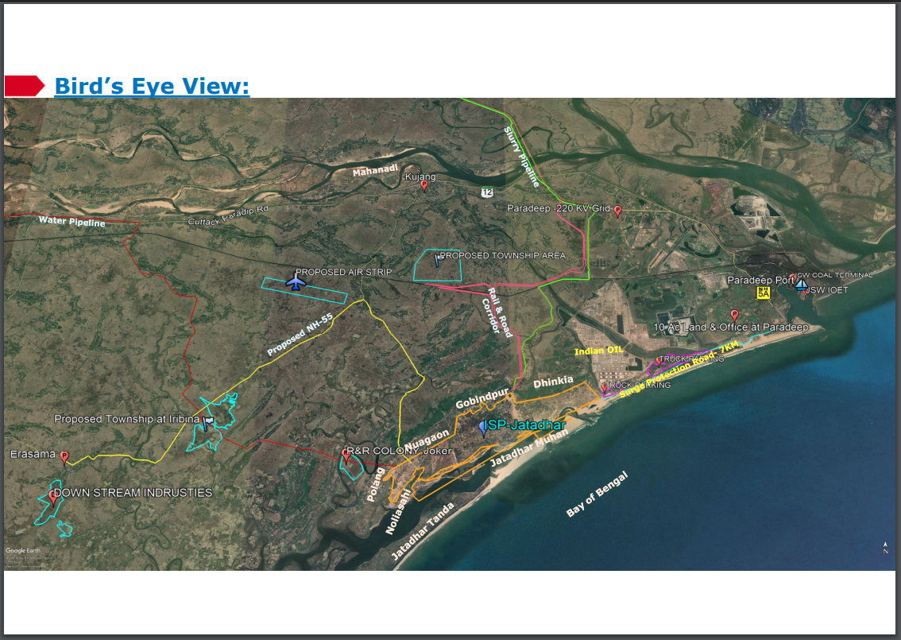
Summary of Project (4/4)

Slide 9
Summary of Project (4/4)
Item | Details
Est. Investment | Rs. 65,000 crores Environment Mitigation Cost – 2,856 crores
Employment | 12,000 direct employment during Operation
Project duration | 84 months after receipt of EC
Power, MW | 1230 (avg) | Captive generating units & State Power Grid
Water, m³/hr | ISP + CPP – 10215 Captive Jetty – 92 Losses – 363 | Sources: 9300 - Upstream of Jobra barrage of Mahanadi River near Cuttack 1370 – CETP recycled water
Land | 2780.58 acres 2,642.94 acre forest land (FC received) 137.64 acre non forest land

Slide 10
Replies to ADS raised at 44th REAC (Industry-I) meeting held on 14th September 2021

Slide 11
44.8.25: a : 1. NOC from WAPCOS to use the data for Common EIA
2. Details of Team Members of WAPCOS
WAPCOS has given their consent which has been included in Common EIA Report.
NABET Declaration of team members of WAPCOS, Included in Common EIA

Slide 12
44.8.25: b : Cumulative impact assessment is not available on Jetty EIA report uploaded on PARIVESH due to steel plant and that of steel plant due to Jetty in the EIA report.
Discipline | Potential impacts | Mitigation measures | Cost in Cr | Administrative Authority & Schedule of Implementation and Monitoring
Construction Phase
Air environment | Emission of dust due to construction activities leading to adverse health & environmental impacts | - Water sprinkling to arrest fugitive dust emission - Wind barrier screen provided to reduce the wind speed and consequently, reduce the fugitive dust emission - Logistics would be designed to minimize movement of trucks transporting construction materials and optimize storage of construction materials at site | 4.5 | Project in-charge Start of construction activities. Fortnightly monitoring of Ambient air quality w.r.t PM, SO2 & NOx
Water quality | Discharge of construction wastewater including sanitary and kitchen wastewater causing adverse health & ecological impacts | - Labour hutments would be provided with proper sanitation facilities - The stockpiles would be protected with toe wall of adequate height along with concrete garland drain & catch pits to prevent uncontrolled discharge of runoffs during monsoon - Temporary discharge of treated water from slurry dewatering to the sea via marine discharge | 2.0 3.0 30.0 | Project in-charge Start of construction activities at site Within 3 months from the start of construction activities Before start of slurry dewatering system

Slide 13
44.8.25: b : Cumulative impact assessment is not available on Jetty EIA report uploaded on PARIVESH due to steel plant and that of steel plant due to Jetty in the EIA report.
Noise | Increase in noise level due to construction activities causing health effects | Provision of Personal Protective Equipment (PPE) like ear muffs, ear plugs etc. - Noise prone construction activities such as piling, drilling, excavation, cutting, etc. would be limited to daytime only | 0.5 | Project in-charge Start of construction activities
Land environment | • Loss of existing vegetation cover • Low lying cyclone prone project site • Potential leaching from use of dredged sand containing toxic metals • Adverse impact on land due to dumping of solid waste, Plastic waste and MSW like construction debris, excess concrete & cement, rejected components, etc and domestic waste | - Development of 33% greenbelt - Land reclamation using dredged sand from construction of navigational channel of captive jetties - Decantation & treatment of water in dredged soil before its release to the sea - Proper segregation of the wastes and use of recyclable materials within the plant/sell to external agencies for secondary use - Handling & disposal of wastes by authorized agencies as per prevalent regulations | 15.0 | Head - Stores Peripheral green belt – at the inception stage Waste water will be analysed through NABL recognised lab. On a weekly basis As per requirement

Slide 14
44.8.25: b : Cumulative impact assessment is not available on Jetty EIA report uploaded on PARIVESH due to steel plant and that of steel plant due to Jetty in the EIA report.
Socio-Economics | • Local employment opportunities, as per required skill set • Promotion and augmentation of ancillary & auxiliary establishments • Potential hike in local purchasing power, land & property prices, rent scales and household income leading to a positive impact on the economic growth of the region • Loss of cashew plantation and betel vineyards, leading to loss of livelihood, contribution to local economy and the generational transfer of traditional knowledge • Potential loss of access or restricted access to surface water bodies for fishing communities | - Support towards vocational and industrial training of local population (having basic qualification) is being provided for up-gradation of skill - Strict adherence to applicable regulations guiding the process of Land Acquisition, Rehabilitation and Resettlement and ensure alternate means of sustenance for the affected people - Strict adherence to applicable regulations guiding the aspect of Riparian Rights | 196.5 (R&R cost allocated separately) | Head – HR & Project in-charge At the inception stage and will be monitored by District Administration.

Slide 15
44.8.25: b : Cumulative impact assessment is not available on Jetty EIA report uploaded on PARIVESH due to steel plant and that of steel plant due to Jetty in the EIA report.
Ecology | • Loss of existing vegetation cover • Emission of dust causing adverse impact on terrestrial flora due to temporary reduction in photosynthesis rate • Potential adverse impact if discharge of wastewater done | - Plantation of diverse deep rooted native plant species - Temporary impact to be abated by measures like water sprinkling, paving roads - Treatment of wastewater and reuse in dust suppression & landscaping - Discharge of CPP cooling water, conforming to CPCB guidelines for discharge to the marine environment, to the sea through marine discharge pipeline | Included under land management | Project in-charge & Head - EHS At the beginning of construction activities. Monitoring will be done by Head-Horticulture on a monthly basis

Slide 16
44.8.25: b : Cumulative impact assessment is not available on Jetty EIA report uploaded on PARIVESH due to steel plant and that of steel plant due to Jetty in the EIA report.
Operation Phase
Land Environ-ment | Potential negative impact due to temporary storage of raw materials and solid waste due to leaching of toxic components, to fugitive dust emission and release of untreated wastewater through drain | - All stockpiles would be on top of concreted area to avoid leaching of materials during monsoon - Abatement of dust emission through water sprinklers, DS/DF system, vacuum cleaning of roads etc. - Discharge of treated wastewater through marine discharge pipeline - Solid waste storage in suitably lined area & construction of TSDF - Soil testing & TCLP analysis to be done | 30.0 | Head of the respective Departments Head of Environmental Engg. Dept. During construction phase. Fugitive dust emission monitoring on a monthly basis Treated waste water analysis on a weekly basis TCLP test –yearly once
Surface Water Resource & quality | Potential Adverse impact on surface water quality due to release of untreated wastewater | - Treatment of wastewater from units in CETP for recycle as fresh make-up water - Release of once-though cooling water of CPP to the sea through marine discharge pipelines, adhering to the Marine Discharge Norms of CPCB in the locations determined through MIKE 21 Water dispersion modeling | 730.0 | Head of the respective Departments Head - Utility Before commissioning of the plant Online montoring of major water quality parameters & complete water analysis on monthly basis through NABL accredited lab.

Slide 17
44.8.25: b : Cumulative impact assessment is not available on Jetty EIA report uploaded on PARIVESH due to steel plant and that of steel plant due to Jetty in the EIA report.
Ground water | • No impact on resource as groundwater abstraction not envisaged • No impact on groundwaterquality due to seepage and leaching | - Concrete box drains to prevent seepage and ground water contamination. - Temporary solid wastes and raw material storage yard will be lined with suitable liner to avoid leaching through soil bed leading to contamination of ground water | Included in water management | Project in charge Head of the respective Departments Before commissioning of the plant
Air Environ-ment | Adverse impacts on health & environment due to emission of PM, SOx, NOx | - Selection & maintenance of APC equipments for fugitive & point source emissions - Process optimization to control emission - Interlocking of APC equipments to shut down plant units in case of APC failure - Pneumatic or covered conveying of raw material - Maintenance of Plant roads and use of industrial vacuum cleaners & water sprinkling at regular intervals - Operation & maintenance of tyre washing system at the strategic locations of the plant - Maximum material handling through captive jetties and slurry pipeline to reduce fugitive emission from vehicular movement | 1575.0 10.0 | Head of the respective Departments Head of Environmental Engg. Dept. Before commissioning of the plant Implementation of CEMS of all DE & Combustion stacks At the start of construction activities

Slide 18
44.8.25: b : Cumulative impact assessment is not available on Jetty EIA report uploaded on PARIVESH due to steel plant and that of steel plant due to Jetty in the EIA report.
Noise | Detrimental impact on the health of working personnel in and around the plant premises | - Noise levels for the quipment & machineries to be fixed at 85 dB(A) Leq within 3 m distance from the noise prone equipment - Highly noise prone equipment having Leq above 90 dB(A) would either be housed separately or the attending personnel need to be housed in a noise-shielded cubicle. - Noise prone rotating/ vibrating equipment provided with vibration dampening anchoring - Use of appropriate PPEs | 50.0 | Project in-charge At the design, engineering and procurement Monitoring of machine noise level and ambient noise level at the factory gates & near by villages such as Dhenkia, Nuagaon, Noliasahi & garhkujang on monthly basis
Socio-Economics | Already addressed | Same as construction phase | Included above | Head – HR & Project in-charge At the inception stage and will be monitored by District Administration. During the project implementation phase within 4 years.
Ecology | Potential adverse impact on terrestrial ecology due to emission of PM, SO2, NOx, generation of noise, release of untreated wastewater, solid waste storage | - Development of 33% greenbelt adsorbing dust & absorbing specific pollutants and maintaining overall ecological balance - Adoption & adherence to the suggested Air pollution control measures, wastewater & solid waste management measures, noise pollution abatement measures | Included in land, air and water management | Project in-charge & Head - EHS Within commissioning stage of plant

Slide 19
44.8.25: b : Cumulative impact assessment is not available on Jetty EIA report uploaded on PARIVESH due to steel plant and that of steel plant due to Jetty in the EIA report.
Impact due to dredging:
Dredging and dumping of dredged spoil causes temporary turbidity, though use of high-powered suction and cutter heads create lesser turbidity. Turbidity due to dumping of dredged sludge gets dispersed quickly as indicated by the model studies.
Due to dredging in the designated channel area- there would be temporary disturbance of bio-diversity but regrouping does happen in the interim period.
The release of contaminants such as heavy metals associated with the suspended sediments can lead to increased availability of contaminants to the food chain. However, the considered location is low in heavy metal barring Iron and hence the impact would be minimal.
Nutrients released from dumped dredge spoil would be available to key secondary producers such as copepods, decapods and chetognaths.
Dumping sediments on the seabed may affect meroplanktonic and other organisms living on the seafloor and may cause changes in benthic habitats and biological communities. The impact of dumping on biological communities in dump sites does not extend far beyond the dump sites.
The maintenance dredging volume at the navigation channel may result in reduction of species diversity and abundance as over a period of time repeated turbidity would make some of the organism adapt.

Slide 20
44.8.25: b : Cumulative impact assessment is not available on Jetty EIA report uploaded on PARIVESH due to steel plant and that of steel plant due to Jetty in the EIA report.
Dredging Mitigation measures:
Cutter Suction Dredger for the hard sandy strata and Trailer Suction Dredger for silty material would be deployed for dredging. The equipment would be provided with high suction and high speed cutters for reduced turbidity. New or properly and meticulously maintained dredgers would be deployed for efficiency and reduced impact on Environment.
Disposal of dredged material would be carried out at the designated disposal site;
The refueling of the dredgers and work boats would be carried out following strict and approved norms and no oil spill would be permitted.
Environmental Monitoring Programme comprising of monitoring of marine water quality, marine sediment quality and marine ecology will be initiated one week prior to commencement of dredging activity and will be carried out throughout dredging period.

Slide 21
44.8.25: b : Cumulative impact assessment is not available on Jetty EIA report uploaded on PARIVESH due to steel plant and that of steel plant due to Jetty in the EIA report.
DREDGING MANAGEMENT PLAN | • Dredging Management plan would include: o Cutter suction and Trailing suction dredgers would be used, with higher suction and cutter head efficiency. o No/Minimal spillage of material (sediment) from the vessel/bucket/dredged area into the surrounding water would be permitted; o Equipment would be selected and deployed after through scrutiny and quality assurance for their functioning • No dredging would be carried in monsoon season in open sea due to bad weather.

Slide 22
44.8.25: b : Cumulative impact assessment is not available on Jetty EIA report uploaded on PARIVESH due to steel plant and that of steel plant due to Jetty in the EIA report.
DREDGING MANAGEMENT PLAN | • Dredging from Deeper to shallower water where possible. • Suction heads at the end of pipes to be kept above the sea bed when not in operation until the scheduled dredging area is reached so that unnecessary sea bed disturbance is prevented. • Disposal of dredged material will be carried out within the designated disposal site; • Hopper de-watering will be confined to the dredging and spoil disposal areas. • Vessel-based plume monitoring should be conducted during the trial period to validate the characteristics of any turbid plumes and to establish ongoing turbidity monitoring requirements.

Slide 23
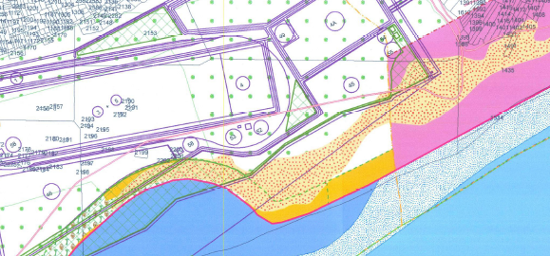
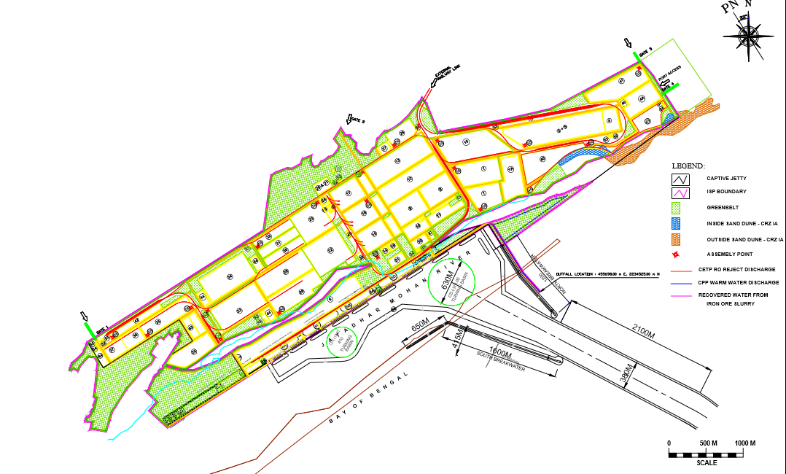
C i) Sand dunes inside the plant boundary measuring 11.53 ha shall be preserved. However, the point raised by EAC related to “in the vicinity of the project” has not been addressed
No of sand dunes near Project area: 1
Total Area : 80.87 ac
Area within Project : 16.87 ac

Slide 24
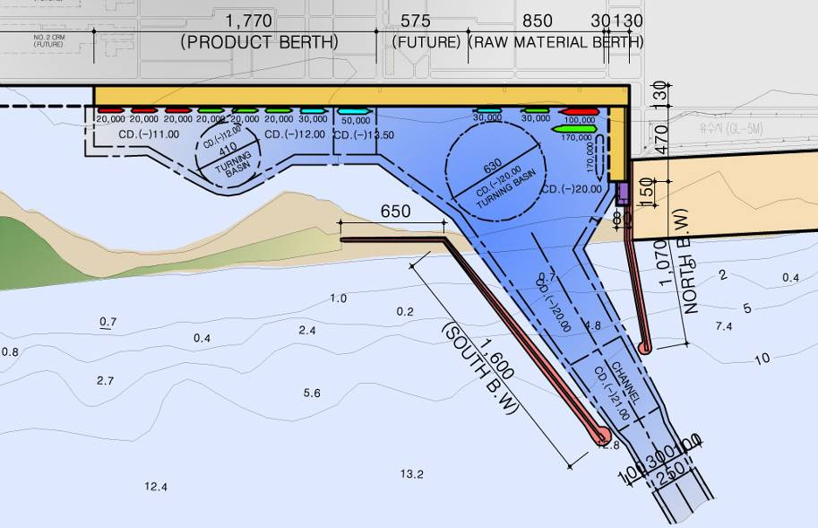
44.8.25: C ii) 27 million cum dredged sand shall be used to raise the plant level by 6.5 meter. Scheme to dispose balance sand and the sand recovered during annual maintenance dredging shall be disposed offshore at two locations in the ocean. The mechanism to control turbidity due to the dredging in the area has not been furnished.
Layout of the Captive Jetty showing the dredged areas
Most dredged material can be used as a resource, providing significant environmental and financial benefits and contributing to sustainability.

Slide 25
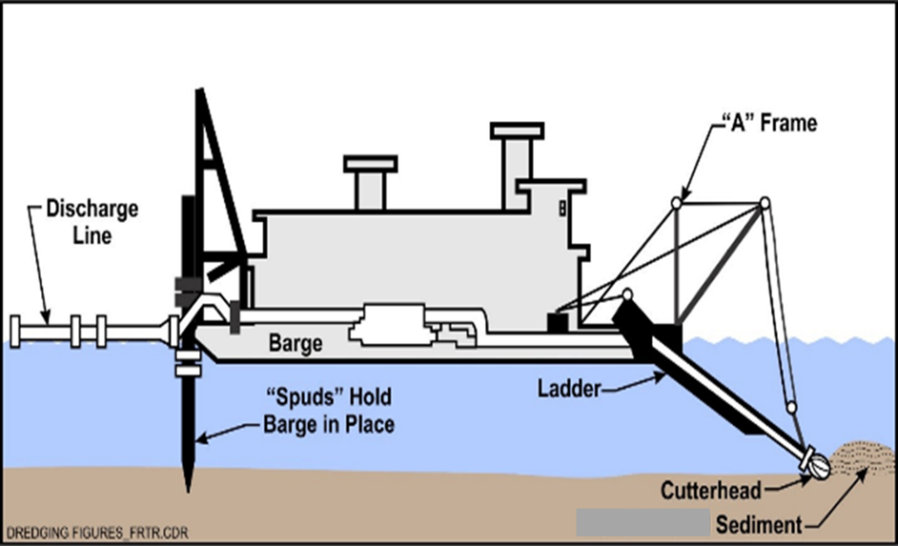
44.8.25: C ii) 27 million cum dredged sand shall be used to raise the plant level by 6.5 meter. Scheme to dispose balance sand and the sand recovered during annual maintenance dredging shall be disposed offshore at two locations in the ocean. The mechanism to control turbidity due to the dredging in the area has not been furnished.
Cutter –suction dredger – Dredging (Top) and being floated to located (bottom)
Dredged material will be pumped to shore for increasing the height to 6.5 m level
or as decided during the detailed engineering

Slide 26
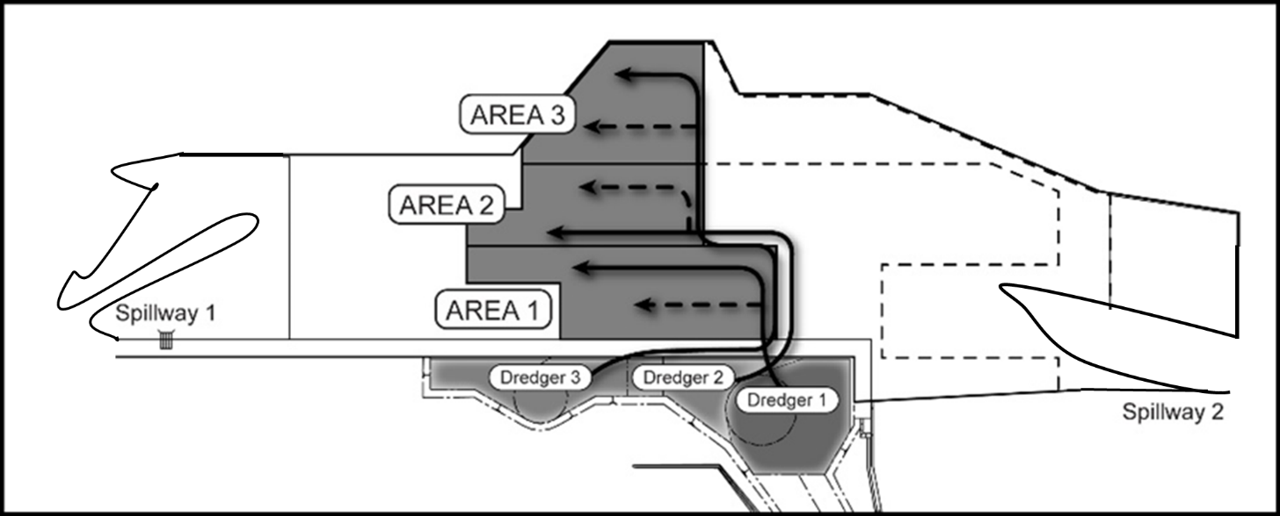
44.8.25: C ii) 27 million cum dredged sand shall be used to raise the plant level by 6.5 meter. Scheme to dispose balance sand and the sand recovered during annual maintenance dredging shall be disposed offshore at two locations in the ocean. The mechanism to control turbidity due to the dredging in the area has not been furnished.
Area for Reclamation would be lined with geo-fabric/clay liner.
Dykes would be constructed around the area from inside up to +7.0 m. Area thus would be divided in to various small areas with smaller height dykes with top level of +6.0 m CD. (All levels are tentative and may change)
The water from the smaller compartments would be collected on the lower end of the disposal area and would be decanted through a rubble spillway to sea

Slide 27
44.8.25: c-iii) Comprehensive drainage study of the area has not been done. It is simply mentioned that there are two streams passing through the property in Northern and Southern side of the plot. These streams shall be diverted and merged with the peripheral drain designed to carry cyclonic run off. No details related to the quantity of approximate drainage in the catchment, the size of diverted drains and peripheral drain that would handle this run off have not been furnished as required under comprehensive study asked by EAC in its meeting held on 18-19th May, 2021
The flood modelling study has been carried out by DHI for peak rainfall period.
Catchment flow, River Discharge and 2D modelling carried out using MIKE 21 Flow Model FM
Model Scenario
Simulation Period- 2 days (26-08-2020 to 27-08-2020) for baseline and proposed condition.
2. Model is performed by considering the existing ground condition for baseline.
3. The maximum precipitation used in the model is 450mm.
4. The flood plain on the left bank of Jatadhari river (western side of Jatadhari river) has lower elevation when compared with right bank of the river.

Slide 28
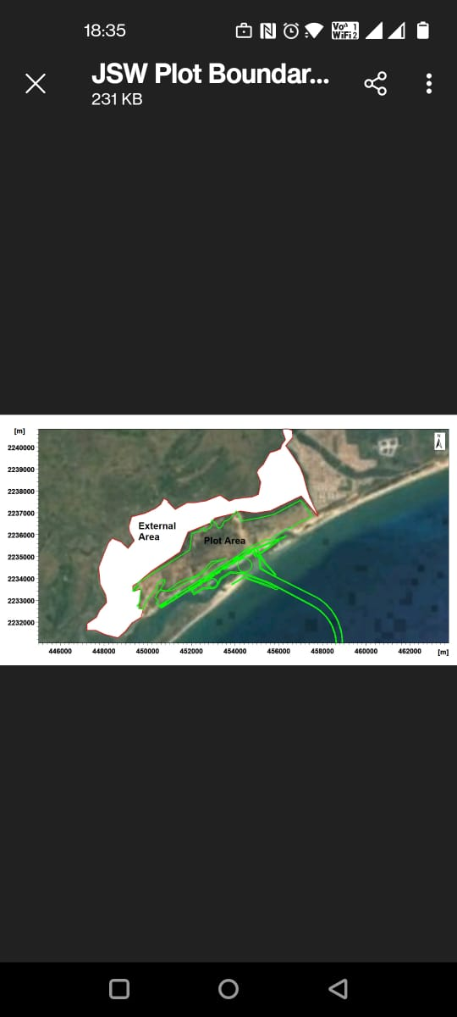
44.8.25: c-iii) Comprehensive drainage study of the area has not been done. It is simply mentioned that there are two streams passing through the property in Northern and Southern side of the plot. These streams shall be diverted and merged with the peripheral drain designed to carry cyclonic run off. No details related to the quantity of approximate drainage in the catchment, the size of diverted drains and peripheral drain that would handle this run off have not been furnished as required under comprehensive study asked by EAC in its meeting held on 18-19th May, 2021
Maximum flood event for the model for port area of 1200 ha and external area of 2200 ha

Slide 29
44.8.25: c-iii) Comprehensive drainage study of the area has not been done. It is simply mentioned that there are two streams passing through the property in Northern and Southern side of the plot. These streams shall be diverted and merged with the peripheral drain designed to carry cyclonic run off. No details related to the quantity of approximate drainage in the catchment, the size of diverted drains and peripheral drain that would handle this run off have not been furnished as required under comprehensive study asked by EAC in its meeting held on 18-19th May, 2021

Slide 30
44.8.25: c-iii) Comprehensive drainage study of the area has not been done. It is simply mentioned that there are two streams passing through the property in Northern and Southern side of the plot. These streams shall be diverted and merged with the peripheral drain designed to carry cyclonic run off. No details related to the quantity of approximate drainage in the catchment, the size of diverted drains and peripheral drain that would handle this run off have not been furnished as required under comprehensive study asked by EAC in its meeting held on 18-19th May, 2021
The maximum discharge for port area - 36 Cumecs
Port area run off – 22 cumec
External area runoff – 14 cumec
The above discharge is the maximum discharge for a single drain.
The drainage would be distributed through 5 drains
The maximum discharge on the highest contributing area is about 5.5 cumec.
Hence the storm drain design will be for 5.5 cumec maximum, i.e. 2.3 m wide and 1.6 m deep as an open channel.

Slide 31
44.8.25: c-iv) Currently 80 % of the Jobra Dam water is drained into the sea as reported by PP. Proposed plant shall draw 98.1 Cusec water from Jobra (PP says), which will reduce the drainage into sea by maximum 10 %. Hence sea water desalination has not been considered from commercial viability point of view and due to high power cost and its implication on climate change
-Detailed report validating this claim that 80 % water is drained into sea has not been submitted.
-Also, the above claim by PP that enough water is available needs to be confirmed by Authorities managing water in the state.
-No calculations are available on the cost of desalination vs the CAPEX and OPEX of water withdrawal from Jobra Barrage

Slide 32
Water Availability:
The earlier proponent for the project was allotted 117 Cusecs of water from Jobra barrage for their 12 MTPA steel project (which was approved after due diligence by Water Resource Department of Government of Orissa)
MoEFCC had also issued the EC to the earlier Project proponent from the same location, considering the availability of 117 Cusecs of water for the 12 MTPA steel plant.
The current data on the water allocation to industries from Mahanadi River is as follows:
  Average non monsoon flow : 12673 Cusecs
  Industries- Allocation & Recommendation : 95 nos
  Water - Allocation & Recommendation : 1074.5 Cusecs (8.48%)
  Current Actual withdrawal by industries : 469.8 Cusecs (3.7%)
  Source: WRD: Data as of 1st April 2021

Slide 33
DAILY DISCHARGE DATA OF MAHANADI BARRAGE AT JOBRA AT 6 A.M. (Discharge in Cusecs)
Low Water flow months : Feb-Mar
High water flow months : Aug-Sep
Lowest Flow recorded : 247 Cusecs in March 2012

Slide 34
DAILY MINIMUM DISCHARGE DATA OF MAHANADI BARRAGE AT JOBRA AT 6 A.M. (Cusecs)
The discharge from Jobra barrage in the past 10 years was zero on 11 days
(2 in Jan 2011; 8 in Feb 2011 and 1 in Oct 2017),
Discharge from the barrage for 99.7% of the time.
Water reservoir inside ISP can meet 8 days of water requirement in critical conditions.

Slide 35
Requirement : 98.1 Cusecs
Analysis of long term data, indicates that enough water is available for a fairly long period and gets wasted by flowing in to sea, a fraction of which could meet the requirements of the ISP proposed to be developed by the JSWUL.

Slide 36
Confirmation from Authorities:
Water Resource Department (WRD) is the nodal agency responsible for managing the water resources in the state.
  An in-principle allocation of 117.1 Cusecs of water was made by WRD for setting up of the steel plant vide letter 2618/WE dated 31st Jan 2018.
  WRD has further conveyed that the Committee comprising of DoWR, IDCO and JSWUL has finalised the location of intake well for drawl 99.8 Cusecs (revised by JSWUL) of water from Mahanadi near Jagatpur (upstream of Jobra)

Slide 37
Desalination of Sea water
Details of Estimates
 | JSWEL-Ratnagiri | PESCO-2019 | JSWUL | Jobra Barrage
Capacity | 200 m3/h | 33,000 m3/h | 9300 m3/h | 9300 m3/h
Product | DM water | SWRO | SWRO | River
Capex in Rs Cr | 15.0 (2011) | 4730 (2019) | 913 | 290 Cr
Opex per m3 | Rs 75 | Rs 51 | Rs 62.7 | Rs 16.5
Details of assumptions and Calculations are provided in word doc
Differential cost of Desalination vs Freshwater: Rs 42.2/m3 ( Rs 376.3 Cr/year)
Tamilnadu: Pioneer in SWRO plants
100,000 m3/d plant in 2010 (DBOOT) at an estimated cost of Rs 515 Cr at Munjur
100,000 m3/d capacity SWRO plant in 2013 at an estimated cost of Rs 533 Cr
Planned 150,000 m3/d SWRO plant at Nemmeli at an estimated cost of Rs 1260 Cr
Planning 400,000 m3/d at Ponur at an estimated cost of Rs 6078 Cr(revised)
JSWUL : SWRO capacity ( 225,000 m3/d):
Require additional 34.2 MW of power with CO2 emissions of 300,000 t Co2 annually
Occupy large area: high cost and is not viable. Orissa, is rich in water resources.

Slide 38
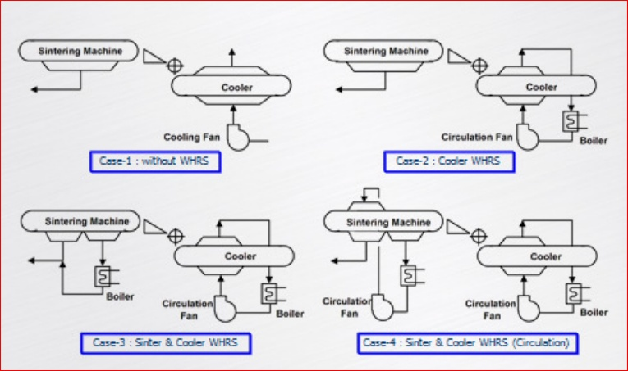
44.8.25: c-v) WHR from Sinter Cooler for preheating of combustion air in ignition furnace has been proposed. No Power recovery as part of energy efficiency has been considered. The benefits of the proposal over the provision of power generation from Sinter Cooler Waste Heat have not been given. PP has ignored the suggestions of EAC w/o giving any reason No Power recovery from Sinter Cooler as part of energy efficiency has been considered
WHRS in Sinter Plant- Options
RINL
WH Boiler for Heat recovery has been
considered in Sinter Cooler for process
steam generation
Steam is used in BF for humidification of
Cold Blast & not for Power Generation
In ISP, Low Pressure Process steam is
generated primarily from WHR systems
(Low quality waste heat)
Comparison :
RINL: 37 kg steam/ts ( 20 bar)
JSW: 40 Kg steam/ts (15 bar)
JSW
Ref: JP STEEL PLANTECH CO. YOKOHAMA, JAPAN

Slide 39
44.8.25 c-vi) MEROS like technology has been proposed for control of dioxins and furan in Sinter plant. Guaranteed emissions per Nm3 of flue gas based on this technology have not been furnished
- Dioxins & Furans are formed mainly due to presence of Oil & Cl in raw mix.
Volatile & Condenses at lower temperatures, mostly on dust particles
EU-BAT Recommendations
Primary Controls
Stable & Consistent operation of SP
Raw material quality control (oil content < 0.2%)
  Secondary Controls:
  Adsorption (Anthracite; Activated carbon; Sodium bi carbonate)
  Waste gas recirculation (~ 50%)
  Control of dust emission (Advanced ESP/MEROS type Bag filter. No guarantee)
EU-BAT: Limits for PCDD/F
< 0,05 – 0,2 ng I-TEQ/Nm3 for the bag filter &
< 0,20 – 0,4 ng-I-TEQ/Nm3 for ESP,
Emissions of PCDD/F is controlled by a combination of controls
Proposed System is designed to comply < 0.2 ng I-TEQ/Nm3.
Suppliers of Bag filters do not Guarantee emissions of PCDD/F

Slide 40
44.8.25 c-vii) Details of the effluent to be generated from Cold Rolling Mill and mechanism to be adopted for the disposal of hazardous waste from CRM has not been submitted
 | Hazardous Waste from Cold Rolling Mills | Annual Generation | Disposal Method
1 | Waste Oil | 40 KL | Sale to authorized re-processor
2 | Used Oil | 20 KL | Sale to authorized re-processor
3 | Waste Pickled Liquor | 18000 KL | Treatment in ARP for recycle
4 | Acid Residue | 300 t | Treatment in ETP. Salt from ZLD to authorised TSDF
5 | Alkaline Residue | 200 t | Treatment in ETP. . Salt from ZLD to authorised TSDF
6 | Oil-soaked cotton wastes | 160 | Incinerate
7 | ETP Sludge | 1500 | Recycle through Sinter Plant
8 | Oil Skimming Residue | 800 t | Incinerate
9 | Spent Ion Exchange resin | 20 t | Recycle through coke oven.
10 | Spent activated Carbon | 100 t | Recycle through coke oven.
11 | Zinc Dross | 14000 t | Sale to authorized re-processor
12 | Filters and filter materials | 100 t | Incinerate
13 | Discarded MS container | 3000 nos | Sale to authorized re-processor
14 | Discarded Plastic Container | 5000 nos | Sale to authorized re-processor
15 | Magnetic separator oil slurry | 1400 t | Incinerate

Slide 41
44.8.25 c-viii) Physical targets of EMPs for socio economic development as per OM of 30th Sept 2020 to be completed @ 196.05 Cr in 4 years have been given. However, EAC recommended to complete in three years. Accordingly, revised action needs to be submitted.
Proposed Action Plan (Details in 8 Slides)
1. Area Development in villages : Rs 47.80 Cr
2. Medical facilities : Rs 24.38 Cr
3. Education : Rs 7.20 Cr
4. Drinking Water facilities : Rs 21.15 Cr
5. Livelihood improvement of fishermen : Rs 11.62 Cr
6. Solar lamps/electricity : Rs 2.11 Cr
7. Infrastructure Development : Rs 16.92 Cr
8. Eco restoration : Rs 15.86 Cr
9. Vocational Training : Rs 60.27 Cr
Total : Rs 207.31 Cr
ISP and Captive Jetty

Slide 42
Socio Economic Development EMP – Physical Activities
Description | Year -1 | Year -2 | Year- 3
Area Development
Development of village roads | Dhinkia & Nuagoan 2km in each village | Gobindpur & Raghunathpur 2km in each village; | Garhkujang 3 km Noliasahi 2km & Abhay-chandapur 3 km
Development of market infrastructure with water & electricity | Garhkujang | Dhinkia | Bayanalkanda & Raghunathpur

Slide 43
Description | Year 1 | Year 2 | Year-3
Area Development (Contd)
Development of public community center and recreation center | Construction of community hall & procurement of TT board& carrom board in Nuagoan | -Construction of community hall & procurement of TT board& carrom board in Dhinkia village | Construction of community hall & procurement of TT board& carrom board in Gadkujang
Development of playground and club house with TT, Carrom board, foot ball & cricket accessories in Garhkujang, Gobindpur & Nuagoan | Development of land and fencing at all 2 villages Commencement of club house construction at 2 villages; | Development of land and fencing at all 1 villages Commencement of club house construction at 1 villages | Completion of club house construction & procurement of all accessories
Establishment of library infrastructure facilities with 500 books, 10 bookshelves and 4 numbers of computers with internet facilities | Dhinkia & Pankapal | Balitutha & Unchanuagan | Taladanda & Bhitarandhari

Slide 44
Description | Year 1 | Year 2 | Year 3
Medical
Infrastructure strengthening of govt. hospital in 4 gram panchayats as per requirement (The upgradation scheme will be finalized with district administration and the approved scheme will be communicated to MoEFCC during 6 monthly compliance) | Balitutha | Dhinkia | Jhimani; Kujang
Establishment of 200 bed hospital in consultation with local authorities | Identification of site and tendering & placement of order for construction | Construction of Hospital building | Development of pathological lab; Procurement of instrument, beds etc
Upgradation of health care facilities in peripheral villages | Portable X-ray in Balitutha and Dhinkia | Portable ECG and USG in Balitutha and Dhinkia | Dental chairs in Balitutha and Dhinkia

Slide 45
Description | Year 1 | Year 2 | Year 3
Education
Establishment of public school at Garhkujang | Identification of site and tendering & placement of order for construction | Construction of school building | Procurement of Chair, Table, computers(20 No.s), books etc
Strengthening of library & up gradation of existing village schools by providing Chair, table & books & 4 Nos of computers with internet to each library | Gobinda Chandra High School Noliashahi UP School, Noliashahi Goura Chandi Bidyapitha Government High School & Sri Aurobindo Shiksya Sadana, Taladanda | Kapteswar Bidyapitha & Sri Aurobindo Shiksya Sadana Janata High School, Kothi AK Bidyapitha UP School, Khuranta | Pankapal High School, Balitutha Panchayat High School & Janata High School; Baladevjiew UP School, Sahada

Slide 46
Description | Year 1 | Year 2 | Year 3
Drinking water
Provision of drinking water through pipelines & installation of portable RO in peripheral villages or contribution to government fund for the same | Naliasahi & Garhkujang | Dhinkia & Raghunath-pur & Nuagoan | Abhaychandra-pur, Bayanalkanda & Gobindpur; Balitutha, Unchanua-gan, Chatua & Raghunathpur
Livelihood
Provision of mechanized boat to fishermen community of Noliasahi village for fishing in the near shore area | 5 Nos | 3 Nos | 2 Nos
Construction of fishing jetty - Fishing boat, engines, navigation equipment and nets would be provided to the fishermen for their livelihood development. | Identification of site & statutory clearance | Start of construction | Continuation of construction; Commissioning of jetty

Slide 47
Description | Year 1 | Year 2 | Year 3
Infrastructure
Construction/development of road in peripheral villages | 2 km in Dhinkia | 4 km in Dhinkia | 4 km in Nuagaon; 2 km in Noliasahi and 2 km in Bayanala Kandha
Solar Lighting
Solar LED street lighting in villages (Dhinkia, Nuagoan, Gobindpur, Raghunathpur Garhkujang, Noliasahi, Pankapal, Bayanalkanda, Raghunathpur, Abhaychandapur & Kujang | 200 Nos. covering Dhinkia, Nuagoan, Gobindpur, Raghunath-pur | 200 Nos covering Garhkujang, Noliasahi, Pankapal, Bayanal-kanda | 200 covering Raghunathpur, Abhaychandapur & Kujang
Swachh Bharat
Distribution of dust bin in the surrounding villages & Mechanised vehicle for garbage lifting and transportation | 1000 coloured bins in Dhinkia, Nuagaon and Gobindpur | 4 Nos of mechanized vehicle | 500 Colored bins in Bayanala Kandha, Gadkujang, Abhaychandpur

Slide 48
Description | Year 1 | Year 2 | Year 3
Environment
Construction of stone pitching in sea beach | Investigation & ordering | 1.0km | 1 km
Carry out urban plantation and afforestation programs in villages including Dhinkia, Govindpur, Kulanga, Noliasahi, Bhunyanpal | 20000 trees | 20000 trees | 60000 trees;
Culture
Lord Jagannath Temple at Gadakujanga shall be provided with electrification and maintenance. | Construction & Handing over |  | -
Sports
Develop sports infrastructure in the area and arrange special training for the talented youths. | 3 villages | 3 villages | 3 villages

Slide 49
Description | Year 1 | Year 2 | Year 3
Vocational training
Skill development training on welding, electrician course, machinery, carpentry etc. and livelihood program | 500 persons | 500 persons | 1000 persons
Skill development for women empowerment on nursing, tailoring, beautician course, animal husbandry at village | Establishment of Skill development center at Kujang | 1000 women | 2000 women;
Providing training to SHG members | 200 Persons | 200 persons | 400 persons;
Establishment of technical training institute for skill development . Location will be decided in discussion with Local administration | Identification of land & tendering | Construction of building; | Construction (contd..); Completion of construction & procurement of tools & tackles
Establishment of BPOs in and provision of employment aid in textile units & machinery | BPO-100 | Tailoring-100 | 100

Slide 50
44.8.25 c-ix) Nearly 1.3 lakh trees likely to be removed to set up the facility. Scheme to ensure felling of trees to bare minimum and the compensatory afforestation against the felling of trees needs to be submitted. Scheme to ensure felling of trees to bare minimum and the compensatory afforestation against the felling of trees needs to be submitted.
A comprehensive plantation is planned under this project of ISP. Details are given below:
Compensatory afforestation(CA) plan has been approved and plantation
has already been done over 745 ha as reported by DFO Cuttack.
CA in mangrove area has been done in an area of 81.94 ha by DFO Rajnagar
Balance CA over an area of 256.751 ha is under implementation by both the DFOs
In addition JSWUSL will bear the cost of regeneration of degraded forest
of area 1254 ha as per the scheme prepared by DFO Rajnagar
Additional 169 ha of forest land adjoining to the project area to be regenerated
nearly 33% of project area will be developed under green belt and greenery enhancement with 2500 trees per Ha.
B. Felling of trees to be bare minimum: During the detailed engineering, care will be taken to preserve non-casuarina trees within the project area.

Slide 51
44.8.25 c-x Justification to select 8 Numbers of AAQ monitoring stations on land has been given. Desulfurization of COG and Power Plant flue gases has been proposed and Low NOx burners and DENOX facility using Ammonia has been proposed. On review of DMP in Chapter seven of EIA report, HIRA for NH3 has not been done
Ammonia storage tanks – 2 nos Horizontal storage tanks
Capacity of each tank – 50 ton – Liquid storage
Location – Near stack of CPP for DeNOx
Event | Nature of hazard | Risk Ranking |  |  | Mitigation Measures
 |  | L | S | RP
Leakage from Ammonia storage | Toxic (Health hazards) | 3 | 4 | 12 | Arrangement for water spray around the ammonia storage tank

Slide 52
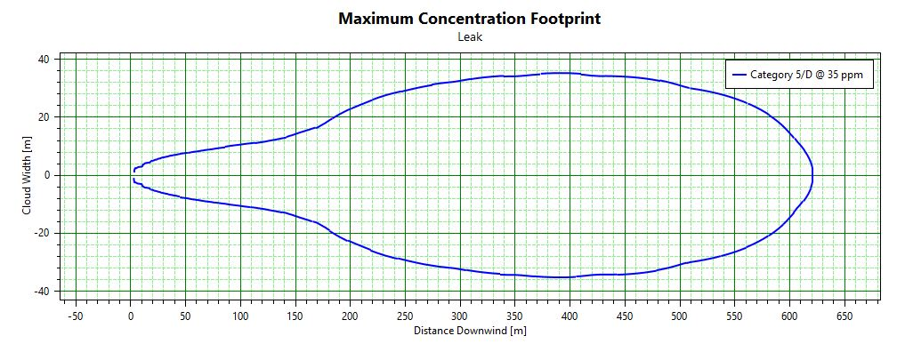
44.8.25 c-x Justification to select 8 Numbers of AAQ monitoring stations on land has been given. Desulfurization of COG and Power Plant flue gases has been proposed and Low NOx burners and DENOX facility using Ammonia has been proposed. On review of DMP in Chapter seven of EIA report, HIRA for NH3 has not been done
The concentration of interest (35 ppm) corresponding to the STEL value of Ammonia extends up to a maximum distance of around 620 m downwind
Given the proposed location of the ammonia storage tank, it may be concluded that the impact due to accidental leakage of ammonia would be contained within the plant boundary.

Slide 53
44.8.25 c-xi) The land use pattern for the diverted forest land as per FC of 10.10.2019 has been given. In this regard, updated status has not been furnished.
No change in status of forest land as per FC
No activity started till date
Boundary wall construction to start. Permission received from MoEFCC
Marginal changes may be required after detailed engineering

Slide 54
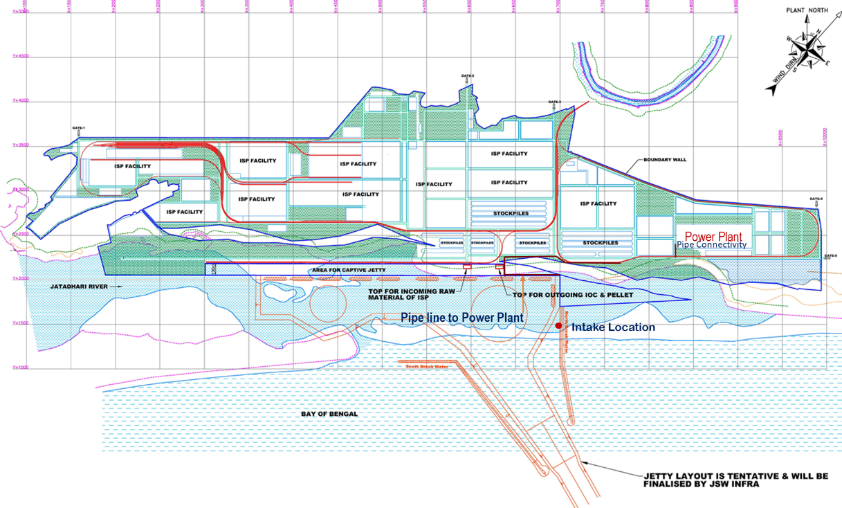
44.8.25 c-xii) Details of sea water requirement for once through cooling for a max temperature increase of 5 degree C has been given. Maximum 130000 cum/Hr. water shall be required. Water shall be discharged in the sea 2.25 km away from the shore. Details of the scientific assessment carried out for selecting the location of the sea water discharge has not been made available.
Alternative locations of Intake well for Seawater

Slide 55
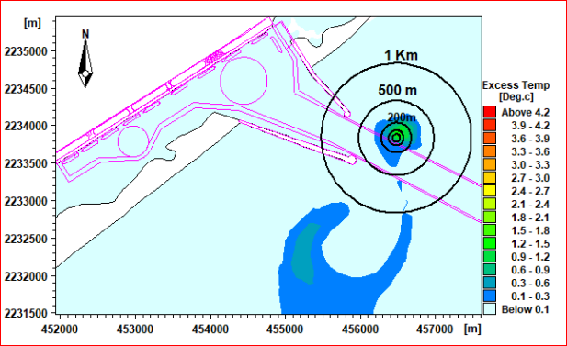
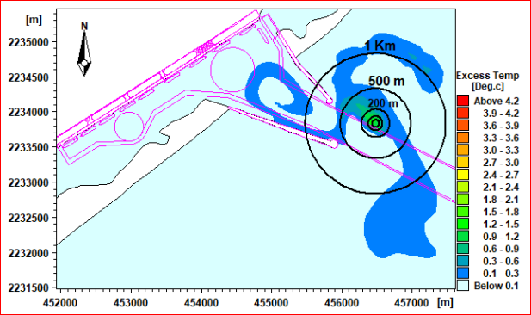
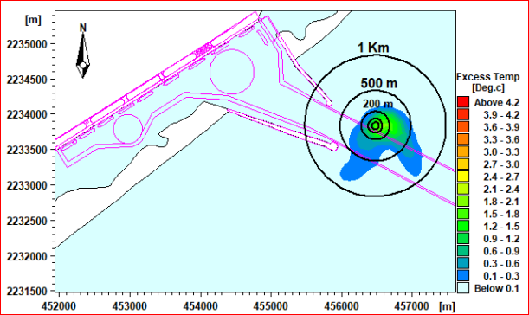
Location of Seawater discharge : North of the proposed breakwater Coordinates : 456480m E and 2233832m N
Excess temperature : Spring Flood Tide
Spring Ebb Tide
Neap Flood Tide
Neap Ebb Tide

Slide 56
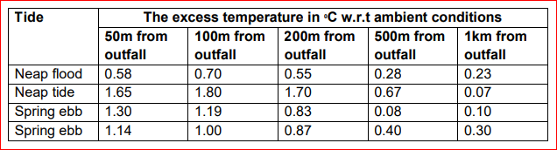
Impact of temperature of ambient sea near the discharge point

Slide 57
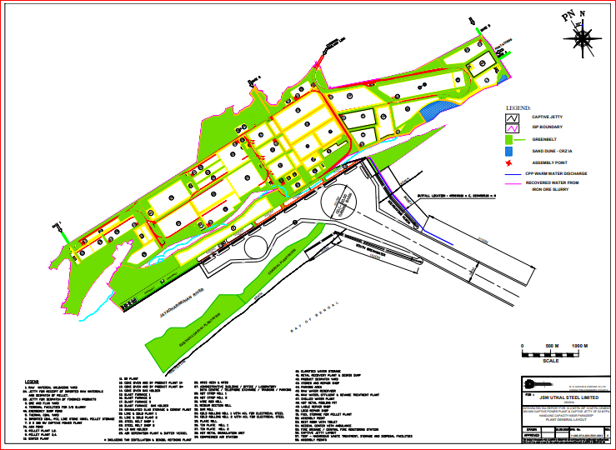
44.8.25 c-xiii) Green belt shall be proposed with a tree density of 2500 trees per ha. Plantation shall be completed in 5 years. During discussions it emerged that only 25 % green belt has been proposed inside the plant and balance 8 % plantation shall be done outside the plant boundary. The land outside does not belong to PP. EAC does not accept this proposal. PP needs to submit revised action plan for green belt development covering 33% of the project area under green belt development with a tree density of 2500 trees per hectare.
Greenbelt to the extent of 33% of total project area would be maintained
Greenbelt: 394.2 ha (Including Jetty) area with a density of 2500 trees per ha
A three-tier plantation scheme would be adopted in the periphery of the plant

Slide 58
Sl. No. | Facilities | Forest | Non- Forest | Greenbelt
1 | Raw material storage & landing yard for Ore & Flux, Iron ore slurry, coal yard | 52.630 | - | 9.086
2 | Raw material storage & landing yard for Imported coal, PCI, Limestone and Pellet | 22.790 | 20.073 | 7.826
3 | Iron making plant | 178.310 | 2.780 | 26.466
4 | Steel making Plant | 73.305 | - | 9.379
5 | Rolling Mill | 183.447 | - | 22.349
6 | Captive Power Plant | 51.330 | - | 8.510
7 | Disposal Area | 20.740 | - | 3.334
8 | Water/ wastewater treatment plants, Treated Wastewater holding pond | 60.240 | - | 4.501
9 | Cement plant | 33.500 | - | 5.024
10 | Main Admin office and common facilities | 7.680 | - | 1.191
11 | Railway siding/ Truck Handling & unload | 30.820 | - | 4.540
12 | Captive Jetty | 14.400 | 54.177 | 22.700
13 | Supporting Auxiliaries comprising of MRSS, | 40.630 | 0.493 | 6.376
14 | Roads, Parking & drains | 43.894 | 3.970 | 5.801
15 | Peripheral Green Belt | 239.720 | 13.030 | 252.750
16 | Water Reservoir | 30.255 | 15.760 | 4.367
 | Total Land | 1083.691 | 110.283 | 394.200

Slide 59
Greenery Development: Implementation Schedule
Plan period | Area, Ha | No. of Trees | Plantation Area | Tree Species
1st year | 100 | 250000 | Along the periphery | Amaltas, Copperpod, Gamga imli, Indian tulip,Jau, Jarul, Jamun, Kadamba, Kachnar, Khajur, Neem, Peepal, Sisua.
2nd year | 72 | 180000 | Along the periphery | Amaltas, Copperpod, Gamga imli, Indian tulip,Jau, Jarul, Jamun, Kadamba, Kachnar, Khajur, Neem, Peepal, Sisua.
3rd year | 100 | 250000 | Avenue plantation and between the shop area | Bakul, Bougainvillea, Jarul, Joba, Kachnar, Karabi Kadamba, Neem, Yellow oleander.
4th year | 50 | 125000 | Avenue plantation and around the slag storage area | Amaltas, Bakul, Devdaru, Jarul,Joba, Kadamba, Khajur, Kachnar, Karabi, Neem, Tagar, Rangan, Yellow oleander.
5th year | 50 | 125000 | In between the shop area | Amaltas, Bakul, Devdaru, Joba, Kadamba, Khajur, Kachnar, Karabi, Tagar, Rangan, Yellow oleander.

Slide 60
44.8.25 c-xiv) Plant runoff water shall be treated for TSS and Oil and Grease. The capacity of the treatment plant based on worst case cyclonic scenario has not been furnished.
The plant layout has been firmed up considering drains all along the plant roads
Plant drains would lead to 5 Nos. of concrete open channels - 2.3 m wide and 1.6 m depth for discharge into Jatadhar Mohan river/Sea.
15 Nos. catchpits of size 10 m (length) x 2.5 m (width) x 4 m (depth) to settle the suspended solids with oil skimmers
The water impounded in the catchpit would be pumped to the raw water treatment plant for utilization to the extent possible
Balance storm water would be drained to the Jatadhar Mohan river/Sea.

Slide 61
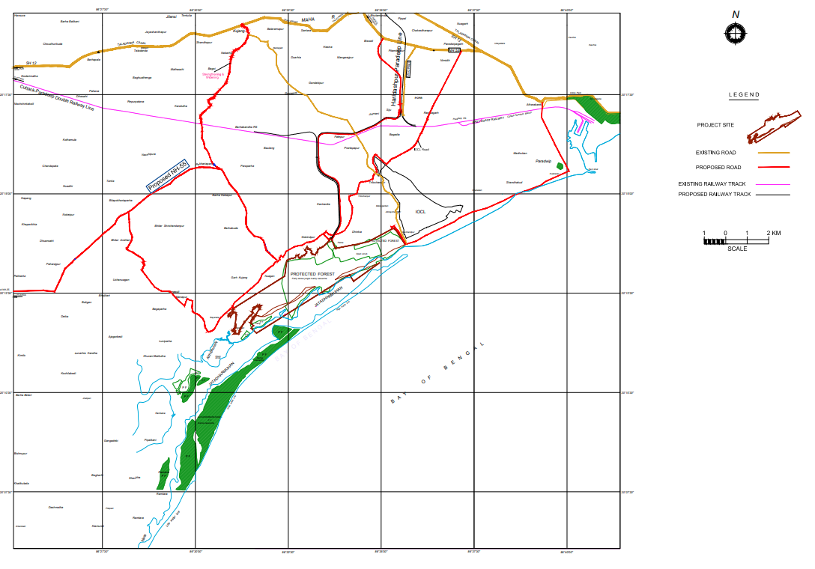
44.8.25 C- xvii Details of access road to NH5 and NH 12 have not been described along with impact of project on the roads.
Details of Connecting Roads

Slide 62
44.8.25 C- xvii Details of access road to NH5 and NH 12 have not been described along with impact of project on the roads.
Impact assessment of vehicular movement for raw materials and finished products has been addressed in Section 4.5.4
Projected Average daily traffic (ADT) in study area
Vehicle type | NH 55 connector | SH 12 connector | NH 53 connector | Surge Road
HMV | 3352 | 1064 | 865 | 747
LMV | 838 | 266 | 465 | 611
Total | 4190 | 1358 | 1330 | 1330
MSA | 91.4 | 29.6 | 29 | 29
* Considering two lane double carriageway
** MSA based on 10 years life
All internal roads shall be of Concrete roads designed for 25 year life and to carry heavy loads
All connecting roads shall be of bituminous type designed as per IRC guidelines

Slide 63
    C -Xviii) Impact of thermal discharge into sea and mechanism to control the Delta T within 5 Degree C has been furnished. Details of scientific study carried out in this regard to be submitted.
Detailed in Sl. No. 44.8.C- vii

Slide 64
    44.8.26 Committee recommended to seek the views of Odisha Pollution Control Board and the project proponent
Comments from Orissa Pollution Control Board has been furnished, vide letter no. 15836/IND-II-PH-810 dated 11.10.2021
Comments of JSWUL has been communicated vide letter no. JSW/U/O/2021/172 dated 23.09.2021

Slide 65
Thank You

