Slide 1
Presentation for Obtaining “Terms of Reference – “A“ Category, under Violation case” MINING PROJECT – “Magnesite and Dunite Mines”
WELCOME
The Honourable Chairman & Members Of EAC, New Delhi
1.Online EAC Proposal No: IA/TN/MIN/70945/2017 dt, 14.11.2017
2. Online EAC Proposal No: IA/TN/MIN/73566/2018 dt, 19.03.2018
Chettichavadi Jaghir Magnesite and Dunite Mines,
S.F No: 6, Govt. Poramboke land, 449.364 Ha,
Chettichavadi Village, Salem Taluk and District, Tamil Nadu
Magnesite Production : 60,000 MT/yr
Dunite Production : 1,20,000 MT/yr
Project Proponent
Dalmia Bharat Sugar and Industries Ltd.,
Salem – 636012, Tamil Nadu.
Phone No: 0427-2345600/2346762,
Fax: 0427 - 2345616
MOB: 09486482746
Email: dalmiamagnesitemines@gmail.com
Environment Consultant
Mr.S.SURIYAKUMAR RQP & EIA Coordinator– “A” Cat. Aadhi Boomi Mining & Enviro Tech (P) Ltd, Salem NABET Accredited EIA Consultant – “A” Cat.

Slide 2
MINING LEASE PARTICULARS
Description | Lease particulars
Initial Grant of Lease | G.O Ms. No: 903 dt 25.02.1966 (20.08.1966 -19.08.1986) 20 Years, Extent -574.46 Ha
1st Renewal | G.O Ms.No: 74 dt 11.03.1997 (20.08.1986 to 19.08.2006)- 20 Years- Reduced Extent :531.98 Ha by State Govt. (To co-terminate for magnesite & Dunite leases)
2nd Renewal | Letter No: SL:G.O: 55200 (1) dated 11.07.2005 - 449.364 Ha (Part of Lease 82.616 Ha surrendered and Mine closure Plan approved by IBM)
The company operated the mine by virtue of order of interim injunction passed in MP No.1 of 2006 in W.P.Nos. 25518 and 25519 of 2006 in the Honourable High court of Madras, since no G.O was issued by Tamil Nadu Govt. within the stipulated time period of one year from the date of application for second renewal. Presently as per Sec 8(A)(5) of the Mines and Minerals (Development & regulation) Amendment MM(D&R) Act, 2015, the lease period has been extended under captive use valid up to 31st March, 2030.

Slide 3
PROJECT DETAILS
Particulars | Details
Proponent | Dalmia Bharat Sugar and Industries Ltd.,
Total Mine Lease Area | 449.364 Ha (Poramboke dry waste land )
Survey No. & Village | S.F. No. 6, Chettichavadi Village, Salem Taluk and District, Tamil Nadu
Name of mineral | Magnesite and Dunite
Geo coordinates of Mining Lease area | Northern Latitude : 11⁰43’09.8” N - 11⁰44’36.3” N Eastern Longitude : 78⁰07’23.2” E and 78⁰09’11.5” E Toposheet No : 58 I/2 Elevation : 300-400m above MSL
Project Cost | Rs 1964.81lakhs as on 31.03.2019.
EMP cost | Rs 20 Lakhs/annum
Mining Plan Approval Letter | Ltr. No. TN/SLM/MMP/MG&DU-2055.MDS dated 01.05.2019 ,For Magnesite & Dunite, Valid up to 31.3.2021.

Slide 4
IDENTIFICATION OF VIOLATION
FOR SEEKING TOR
Description | Details
Date of application for TOR | 17.08.2010 submitted to MoEF&CC under EIA Notification 1994 12.10.2011 & 10.01.2012 “ under EIA Notification, 2006 and presented in EAC Meeting on 17.04.2012 in Scope Complex, New Delhi ToR was granted on 24.08.2012 in MOEF & CC Website. Due to delay in EIA submission, the ToR validity period expired on 23.08.2015.
Subsequent to MoEF & CC Notification S.O 804 (E) dated 14.03.2017 under Violation
Date of application for TOR under violation | IA/TN/MIN/70945/2017 dated 14.11.2017.
Date of application for TOR for the second time due to delay beyond Window Period. | IA/TN/MIN/73566/2018 dated 19.03.2018 based on Office memorandum vide F. No. Z-11013/ 22/2017-IA.II (M) dated 16.03.2018 for extension of window period due to delayed submission.
Date of Scoping in EAC meeting for ToR | EAC scoping (ToR) on 25.11.2019 in Brahmaputra Hall, New Delhi and deferred seeking ADS. EAC Scoping (ToR) meeting called on 21.09.2020 but Proponent unable to attend due to COVID 19 issues.

Slide 5
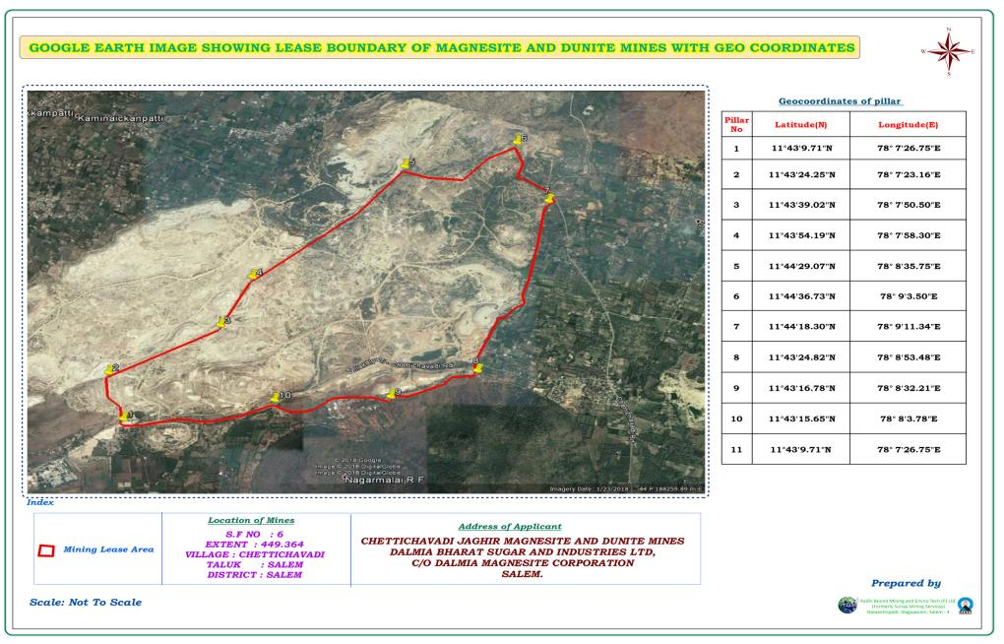
TANMAG Magnesite Mines
SRCL Magnesite Mines
DALMIA Magnesite Mines

Slide 6
ADS SOUGHT BY EAC:
(i) Revised affidavit to comply with all the statutory requirements and judgment of
Hon’ble Supreme Court dated the 2ndAugust 2017 in Writ Petition (Civil) No.
114 of 2014 in the matter of Common Cause versus Union of India and Ors.
before grant of ToR/ EC. The undertaking interalia include commitment of the
PP not to repeat any such violation in 72 future. In case of violation of above
undertaking, the ToR/Environmental Clearance shall be liable to be terminated
forthwith.
(ii) Details of mine closure notice submitted to the DGMS.
(iii)Total excavation details to be submitted in the revised Form1.
(iv) Detail of court case to be submitted in the revised form1 and to be presented
before the committee.
(v) Second renewal is not deemed therefore letter of intent for the second
renewal of mining lease is to be submitted.
(vi) Justification for continuing mining.
Notes:
ADS SOUGHT

Slide 7
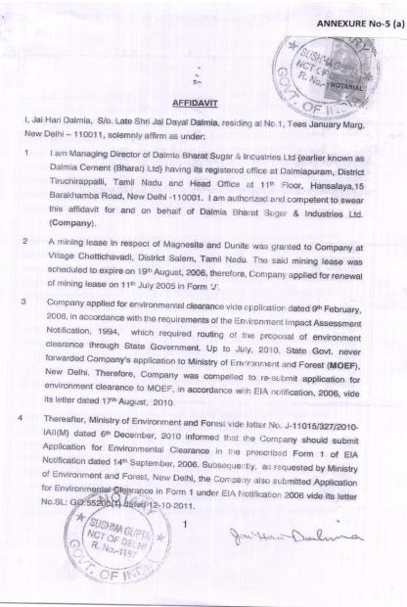
ADS NO-1
Revised affidavit to comply with all the statutory requirements and judgment of Hon’ble Supreme Court dated the 2ndAugust 2017 in Writ Petition (Civil) No. 114 of 2014
The issue is Sub Judice under W.A.No-834 & 835 of 2020. However in order to comply with the spirit of the directions given we had already filed affidavits dated 21st Oct 2019 and 20th Nov 2019 as under:
We request TOR may be issued without insisting for revised Affidavit and without waiting for disposal of legal proceedings intiated against the Project Proponent on the Ground of Mining without EC during deemed extension period.

Slide 8
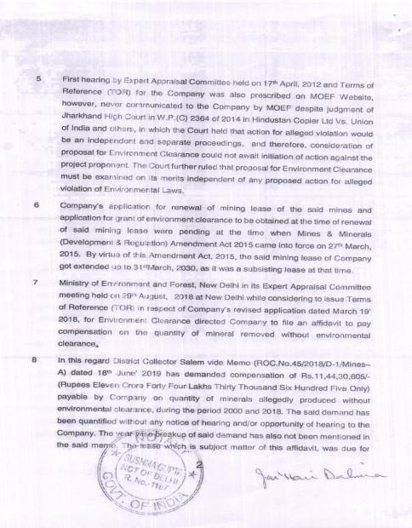
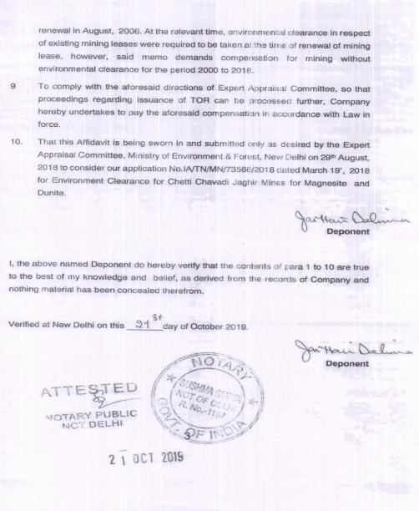

Slide 9
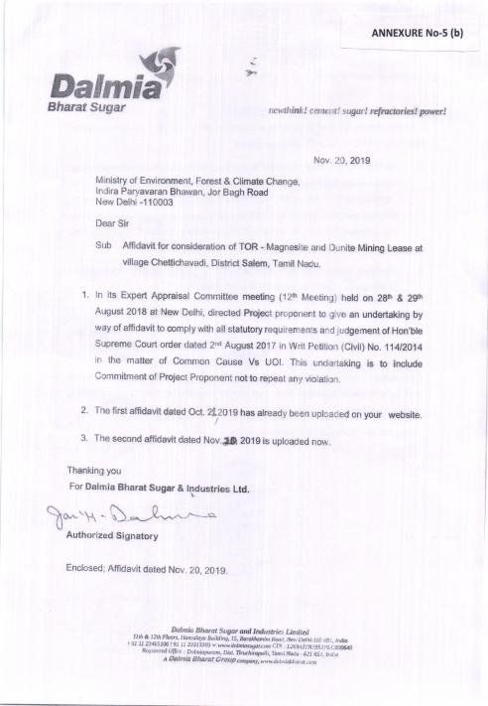
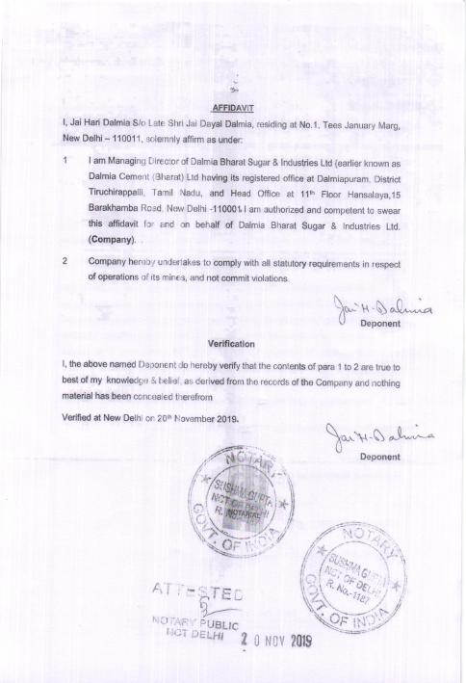

Slide 10
ADS NO-2 NOTICE OF TEMPORARY DISCONTINUANCE SUBMITTED TO DGMS:
We, submitted notice for temporary closures of mines vide our letter no. SL: MM: 26102 dated 14.01.2020.
Later on, vide our letter no. SL: MM: 26102 dated 08.08.2020, we have given notice for the re-opening of mines.
The reopening of mines has been sought by us for deepening and desilting of water pits in MT and C Blocks for augmenting drinking water supply in the surrounding villages as per the letter vide ROC No.711/2019/ Mineral A dated 01.08.2019 issued by the District Collector Salem under Jal Shakti Abhiyan Scheme of the Prime Minister.

Slide 11
ADS NO-3
Excavation Details Year wise since 1975:
Chettichavadi Jaghir Magnesite and Dunite Mine is in operation since 1958. The total excavation details are listed from 1975 till date as under:
Year | Excavated Quantity in ts
1975-76 | 1669522
1976-77 | 1941029
1977-78 | 2100532
1978-79 | 2072483
1979-80 | 1609826
1980-81 | 1453791
1981-82 | 1335338
1982-83 | 1385402
1983-84 | 1381703
1984-85 | 2125523
1985-86 | 1360989
1986-87 | 1449782
1987-88 | 1628432
1988-89 | 2450684
1989-90 | 2847687
1990-91 | 3379287
1991-92 | 3082412
1992-93 | 2858352
1993-94 | 1069236
1994-95 | 2263000
1995-96 | 2387964
1996-97 | 2467666
1997-98 | 2361094
1998-99 | 1794096
1999-2000 | 1730764
Year | Excavated Quantity in ts
2000-01 | 1741896
2001-02 | 962352
2002-03 | 260244
2003-04 | 267733
2004-05 | 440532
2005-06 | 267912
2006-07 | 228168
2007-08 | 331416
2008-09 | 935188
2009-10 | 1207464
2010-11 | 881832
2011-12 | 353088
2012-13 | 144500
2013-14 | 76623
2014-15 | 65376
2015-16 | 179064
2016-17 | 116372
2017-18 | 27761
2018-19 | 11848
2019-20 | Nil

Slide 12
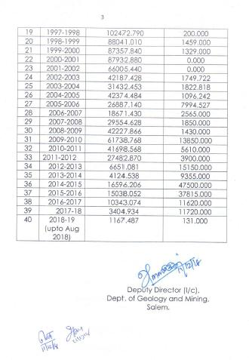
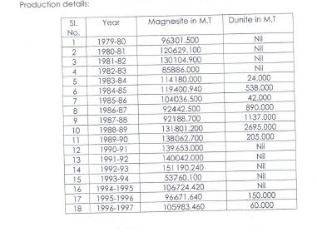
DETAILS OF PAST PRODUCTION SINCE 1979 AUTHENTICATED BY DMG:

Slide 13
ADS No-4
DETAILS OF COURT CASES:
S.NO | Case Reference | Facts | Current Status
MMRD
1 | W.P.25518/2006 Madras HC | Since Mines and Geology Dept. was not disposing of the application for renewal of mining lease, Writ Petition No. 25518 of 2006, filed by Project Proponent Hon’ble Court granted an interim injunction vide orders dated 17th August 2006 infavour of the Project Proponent to operate the said mining lease under deemed extension in terms of Rule 24 A (6) of Mineral Concession Rules (MCR) 1960. Accordingly, in light of the interim relief granted by this Hon’ble Court, the Appellant continued its mining operations without any expansion and or modification. Copy of order dated 17th August 2006 is marked as Annexure No-9. | The said order dated 17th August, 2006 still continues to be in force and the said W.P. No. 25518 of 2006 is also pending as on date.
2 | Writ Petition No.29275 of 2016 Madras HC | Writ for issuance of transport permit for Dunite. As an interim measure High Court directed for the issuance of transport permit. Copy marked as Annexure No-10. | Pending
Notes:
DETAILS OF COURT CASES:

Slide 14
3 | In terms of the Supreme Court Order dated 2nd August 2017 in Writ Petition (Civil) No. 114 of 2014, Dist. Collector Salem raised a demand vide order 18th June 2019 directing Dalmia Bharat Sugar & Industries Ltd. (DBSIL), project proponent here to pay sum of INR 11.44 crore (approx.) on the quantity of Dunite mined without EC for the period 1st April 2000 to 31st August 2018. Writ for declaration to the effect that its mining lease has got extended till 31st March 2030, | The said demand was challenged by the DBSIL before Hon’ble Madras High Court by WP No.894 and 889 of 2020 wherein DBSIL also sought a declaration to the effect that its mining lease has got extended till 31st March, 2030, in which MoEF is also one of parties. The said writ petitions were dismissed by Hon’ble High Court videits orders dated 12th June, 2020. The orders dated 12th June, 2020 passed by Hon’ble High Court has been challenged by DBSIL vide Writ Appeal No 834 & 835 of 2020 which are yet to be taken up for hearing. In the meanwhile, Hon’ble Madurai Bench of Madras High Court in a different batch of writ petitions challenging demands by other District Collectors in terms of the said Supreme Court Order dissented with the orders dated 12th June, 2020 on the ground that raising of demand without opportunity of hearing may not be proper. The Madurai Bench of Madras High Court recorded its reasons for dissent in its order dated 19th August 2020 in W.P(MD)No.24463 of 2018 and etc. batch and requested Hon’ble Chief Justice of Madras High Court to place the matter before an appropriate bench. Please See Annexure No-4. District Collector has also issued notice date 8th July 2020 for recovery of the amount. We have requested to keep the recovery proceedings in abeyance in view of the matter being sub judice. | Pending

Slide 15
4 | District Collector, Salem has also raised another demand vide order dated 8th July, 2020 directing project proponent to pay sum of INR 7.24 Crore on the quantity of Magnesite mined without EC for the period 1st April, 2000 to 31st August, 2018 ( Annexure -2 above) | Project Proponent has sought basis of demand from District Collector. | Pending
5 | District Collector’s demand of surface compensation of Rs.79,88,39,062from20.08.1966 till 31.10.2017. Copy of Demand Letter is enclosed as Annexure 11-a) | Project Proponent has filed W.P.No.2517 of 2018 before Madras High Court. The said demand has been stayed by Madras HC vide orders dated 6thFebruary, 2018. Order copy marked as Annexure No-11(b). | The Stay has been continued by the order dated 07.03.2018. marked as Annexure No-11 (c).

Slide 16
ADS No-5
LETTER OF INTENT
The Supreme Court of India in W.P. (Civil).NO.114 of 2014 and W.P.(C).No.194 of 2014 pronounced judgement dated 04.04.2016.Inpara 25, Page24 of the Judgement, the court mentioned; quote:
“Under Sub Section (5) & (6) of Section 8 (A) in our view, such lease holders, who had moved application
for renewal of captive/non captive mines, would be entitled to continue up to 31.03.2030/31.03.2020.”
In view of the above it is clear that since DBSIL has already timely moved an application for renewal of its application of its Mining Lease, no specific order refusing renewal of Mining lease was passed till the promulgation of MMDR 2015 therefore the mining lease in question got automatically extended up to 31st March 2030, hence no letter of intent or NOC would be required by the Department of Geology and Mines to effectuate the said automatic extension of Mining lease till 31stMarch, 2030, in view of the Section 8(A) (5) and (6) of MMDR Amendment Act, 2015. It is pertinent to mention here that while drawing the above conclusions the Apex Court has not made any distinction between first renewal and second renewal of Mining leases.
Please see Paragraph 1 of MOEF Circular No: F.NO.J-11013/41/2006-IA-II (I) dated 21-11-2006. wherein it is stated that no NOC or Letter of Intent from State Government or SPCB to complete process of EC.
As per Director of Geology & Mining, Chennai letter no: 5405/PM4/2019 dated 13.03.2020 there is no provision for issuance of LOI in MMDR Act.

Slide 17
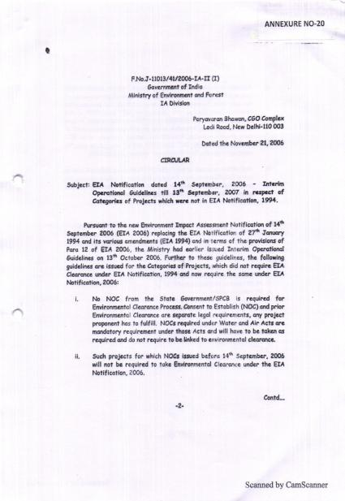
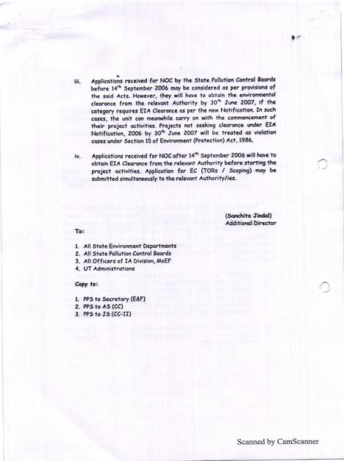
Notes:
ADS No-5
LETTER OF INTENT

Slide 18
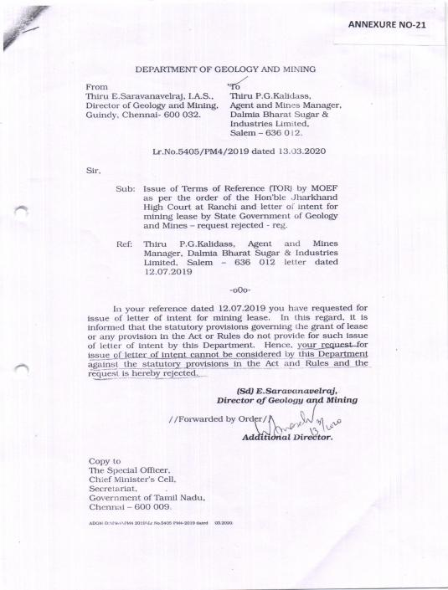

Slide 19
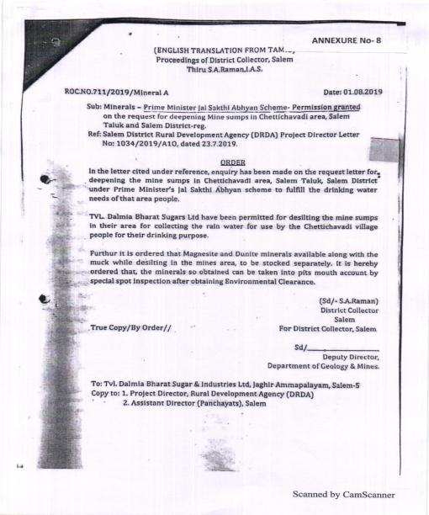
ADS No-6
JUSTIFICATION FOR MINING:
Deepening & Desilting of water pits only is carried out under District Collectors Order ROC N0.711/2019/Mineral A dated 01.08.2019 under PM Jal Sakthi Abhiyan Yojana for augmenting drinking water supply in the water scarce villages in Salem and Omalur Taluks.
Chettichavadi Village Panchayat President issued a thanks giving letter to the Prime Minister Office dated 29.10.2020 for the Jal Sakthi Abhiyan Yojana.

Slide 20
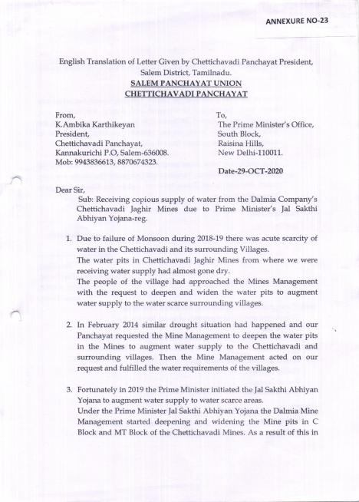
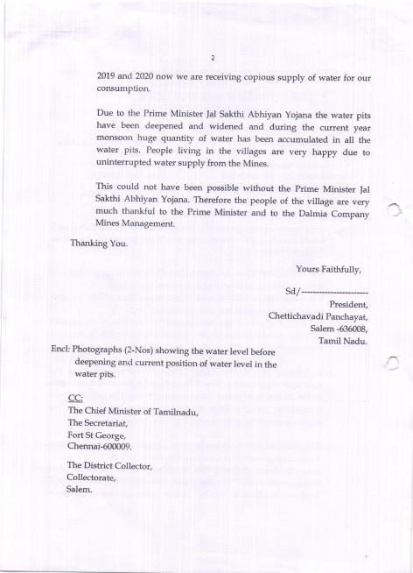

Slide 21
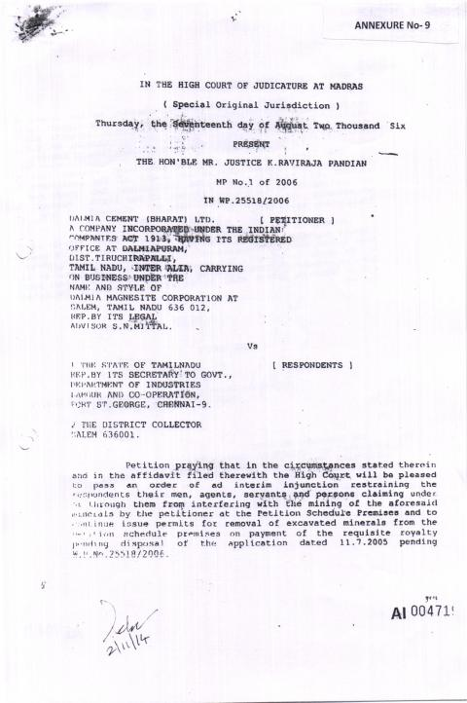
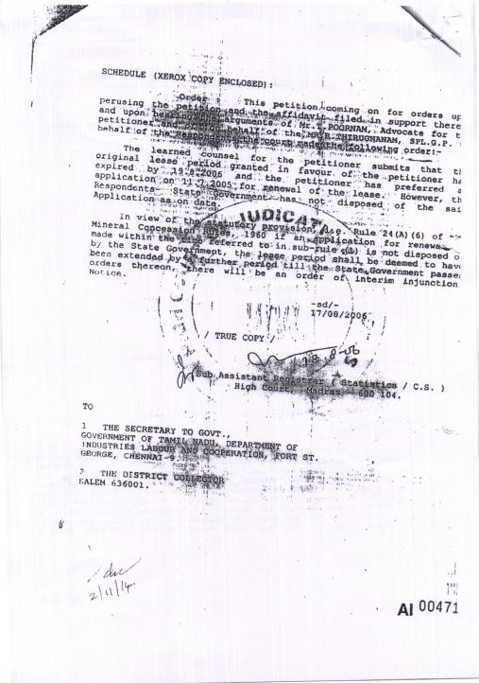

Slide 22
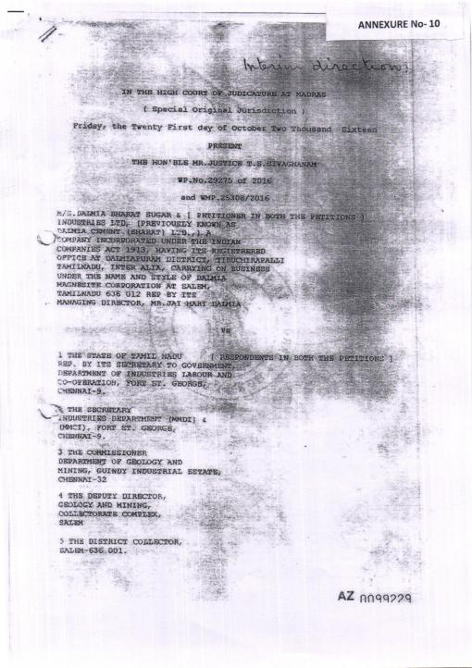
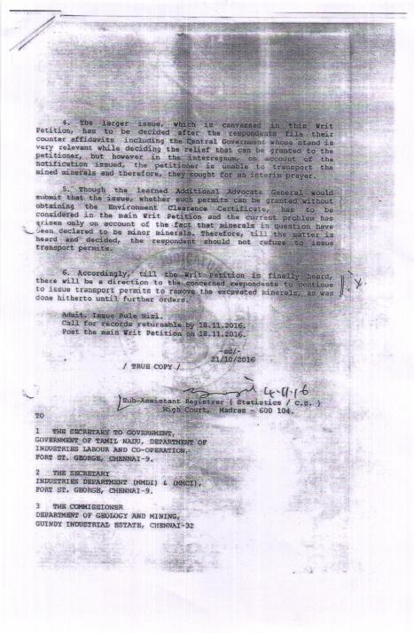

Slide 23
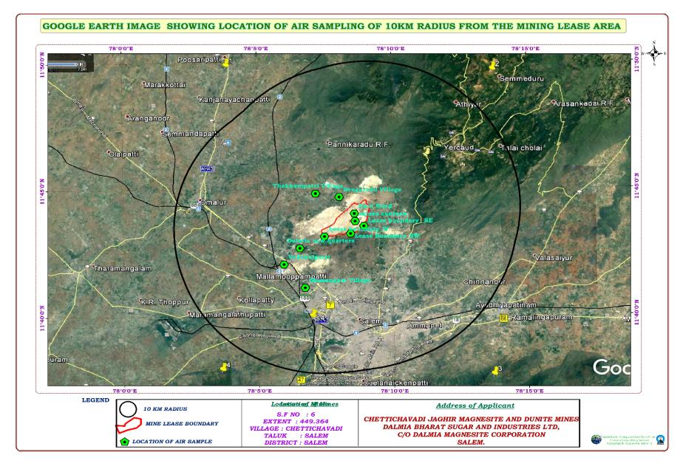
PROPOSED LOCATION OF AIR SAMPLING AROUND 10 KMS

Slide 24
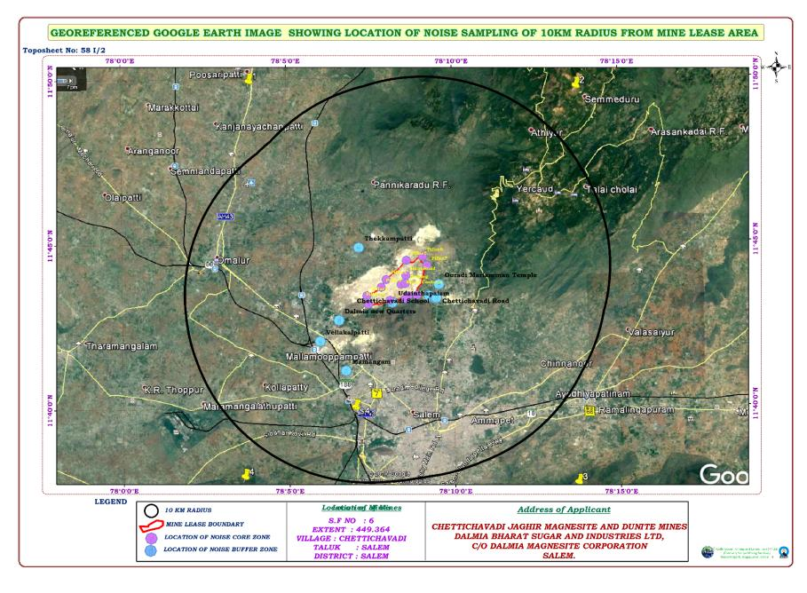
PROPOSED LOCATION OF NOISE SAMPLING AROUND 10 KMS

Slide 25
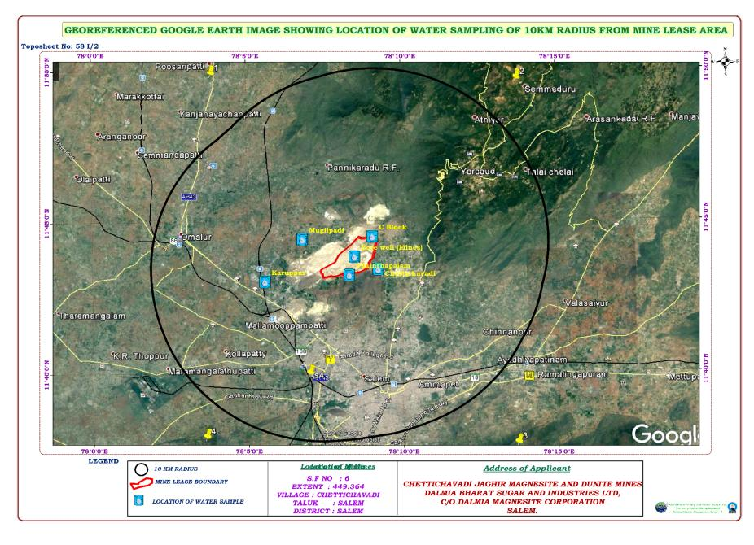
PROPOSED LOCATION OF WATER SAMPLING AROUND 10 KMS

Slide 26
Project Cost
Project Cost (31.03.2019)
S. No | Particulars | Rs in Lakhs
1 | Land Cost | Rs. 66.12
2 | Buildings | Rs. 430.44
3 | Machinery | Rs. 1444.82
4 | Others assets | 23.43
 | Total | Rs. 1964.81

Slide 27
Environmental Monitoring Program for EIA Study as per standard ToR
S. No | Attributes | Parameters | Source and Frequency
1 | Meteorology | Temperature, Wind Speed, Wind Direction, Rain fall, Relative Humidity, | Secondary sources of IMD station, Salem. Hourly recorded data for the period of 3months.
2 | Ambient Air Quality | PM₁₀, PM_{2.5}, SO₂, NO_{x} , | 8 hour samples twice a week for three months at 10 locations.
3 | Water Quality | Physical, Chemical and Biological parameters | Grab sampling at 6 locations once during study period.
4 | Noise levels | Noise levels in dB(A) | At 6 locations data monitored once in a Month for three months for 24 hours during EIA study.
5 | Soil Characteristics | Physical and Chemical parameters | Once at 6 locations during study period
6 | Hydrogeology | Drainage area and pattern, nature of streams, aquifer characteristics, recharge and discharge areas | Based on data collected through field investigation devices once in a study.
7 | Land use | Existing land use for different categories | Based on Survey of India Toposheet and Google Earth imagery
8 | Ecology and Biodiversity | Existing terrestrial flora and fauna within 10Km radius | Field observation and utilization of Secondary data.
9 | Socio–Economic aspects | Socio–economic and demographic characteristics, worker characteristics | Based on collection of primary data through questionnaire analyses and utilization of Secondary data from census records (2001 –2011), statistical hand books, topo sheets, health records and relevant official records.
10 | Risk assessment and Disaster Management Plan | Identify areas where disaster can occur by fires and explosions and release of toxic substances if any | Based on the findings of Risk associated with explosives, landslides, slips and fire etc..,

Slide 28
Proposal for Ecological Damage Assessment and Remediation Plan
1. | Change Detection Analysis using Remote sensing (GIS) and Satellite Data | Change Detection Analysis
 |  | Pre operational |  | Operational |  |  |  |  | Post operational |  |  | Deviation |  | Remediation Plan |  |  | Remediation Cost |  |  |  | Remarks
2. | LAND DEGRADATION | Working Pit
 |  | Planned |  | Actual |  |  | Deviation |  |  |  | Remediation Plan |  |  |  | Remediation Cost |  |  |  | Remarks
 |  | Pit Dimension
 |  | Planned |  | Actual |  |  |  | Deviation |  |  | Remediation Plan |  |  |  | Remediation Cost |  |  |  | Remarks
 |  | Bench Height
 |  | Planned |  |  | Actual |  |  | Deviation |  |  | Remediation Plan |  |  |  | Remediation Cost |  |  |  | Remarks
 |  | Pit Slope
 |  | Designed | Overall |  |  | Deviation/ Current |  |  |  | Remediation Plan |  |  | Remediation Cost |  |  | Remarks
 |  |  |  |  |  |  |  |  |  |  |  |  |  |  |  | High |  | Normal |  | Moderate

Slide 29
3. | GEO -HYDROLOGY | Water Table
 |  | Planned | Actual | Deviation | Remediation Plan |  |  | Remediation Cost |  | Remarks
 |  | Depth of Mining
 |  | Planned | Actual | Deviation |  |  | Remediation Plan |  | Remediation Cost |  | Remarks
4. | RAINWATER HARVESTING | Catchment area | Surface drainage | Location of bore well |  |  | Remediation Plan |  | Remediation Cost |  | Remarks
 |  |  |  | Area |  | No of bore well
 | Yes
 | Surface water
 | Subsurface water

Slide 30
5. | GEOLOGY | Geological map |  | Geological disturbance if any |  |  |  | Deviation | Remediation Plan | Remediation Cost | Remarks
 |  |  |  | Yes |  | No
6. | AIR QUALITY | Pre-operation stage | Operation stage |  |  | Current stage |  | Deviation | Remediation Plan | Remediation Cost | Remarks
7. | SOIL QUALITY | Amount of Top soil Excavation /Dumped |  |  |  |  |  |  | Remediation Plan | Remediation Cost | Remarks
 |  | Planned |  |  | Actual |  | Deviation
8. | NOISE & VIBRATION
Habitation around 300 m(yes/No)
Types of explosives
Quantity of explosives used
Blasting methods

Slide 31
9. | ECOLOGY & BIODIVERSITY | Afforestation |  |  |  | Remediation Plan |  |  | Remediation Cost | Remarks
 |  | Planned | Actual | Deviation
 |  | Issues | Related damage | Remediation Plan |  | Remediation Cost |  |  | Remarks
 | Flora
 | Fauna
 | Wetland (River, Pond, Lake) if any
 | Siltation | No.
10 | WASTE DUMP | Planned | Actual | Deviation |  | Remediation Plan |  | Remediation Cost |  | Remarks
11 | OCCUPATIONAL HEALTH
 |  | Issues | Related damage |  | Remediation Plan |  | Remediation Cost |  | Remarks

Slide 32
Thank You….

