Slide 1
Proposal No: IA/MP/THE/10749/2003
Presentation To
Expert Appraisal Committee (EAC)
Ministry of Environment, Forest and Climate Change, Govt. of India
Request for Environmental Clearance (EC)
For
1x660 MW Amarkantak Supercritical Thermal Power Project (Expansion) in place of existing Amarkantak Thermal Power Station (Phase – I & II: 290 MW), Chachai Village, Anuppur District, Madhya Pradesh
Proponent
Consultant
Ramky Enviro Services Private Ltd
Ramky Grandiose, Ramky Towers, Gachibowli,
Hyderabad, Telangana -500032
NABET Certificate No: NABET/ EIA/1922/ SA 0134
MP Power Generating Company Ltd
Govt. of M.P Undertaking
Shed No. 1& 2, Rampur, Jabalpur- 482008 (MP)

Slide 2
Categorization and project details
EIA Notification – 14.09.2006 No.S.O.1533 & Subsequent Amendments
Project Activity | Project/Activity 1 (d) – Thermal Power Plants
Project Category | Category A : >= 500 MW (coal /lignite / naphtha and gas based)
Project details
Proposal | Setup 1x660 MW supercritical coal based Thermal Power Station (TPS)
Location | In place of retired units of PH-I (1X20 MW+1X30MW) & PH-II (2X120 MW) in premises of existing ATPS site, Chachai (Village), Anuppur (District), MP
Geographical coordinates | Latitude 23°9'22.1"N to 23°10'08.5"N Longitude 81°37'53.7"E to 81°38'45.8"E
Project area | 223 Acres (90.25 Ha) within ATPS site boundary
Project cost | About Rs 4665.87 crores
EMP Budget | About 768.75 crores
TOR Issued | File No: . J-13012/07/2019-IA.I(T) dated: 10/10/2019.
Public Hearing | Conducted on 17/12/2020 at Govt. High School, Gram Panchayat Kelhauri, Tehsil and District Anuppur, MP (about 2 km from project site)

Slide 3
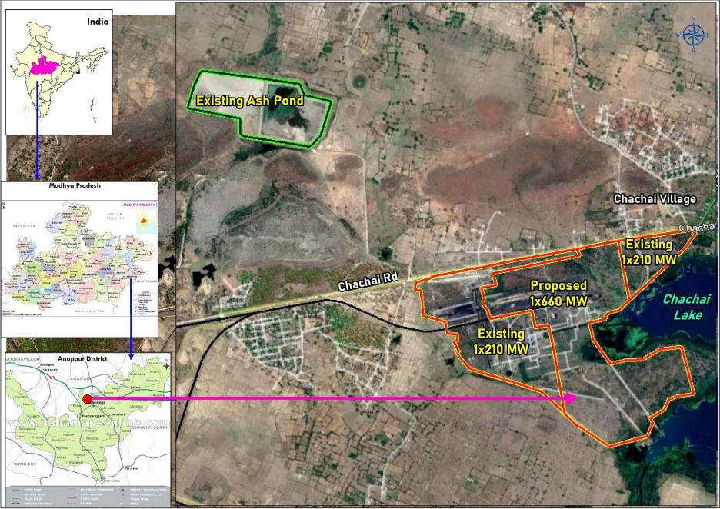
Project location map
KML file

Slide 4
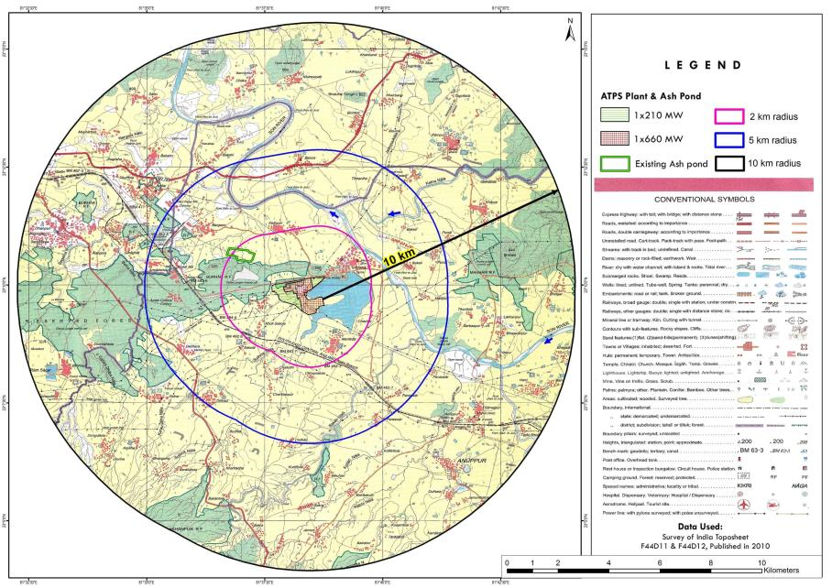
Topographical map – 10 km radius
Topo map of 5 km
Back to TOR Q

Slide 5
A. Additional TOR Compliance

Slide 6
Additional TOR compliance (1/ 7)
TOR i | No additional ash pond (as proposed in 165 acres) is allowed. Only existing ash pond (65 acres) is to be used as an emergency ash pond for the proposed project.
As informed existing ash pond of an area of 67.70 acres (27.4 Ha) will be used for proposed project As per Notification S.O. 54819E dated 31st December 2021, TPP may be permitted an emergency or temporary ash pond with an area of 0.1 hectare per Mega Watt (MW). The difference of ash pond area (66 Ha – 27.4 Ha = 38.6 Ha) and 33% of the GB along the ash dyke together will be 51.4 Ha Hence, request honorable EAC to allow to allot 52 Ha (128 Ac) of land for new ash pond
TOR ii | A copy of Environmental Clearance obtained for 210 MW plant and certified compliance report from MoEF&CC, Regional Office for operating 210 MW Power Plant shall be submitted
EC for 1X210 MW unit was received on 29th April 2004 (No,J-13011/20/2002.IA-II(T) ) Certificate of compliance for 1x210 MW unit issued on 7/02/2020 by RO MOEF&CC Bhopal

Slide 7
Additional TOR compliance (2/ 7)
TOR iii | Regional office while conducting site visit for examining the compliance shall also ascertain the cause for high particulate emissions and suggest mitigative measures. Project proponent shall submit an action plan for reduction in particulate matter in the ambient air
Official from Regional Office, MoEF&CC, Bhopal visited unit on 12 & 13th Dec 2019 and certificate of compliance for 1x210 MW unit issued on 7/02/2020. Action plan for reduction in particulate matter in AAQ includes Water is sprayed regularly by water tankers on main road, CHP, Ash handling area (silo area) & other highly loaded area of power house To suppress coal dust dispersion, dust extraction & dust suppression systems (DE & DS) provided in CHP area & water spraying system on conveyor belt operated continuously during the belt operation Ventilation system is provided at track hopper & conveyor belt no. 21 A/B, 22 A/B & 26 A/B ( working effectively) Water spray system provided in ash silo area around the loading point of ESP Fly ash & operates continuously during filling of fly ash in the bulkers Enhance existing GB by planting 3 years old saplings for open area will be moist for most part of day As part of proposed plant additional GB of 76.4 acers ( 30.92 Ha) ( shall be developed within the plant boundary there by reducing available open area.
TOR iv | No objection certificate under Forest Rights Act and whether rights of forest tribes and other forest dwellers are affected due to proposed plant
There are no tribal population within the plant area hence rights of forest tribes and other forest dwellers are not affected. Online application for forest clearance for diversion of 6.171 Ha land within plant boundary is submitted ( Proposal No: FP/ MP/ THE/ 130772/2021)

Slide 8
Additional TOR compliance (3/ 7)
TOR v | Tree enumeration is to be carried out for forest land and non-forest land separately to ascertain number of trees to be cut for proposed project.
Tree enumeration study in forest & non-forest land within project boundary carried out separately 580 trees in the forest area & 586 tress in non-forest area within the plant boundary will be removed / moved. For each tree removed, 3 plants will be planted within plant boundary as part of GB
TOR vi | Status of stage-I Forest Clearance for diversion of 7.086 ha Reserve forest
Application for forest clearance for diversion of 6.171 Ha forest land within plant boundary is submitted and is under progress ( Stage-I application)
TOR vii | Status of implementation of FGD for the existing unit and implementation of NOx control measures to comply with the emission norms dated 7.12.2015
For existing 1x210 MW unit FGD NIT for installation of FGD issued on 28.08.2020 Schedule date of Bid opening 26/27/11/2020 & Expected order placement data Sep 2022 Tentative project completion date – Dec 2024 NOX control system Techno-Commercial specification under preparation by consultant NIT expected to be issued in April 2022 Expected date of placement of order oct 2022 Tentative project completion date Feb 2024

Slide 9
Additional TOR compliance (4/ 7)
TOR viii | The action plan to achieve 33% greenbelt area for the total plant area excluding the greenbelt in the colony
For 1x660 MW unit an area of 76.4 acres (34% of plant area) will be developed as GB. For 1x210 MW unit an area of 56.1 acres (34% total area) is developed as GB excluding GB in colony. For 1X660 MW unit an budget of 175 lakhs is earmarked for GB development including About 61,000 plants will be planted as a part of GB Greenbelt with native species of 15 m width consisting of 3 tires around plant boundary will be developed based on land available within the project boundary Avenue plantation of 2 m on both sides of the road will be developed. Block plantation will be developed in areas earmarked for greenbelt.
TOR ix | Details of fly ash utilization for existing plant & action plan to achieve 100% fly ash utilization
Action plan to achieve 100% fly ash utilization by 1X210 MW unit is activity following up with Coal mines in the area, cement & brick manufactures in the area by allocation of free ash to enhance ash utilization Initiated correspondence with District Collectors in 100 km radius, Chief Engineer National Highway, Bhopal & to enhance the utilization of Fly Ash as per notification 2009 for other purposes such as embankment of roads, various construction works etc. Meeting was held at MPPCB headed by Chairman/Member Secretary& Coal mines in the area like SECL, NCL, WCL to allocate abandoned coal mine for backfilling by pond ash to enhancing 100% utilization of fly ash

Slide 10
Additional TOR compliance (5/ 7)
TOR x | List of industries and mines within 10 km and 40 km radius of the proposed project and estimation of cumulative environmental impacts is to be carried out
2 major industries within 10 km radius (1x210 MW TPP adjacent to proposed project & Oriental Paper Mills 3.8 km NW) & 2 running mines with in 10 km & other 3 in 30 to 40 km radius of the project site. Cumulative environmental impact was evaluated & post project AAQ values estimated are PM10: 69.02 µg/m³; PM2.5: 46 µg/m³.15; SO2 18.4 µg/m³ & NOX 27.6 µg/m³ which are within standard.
TOR xi | Requirement of water consumption at each process shall be assessed and possible reduction and conservation measures shall be adopted to achieve zero liquid discharge etc. Action plan in this regard for both existing and proposed project shall be submitted
Water consumption of 1x660 MW & 1x210 MW units was analysed to optimize water requirement At 1X660 MW unit: Specific water consumption is < 1 m³ /MWh against a standard of 3.0 m³ /MWh achieving by providing Air-Cooled Condenser technology with COC @ 5 Wastewater system (with ETP & Ash water recycling system ) is proposed to achieve ZLD Process wastewater generated is treated within plant and reused for ash slurry preparation, dust suspension and green belt development within the plant At 1x210 MW unit: Specific water consumption is < 3.5 m³ /MWh against a standard of 3.5 m³ /MWh & COC @ 5. Wastewater management system (with ETP & Ash water recycling system ) is implemented to achieve Zero Liquid Discharge (ZLD).

Slide 11
Additional TOR compliance (6/7)
TOR xii | Action plan to achieve specific water consumption of 3.5 m3 /MWh for operating plant and 3.0 m3/MWh for proposed project as per the Ministry’s notification dated 07.12.2015 shall be submitted
Specific water consumption of 1x210 MW unit is < 3.5 m³ /MWh against a standard of 3.5 m³ /MWh Specific water consumption of 1x660 MW unit is < 1 m³ /MWh against a standard of 3.0 m³ /MWh
TOR xiii | The details of land (status whether revenue/private, agriculture/barren/forest) and acquisition for the proposed infrastructure to set up additional pumps and lay pipelines to carry water from Suthna reservoir and Sone river shall be submitted
No additional land acquisition is required for proposed infrastructure to set up additional pumps & to lay pipe lines to carry water to project as sufficient land is available with MPPGCL for above work
TOR xiv | The water sustainability studies shall be conducted to assess the availability of water in-stream and downstream users after drawing water for proposed project
Water Resource Department (WRD) Reva MP, has allocated 5.15 Million Cubic Meters per year (MCM) to proposed 1X660 MW TPP. Decommissioned plants of 290 MW would be utilizing about 1015 m³/ h of water @ 3.5 m³ /MWh which is about 40% more than 1x660 MW units water requirement. With a reduction in water requirement, other water users will benefit from additional water available for them, hence enhancing positive gains for stakeholders.

Slide 12
Additional TOR compliance (7/ 7)
TOR xv | Assessment of water quality & aquatic fauna for adjacent chachai lake is to be conducted. Time bound action plan along with financial allocations for lake rejuvenation & promotion of tourism as part of CSR activities shall be submitted
As part of study, following activities were carried out for Chachai lake Analysis results of lake water indicates Designated-Best-Use of water is suitable for class C, D & E activities. Action plan for lake rejuvenation is proposed with an estimated cost of about 2.5 crores It will be carried out as part of CSR activities after obtaining administrative approval from competent authorities. Further MP Tourism Board shall also be requested to provide guidance for development of Chachai lake for promoting tourism activities. C: Drinking water source after conventional treatment and disinfection; D: Propagation of Wild life and Fisheries; E: Irrigation, Industrial Cooling, Controlled Waste disposal

Slide 13
Honorable Expert Appraisal Committee is requested to grant EC for proposed project
Thank You

Slide 14
B. Standard TOR compliance

Slide 15
Standard TOR compliance (1/ 21)
TOR xvi | Vision document specifying prospective long term plan of the project shall be formulated and submitted
MPPGCL has Vision document specifying prospective long term plan keeping inline with State’s and national growth plan.
TOR xvii | Latest compliance report duly certified by the Regional Office of MoEF&CC for the conditions stipulated in the environmental and CRZ clearances of the previous phase(s) for the expansion projects shall be submitted.
EC compliance report details are provided at Sno ii of Additional ToR Compliance CRZ clearances of the previous phase(s) and the expansion projects is not applicable
TOR xviii |  | The project proponent needs to identify minimum three potential sites based on environmental, ecological and economic considerations, and choose one appropriate site having minimum impacts on ecology and environment. A detailed comparison of the sites in this regard shall be submitted
Land for proposed plant is made available by dismantling of PH-I & PH-II units. Proposed site is within the ATPS boundary and is easily approachable / accessible from rail and road. Location of site is quite suitable and satisfies relevant guidelines issued by MoEF&CC for site selection. Site meets the site suitability requirement

Slide 16
Standard TOR compliance (2/ 21)
TOR xix | Executive summary of the project indicating relevant details along with recent photographs of the proposed site (s) shall be provided. Response to the issues raised during Public Hearing and the written representations (if any), along with a time bound Action Plan and budgetary allocations to address the same, shall be provided in a tabular form, against each action proposed
Executive Summary of the project is provided as separate section/ chapter in the EIA report covering Project requirement, Baseline environmental status of study area, Anticipated environmental impacts and mitigative measures and EMP along with project cost details Recent photographs of the proposed site are given in the EIA report PH was conducted by MPPCB on 17/12/2020 at Government High School, GramPanchayat Kelhauri, Anuppur district which is about 2 km from project site. Response to the issues raised during Public Hearing along with a time bound Action Plan is tubulated and budgetary allocations to address Time bound action plan
TOR xx | Harnessing solar power within the premises of the plant particularly at available roof tops and other available areas shall be formulated and for expansion projects, status of implementation shall also be submitted
A proposal for harnessing solar power within the premises of plant particularly at available roof tops is formulated. (solar area of about 1.1 Ha within the plant can be harvested with estimated capacity of 1.18 MW).

Slide 17
Standard TOR compliance (3/ 21)
TOR xxi | The geographical coordinates (WGS 84) of the proposed site (plant boundary), including location of ash pond along with topo sheet (1:50,000 scale) and IRS satellite map of the area, shall be submitted. Elevation of plant site and ash pond with respect to HFL of water body/nallah/River and high tide level from the sea shall be specified, if the site is located in proximity to them
Projects falls from Latitude 23°9'22.1"N to 23°10'08.5"N & Longitudes 81°37'53.7"E to 81°38'45.8"E Toposheet numbers : F44D11 & F44D12 Satellite imagery map of the study area showing plant boundary & existing ash pond is provided Elevation levels of existing plant are in the range of 477 to 498 m above MSL
TOR xxii | Layout plan indicating break-up of plant area, ash pond, green belt, infrastructure, roads etc. Shall be provided
1x660 MW unit has an area of 223 Ac ( 90.24 Ha) within the plant boundary out of which 74.6 Ac (30.9Ha ) (34%) is earmarked for GB development. Existing ash pond area of 67.70 Ac (27.4 Ha) Land plan with breakup details of proposed plant are given
TOR xxiii | Land requirement for project shall be optimized and in any case not more than what has been specified by CEA from time to time. Item wise break up of land requirement shall be provided
Land requirement of proposed plant is about 0.34 Ac /MW V/s CEA guidelines of 0.35 Ac /MW for plant (Pit head / Load centre station using indigenous coal) for different activities. Land breakup details of proposed unit is given

Slide 18
Project requirement
Land requirement & Greenbelt
 | Description |  |  | 1x660 MW (acres) | 1x210 MW (acres)
A. Inside plant boundary
 |  | Plant area |  | 146.6 | 109.9
 |  | Green Belt |  | 76.4 | 35.1
 |  | Total |  | 223 | 145
B. Outside plant boundary ( Existing ash pond)
 |  | Pond -1 | As per ToR existing ash pond to be used |  | 32.52
 |  | Pond- 2 |  |  | 35.18
 |  | Total |  |  | 67.70
C. Existing green belt developed outside plant boundary
 |  | Green belt along the road | - |  | 21
 |  | Total |  |  | 21
Total Green belt developed for 1x210 MW plant (A+C) |  |  |  |  | 56.1
Note: Additional GB developed in colony is 62.3 acres
6.171 Ha (15.249 Ac) within ATPS site boundary; Stage -1 online application for Forest clearance (Proposal no: FP/MP/THE/130772/2021)
Back to TOR Q
Map
Notes:
Small changes made for simplification of text

Slide 19
Land area break up of proposed 1x660 MW unit
S. No | Description | Area (acres) |  | %
A. Within the plant boundary
1 | Main plant & equipment | 21 | 21 | 9.42
2 | Coal handling plant | 61 | 61 | 27.35
3 | Water facilities including cooling tower | 30 | 30 | 13.45
4 | Switch yard | 13 | 13 | 5.83
5 | Misc. (Plant boundary, road etc.) | 21.6 | 21.6 | 9.69
6 | Greenbelt | 76.4 | 76.4 | 34.26
 | Total(A) | 223 | 223 | 100
Back to TOR Q
Map
Additional ash pond location ,ap

Slide 20
Standard TOR compliance (4/21)
TOR xxiv | Present land use (including land class/ kism) as per the revenue records and State Govt. Records of the proposed site shall be furnished. Information on land to be acquired including coal transportation system, laying of pipeline, ROW, transmission lines etc. Shall be specifically submitted. Status of land acquisition and litigation if any, should be provided
The present land use of the project site is under Industrial use and land is owned by MPPGCL known as ATPS project site. No additional land is required to be acquired for project activities .
TOR xxv | If project involves forest land, details of application, including date of application, area applied for & application registration number, for diversion under FCA & status be provided along with copies of relevant documents
Application for forest clearance for diversion of 6.171 Ha forest land within plant boundary is submitted and is under progress ( Stage-I application)
TOR xxvi | The land acquisition and R&R scheme with a time bound Action Plan should be formulated and addressed in the EIA report
There is no R&R plan required as land required for the project is in possession of ATPS/ MPPGCL
TOR xxvii | Satellite imagery and authenticated topo sheet indicating drainage, cropping pattern, water bodies (wetland, river system, stream, nallahs, ponds etc.), location of nearest habitations (villages), creeks, mangroves, rivers, reservoirs etc. in the study area shall be provided
Satellite imagery and authenticated topo maps indicating the environment setting representing 10 km radius of study area is given

Slide 21
Standard TOR compliance (5/ 21)
TOR xxviii | Location of any National Park, Sanctuary, Elephant/Tiger Reserve (existing as well as proposed), migratory routes/ wildlife corridor, if any, within 10 km of project site shall be specified & marked on map duly authenticated by Chief Wildlife Warden of the State or an officer authorized by him
No National park, Sanctuary, Elephant/Tiger Reserve, and migratory routes/wildlife corridor within 10 km radius of proposed project site. The sensitivity map of the project site with 15 km radius is given
TOR xxix | Topography of the study area supported by toposheet on 1 :50,000 scale of Survey of India, along with a large scale map preferably of 1 :25,000 scale and the specific information whether the site requires any filling shall be provided. In that case, details of filling, quantity of required fill material; its source, transportation etc. shall be submitted
Topographical features of proposed project site and study area are shown on Topo sheet of 1:50,000 scale and given No filling is envisaged for the project
TOR xxx | A detailed study on land use pattern in the study area shall be carried out including identification of common property resources (such as grazing and community land, water resources etc.) available and Action Plan for its protection and management shall be formulated. If acquisition of grazing land is involved, it shall be ensured that an equal area of grazing land is acquired and developed and detailed plan submitted
Land use land cover classification of the study area was analysed and details given No damage/ impact are envisaged to common properties in study area due to proposed project

Slide 22
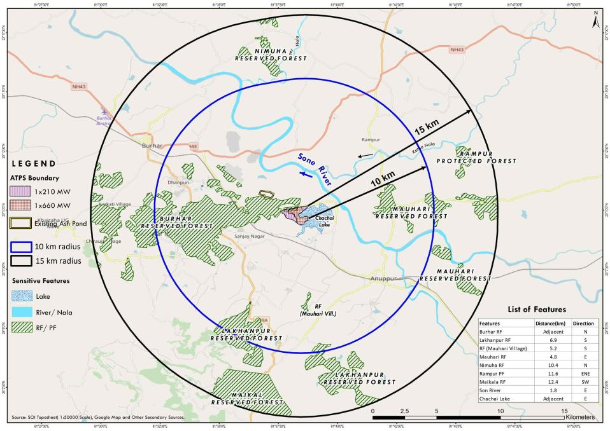
Sensitivity map of 15 km radius
Back to TOR Q

Slide 23
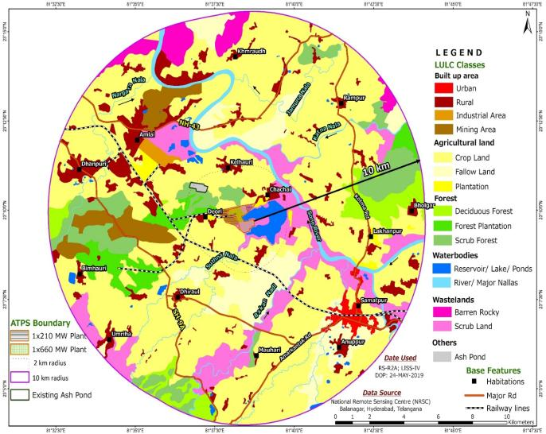
LULC map of study area
Classes ( L 1) | % of area
Study area
Built-up | 11.17
Agricultural land | 63.03
Forest | 11.76
Water bodies | 3.27
Waste lands | 10.53
Other | 0.24
Total | 100
Project Site
Back to TOR Q

Slide 24
Standard TOR compliance ( 6 / 21)
TOR xxxi | A mineralogical map of the proposed site (including soil type) and information (if available) that the site is not located on potentially mineable mineral deposit shall be submitted
Land for project is are in possession of ATPS. No minerals are present within site
TOR xxxii | Details of fly ash utilization plan as per the latest fly ash Utilization Notification of GOI along with firm agreements / MoU with contracting parties including other usages etc. Shall be submitted. The plan shall also include disposal method / mechanism of bottom ash
Action plan for 100% utilization of Fly ash is given in Sno ix of Additional TOR Compliance
TOR xxxiii | The water requirement shall be optimized (by adopting measures such as dry fly ash and dry bottom ash disposal system, air cooled condenser, concept of zero discharge) and in any case not more than that stipulated by CEA from time to time, to be submitted along with details of source of water and water balance diagram. Details of water balance calculated shall take into account reuse and re-circulation of effluents
Water requirement and reuse details are given in Sno xi of Additional TOR Compliance
TOR xxxiv | Water body/ Nallah (if any) passing across the site should not be disturbed as far as possible. In case any Nallah / drain is proposed to be diverted, it shall be ensured that the diversion does not disturb the natural drainage pattern of the area. Details of proposed diversion shall be furnished duly approved by the concerned Department of the State
No water body or nallah requiring diversion is passing through site. Hence diversion is not envisaged

Slide 25
Standard TOR compliance ( 7 / 17)
TOR xxxv | It shall also be ensured that a minimum of 500 m distance of plant boundary is kept from the HFL of river system / streams etc. and the boundary of site should also be located 500 m away from railway track and National Highways
Sone river is about 1.8 km (E) from proposed site. The nearest highways are SH-9A- 4.4 km (W) , NH -43- 4.3 km(N) from proposed site. The nearest railway track is more than 500 m ( 1.5 Km ) from proposed site
TOR xxxvi | Hydro-geological study of the area shall be carried out through an institute / organization of repute to assess the impact on ground and surface water regimes. Specific mitigation measures shall be spelt out and time bound Action Plan for its implementation shall be submitted
The proposed project area is already a developed/ graded area. Hydrogeological & drainage pattern in study area was analysed & no impacts due to proposed activity
TOR xxxvii | Detailed Studies on the impacts of the ecology including fisheries of the River/Estuary/Sea due to the proposed withdrawal of water / discharge of treated wastewater into the River/Sea etc shall be carried out and submitted along with the EIA Report. In case of requirement of marine impact assessment study, the location of intake and outfall shall be clearly specified along with depth of water drawl & discharge into open sea
The ecological studies was carried out during the baseline study period. Primary & secondary data of flora and fauna present in study area was collected No REET species are found in study area. Impact is minimum as emissions from project are within standards

Slide 26
Standard TOR compliance ( 8 / 21)
TOR xxxviii | Source of water and its sustainability even in lean season shall be provided along with details of ecological impacts arising out of withdrawal of water and taking into account inter-state shares (if any). Information on other competing sources downstream of the proposed project and commitment regarding availability of requisite quantity of water from the Competent Authority shall be provided along with letter/ document stating firm allocation of water
Consumptive water requirement for proposed plant will be drawn from Suthna reservoir (Chachai lake) through dedicated intake. Water sustainability details are given Sr No xiv of Additional TOR Compliance
TOR xxxix | Detailed plan for rainwater harvesting and its proposed utilization in the plant shall be furnished
The rain water will be harvested and utilized for various plant operations. Excess water will be send to Chachai lake by storm water drains along the road.
TOR xl | Feasibility of near zero discharge concept shall be critically examined and its details submitted
Wastewater management system is proposed to achieve Zero Liquid Discharge (ZLD) to reduce raw water requirement. Details of proposed wastewater management system is given in Sr No xi Additional TOR Compliance
TOR xli | Optimization of Cycles of Concentration (COC) along with other water conservation measures in the project shall be specified.
Water required for the project is optimized by utilizing Air Cooled Condenser (ACC) instead of conventional Water Cooled Condenser (WCC) technology to save consumptive water. It also designed to maintain Cycles of Concentration (COC) of 5.

Slide 27
Standard TOR compliance ( 9 / 21 )
TOR xlii | Plan for recirculation of ash pond water & its implementation shall be submitted
After settlement of ash particles, clear supernatant ash slurry water is recovered by Ash water recovery system & reused for making ash slurry and dust suspension within the plant. A budgetary allocation of about 10 crores is made for setting up Ash water recycling system
TOR xliii | Detailed plan for conducting monitoring of water quality regularly with proper maintenance of records shall be formulated. Detail of methodology and identification of monitoring points (between plant and drainage in the direction of flow of surface/ ground water) shall be submitted. It shall be ensured that parameter to be monitored also include heavy metals. A provision for long term monitoring of ground water table using Piezometer shall be incorporated in EIA, particularly from the study area
Detailed plan for monitoring of water quality regularly (monthly major & minor parameters; Heavy metals quarterly) with proper maintenance of records will be formulated & maintained. Same will be shared to concerned authorities as per the requirement. 3 SW quality monitoring locations will be identified near project site with due consideration of flow of water in the area. 4 GW quality monitoring locations around ash pond covering all directions will be identified. GW levels will be monitored as per CGWB norms.
TOR xliv | Socio-economic study of the study area comprising of 10 km from the plant site shall be carried out through a reputed institute / agency which shall consist of detail assessment of the impact on livelihood of the local communities
Socio-economic study was carried out in study area. Detailed impact assessment survey was carried out & mitigation measures proposed. Summary & details of demography & socioeconomic conditions is given

Slide 28
Socio-economics of study area
Socio Economic Condition
No. of households in study areas | 32970
Total population in study area | 149076
Total workers | 50313
Main workers | 33874
Marginal workers | 16439
Literacy ( %) | 67.02
Average population density in study area is 174 persons per km2. Decadal population growth rate of Anuppur district in 2001-11 was 12.3% with 11.4% & 13.2% growth rate of male and female population respectively.
In study area 36.7% of people belong to scheduled category, of which notably 26.2% belongs to Scheduled Tribes (ST) and 10.5% to Scheduled Castes (SC).
As per 2011 census, 22.7 % people are engaged in main works in the study area. The marginal workers & non-workers constitute 11% & 66.3% of total population respectively.
Back to TOR Q

Slide 29
Standard TOR compliance ( 10 / 21 )
TOR xlv | Action Plan for identification of local employable youth for training in skills, relevant to project, for eventual employment in project itself shall be formulated and numbers specified during construction & operation phases of the Project
As part of CER budget an amount of about Rs. 1.5 crores allocated to provide vocational training to identified youth from nearby villages on job oriented courses. Same will also be taken up as part of CSR.
TOR xlvi | If the area has tribal population it shall be ensured that the rights of tribals are well protected. The project proponent shall accordingly identify tribal issues under various provisions of the law of the land | If the area has tribal population it shall be ensured that the rights of tribals are well protected. The project proponent shall accordingly identify tribal issues under various provisions of the law of the land
The proposed project is within the existing ATPS boundary, which is under ATPS management. There is no tribal population within the ATPS plant boundary
TOR xlvii |  | Detailed CSR plan along with activities wise break up of financial commitment to be prepared. CSR component shall be identified considering need based assessment study & PH issues. Sustainable income generating measures which help in uplift merit of affected section of society, consistent with traditional skills of people identified. Separate budget for community development activities and income generating programmes shall be specified
MPPGCL will ensure at least 2% of average net profits of company made during 3 immediately preceding financial years spent on CSR activities in every financial year as per existing guidelines of Sate & Central Government (applicability of CSR under Section 135 (I) of Companies Act, 2013).

Slide 30
Standard TOR compliance ( 10 / 17 )
TOR xlviii | While formulating CSR schemes it shall be ensured an in-built monitoring mechanism for schemes identified are in place and mechanism for conducting annual social audit from nearest government institute of repute in the region shall be prepared. The project proponent shall also provide Action Plan for the status of implementation of the scheme from time to time and dovetail the same with any Govt. Schemers]. CSR details done in the past should be clearly spelt out in case of expansion projects
ATPS suggests the sector wise interventions for implementing the CSR initiatives which shall support income generating measures helping to uplift section of society, skill development, community development activities and income generating programs.
TOR xlix | R&R plan, as applicable, shall be formulated wherein mechanism for protecting the rights & livelihood of the people in the region who are likely to be impacted, is taken into consideration. R&R plan shall be formulated after a detailed census of population based on socio economic surveys who were dependent on land falling in the project, as well as, population who were dependent on land not owned by them
No R&R is envisaged for the proposed project as total land is under ATPS management
TOR l | Assessment of occupational health & endemic diseases of environmental origin in study area carried out & Action Plan to mitigate same shall be prepared
There are no specific endemic diseases in the area. General sanitation and hygiene shall be maintained in the labor camp. Health checkup will be carried out for communities in nearby villages & distribution of medicines to needy will be done as part of CER & CSR

Slide 31
Standard TOR compliance (11 / 21 )
TOR li | Occupational health and safety measures for the workers including identification of work related health hazards shall be formulated. The company shall engage full time qualified doctors who are trained in occupational health. Health monitoring of the workers shall be conducted at periodic intervals and health records maintained. Awareness programme for workers due to likely adverse impact on their health due to working in non-conducive environment shall be carried out and precautionary measures like use of personal equipment’s etc. shall be provided. Review of impact of various health measures undertaken at intervals of two to three years shall be conducted with an excellent follow up plan of action wherever required.
Basic health care facilities like First-aid and ambulance facility will be made available to the workers during the construction period. Contractors will be responsible for all the basic amenities during construction. Company will engage qualified doctors and conduct health camps for the workers. Required treatment and medicines will be provided as per company policy. Workers will not be allowed to work without personal protective equipment’s like safety jackets, safety shows, helmets etc. Mock drills will be conducted for all the employs for effective emergency response.
TOR lii | One complete season site specific meteorological and AAQ data (except monsoon season) as per latest MoEF Notification shall be collected and the dates of monitoring shall be recorded. The parameters to be covered for AAQ shall include PMlO, PM2.5, S02, NOx, CO and Hg. The location of the monitoring stations should be so decided so as to take into consideration of the upwind direction, pre-dominant downwind direction, other dominant directions, habitation and sensitive receptors. There should be at least one monitoring station each in the upwind and in the pre-dominant downwind direction at a location where maximum ground level concentration is likely to occur
Ambient air quality monitoring was carried out during April to June 2019 in study area at 11 locations. Meteorological & AAQ monitoring details given

Slide 32
Baseline environmental survey
Study Period : One Season
April to June 2019 (Summer season)
Study Area : 10 km radius from project boundary
Back to TOR point

Slide 33
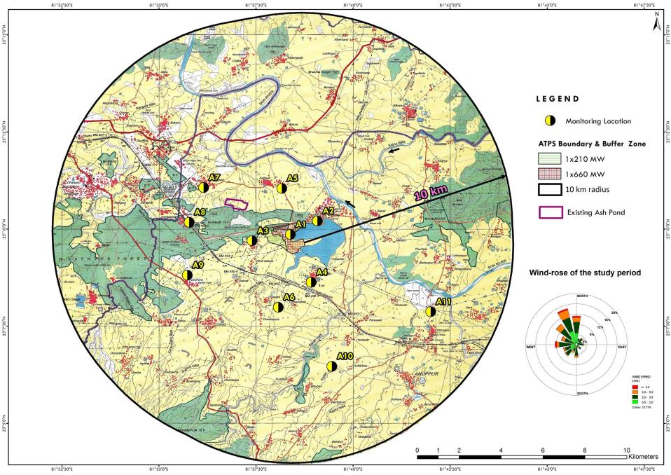
AAQ monitoring location in study area
Back to TOR point

Slide 34
Baseline environmental quality of study area
Ambient air quality of study area ( 11 monition locations )
Parameter | Values (98th Percentile) μg/m³ | Standard μg/m³
Particulate matter (PM₁₀) | 54.5 to 68.6 | 100
Particulate matter (PM_{2.5}) | 34.9 to 45.9 | 60
Sulphur dioxide (SO₂) | 11.4 to 17.1 | 80
Oxides of Nitrogen ( NO_{x}) | 18.9 to 26.3 | 80
Ammonia (NH₃ ) | 15.9 to 24.4 | 400
Ozone (O₃) | 20.6 to 40.2 | 100
Carbon monoxide (CO) | 660 to 940 | 2000
Mercury values in all monitoring stations is less than 0.001 1μg/m³
Air Quality Index | Baseline Air Quality Index (AQI) of study area is in the range of 56 to 69 which falls under Satisfactory range. 5 AAQ monitoring station fall under Good and remaining 4 under satisfactory range.
Report
Back to TOR point

Slide 35
Standard TOR compliance ( 12 / 21 )
TOR liii | In case of expansion project, air quality monitoring data of 104 observations a year for relevant parameters at air quality monitoring stations as identified/ stipulated shall be submitted to assess for compliance of AAQ Standards (annual average as well as 24 hrs.)
Ambient Air quality monitoring data with 104 observation a year for relevant parameters at air quality monitoring station of existing plant was monitored 24 hr Annual average values are PM₁₀ 42.2 (µg/m³); SO₂ 6.9 (µg/m³) & NOx 17.2 (µg/m³) against a standard of PM₁₀ 60 (µg/m³) SO₂ 50 (µg/m³) & NOx 40 (µg/m³)
TOR liv | A list of industries existing and proposed in the study area shall be furnished
Major industries in study area are : 1x210 MW TPP within ATPS boundary and Orient Paper Mill is around 3.8 km in NW direction
TOR lv | Cumulative impacts of all sources of emissions including handling and transportation of existing and proposed projects on the environment of the area shall be assessed in detail. Details of the Model used and the input data used for modeling shall also be provided. The air quality contours should be plotted on a location map showing the location of project site, habitation nearby, sensitive receptors, if any. The wind rose and isopleths should also be shown on the location map. The cumulative study should also include impacts on water, soil and socio-economics
Cumulative impact on AAQ in the study area was estimated using AERMOD 7.0.3 software . Maximum ground level concentrations in Post project scenario (with cumulative environmental impact) for PM10, PM_{2.5} SO₂ & NO^{X} is 69.02 µg/m3, 46.15 µg/m³, 18.4 µg/m³ & 27.6 µg/m³ . These values are well within the CPCB AAQ standards.

Slide 36
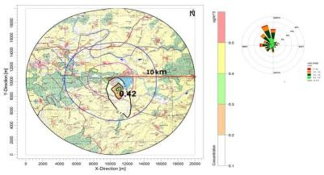
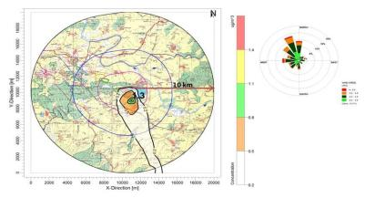
AAQ post project scenario unit: μg/m3 (Worst case)
Worst case scenario
Particulates | PM (µg/m³) | SO₂ (µg/m³) | NO_{x} (µg/m³)
 | With ESP | With FGD | With SCR
Maximum baseline value | 68.6 | 17.1 | 26.3
Predicted increment in GLC | 0.42 | 1.3 | 1.3
Post project scenario | 69.02 | 18.4 | 27.6
CPCB NAAQ standard (24hr) | 100 | 80 | 80
Predicted 24- hourly average GLCs of PM (μg/m³)
Predicted 24- hourly average GLCs of SO2 (μg/m³)
Predicted 24- hourly average GLCs of NOx (μg/m³)
Back to TOR point
Max Concentration of PM is 0.42 µg/m3 , SO₂ & NOx is 1.3 µg/m³ @ 1.3 km distance in SSE direction

Slide 37
Standard TOR compliance ( 13 / 21)
TOR lvi | Radio activity and heavy metal contents of coal to be sourced shall be examined and submitted along with laboratory reports.
SECL coal mines from which coal will be supplied is yet to be communicated. Coal will be sent to accreted lab for testing once finalized.
TOR lvii | Fuel analysis shall be provided. Details of auxiliary fuel, if any, including its quantity, quality, storage etc should also are furnished.
The primary fuel used is domestic coal and support fuel used is Light Diesel Oil (LDO).
TOR lviii | Quantity of fuel required, source characteristics & documentary evidence to substantiate confirmed fuel linkage shall be furnished. Ministry's Notification dated 02.01.2014 regarding ash content in coal shall be complied. For expansion projects, compliance of existing units to said Notification shall also be submitted
1x660 MW unit has a coal consumption of 4,279 TPA per MW @ 85% PLF Normative requirement of 2.542 MTPA @ 90% (LOA) as per CEA norms dated 23.3.2019 LOA for grant of coal linkage with SECL (minutes of 34th CLOA meeting dated 20th Dec 2019 ). Coal likely to be sourced from Sangma & Korba side of SECL The Ministry's Notification dated 02.01.2014 regarding ash content in coal will be complied Support fuel Light Diesel Oil (LDO) of 2730 KL per year @ 0.5 ml/kwh for Boiler start-up / support and for subsequent low load operations

Slide 38
Standard TOR compliance ( 14 / 21 )
TOR lix | Details of transportation of fuel from source (including port handling) to plant & its impact on AAAQ shall be suitably assessed & submitted. If transportation entails a long distance it shall be ensured rail transportation to site be first assessed. Wagon loading at source preferably be through silo/ conveyor belt.
Coal is transported to project site by Indian Railways & own rail system of MPPGCL from Sangma & Korba side of South Eastern Coalfields Limited (SECL). Dust prevention and mitigation measures are proposed to minimise impact on AAQ as detailed in Additional TOR iii .
TOR lx | For proposals based on imported coal, inland transportation and port handling and rail movement shall be examined and details furnished. The approval of the Port and Rail Authorities shall be submitted
Not applicable as domestic coal is proposed to be used as fuel for proposed plant
TOR lxi | Details regarding infrastructure facilities such as sanitation, fuel, restrooms, medical facilities, safety during construction phase etc. to be provided to labour force during construction as well as to the casual workers including truck drivers during operation phase should be adequately catered for and details furnished
Basic health care facilities i.e. first-aid & ambulance will be made available to workers during construction period. Temporary sanitary facilities will be provided. Contractors will be responsible for all basic amenities during construction other than sanitation & basic health care. Necessary conditions will be imposed in work order of contractors

Slide 39
Standard TOR compliance ( 15 / 21)
TOR lxii | EMP to mitigate the adverse impacts due to the project along with item - wise cost of its implementation in a time bound manner shall be specified
As amount of Rs 768.75 crores is earmarked for EMP Budget Item wise EMP during construction an operations phases is analysed and suggested prevention and mitigative measures to keep the impacts if any within the standards.
TOR lxiii | A Disaster Management Plan (DMP) along with risk assessment study including fire and explosion issues due to storage and use of fuel should be carried out. It should take into account the maximum inventory of storage at site at any point of time. The risk contours should be plotted on the plant layout map clearly showing which of the proposed activities would be affected in case of an accident taking place. Based on the same, proposed safeguard measures should be provided. Measures to guard against fire hazards should also be invariably provided. Mock drills shall be suitably carried out from time to time to check the efficiency of the plans drawn.
Details of Disaster Management Plan, Onsite Emergency Plan, Hazardous Assessment and Evaluation, along with risk assessment study including fire and explosion issues due to storage and use of fuel is with mitigative measures is given
TOR lxiv | The DMP so formulated shall include measures against likely Fires/ Tsunami/ Cyclones/ Storm Surges/ Earthquakes etc, as applicable. It shall be ensured that DMP consists of both On-site and Off-site plans, complete with details of containing likely disaster and shall specifically mention personnel identified for the task. Smaller version of the plan for different possible disasters shall be prepared both in English and local languages and circulated widely
Details of Disaster Management Plan (DMP) covering all hazards like Fires/ Tsunami/ Cyclones/ Storm surges/ Earthquakes etc was done.

Slide 40
Standard TOR compliance ( 16 / 21)
TOR lxv | Detailed scheme for raising green belt of native species of appropriate width (50 to 100 m) and consisting of at least 3 tiers around plant boundary with tree density of 2000 to 2500 trees per ha with a good survival rate of around 80% shall be submitted. Photographic evidence must be created and submitted periodically including NRSA reports in case of expansion projects. A shrub layer beneath tree layer would serve as an effective sieve for dust and sink for C02 and other gaseous pollutants and hence a stratified green belt should be developed
For 1x660 MW plant an area of 76.4 acres (34% of plant area) will be developed as green belt. For 1x210 MW plant an area of 56.1 acres (34% total area) is developed as greenbelt excluding GB in colony. For 1X660 MW unit an budget of 175 lakhs is earmarked for development green belt including About 61,000 plants will be planted as a part of GB Greenbelt with native species of 15 m width consisting of 3 tires around plant boundary will be developed based on land available within the project boundary Avenue plantation of 2 m on both sides of the road will be developed. With plants grown at a distance of 10 m between then i.e 200 plants per each kilometer of road length. Block plantation will be developed in areas earmarked for greenbelt

Slide 41
Standard TOR compliance ( 17 / 21)
TOR lxvi | Over and above the green belt, as carbon sink, plan for additional plantation shall be drawn by identifying blocks of degraded forests, in close consultation with the District Forests Department. In pursuance to this the project proponent shall formulate time bound Action Plans along with financial allocation and shall submit status of implementation to the Ministry every six months
In consultation with the District Forest Department, additional plantation will be done within the identified blocks of degraded forest under CER & CSR activities.
TOR lxvii | Corporate Environment Policy
i. | Does the company has a well laid down Environment Policy approved by its Board of Directors? If so, it may be detailed in the EIA report.
ii | Does the Environment Policy prescribe for standard operating process/ procedures to bring into focus any infringement/ deviation/ violation of the environmental or forest norms/ conditions? If so, it may be detailed in the EIA.
MPPGCL has well laid down mission statement approved by Board of Directors with emphasis on environmental protection and health, safety and communication. Details of the vision and mission statement is given in Annexure-T 7 Environmental cell under the control of Chief Engineer to monitor the issues and make necessary report to Directors. Environmental cell/ department monitors and implements the requisite measures to protect the environment as directed by the statutory authorities.

Slide 42
Standard TOR compliance ( 18 / 21)
iii. | What is the hierarchical system or Administrative order of the company to deal with the environmental issues and for ensuring compliance with the environmental clearance conditions Details of this system may be given
Hierarchical system/ administrative setup of the company to deal the environmental related issues for ensuring compliances with environmental clearance conditions is developed in line with MPPGCL policy
iv. | Does company has compliance management system in place wherein compliance status along with compliances/ violations of environmental norms are reported to the CMD and the Board of Directors of the company and/ or shareholders or stakeholders at large? This reporting mechanism should be detailed in the EIA report
Yes, company has compliance management system in place with Environmental cell under the control of Chief Engineer to monitor the issues and make necessary report to Directors. Environmental cell/ department monitors and implements the requisite measures to protect the environment as directed by the statutory authorities
TOR lxviii | Details of litigation pending or otherwise with respect to project in any Court, Tribunal etc. shall invariably be furnished | Details of litigation pending or otherwise with respect to project in any Court, Tribunal etc. shall invariably be furnished
No litigation/complaints are pending against the proposed project

Slide 43
Organization Structure of Environmental Management Group (EMG)
Plant Head /
Chief Engineer
Environment Management Group (EMG) Head
Ash Utilisation Group
Environment Engineer / Scientist
Sr. Chemist /
Chemical Engineer
Flora Fauna /
Soil Expert
Lab Assistant /
Technical staff
Back to TOR Q

Slide 44
Standard TOR compliance (19 / 21 )
16 | Besides the above, the following general points shall be followed
a. | All documents properly referenced with index, page numbers & continuous page numbering
Noted and followed
b | Where data is presented in the report especially in table, the period in which the data was collected and the source should invariably be indicated
Noted and followed
c. | Where documents provided are in a language other than English, an English translation should be provided
Noted and followed
d. | The Questionnaire for environmental appraisal of thermal power projects as devised earlier by the Ministry shall also be filled and submitted
Filled up questionnaire is given in Annexure-T 13
e. | The consultants involved in the preparation of EIA/EMP report after accreditation with Quality Council of India (QCI)/ National Accreditation Board of Education and Training (NABET) would need to include a certificate in this regard in the EIA/ EMP reports prepared by them and data provided by other organization/ Laboratories including their status of approvals etc. In this regard circular no. F.No. J-11013/77/2004-IA-II (I) dated 2nd December, 2009 is posted on the Ministry's website: http://www.moef.nic.in may be referred
Noted and followed. Ramky Enviro Services Private Ltd, Hyderabad -500032 with NABET Certificate No: NABET/EIA/1922/SA 0134 . Was involved in EIA/ EMP preparation. NABET certificate included as part of EIA report, which is valid till 21/05/2022

Slide 45
Standard TOR compliance (20/ 21 )
17. | In addition to above, information on following may be incorporated/ in EIA report.
1 | Is the project intended to have CDM-intent?
Yes
i. | If not, then why?
NA
ii. | If yes, then a. Has PIN (Project Idea Note) {or PCN (Project Concept Note)} submitted to the? NCA? (National CDM Authority) in the MoEF?
NA
b. | If not, then by when is that expected?
Subsequently after commissioning
c. | Has PDD (Project Design Document) been prepared?
No
d. | What is Carbon intensity? From your electricity generation projected (i.e. CO2 Tons/ MWH or Kg/ KWH)
0.53 Tons/MWh of CO2.
e. | Amount of CO2 in Tons/year expected to be reduced from the baseline data available on the CEA?s web-site (www.cea.nic.in)
1448508 tons/year of CO2

Slide 46
Standard TOR compliance (21 / 21 )
2. | Notwithstanding 1 (i) above, data on (d) & (e) above shall be worked out and reported.
Noted and followed.
18 | The Environmental Clearance shall be applied only after fuel and water linkage are firmed up
Proposed unit has a coal linkage with SECL (LOA dated 20th Dec 2019 ) Proposed unit has Water allocation by Water Resources Department, Major Project Control Board, MP (Letter dated 07/03/2020)
19 | After preparing the draft EIA (as per the generic structure prescribed in Appendix-II of the EIA Notification 2006) coving the above mentioned issues, the same shall be submitted to the SPCB for conducting the for conducting the public hearing as per procedure of EIA notification 2006. The issue emerged during public hearing shall be further incorporated in the draft EIA/ EMP report. The final EIA/ EMP report along with public hearing report and the Ministry for appraisal by Expert Appraisal committee for consideration of awarding environmental clearance under the provisions of Environmental Impact Assessment notification dated September 14,2006
Draft EIA report as per TOR was submitted to SPCB for conducting the public hearing. PH was conducted on 17/12/2020. Issues during PH are incorporated in the draft EIA/ EMP report and Final EIA report prepared. Same is submitted to EAC committee for consideration of awarding environmental clearance.
20 | TOR prescribed shall be valid for a period of 3 years from the date of issue for submission of Final EIA / EMP report, after pubic heating
Noted and Final EIA report submitted before 3 years issue of TOR (TOR issued on 10/10/2019)

Slide 47
Honorable Expert Appraisal Committee is requested to grant EC for proposed project
Thank You

Slide 48
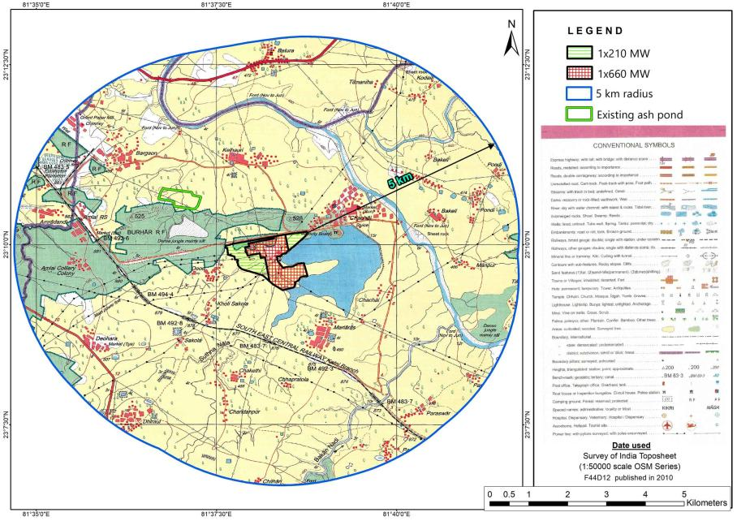
Topographical map – 5 km radius
Back to TOR Q
Topo map of 10 km

Slide 49
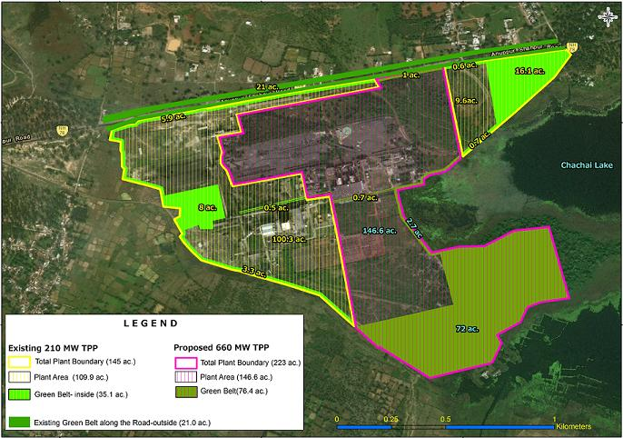
Green Belt plan for the plant area
Back to TOR point

Slide 50
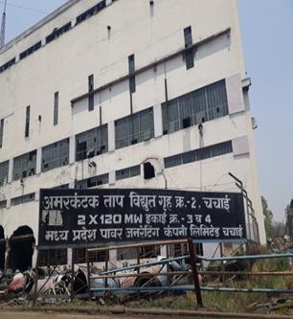
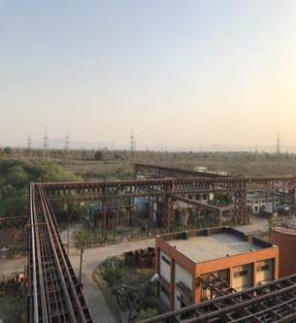
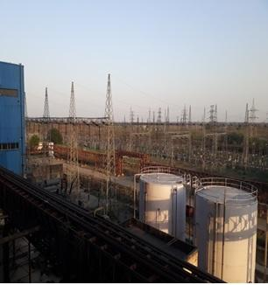
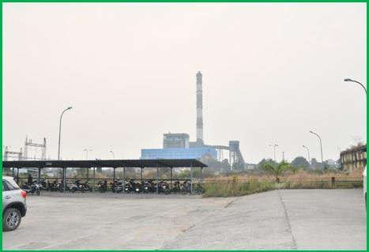
Proposed project site photographs
Back to TOR point

Slide 51
Action plan for lake rejuvenation
S. No | Activity | Timeline* (months) | ROM estimated ( Rs. Lakhs) | Remarks
1 | Topographic survey for mapping Lake boundary as per revenue records along with | 3 | 15 | MPPGCL will hire an approved Surveying agency to map the lake. MPPGCL will work with revenue department to secure the boundaries
2 | De-silting/ dredging of lake | 2 | 35 | De-silting of lake area will be taken up during summary season. Silt generated will be used for bund and Recreational area development.
3 | Construction of Silt traps for storm water inlets | 3 | 10 | All storm water inlet points will be identified and silt traps will be constructed to reduce silting of the lake.
4 | Strengthening of existing bunds and development of new bunds | 3 | 50 | Strength of existing bund and development of new bund all along the perimeter of water spread area will be carried out.
5 | Steel/ Iron wire fencing (safety rails) of 3 m height around water body | 1 | 30 | Location of fencing shown in the Figure 9.1
6 | Development of identified area (about 17.3 acers)along NH for recreation purpose open to public (Develop green belt, walk-ways provide provision for food stalls, children park) | 6 | 90 | Area to be developed is shown in the Figure 9.1
7 | Boundary wall / grill for controlled access | 3 | 20 | Location of wall/ grill shown in the Figure 9.1
 | Total |  | 250 | About 2.5 crores
* After approvals All cost are indicative and detailed estimates will be derived /provided after completion of Topo graphic study
Back to TOR point

Slide 52
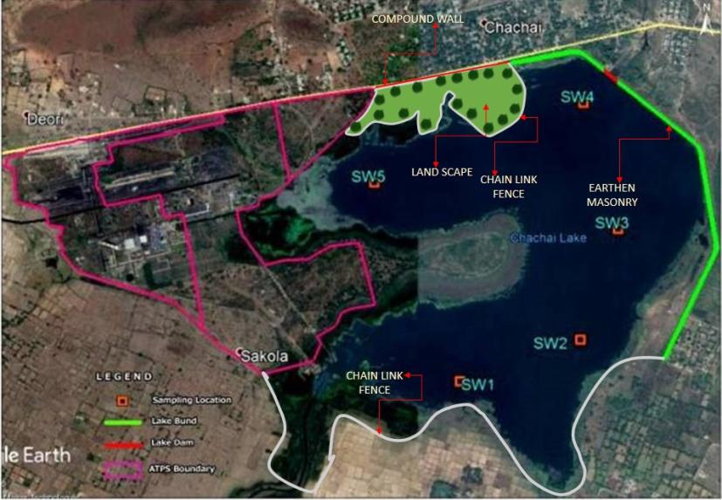
Chachai Lake development plan
Back to TOR point
Back to TOR point

Slide 53
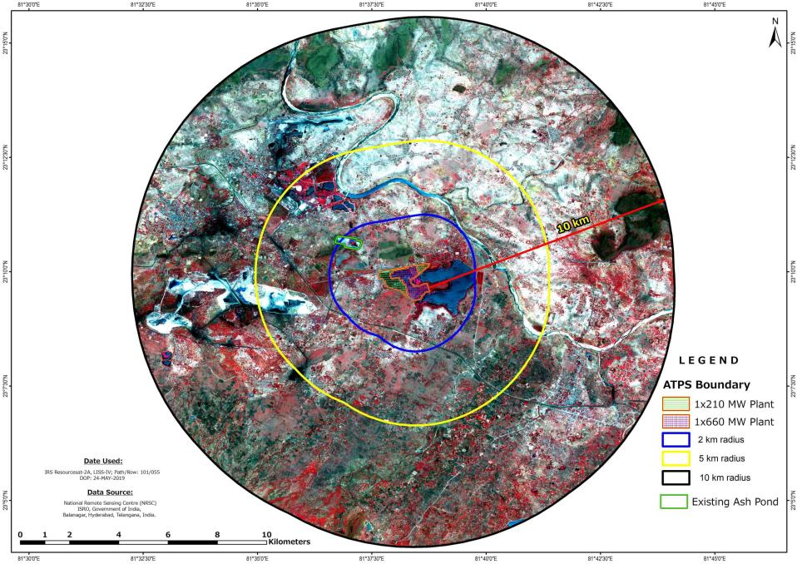
Satellite imagery of the study area
Back to TOR Q

Slide 54
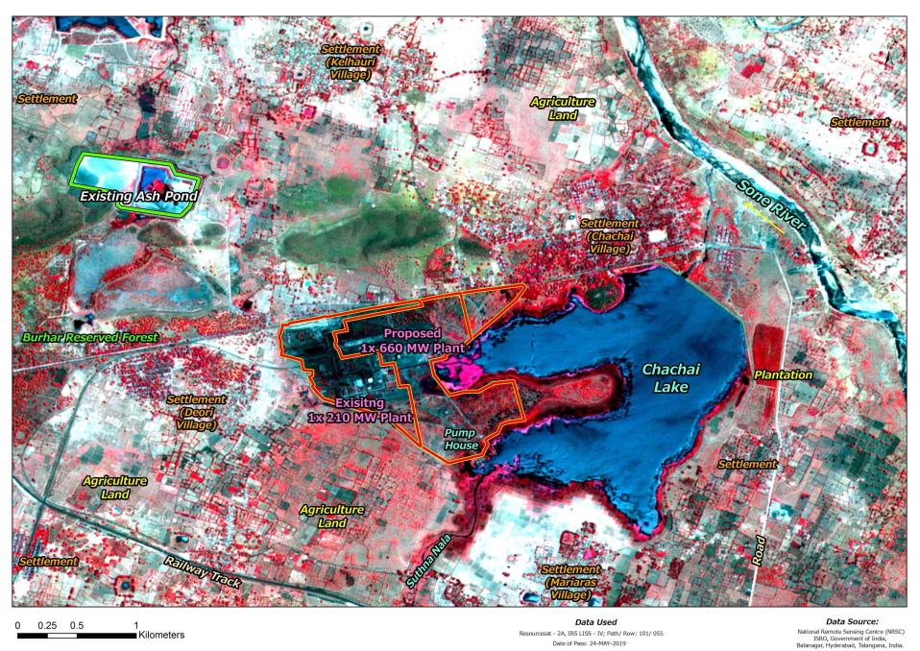
Satellite imagery of the study area
Back to TOR Q

Slide 55
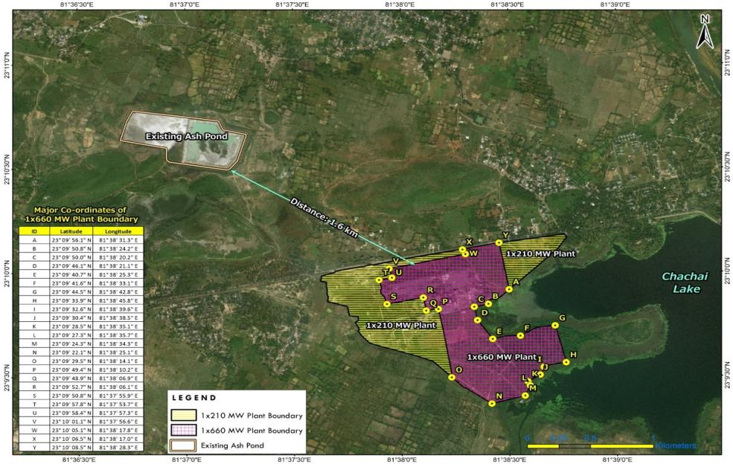
Land area break up existing & proposed plants
Map expansion

Slide 56
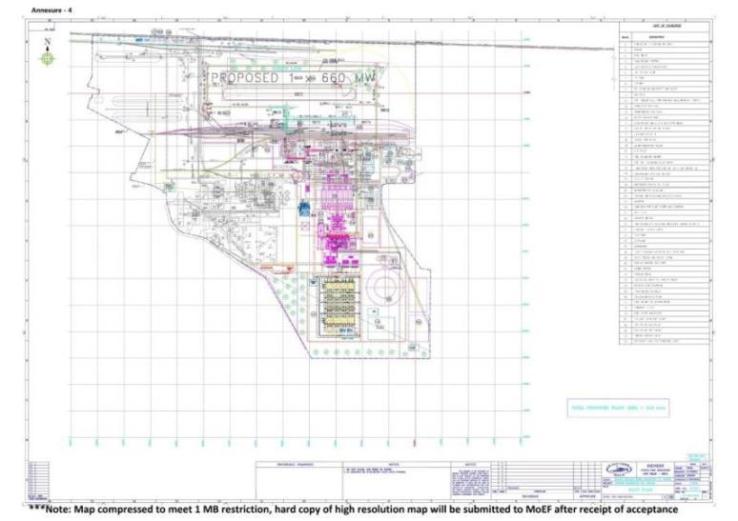
Land area break up of proposed 1x660 MW unit
Back to TOR Q
Map expansion
Additional ash pond location ,ap

Slide 57
Fuel requirement
Details of coal for 1x660 MW unit
Sno | Particulars | Worst | Designed | Other | Linkage coal / LOA
1 | Coal in required MTPA | 3.52 | 3.22 | 3.04 | 2.542*
2 | Plant Load Factor (PLF) | 85%
3 | Station Heat Rate (kcal/kwh) | 2292
Source: Project DPR * Representative grade G11 (GCV range 4000-4300 Kcal/Kg); Indicative grade G9-G14; Annual coal consumption @85% PLF 4279 TPA/ MW; Normative requirement of 2.542 MTPA @90% as per CEA norm (MOM of 30th CLOA meeting held on 20th December 2019) Note: For existing 1x210 MW unit Coal supply is 0.933 MTPA (SECL letter dated 27/09/2019 on revised ACQ)
Support fuel Light Diesel Oil (LDO) of 2730 KL per year @ 0.5 ml/kwh is required for Boiler start-up / support and for subsequent low load operations
Back to TOR Q

Slide 58
Coal Analysis
SNo | Parameters | Worst coal | Design coal | Other coal | Remarks
1 | Moisture (%) | 15.0 | 12.0 | 10.0 | Proximate Analysis
2 | Ash content (%) | 45.6 | 44.0 | 43.2
3 | Volatile matter (%) | 19.4 | 19.0 | 23.1
4 | Fixed Carbon (%) | 20.0 | 25.0 | 23.7
 | Total | 100 | 100 | 100
 | GCV (kcal/kg) | 3200 | 3500 | 3700
1 | Moisture (%) | 15.0 | 12.0 | 10.0 | Ultimate Analysis
2 | Ash content (%) | 45.6 | 44.0 | 43.2
3 | Carbon (%) | 31.5 | 35.38 | 37.11
4 | Hydrogen (%) | 2.33 | 2.5 | 2.75
5 | Nitrogen ( %) | 0.59 | 0.66 | 0.7
6 | Sulphur (%) | 0.44 | 0.26 | 0.47
7 | Oxygen (%) | 4.54 | 5.20 | 5.77
 | Total | 100 | 100 | 100
Source: DPR & EPC Tender Specification
Back to TOR Q

Slide 59
Fuel Oil Analysis
Sno | Particulars | Unit | LDO Grade-II (IS : 1460)
1 | Flash Point | ºC | 66
2 | Viscosity | Cst @ 50 ºC | 2.5 to 15.7
3 | Ash content by weight | % max | 0.02
4 | Water content by volume | % max | 0.25
5 | Sediments by weight | % max | 0.10
6 | Total Sulphur by Weight | % max | 1.8
7 | Approximate GVC | kcal/kg | 10000
8 | Pour Point | ºC | 21
Source: EPC Tender Specification
Typical Ash Analysis
Sno | Parameter | Design coal | Worst coal | Other coal
1 | Silica % | 60.16 | 65.5 | 69.5
2 | Alumina % | 27.44 | 24.3 | 24.8
3 | Iron oxide % | 5.6 | 2.72 | 3.33
4 | Titania % | 1.53 | 1,47 | 1.37
5 | Phosphoric anhydride | 0.53
6 | CaO % | 1.43 | 0.48 | 0.71
7 | MgO % | 0.97 | 0.42 | 0.43
8 | Alkalics % | 1.99 | 1.46 | 1.65
Source: EPC Tender Specification
Back to TOR Q

Slide 60
Ash Management
Ash generation details of 1x660 MW unit
S. No | Particulars | Worst coal (MTPH)
1 | Ash content | 45.60 %
2 | Ash generated | 1.60
 | Fly ash generated @ 70% | 1.12
 | Bottom and Coarse ash @30% | 0.48
Expected Ash generated for Representative grade G11is about : 1.13 MTPA; Fly ash 0.79 MTPA; Bottom Ash 0.34 MTPA (based on below) (Linked coal) Representative grade G11 Annual coal consumption @85% PLF 4279 TPA/ MW; Ash content of about 40% (as per 1x210 MW unit EC & Monthly Ash generation report FY 2020-21 for 1x210 unit )
Proposed unit will plan for 100% utilization of ash (fly ash & bottom ash) as per notification S.O. 54819E dated 31st December 2021 issued by MOEF&CC, New Delhi
Ash will be utilized only for the following eco-friendly purposes, namely:-
Fly ash based products viz. bricks, blocks, tiles, fibre cement sheets, pipes, boards, panels;
Cement manufacturing, ready mix concrete;
Construction of road and fly over embankment, Ash and Geo-polymer based construction material;
Construction of dam;
Filling up of low lying area;
Filling of mine voids;
Manufacturing of sintered or cold bonded ash aggregate;
Agriculture in a controlled manner based on soil testing;
Construction of shoreline protection structures in coastal districts;
Ash utilization plan of 1X210 MW unit

Slide 61
Water requirement 1X660 MW unit
Consumptive water requirement of proposed plant is drawn from Suthna reservoir ( Chachai lake) by dedicated intake
Proposed plant has a water allocation of 5.15 Million Cubic Meters per year (MCM) by Water Resource Department (WRD), Bhopal . Water allocation letter
S. No | Details |  | Water requirement
 |  |  | m³ | m³ / h
I | Auxiliary cooling system |  | 4200
 | Fire water requirement as per TAC norms (about) |  | 2000
 | One time requirement- Total |  | 6200
II | Auxiliary cooling tower make up water | (m³/h) | - | 95
 | Evaporation loss @ 1.458% | 76
 | Drift loss | 2
 | Blow down @ 5 COC | 17
 | Service water | (m³/h) | - | 120
 | CHP dust suspension & fogging | 10
 | HVAC make up | 50
 | Plant service | 25
 | Miscellaneous | 35
 | FGD make up water |  | - | 150
 | AHP seal water |  | - | 50
 | DM plant feed |  | - | 65
 | Clarifier reject |  | - | 10
 | Green Belt, Buffer & miscellaneous |  | - | 10
 | Hourly requirement -Total |  |  | 500
 | Make-up pumps requirement 122 m3/hr, to be used in emergency purpose only
Water balance Diagram
WW management scheme
Back to TOR point

Slide 62
Details of fly ash utilization 1x210 MW unit
FY |  | Generated | Generated | Utilization | Utilization (%)
2017-18 |  | 309086 | 309086 | 175952 | 56.93
2018-19 |  | 247702 | 247702 | 164533 | 66.42
2019-20 |  | 314659 | 314659 | 316396 | 100.55
2020-21 |  | 336514 | 336514 | 218111.2 | 64.81*
Action Plan for fly ash utilization in next 5 years (estimated)
FY |  | Generated (LMT) |  | Utilization (LMT) | Utilization (%)
2022-23 |  | 3.50000 |  | 3.50000 | 100
2023-24 |  | 3.50000 |  | 3.50000 | 100
2024-25 |  | 3.50000 |  | 3.50000 | 100
2025-26 |  | 3.50000 |  | 3.50000 | 100
2026-27 |  | 3.50000 |  | 3.50000 | 100
Mode of average annual fly ash utilization (Estimated)
 | Mode |  |  | Utilization (LMT) | Utilization (%)
1 | Cement Manufactures |  |  | 1.75 | 50
2 | Mining Filling* |  |  | 0.481 | 23
3 | Bricks & Tiles Manufacturers |  |  | 0.53 | 15
4 | Ash dyke raising |  |  | 0.35 | 10
5 | Road & Flyovers |  |  | 0.004 | 1
6 | Concrete |  |  | - | -
7 | Agriculture |  |  | 0.04 | 1
8 | Hydropower sector |  |  | -- | --
9 | Other / Miscellaneous |  |  | -- | --
 | Total |  |  | 3.50 | 100
* Proposed abandoned mines identified for backfilling of fly ash Sharda Mine(QPQR 12 L.Cu.M; Bakehi Patch 25 L.Cu.M; Trench T1 65 L.Cu.M) & Amlai Mine 5 L.Cu.M * For FY 20-21 short lifting due to Covid 19 Lockdown)
Back to Tor point
Ash utilization plan of 1X660 MW unit

Slide 63
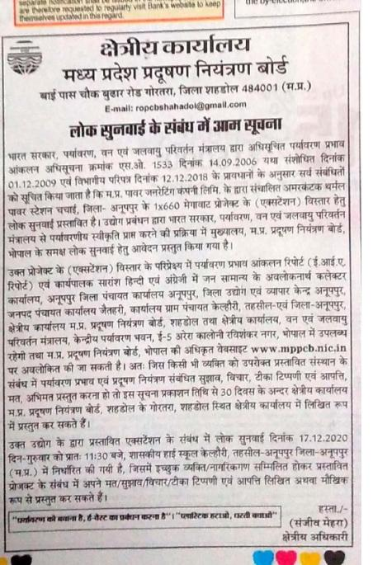
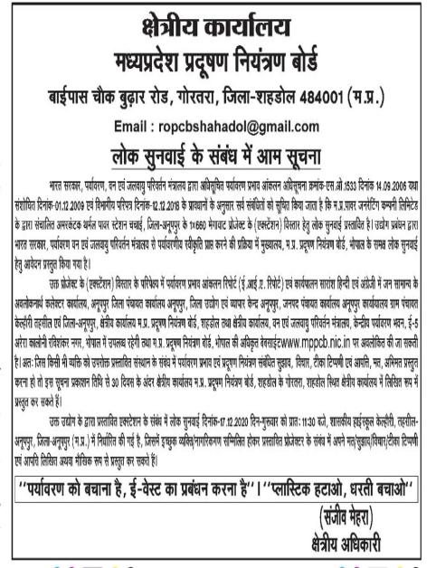
PH news paper notification
Summary PH
Back to TOR Q
Times of India
Raj Express

Slide 64
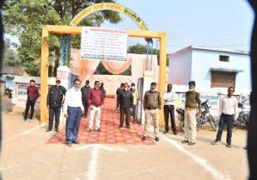
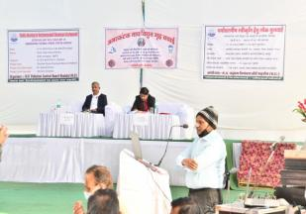
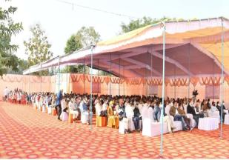
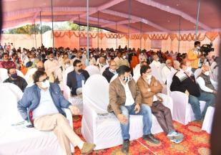
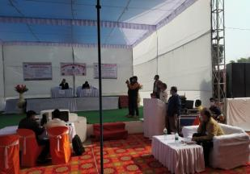
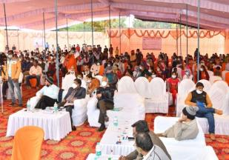
Details of PH conducted for the project by MPPCB
PH Conducted on 17th December, 2020 at 11:30 am
Location : at Govt. high school premises, gram panchayat Kelhouri, tehsil & district - Anuppur (about 2 Km from project site)
Original proceedings along with English translation of PH, Response to comments & suggestions received during PH are given
PH details

Slide 65
Response to comments & suggestions received during PH
S. No | Name & address | Comments & suggestions | Response by ATPS management | Action plan
1 | Satyanarayan Soni, Kelhouri | Employment should be provided to local people | As much possible according to govt. rules, employment will be provided. Norms set by the govt. will be followed | MPPGCL shall provide employment as per government rules
2 | Jeetu Singh Parihar, Mahuhar Tola, Chechai | Medical facilities should be provided to local people | These facilities will be provided and development work will be done | MPPGCL shall allocate funds to conduct health camps & provide medical assistance under CER (as per MoEF&CC OM dated 30.09.2020) / CSR (applicability of CSR under Section 135 (I) of Companies Act, 2013) activities
3 | Vijay Kumar Mishra, Devari | CSR funds should be used properly | Under CSR, as per the rules development work will be done and as much development work as possible will be done in nearby areas | MPPGCL shall ensure at least 2% of average net profits of the company made during three immediately preceding financial years shall be spent on CSR activities in every financial year as per existing guidelines of State & Central Government (applicability of CSR under Section 135 (I) of Companies Act, 2013) CSR funds will be used for taking up social development activists in surrounding villages which includes Infrastructure like roads development; Livelihood & support to agriculture; Education & Skill development; Health and medical facilities etc.
4 | Tilak Raj Soni, Kelhouri | This plant should provide employment to the people and they are developed | As much possible according to govt. rules, employment will be provided to locals. Work will be done in understanding with the villagers. Government norms will be followed. | MPPGCL shall provide employment as per government rules
Summary PH
Back to TOR Q

Slide 66
Response to comments & suggestions received during PH
S. No | Name & address | Comments & suggestions | Response by ATPS management | Action plan
5 | Subhash Mishra, Bargawa | The facilities available under CSR should be provided to everyone | Works will be done under CSR and as per the norms | MPPGCL ensures that at least 2% of average net profits of company made during 3 immediately preceding financial years shall be spent on CSR activities in every financial year as per existing guidelines of State & Central Government (applicability of CSR under Section 135 (I) of Companies Act, 2013)
6 | Ajay Chourasia, Kelhouri | Corruption should be removed | This issue is not related to environment | Noted, necessary steps will be taken to avoid corruption in expenditure incurred under CER/ CSR fund.
7 | Ajeet Mishra, Anuppur | Care should be taken on the pollution from the plant. Farmers did not know about PH meeting. | Noise pollution and dust pollution will be controlled. Environmental regulations will be fully implemented. The notice of public hearing was published in leading newspapers and local newspapers. 30 days’ time was given. Technical documents related to the project were kept in public offices for the public's observation. Announcement was also done. The date and time of public hearing was also informed by flexi, banners, pamphlets and posters by proclamation to the villagers of the nearby villages by installing a van extension loud speaker in a moving vehicle. Approx. 500 people were present. | As part of Environmental Management Plan (EMP), preventive & protective mitigation measures are proposed. Budgetary allocation of Rs 768.75 crores is made for implementation of pollution control measures detailed in EMP. By implementing proposed mitigative measures, environmental impact on study area shall be minimal and within applicable standards
Summary PH
Back to TOR Q

Slide 67
Response to comments & suggestions received during PH
S. No | Name & address | Comments & suggestions | Response by ATPS management | Action plan
8 | Ramsumer Chourasia, Kelhouri | The compensation that has not been received should be given and employment should be provide | Not a subject related to the environment. Employment will be given as per the government guidelines. | Compensation related to land during 1960 was raised, to which district officials informed compensation was paid to beneficiaries as per govt. rules. In case of any graveness advised to contact the district officials for review. MPPGCL shall provide employment as per government rules
9 | Janki Vishwakarma, Kelhouri | School facility should be provided & teachers vacancy should be filled | Not a subject related to environment. Subject related to education department. | MPPGCL under CER / CSR activities shall take up modernization of class rooms, provision of potable drinking water, improving sanitation and distribution of school dress & stationary in government schools
10 | Amit Sharma, Kelhouri | Unemployment should be reduced and medical facility should be provided | As much employment as in accordance with the govt. norms will be provided. Work will be done with establishing an understanding with the villagers. Government decided CSR norms will be followed. | MPPGCL shall provide employment as per Government rules. MPPGCL under CER / CSR activities shall conduct health camps & provide medical assistance at regular interval
Summary PH
Back to TOR Q

Slide 68
Response to comments & suggestions received during PH
S. No | Name & address | Comments & suggestions | Response by ATPS management |  | Action plan
 | By groups
1 | Farmers of Kelhouri, Devari, Kanhaiyalal, Ramlakhan and others | Regarding proper ash management and related to free the land from acquisition and regarding compensation | As per the rules for ash fly ash management will be done as per the provisions of fly ash management rules (MoEF&CC notification dated 3rd November, 2009 and its amendments). New land is not required. | Ash management will be done as per existing MoEF&CC guidelines and only, existing ash pond will be used for proposed project. Action plan for 100% fly ash utilization by project shall be implemented as per MoEF&CC notification dated 3rd November, 2009 and its amendments. It is proposed to provide sheet of 3 m height around silos and ash pond area along with water sprinkler’s to prevent dust nuisance. As part of EMP, ash suspension measures proposed shall be implemented to minimise impacts, if any within standards. No new land acquisition for the project and no R&R are involved | Ash management will be done as per existing MoEF&CC guidelines and only, existing ash pond will be used for proposed project. Action plan for 100% fly ash utilization by project shall be implemented as per MoEF&CC notification dated 3rd November, 2009 and its amendments. It is proposed to provide sheet of 3 m height around silos and ash pond area along with water sprinkler’s to prevent dust nuisance. As part of EMP, ash suspension measures proposed shall be implemented to minimise impacts, if any within standards. No new land acquisition for the project and no R&R are involved
2 | Amit Sharma, Kisan Ekta Manch and others | Ash should be managed and healthcare facilities should be provided under CSR and employment be provided. | The provisions of fly ash management rules (MoEF&CC notification dated 3rd November, 2009 and its amendments) will be followed and employment and medical health facilities will be given as per the rules of the government. | Ash management will be done as per existing MoEF&CC guidelines and only, existing ash pond will be used for proposed project. Action plan for 100% fly ash utilization by project shall be implemented as per MoEF&CC notification dated 3rd November, 2009 and its amendments. It is proposed to provide sheet of 3 m height around silos and ash pond area along with water sprinkler’s to prevent dust nuisance. As part of EMP, ash suspension measures proposed shall be implemented to minimise impacts, if any within standards. No new land acquisition for the project and no R&R are involved | Ash management will be done as per existing MoEF&CC guidelines and only, existing ash pond will be used for proposed project. Action plan for 100% fly ash utilization by project shall be implemented as per MoEF&CC notification dated 3rd November, 2009 and its amendments. It is proposed to provide sheet of 3 m height around silos and ash pond area along with water sprinkler’s to prevent dust nuisance. As part of EMP, ash suspension measures proposed shall be implemented to minimise impacts, if any within standards. No new land acquisition for the project and no R&R are involved
Back to TOR Q
Summary PH

Slide 69
Response to comments & suggestions received during PH
S. No | Name & address | Comments & suggestions | Response by ATPS management | Action plan
 | By groups
3 | Farmers folks of Gram Panchayat Mediaras, Shankar Patel and others | Pollution from fly ash should be stopped and education, healthcare, and employment be provided. | The provisions of fly ash management rules (MoEF&CC notification dated 3rd November, 2009 and its amendments) will be followed and employment and medical health facilities will be given as per the rules of the government. | Ash management will be done as per existing MoEF&CC guidelines and only, existing ash pond will be used for proposed project. Action plan for 100% fly ash utilization by project shall be implemented as per MoEF&CC notification dated 3rd November, 2009 and its amendments. It is proposed to provide sheet of 3 m height around silos and ash pond area along with water sprinkler’s to prevent dust nuisance. As part of EMP, ash suspension measures proposed shall be implemented to minimise impacts, if any within standards. No new land acquisition for the project and no R&R are involved
Summary PH
Back to TOR Q

Slide 70
Project cost of 1 X660 MW unit (Rs in Crores)
Sno | Description | Cost (Rs. Crores)
1 | Total Equipment Cost Incl. Freight & Insurance | 3142.93
2 | Civil Works & others | 405.25
3 | Erection, testing & Commissioning | 245.35
4 | GST | 140.45
5 | Total works Cost (NON-EPC Cost) ( 2+3+4) | 791.05
6 | Contingency @ 2.5% of Total works | 19.78
7 | Sub Total (EPC& NON-EPC Cost) ( 1+5+6) | 3953.76
8 | Other costs | 127.36
9 | Project cost excluding IDC & Financing costs (7+8) | 4081.13
10 | IDC & Financing Cost | 584.74
11 | Total Project cost (9+10) | 4665.87

Slide 71
EMP cost of project
Attribute | Particulars | Cost (in Rs. Crores)
Air | Chimney and chimney elevator | 16.50
 | Electrostatic precipitators (ESP) | 120.00
 | Flue-Gas Desulfurization (FGD) | 231.00
 | Selective Nitrogen Catalytic Reduction (SNCR) | 279.00
 | Dust extraction / dust suppression system | 4.00
Water | Raw water treatment – Clariflocculator & DM plant | 15.00
 | Cooling tower – ACC & aux. (Aux. CT) ACC: 21 | 21.00
 | Effluent Treatment Plant (ETP) | 7.00
 | Drainage, sanitary , sewage system (STP) | 5.00
 | Roof top rain water harvesting system | 1.00
Ash | Ash handling plant | 55.00
 | Ash water recycling | 10.00
Others | Pollution monitoring equipment | 2.50
 | Greenbelt development, afforestation, etc. | 1.75
 | Total | 768.75
Back to TOR Q

Slide 72
CER activities and budget allocation in crores
Activities | Details | Frequency | Total amount
Health checkups & Medical facilities | Health checkup at nearby villages & distribution of medicines to needy | Once a quarter in villages in core zone & needy villages in other zones | 2.7
Rainwater harvesting pits | Technical & financial assistance for rain water harvesting pits in villages | Need based | 1.5
Installation of hand pumps | Hand pump & community water filter units in nearby villages | Need based | 1.5
Installation of solar lights | Solar street lights will be installed in project area villages | Need based | 1.5
Infrastructure development of schools | Modernization of class rooms, provision of potable drinking water and improving sanitation, distribution of school dress and stationary in local Government schools | Need based | 2.5
Plantation drives | Identified blocks of degraded forests, schools and community building in the project area | Once in six months in project area | 1.5
Construction of community toilets | A total of 5 toilets will be constructed for the community use in the needy villages | 5 villages will be targeted in the project area. SBM-Rural funding of Rs. 65,000/- for each community toilet will be mobilized. O&M will be provided for first 3 years | 1.5
Vocational education training program | Identified youth for nearby villages to be trained in job oriented courses | Half yearly one batch | 1.5
Strengthening agriculture | Enhancement of infrastructure in local mandis / markets | Once in a quarter/ Need based | 1.5
 | Total |  | 15.7

Slide 73
Greenbelt development action plan
Green belt to be developed in 76.40 Ac / 30.92 Ha (34%)
About 61 thousand plants will be planted in GB
About 1.75 lakhs is earmarked for GB development
GB of 15 m width around plant boundary
Avenue plantation of 2 m on both sides of the road will be developed
Block plantation will be developed in areas earmarked for greenbelt
Manpower required
S. No | Phase | Number of Employees
 |  | Permanent | On-Contract | Total
1 | Construction Phase | 100 | 3000 | 3100
2 | Operation Phase | 200 | 200 | 400*
* Additional manpower requirement will be about 150 people out of 400 required

Slide 74
Greenbelt development plan
GB of 15 m width around plant boundary
Avenue plantation of 2 m on both sides of the road will be developed
Block plantation will be developed in areas earmarked for greenbelt

Slide 75
Baseline noise levels in study area
Locations | Day* |  | Night* |  | L_{eq} dB(A)
 | Min | Max | Min | Max | L_{day} | L_{night}
Industrial area
Site | 50.2 | 69.3 | 45.4 | 54.2 | 63.3 | 47.9
ATPS entrance | 46.4 | 65.3 | 43.5 | 50.2 | 58.6 | 45.1
Chachai junction | 44.5 | 56.5 | 41.3 | 47.3 | 53.3 | 42.6
ATPS guest house | 45.3 | 58.3 | 41.2 | 48.7 | 53.9 | 43.1
Commercial area
Chachai market | 45.6 | 60.2 | 42.3 | 48.5 | 56.1 | 43.4
Anuppur village | 45.3 | 57.5 | 41.4 | 50.3 | 53.9 | 43.3
Residential area
Deori village | 46.1 | 56.4 | 40.2 | 47.6 | 53.8 | 42.5
Kelhouri village | 45.8 | 57.3 | 42.5 | 50.8 | 53.9 | 43.9
Silence zone
Mariaras village | 43.2 | 52.4 | 39.1 | 44.1 | 49.5 | 39.9
Chakethi village | 42.6 | 52.5 | 39.2 | 44.6 | 49.9 | 39.9
* Day Time: 6 a.m. to 10 p.m. ; Night Time: 10 p.m to 6 a.m.
Noise Summary

Slide 76
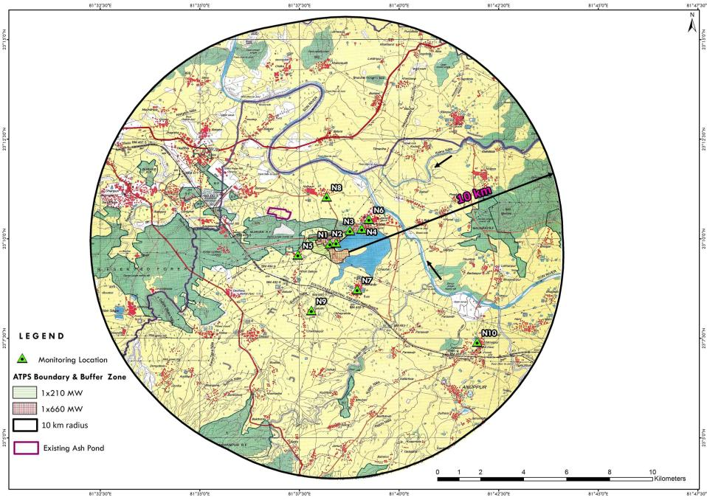
Noise monitoring location in study area

Slide 77
Baseline environmental quality of study area
Noise Levels in study area ( 10 monition locations )
Day equivalent noise levels
Location | Values dB(A) | Standard dB(A)
Industrial area | 53.3 to 63.3 | 75
Commercial area | 53.9 to 56.1 | 65
Residential area | 53.8 to 53.9 | 55
Silence zone | 49.5 to 49.9 | 50
Night equivalent noise levels
Industrial Area | 42.6 to 47.9 | 70
Commercial area | 43.3 to 43.4 | 55
Residential area | 42.5 to 43.9 | 45
Silence zone | 39.9 | 40
Based on above analysis noise levels in study area are within the Noise Pollution Rules, 2000
Report

Slide 78
Noise levels at project boundaries – dB (A)
Site boundary | Latitude | Longitude | Baseline | Predicted | Post Project
North | 23º 10’ 00’ | 81º 38’ 01” | 60.0 | 43.9 | 60.1
East | 23º 09’ 26’ | 81º 38’ 20” | 57.0 | 55.9 | 59.5
South | 23º 09’ 22’ | 81º 38’ 25” | 50.0 | 39.9 | 50.4
West | 23º 09’ 38’ | 81º 37’ 55” | 68.0 | 47.9 | 68.0
Noise Standard for Industrial area : 75 dB(A) Noise sources spread across proposed facility
Noise generating equipment
Sources | Noise level dB(A) | Area
ID & FD Fans | 100 | Near boiler stack areas
Turbines generator | 92 | Near generator area
DG sets generator | 90 | Near DG set area
Cooling tower | 85 | Near Cooling tower area
Crusher unit | 80 | Near Coal handling plant
ESP & FGD | 80 | Near FGD proposed for both plants
Boilers & feed pumps | 78 | Near boiler house
DM plant | 70 | Near DM plant
ETP & STP | 69 | Near ETP area
* at a distance of 1 m from the source

Slide 79
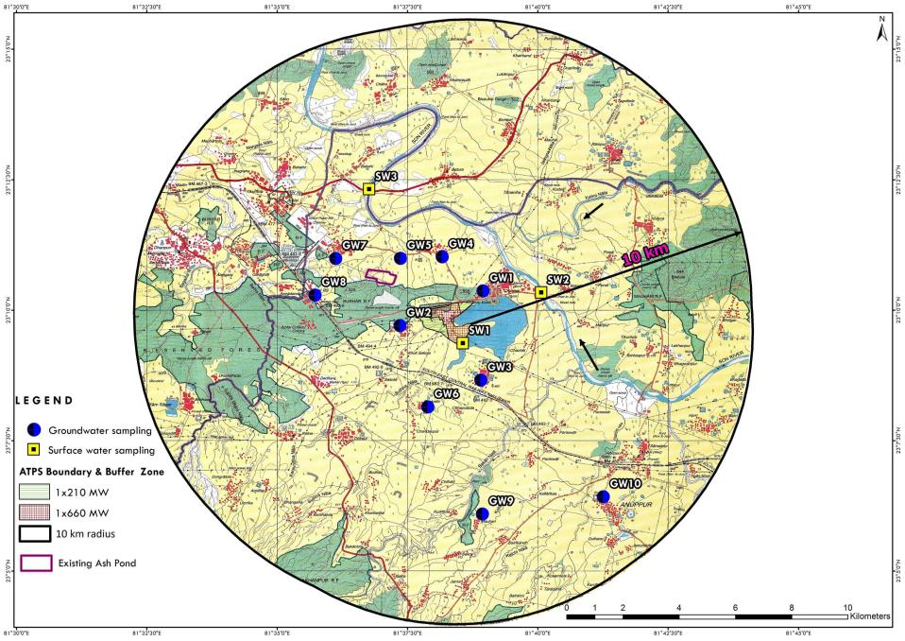
Surface & Ground water sampling location

Slide 80
Baseline environmental quality of study area
Water environment in study area
Surface water (samples from 3 major lake)
Location |  | pH | EC (µS/cm) |  | DO mg/l | BOD mg/l | Boron mg/l | Total coliforms MPN / 100 ml | Class
Chachai lake |  | 7.6 | 320 |  | 4.4 | < 3 | 0.17 | 130 | C & D & E
Sone river ( Up Stream) Plant |  | 7.3 | 278 |  | 4.2 | < 3 | 0.1 | 140 | C & D & E
Sone river ( Down Stream) Plant |  | 7.8 | 2200 |  | 2.8 | 18 | 0.25 | 350 | E
Designated Best Use Water Quality Criteria
Drinking Water Source without conventional treatment but after disinfection | 6.5 -8.5 | 6.5 -8.5 |  |  | >= 6 | <= 2 | -- | < = 50 | A
Outdoor bathing (Organised) | 6.5 – 8.5 | 6.5 – 8.5 |  |  | >= 5 | <= 3 | -- | <=500 | B
Drinking water source after conventional treatment and disinfection | 6 – 9 | 6 – 9 |  |  | >= 4 | <= 3 | -- | < = 5000 | C
Propagation of Wild life and Fisheries | 6.5 – 8.5 | 6.5 – 8.5 |  |  | >= 4 | Free NH₃ ( as N) <= 1.2 mg/l |  |  | D
Irrigation, Industrial Cooling, Controlled Waste disposal | 6.0 – 8.5 | 6.0 – 8.5 | Max 2250 | Max 2250 | Sodium absorption ratio <= 26 |  | < = 2 | -- | E
Lab report
Back to ToR Q

Slide 81
Baseline environmental quality of study area
Water environment in study area
Ground water ( samples from 10 locations)
 | Value | Standard | Details
pH value | 6.8 to 7.8 | 6.5 to 8.5 | Indicates pH values of all GW samples are within acceptable limits.
TDS | 214 mg/l to 762 mg/l | AL: 500 mg/l PL: 2000 mg/l. | Indicates TDS values of all GW samples except samples collected from Amlai village & Anuppur village are within acceptable limits. The value of these two samples is above acceptable limit but within permissible limit.
Chloride (as Cl) | 22 mg/l to 158 mg/l | AL: 250 mg/l PL: 1000 mg/l | Indicates Chloride (as Cl) values of all GW samples collected are within acceptable limits
Total hardness (as CaCO3) | 132 mg/l to 528 mg/l | AL: 200 mg/l PL: 600 mg/l | Indicating sample from Mariaras village & Kelhouri village are within permissible limit. Whereas total hardness values of other samples are above acceptable limit but within permissible limit.
Fluoride (as F) | < 0.5 mg/l | AL: 1.0 mg/l PL: 1.5 mg/l | Indicates Fluoride (as F) values of all samples are within acceptable limits.
AL : Acceptable Limit; PL: Permissible limit
Report
Back to ToR Q

Slide 82
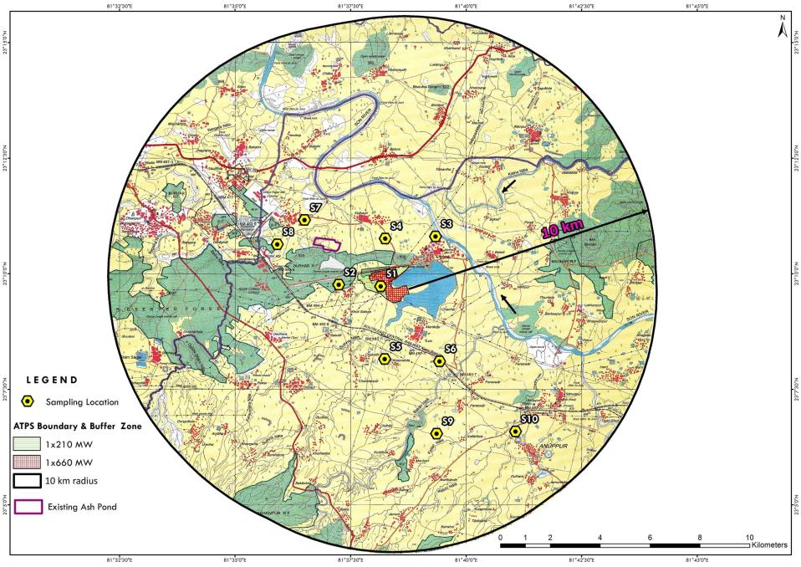
Soil sampling location

Slide 83
Baseline environmental quality of study area
Soil quality (samples from 10 locations)
 | Value | Details
PH | 6.4 to 7.4 | indicating all soil samples fall under normal category (Neutral pH range).
EC | 73 to 211 µS/cm | indicating all soil samples fall under normal category.
Organic carbon | 0.13 % to 2.30 %. | Samples collected from barren land at Deori village and Chachai village have low organic carbon content, Anuppur village sample has medium organic carbon content and rest of the sample have high organic carbon content.
Available nitrogen | 249 to 325 kg/Ha | Available nitrogen values of soil samples range from Six samples have low nitrogen content & remaining four samples have medium nitrogen content.
Available phosphorus | 10.8 to 24.6 kg/Ha | Indicating all samples have medium phosphorus content.
Available potassium | 60 to 161 kg/Ha | Six samples have low potassium content and remaining four have medium potassium content.
NPK values of soil samples collected are in low to medium category indicating need for fertilizers with high NPK values for agriculture and horticulture activities
Report
Back to ToR Q

Slide 84
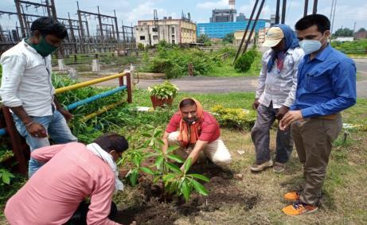
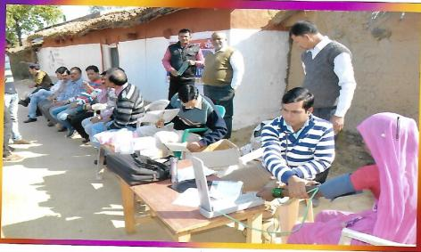
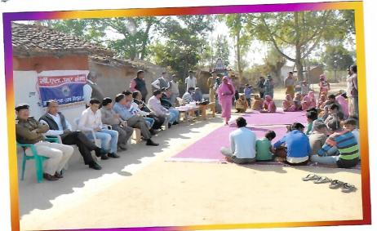
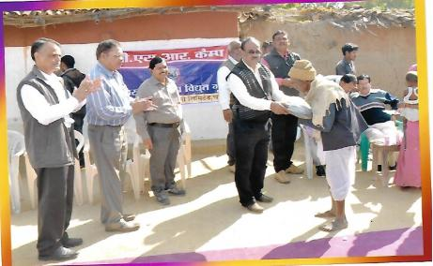
CSR activities carried out by the ATPS
Plantation activity
Medical Camp
Summary PH
Medical Camp
Warm Cloths distribution

Slide 85
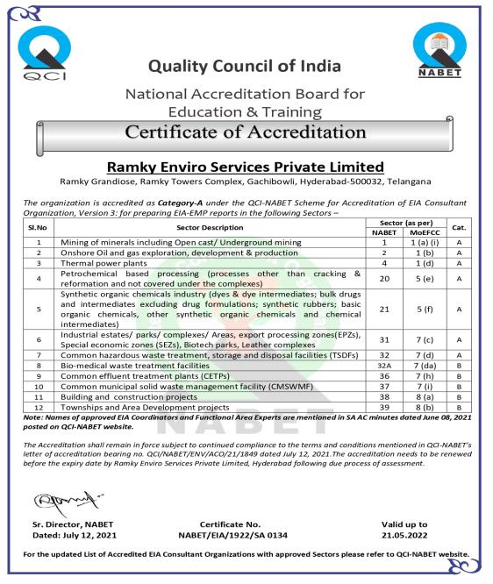
Certificate of Accreditation

Slide 86
Honorable Expert Appraisal Committee is requested to grant EC for proposed project
Thank You

