Slide 1

PRESENTATION TO THE EXPERT APPRAISAL COMMITTEE
FOR
FINAL ENVIRONMENT AND CRZ CLEARANCE FOR THE PROPOSED MULTIPURPOSE TERMINAL
AT
VILLAGE CHANJE, DISTRICT RAIGAD, MAHARASHTRA
PROJECT BY
KARANJA TERMINAL & LOGISTICS PRIVATE LIMITED (F.No. 11-59/2010-IA.III)
Date: December 21, 2012

Slide 2
THE FOLLOWING PRESENTATION IS DIVIDED INTO 6 SECTIONS
SECTION I - PROJECT BACKGROUND AND CURRENT STATUS
SECTION II -
SECTION III -
TOR COMPLIANCES
PUBLIC HEARING
SECTION IV -
GREEN INITIATIVES
SECTION V -
SECTION VI -
SECTION VII -
CSR INITIATIVES
CRZ STATUS
UTILITY REQUIREMENTS OF THE PROJECT
SECTION VIII -
ENVIRONMENTAL ASPECTS
Karanja Terminal & Logistics Private Limited

Slide 3
SECTION - I
PROJECT BACKGROUND
PROJECT BACKGROUND
CURRENT STATUS
STUDIES CONDUCTED
Karanja Terminal & Logistics Private Limited

Slide 4
ABOUT THE PROJECT
‘Karanja Terminal & Logistics Pvt. Ltd’ proposes to develop a ‘Multipurpose Terminal Facility’ along 1000m waterfront at Karanja creek sanctioned by the Maharashtra Maritime Board.
Proposed development will be carried out on about 80 hectares (60
hectares modeled) of inter tidal zone.
The proposed multi-purpose terminal will include container and general cargo jetties and a suitable yatch/boat parking facility.
Main cargo expected to be handled are Containers and Steel coils, including bulk and break bulk etc.
Proposed jetties will be designed to cater to vessels/barges of up to 4000 DWT to serve the various industries in the hinterland, facilitate coastal movement of cargo as well as serve to decongest the existing major ports in the vicinity.
Karanja Terminal & Logistics Private Limited

Slide 5
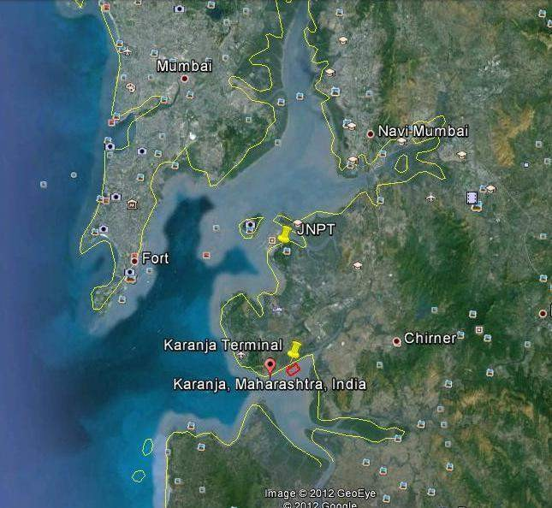

LOCATION MAP - 1
Karanja Terminal & Logistics Private Limited

Slide 6
CURRENT STATUS OF THE PROJECT
The project was considered in the EAC meeting on May 31, 2011 and subsequently received Terms of Reference (ToR) on June 16, 2011
The project was thereafter considered in the 75th meeting of the Maharashtra Coastal Zone Management Authority (MCZMA) on May 15, 2012, whereby MCZMA has recommended the proposal to MoEF
‘Consent to Establish’ received from Maharashtra Pollution Control Board (MPCB) on August 3, 2012
Public Hearing conducted on October 30, 2012 under the Chairmanship of Collector of Raigad District– received unanimous support from locals
Karanja Terminal & Logistics Private Limited

Slide 7
STUDIES /REPORTS CARRIED OUT
Market Research & Demand Analysis
CRZ Demarcation
CRISIL, Mumbai
Institute of Remote Sensing,
Anna University, Chennai
Maharashtra Maritime Board,
Royal Haskoning
Fresh Bathymetry Study
Pre-feasibility study for site selection
Master Plan Report
- Royal Haskoning
Environment Impact Assessment Report
- Fine Envirotech Engineers, Mumbai
Geotechnical Investigation
- DBM Geotech, Mumbai
Mathematical Modeling Studies
- WAPCOS, Pune
Marine Traffic Assessment
- Zebec Marine, Mumbai
Tide and Current Measurement
- Zenith Consulting, Mumbai
Traffic Study for Road Connectivity
- Aakar Abhinav Consultants, Navi Mumbai
Karanja Terminal & Logistics Private Limited
7

Slide 8
SECTION - II
TOR COMPLIANCES
Karanja Terminal & Logistics Private Limited

Slide 9
ToR Point No. 1 & 2
The proposed layout plan is occupying almost half of the width of the creek which will have a significant adverse effect on the mangroves in the upper reaches of the creek. The entire project facilities are in the inter- tidal zone and there is a patch of mangroves on the landward side of the layout plan. The present free inter- tidal water availability for these mangroves will therefore be influenced and become limited to water movements through culverts proposed under the approach roads.
Response:
Mathematical modelling carried out by CWPRS
Studied hydrodynamics before and after project completion
Study concluded that:
  No appreciable change in hydrodynamics post construction
  Entire reclamation falls in no flow zone and therefore does not disturb main channel, hence minimal or no disturbance to mangroves in upper creek
  Flow around reclaimed area not much affected except during peak currents thereby causing minimal disturbance to mangroves on the landward side
  Approach trestles to the facility from the mainland will be constructed on stilts/piles, therefore providing for uninterrupted tidal flushing of mangrove area
Karanja Terminal & Logistics Private Limited

Slide 10
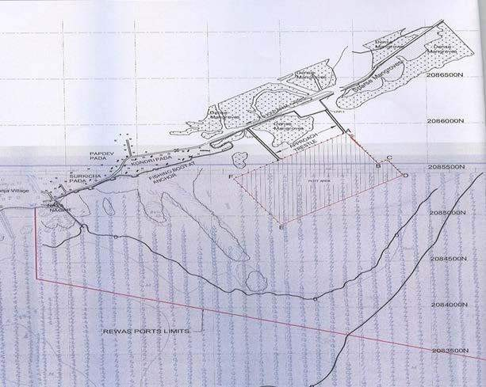
ToR Point No. 1 & 2 ….. Cont.
Entire reclamation falls in ‘no flow zone’ and therefore does not disturb main channel, hence minimal or no disturbance to mangroves in upper creek

Slide 11
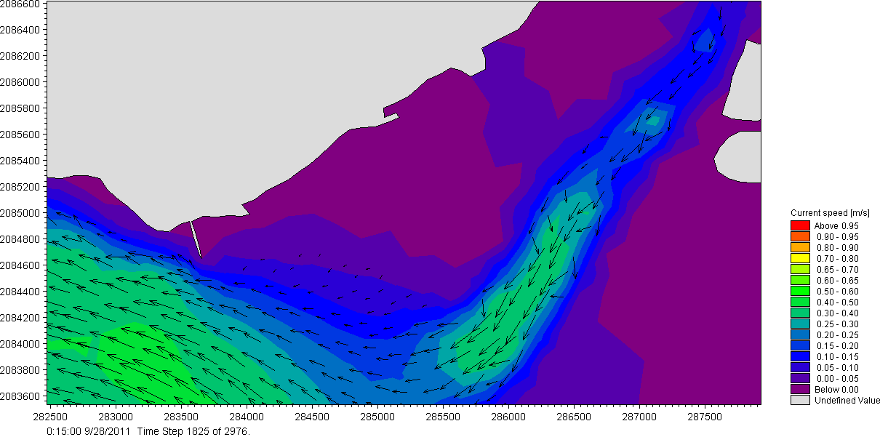
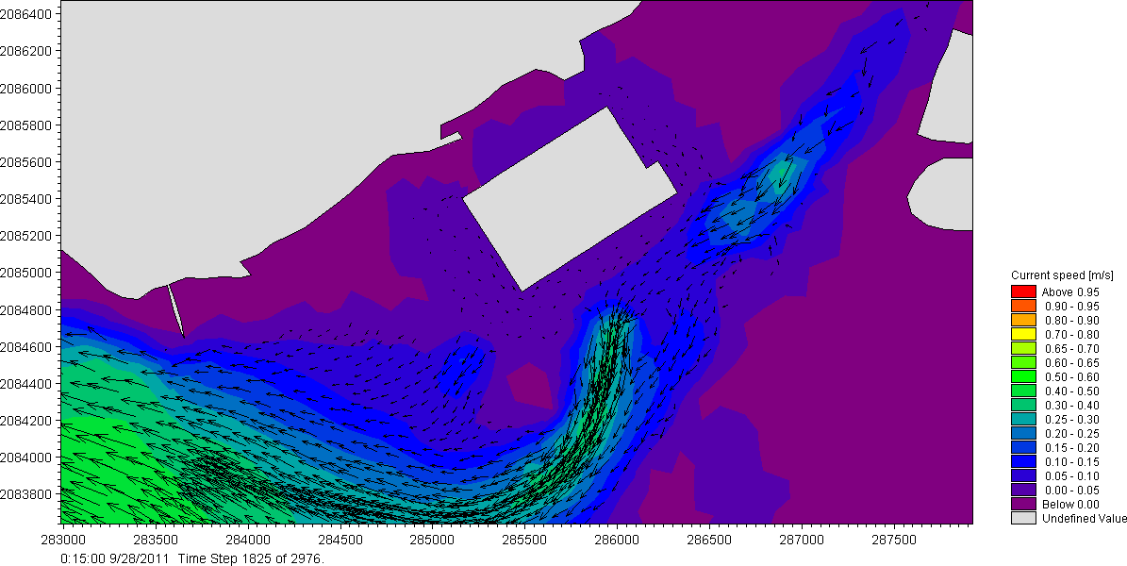
ToR Point No. 1 & 2 ….. Cont.
Pre- Construction: Predicted tide currents two and half hours after peak ebb current near thesite
Post construction the flow of sea water will get slightly aligned in the direction of landward side, and there will be more water flow to the
mangroves on
the side project.
landward
of the
Post Construction: Predicted tide currents two and half hours after peak ebb current near the site
As such the flow of tidal to the
mangroves on the landward side will not be adversely impacted post construction.

Slide 12
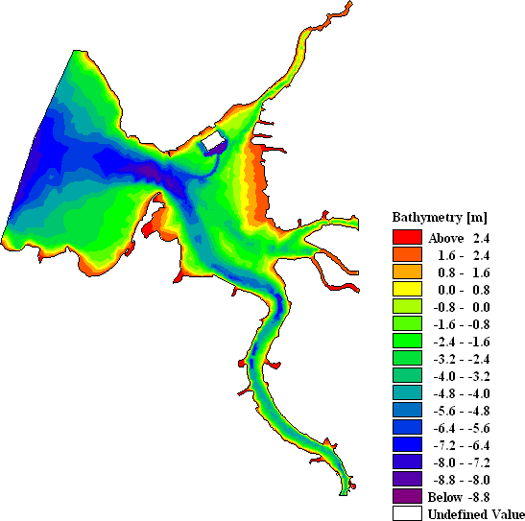
ToR Point No. 1 & 2 ….. Cont.
Bathymetry of the detailed model with proposed development

Slide 13
ToR Point No. 3
The Committee wanted to know the reasons for selecting the site with details of alternative sites examined earlier and rejected/ selected on merits with a comparative statement. The Committee also wanted to know if any other site within a radius of 50 km from the present site has been examined with scientific studies with a check list for selection or rejection and if so the details of the sites and if not why, and ask to submit a map of all the short listed sites on the latest satellite imagery.
Response:
KTLPL identified two additional sites with the help of Maharashtra Maritime Board
  Alibaug (approx. 24 miles south of JNPT) and
  Murud (approx. 47 miles south of JNPT)
Detailed alternative site evaluation study was carried out for all three sites
Evaluation criteria included navigation, port accessibility, environment / coastal /
hydraulic parameters, spatial planning, constructability and cost
Karanja was found to be the most suitable for the proposed development
Karanja Terminal & Logistics Private Limited

Slide 14
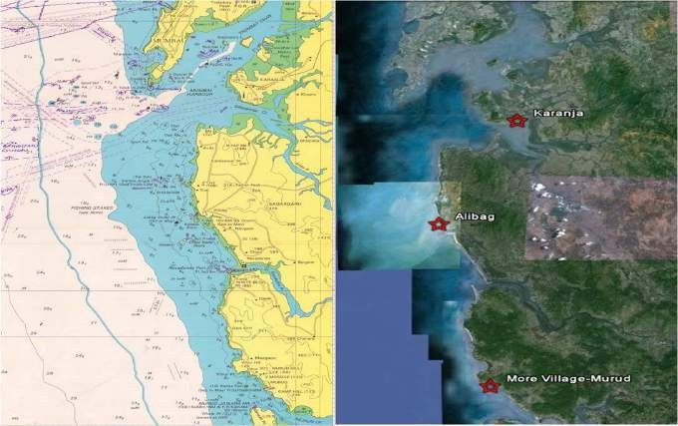
LOCATION MAP FOR ALTERNATIVE SITES
Karanja Terminal & Logistics Private Limited

Slide 15




Multi Criteria evaluation for alternative port site
score with 1 to 5 [1 being lowest rank (worse) and 5 being highest rank (best)]
 |  |  | Karanja | More Village, Murud | Alibag
1 | Navigation Navigability (Open Sea v/s Protected Harbour) Security (from Illegal Ship movement) Environment & coastal Erosion / accretion Mangroves Social habitation Fishing activity | 27% | 3.7 | 2.7 | 2
 |  | 65% | 4 | 3 | 2
 |  | 35% | 3 | 2 | 2
2 |  | 33% | 3.1 | 2.6 | 2.2
 |  | 20% | 4 | 2 | 1
 |  | 30% | 2 | 4 | 4
 |  |  | (more mangroves than other 2 sites) | (fewer mangroves) | (fewer mangroves)
 |  | 30% | 3 | 2 | 2
 |  | 20% | 4 | 2 | 1
Location of alternative port site
Fishingdata

Slide 16
Multi Criteria evaluation for alternative port site
score with 1 to 5 [1 being lowest rank (worse) and 5 being highest rank (best)]
 |  |  | Karanja | More Village, Murud | Alibag
3 | Port Accessibility | 20% | 4 | 3 | 2.5
 | a Connection to NH | 50% | 4 | 3 | 2
 | b Distance from City limits | 50% | 4 | 3 | 3
4 | Constructability | 13% | 3.6 | 3 | 2.4
 | a Movement to site | 60% | 4 | 3 | 2
 | b Long term expansion | 40% | 3 | 3 | 3
5 | Cost Aspects | 7% | 4 | 2 | 1.5
 | a Hard material dredging | 50% | 4 | 2 | 1
 | b Breakwater requirement | 50% | 4 | 2 | 2
 | Total |  | 3.6 | 2.7 | 2.2
Location of alternative port site

Slide 17
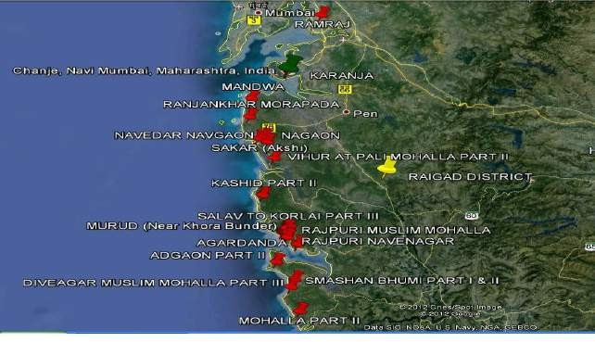
ToR Point No. 4
Though the proponent submitted that the site is not a hot spot as per the ICMAM study, the Committee suggested to conduct the shore line change study to know the erosion status. If site fall in high erosion zone, the project is not permissible as per the CRZ Notification, 2011.
Karanja Terminal & Logistics Private Limited

Slide 18
ToR Point No. 5
Study and submit the details of the feasibility of the project without the repairing works.
Response:
Techno-economic feasibility studied by MITCON – Report establishes feasibility of the project even without repairing works. The report concludes that the project is Feasible & Economically Viable.
The salient points in conclusion of the report are:
  The project is coming at prime location, near industrial hub such as Mumbai & Pune (Auto Hub of India) and therefore has ample scope.
  The operational viability of KTLPL project will further increase considering the present upward market trend in containerization.
  The project will generate Internal Rate of Return (IRR) of 17.5 %.
  The financial projection indicate adequate cash generation to service the financing charges and operational expenses.
Karanja Terminal & Logistics Private Limited

Slide 19
ToR Point No. 6
6. The water quality data in the preliminary EIA report circulated indicate very high levels of oil & grease. The activities like ship repairing and painting will therefore further aggravate water quality problems in the creek.
Response:
The high levels of oil & grease, reported in water quality were a typographical error. The levels are within permissible limits. Water sample testing was repeated to ascertain the same.
Parameter | Winter | Summer | Post Monsoon
Oil & Grease , mg/L | 0.8 | 0.9 | 0.5
Karanja Terminal & Logistics Private Limited

Slide 20
ToR Point No. 7
7. The comprehensive EIA to be conducted in case of the site suitability should incorporate the above observations and the monitoring should include representative sampling of the air, water, sediments, borehole sediments and their analysis for all parameters (including toxic metals) relevant to the activity.
Response:
Sampling Parameter Analysis
Karanja Terminal & Logistics Private Limited

Slide 21
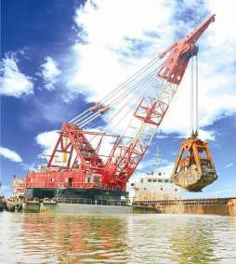
ToR Point No. 8 & 9
The comprehensive EIA should also submit the complete details in respect of the quality and the toxic metal contents of the dredged material and its use/disposal based on its composition.
Submit details of dredging, quality and method of disposal
Response to 8 & 9:
  Dredging will be carried out using a Grab Dredger.
  Dredging spoils will be carried to the dumping location in hopper barges & disposed to the extent possible during the ebb tides.
  Use of hose pipes for pumping out dredge spoils from the barges will be considered to limit dispersal of dredge spoil
Karanja Terminal & Logistics Private Limited

Slide 22
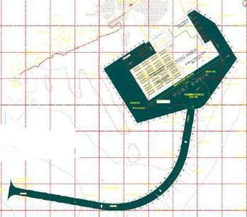
DREDGING DETAILS
Dredging plan:
Total estimated dredging quantity: approx 2.8 - 3mn Cubm.
Dredging of the approach channel and other navigational areas will be reduced by taking advantage of the tidal window available in Mumbai harbour.
Dredge depths (mtr): Approach channel : (-) 1.70 Berthing pocket : (-) 3.75

Slide 23
ToR Point No. 10
10. Submit details of tide gauge and velocity profile to check model calculations.
Response:
Fresh tide and current measurements were undertaken and the same for model calculations.
Surveyor : Zenith Surveys (I) Pvt Ltd.
were used
Equipment used
vessel.
: Valeport 106SR/DR Current Meters lowered from the surveying
Study Location
: 3 (upstream, jetty area & channel)
Recording interval : 10 minutes
Karanja Terminal & Logistics Private Limited

Slide 24
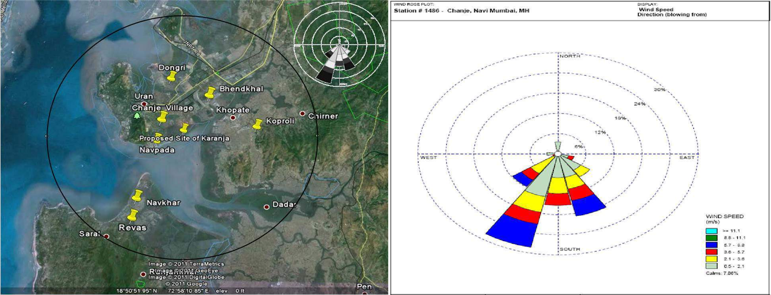
ToR Point No. 11
11. Selection of the sampling location shall be based on the wind rose. Submit the details.
LOCATION OF SAMPLING IN STUDY AREA
Karanja Terminal & Logistics Private Limited

Slide 25
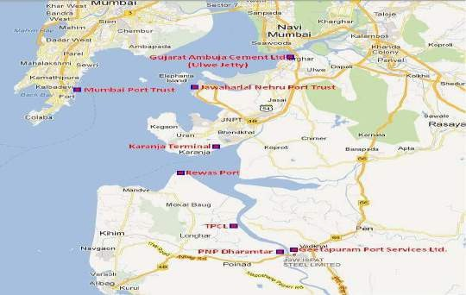
ToR Point No. 12
12. Marine Traffic should not affect others, submit the analysis.
Response:
Marine traffic was analysed for MPT, Ulwe Jetty, JNPT, Karanja Creek, Rewas Port,
TPCL, PNP-Dharamtar Jetty.

Slide 26
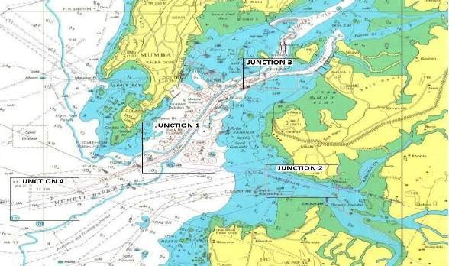
ToR Point No. 12 ….. Cont.
Four critical junctions were identified for the purpose:
Junction 1: Mumbai Port Trust
Junction 2: The region near Rewas headland / Karanja creek entry
Junction 3: The traffic coming to/from JNPT.
Junction 4: The traffic exiting/entering the Mumbai harbour will intersect.

Slide 27
ToR Point No. 12 ….. Cont.
As per the study, the utilization at Junction 2 will be 37.95%, while that at Junction 1, 3 & 4 would remains below 30%.
The study concludes that overall channel utilization will be low, without any congestion and projected traffic at Karanja terminal will not create any hindrance to vessels calling at MbPT and JNPT.

Slide 28
ToR Point No. 13
13. Submit recommendation of SCZMA
Response:
Recommendation from the Maharashtra Coastal Zone Management Authority (MCZMA) submitted. Excerpts from minutes of the meeting of the MCZMA below:
“After detailed discussion the Authority decided to recommend the proposal to MoEF subject to compliance of following conditions:
Karanja Terminal & Logistics Private Limited

Slide 29
ToR Point No. 13….. Cont.
Sr. No | Condition | Compliance
1. | Prior permission of High Court should be obtained if mangroves destruction is involved in the proposed activity. If mangroves destruction is involved, the project proponent should submit quantitative details of the mangroves affected by the proposed activity and plan for compensatory plantation of mangroves. | No destruction of mangroves is involved
2. | The waste generated due to proposed activity should not be disposed off in the CRZ area. | Onsite Sewage Treatment Plant (STP) of 50 cmd capacity will be installed. Sewage will be used as manure for green belt development.
3. | No chemical products should be stored in the CRZ area except those permissible as per the Annexure II of the CRZ Notification 2011 | Only cargoes permissible under CRZ Notification 2011 will be handled.
4. | Construction on the stilt only without affecting the Mangroves and Tidal flow in the Mangroves area. | Layout plan is based on this requirement.

Slide 30
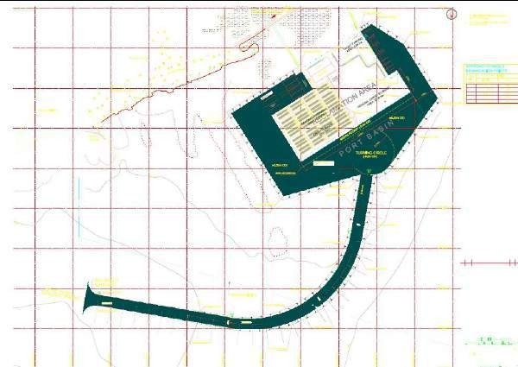
PROJECT PLAN
Karanja Terminal & Logistics Private Limited

Slide 31
ToR Point No. 14
14. Study likely impact on marine environment and submit EMP with budgetary provisions
ENVIRONMENTAL MANAGEMENT COST
Sr. No | Items | Cost (INR) during Construction (in Lakhs) | Cost (INR) during Post-Construction Per annum (in Lakhs)
1 | Air Environment | 12 | 7.5
2 | Water Environment | 6.5 | 8.5
3 | Noise Environment | 5.5 | 3.5
4 | STP - O & M | ----- | 22
5 | Green belt | 7.5 | 3.5
 | Total EMP Cost | 31.5 | 55
In addition to this, the Capital Cost of ETP is Rs. 55 lakhs and STP is Rs. 25 lakhs.
Also, Green Belt development cost will be Rs. 20 lakhs.
Karanja Terminal & Logistics Private Limited

Slide 32
ToR Point No. 15
Submit likely impact on Mangroves and proposed mitigation
Response:
  A preliminary report on ‘Mangrove Management and Development Plan’ prepared
by PEC Solutions (CSR Consultant to project proponent)
  KTLPL proposes to undertake mangroves development program at the project site
  In addition, the company is also exploring to develop mangroves at sites other than the proposed project site, which will be identified in consultation with local authorities
  The company has set aside a budget of Rs. 1 Crore to develop mangroves over the next 5 year period
Karanja Terminal & Logistics Private Limited

Slide 33
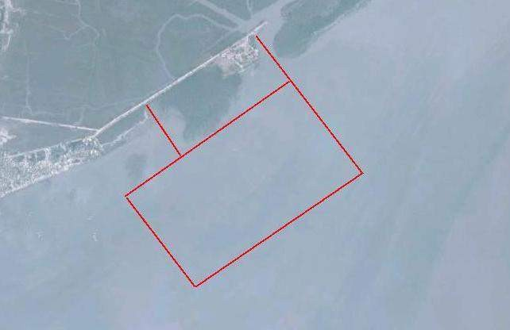
MANGROVE MANAGEMENT & DEVELOPMENT
MANGROVE DEVELOPMENT PLAN AT PROJECT SITE:
The company will enable further development of mangrove areas. This will result in an increase in the surface area of mangroves, which the company is proposing to take up as part of its CSR plan.
Karanja Terminal & Logistics Private Limited

Slide 34
MANGROVE MANAGEMENT & DEVELOPMENT
MANGROVE MANAGEMENT PLAN:
The project is being planned in such a way that there is no direct impact on the mangroves area. The project does not involve any destruction or removal of mangroves.
Causes of Indirect Impact on mangroves and mitigating measures:
Altered Tidal Flushing
Irrigation channels will be provided for mangroves to minimise impact
Slippage of Fill
Engineering measures to manage and/or prevent slippage of fill, as much as practicable, include the use of rock armouring to contain fill and stabilise earth fill
Dust Deposition
watering of unsealed roads, exposed surfaces, active construction areas and stockpiles;
use of environmentally safe dust suppressants;
restriction of vehicle movements and vehicle speeds to reduce dust emissions;
Karanja Terminal & Logistics Private Limited

Slide 35
RECLAMATION DETAILS
Total area envisaged for reclamation is about 80ha.
It is located seaward of the existing protective saltwater bund and around 250 to
300m from the shoreline.
Material will be procured from the authorised quarry and also from dredged material. Dredged material is expected to constitute approximately 20% of total fill material.
Total fill required is estimated to be about 3.8 million cum.
Karanja Terminal & Logistics Private Limited

Slide 36
SECTION – III
PUBLIC HEARING
36

Slide 37
PUBLIC HEARING
The Environmental Public Hearing was conducted on 30th Octber, 2012 at 11.30 am at Rajiv Gandhi Town Hall, Uran, Tal Uran, Dist. Raigad.
Officials present
  Shri H.K. Jawale,
Raigad,
District Collector & District Magistrate,
Shri
^{B.B. Nimbarte,} Regional Officer, MPCB, Member, Navi
Mumbai,
Shri Sujit Dholam, Sub Regional Officer, MPCB, Navi Mumbai III,
Convenor.
Q & A

Slide 38
PUBLIC HEARING
Major issues/concerns raised by locals during the Public Hearing included:
Employment (preference to locals)
Compensation to Fishermen community in case of casualties (to
be discussed and agreed upon by Joint Committee of local fishermen, project proponent and local government officials)
Education (addressed as part of CSR initiatives)
Land acquisition (no land acquisition involved)
Kind of cargo to be handled at the port (environmentally
damaging cargo will not be handled)
Q & A

Slide 39
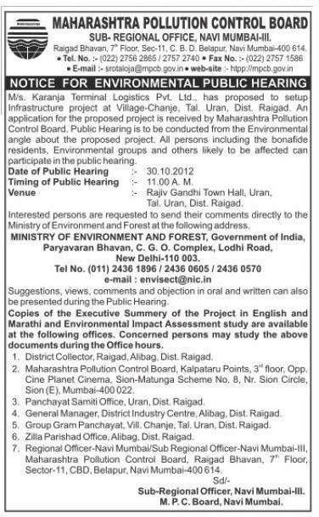
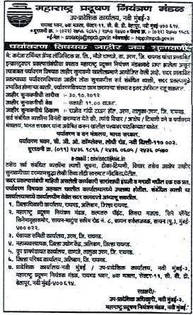
PUBLIC HEARING
PUBLIC NOTICE IN NEWSPAPERS

Slide 40
SECTION - IV
GREEN INITIATIVES AND INNOVATION
Karanja Terminal & Logistics Private Limited

Slide 41

FIRST GREEN PORT OF INDIA
Registered the project with Indian Green Building Council (IGBC)
IGBC Membership – CS - 1910
Registration of project – (GF- 121063) certification procedure.
Instituted ‘Sustainability Policy’ – Port to comply with standards of IGBC
Appointed certified Green Accredited Sustainability Advisor Mrs. Mala Singh (PEC Solutions) on advisory board
PEC Solutions to undertake design analysis, energy modeling and simulation and Environmental analysis as per IGBC standards
Continuous monitoring and internal audit of compliances will be the
responsibility of PEC

Slide 42

EMP THROUGH GREEN INNOVATION

Slide 43
METHODOLOGY AND APPROACH
5 Elements of Earth (for analysis)
Site Sustainability
Water Sustainability
Energy Sustainability
Material Sustainability
Green Innovation & education

Slide 44
WATER SUSTAINABILITY
Water efficient fitting fixtures as per IGBC standards (more than 40% reduction than baseline )
Rain water harvesting by collecting roof & surface storm water run off in the storage sump, which will be reused for flushing & irrigation purpose.
Waste water treatment plant 50 cu.m. with MBR technology for recycling and reuse(zero discharge)
Water efficient irrigation system by using drip irrigation & sprinkler etc.
Water metering for measurement & verification
Frequent water audits

Slide 45
ENERGY SUSTAINABILITY
Energy Efficient lightings in combination of LED, T5 & CFL. Solar pole lights will be also explored for exterior lighting designs
5 star rated (BEE) electrical equipment's & fixtures.
Energy efficient air conditioning fixtures (CFC free) as per ASHRAE & ECBC standard.
Captive Power Generation
On site renewable energy – solar power generation will be done on site for common area lighting and other innovative technologies will be also explored through analysis during energy modeling & simulation
Optimized building envelope in the design
Performance approach for energy modeling
Continuous Energy Audit

Slide 46
SECTION - IV
CSR INITIATIVES
PROPOSED DEVELOPMENT PROGRAMS FOR THE COMMUNITY
Karanja Terminal & Logistics Private Limited

Slide 47
CSR INITIATIVES
The company proposes to spend 2% of the project cost on CSR initiatives over the tenure of its lease agreement with the Maharashtra Maritime Board.
CSR Program will address the following areas for community development in the Chanje area:
Education / Literacy Enhancement
Employment / Skill Development
Community Development
Health and Sanitation
Help to the Fishermen Community
Social amenities/Infrastructure Development
Environment Protection
: 15%
: 20%
: 10%
: 15%
: 15%
: 10%
: 15%
These are indicative percentages; Actual expenditure amongst these thrust areas will depend upon local needs and discussion with local government bodies, citizen forums etc.
Karanja Terminal & Logistics Private Limited

Slide 48

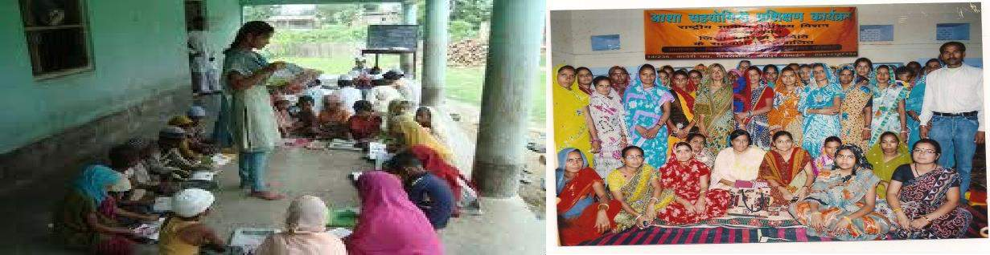
CSR INITIATIVES – EDUCATION & SPORTS
Educational support in the form of distribution of stationery like books etc., will be provided to the children of neighboring communities/villages.
Students with higher grades will be offered scholarship for higher education.
Up-gradation/Repair work/Painting of existing education buildings will be carried
out
Skill development programs will be proposed for womenfolk to enhance their quality of life & for their better livelihood.
Computer training courses to be sponsored for interested candidates.
Financial support for developing sports facilities such as playgrounds and gymnasiums will be provided
Karanja Terminal & Logistics Private Limited

Slide 49
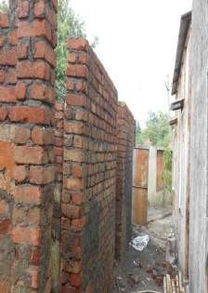
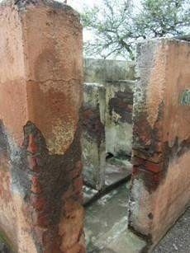
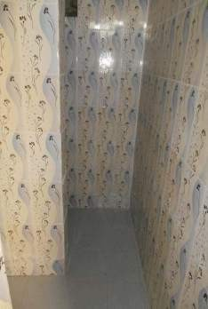
At DEVPARA – Primary school for the children of salt pan workers
Construction of new
toilet blocks
Before Renovation
After Renovation
49

Slide 50
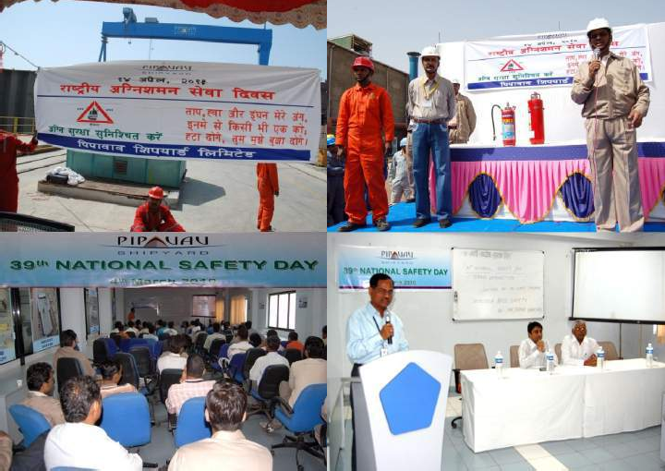
Health and Safety Awareness Programs
50

Slide 51
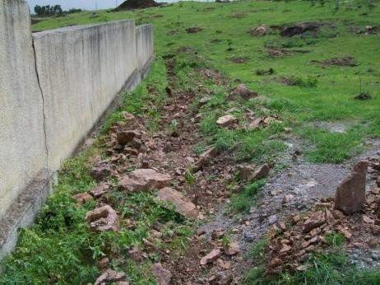
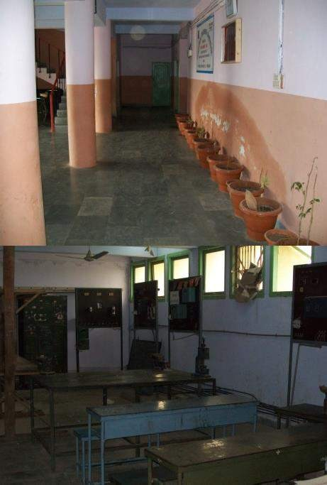
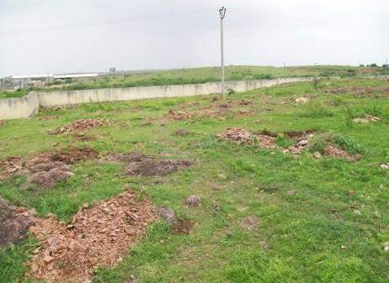
Adopted the ITI (Industrial Training Institute) at Rajula & Mahuva, provide training opportunity
to ITI students at company premises
BEFORE
51

Slide 52
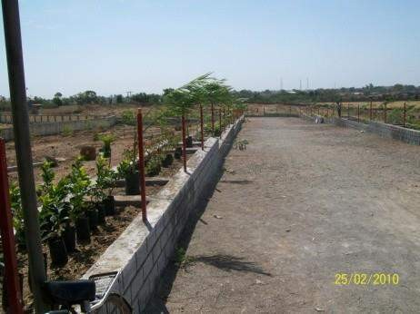
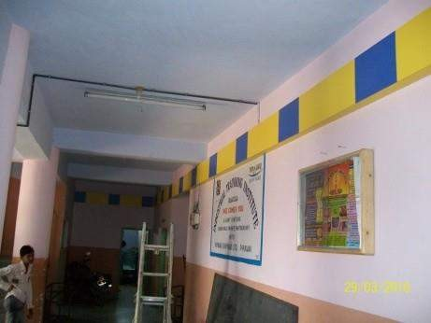
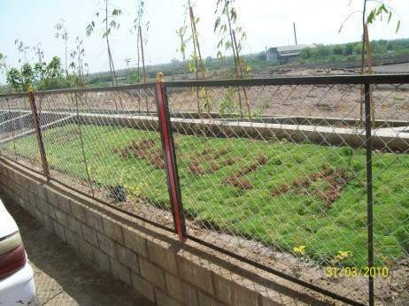
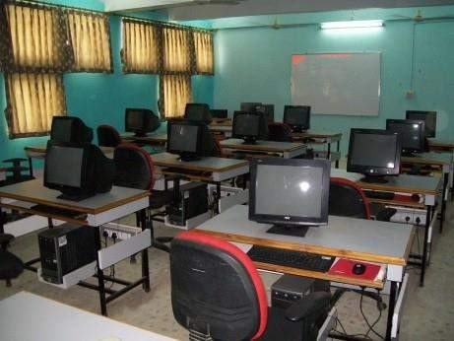
Adopted the ITI (Industrial Training Institute) at Rajula & Mahuva, provide training opportunity
to ITI students at company premises
AFTER
52

Slide 53
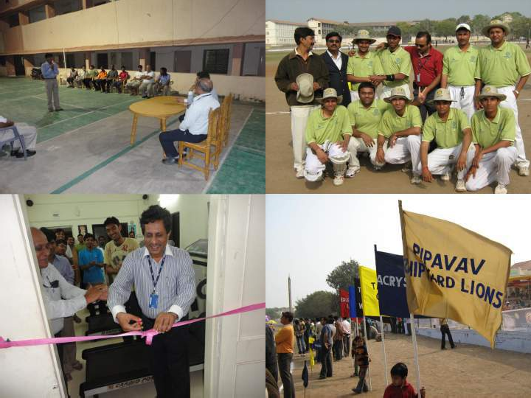
Financial support for developing sports
facilities such as playgrounds and gymnasiums
53

Slide 54
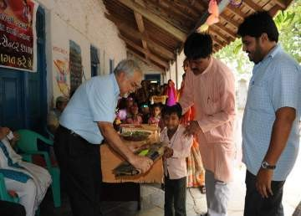
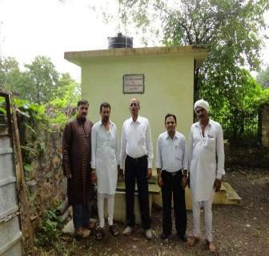
Educational support in the form of distribution of stationery
Provide financial support in developing public toilet
facilities
At BEHRAI Village –
Constructed new toilet
At BEHRAI Village – Essential Facilities for School
Distributed School Bags to students
54

Slide 55
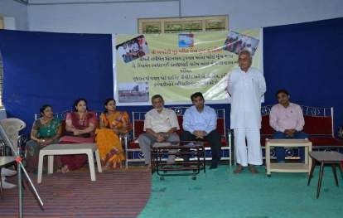
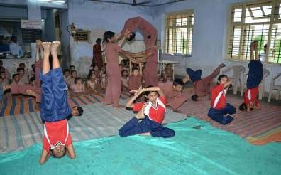
At AMRELI Village – Muk Badhir Trust School for the Hearing impaired
The school has 65 boarders and 15 day scholars.
Provided aid for Hearing Machines, dining facility and Education
55

Slide 56
CSR INITIATIVES - EMPLOYMENT
The facility expects to create approximately 200-500 direct and indirect
jobs as well as several opportunities for local entrepreneurs
The company proposes to tie up with local Industrial Training Institutes (ITIs) for introducing new courses to train and equip local youth with relevant skill sets for the job opportunities being created
Preference for local youth in employment
Employment/Career counseling workshops will be conducted to guide local youth in making educated and informed career choices
Karanja Terminal & Logistics Private Limited

Slide 57
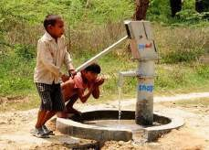
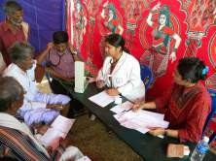
CSR INITIATIVES – HEALTH & SANITATION
Free medical and dental camps will be conducted for locals on a periodic basis, along with free distribution of medicines
Ambulance will be donated as additional health facility to the locals
Safe drinking water facility will be provided.
Sanitation facilities will be provided for the villagers, wherever
needed.
Karanja Terminal & Logistics Private Limited

Slide 58
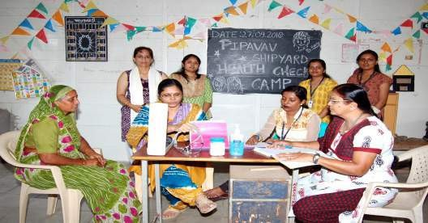
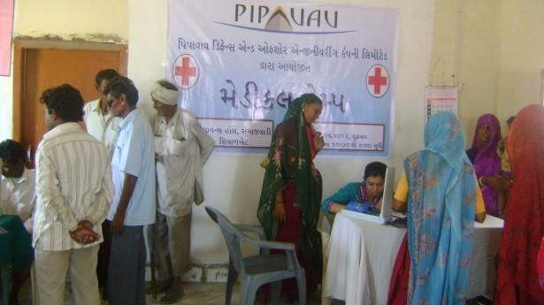
Free medical and dental camps conducted for locals on a periodic basis, along withfree
distribution of medicines
58

Slide 59
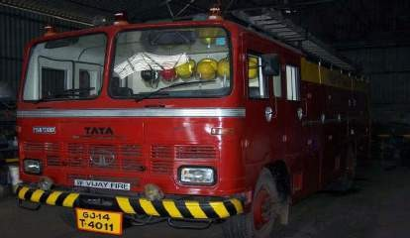
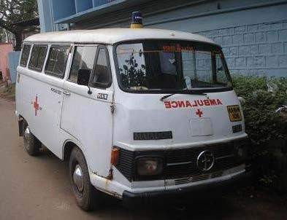
Emergency Assistance for neighbouring villages
Free ambulance
service for all
Provide Emergency assistance for neighbouring villages and industries during fire accidents, flood, building collapse, rescue from bore well, and others
50

Slide 60
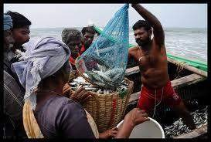
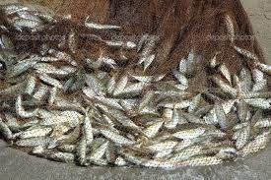
CSR INITIATIVES – FISHERMEN COMMUNITY
Company proposes to install solar lamps in the fish market
Provide financial support in developing public toilet facilities near the fish market
Provide financial support in developing a cold storage facility for the local
fishing business
Karanja Terminal & Logistics Private Limited

Slide 61
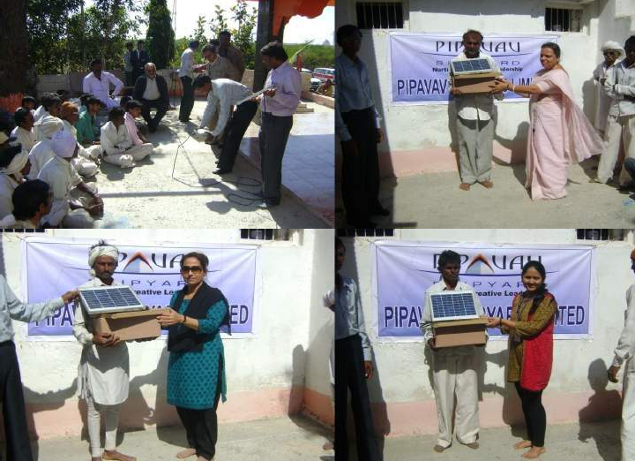
Distribution of Solar Panels & Training to Fishermen

Slide 62
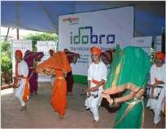
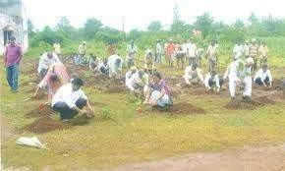
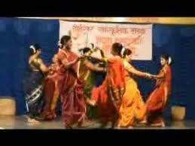
CSR INITIATIVES – SOCIAL & CULTURAL
Company will support from time to time the required development in the
village for better quality of life.
Awareness Programme will be conducted to educate the local people to save the environment & will arrange Tree Plantation programme at various intervals during a year.
Social Gathering & Cultural activities will be facilitated by the company from time to time
Karanja Terminal & Logistics Private Limited

Slide 63
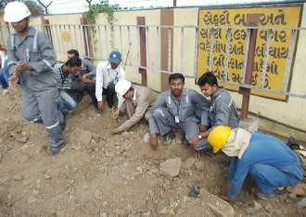
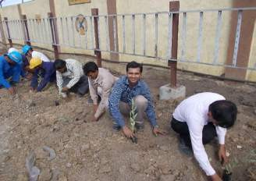
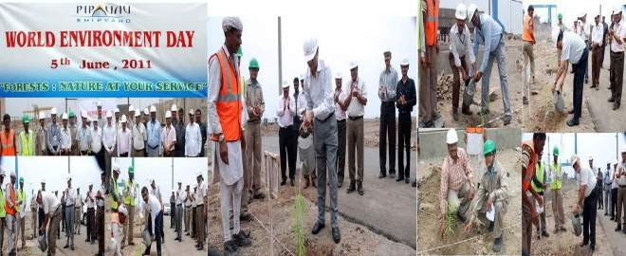
More than 12,000 trees planted over 3 years

Slide 64
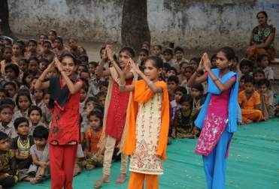
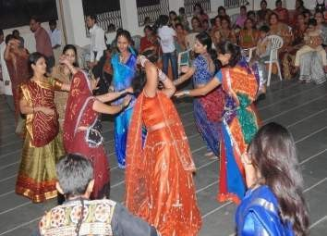

Social Gathering & Cultural activities

Slide 65
SECTION - V
CRZ STATUS
CRZ DEMARCATION STUDIES
SUPERIMPOSITION OF CONCEPT PLAN ON CRZ MAP
Karanja Terminal & Logistics Private Limited

Slide 66
CRZ STATUS
Location of the proposed terminal / jetty is in CRZ – I area, which is permissible activity under CRZ rules
As per the CZMP, bund is HTL line
Project engineering will be such that, there will be least damage to the mangroves area
To further minimize disturbance to the mangroves, approach to the proposed facility will be on the elevated columns / piles thus allowing for continuous, uninterrupted availability of saline water for mangroves
CRZ demarcation studies carried out by Institute of Remote Sensing, Anna University, Chennai, which is an MoEF approved agency
Karanja Terminal & Logistics Private Limited
66

Slide 67

CRZ STATUS- Demarcation
HTL, LTL And CRZ Boundaries Are Demarcated In 1:4000 Scale Maps.
Karanja Terminal & Logistics Private Limited
67

Slide 68
SECTION – VI
UTILITY REQUIREMENTS FOR THE PROJECT
WATER AND WASTEWATER SCENARIO
ENERGY REQUIREMENT
FIRE FIGHTING AND FIRE PROTECTION SYSTEM
SOLID WASTE MANAGEMENT
Karanja Terminal & Logistics Private Limited

Slide 69
WATER REQUIREMENT AND SUPPLY (SOURCE)
 | Quantity
Water uses | 50 m³/day
Water supply (source) | CIDCO/MIDC/MJP
Karanja Terminal & Logistics Private Limited
69

Slide 70
WASTE WATER TREATMENT
Sewage generated will be treated in on site sewage treatment plant and
treated effluent will be used for green belt development and utilities.
Waste water from offices and stockyards will be transported to a treatment
facility as required.
A drainage system will be provided with buried perforated drain lines connected to open concrete trenches.
Effluent generated from the washings from storage area will be treated fully appropriately.
Karanja Terminal & Logistics Private Limited
79

Slide 71
ENERGY
ELECTRICAL LOAD ESTIMATE
During Construction Phase | : | 500 KVA
During Operation Phase | : | 1.0 MW
Power Supply | : | MSEB
DG POWER BACK _UP
100% DG Power back-up proposed
Selected DG capacity | : | 1 DG sets of 500 KVA
Karanja Terminal & Logistics Private Limited
71

Slide 72
FIRE FIGHTING & FIRE PROTECTION SYSTEM
The facilities developed at the Multi Purpose Terminal based on Indian Standards and shall conform to provisions of the Tariff Advisory committee’s fire protection manual
A fire alarm system activated by push buttons will be installed at strategic locations.
Smoke detectors and fire alarm system shall be provided at all operating control rooms, operating cabins, MCCs and Offices
Suitable fire extinguishers shall be provided in all MCCs, electrical houses and Transfer towers as well as offices
Wet type Fire hydrants shall be provided at all Transfer points, Truck loading stations, jetties, and outside all building premises.
Adequate arrangements with automatic jockey pumps, pressure switches etc., shall be provided.
Karanja Terminal & Logistics Private Limited
72

Slide 73
SECTION – VII
ENVIRONMENTAL ASPECTS OF THE PROJECT
ENVIRONMENT MANAGEMENT PLAN
ENVIRONMENT MANAGEMENT COST
BASELINE ENVIRONMENTAL DATA
Karanja Terminal & Logistics Private Limited
73

Slide 74
ENVIRONMENTAL MANAGEMENT PLAN
S.N | Components | Mitigative Measures
 |  | Construction phase | Operation phase
1 | Air | Water sprinkling Vehicles with valid PUC Maintaining smooth traffic flow Restriction open burning of solid waste Pre-cast construction with in-situ concrete topping will be adopted | Water sprinkling at all the areas prone to dust emissions Exhaust emissions from ships/vessels shall be controlled on the shipitself Day to day management and maintenance of the facility and the ancillary structures
2. | Noise | Barricades along the periphery of the site Ear plugs for workers work during day time Proper maintenance of construction equipment Continuous Noise monitoring will be carried out during operational phase to collect comparative data. | Workers exposed to excessive noise will be given appropriate PPEincluding ear plugs, muffs, or both Green belt development plan Major Noise generating equipment will be designed such that the cumulative noise at a distance of 1m remains 80 Db(A)
Karanja Terminal & Logistics Private Limited

Slide 75
ENVIRONMENTAL MANAGEMENT PLAN
S.N | Components | Mitigative Measures
 |  | Construction phase | Operation phase
3. | Water | Construction water will be channelized properly A water storage system to be created no treated or untreated waste water shall be let into the water body. | Use of water saving practices Provision of waste water treatment facility –STP Recycling of treated water from STP for non potable use Oil & grease traps will be installed on sewers and SWD Drainage system shall be buried perforated drain lines connected to open concrete trenches. No ballast water shall be discharged from the vessel All vessels will comply with all of the design and pollution prevention equipment provisions specified in The International Convention for the Prevention of Pollution from Ships, 1973, as modified by the protocol of 1978 (MARPOL, 73/78) guidelines.
Karanja Terminal & Logistics Private Limited

Slide 76
ENVIRONMENTAL MANAGEMENT PLAN
S.N | Components | Mitigative Measures
 |  | Construction phase | Operation phase
4 | Land | Use of excavated materials for leveling and backfilling Proper and separate storage of construction materials Storage of petroleum products on impervious layers viz, concrete Usage of oil trays wherever oil spillage is expected. Segregation of garbage at source | A green strip of local trees on both sides of the road will be planted on the approach roads Tree loss due to access roads, if any, will be mitigated by tree planting programs at the ratio of 1:2, i.e. two tree plantations for one tree cutting. Oil from oily wastes willbe sent for recovery and re-use. Solid waste will be segregated into recyclable, degradable and Non- degradable at site itself.
5. | Biological | Plantation of trees will start in mid of construction phase Proper maintenance of machinery. Regulation of vehicle trips and speed. | Landscaping Plantation of local tree species.
Karanja Terminal & Logistics Private Limited
76

Slide 77
ENVIRONMENTAL MANAGEMENT PLAN
S.N | Components | Mitigative Measures
 |  | Construction phase | Operation phase
6. | Socio Economic | Adequate water facility Personal protective and safety equipment will be provided First aid facility. Educational and awareness programme for safety measures. | Environmental awareness programme for surrounding area. Disaster management plan will be prepared.
Karanja Terminal & Logistics Private Limited
77

Slide 78
ENVIRONMENTAL MONITORING PLAN
DURING OPERATION PHASE
 | ITEM | PARAMETERS | FREQUENCY | LOCATION
1. | Ambient Air Quality | SPM,RSPM,SO₂, NO_{X},HC &CO | Quarterly | Total 3 Stations around periphery of the site.
2. | Noise Level | Equivalent noise level | Quarterly | Near DG sets, Near STP, Near parking area.
3. | Exhaust from DG Set | SPM, SO₂ | Quarterly | Stack of DG sets.
4. | Water Analysis | Physical, chemical and Biological parameters | Weekly During rainy season | Harvested water stored in tank (After treatment).
5. | Wastewater Analysis | pH, BOD, COD, TSS TDS, O & G | Monthly | Before & after treatment from STP.
Karanja Terminal & Logistics Private Limited

Slide 79

SAMPLING LOCATIONS
Sr. No | Study Location | Direction | Distance from Site (km)
1. | Proposed project Site | At Site | -
2. | Navapada | East | 2.24
3. | Koproli | West | 5.42
4. | Dongri | North | 4.30
5. | Revas | South | 8.40
6. | Chanje Village | North-west | 1.84
7. | Bhendkhal | North-east | 3.37
8. | Navkhar | South-west | 6.71
Karanja Terminal & Logistics Private Limited
79

Slide 80
AIR QUALITY DATA
AVERAGE AMBIENT AIR MONITORING REPORT (DURING SUMMER)
Sr No. | SITE LOCATION | CONCENTRATION OF AIR POLLUTANTS
 |  | SO2 μg/m3 | NO2 μg/m3 | Particulate Matter (PM10 μg/m3) | Particulate Matter (PM2.5 μg/m3) | Carbon Monoxide mg/m3
Standards* |  | 80 | 80 | 100 | 60 | 2
1 | At Site | 24 | 54 | 68 | 45.6 | 0.8
2 | Navapada | 21 | 47 | 62 | 42 | 0.9
3 | Koproli | 26 | 49 | 58 | 40 | 1.2
4 | Dongri | 31 | 58 | 66 | 45 | 1.0
5 | Revas | 20 | 64 | 54 | 36 | 0.7
6 | Chanje Village | 21 | 58 | 61 | 38 | 0.8
7 | Bhendkhal | 24 | 61 | 67 | 43.1 | 1.0
8 | Navkhar | 22 | 53 | 55.1 | 40 | 0.7
Min |  | 20 | 47 | 54 | 36 | 0.7
Max |  | 31 | 64 | 68 | 45.6 | 1.2
Avg |  | 23.62 | 55.5 | 61.38 | 41.21 | 0.88
Karanja Terminal & Logistics Private Limited
Back

Slide 81
AIR QUALITY DATA
AVERAGE AMBIENT AIR MONITORING REPORT (DURING WINTER)
Sr No. | SITE LOCATION | CONCENTRATION OF AIR POLLUTANTS
 |  | SO2 μg/m3 | NO2 μg/m3 | Particulate Matter (PM10 μg/m3) | Particulate Matter (PM2.5 μg/m3) | Carbon Monoxide mg/m3
Standards* |  | 80 | 80 | 100 | 60 | 2
1 | At Site | 26 | 57 | 69 | 37 | 1.1
2 | Navapada | 22 | 51 | 64 | 32 | 1.0
3 | Koproli | 28 | 50 | 60 | 28 | 0.9
4 | Dongri | 30 | 57 | 68 | 34 | 1.2
5 | Revas | 21 | 63 | 60 | 28.4 | 0.8
6 | Chanje Village | 22 | 60 | 63 | 34 | 0.9
7 | Bhendkhal | 26 | 63 | 68 | 41 | 1.1
8 | Navkhar | 24 | 55 | 61 | 38.7 | 0.7
Min |  | 21 | 50 | 60 | 28 | 0.7
Max |  | 30 | 63 | 69 | 41 | 1.2
Avg |  | 24.87 | 57 | 64.12 | 34.13 | 0.96
Karanja Terminal & Logistics Private Limited
Back

Slide 82
AIR QUALITY DATA
AVERAGE AMBIENT AIR MONITORING REPORT (DURING POST MONSOON)
Sr No. | SITE LOCATION | CONCENTRATION OF AIR POLLUTANTS
 |  | SO2 μg/m3 | NO2 μg/m3 | Particulate Matter (PM10 μg/m3) | Particulate Matter (PM2.5 μg/m3) | Carbon Monoxide mg/m3
Standards* |  | 80 | 80 | 100 | 60 | 2
1 | At Site | 22 | 51 | 59 | 21 | 0.7
2 | Navapada | 20 | 45 | 53 | 19 | 0.9
3 | Koproli | 23 | 44 | 50 | 17.5 | 1.0
4 | Dongri | 29 | 54 | 58 | 20 | 0.8
5 | Revas | 19 | 62 | 48 | 17 | 0.65
6 | Chanje Village | 20 | 61 | 50 | 18 | 0.8
7 | Bhendkhal | 24 | 58 | 54 | 21 | 0.9
8 | Navkhar | 22 | 60 | 47 | 15 | 0.8
Min |  | 19 | 47 | 48 | 21 | 0.65
Max |  | 29 | 64 | 59 | 17 | 1.0
Avg |  | 22.6 | 51 | 53.6 | 19 | 0.81
Karanja Terminal & Logistics Private Limited
Back
82

Slide 83
NOISE QUALITY DATA
Ambient Noise Levels
Season |  | Pre Monsoon |  | Post Monsoon
Sr. No. | Locations | Leq Day time | Leq Night time | Leq Day time | Leq Night time
1. | At Site | 51.00 dB | 42.00 dB | 54.00 dB | 40.00 dB
2. | Navapada | 54.00 dB | 39.00 dB | 52.00 dB | 42.00 dB
3. | Koproli | 50.00 dB | 43.00 dB | 55.00 dB | 38.00 dB
4. | Dongri | 52.00 dB | 38.00 dB | 53.00 dB | 39.00 dB
5. | Revas | 49.00 dB | 41.00 dB | 48.00 dB | 42.00 dB
6. | Chanje Village | 52.00 dB | 41.00 dB | 53.00 dB | 41.00 dB
7. | Bhendkhal | 50.00 dB | 39.00 dB | 49.00 dB | 39.00 dB
8. | Navkhar | 51.00 dB | 40.00 dB | 51.00 dB | 40.00 dB
Permissible Noise Level (CPCB Standards)
Area | Category of Area | Permissible Limit in dB(A) Leq*
 |  | L_{eq} Day time | L_{eq} Night time
A | Industrial Area | 75 | 70
B | Commercial Area | 65 | 55
C | Residential Area | 55 | 45
D | Silence Zone | 50 | ₄₀ 83
Karanja Terminal & Logistics Private Limited
Back

Slide 84
WATER QUALITY DATA
KARANJA CREEK
SR. NO. | PARAMETERS | WINTER | SUMMER | POST MONSOON
1 | pH | 7.5 | 7.8 | 7.4
2 | Temperature,oC | 29.1 | 30.3 | 27.2
3 | TSS, mg/L | 120 | 46 | 47
4 | TDS, mg/L | 38450 | 42850 | 1040
5 | Oil & grease, mg/L | 0.8 | 0.9 | 0.5
6 | Salinity, ppt | 33 | 36.7 | 3.0
7 | Nitrite-N, mg/L | 0.43 | 0.33 | 0.33
8 | Nitrate-N, mg/L | 0.21 | 0.41 | 13.4
9 | Phosphate-P, mg/L | 0.08 | 0.15 | 1.68
10 | Dissolved Oxygen, mg/L | 5.9 | 6.0 | 8.3
11 | Biochemical Oxygen | 2.0 | 2.4 | 2.8
12 | Cadmium, mg/L | 0.01 | 0.012 | BDL
13 | Lead, mg/L | BDL | BDL | BDL
14 | Mercury, mg/L | BDL | BDL | BDL
15 | TOC, mg/L | 4.2 | 3.8 | 5.1
16 | Fecal Coli form, MF Count/100ml | <2 | <2 | <2
17 | Total Heterotrophic Bacteria,SPC/ml | 148 | 164 | 120
Karanja Terminal & Logistics Private Limited
Back

Slide 85
WATER QUALITY DATA
GROUND WATER QUALITY IN THE STUDY AREA DURING SUMMER SEASON
 | Navapad a | Koproli | Dongri | Revas | Chanje Village | Bhendkhal | Navkhar | Standard
pH | 8.4 | 7.58 | 8.32 | 7.9 | 7.84 | 8.1 | 7.9 | 6.5 to 8.5
Turbidity (NTU) | 1 | 0.6 | 1 | 1.1 | 1.6 | 1.2 | 1.4 | 5
Total Dissolved Solids (mg/l) | 280 | 138.2 | 272 | 215 | 168.3 | 224 | 194.1 | 500
Total Hardness (as CaCO3 mg/l) | 98.8 | 78.2 | 170 | 99.5 | 72.4 | 100.5 | 78.4 | 300
Calcium (mg/l) | 28.4 | 17.6 | 54.4 | 41.4 | 22 | 64.4 | 34 | 75
Magnesium (mg/l) | 22.2 | 8.9 | 38 | 17.1 | 10.1 | 42.1 | 21.1 | 30
Sulphate (mg/l) | 41.4 | 15 | 94.4 | 17 | 24.4 | 24 | 27.3 | 200
Chloride (mg/l) | 98.4 | 30.2 | 87.96 | 31.98 | 101 | 38.6 | 89.4 | 250
Iron (mg/l) | BDL | BDL | BDL | BDL | BDL | BDL | BDL | 0.3
EC (milli mho /cm) | 0.491 | 0.21 | 0.61 | 0.202 | 0.26 | 0.202 | 0.26 | -
Karanja Terminal & Logistics Private Limited
Back

Slide 86
WATER QUALITY DATA
GROUND WATER QUALITY IN THE STUDY AREA DURING WINTER SEASON
 | Navapa da | Kopro li | Dongri | Revas | Chanje Village | Bhendkh al | Navk har | Standard
pH | 8.3 | 7.62 | 8.21 | 8 | 7.8 | 8.2 | 8 | 6.5 to 8.5
Turbidity (NTU) | 1.1 | 0.8 | 1.3 | 1.4 | 1.7 | 1.1 | 1.5 | 5
Total Dissolved Solids (mg/l) | 291 | 154.4 | 281 | 224.4 | 171.4 | 2251.4 | 212 | 500
Total Hardness (as CaCO3 mg/l) | 101.4 | 81.4 | 178.1 | 98.7 | 81.4 | 110.4 | 88.6 | 300
Calcium (mg/l) | 31.1 | 22.4 | 56.4 | 44.1 | 24.4 | 74.4 | 38.1 | 75
Magnesium (mg/l) | 24.1 | 9.1 | 39 | 21 | 11.4 | 46.1 | 24.8 | 30
Sulphate (mg/l) | 43.7 | 17.9 | 93.7 | 19.9 | 27.1 | 25.4 | 28.4 | 200
Chloride (mg/l) | 99.1 | 31.4 | 88.7 | 33.7 | 100.4 | 39.7 | 92.4 | 250
Iron (mg/l) | BDL | BDL | BDL | BDL | BDL | BDL | BDL | 0.3
EC (milli mho /cm) | 0.51 | 0.24 | 0.68 | 0.21 | 0.24 | 0.206 | 0.29 | -
Karanja Terminal & Logistics Private Limited
Back

Slide 87
WATER QUALITY DATA
RESULTS OF GROUND WATER QUALITY IN THE STUDY AREA DURING POST MONSOON SEASON
 | Navapad a | Koproli | Dongri | Revas | Chanje Village | Bhendkh al | Navkha r | Standard
pH | 8.4 | 7.58 | 8.32 | 7.9 | 7.84 | 8.1 | 7.9 | 6.5 to 8.5
Turbidity (NTU) | 1 | 0.6 | 1 | 1.1 | 1.6 | 1.2 | 1.4 | 5
Total Dissolved Solids (mg/l) | 240 | 112.1 | 241 | 197.4 | 158.6 | 201 | 187.4 | 500
Total Hardness (as CaCO3 mg/l) | 99.4 | 79.1 | 171 | 98.6 | 78.4 | 99.6 | 81.4 | 300
Calcium (mg/l) | 32.4 | 20.2 | 56.6 | 38.2 | 24 | 66.4 | 36 | 75
Magnesium (mg/l) | 25.5 | 9.9 | 40 | 20.1 | 11.2 | 44.5 | 24.4 | 30
Sulphate (mg/l) | 50.4 | 15 | 94.4 | 17 | 24.4 | 24 | 27.3 | 200
Chloride (mg/l) | 98.4 | 30.2 | 87.96 | 31.98 | 101 | 38.6 | 89.4 | 250
Iron (mg/l) | BDL | BDL | BDL | BDL | BDL | BDL | BDL | 0.3
EC (milli mho /cm) | 0.491 | 0.21 | 0.61 | 0.202 | 0.26 | 0.202 | 0.26 | -
Karanja Terminal & Logistics Private Limited
Back

Slide 88
SOIL QUALITY DATA
Sediment Analysis of the creek near Project Site
Parameter | Unit | Concentration
Organic Content | % | 6.8
Nitrates | g/kg | 0.7
Phosphates | g/kg | 0.6
Aluminum | % | 0.2
Chromium | g/kg | 0.01
Manganese | g/Kg | 0.2
Iron | % | BDL
Nickel | g/Kg | BDL
Zinc | g/Kg | 0.04
Copper | g/Kg | 0.07
Cadmium | g/Kg | BDL
Lead | g/Kg | BDL
Karanja Terminal & Logistics Private Limited
Back

Slide 89
SOIL QUALITY DATA
Soil Quality Analysis of the Study area
Sr. No |  | Parameter | Units | Result
Sample Identification |  |  |  | At site | Navapada | Koproli | Dongri | Revas | Chanje | Bhendkhal | Navkhar
1 | pH (1:5 Soil Suspension) |  | --- | 7.3 | 7. 1 | 6.98 | 7.3 | 7.2 | 7.1 | 6.85 | 6.92
2 | Moisture Content |  | % | 57 | 43 | 51 | 48 | 47 | 49 | 50 | 48
3 | Chloride Content |  | ppm | 1780 | 1021 | 1004 | 1200 | 1134 | 1129 | 1012 | 1102
4 | Sulphate Content |  | ppm | 2.1 | 1.18 | 1.25 | 1.7 | 1.42 | 1.7 | 1.12 | 1.18
Karanja Terminal & Logistics Private Limited
Back

Slide 90
THANK YOU
Karanja Terminal & Logistics Private Limited
90

