Slide 1
Project Name
Proposed Expansion-cum-Modification of
Existing Integrated Steel Plant
at
Village: Dhasna, P.O: Bahadurpur, P.S. - Jamuria,
District – Paschim Burdwan, West Bengal.
EAC MEETING DETAILS & AGENDA NO.
Meeting No. of EAC (Industry–1): -
Date: -
Agenda No.: -
PROPOSAL NO. IA/WB/IND/6700/2008
FILE NO. J-11011/887/2007-IA.II(I)
Project Proponent
M/s Shyam Sel & Power Ltd.
S.S. Chamber, 5, C.R Avenue, Kolkata, West Bengal
Consultant
M/s Envirotech East Pvt. Limited
NABET/EIA/1821/RA 0118
VALIDITY – 8th October, 2021

Slide 2
PROJECT BACKGROUND
SL. NO. | DESCRIPTION | DATE
1 | Online TOR Application | 7th November, 2020
2 | Standard TOR issued by MoEF&CC | 11th November, 2020
3 | Baseline Data Generation | 1st October, 2020 to 31st December, 2020
4 | Public Hearing conducted | 9th March, 2021
5 | Online EC Application | 6th July, 2021
6 | EC Presentation in the 41st EAC Meeting In the said meeting the Committee raised issues regarding the KML file and ultimately returned the proposal in its present form. | 30th July, 2021
7 | Online EC Application - 2nd Time | 2nd September, 2021

Slide 3
BRIEF INFORMATION
Sl. No. | Particulars | Details
1 | Date of grant of TOR | 11th November, 2020
2 | Baseline Study Period | 1st October, 2020 to 31st December, 2020
3 | Date of PUblic Hearing | 9th March, 2021
4 | Project Cost | Rs. 1987.36 Crores
5 | EMP Cost (Capital & Recurring) | Capital - Rs. 192.84 Crores Recurring - Rs. 18.42 Crores / annum
6 | Manpower Details | 1860 persons during construction phase 2750 persons during operational phase
7 | DETAILS IF PROJECT FALLS UNDER THE PURVIEW OF A) FCA,1980 B) WLPA,1972 C) CRZ, 2011 | Not Applicable
8 | CPA/SPA/ESA/ESZ, IF ANY | Not Applicable
9 | INTERLINKED PROJECT, IF ANY, WITH STATUS | Not Applicable
10 | ANY OTHER RELEVANT INFORMATION | -

Slide 4
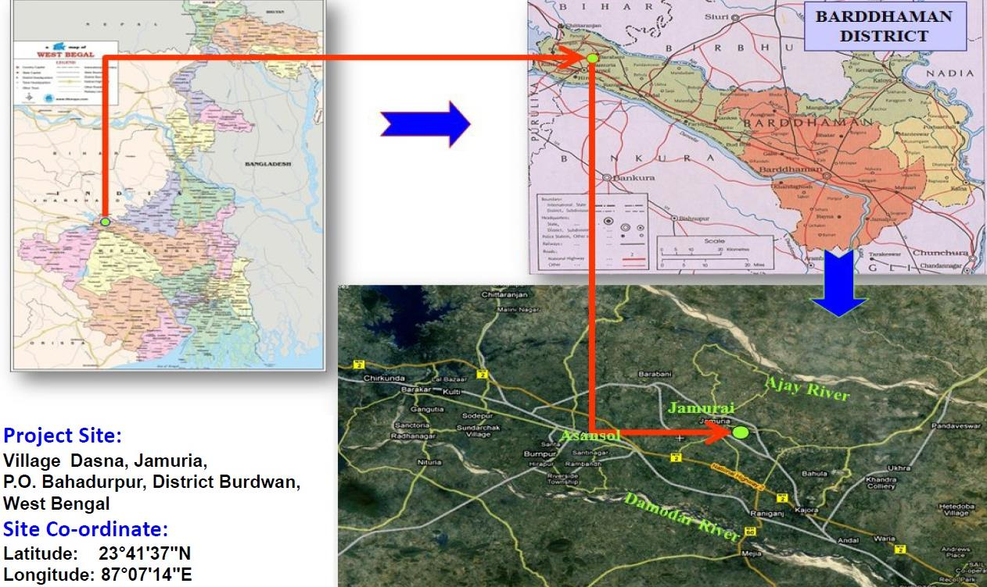
LOCATION MAP
Project Site:
Village: Dhasna, P.O: Bahadurpur, P.S. - Jamuria, District – Paschim Burdwan, West Bengal.
Site Co-ordinate:
Latitude 23°40’02.06"N to 23°41’50.13"N and Longitude 87°07’00.06"E to 87°07’53.20"E with Above Mean Sea Level 104 meters
Project Site

Slide 5
LINK FOR KML FILE & GOOGLE EARTH IMAGE
Project Site
Project Site: Village: Dhasna, P.O: Bahadurpur, P.S. - Jamuria, District – Paschim Burdwan, West Bengal.
Site Co-ordinate: Latitude 23°40’02.06"N to 23°41’50.13"N and Longitude 87°07’00.06"E to 87°07’53.20"E with Above Mean Sea Level 104 meters
Link for KML

Slide 6
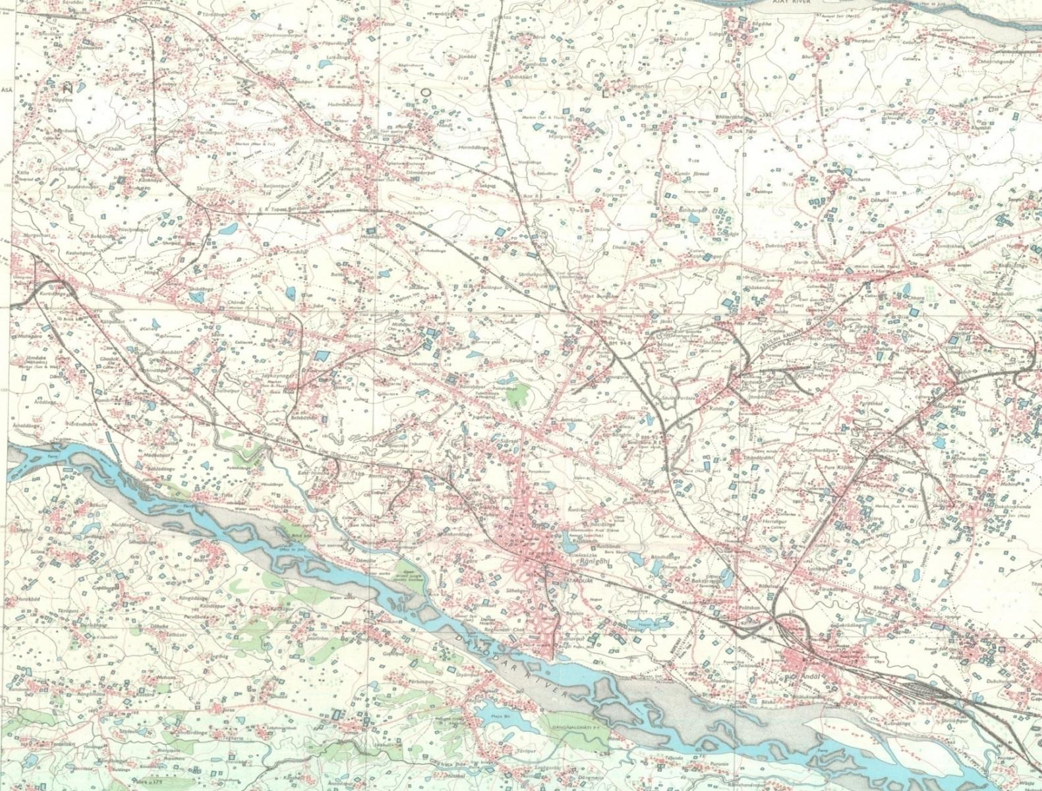
TOPOGRAPHICAL MAP
Toposheet No. 73(M/2)
Project Site
Project Site: Village: Dhasna, P.O: Bahadurpur, P.S. - Jamuria, District – Paschim Burdwan, West Bengal.
Latitude 23°40’02.06"N to 23°41’50.13"N and Longitude 87°07’00.06"E to 87°07’53.20"E
with Above Mean Sea Level 104 meters

Slide 7
LAND ALLOTTED / ACQUISTION STATUS
Proposed project shall be installed on the available land, within the existing plant premises comprising of total 262.64 Hectares (649 acres) of land as well as on some additional land of 21.45 Hectares (53 acres) which has already been acquired by the company.
Total land area for the project shall be 284.09 Hectares (702 Acres).

Slide 8
LANDUSE BREAKUP OF THE PROJECT SITE
Sl. No. | Name of Product | Name of Unit | Existing Area (in m) | Proposed area Expansion (in m) | Existing Area (in acre) | Existing Area used in proposed Plant (in acre) | Proposed Area (in acre) | Total Area (in acre)
1 | Sinter | Sinter Plant | 300m x 140m | - | 10.38 |  |  | 10.38
2 | Iron Ore Pellets | Pellet Plant | 362m x 125m 260m x 50m | - | 14.4 |  |  | 14.4
3 | Hot metal / Pig Iron | Blast Furnace | 270m x 250m | - | 16.68 |  |  | 16.68
4 | Sponge Iron | Direct Reduced Iron (DRI) Plant (with Coal shed) | 303.5m x 200m 315m x 230m | 300m x 265m | 32.91 |  | 19.27 | 52.18
5 | Ferro Alloys | Ferro Alloys Plant | 160m x 126m | - | 4.98 |  |  | 4.98
6 | Steel Billets / ingots | Steel melting shop (SMS) (Induction Furnace route) | 200m x 100m 170m x 50m 350m x 70m 258m x 63m | 200m x 60m 250m x 77m | 17.11 | 2.96 | 4.74 | 24.81
 |  | SMS (Electric arc Furnace route) | 325m x 25m |  | 2.01 |  |  | 2.01
7 | Rolled products & Structural (angle, channel, joist, etc.) | Rolling Mill - 1 Structurals | 100m x 40m | - | 0.99 |  |  | 0.99
 |  | Rolling Mill - 2 Bars | 270m x 100m | - | 6.67 |  |  | 6.67
 |  | Rolling Mill - 3 Wire Rods | 325m x 40m | - | 3.20 |  |  | 3.20
 |  | Rolling Mill - 4 Long Product | 360m x 40m | - | 3.56 |  |  | 3.56
 |  | Rolling Mill - 5 Long Product | 325m x 60m | - | 4.82 |  |  | 4.82
 |  | Cold Rolling Mill - 6 | - | 230m x 70m | - | - | 3.98 | 3.98
8 | Coke | Coke oven Plant | 300m x 270m |  | 20.02 |  |  | 20.02
9 | Ductile Iron Pipe | DI Pipe Plant | 370m x 135m |  | 12.35 |  |  | 12.35
10 | Electricity | Captive Power Plant | 300m x 142m 230m x 200m | 240m x 110m | 21.90 | 6.52 |  | 28.42
11 | Cement | Cement Grinding unit | 200m x 190m |  | 9.39 |  |  | 9.39
12 | Producer Gas | Producer Gas Plant | 220m x 30m | 150m x 60m | 1.63 | 2.22 |  | 3.85
13 |  | Internal Road | 6009m x 8m 8025m x 8m | 1230m x 8m | 27.75 |  | 2.43 | 30.18
14 |  | Reservoir | 155m x 110m 80m x 45m 300m x 200m | 154m x 130m | 19.93 | 4.94 |  | 24.87

Slide 9
LANDUSE BREAKUP OF THE PROJECT SITE
Sl. No. | Name of Product | Name of Unit | Existing Area (in m) | Proposed area Expansion (in m) | Existing Area (in acre) | Existing Area used in proposed Plant (in acre) | Proposed Area (in acre) | Total Area (in acre)
15 |  | Admin Building | 80m x 18m 120m x 55m |  | 1.99 |  |  | 1.99
16 |  | Assembly Point | (40m x 40m) x 2 (40m x 40m) x 3 | 30m x 30m | 1.98 |  | 0.22 | 2.20
17 |  | Storage Yard | 120m x 120m 275m x 150m 565m x 65m |  | 22.83 |  |  | 22.83
18 |  | Temple | 25m x 13m |  | 0.85 |  |  | 0.85
19 |  | Oxygen Plant |  | 70m x 60m |  | 1.04 |  | 1.04
20 |  | Weigh Bridge | (18m x 7m) x 9 |  | 0.28 |  |  | 0.28
21 |  | Railway siding | 910m x 115m |  | 25.87 |  |  | 25.87
22 |  | Rain Water Harvesting |  |  | 29.0 |  |  | 29.0
23 |  | Truck Parking | 150m x 50m | 185m x 37m | 1.85 | 1.69 |  | 3.54
24 |  | Switch Yard | 80m x 70m 55m x 24m |  | 1.71 |  |  | 1.71
25 |  | Settling Tank | 40m x 20m 50m x 30m | 40m x 20m | 0.57 |  | 0.20 | 0.77
26 |  | Green Belt Area |  |  | 214 |  | 21 | 235
27 |  | Staff Quarter | 82m x 76m |  | 1.54 |  |  | 1.54
28 |  | Labour Quarter | 85m x 45m 200m x 50m |  | 3.42 |  |  | 3.42
29 |  | Car Parking, Garlon Drain, Open Area (63.71 acre) Utility (30.47 acre) |  |  | 98.40 |  | 0.72 | 100.81
30 |  | Linz-Donawitz Converter (LD Converter) | 60m x 30m |  |  |  | 0.44 | 0.44
31 |  | Hazardous Waste Yard | 40m x 40m |  |  | 0.40 |  | 0.40
 |  |  |  |  | 629.23 | 19.77 | 53.00 | 702
 |  |  |  |  | 649.00 |  | 53.00 | 702
 |  | Extra 7% increase in greenbelt area outside plant as discussed in the EAC meeting |  |  | 45 |  |  | 45

Slide 10
PREVIOUS EC DETAILS
EC granted vide File No. J-11011/887/2007-IA.II(I) dated 26th December, 2019
Sl. No. | Capacity as per EC |  |  | Consent Status |  | Implementation Status | Remarks
 | Facilities envisaged | Capacity | Ultimate Capacity | CTE | CTO
1 | Sinter Plant | 0.85 MTPA | 0.85 MTPA | 0.85 MTPA | - | To be implemented | Capacity Enhancement from 0.85 MTPA to 1.11 MTPA proposed in current proposal
2 | Pellet Plant 1 | 0.6 MTPA | 1.8 MTPA (1800000 TPA) | 0.6 MTPA | 0.6 MTPA | Implemented | Capacity Enhancement from 0.6 MTPA to 0.9 MTPA proposed in current proposal
 | Pellet Plant 2 | 0.6 MTPA |  | 0.6 MTPA | 0.6 MTPA | Implemented | Capacity Enhancement from 0.6 MTPA to 0.9 MTPA proposed in current proposal
 | Pellet Plant 3 | 0.6 MTPA |  | 0.6 MTPA | - | To be implemented | Capacity Enhancement from 0.6 MTPA to 1.2 MTPA proposed in current proposal
3 | Blast Furnace | 0.6 MTPA (1x450 m³) | 0.6 MTPA (600000 TPA) | 0.6 MTPA (1x450 m³) | - | To be implemented | Capacity Enhancement from 450 m³ to 550 m³ proposed in current proposal
4 | Direct Reduced Iron (DRI) Plant | 2 x 100 TPD | 0.89 MTPA (890000 TPA) | 2 x 100 TPD | 2x100 TPD | Implemented | Capacity Enhancement from 100 TPD to 150 TPD proposed in current proposal
 |  | 3 x 300 TPD |  | 3 x 300 TPD | 3x300 TPD | Implemented | Capacity Enhancement from 300 TPD to 450 TPD proposed in current proposal
 |  | 2 x 90 TPD |  | 2 x 90 TPD | 2x90 TPD | Implemented | Capacity Enhancement from 90 TPD to 150 TPD proposed in current proposal
 |  | 4 x 350 TPD |  | 4 x 350 TPD | 1x350 TPD | 1x350 TPD Implemented 2x350 TPD under implementation 1x350 TPD to be implemented | Capacity Enhancement from 350 TPD to 450 TPD Capacity Enhancement from 350 TPD to 700 TPD proposed in current proposal

Slide 11
PREVIOUS EC DETAILS
EC granted vide File No. J-11011/887/2007-IA.II(I) dated 26th December, 2019
Sl. No. | Capacity as per EC |  |  | Consent Status |  | Implementation Status | Remarks
 | Facility | Capacity | Ultimate Capacity | CTE | CTO
5 | Ferro Alloys Plant | 3 X 9 MVA 2 x 4.5 MVA | 0.1 MTPA | 0.1 MTPA | 0.1 MTPA | Implemented
6 | Steel Melting Shop (SMS) (Induction Furnace route) | 12x18 T | 1.51 MTPA (1.11 MTPA+ 0.4 MTPA) | 1.51 MTPA | 0.71 MTPA | 4x18T, 2x15T, 4x5T, 8x8T Implemented 4x18T under implementation 4x18T, 1x45T to be implemented
 |  | 2x15 T
 |  | 4x5 T
 |  | 8x8 T
 | SMS (Electric Arc Furnace route) | 1 x 45 T (0.4 MTPA)
7 | Rolling Mill 1 - Structurals | 0.15 MTPA | 1 MTPA (1000000 TPA) | 0.15 MTPA | 0.15 MTPA | Implemented | Capacity Enhancement From 0.15 MTPA to 0.2 MTPA proposed in current proposal
 | Rolling Mill 2 - TMT Bars | 0.15 MTPA |  | 0.15 MTPA | 0.15 MTPA | Implemented | -
 | Rolling Mill 3 - Wire Rods | 0.2 MTPA |  | 0.2 MTPA | 0.2 MTPA | Implemented | Capacity Enhancement from 0.2 MTPA to 0.3 MTPA proposed in current proposal
 | Rolling Mill 4 - Long Product | 0.3 MTPA |  | 0.3 MTPA | - | To be implemented | Capacity Enhancement from 0.3 MTPA to 0.5 MTPA proposed in current proposal
 | Rolling Mill 5 - Long Product | 0.2 MTPA |  | 0.2 MTPA | - | Under implementation | -
8 | Coke Oven Plant | 0.3 MTPA | 0.3 MTPA (300000 TPA) | 0.3 MTPA | - | To be implemented | Capacity Enhancement from 0.3 MTPA to 0.45 MTPA proposed in current proposal
9 | DI Pipe Plant | 0.1 MTPA | 0.1 MTPA (100000 TPA) | 0.1 MTPA | - | To be implemented | Capacity Enhancement from 0.1 MTPA to 0.25 MTPA proposed in current proposal

Slide 12
PREVIOUS EC DETAILS
EC granted vide File No. J-11011/887/2007-IA.II(I) dated 26th December, 2019
Sl. No. | Capacity as per EC |  |  | Consent Status |  | Implementation Status | Remarks
 | Facility | Capacity | Ultimate Capacity | CTE | CTO
10 | Captive Power Plant | WHRB - 93 MW CFBC - 43 MW | 136 MW | 136 MW | 91 MW | 91 MW Implemented 45 MW to be implemented | -
11 | Cement Grinding Unit | 1.2 MTPA | 1.2 MTPA | - | - | To be implemented | -
12 | Producer Gas Plant | 36,000 Nm³/Hr (12 Nos. x 3000 Nm³/Hr) | 36,000 Nm³/Hr (12 Nos. x 3000 Nm³/Hr) | 36,000 Nm³/Hr (12 Nos. x 3000 Nm³/Hr) | 36,000 Nm³/Hr (12 Nos. x 3000 Nm³/Hr) | Implemented | -

Slide 13
Compliance status of existing unit
Certified report issued on 25.05.2021. Closure Report on Non-Compliances on 29.7.2021
S. N. | Non- compliances reported if any | Corrective action taken | Present status | Remarks
1 | It has been observed that the PA’s have not installed CAAQMS in the plant. It is required to install 4 CAAQMS in or outside the Project Boundary as recommended by the WBPCB. | Purchase order for 4 Nos of Continuous ambient air quality monitoring station (USEPA / MCERT) using high quality laser sensors (Beta Rays Attenuation) technology already issued (PO No. J9/PA217-00043/21-22 dated 8th June, 2021) in compliance to point no –II. Air Quality Monitoring and Preservation Condition No. iii of EC dated 26.12.2019. | - | Complied
2 | It has been observed that the PA has not yet developed a fully functional tyre washing area. The PA is required to do the same at the designated place inthe trucking parking area. | The tyre washing facility in the truck parking area has been installed. Now the trucks tyre are washed before entering and leaving the plant premises. | - | Complied
3 | The PA is required to provide GCP of SMS to reduce PH in circulating water to ensure optimal recycling of treated water for converter gas cleaning. It should be done and report must be submitted. | The existing Steel Melting Shops are equipped with Induction Furnaces (IF) with charge mix mostly with DRI and small part of scrap or pig iron. As such, during charging and initial heating, generated fumes are sucked by ID Fans of adequate capacity through hood, passes through respective bag house to Chimneys of adequate height to ensure State/ Central Pollution norms. It may be noted the circulating cooling water systems of these furnaces are by soft water and there is no connection between GCP and pH in circulating water. |  | Complied

Slide 14
Compliance status of existing unit
Certified report issued on 25.05.2021. Closure Report on Non-Compliances on 29.7.2021
S. N. | Non- compliances reported if any | Corrective action taken | Present status | Remarks
4 | The PA is required to Provide solar generation on roof tops of buildings, for solar light system for all common areas, street lights, parking around project area and maintain the same regularly. | In accordance with the observation no. 4 that is to provide solar power generation and installation of solar lighting system, we are pleased to inform you that, a contract / agreement has already been signed between M/S Shyam Sel & Power ltd and VSV Renewable Pvt. Ltd. (Floating Type & Roof Top Type) and work regarding the same are already in progress. | - | Complied
5 | The PA shall install waste recycling plant to recover scrap, metallic and flux for recycling to SMS. | The metal recovery plant to recover scrap, metallic and flux for recycling to SMS has already been installed. | - | Complied

Slide 15
ENVIRONMENTAL SITE SETTINGS
Sl. No. | Parameters | Details
a. | Water body | Damodar River is 11.0 km in SW Ajay river is 7.0 km in NE
b. | Highway | National Highway-2 is 6.0 km in S National Highway-60 is 2.6 km in SE
c. | Railway line | Ikrah Railway Station is 0.6 km Raniganj Railway Station is 10 km
d. | Habitation | Jamuria Town is 1.0 km in W Raniganj Town is 9.0 km in S Asansol Town is 14.0 km in W Durgapur Town is 29.0 km in SE
e. | National Park / Wildlife Sanctuary / Bio-sphere Reserve / Elephant corridor / Tiger reserve / Eco-sensitive Zone / Eco sensitive Area | None
f. | Any other | -

Slide 16
EXISTING & PROPOSED UNIT CONFIGURATION WITH CAPACITY
Sl. No. | Facility | Capacity as per EC |  | Units under Operation | Units under Implementation / To be Implemented | Proposed Project | Ultimate Capacity
 |  | Capacity | Ultimate Capacity
1 | Sinter Plant | 0.85 MTPA | 0.85 MTPA | - | 0.85 MTPA* | Capacity Enhancement from 0.85 MTPA to 1.11 MTPA | 1.11 MTPA* (1X90 m²)
2 | Pellet Plant 1 | 0.6 MTPA | 1.8 MTPA (1800000 TPA) | 0.6 MTPA* | - | Capacity Enhancement from 0.6 MTPA to 0.9 MTPA | 0.9 MTPA*
 | Pellet Plant 2 | 0.6 MTPA |  | 0.6 MTPA* | - | Capacity Enhancement from 0.6 MTPA to 0.9 MTPA | 0.9 MTPA*
 | Pellet Plant 3 | 0.6 MTPA |  | - | 0.6 MTPA* | Capacity Enhancement from 0.6 MTPA to 1.2 MTPA | 1.2 MTPA*
3 | Blast Furnace | 0.6 MTPA (1x450 m³) | 0.6 MTPA (600000 TPA) | - | 0.6 MTPA* (1x450 m³) | Capacity Enhancement from 450 m³ to 550 m³ | 0.77 MTPA* (1x550 m³)
4 | Direct Reduced Iron (DRI) Plant | 2 x 100 TPD | 0.89 MTPA (890000 TPA) | 2x100 TPD* | - | Capacity Enhancement from 100 TPD to 150 TPD | 2x150 TPD*
 |  | 3 x 300 TPD |  | 3x300 TPD* | - | Capacity Enhancement from 300 TPD to 450 TPD | 3x450 TPD*
 |  | 2 x 90 TPD |  | 2x90 TPD* | - | Capacity Enhancement from 90 TPD to 150 TPD | 2x150 TPD*
 |  | 4 x 350 TPD |  | 1x350 TPD* | 3x350 TPD* | Capacity Enhancement from 350 TPD to 450 TPD Capacity Enhancement from 350 TPD to 700 TPD | 3X450 TPD* 1x700 TPD*
 |  | - | - | - | - | 4x700 TPD (New) | 4x700 TPD (New)
MTPA : Million Tonnes per Annum

Slide 17
Sl. No. | Name of Unit | Capacity as per EC |  | Units under Operation | Units under Implementa-tion / To be Implemented | Proposed Project | Ultimate Capacity
 |  | Capacity | Ultimate Capacity
5 | Ferro Alloys Plant | 3 X 9 MVA 2 x 4.5 MVA | 0.1 MTPA | 0.1 MTPA | - | - | 0.1 MTPA (3 X 9 MVA 2 x 4.5 MVA)
6 | Steel Melting Shop (SMS) (Induction Furnace route) | 12x18 T | 1.51 MTPA (1.11 MTPA+ 0.4 MTPA) | 4x18 T | 8x18 T | 2 x 8 T (New) 20 x 20 T (New) | 12x18 T
 |  | 2x15 T |  | 2x15 T | - |  | 2x15 T
 |  | 4x5 T |  | 4x5 T | - |  | 4x5 T 2 x 8 T (New) 20 x 20 T (New)
 |  | 8x8 T |  | 8x8T | - |  | 8 x 8T
 | SMS (Electric Arc Furnace route) | 1 x 45 T (0.4 MTPA) |  | - | 1 x 45 T (0.4 MTPA) | - | 1 x 45 T (0.4 MTPA)
7 | Rolling Mill 1 - Structurals | 0.15 MTPA | 1 MTPA (1000000 TPA) | 0.15 MTPA* | - | Capacity Enhancement From 0.15 MTPA to 0.2 MTPA | 0.2 MTPA*
 | Rolling Mill 2 - TMT Bars | 0.15 MTPA |  | 0.15 MTPA | - | - | 0.15 MTPA
 | Rolling Mill 3 - Wire Rods | 0.2 MTPA |  | 0.2 MTPA* | - | Capacity Enhancement from 0.2 MTPA to 0.3 MTPA | 0.3 MTPA*
 | Rolling Mill 4 - Long Product | 0.3 MTPA |  | - | 0.3 MTPA* | Capacity Enhancement from 0.3 MTPA to 0.5 MTPA | 0.5 MTPA*
 | Rolling Mill 5 - Long Product | 0.2 MTPA |  | - | 0.2 MTPA | - | 0.2 MTPA
 | Cold Rolling Mill 6 - Long Product | - |  | - |  | 0.3 MTPA - New | 0.3 MTPA - New
8 | Coke Oven Plant | 0.3 MTPA | 0.3 MTPA (300000 TPA) | - | 0.3 MTPA* | Capacity Enhancement from 0.3 MTPA to 0.45 MTPA | 0.45 MTPA* (450000 TPA)
9 | DI Pipe Plant | 0.1 MTPA | 0.1 MTPA (100000 TPA) | - | 0.1 MTPA* | Capacity Enhancement from 0.1 MTPA to 0.25 MTPA | 0.25 MTPA* (250000 TPA)
MTPA : Million Tonnes per Annum

Slide 18
Sl. No. | Name of Unit | Capacity as per EC |  | Units under Operation | Units under Implementa-tion / To be Implemen-ted | Proposed Project | Ultimate Capacity
 |  | Capacity | Ultimate Capacity
10 | Captive Power Plant | WHRB - 93 MW CFBC - 43 MW | 136 MW | WHRB - 48 MW CFBC –43 MW | WHRB - 45 MW | WHRB - 86 MW (New)CFBC - 94 MW (New) | WHRB –179 MWCFBC - 137 MW Total : 316 MW
11 | Cement Grinding Unit | 1.2 MTPA | 1.2 MTPA | - | 1.2 MTPA | - | 1.2 MTPA
12 | Producer Gas Plant | 36,000 Nm³/Hr (12 Nos. x 3000 Nm³/Hr) | 36,000 Nm³/Hr (12 Nos. x 3000 Nm³/Hr) | 36,000 Nm³/Hr (12 Nos. x 3000 Nm³/Hr) | - | 48,000Nm³/Hr (12 Nos. x 4000 Nm³/Hr) - New | 84,000 Nm³/Hr (12 Nos. x 3000 Nm³/Hr) +12 Nos. x 4000 Nm³/H)
13 | L D Convertor Plant | - | - | - | - | 0.48 MTPA 60 Ton/ Heat - New | 0.48 MTPA 60 Ton/Heat – New
14 | Oxygen Plant | - | - | - | - | 10000 M³/ Day - New | 10000 M³/ Day – New
Note: * Denotes Capacity enhancement of units under operation / units under implementation / units to be implemented for which EC has already been granted.
MTPA : Million Tonnes per Annum

Slide 19
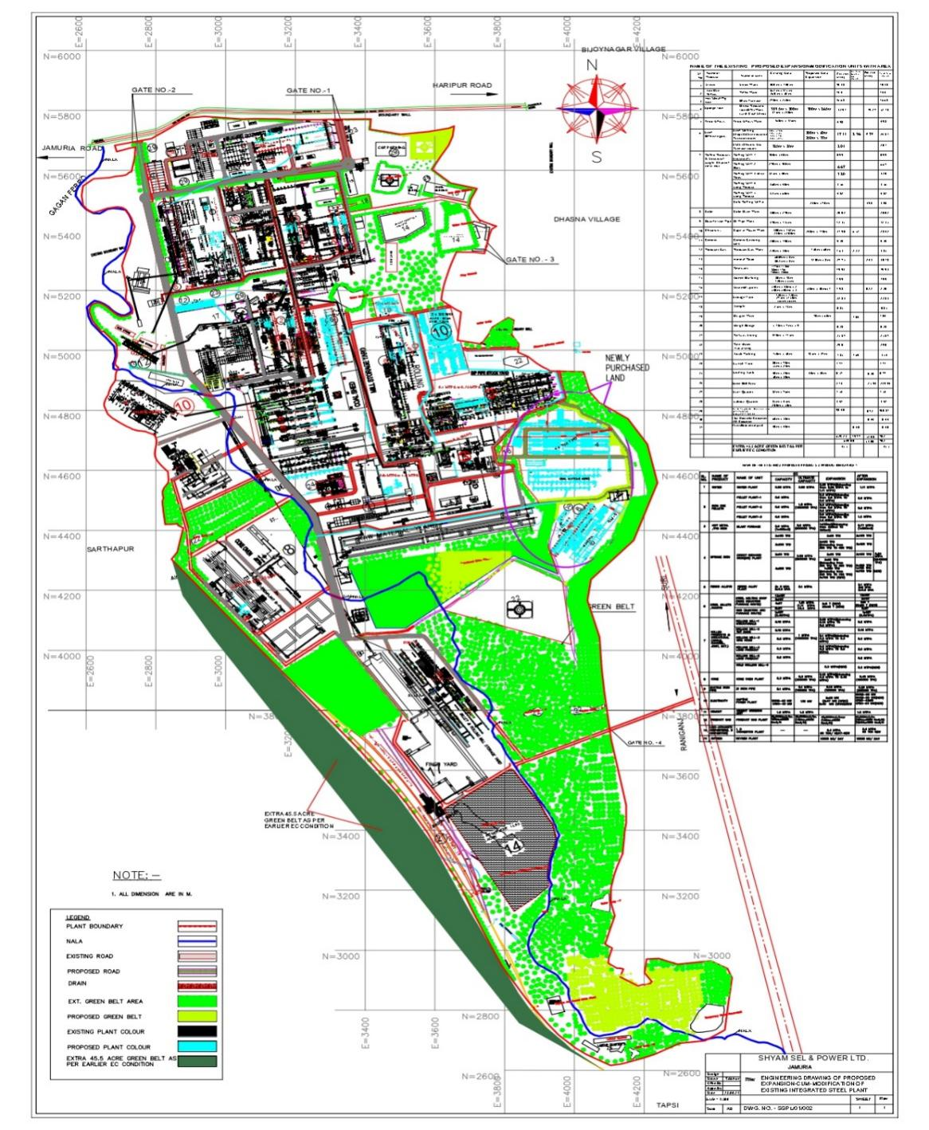
PLANT LAYOUT (ENGINEERING DRAWING)
HyperLink for
Area Break up Table
(Slide No. 7 & 8)

Slide 20
DETAILS OF THE PROJECT SITE AS SHOWN IN THE KML FILE
Proposed project shall be installed on the available land, within the existing plant premises comprising of total 262.64 Hectares (649 acres) of land as well as on some additional land of 21.45 Hectares (53 acres) which is under acquisition of the Company.
Hence, total land area for the project shall be 284.09 Hectares (702 Acres).
The KML file for the project site shows that the existing units are located in the north part. The new units shall be situated mostly along the existing units in the northern part as well as in the adjoining areas. The southern part contains mostly moderate to thick plantation as well as a number of water bodies, which are proposed to be retained as it is. Overall, there are ten water bodies, out of which two number are temporary and exists only during the rains. Besides, there is one Nala which passes through the project site by entering from the north-west side and exiting through the southern side. The Company is very much concerned to protect this nala by providing guard rails on both sides of the nala. It has already created such guard rails with the nala, passing through its existing plant areas. The same shall be provided all along the remaining part of the nala, passing through the project area.
Apart from that, there is one hutment for the contractual labourers, located in the southern part of the project site. This hutment houses around 40 contractual labourers. These contractual labourers are presently engaged in loading & unloading activities at the plant’s own railway siding, located adjacent to this hutment area. The Company has a plan to shift all these contractual labourers to the new labourers quarters which is presently under construction at around 650 m further down in the south direction inside the plant area.
In the plant area, there are three brick plants, which are presently abandoned and have been purchased by the Company. One is located around the center part and the other two are situated in the southern part of the project area. Most of the area coming under the abandoned brick plants shall be developed as green belt.

Slide 21
The geographical co-ordinates of water bodies, Nala, hutment for the contractual labourers, abandoned brick plants are presented below,
SL. NO. | DESCRIPTION | LATITUDE | LONGITUDE
1. | Water Body - 1 | 23°41'40.32"N | 87° 7'33.11"E
2. | Water Body - 2 | 23°41'28.20"N | 87° 7'26.81"E
3. | Water body - 3 | 23°41'05.51"N | 87° 7'05.86"E
4. | Water body - 4 | 23°40'40.97"N | 87° 7'34.92"E
5. | Water body - 5 | 23°40'40.12"N | 87° 7'40.58"E
6. | Water Body - 6 | 23°40'29.74"N | 87° 7'28.14"E
7. | Water Body - 7 | 23°40'19.29"N | 87° 7'38.17"E
8. | Water Body - 8 | 23°40'03.39"N | 87° 7'38.34"E
9. | Water Reservoir - 1 | 23°41'36.44"N | 87° 7'32.98"E
10. | Water Reservoir - 2 | 23°41'34.10"N | 87° 7'38.63"E
11. | Temporary Water Reservoir-1 | 23°41'09.58"N | 87° 7'46.21"E
12. | Temporary Water Reservoir-2 | 23°40'05.30"N | 87° 7'45.94"E
13. | ADM Building | 23°41'37.62"N | 87° 7'38.93"E
14. | Labour Quarter - 1 (Near ADM Building) | 23°41'32.77"N | 87° 7'41.13"E
15. | Labour Quarter - 2 (Near Water Body 8) | 23°40'04.76"N | 87° 7'35.74"E
16. | Abandoned Brick Plant - 1 | 23°40'58.00"N | 87° 7'31.78"E
17. | Abandoned Brick Plant - 2 | 23°40'11.33"N | 87° 7'35.86"E
18. | Abandoned Brick Plant - 3 | 23°40'08.96"N | 87° 7'41.28"E
19. | Hutment for contractual Labourers | 23°40'24.22"N | 87° 7'28.82"E
20 | Nala (Entry Point – North-west) | 23°41'24.89"N | 87° 7'02.07"E
 | Nala (Exit Point - South) | 23°40'03.42"N | 87° 7'46.65"E

Slide 22
RAW MATERIAL CONSUMPTION
Sl. No | Raw Material | Annual Requirement (in TPA) |  |  | Source | Distance (in km) | Transportation
 |  | Under Operation | Expansion + Under implementation / to be implemented | Total |  |  | Internal | Rail | Road (Through Covered Vehicle)
COKE OVEN PLANT
1 | Coking Coal |  | 600000 | 600000 | Imported – Haldia Port | 290 to 300 | - | 540000 | 60000
SINTER PLANT
1 | Iron ore fines |  | 998000 | 998000 | Barbil-Joda, Orissa | 300-350 | - | 898200 | 99800
2 | Limestone |  | 88700 | 88700 | Birmitrapur,Orissa Bilaspur Raipur CG Katni MP | 300 700 800 900 | - | - | 88700
3 | Quicklime |  | 55440 | 55440 | Katni, MP | 900 | - | - | 55440
4 | Dolomite |  | 44350 | 44350 | Raipur CG Katni MP | 800 900 | - | - | 44350
5 | Coke Breeze |  | 66530 | 66530 | In House - Conveyor, Local Market | 200 | 21500 | - | 45030
BLAST FURNACE
1 | Iron ore Lumps |  | 123200 | 123200 | Barbil-Joda, Orissa | 350 | - | 110880 | 12320
2 | Coke |  | 494000 | 494000 | In House - Conveyor, Local Market | 200 | 428500 | 58950 | 6550
3 | PCI Coal |  | 154000 | 154000 | Imported – Haldia Port | 290-300 | - | 38600 | 15400
4 | Limestone |  | 15400 | 15400 | Birmitrapur,Orissa Bilaspur Raipur CG Katni MP | 300 700 800 900 | - | - | 15400
5 | Dolomite |  | 7700 | 7700 | Raipur CG Katni MP | 800 900 | - | 6930 | 770
6 | Quartzite |  | 7700 | 7700 | Belpahar, Orissa Bilaspur, Raipur CG | 350 700 | - | - | 7700
7 | Sinter |  | 1108800 | 1108800 | In-house | - | 1108800 | -

Slide 23
Sl. No | Raw Material | Annual Requirement (in TPA) |  |  | Source | Distance (in km) | Transportation
 |  | Under Operation | Expansion + Under implementation / to be implemented | Total |  |  | Internal | Rail | Road (Through Covered Vehicle)
SPONGE IRON PLANT
1 | Iron Ore | 89890 | 285110 | 375000 | Barbil-Joda, Orissa | 350 | - | 337500 | 37,500
2 | Coal | 591690 | 1876710 | 2468400 | Imported – Haldia Port | 290-300 | - | 2221560 | 246840
3 | Dolomite | 322716 | 1023584 | 1346300 | Raipur CG Katni MP | 800 900 | - | 1211670 | 134630
4 | Pellet | 719118 | 2280882 | 3000000 | In-house - Conveyor | - | 3000000 | -
PELLET PLANT
1 | Iron ore Fines | 1440000 | 2160000 | 3600000 | Barbil-Joda, Orissa | 350 | - | 3240000 | 360000
2 | Limestone | 12000 | 18000 | 30000 | Birmitrapur,Orissa Bilaspur Raipur CG Katni MP | 300 700 800 900 | - | 27000 | 3000
3 | Bentonite | 102000 | 153000 | 255000 | Gujarat | 2200 | - | - | 255000
4 | Coal | 48000 | 72000 | 120000 | Imported – Haldia Port | 290-300 | - | 108000 | 12000
PRODUCER GAS PLANT
1 | Coal | 158400 | 211200 | 369600 | Imported – Haldia Port | 290-300 | - | 332640 | 36960
DUCTILE IRON PIPE
1 | Pig Iron |  | 225000 | 225000 | In-house | - | 225000 | - | -
2 | Zinc |  | 1750 | 1750 | Local Market | 200 | - | - | 1750
3 | Scrap |  | 25000 | 25000 | In-house | - | 25000 | - | -
SMS (EAF ROUTE)
1 | Sponge |  | 400000 | 400000 | Local Market | 100 | - | - | 400000
2 | Scrap |  | 19370 | 19370 | In-house | - | 19370 | - | -
3 | Ferro Alloys |  | 750 | 750 | In-house | - | 750 | - | -
4 | Lime |  | 39204 | 39204 | Katni, MP | 900 | - | - | 39204
5 | DRI |  | 66825 | 66825 | In-house | - | 66825 | -

Slide 24
Sl. No | Raw Material | Annual Requirement (in TPA) |  |  | Source | Distance (in km) | Transportation
 |  | Under Operation | Expansion + Under implementation / to be implemented | Total |  |  | Internal | Rail | Road (Through Covered Vehicle)
SMS (IF ROUTE)
1 | Pig Iron | 109885 | 330835 | 440720 | In-house Conveyor Local Market | 200 | 69800 | - | 370920
2 | Scrap | 30952 | 93188 | 124140 | In-house |  | 124140 | - | -
3 | Ferro Alloys | 1238 | 3727 | 4965 | In-house |  | 4965 | - | -
4 | DRI | 619036 | 1863764 | 2482800 | In-house - Conveyor Local Market | 100 | 2249600 | - | 233200
L D CONVERTOR
1 | Pig iron |  | 475200 | 475200 | In-house | - | 475200 | - | -
2 | Scrap |  | 124140 | 124140 | In-house | - | 124140 | - | -
3 | Ferro Alloys |  | 5760 | 5760 | In-house | - | 5760 | - | -
ROLLING MILL
1 | Billet | 525000 | 1207500 | 1732500 | In-house | - | 1732500 | - | -
CEMENT GRINDING UNIT
1 | Clinker |  | 708000 | 708000 | Satna, MP | 900 | - | 637200 | 70800
2 | Gypsum |  | 60000 | 60000 | Katni, MP | 900 | - | - | 60000
3 | Slag from BF |  | 163800 | 163800 | In-house | - | 163800 | -
4 | Fly Ash from CPP |  | 288000 | 288000 | In-house | - | 288000 | -
FERRO ALLOYS
1 | Ore | 226300 |  | 226300 | Imported – Haldia Port Odisha, Barbil | 290-300 200 | - | 203670 | 22630
2 | Coke & Coal | 70300 |  | 70300 | Jharkhand Assam | 200 1100 | - | 63270 | 7030
3 | Quartzite | 32750 |  | 32750 | Belpahar, Orissa Bilaspur, Raipur CG | 350 700 | - | - | 32750
4 | Dolomite | 30000 |  | 30000 | Raipur CG Katni MP | 800 900 | - | 27000 | 3000
CAPTIVE POWER PLANT
1 | Coal | 211296 | 461904 | 673200 | Imported – Haldia Port Local market | 290-300 100 | - | 605880 | 67320
2 | Dolochar | 211296 | 461904 | 673200 | In-House | - | 673200 | -
TOTAL |  | 5921924 | 18499870 | 24421794 |  |  | 10806850 | 10768950 | 2845994
Percentage (%) |  |  |  |  |  |  | 44% | 44% | 12%

Slide 25
FUEL, POWER / ENERGY & WATER REQUIREMENT WITH REQUISITE PERMISSION DETAILS
Sl. No. | Type | Requirement | Permission Details | Remark
1 | Fuel | Coal - 3876200 TPA | Linkage with CCL / ECL for domestic coal. Agreement with supplier for imported coal.
2 | Power / Energy | 472 MW (Existing Units : 141 MW, Proposed Units + Units under implementation / to be implemented : 331 MW) Source: 316 MW from CPP and balance 156 MW from DVC & IPCL. | Agreement with DVC and IPCL available
3 | Water Requirement | 16,706 m³/day (Existing Units : 5573 m³/day, Proposed + Units under implementation / to be implemented : 11133 m³/day) Source: Ajay River | Permission for supply of 2.5 MGD (11,365 m³/day) from Irrigation & Waterways Department, West Bengal vide Memo No. 63-I/I-4M-26/2006 dated 11.09.2008 obtained. Permission for supply of 7000 KLD from Asansol Municipal Corporation obtained vide Ref. No. 0853/B-1/J/A.M.C dated 29.06.2021

Slide 26
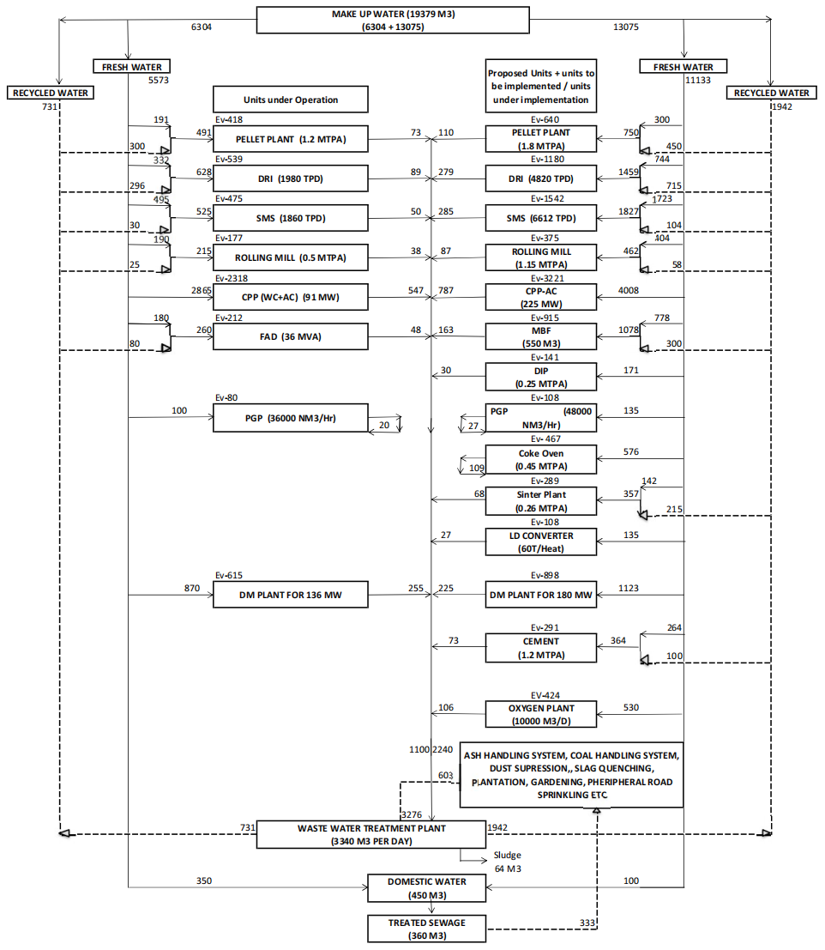
WATER BALANCE DIAGRAM

Slide 27
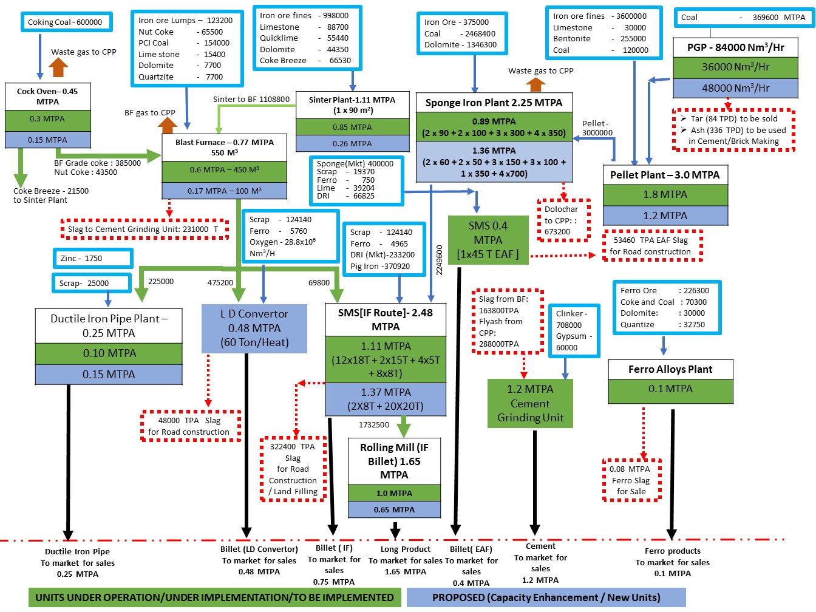
Materials Balance Diagram

Slide 28
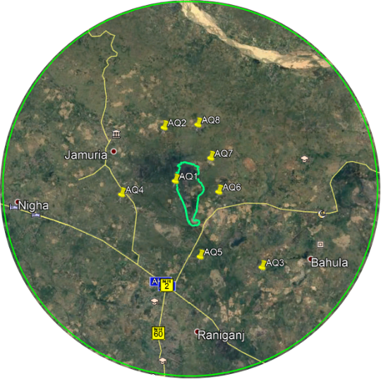
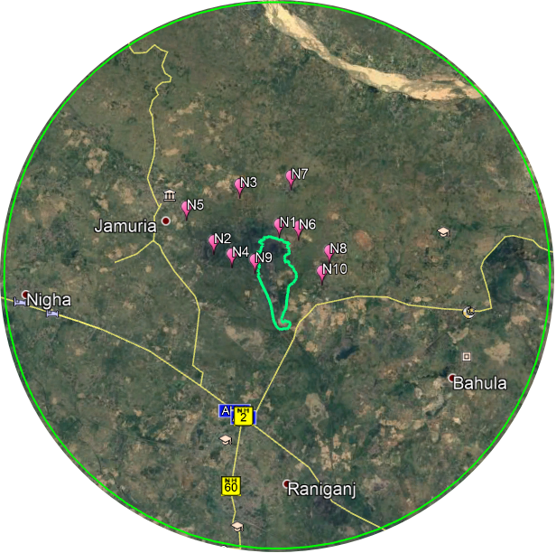
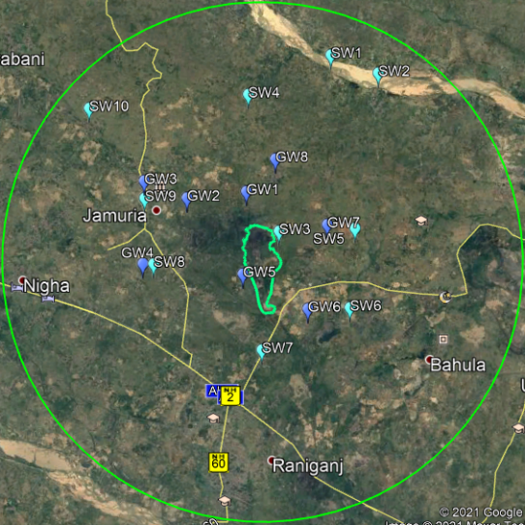
Code | Location Name
AMBIENT AIR
AQ1 | Near Project Site
AQ2 | Hormodanga
AQ3 | Parasea Junior Basic School, Parasia
AQ4 | Jadudanga
AQ5 | Khushtoria Village
AQ6 | Dhasla
AQ7 | Bijaynagar
AQ8 | Hijalgora
SOIL
S1 | Sarthakpur
S2 | Damodarpur
S3 | Hijlagora
S4 | Dhasal
Ambient Air Monitoring Locations
Noise Monitoring Locations
SURFACE WATER
SW1 | Ajay River (Near Dorbodanga)
SW2 | Ajoy River (Near Jamuria - 2)
SW3 | Dhasna
SW4 | Barul
SW5 | Chak Dola
SW6 | Jot Jonaki
SW7 | Khushtoria
SW8 | Benali
SW9 | Jamuria
SW10 | Shibpur
GROUND WATER
GW1 | Near project Site
GW2 | Damodarpur
GW3 | Jamuria
GW4 | Benali
GW5 | Sharthakpur
GW6 | Jot Jonaki
GW7 | Bahadurpur
GW8 | Hijolgora
NOISE
BASE LINE STUDY AREA MAP WITH LOCATIONS
Soil Sampling Locations
Surface & Ground Water Sampling Locations
N1 | Near Shyam Sel Limited
N2 | Near Shivam Dhatu
N3 | Humur Danga village market
N4 | Ikrah Bazar
N5 | Village Damodarpur
N6 | Village Bijaynagar
N7 | Village Hijalgora
N8 | Bahadurpur Hospital
N9 | Mamudpur Primary School
N10 | Dhasal Primary School

Slide 29
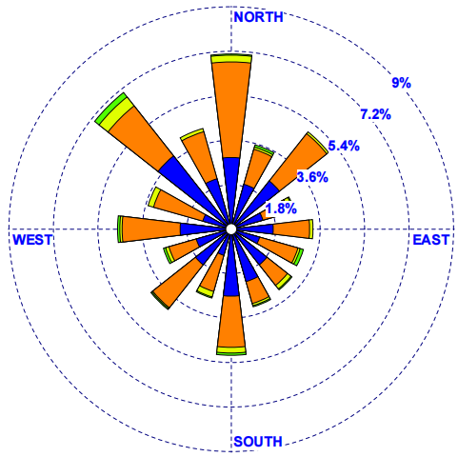
METEOROLOGICAL DETAILS WITH WIND ROSE DIAGRAM
Month | Temperature |  | Relative Humidity |  | Barometric Pressure |  | Average Velocity (km/hr)
 | Max. | Min. | 08:30 hrs | 17:30 hrs | 08:30 hrs | 17:30 hrs
 | (°C) |  | (%) |  | (mm Hg)
Oct, 2020 | 38 | 23 | 79 | 52 | 757.3 | 751.9 | 4.7
Nov, 2020 | 32 | 17 | 73 | 47 | 757.3 | 747.8 | 3.4
Dec, 2020 | 28.5 | 9.5 | 78 | 50 | 758.7 | 753 | 3.3
Overall | 38 | 9.5 | 79 | 47 | 758.7 | 747.8 | 3.8
Overall Wind Rose diagram
(Calm – 34.71%)
(October, 2020 – December, 2020)

Slide 30
BASE LINE STUDY REPORTS
Period | October, 2020 – December, 2020
AAQ PARAMETERS AT 8 LOCATIONS | PM_{2.5} = 21 - 45 µg/m³ PM₁₀ = 56 - 89 µg/m³ SO₂ = 5 - 22 µg/m³ NO₂ = 9 - 38 µg/m³ CO = 0.163 - 1.346 mg/m³
AAQ MODELLING (Incremental GLCs) Model Used : ISCST3 | PM = 5.15 µg/m³ (1.0 km in SE) SO2 = 7.69 µg/m³ (1.8 km in SSE) NOx = 7.63 µg/m³ (1.8 km in SSE)
GROUND WATER QUALITY AT 8 LOCATIONS | pH: 7.62 - 7.07, Total Hardness: 155 - 280 mg/l, Chlorides: 42 - 115 mg/l, Fluoride: 0.21 - 0.33 mg/l, Iron: 0.12 - 0.25 mg/l, TDS: 220 - 462 mg/l
SURFACE WATER QUALITY AT 10 LOCATIONS (2 River water & 8 pond water samples) | River Water pH: 7.36 - 7.43, DO: 7.3 - 7.7 mg/l, BOD: 2 mg/l, COD: 4 mg/l, Fe: 0.06 - 0.07 mg/l, Coliform: 779 - 995 MPN/100ml, TDS: 118 - 131 mg/l, Total Hardness: 76 - 86 mg/l, Chloride: 23 - 26 mg/l Pond Water pH: 7.21 - 7.56, DO: 6.4 - 7.1 mg/l, BOD: 2 - 5 mg/l, COD: 8 - 24 mg/l, Fe: 0.08 - 0.21 mg/l, Coliform: 447 - 986 MPN/100ml, TDS: 219 - 372 mg/l, Total Hardness: 120 - 155 mg/l, Chloride: 42 - 86 mg/l
NOISE LEVELS AT 10 LOCATIONS | 54.5 to 70.6 dBA for day time and 46.0 to 58.4 dBA for night time.

Slide 31
ECOLOGY OF THE STUDY AREA
FLORAL COMPOSITION IN THE STUDY AREA
Trees | Climbers | Grasses & Bamboos
65 | 17 | 12
FAUNAL COMPOSITION IN THE STUDY AREA
Insects & Butterflies | Molluscs | Amphibia | Reptiles | Birds | Mammals | Fish
34 | 4 | 2 | 10 | 48 | 18 | 24
The biodiversity index value obtained was 3.54. This signifies positive ecological health of the site. Estimation of quantitative parameters such as frequency, abundance and density shows that 38 out of 65 plant species have frequency of 10, 34 out of 65 plant species have density of 0.1 and 60 out of 65 plant species showed abundance value of 100. All three (3) parameters indirectly indicate quite high evenness in distribution pattern of plant species.
Faunal communities of the area are also fairly rich. The study area has several categories of water bodies, so the richness and diversity of aquatic flora and fauna is also high. A good number of birds were also observed which is due to good vegetation cover and open fields in the area.
Recycling of wastewater is / will be adopted & no untreated waste water is / will be discharged into the green belt.
Adequate Pollution Control Measures have been / will be adopted to ensure emission within permissible limit.
Periodic cleaning of water bodies in the surrouing areas shall be carried out.

Slide 32
TRANSPORTATION PLAN - VEHICULAR TRAFFIC LOAD STUDY
AS PER IRC GUIDELINE
Particulars | Details | Remarks
Traffic Load Study period | 24 hours on 11.11.2020, 12.11.2020 and 13.11.2020 at 3 different locations respectively
Traffic Load (Baseline) (PCU/Day) | 28844 at NH-2 near Ranisayar More 10511 at Jamuria Cinema More 11385 at Chakdola More Bus stand
Additional traffic load during operation of the proposed expansion project (PCU/Day) | 1434
Total Traffic Load During Operation of Existing and Proposed Expansion (PCU/Day) | 30278 at NH-2 near Ranisayar More 11945 at Jamuria Cinema More 12819 at Chakdola More Bus stand
Traffic Capacity as per the IRC 73: 1980 for Highways (PCU/Day) | 86,400 for NH-2 near Ranisayar More 36,000 for Jamuria Road at Jamuria Cinema More 86,400 for NH-60 at Chakdola More Bus stand | As per IRC:106 – 1990 code, Guidelines for Capacity of Urban Roads in Plain Areas, the total traffic load during operation of the proposed expansion shall be well within the traffic capacity.

Slide 33
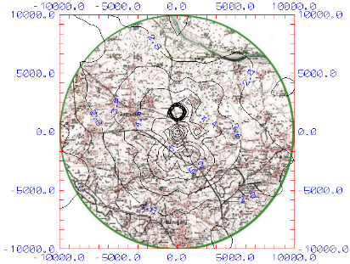
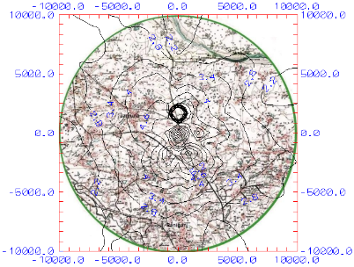
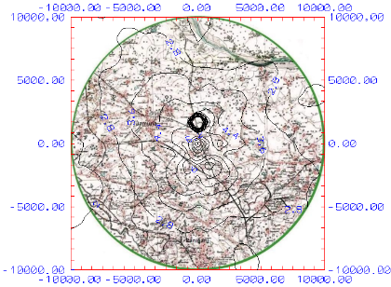
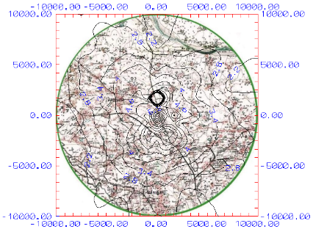
Isopleths of SO₂ (Case- I)
Isopleths of SO₂ (Case- III)
Isopleths of NOx (Case- I)
Isopleths of NOx (Case- III)

Slide 34
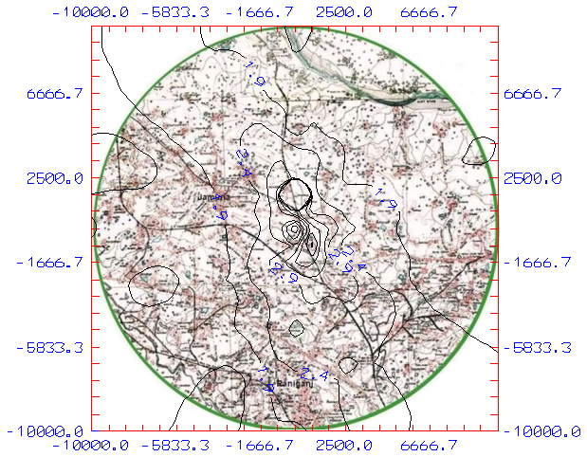
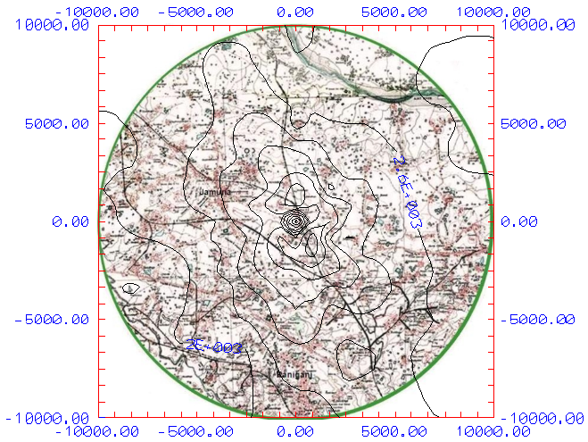
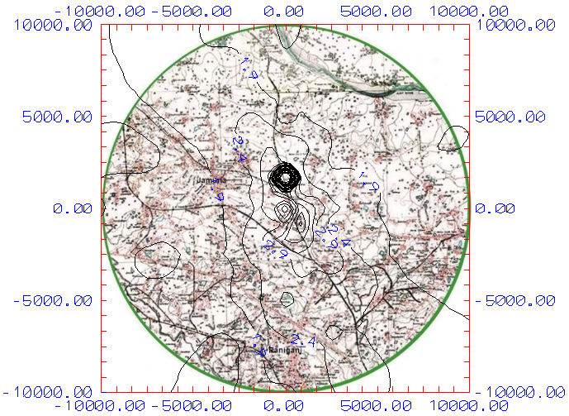
Isopleths of PM (Case- I)
Isopleths of PM (Case- II)
Case-I: Ultimate Scenario with Air Pollution Control Devices – Existing + Proposed projects (for 37 stacks, attached with existing units, units after capacity Enhancement, units under Implementation/to be implemented & New Units)
Case-II: Ultimate Scenario without Air Pollution Control Devices – Existing + Proposed projects (for 37 stacks attached with existing units, units after capacity Enhancement, units under Implementation/to be implemented & New Units)
Case-III: Future scenario (only incremental load) – enhanced load of the Existing Units + units under Implementation/to be implemented + New Units)
Isopleths of PM (Case- III)

Slide 35
ANALYSIS OF MODELLING RESULTS
The maximum incremental value of SO₂, NOx & PM in Case-I (during operation of the overall plant) would be about 9.45 µg/m³, 9.31 µg/m³ and 5.96 µg/m³ respectively, which will occur at a distance of 1.5-1.0 km in SSE & SE directions. The maximum incremental value of SO₂, NOx & PM in Case-III (due to additional load after proposed project) would be about 7.69 µg/m³, 7.57 µg/m³ and 5.15 µg/m³ respectively, which will occur at a distance of 1.8-1.0 km in SSE & SE directions. However, it may be observed that these values have been attained only on one day in the post monsoon season.

Slide 36
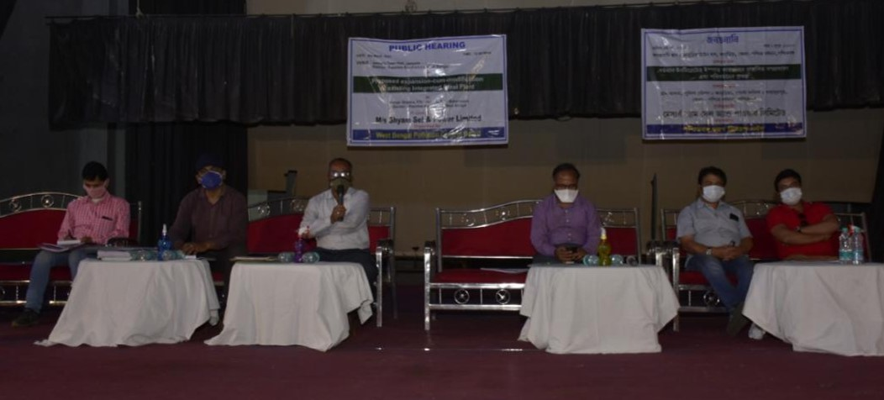
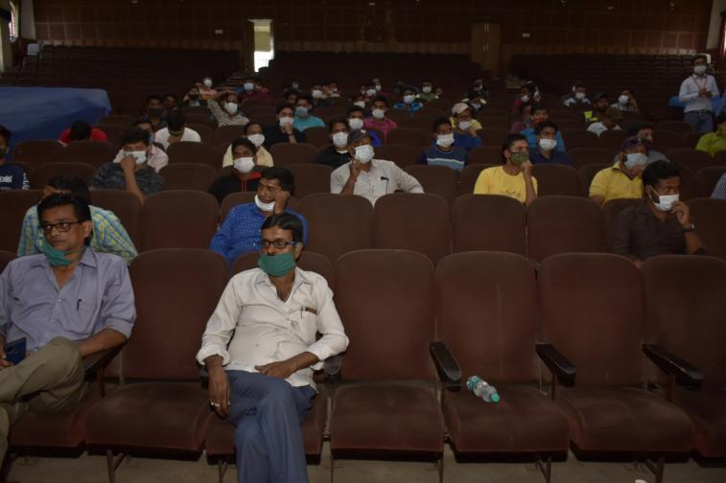
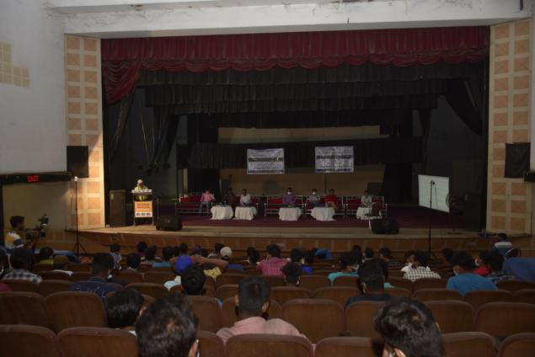
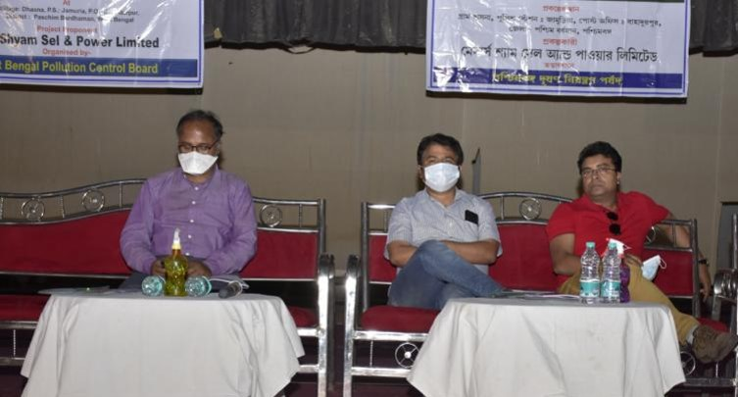
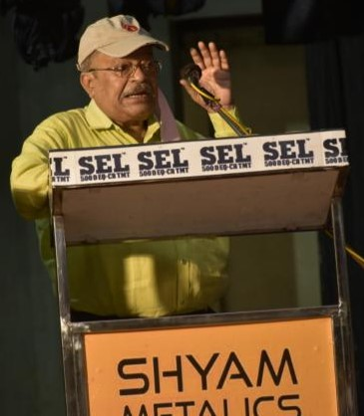
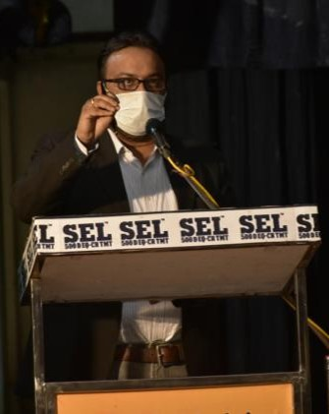
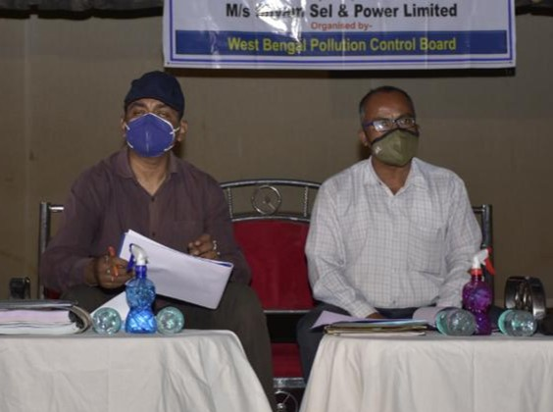
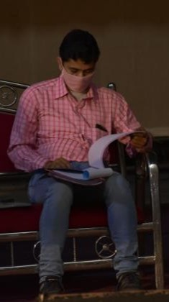
PUBLIC CONSULTATION PHOTOGRAPHS

Slide 37
PUBLIC CONSULTATION
Notice made through advertisement in the Newspapers Sanmarg (Hindi), Bartaman (Bengali) and The Times of India (English) on 06.02.2021, 05.03.2021 and 05.03.2021 respectively.
Conducted on 9th March, 2021 at 12.00 noon at Jamuria Town Hall, Jamuria, Dist. - Paschim Bardhaman, West Bengal under the chairmanship of Sri. Apratim Ghosh, Additional District Magistrate, Paschim Bardhaman
Attended by 89 people
Issues are:
Greenbelt development
Source of water for the proposed expansion project
Employment of local people
Regarding Plastic Waste and its recycling
Providing financial aid & employment for local widows
Regarding Medical Camp for Eye Care
Regarding water spreading on road
Regarding setting up of Cultural & sports centre
Improvement of local school

Slide 38
ACTION PLAN TO ADDRESS PH ISSUES
(As per MoEF&CC OM dated 30-09-2020)
Concerns raised during Public Hearing | Physical Activity and Action Plan | Particulars | YEAR OF IMPLEMENTATION
 |  |  | 1st Year | 2nd Year | 3rd Year | 4th Year | 5th Year
Greenbelt development in the area | There is proposal for development of parks, plantation of trees (greenbelt development) in the nearby areas. | Physical Target | Development of 1 park Plantation of 1000 nos. of trees | Development of 1 park Plantation of 1000 nos. of trees | Development of 1 park Plantation of 1000 nos. of trees | Plantation of 2000 nos. of trees | Plantation of 2000 nos. of trees
 |  | Budget : Rs. 111 Lakhs | 25 Lakhs | 25 Lakhs | 25 Lakhs | 18 Lakhs | 18 Lakhs
Source of water for the proposed expansion project | Requirement of the total 16,706 KLD water (Existing : 9605 KLD and Expansion : 7101 KLD) will be sourced from Ajoy river and Asansol Municipal Corporation. | Physical Target | - | - | - | - | -
 |  | Budget | - | - | - | - | -
Employment of local people | In the proposed project, top most priority will be given to the local people based on their academic qualification. Skill development for unemployed local youths through National Skill Development Corporation, Govt. of India Scheme. Construction of a building along with the necessary infrastructures for this purpose like different machineries for industries. | Physical Target | Construction of 6 - room training building and installation of 20 sewing machines, 10 computer systems & 10 machines for making hand craft items along with necessary raw materials, developing 5 workshops for practical training, providing equipment, machinery and raw materials based on the need of the local people
 |  | Budget: Rs. 114 Lakhs | 24 Lakhs | 35 Lakhs | 25 Lakhs | 15 Lakhs | 15 Lakhs

Slide 39
ACTION PLAN TO ADDRESS PH ISSUES
(As per MoEF&CC OM dated 30-09-2020)
Concerns raised during Public Hearing | Physical Activity and Action Plan | Particulars | YEAR OF IMPLEMENTATION
 |  |  | 1st Year | 2nd Year | 3rd Year | 4th Year | 5th Year
Regarding Plastic Waste and its recycling | The plant premises shall be declared as a plastic free zone. Plastic waste generation shall be minimized and the waste generated shall be disposed at a designated site from where it shall be collected at regular intervals and disposed through registered vendors. | Physical Target | The physical Target for the entire activities shall be achieved in 5 years.
 |  | Budget | Included in the EMP Cost.
Providing financial aid & employment for local widows Regarding present poor condition of the local women | Women of Mamudpur village along with their existing self-help group shall be involved in various activities like jute handcraft, sewing, jam jelly and sauce making project etc. | Physical Target | Workshop centre with latest tailoring machines for training of women especially widows in activities like jute handicraft, sewing, jam jelly and sauce making project etc., financial assistance to the local self-help groups already operational in the area, working for the upliftment of women.
 |  | Budget : Rs. 78 Lakhs | 25 Lakhs | 20 Lakhs | 13 Lakhs | 10 Lakhs | 10 Lakhs
Regarding Medical Camp for Eye Care | Medical camp for eye checkup for local people suffering from eye ailment shall be organized. Arrangements shall be made for cataract operation in Shankar Netralaya, Kolkata, at free of cost. | Physical Target | It will be done on regular basis.
 |  | Budget | As per requirement

Slide 40
Concerns raised during Public Hearing | Physical Activity and Action Plan | Particulars | YEAR OF IMPLEMENTATION
 |  |  | 1st Year | 2nd Year | 3rd Year | 4th Year | 5th Year
Regarding pollution control by installing proper pollution control equipment | Adequate control measures like installation of ESP, Bag filters, dust suppression system, fume extraction system, sprinklers & stacks of adequate height at relevant places will be installed. Air borne dust shall be controlled by mobile water tanker inside the plant premises. Maintenance of air pollution control equipment shall be done at regular intervals. All roads shall be paved on which movement of raw materials or products will take place inside the plant premises. No waste water will be discharged outside the plant area. The plant is designed as a zero discharge plant. The entire wastewater will be recirculated and recycled. The equipment shall comply with the Statutory limit of 85 dB(A) (at 1 m. from the source). Noise Reduction Systems will be provided. | Physical Target | The physical Target for the entire activities shall be achieved in 5 years.
 |  | Budget | Included in the EMP Cost.
Regarding water spreading on road | Procurement of Mobile tankers for water sprinkling on Jamuria-Haripur Road. | Physical Target | Procurement of 1 tanker | Procurement of 1 tanker | - | - | -
 |  | Budget : Rs. 30 Lakhs | Rs. 15 Lakhs | Rs. 15 Lakhs | - | - | -

Slide 41
Concerns raised during Public Hearing | Physical Activity and Action Plan | Particulars | YEAR OF IMPLEMENTATION
 |  |  | 1st Year | 2nd Year | 3rd Year | 4th Year | 5th Year
Regarding setting up of Cultural & Sports centre | Development of cultural & Sports centre at Chandipur for carrying out various events / activities will be started after visiting Chandipur village | Physical Target | Development of cultural & Sports centre at Chandipur for carrying out various events / activities
 |  | Budget: Rs. 68 Lakhs | Rs. 30 Lakhs | Rs. 20 Lakhs | Rs. 10 Lakhs | Rs. 5 Lakhs | Rs. 3 Lakhs
Regarding improvement of the local Adibashi school | Development of building infrastructure, playground, class rooms, library facilities and providing computers in the Local Adibashi School (Dhasna Free Primary School). | Physical Target | Renovation & repairing of school building and constructing 4 extra classrooms in the school | Supplying desks, benches, chairs, black-boards | Development of library and providing books | Development of playground in the school and providing sports goods to the students | Providing 10 nos. of computers to the school
 |  | Budget : Rs. 40 Lakhs | Rs. 15 Lakhs | Rs. 10 Lakhs | Rs. 5 Lakhs | Rs. 5 Lakhs | Rs. 5 Lakhs
Total Budget - Public Hearing related: Rs. 441 Lakhs
Need based Activities | Particulars | Year of Implementation
 |  | 1st Year | 2nd Year | 3rd Year | 4th Year | 5th Year
Construction of W/C/Toilet (2) each - 10 numbers (@ Rs. 3.00 Lakhs per set of 2 Toilets). | Physical Target: | Construction of 2 nos. Toilets | Construction of 2 nos. Toilets | Construction of 2 nos. Toilets | Construction of 2 nos. Toilets | Construction of 2 nos. Toilets
 | Budget : Rs. 30 Lakhs | Rs. 6 Lakhs | Rs. 6 Lakhs | Rs. 6 Lakhs | Rs. 6 Lakhs | Rs. 6 Lakhs
Construction & Repairing of roads in the surrounding areas | Physical Target: | Construction of 1 km and repairing of existing roads | Construction of 1 km and repairing of existing roads | Construction of 1 km and repairing of existing roads | Construction of 1 km and repairing of existing roads | Construction of 1 km and repairing of existing roads
 | Budget : Rs. 50 Lakhs | Rs. 10 Lakhs | Rs. 10 Lakhs | Rs. 10 Lakhs | Rs. 10 Lakhs | Rs. 10 Lakhs

Slide 42
Need based Activities | Particulars | Year of Implementation
 |  | 1st Year | 2nd Year | 3rd Year | 4th Year | 5th Year
Street Lighting (Solar) provision at suitable public places in and around the nearby villages (150 numbers, @ Rs. 20,000/- per Solar Light) | Physical Target: | Providing 30 nos. Solar light | Providing 30 nos. Solar light | Providing 30 nos. Solar light | Providing 30 nos. Solar light | Providing 30 nos. Solar light
 | Budget : Rs. 30 Lakhs | Rs. 6 Lakhs | Rs. 6 Lakhs | Rs. 6 Lakhs | Rs. 6 Lakhs | Rs. 6 Lakhs
Creation of irrigation and other agricultural infrastructures in the peripheral villages | Physical Target: | Development of pipelines to carry the irrigation water from Ajay / Damodar river to the fields |  |  | Supplying crop harvesting machines | Supplying pest control machines
 | Budget : Rs. 107 Lakhs | Rs. 32 Lakhs | Rs. 30 Lakhs | Rs. 30 Lakhs | Rs. 10 Lakhs | Rs. 5 Lakhs
Drinking water supply facility for the local villagers by treating (Ajay / Damodar) river water. | Physical Target: | Setting up of a water treatment plant | - | - | - | -
 | Budget : Rs. 20 Lakhs | Rs. 20 Lakhs | - | - | - | -
Development and maintenance of existing ponds in the local villages | Physical Target: | Development & maintenance of 2 ponds | Development & maintenance of 2 ponds | Development & maintenance of 2 ponds | Development & maintenance of 2 ponds | Development & maintenance of 2 ponds
 | Budget : Rs. 25 Lakhs | Rs. 5 Lakhs | Rs. 5 Lakhs | Rs. 5 Lakhs | Rs. 5 Lakhs | Rs. 5 Lakhs
Construction of Rain Water Harvesting structures in nearby villages for groundwater recharging | Physical Target: | Construction of 20 nos. RWH structures | Construction of 20 nos. RWH structures | Construction of 20 nos. RWH structures | Construction of 20 nos. RWH structures | Construction of 14 nos. RWH structures
 | Budget : Rs. 28.5 Lakhs | Rs. 6 Lakhs | Rs. 6 Lakhs | Rs. 6 Lakhs | Rs. 6 Lakhs | Rs. 4.5 Lakhs

Slide 43
Need based Activities | Particulars | Year of Implementation
 |  | 1st Year | 2nd Year | 3rd Year | 4th Year | 5th Year
Rain Water Harvesting ponds in nearby villages | Physical Target: | Development of 2 ponds | Development of 2 ponds | Development of 2 ponds | Development of 2 ponds | Development of 2 ponds
 | Budget: Rs. 30 Lakhs | Rs. 6 Lakhs | Rs. 6 Lakhs | Rs. 6 Lakhs | Rs. 6 Lakhs | Rs. 6 Lakhs
Providing green and blue dustbins in local villages (under Swach Bharat Scheme) for waste segregation and handling | Physical Target: | Providing 250 green dustbins and 250 blue dustbins | Providing 250 green dustbins and 250 blue dustbins | Providing 250 green dustbins and 250 blue dustbins | Providing 250 green dustbins and 250 blue dustbins | Providing 250 green dustbins and 250 blue dustbins
 | Budget : Rs. 2.5 Lakhs | Rs. 0.5 Lakh | Rs. 0.5 Lakh | Rs. 0.5 Lakh | Rs. 0.5 Lakh | Rs. 0.5 Lakh
Procurement of buses to facilitate transportation of school students | Physical Target: | Procurement of 1 bus | Procurement of 1 bus | - | - | -
 | Budget : Rs. 28 Lakhs | Rs. 14 Lakhs | Rs. 14 Lakhs | - | - | -
Reformation of Singaran River by clearing of water hyacinth and plastic waste | Physical Target: | Cleaning of the Singaran River twice in a year, by clearing of water hyacinth and plastic waste being dumped into the river. Setting up of awareness message printed placards along the shore to spread consciousness and prevent the locals from dumping waste into the river.
 | Budget : Rs. 20 Lakhs | Rs. 4 Lakh | Rs. 4 Lakh | Rs. 4 Lakh | Rs. 4 Lakh | Rs. 4 Lakh
Total Budget - Need based activities : Rs. 371 Lakhs
Overall Budget (Public Hearing related + Need based Activities): Rs. 812 Lakhs

Slide 44
EMP – AIR (Construction / Operation)
Control of Fugitive Emissions during Operation
For the purpose of effective prevention and control of fugitive emissions, following efforts will be made:
Storage area shall be clearly earmarked.
Enclosure shall be provided for all the loading & unloading operations, if possible.
Sufficient number of mobile or stationary vacuum cleaners shall be provided to clean plant roads, shop floors, roofs, regularly.
All transfer points shall be fully enclosed.
Airborne dust shall be controlled by sprinkling of water.
All roads shall be paved on which movement of raw materials or products will take place.
Preventive measures shall be employed to minimize dust build up on road.
Conveyors shall be provided with conveyor cover.
Maintenance of air pollution control equipment shall be done regularly.
All the workers shall be provided with disposable dust mask.
Green belt will be developed around the plant to arrest the fugitive emissions.
Regular training shall be given to the personnel operating and maintaining fugitive emissions control systems.
During Construction
All vehicles shall be maintained and have valid PUC.
During construction, SSPL shall take adequate measures (e.g. water spraying) to avoid dust emissions.
Proper maintenance of the construction equipment shall be ensured.
Construction material/ the debris shall be transported with proper cover to avoid the fugitive emissions of dust.

Slide 45
EMP – AIR (Operation)
Probable Pollution Sources | Mitigation Measures
Sinter Plant:
Fumes from process & Dust from Raw Material Handling Section | Control system based on MEROS Technology
Pellet Plant:
Fumes from process & Dust from Raw Material Handling Section | Electrostatic Precipitator (ESP) & Bag Filters comprising of PTFE membrane bags
Blast Furnace:
Dust and Fumes from Blast Furnace, Ladles and Cast House and dust from stock house | Dust Collectors, Gas Cleaning Plant, Fume Extraction System and Bag Filter comprising of PTFE membrane bags
Sponge Iron Plant:
Dust & Fumes from DRI Kilns & Dust from Raw Material Handling Section, Material transfer, Product separation and loading point | Electrostatic Precipitator (ESP) & Bag Filters comprising of PTFE membrane bags
Steel Melting Shop :
Dust and Fumes from Furnaces | Fume Extraction System and Bag Filters
Coke Oven Plant:
Coke Oven Plant | Bag Filter comprising of PTFE membrane bags
LD Converter:
Dust and Fumes from LD Converter | Fume Extraction System and Bag Filter
Rolling Mill:
Minor Fumes from Heating Furnace (Direct charging of hot billet) | Skylight exhaust system
Ductile Iron Pipe Unit:
Fumes from Furnaces | Pulse Jet Bag Filter, OCEMS(PM)
Bitumen Coating Line | Fume Extraction System, Scrubber
Captive Power Plant:
Unloading of Coal | Sprinkler / Dry Fog Dust Suppression System
Coal Handling | Bag Filter / Dry Fog Dust Suppression System
Boiler Flue Gases | Electrostatic Precipitation (ESP)
Ash Handling Area | Fixed and Mobile water Sprinkler

Slide 46
EMP – NOISE (Construction / Operation)
Both during Construction and operation phases, the equipment shall comply with the Statutory limit of 85 dB(A) (at 1 m. from the source).
EMP – WATER (Construction / Operation)
During Operation
M/s SSPL will follow “the zero wastewater discharge concept” and the entire wastewater will be recycled to the plant for various uses.
Source | Pollutants | Control System
Raw Water Treatment Plant (softening through ion exchange) | Treatment through ion exchange | Ion exchanger maintained by the supply agency.
Cooling Tower & Boiler Blow down | Temperature, Dissolved Solids, Free Cl and TSS | Used in the plant area for Gardening/ Dust suppression.
DM Water Plant | pH | After Neutralizing Pit, the treated waste water will be used in non-critical purposes within the plant premises.
Canteens, Toilets | BOD, O&G, TSS / TDS. | Sewage Treatment Plant (STP). Treated waste water will be used for gardening purpose.
During construction phase, drains from different construction sites will be led to sedimentation pits where excess suspended solids will be settled out and relatively clear supernatant will be discharged into the outside surface drains.

Slide 47
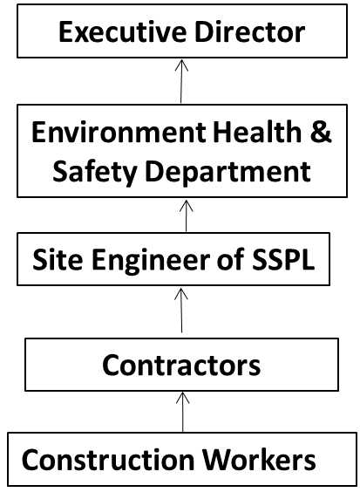
EMP at site during Construction
1) Management of fugitive emissions
All vehicles shall be maintained with valid PUC.
Adequate measures (e.g. water spraying) to avoid dust emissions.
Ensuring proper maintenance of construction equipment.
Transportation of construction material/debris with proper cover to avoid the fugitive emissions of dust.
2) Covering responsible person’s contact details
Name - Sumit Chakraborty
Contact No. - 9903911618
3) Communication protocol details
4) Site preparation
Site clearing and preparation activities will involve removal of scanty vegetation in the plant site and landfilling to level the land by filling up the undulations.
5) Setting up measuring stations at plant boundary
5 monitoring stations shall be set up along the plant boundary for regular monitoring of the environmental parameters.
6) Inspection of site by project authorities and district authorities
There will be regular inspection of the site by the concerned project authorities and the concerned district authorities to ensure the compliance of all the applicable norms
7) Complaint registration and response mechanism & record keeping A complaint register shall be maintained at the site to record the grievances of the local people / workers. Dedicated personnel shall be deployed fixing the responsibility to address the grievances along with maintaining the record of the same at the site itself.
8) Display of pollution level at site entry point/gate
There shall be one display board at site entry point/gate containing all necessary parameters for ambient air quality, fugitive emissions, noise, etc.
9) Mitigation measures including water fogging and air curtains and restoring back the site surroundings after completion of construction
Mitigation measures already explained above. The entire activity shall be confined within the project site itself.
10) Shall also be provided with project time frame
The entire project will be completed in 60 months.

Slide 48
EMP – GREEN BELT (Construction/Operation)
Proposed project shall be installed on the available land, within the existing plant premises comprising of total 262.64 Hectares (649 acres) of land as well as on some additional land of 21.45 Hectares (53 acres) which has already been acquired by the company. Total land area for the project shall be 284.09 Hectares (702 Acres).
As, the proposed project shall be installed on the vacant land within the existing plant premises as well as on the additional land which is also vacant, there is no proposal for felling of any tree during the construction period.
M/s Shyam Sel & Power Ltd. has earmarked 97.1 Hectares (239.94 acres) for Green Belt Development, which is around 34% of the total plant area of 284.09 Hectares (702 acres) of land. Out of this 97.1 Hectares (239.94 acres) of land for greenery, 87.4 Hectares (216 acres) of land is already developed as greenery within the plant premises where around 2,21,990 number of trees (@2540 trees per hectares) have been planted. Remaining 9.7 Hectares (24 acres) of land will be utilised for greenery development in the plant area where around 24,250 number of trees (@2500 trees per hectares) will be planted. Thus, finally total 2,46,240 number of trees shall come under greenbelt in the plant premises.
In addition to that around 18.4 Hectares (45.5 acres) of land will be used for greenbelt development purpose outside the plant premises. This 18.4 Hectares (45.5 acres) of land is just adjacent to the main plant. Around 46,000 number of trees (@2500 trees per hectares) will be planted in this additional land. Thus, total plantation area will be 28.1 Hectares (69.44 acres).
Time Schedule and Approximate Capital Cost of the Proposed Green Belt
Year of establishment / formation | Area to be planted (in Hectare) | Expenditure on Formation/ Establishment @7500 Mandays (MD) /hectare
1st Year | 10.0 | 75,000 MD or Rs. 3,00,00,000 (For 10.0 Hectares)
2nd Year | 10.0 | 75,000 MD or Rs. 3,00,00,000 (For 10.0 Hectares)
3rd Year | 8.1 | 60,750 MD or Rs. 2,43,00,000 (For 8.1 Hectares)
Total Initial Cost | 28.1 | 2,10,750 MD or Rs. 8,43,00,000 (For 28.1 ha)

Slide 49
Time Schedule and Approximate Maintenance Cost of the Proposed Green Belt
Year of establishment | Area to be planted (in Hectare) | Cumulative Area (in Hectare) | Year wise Expenditure on Maintenance | Initial Establishment cost | Total Year wise Expenditure on Maintenance
1st Year | 10.0 | 10.0 | @ 5250 MD / Ha | 70% | 52,500 MD or Rs. 2,10,00,000 (For 10.0 ha)
2nd Year | - | 10.0 | @ 3750 MD / Ha | 50% | 37,500 MD or Rs. 1,50,00,000 (For 10.0 ha)
 | 10.0 | 10.0 | @ 5250 MD / Ha | 70% | 52,500 MD or Rs. 2,10,00,000 (For 10.0 ha)
3rd Year | - | 10.0 | @ 2250 MD / Ha | 30% | 22,500 MD or Rs. 90,00,000 (For 10.0 ha)
 | - | 10.0 | @ 3750 MD / Ha | 50% | 37,500 MD or Rs. 1,50,00,000 (For 10.0 ha)
 | 8.1 | 8.1 | @ 5250 MD / Ha | 70% | 42,525 MD or Rs. 1,70,10,000 (For 8.1 ha)
Total | 28.1 |  |  |  | 2,45,025 MD or Rs. 9,80,10,000 (For 28.1 ha)
From 4th Year onward annual recurring maintenance operation cost of the entire greenbelt beyond initial establishment | 28.1 | 28.1 | @ 375 MD/Ha | 5% | 10,537.5 MD or Rs. 42,15,000 (For 28.1 ha)

Slide 50
EMP - SOLID & HAZARDOUS WASTE MANAGEMENT & DISPOSAL
Sl. No. | Type | Source | Quantity in Tons/Year |  |  | Utilization with Treatment
 |  |  | Existing Units | Proposed Units + Units to be implemented / under implementation | Total
1 | Dolochar from | DRI Kilns | 1,61,370 | 5,11,830 | 6,73,200 | 100% to be used in FBC boiler of CPP.
2 | Slag | MBF | - | 2,31,000 | 2,31,000 | 100% to be used in captive Cement Grinding Unit
3 | Slag | Induction Furnaces, LD Converter & EAF | 63,097 | 3,60,763 | 4,23,860 | The slag generated from the furnaces shall be 4,23,860 TPA considering 100% production in all furnaces. After metal recovery about 10% metal shall be recovered from the total slag and the balance 3,81,474 TPA (as stone chips / road construction materials) shall be used for road construction & repairing / land filling purposes. Considering 7 m width & depth 24 inch (0.6 m) of the road and density of the slag as 3.5 ton/cum, 14700 T slag may be consumed for 1.0 km stretch. Therefore, the entire quantity of slag generated in a year (4,23,860 TPA) can be utilized for the construction of around 26 km roads among which around 6 km are internal roads i.e. within the plant site. Development of additional land for the proposed project will also consume around 2,25,225 Tons which is around 60% of the total annual generation of the slag. As per an estimate, it was found that around 600 km undeveloped (Kuchha) road is existing in the surrounding villages in the 10 km radius area. Hence, there is lot of potential of slag utilisation during construction of these roads.

Slide 51
Sl. No. | Type | Source | Quantity in Tons/Year |  |  | Utilization with Treatment
 |  |  | Existing Units | Proposed Units + Units to be implemented / under implementation | Total
4 | Tar Sludge | PGP | 21,000 | 7,000 | 28,000 | Sold to WBPCB authorized vendor.
5 | Coal Ash | PGP | 82,875 | 27,625 | 1,10,500 | To be used for making construction Materials
6 | Dust | ESP and Bag Filters of Sinter Plant |  | 65,000 | 65,000 | To be reused in process
7 | Dust | ESP and Bag Filters of Pellet Plant | 93,800 | 1,40,700 | 2,34,500 | To be reused in process
8 | Dust | GCP and Bag Filters of Blast Furnace |  | 77,200 | 77,200 | 100% to be reused in Sinter Plant
9 | Dust | ESP and Bag Filters of DRI Plant | 42,787.5 | 1,35,712.5 | 1,78,500 | 100% to be reused in Sinter Plant
10 | Dust | Bag Filters of Induction Furnaces | 26,323 | 1,08,177 | 1,34,500 | To be reused in process
11 | Mill scales | Rolling mill and casting machines | 10,000 | 23,000 | 33,000 | To be reused in Induction Furnaces
12 | Slag | Ferro Alloy Plant | 80,000 | - | 80,000 | The maximum slag generation is 80,000 TPA considering 100% production. After metal recovery about 10% metal is recovered from the total slag and the balance 72,000 TPA (as stone chips / road construction materials) is being used for road construction & repairing / land filling purposes. Considering 7 m width & depth 24 inch (0.6 m) of the road and density of the slag as 2.5 ton/cum, 10,500 T slag is consumed for 1.0 km stretch. Therefore, the entire quantity of slag generated in a year (80,000 TPA) is being utilized for the construction of around 7 km roads. Besides, significant amount of slag is also used for landfilling purposes both inside & outside the project site.

Slide 52
Sl. No. | Type | Source | Quantity in Tons/Year |  |  | Utilization with Treatment
 |  |  | Existing Units | Proposed Units + Units to be implemen-ted / under implemen-tation | Total
13 | Fly Ash | CPP | 1,49,452 | 3,69,523 | 5,18,975 | Fly ash to be utilised for cement making / brick making. Bottom ash to be utilised for brick making / landfilling purposes. The company has proposed a cement grinding unit of 1.2 MTPA capacity with the current proposal.Besides, the company is already operating a brick manufacturing plant within its existing plant premises with a capacity of 50,000 bricks per day. 3,34,873 TPA fly ash shall be utilised in the proposed Cement Grinding unit. The balance 34,650 TPA fly ash shall be utilised in brick making. All the necessary calculations for both fly and bottom ash in brick making are presented below: Weight of each brick - 3.5 kg Weight of 50,000 bricks = 1,75,000 kg Weight of bricks manufactured in a year = 57750 TPA Composition of the bricks : Fly ash - 60%, Bottom Ash - 34% and Cement - 6% For manufacturing 57,750 TPA of bricks, 34,650 TPA fly ash and 19,635 TPA bottom ash is required. Hence, balance 72,746 TPA bottom ash shall be used for landfilling purposes both inside and outside the plant premises. Alternatively, this balance bottom ash may also be disposed through filling of the abandoned mines of ECL the permission for which is already available.
14 | Bottom Ash | CPP | 37,363 | 92,381 | 1,29,744
Besides, there will be generation of Used / Spent Oil in very small quantity. Used oils removed from machinery, gear boxes, compressors etc. will be collected in drums and temporarily stored in specifically earmarked areas. They will be disposed through the authorised agencies.

Slide 53
POST PROJECT MONITORING
SL. NO. | ENVIRONMENT / SOCIAL CONTROL MEASURE | COST OF EMP (IN CRORES) |  |  |  |  |  | REMARKS
 |  | EXISTING |  | PROPOSED |  | TOTAL
 |  | CAPITAL | RECURRING (PER ANNUM) | CAPITAL | RECURRING (PER ANNUM) | CAPITAL | RECURRING (PER ANNUM)
1 | Air Pollution Control Systems | 52.0 | 5.2 | 89 | 8.9 | 141 | 14.1
2 | Water conservation & Pollution Control | 10.5 | 1.05 | 18 | 1.8 | 28.5 | 2.85
3 | Solid / Hazardous Waste Management System | 9.5 | 0.95 | 16 | 1.6 | 25.5 | 2.55
4 | Green belt development | 10.5 | 0.50 | 8.43 | 0.42 | 18.93 | 0.92
5 | Noise Reduction Systems | 10.0 | 1.0 | 17 | 1.7 | 27 | 2.7
6 | Occupational Health Management | 9.0 | 0.9 | 15 | 1.5 | 24 | 2.4
7 | Risk Mitigation & Safety Plan | 10.5 | 1.05 | 18 | 1.8 | 28.5 | 2.85
8 | Environmental Management Department | 4.0 | 0.4 | 7 | 0.7 | 11 | 1.1
9 | Total Budget - Public Hearing related | - | - | 4.41 | - | 4.41 | -
 | TOTAL | 116.0 | 11.05 | 192.84 | 18.42 | 308.84 | 29.47

Slide 54
RISK ASSESSMENT FINDINGS AND ITS MITIGATION
Components / Process | Failure Mode |  | FailureEffect | FailureCause | Existing Control | S | O | D | RPN | Additional Control
Sinter Plant
Conveyor feed belt to sinter plant |  | Friction | Fire | Improper Maintenance | - | 9 | 2 | 2 | 36 | Lubricating the rotating parts regularly
Pneumatic lime transportation system |  | Failed toOperate | Spillage of Hot Lime | Improper Maintenance | - | 7 | 2 | 2 | 28 | Regular inspectionand Periodic maintenance
Automatic lubricating system |  | Failed toOperate | Mechanical Failure | Improper Maintenance | - | 4 | 3 | 3 | 36 | Periodic Maintenance
Double cone dust valves |  | Failed toOperate | Improper dust cleaning | Corrosion | - | 3 | 2 | 3 | 18 | Periodic Maintenance
Mixed gas injection |  | Pipeline rupture | Fire &Explosion | Over Pressure | - | 5 | 2 | 3 | 30 | Provide detectorswith alarm system
Sinter Cooler |  | Failed toOperate | Combustion failure in Sinter | Improper Maintenance | - | 4 | 3 | 3 | 36 | Regular inspectionand Periodic maintenance
Pellet Plant
Conveyor Belt to Travelling Gate | Friction |  | Corrosion | Improper Maintenance | Belt Sway Switch | 7 | 2 | 2 | 28 | Lubricating therotating parts regularly
Coal / Producer Gas injection to indurating furnace | Pipeline rupture |  | Fire &Explosion | Over Pressure | Detectors | 8 | 3 | 2 | 48 | Provide detectors with alarm system

Slide 55
Blast Furnace
Bleeder valves | Failed to Operate | Explosion | Corrosion | - | 9 | 2 | 3 | 54 | Periodic Maintenance
Conveyor feed belt | Friction | Fire | Improper Maintenance | - | 8 | 2 | 3 | 48 | Lubricating the rotating parts regularly
Cold blastBlower | Flow Pressure Increase | Rupture instove | Failure of valves | - | 8 | 2 | 2 | 31 | Interlock system
Hot blastBlower | Stove shellcrack | Fire &Explosion | Excess Temperature | - | 9 | 1 | 2 | 18 | Periodic Maintenance
Blast Furnace gas | Pipeline rupture | CO poisoning | Over Pressure | - | 10 | 3 | 2 | 60 | Provide detectors with alarm system
Oxygen Injection | Pipeline rupture | Fire & Explosion | Over Pressure | - | 9 | 2 | 2 | 36 | Provide detectors with alarm system
Cooling water supply pump | Pumpfailure | Explosion | No power supply | - | 9 | 3 | 2 | 54 | Check the fuel level of diesel generator
Tapping hose | Oxygen hose cut | Fire | Ageing | - | 8 | 3 | 3 | 72 | Change hose periodically
Hot metal lifting by crane | Rope breakage | Hot Metal ladle down | Overloading | - | 8 | 3 | 2 | 48 | interlocks with alarm
Hot metal transfer by trolley | Mechanical Failure (Gearbox, Axial, Wheel) | Spillage of hot metal | Improper Maintenance | - | 9 | 3 | 2 | 54 | Regular inspectionand Periodic maintenance
Gas cleaning filter bags | Filter bags failure | Improper gas cleaning | Excess Temperature | - | 4 | 3 | 3 | 36 | Regular inspectionand Periodic maintenance
Lancing Hose | Tuyers puncture | Burns | Ageing | - | 4 | 4 | 4 | 64 | Check defects before use
Butterfly valve to regulate flow | Valve partially closed | CO Poisoning | Dust | - | 9 | 2 | 3 | 54 | Periodic Maintenance
Steam Injection | Pipeline cracks | Burns | Excess pressure | - | 7 | 3 | 3 | 63 | Display cautionary notice

Slide 56
DRI
Conveyor feed belt to DRI | Friction | Corrosion | Improper Maintenance | Belt Sway Switch | 7 | 2 | 2 | 28 | Lubricating the rotating parts regularly
Reducing Gas injection | Pipeline rupture | Process Failure inDRI Kiln | Over Pressure | Line Inspection | 7 | 3 | 3 | 42 | Regular inspection and Periodic maintenance
Cooler Discharged Gas | Pipeline rupture | Failure in After Burning Chamber | Excess Pressure | Line Inspection | 5 | 2 | 3 | 30 | Regular inspectionand Periodic maintenance
Mag Pulley | Mechanical Failure | Waste Conveying System Failure | Improper Monitoring | Inspection | 6 | 3 | 3 | 54 | Periodic Maintenance
Conveyor Beltto storage Bins | Friction | Waste Storage System Failure | Improper Maintenance | Belt Sway Switch | 5 | 2 | 2 | 20 | Lubricating the rotating parts regularly
Steel Melting Shop
Flow monitoring switch | Failure to operate | Rupture in Current Flow | Switch broken | Reliable Supplier | 7 | 3 | 2 | 42 | Regular Inspection
DC Choke | Failure to operate | Rise of current to dangerous level | Electric Failure | Reliable Supplier | 7 | 2 | 3 | 42 | Regular Inspection
DM Water circulating unit | Failure to circulate de ionized water | Excessive Heat generation in solid state power supply unit | Electric Failure | Inspection | 4 | 3 | 3 | 24 | Regular inspectionand Periodic maintenance
Direction Control Valve | Failure to operate | furnace tilting control failure | Corrosion | Reliable Supplier | 7 | 3 | 2 | 42 | Periodic Maintenance
Furnace lamination packet | Electric / magnetic failure | Failure to provide a return path to the flux | Overheating of the structure | Inspection | 6 | 3 | 2 | 36 | Regular inspectionand Periodic maintenance
Flow regulating valves in furnace | Failed to Operate | Excessive Temperature | Improper Maintenance | Indicator | 8 | 4 | 3 | 96 | Periodic Maintenance

Slide 57
Hot metal lifting by crane | Rope breakage | Hot Metal ladle down | Overloading |  | Safe working load are marked | 8 | 3 | 3 | 72 | interlocks with alarm
Hot metaltransfer bytrolley | Mechanical Failure (Gearbox, Axial, Wheel) | Spillage of hot metal | Improper Maintenance |  | ROW (3 m) marked, cover ladle, loading within granted permissible limit | 9 | 2 | 3 | 54 | Regular inspectionand Periodic maintenance
Ladle Refining Furnace
Hot metal ladletransfer car | Friction | Fire | Improper Maintenance |  | Belt Sway Switch | 9 | 2 | 2 | 36 | Lubricating the rotating parts regularly
Continuous Casting Machine
Ladle car | Friction | Fire | Improper Maintenance |  | Belt Sway Switch | 8 | 2 | 2 | 32 | Lubricating the rotating parts regularly
Stopper | Mechanical Failure | Fire & Explosion | Improper Maintenance |  | Indicator | 7 | 3 | 2 | 42 | Regular Inspection
Tundish | Failed toOperate | Spillage of Hot liquid metal | Mechanical Failure |  | Line inspection | 7 | 2 | 3 | 42 | Regular inspectionand Periodic maintenance
Rolling Mill (Hot)
Conveyorrollers to feed | Friction | Fire | Improper Maintenance | Belt SwaySwitch |  | 7 | 3 | 2 | 42 | Lubricating the rotating parts regularly
Water cooling pump | Pumpfailure | Explosion | No power supply | Redundant power supply |  | 10 | 2 | 2 | 40 | Check the fuel levelof diesel generator
Coke Oven Plant
Conveyor belt to top of the coal tower | Operation failure | Injury | Improper Maintenance |  | - | 4 | 3 | 2 | 24 | Periodic maintenance

Slide 58
Ductile Iron Pipe
Conveyor feed belt | Friction | Fire | Improper Maintenance | - | 7 | 2 | 2 | 28 | Lubricating the rotating parts regularly
Magnesium treatment | Pipelines crack | Explosion | Excess Pressure | - | 7 | 3 | 2 | 42 | Display cautionary notice
Cooling water supply pump | Pump Failure | Explosion | No power supply | - | 8 | 4 | 2 | 64 | Check the fuel level of diesel generator & provision for stand by pump
Core making jets | Operational Failure | Injury | Improper Maintenance | - | 7 | 4 | 2 | 56 | Periodic maintenance
Steam Injection Heat Treatment) | Pipelines crack | Burns | Excessive Pressure | - | 7 | 3 | 2 | 42 | Display cautionary notice
Cement spraying Nozzle | Pin Holes | Gas temperature increase | Spraying cement excessively | - | 6 | 3 | 3 | 54 | Check the level for every 5 minutes
Gas Cleaning filter bags | Filter bags failure | Improper gas cleaning | excess Temperature | - | 4 | 3 | 3 | 36 | Regular inspection
Bitumen spraying Nozzle | Pin Holes | Gas temperature increase | Spraying Bitumen excessively | - | 6 | 5 | 2 | 60 | Check the level for every 5 minutes
Dolochar & Coal Mix based CPP
Air Supply Fluidized Bed | Flow Air Fuel Ratio | Operation Failure | Air Flow Below 30 % | Line inspection | 6 | 3 | 4 | 72 | Provide detectors with alarm system
Boiler | Corrosion Effect | Cooling of tube increases temperature | Creep Failure | Line inspection | 4 | 4 | 5 | 80 | Regular inspection
Boiler | Boiler Tube | Damage inside & outside the tube | Extremely combustion | Monitors | 5 | 3 | 5 | 75 | Periodic Maintenance
Boiler | Tube Alignment & Setting | Deformation of vibration Arrestor | Vibration increases | Inspection | 6 | 3 | 4 | 72 | Periodic Maintenance

Slide 59
Boiler | Incomplete Combustion | Air Fuel Losses | Insufficient air supply to Furnace | Line inspection | 5 | 2 | 5 | 50 | Regular inspection
Turbine / Steam Generator | Temp of Super Heater & Reheater | Failure of turbine blades | Changing the plant load | Line inspection | 5 | 2 | 6 | 60 | Periodic Maintenance
Turbine / Steam Generator | Loss of fuel | Abnormal Combustion | Improper air fuel mixture | Monitors | 5 | 3 | 4 | 60 | Check the level for every 5 minutes
water Tank | Water Level of Drum | Excess Steam Pressure | Failure of Indicators | Monitor | 6 | 3 | 3 | 54 | Regular inspection
Producer Gas Plant
Air Injection | Pipeline rupture | Operation failure | Improper Maintenance | - | 6 | 3 | 3 | 54 | Provide detectors with alarm system
Turbine | Temp of Super Heater & Reheater | Failure of turbine blades | Changing the plant load | - | 5 | 3 | 4 | 60 | Periodic Maintenance
L D Converter
Flow monitoring switch | Failure to operate | Rupture in Current Flow | Switch broken | - | 6 | 3 | 3 | 54 | Regular Inspection
Direction Control Valve | Failure to operate | furnace tilting control failure | Corrosion | - | 7 | 2 | 3 | 42 | Periodic Maintenance
Flow regulating valves in furnace | Failed to Operate | Excessive Temperature | Improper Maintenance | - | 6 | 3 | 4 | 72 | Periodic Maintenance
Hot metal lifting by crane | Rope breakage | Hot Metal ladle down | Overloading | - | 9 | 3 | 2 | 54 | interlocks with alarm
Hot metal transfer by trolley | Mechanical Failure (Gearbox, Axial, Wheel) | Spillage of hot metal | Improper Maintenance | - | 8 | 3 | 3 | 72 | Regular inspection and Periodic maintenance

Slide 60
Oxygen Plant
Air feed | Pipeline rupture | Operation failure | Improper Maintenance | - | 4 | 3 | 3 | 36 | Provide detectors with alarm system
Cement Grinding Unit
Conveyor belt | Friction | Corrosion | Improper Maintenance | - | 8 | 3 | 2 | 48 | Lubricating the rotating parts regularly and maintaining the cover sheet to avoid corrosion
Moving Machinery, onsite transport, crane & forklifts | Mechanical Failure | Conveying System Failure | Improper Monitoring | - | 5 | 4 | 3 | 60 | Continuous monitoring, Periodic Maintenance & Mechanical Strength testing

Slide 61
ENERGY AND WATER CONSERVATION MEASURES
ENERGY CONSERVATION MEASURES
SSPL shall provide solar generation on roof tops of buildings, for solar lighting system for all common areas, street lights, parking around project area and maintain the same regularly.
LED lighting system has been installed throughout the office buildings and plant area.
WATER CONSERVATION MEASURES
Cooling Tower & Boiler Blow-down from various recirculation systems will be cascaded for reuse in Ash Handling, gardening and dust suppression as shown in water balance diagram.
Efforts will be made to harvest rainwater in the plant. Run-off water from the office areas, shop roofs will be collected and stored for future use. Apart from Surface storage of rain water, there is plan for rain water harvesting through recharging of ground water in the surrounding villages. The company will also develop 10 ponds in the nearby villages.
The plant will be designed as a zero discharge plant as far as the process effluents are concerned. The water will be recirculated through cooling and treatment. No plant effluent will be discharged outside the plant premises. The entire waste water will be recycled for various purposes inside the plant.
Domestic effluent from the various buildings / sheds of the plant will be conveyed through separate drains to Sewage Treatment Plant (STP). The treated effluent from STP will be used in Gardening purpose.

Slide 62
ANY OTHER RELEVANT INFORMATION
In the wake of the recent outbreak of COVID-19, the entire world is facing one of the greatest challenges to lead a normal life. The pandemic has done multiple damages on the life of the people.
In this context, the company has decided to undertake the various related activities to address the issue. It has already conducted a mass drive by providing the local people with the necessary items like masks, sanitizer etc. besides making efforts towards generating awareness among them to maintain social distancing, to use masks, to maintain personal hygiene etc. The company shall also provide training to the local people in preparing masks, sanitizer etc. through its skill development programme. The Company has already undertaken the mass vaccination drive for the local villagers apart from its own personnel and their family members. Besides, it has also provided well equipped three numbers Ambulance for the local people.
DIRECTION / COURT CASE / LITIGATION
There are no Directions / Court Cases / Litigations pending against the project.

Slide 63
THANK YOU
Project Proponent
M/s Shyam Sel & Power Ltd.
S.S. Chamber, 5, C.R Avenue, Kolkata, West Bengal

