Slide 1
DETERGEO CHEM (EAST) PRIVATE LIMITED
WELCOMES HON’BLE CHAIRMAN, MEMBER SECRETARY & MEMBERS OF EAC, MoEF&CC
IN THE PRESENTATION FOR GRANT OF EC
FOR
establishment of new natural and synthetic surfactant chemical manufacturing AT
Mouza Kulepairi, P.S. Bagnan, Dist.-Howrah, West Bengal
(CATEGORY “A” AS PER EIA NOTIFICATION 2006 AND ITS CONTINUOUS AMENDMENTS)
Date of Application Submission: 07/02/2024 | Detail of Public Hearing : 23/08/2021
EDS raised on – 21/02/2022 | Status of forest clearance (FC) : N/A
Date of acceptance : | Applicability of Coastal regulatory zone (CRZ) if any – N/A
Project Type : Industry project-3 | Certified Compliance submitted: N/A
Wildlife Sanctuary :N/A | EIA Co-ordinator : Mr. Nilesh Vitthal Potdar
Mantec Consultants Pvt. Ltd.
NABET Certificate No.: NABET/EIA/23-26/RA 0305_Rev.01 | Validity: April 20,2026
Environmental Consultant
Mantec Consultants Private Limited

Slide 2
INTRODUCTION OF THE PROJECT PROPONENT
M/s Detergeo Chem (East) Private Limited (DCEPL) is a fully owned subsidiary of New India Group.
New India Group is a fourth generation family-owned and professionally managed diversified business group.
The group was founded in 1947 and is primarily into manufacturing and trading of dyes, chemical and textiles.
The group has been manufacturing surfactants since the year 1990.
The group’s mission is to best serve the needs of its valuable customers by conducting business in line with its core values of integrity and reliability.
Proposed project is for the establishment of new natural and synthetic surfactant chemical manufacturing unit at DAG No. 42, 44, 45, 46, 52, 53, 54, 55, 131, 132, 138, 139,141, Mouza Kulepairi, P.S. Bagnan, Dist-Howrah, West Bengal by M/s Detergeo Chem (East) Private Limited (DCEPL).

Slide 3
INTRODUCTION OF THE PROJECT
The unit planned for the production of Linear Alkylbenzene Sulphonic Acid, Alpha Olefin Sulphonate, Sodium Lauryl Ether Sulphate, Sodium Lauryl Sulphate, Cocoamidopropyl Betaine, Cocamide Monoethanolamine, Cocamide Diethanolamine, Ethylene Glycol Distearate and Ethylene Glycol Monostearate.
As per EIA Notification dated 14th Sep.,2006, the proposed project of falls under Activity 5(f) for project covered under “Synthetic Organic Chemicals Industry” and falls under ‘A’ category.
M/s Detergeo Chem (East) Private Limited (DCEPL) is a fully owned subsidiary of New India Group.
Production capacities , has been estimated as 82,400 MT/A.
The total area of the project is 1.3493 ha.
The unit proposes to consume 203 KLD of Fresh water from state water tankers.
33% of the Total Project Area (i.e. 3019 sq. m) is for green belt development.
D.G. Set and Sulphonation process emissions are the main sources of air pollution.
Noise generated due to plant operations, and transportation are the main sources of noise pollution.
Average cost of the project be Rs. 20 Crores.
The total man power requirement of the project will be 200 men.
The CER Cost of the project is Rs. 40 Lakhs.

Slide 4
INTRODUCTION OF THE PROJECT
Name of the Project | M/s Detergeo Chem (EAST) Private Limited (DCEPL)
Location | Village | Mouza Kulepairi,
 | Tehsil | P.S. Bagnan
 | District | Howrah
 | State | West Bengal
 | Geographical Coordinates | 22°31'49.08"N & 87°55'47.78"E
 | Toposheet (OSM) No. | 73N/14, 73N/15, 79B/2 & 79B/3.
Size of the Project | 1.3493 Ha
% of green belt provided | 33% of the Total Project Area , 3019 sq. m
Category of Project | 5(f) Category “A” of EIA notification
Manpower | 200 men {operational phase-40(permanent) & construction phase-160(temporary)}
Estimated Project Cost | Average cost of the project be Rs. 20 Crores
EMP Cost | Rs. 150 Lakhs (capital cost), Rs. 17 Lakhs /Yr (Recurring cost)
CER Cost | Rs. 40 Lakhs

Slide 5
INTRODUCTION OF THE PROJECT
Water Consumption/day | 203 KLPD
Source of water | Water Tanker
Kind of Fuel used | Name of Fuel | Use
 | HSD | DG Set 1
 | Sulfur | Sulphonation Plant
 | LDO | 2tph Boiler
Quantity of fuel used | Name of Fuel | Quantity
 | HSD | 100 L/hr
 | Sulfur | 500 KG/hr
 | LDO | 155 L/hr
Waste Water Generated/day | The total waste water generation is 10.7 KLPD which will be treated in in-house ETP and this treated water will be re-used in the scrubber and for gardening purpose.
Mode of discharge | Zero Discharge and will successfully recycle the entire water back to plant use.
Energy Consumption | 1000 KW sourced through WBSEDCL. DG set will be installed of 1000 KW in case of power failer.

Slide 6
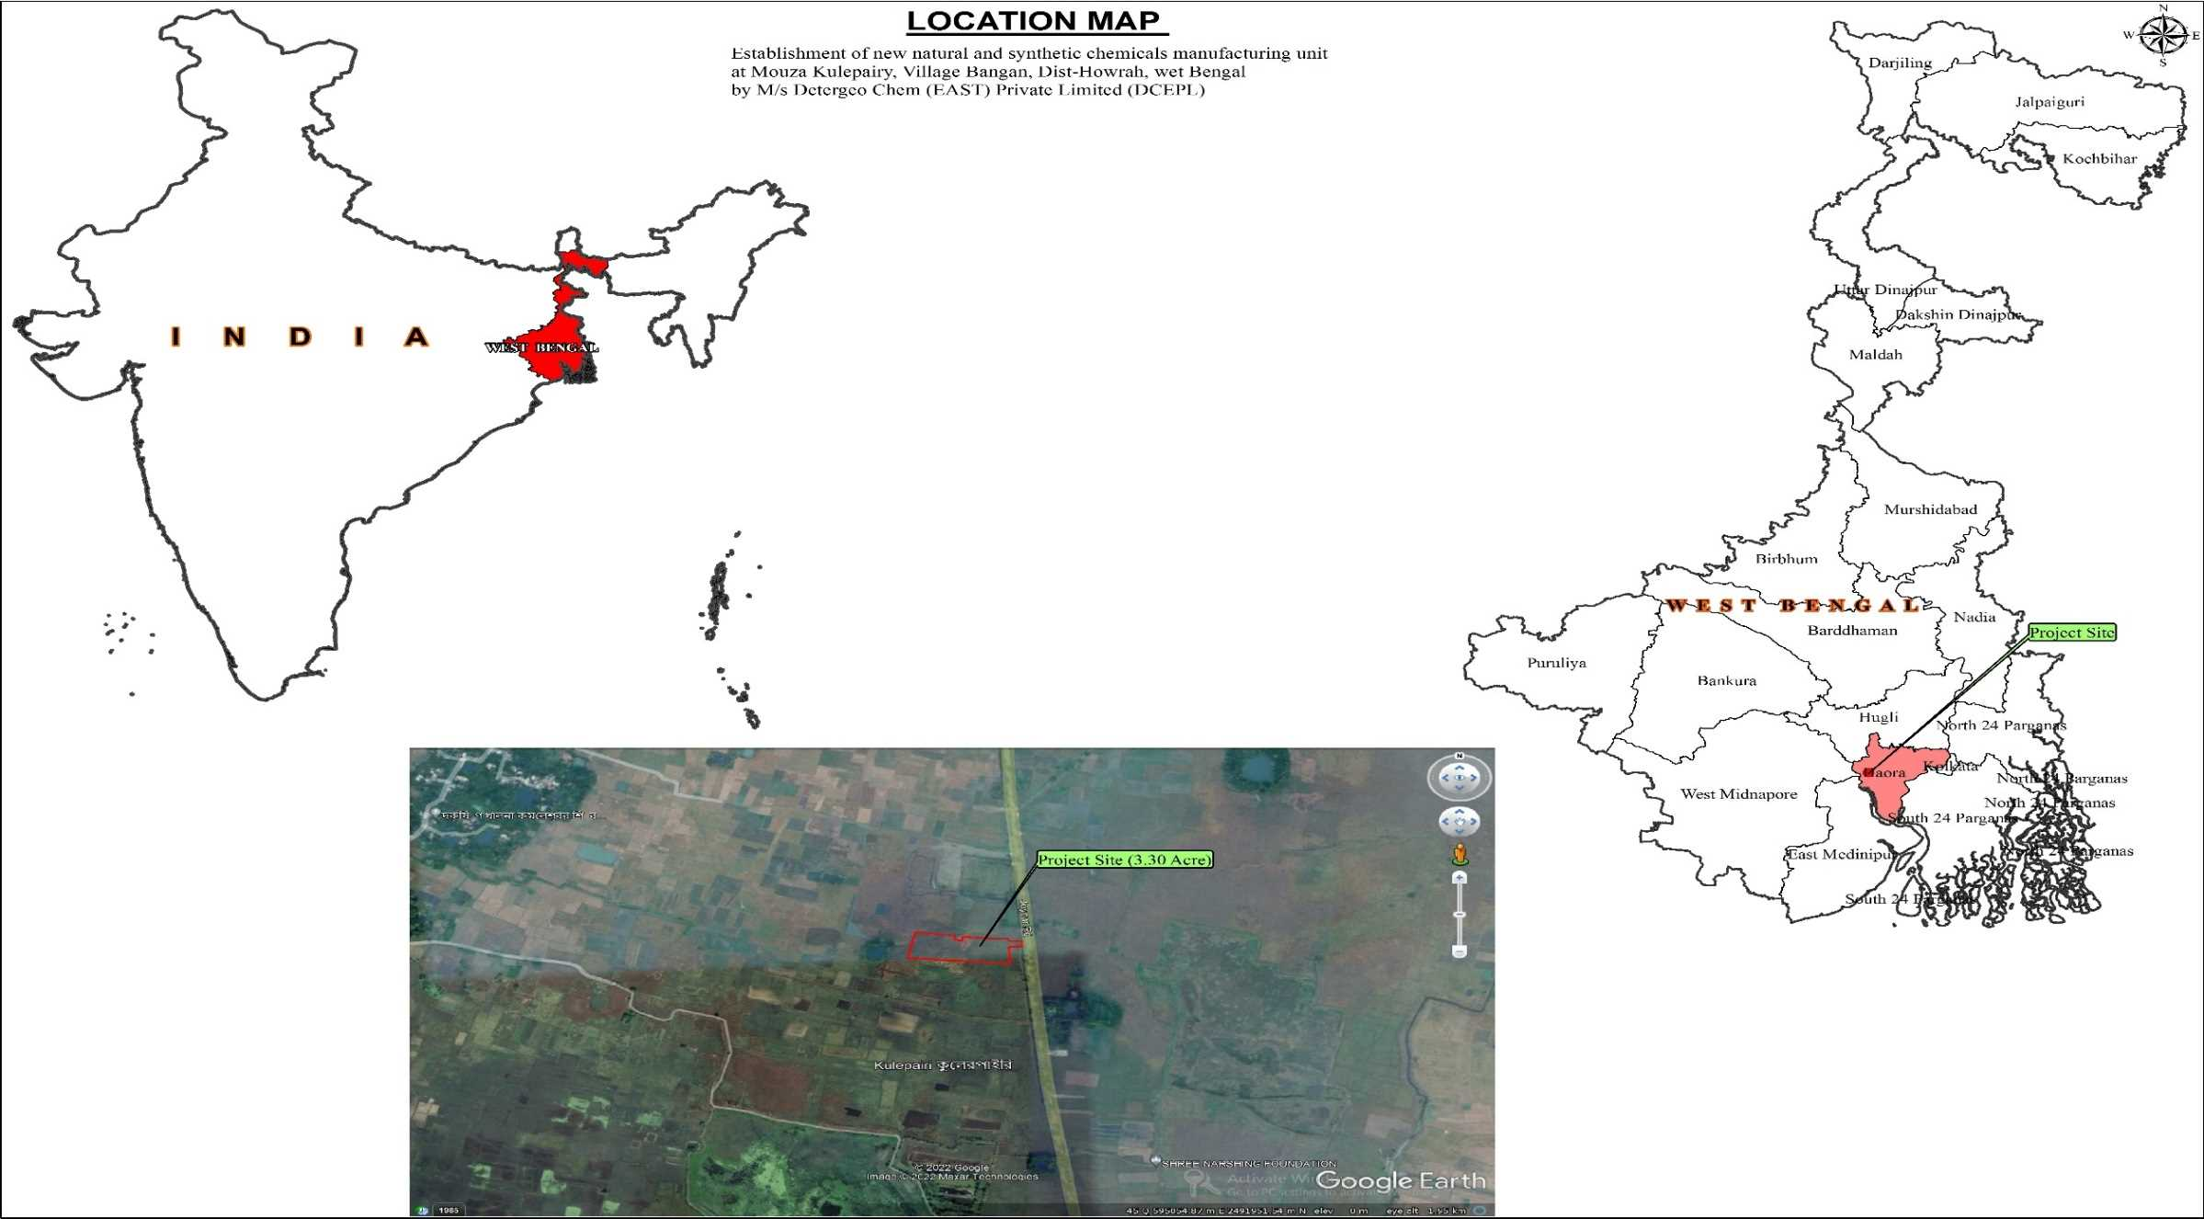
LOCATION MAP
Geographical Coordinates | 22°31'49.08"N & 87°55'47.78"E

Slide 7
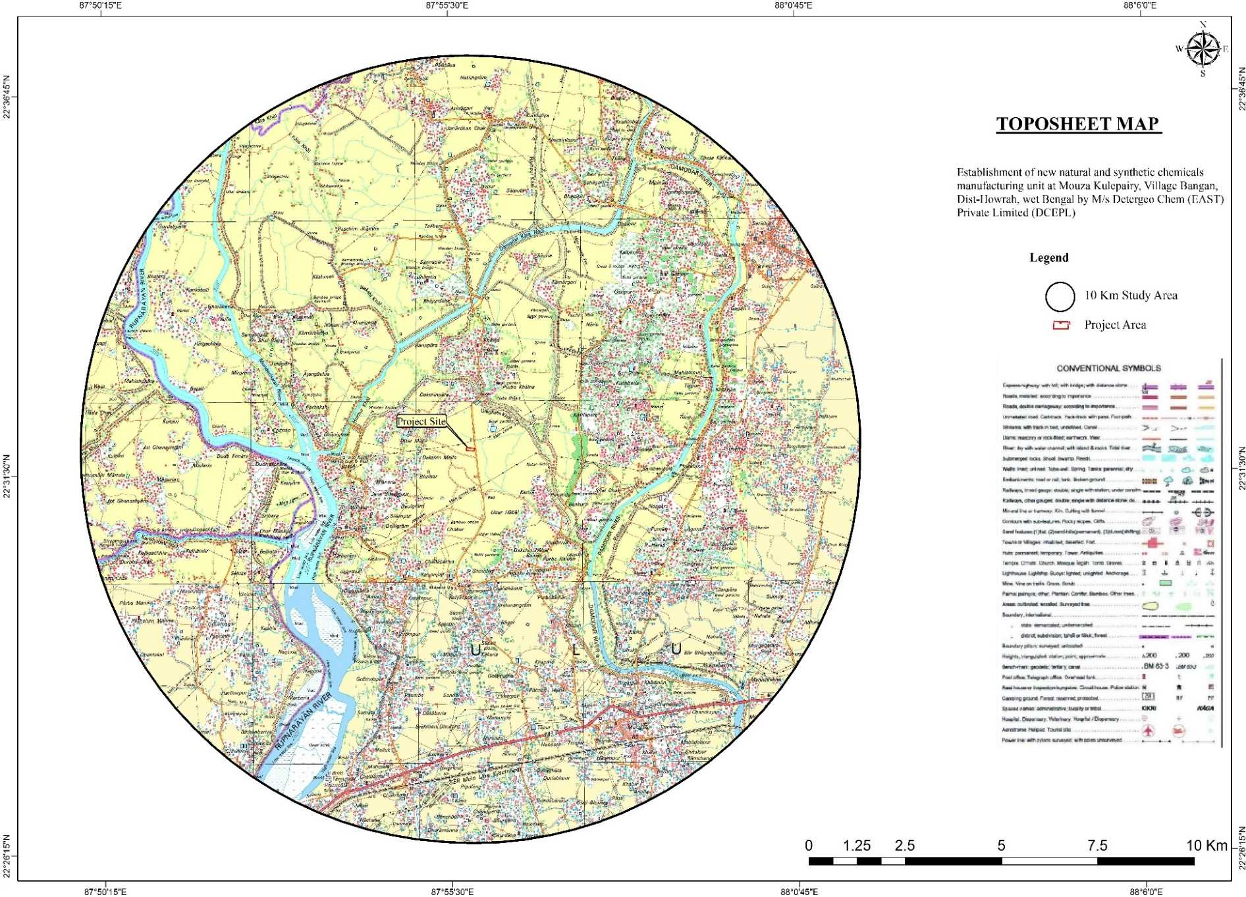
TOPOGRAPHICAL MAP
Particulars | Details & Direction
Water Bodies | Rupnarayan river- 3.6 Kms Damodar kata Nadi (Hurhur khal)-2.7 Kms Mendeshwari River-3.8 Kms Kanashabat Nadi- 49 Kms Damodar River- 4.0 Kms Gaighata Khal -1.1 Kms
Toposheet (OSM) No. | 73N/14, 73N/15, 79B/2 & 79B/3.

Slide 8
CONNECTIVITY OF PROJECT SITE
Nearest Airport | Netaji Subhash Chandra Bose International Airport~ 54 Km, E
Nearest Railway Station | Bagnan~ 8.7 Km, SE
Nearest State Highway/ National Highway | NH-16 ~7.4 Km, SE SH-15 ~5.7 Km, SE
Seismic Zone | Zone II
Water Body | Rupnarayan River- 3.6 Kms Damodar Kata Nadi (Hurhur Khal)-2.7 Kms Mendeshwari River-3.8 Kms Kanashabat Nadi- 49 Kms Damodar River- 4.0 Kms Gaighata Khal -1.1 Km
Nearest Town/ Major City with 200000 population | Bagnan~7.4 Km, SE
Medical Facilities | Rural Hospital, Bagnan~7.8, SE
Education Facilities | DMB high school, Mankur~1.90km, SW
List of industries/ Project activities within 10 Km radius | M/s. Tandhan Cotton Mills Private Limited- Textile M/s. Tandhan biochemical Private Limited M/s Mohan Boards Pvt Ltd

Slide 9
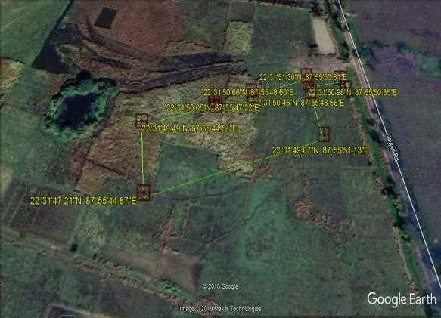
GOOGLE EARTH IMAGE OF THE PROJECT SITE

Slide 10
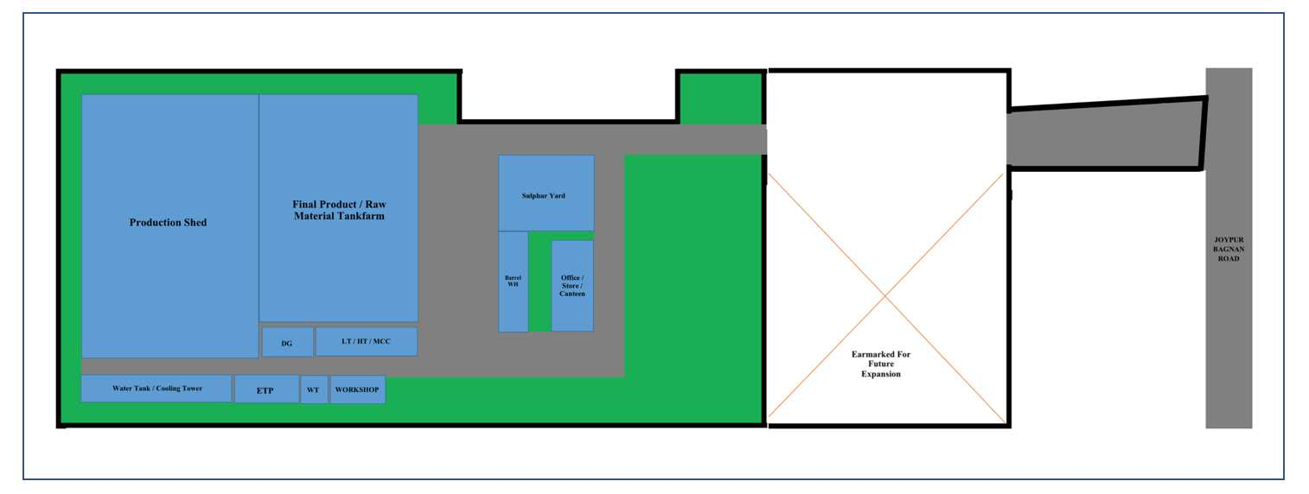
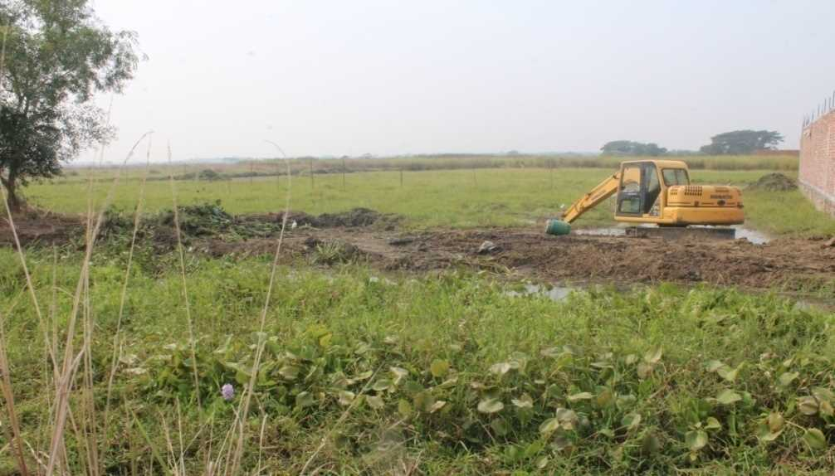
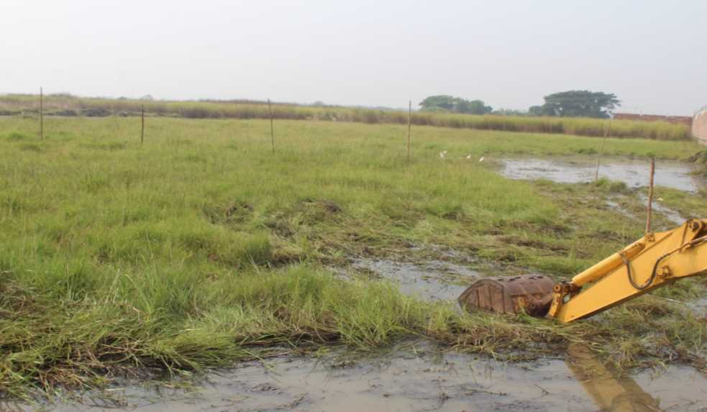
PROJECT LAYOUT AND SITE PHOTOS
SITE PHOTOS
PROJECT LAYOUT

Slide 11
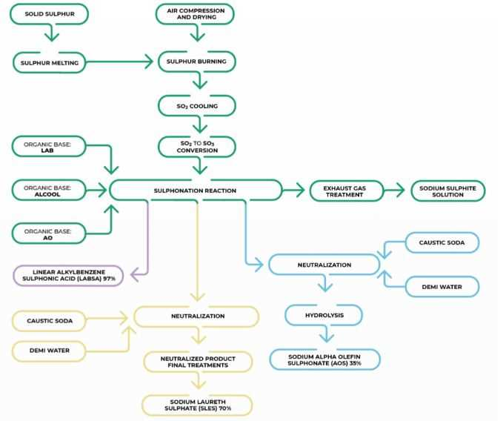
LINE DIAGRAM OF CONTINUOUS SULPHONATION PLANT

Slide 12
RAW MATERIAL REQUIREMENT
S. No. | Product Name | Manufacturing Capacity (MTA) | Mode of Transport
1. | Linear Alkyl Benzene | 17,215 | MS Tanker
2. | Alpha Olefin | 560 | ISO Tanks
3. | Lauryl Ether | 13,200 | ISO Tanks
4. | Lauryl Alcohol | 3,150 | ISO Tanks
5. | Sulfuric Acid 98% | 12,000 | MS Tanker
6. | Caustic Soda | 4,052 | MS Tanker
7. | Sulfur | 3,487 | Truck
8. | Coconut Fatty Acid | 5,028 | ISO Tank
9. | Dimethylaminopropylamine | 264 | ISO Tank
10. | Monochloroacetic acid | 243 | Truck
11. | Monoethanolamine | 732 | ISO Tank
12. | Diethanolamine | 1029 | ISO Tank
13. | Stearic Acid | 5490 | ISO Tank
14. | Ethylene Glycol | 870 | MS Tanker

Slide 13
WATER REQUIREMENT
Source of Water is State Water tanker and the approval has been taken from the authority.
WATER BALANCE
S. No. | Particulars | Water Consumption (KLPD)
1 | Domestic | 2
2 | Industrial
 | Process - Dilution / RO Reject / Washings | 13
 | Cooling Tower Makeup Water | 168
 | Boiler Makeup Water | 20
 | Alkali Scrubber (Recycle Water) | 5
3 | Gardening | 5.5
Actual Water Requirement (KLPD) |  | 203

Slide 14
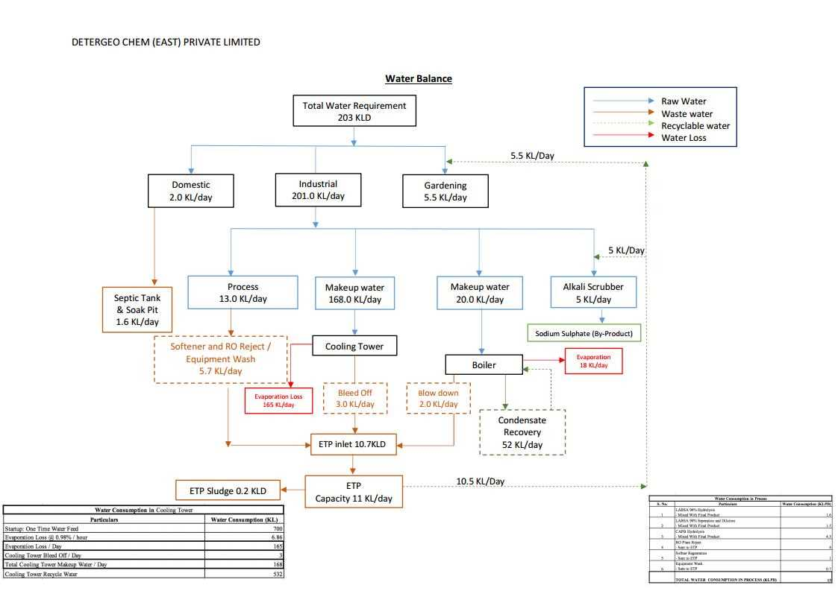
WATER BALANCE DIAGRAM

Slide 15
WASTE WATER GENERATION AND MANAGEMENT
S. No. | Particulars | Water Consumption (KLPD) | Treatment
1 | Domestic Sewage | 1.6 | Septic Tank / Soak Pit
2 | Utilities and Process
 | Cooling Tower Blow down | 3 | ETP
 | Boiler Blow down | 2 | ETP
 | Softener Regeneration | 1 | ETP
 | RO Reject | 4 | ETP
 | Equipment Wash | 0.7 | ETP
The total waste water generation is 10.7 KLPD which will be treated in our in-house ETP and this treated water will be re-used in the scrubber and for gardening prupose
Domestic sewage to be treated in septic tank and disposed in soak pit.
The blow down from boiler and circulating cooling water system will be process in ETP.
The entire process effluent will be treated in ETP and the treated water will be used in Alkali Scrubber and Gardening.
The facilities will be operated with zero effluent discharge.
Online effluent quality monitoring system to be installed at the outlet of the unit for measurement of the parameters flow, pH, COD, BOD & TSS etc. and transmission of online data to SPCB and CPCB to be done.

Slide 16
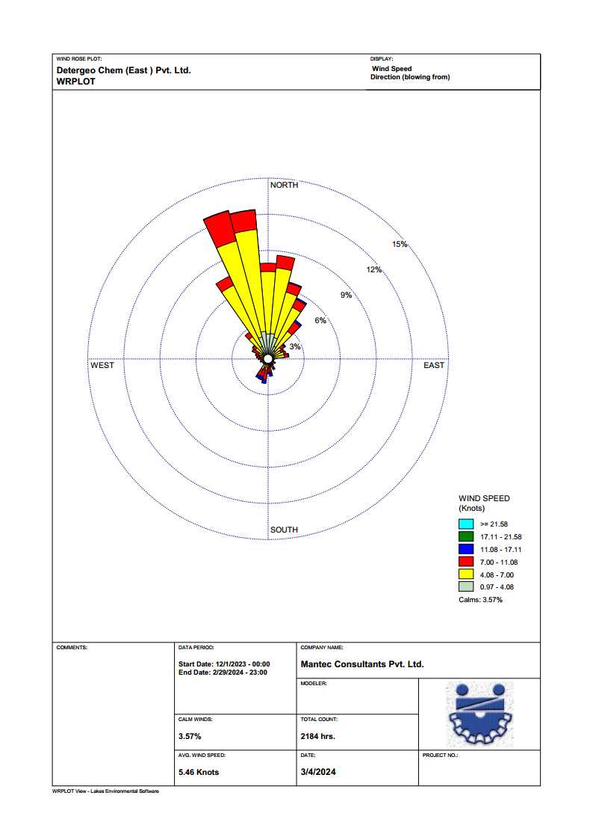
WIND ROSE DIAGRAM
Period: DEC 2023-FEB 2024
Months | Temp (°C) |  | Relative Humidity (%) | Average wind speed (Km/h) | Total Rainfall (mm)
 | Max | Min | Average | Average
Dec. 2023 | 27 | 18 | 46 | 9.5 | 10.63
Jan. 2024 | 28 | 16 | 40 | 8.8 | 7.77
Feb. 2024 | 31 | 19 | 46 | 10.5 | 6.05

Slide 17
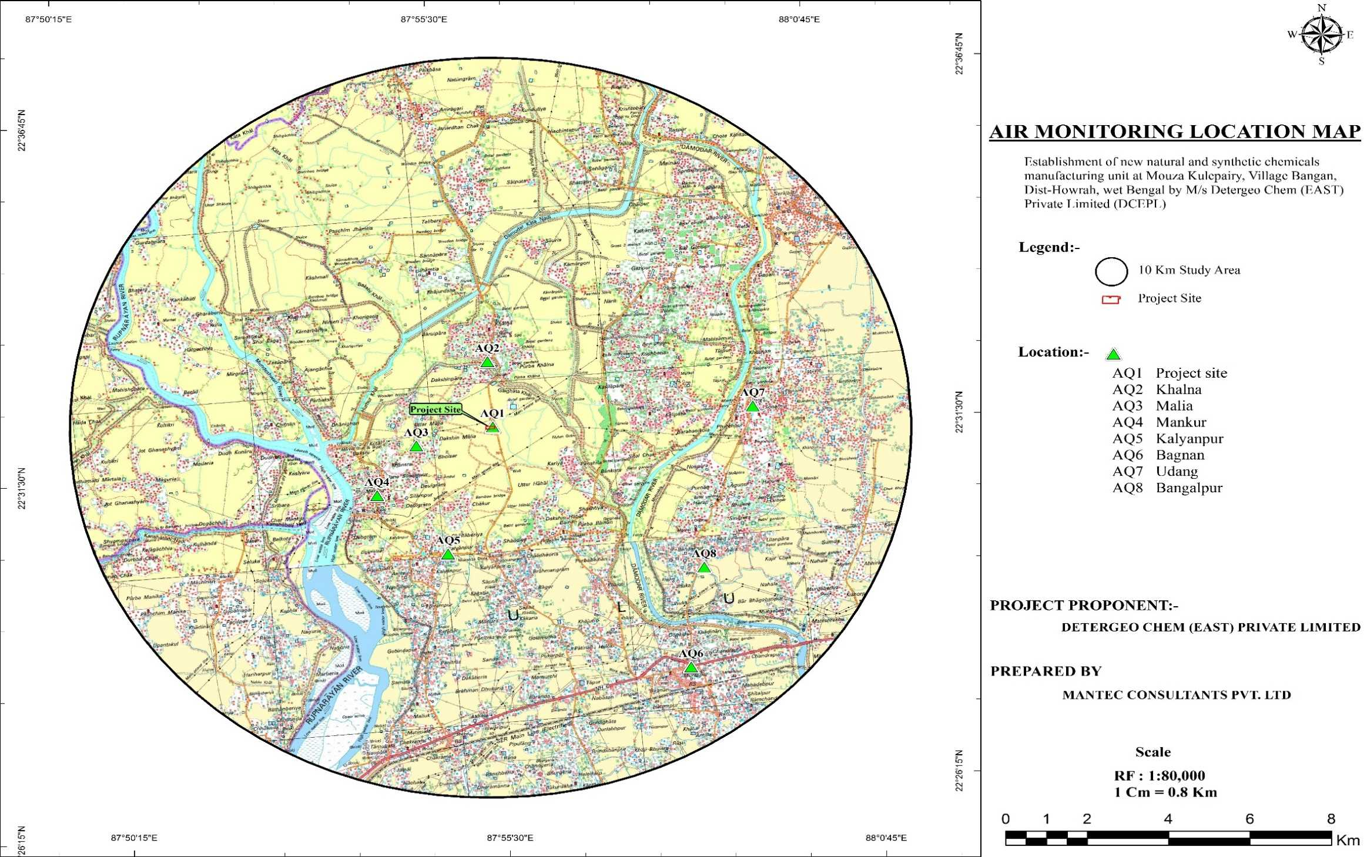
AMBIDENT AIR QUALITY MONITORING MAP

Slide 18
AMBIENT AIR QUALITY MONITORING LOCATIONS
S. No. | Monitoring Locations | Latitude | Longitude | Location w.r.t site
AQ-1 | Project site | 22°31'50.82"N | 87°55'50.48"E | ---
AQ-2 | Khalna | 22°32'48.48"N | 87°55'51.43"E | 1.8 Km, N
AQ-3 | Malia West | 22°31'39.25"N | 87°54'44.74"E | 1.7 Km , W
AQ-4 | Mankur | 22°30'58.27"N | 87°54'7.81"E | 3.2 Km, SW
AQ-5 | Kalyanpur | 22°30'2.23"N | 87°55'2.49"E | 3.5 Km, S
AQ-6 | Bagnan | 22°28'6.19"N | 87°58'16.83"E | 8.0 Km, SE
AQ-7 | Udang | 22°31'51.41"N | 87°59'30.22"E | 6.3 Km, E
AQ-8 | Bangalpur | 22°29'33.07"N | 87°58'36.13"E | 6.3 Km, SE
Parameters | Description | Permissible Level
Ambient Air Quality | PM ₁₀ - 52µg/m³ and 79µg/m³ PM _{2.5} - 25µg/m³and 46µg/m³ SO₂ - 9µg/m³ to 16µg/m³ NO₂- 15µg/m³ to 32µg/m³ CO – 0.54µg/m³ to 0.97µg/m³ All above results are within permissible limit | 100 µg/ m³ 60 µg/ m³ 80 µg/ m³ 80 µg/ m³ 2 mg/ m³

Slide 19
NOISE MONITORING MAP

Slide 20
NOISE MONITORING LOCATIONS
S. No. | Monitoring Locations | Latitude | Longitude | Location w.r.t site | Category of Area
NQ-1 | Project site | 22°31'50.82"N | 87°55'50.48"E | --- | Industrial
NQ-2 | Khalna | 22°32'48.48"N | 87°55'51.43"E | 1.8 Km, N | Residential
NQ-3 | Malia | 22°31'39.25"N | 87°54'44.74"E | 1.7 Km , W | Residential
NQ-4 | Mankur | 22°30'58.27"N | 87°54'7.81"E | 3.2 Km, SW | Residential
NQ-5 | Kalyanpur | 22°30'2.23"N | 87°55'2.49"E | 3.5 Km, S | Residential
NQ-6 | Bagnan | 22°28'6.19"N | 87°58'16.83"E | 8.0 Km, SE | Residential
NQ-7 | Udang | 22°31'51.41"N | 87°59'30.22"E | 6.3 Km, E | Residential
NQ-8 | Bangalpur | 22°29'33.07"N | 87°58'36.13"E | 6.3 Km, SE | Residential
Parameters | Description | Permissible Level
Ambient Noise Quality | Noise Level (Day) - 42.5 to 62.3 Leq dB (A) Noise Level (Night) - 38.1to 48.6 Leq dB(A) | For industrial: 75 (day) – 70 (night)
 |  | For commercial: 65 (day) – 55 (night)
 |  | For residential: 55 (day) –45 (night)
 |  | For silence zone: 50 (day) – 40 (night)

Slide 21
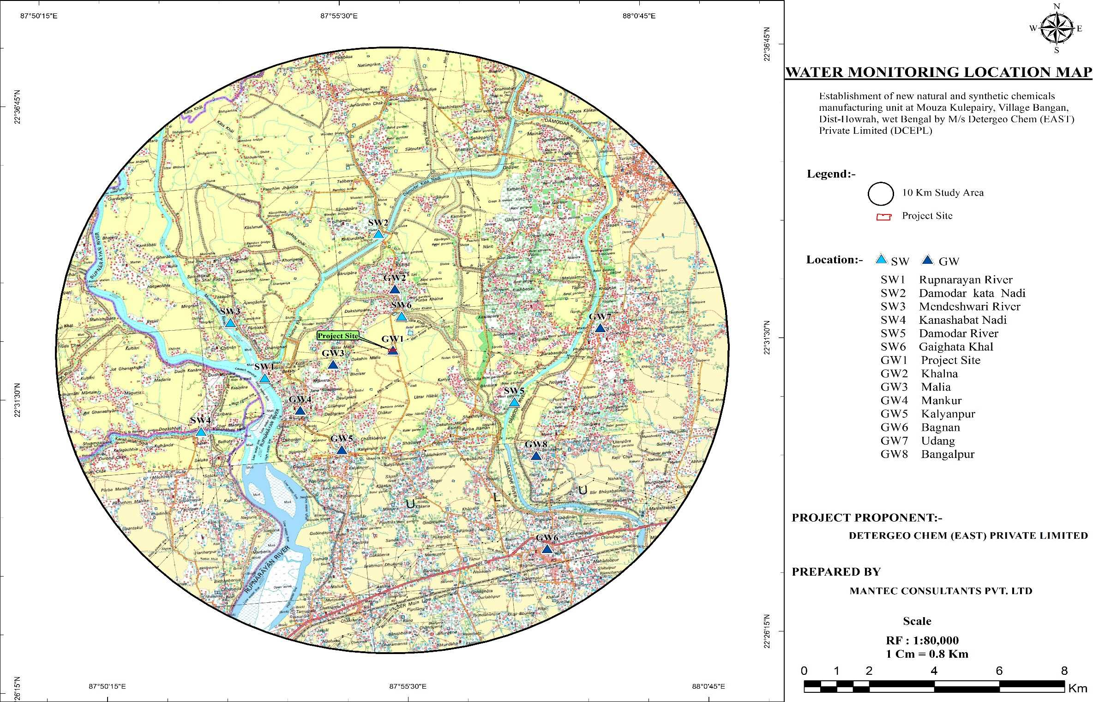
WATER MONITORING MAP

Slide 22
GROUND WATER MONITORING LOCATIONS
S. No. | Monitoring Locations | Latitude | Longitude | Location w.r.t site
GW-1 | Project site | 22°31'50.82"N | 87°55'50.48"E | ---
GW -2 | Khalna | 22°32'48.48"N | 87°55'51.43"E | 1.8 Km, N
GW -3 | Malia | 22°31'39.25"N | 87°54'44.74"E | 1.7 Km , W
GW -4 | Mankur | 22°30'58.27"N | 87°54'7.81"E | 3.2 Km, SW
GW -5 | Kalyanpur | 22°30'2.23"N | 87°55'2.49"E | 3.5 Km, S
GW -6 | Bagnan | 22°28'6.19"N | 87°58'16.83"E | 8.0 Km, SE
GW -7 | Udang | 22°31'51.41"N | 87°59'30.22"E | 6.3 Km, E
GW -8 | Bangalpur | 22°29'33.07"N | 87°58'36.13"E | 6.3 Km, SE
Parameters | Description | Permissible Level
Ground Water Quality | Ground Water: All the Parameters Like pH- 7.30 to 7.72. Total Hardness - 352 to 510 mg/l. TDS – 466 to 675 mg/l. Chloride - 90 to 136 mg/l. Sulphate -26 to 38 mg/l. Metal: Iron- <0.02 to 0.052 mg/l. All are under permissible limit. | 6.5-8.5 200-600 mg/l 500-2000 mg/l 250-1000 mg/l 200-400 mg/l < 0.3 mg/l.

Slide 23
SURFACE WATER MONITORING LOCATIONS
S. No. | Location | Dist (Km) | Dir. | Latitude | Longitude
SW1 | Rupnarayan river | 3.8 | W | 22°31'31.56"N | 87°53'32.22"E
SW2 | Damodar River | 4 | SE | 22°30'44.44"N | 87°57'51.51"E
SW3 | Mendeshwari River | 4.8 | NW | 22°32'33.83"N | 87°53'1.71"E
SW4 | Kanashabat Nadi | 6.2 | SW | 22°30'39.40"N | 87°52'19.88"E
SW5 | Hurhur Khal | 3.8 | N | 22°33'56.45"N | 87°55'46.07"E
SW6 | Gaighata Khal | 1 | NE | 22°32'26.13"N | 87°56'1.93"E
Parameters | Description | Permissible Level
Surface Water Quality | Surface Water: All the Parameters Like pH- 6.95 to 7.91. Total Hardness - 118 to 154 mg/l. TDS – 169 to 223 mg/l. BOD- 7 to 13 mg/l. COD- 60 to 110 mg/l. All are under permissible limit. | 6.5-8.5 DO >4 mg/l Designated Class D

Slide 24
SOIL SAMPLING LOCATION MAP

Slide 25
SOIL SAMPLING LOCATION
S. No. | Monitoring Locations | Latitude | Longitude | Location w.r.t site
S1 | Project site | 22°31'50.82"N | 87°55'50.48"E | ---
S2 | Khalna | 22°32'48.48"N | 87°55'51.43"E | 1.8 Km, N
S3 | Malia | 22°31'39.25"N | 87°54'44.74"E | 1.7 Km , W
S4 | Mankur | 22°30'58.27"N | 87°54'7.81"E | 3.2 Km, SW
S5 | Kalyanpur | 22°30'2.23"N | 87°55'2.49"E | 3.5 Km, S
S6 | Bagnan | 22°28'6.19"N | 87°58'16.83"E | 8.0 Km, SE
S7 | Udang | 22°31'51.41"N | 87°59'30.22"E | 6.3 Km, E
S8 | Bangalpur | 22°29'33.07"N | 87°58'36.13"E | 6.3 Km, SE
Parameters | Description | Permissible Level
Soil Sampling | All the Parameters Like pH- 7.25 to 7.61. Organic Matter – 1.96 to 2.82% Concentration of Nitrogen – 13.91 to 14.62 mg/100gm Phosphorus – 0.67 to 0.93 mg/100gm Potassium – 9.63 to 10.21 mg/100gm | -

Slide 26
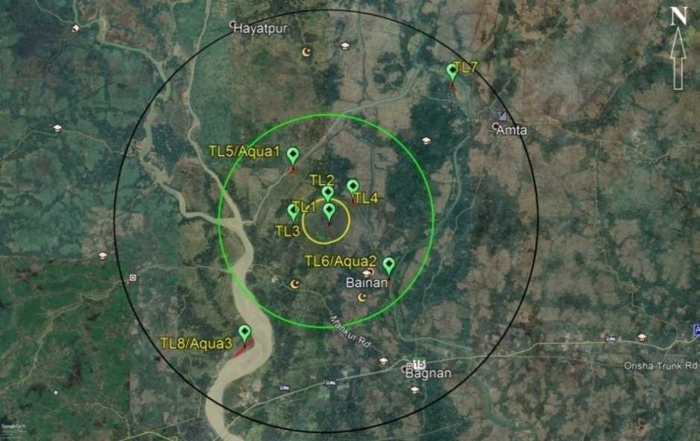
BIOLOGICAL ENVIRONMENT MAP

Slide 27
BIOLOGICAL ENVIRONMENT LOCATIONS
Range | S. No. | Sampling code | Nearest Location | Latitude | Longitude
Within 0-1 Km | 1 | TL1 | Kulepairi | 22°31'41.66"N | 87°55'53.54"E
 | 2 | TL2 | Dakshin Khalna | 22°32'8.76"N | 87°55'51.28"E
Within 1- 5 Km | 3 | TL3 | Malia / Dakhin Malia | 22°31'40.66"N | 87°54'53.99"E
 | 4 | TL4 | Purbba Khalan | 22°32'18.04"N | 87°56'33.18"E
 | 5 | TL5/Aqua1 | Pashchim Khalna | 22°33'7.71"N | 87°54'53.00"E
 | 6 | TL6/Aqua2 | Purbba Bainan | 22°30'17.65"N | 87°57'33.29"E
Within 5-10 km | 7 | TL7 | Khariop | 22°35'17.79"N | 87°59'19.68"E
 | 8 | TL8/ Aqua3 | Faridpur | 22°28'33.15"N | 87°53'32.52"E

Slide 28
GREEN BELT DEVELOPMENT
A 1 m wide greenbelt, consisting of at least 3 tiers around the plant boundary shall be developed as greenbelt and green cover as per the Terms of Reference and 33% green cover.
The plant density of 1500 trees per hectare with local native species will be implemented.
The expenditure on development and maintenance of green belt is of revenue nature and sufficient fund shall be provided to meet the requirement.
The plantation schedule will be completed within five years from the construction period of the project.
The greenbelt will be developed in an area of 3019 sq.m (33%) of the total land area of 13,493 sq.m.
The plantation in and around the project site will help to attenuate the pollution level.
Native species will be given priority for Avenue plantation.
The plantation would start along with the start of the construction activities of the proposed unit.

Slide 29
SOCIO-ECONOMIC ENVIRONMENT
S. No. | Description | Number | Percentage to Respective Total
1 | Total Population | 248181 | 100
 | Male | 127038 | 51.19
 | Female | 121143 | 48.81
 | Sex Ratio | 954
2 | Population Scheduled Caste | 65882 | 100
 | Male | 33529 | 51.00
 | Female | 32353 | 49
 | Sex Ratio | 965.00
3 | Population Tribe Caste | 1704 | 100
 | Male | 854 | 50.12
 | Female | 850 | 49.88
 | Sex Ratio | 995
4 | Total Literates | 153507 | 100
 | Male | 88587 | 57.71
 | Female | 64920 | 42.29
 | Overall Literacy Rate West Bengal | 76.26%
 | Male | 81.69%
 | Female | 70.54%
 | Gender Gap in Literacy Rate | 11.15%
7 | Total Workers | 86235 | 100
 | Male | 69454 | 80.54
 | Female | 16781 | 19.46
 | Gender Gap in Work Participation Rate | 61.08
S. No. | Description | Number | Percentage to Respective Total
8 | Main Workers | 63390 | 100
 | Male | 56618 | 89.37
 | Female | 6772 | 10.68
 | Gender Gap in Work Participation Rate | 78.69
9 | Marginal Workers | 13986 | 100
 | Male | 13424 | 95.98
 | Female | 562 | 4.02
 | Gender Gap in Work Participation Rate | 91.96
10 | Household Industrial Workers | 3941 | 100
 | Male | 1618 | 41.06
 | Female | 2323 | 58.94
11 | Total Agricultural Workers | 9348 | 100
 | Male | 6536 | 69.92
 | Female | 2812 | 30.08
11 (a) | Cultivators | 2901 | 100
 | Male | 1441 | 49.67
 | Female | 1460 | 50.33
11 (b) | Agricultural Labour | 6447 | 100
 | Male | 3610 | 56.19
 | Female | 837 | 43.81
12 | ‘Other Workers’ | 6654 | 100
 | Male | 3240 | 48.68
 | Female | 3415 | 51.32

Slide 30
CORPORATE ENVIRONMENT RESPONSIBILITY (CER)
Details of CER to be made as part of EMP as per Ministry’s O.M dated 30.09.2020.
As per the Office Memorandum F.No. 22-65/2017-IA.III dated 30.09.2020 of the MOEFCC regarding “Corporate Environment Responsibility” (CER), the project proponents are required to allocate funds towards environment development activities as the case may be, shall be apart of EMP and the commitments made by project proponent to address the concerns raised during Public consultation.
A provision of Rs.3 lakhs has been made under Public Hearing Budget towards provision of scheme of Zero Liquid Discharge (ZLD) (1 lakhs) and for awareness and training programme for local employment (2 lakhs) based on the commitment made under Public hearing meeting held on o23.08.2021.

Slide 31
ENVIRONMENT MANAGEMENT PLAN
Air Quality Management Plan:
Local exhaust ventilation system will be provided for chemicals/powders transferring to control fugitive emissions.
For all chemicals charging through drums or other chemical containers chemical charging will be in closed environment and connected to scrubber. VOC is monitored continuously in the area.
The main Reactors will be attached with Scrubbers.
The sprinkling of water will be done along the internal roads in the plant in order to control the dust arising due to the movement of vehicular traffic.
Noise Management Plan:
Installation of noise barriers/ absorbers for stationary noise sources & anti-vibration pad for equipments with high vibration.
Periodic checking and servicing of noisy equipments.
Timely oiling, lubrication & preventive monitoring of machines & equipments.
Proper PPE e.g. ear plugs/ muffs to workers.
Transportation in PUC Vehicles.
Regular monitoring of noise.
Green Belt Development will be taken up with the start of construction phase.

Slide 32
ENVIRONMENT MANAGEMENT PLAN
Water and Waste Water Management Plan
Implement a scheme for source reduction of water coming from washings by articulating a recycle and reuse scheme.
The plant will have a zero discharge and will successfully recycle the entire water back to plant use.
These are the four waste water streams will be generated. Washing/Spillage Effluent, utilities and process waste water will be collected and fed into the Effluent treatment plant appropriately.
The domestic sewage will be treated through septic tank and soak pits. The treated water from ETP will be reused for Alkali Scrubber.
Water harvesting system will be installed to collect natural water.
Solid and Hazardous Waste Disposal Management
Total hazardous waste will be generated from used and spent oil, Pump Seal Oil Transformer Oil, Expired Raw Materials, Empty Raw material Drums, Bag liners which are contaminated with chemical powders, Effluent Treatment Plant sludge and ETP -Evaporator Residue. These waste are stored safely and will be send for disposal to WBPCB authorized vendors & recyclers.

Slide 33
ENVIRONMENT MANAGEMENT PLAN – BUDGET
For amount of 150 Lakhs for Capital and 17.0 Lakhs amount will be incurred for Environmental Management activities.
S. No. | Infrastructure | Capital cost (lakhs) | Recurring cost (lakhs per annum) Including power and O&M
1. | Air Pollution Control | 75.0 | 2.0
2. | Effluent Treatment Plant (ETP) & Rain water harvesting measures | 17.0 | 2.5
3. | Environment Monitoring and Management | 10.0 | 1.5
4. | Solid and Hazardous Waste Management (Membership & Facility development) | 10.0 | 3.0
5. | Occupational Health & Safety | 25.0 | 5.0
6. | Green belt Development | 13.0 | 3.0
Total |  | 150.0 | 17.0

Slide 34
RISK STUDIES
List of Hazardous Substances and quantity stored.
S. No. | Product | No of Tanks | Classification | Design Capacity
1 | HSD | 1 | Flammable | 20 KL
2 | H₂SO₄ | 1 | Corrosive | 420 MT
Consequence Analysis in worst scenario.
Scenario considered | Pasquill stability class | LFL concentration PPM | Flash fire At LFL concentration distance (m) | Pool Fire Damage distance for various heat loads (m)
 |  |  |  | 37.5 kW/m²
HSD Tank Rupture | 2F | 8000 | 11.66 | 6.64
 | 3D |  | 12.18 | 6.72
 | 5D |  | 12.54 | 6.81
HSD Tank (Leak 50mm) | 2F | 8000 | 2.32 | 6.79
 | 3D |  | 2.41 | 7.08
 | 5D |  | 2.47 | 7.27
HSD storage Tank (Leak 10mm) | 2F | 8000 | 1.92 | 4.46
 | 3D |  | 2.04 | 4.91
 | 5D |  | 2.15 | 5.47

Slide 35
RISK STUDIES
Preliminary Hazard Analysis in General:
PHA Category | Description of Plausible Hazard | Recommendation | Provision
Environmental Factors | If there is any leakage and eventuality of source of ignition. | --- | All electrical fittings and cables will be provided as per the specified standards. All motor starters will be flame proof.
 | Highly inflammable nature of the chemicals may cause fire hazard in the storage facility. | A well designed fire protection including AFFF foam, water sprinkler system, dry powder, CO2 extinguisher will be provided. | Fire extinguisher of small size and big size will be provided at all potential fire hazard places. In addition to the above, fire hydrant network will also provided.
Preliminary Hazard Analysis for Process and Storage Areas:
Equipment | Process | Potential Hazard | Provision
Generator | Converts mechanical energy into electrical energy | Mechanical hazards and fire hazards in Lube oil system Cable galleries Short circuits | Safety interlocks and manhole locks are provided to ensure safe operation and maintenance of the unit.
Power Transformers | - | Fire and explosion | All electrical fittings and cables are provided as per the specified standards.
Switch Yard control room | - | Fire in cable galleries and switch | As above
HSD Storage | Used as start-up fuel for DG sets, and also will be used for vehicular transportation | Fire & explosion | Leaks detection system will be provided.

Slide 36
RISK MITIGATION MEASURES TO BE ADOPTED DURING TRANSPORT
S. No | Improvement Areas | Risk Mitigation Measures
1 | Driver Management | Driver training shall be mandated through Detergeo approved DTI.
 |  | Driver medical shall be mandated through Detergeo approved medical centers.
 |  | Defensive driving training to errant driver
 |  | Minimum age of Driver is required to be 25 Years
 |  | Keep a record of the substances being transported i.e., shipping papers and written emergency instructions are critical for safety
2 | Journey Management | Buyer/customer to be informed to define route with proper rest stations. Customer to submit the document to Detergeo. Detergeo may review and provide input. Customer shall review and release final document to Detergeo and communicate to all transporters and driver by the customers, via Journey Route Management document for every journey. Journey management documents should also take care of details like on route nearby Hospital, Crane provider etc. A sample format may be shared by Detergeo to customer.
 |  | Restrict night time driving (12:00 am – 5:00 am) inclusive of empty vehicles which is the most accident-prone time zone
 |  | Mandate resting time of at least 30 minutes for drivers after continuous driving of maximum of 4 hours.
 |  | Vehicles are not allowed to driver more than 60 Km/hr.
 |  | 24x7 Proactively monitor all safety violations and provide timely alerts to drivers/ SPOC for controlling any possible damage through VTS compatible with Detergeo System

Slide 37
RISK MITIGATION MEASURES TO BE ADOPTED DURING TRANSPORT
S. No | Improvement Areas | Risk Mitigation Measures
3 | Vehicle Management | All the vessels and tanks will be provided with temperature indicator, pressure gauge and safety valves as depending upon the material being transported and operating parameters
 |  | Suitable fire extinguishers, such as, DCP (Dry Chemical Powder), CO2 & foam type to be kept in the transporter vehicle at easily approachable spots and in sufficient numbers
 |  | Inspect the vehicle's general condition, including tires, condition of valves, electrical wiring, adequate sealing, condition of wipers, headlights, signal lights, etc.
 |  | Following the dangerous goods segregation rules for carrying mixed classes of hazardous chemicals; chemicals must be separated when being transported/stored to ensure incompatible chemicals do not mix if there is a spill
 |  | Placards are standard hazmat identifiers, designed to meet individual specifications, will be placed on outer containers, trucks, cylinders, or other vehicles used for transport
 |  | Have an emergency kit readily available with safety goggles, chemical information sheets, and MSDS
 |  | Securing container tanks against movement on transportation vehicles i.e., proper loading and bracing all containers so they do not fall, slide, or bounce around during transportation
 |  | Suraksha certification from Detergeo authorized center for liquid tankers
 |  | Periodic Testing of Safety Relief Valve (SRV) and EFCV/IEFCV (Excess Flow/Internal Excess Flow Check Valve) under Rule 18 and Tanker testing under Rule 19 for Tanker integrity testing through Hydrotesting through DETERGEO approved centers along with TPI presence during testing.
 |  | Speed Governor Speed limiting devices can avoid the risk of accidents due to over-speeding
 |  | ABS (Anti-Lock Braking system) and EBS in Trailers with ESC – Electronic Stability Controller
 |  | RUPD/SUPD should be available in the vehicle. The rear bumper should not extend beyond the RUPD.
 |  | Vehicle Age: Age of vehicle restricted up to 10 yrs. to improve distribution safety and sustainability
4 | Emergency Response | Customer should have their own Offsite Transport Emergency Response Plan

Slide 38
DISASTER MANAGEMENT PLAN
The Disaster Management Plan is aimed to ensure safety of life, protection of environment, protection of installation, restoration of production and salvage operations in this same order of priorities. For effective implementation of the Disaster Management Plan, it should be widely circulated and personnel training should be provided through rehearsals/drills.
The objective of the Industrial Disaster Management Plan is to make use of the combined resources of the plant and the outside services to achieve the following:
Effect the rescue and medical treatment of casualties;
Safeguard other people;
Minimize damage to property and the environment;
Initially contain and ultimately bring the incident under control;
Identify any dead;
Provide for the needs of relatives;
Provide authoritative information to the news media;
Secure the safe rehabilitation of affected area;
Preserve relevant records and equipment for the subsequent inquiry into the cause and circumstances of the Emergency.

Slide 39
DISASTER MANAGEMENT PLAN
General Safety Measures for Chemicals Storage & Handling.
Following safety measures for chemicals storage and handling will be provided.
Availability of MSDS (Material Safety Data Sheets) information for all chemicals Proper layout of tank farm and other storage areas for chemicals.
Proper segregation of chemicals storage taking into account compatibility Matrix Instrumentation and control system for tanks, Sulphonator etc. SO2 and SO3 Gas detection and fire protection systems.
Periodic inspection and maintenance system Standard operating procedures and check lists Training of operation and maintenance personnel Safety work permit system.
Electrical hazardous area classification for process units and storage areas Incident investigation and implementation of recommendations.
Hazard and Operability Study (HAZOP):
A hazard and operability study (HAZOP) is a structured and systematic examination of a complex system, usually a process facility, in order to identify hazards to personnel, equipment or the environment, as well as operability problems that could affect operations efficiency.

Slide 40
TOR COMPLIANCE

Slide 41
COMPLIANCE OF TOR
ToR-1: Executive Summary.
Compliance: Complied
ToR-2: Introduction
Details of the EIA Consultant including NABET accreditation.
Information about the project proponent.
Importance and benefits of the project.
Compliance:
Mantec Consultants Pvt. Ltd, is an accredited organization by Quality Council of India/NABET certificate no. NABET/EIA/23-26/RA 0305_ Rev. 01 dated January 31,2024 valid up to April 20, 2026.
Applicant: Mr. Raman Arora (Owner)
Regd. Office: M/s Detergeo Chem (East) Private Limited, A-29, Block B1 Ext. Mohan Co-op. Industrial Estate, New delhi-1110044
Mobile no: +91-9999696943
Mail id: raman@newindiachem.com.
The project shall generate direct and indirect employement for about 200 people.
CER budget of Rs. 40.0 Lakhs will be utilized under the consultation of the sarpanch/gram Pradhan of nearby village (Kulepairi) & in consultation with the District Administration.

Slide 42
COMPLIANCE OF TOR
COMPLIANCE OF TOR
ToR-3: Project Description.
I. Cost of project and time of completion.
Compliance: Capital Cost of the Project- Rs. 20 Crores . The proposed project will be executed within 12 months after grant of Environment Clearance and other Statuary clearance.
II. Products with capacities for the proposed project.
Compliance: The proposed project is for the manufacturing of natural and synthetic chemical surfactants of 82400 MTPA.
S. No. | Product Name | Proposed Manufacturing Capacity (MTA) | Mode of Transport
1. | Linear Alkyl Benzene Sulphonic Acid 96% | 12,000 | MS Tanker
2. | Linear Alkyl Benzene Sulphonic Acid 90% | 12,000 | MS Tanker
3. | Alpha Olefin Sulphonate | 1,000 | SS Tanker
4. | Sodium Lauryl Ether Sulphate | 24,000 | SS Tanker
5. | Sodium Lauryl Sulphate | 6,000 | SS Tanker
6. | Cocoamidopropyl Betaine | 3,000 | Truck
7. | Cocamide Monoethanolamide | 3,000 | Truck
8. | Cocamide Diethanolamide | 3,000 | Truck
9. | Ethylene Glycol Distearate | 3,000 | Truck
10. | Ethylene Glycol Monostearate | 3,000 | Truck
11. | Dilute Sulphuric Acid | 12,000 | MS Tanker
12. | Sodium Sulphate | 400 | -
Total Capacity |  | 82,400

Slide 43
COMPLIANCE OF TOR
COMPLIANCE OF TOR
ToR-3(III): If expansion project, details of existing products with capacities and whether adequate land is available for expansion, reference of earlier EC if any.
Compliance: Not applicable as this is a green field project. The total land available under the ownership of Detergeo Chem (EAST) Private Limited.
ToR-3(IV): List of raw materials required and their source along with mode of transportation.
Compliance:
S. No. | Material Description | Physical Form | Type of Storage | Storage Capacity (MT) | Sourcing
1 | Linear Alkyl Benzene | Liquid | MS Tank | 500 | Import
2 | Alpha Olefin | Liquid | SS Tank | 100 | Import
3 | Lauryl Ether | Liquid | SS Tank | 750 | Import
4 | Lauryl Alcohol | Liquid | SS Tank | 100 | Import
5 | Sulfuric Acid | Liquid | MS Tank | 420 | Domestic
6 | Caustic Soda Liquid | Liquid | SS Tank | 650 | Domestic
7 | Sulfur | Solid | Closed Yard | 1000 | Domestic / Import
8 | Coconut Fatty Acid | Liquid | SS Tank | 200 | Import
9 | Dimethylaminopropylamine | Liquid | SS Tank | 36 | Import
10 | Monochloroacetic acid | Solid | Closed Yard | 30 | Domestic
11 | Monoethanolamine | Liquid | SS Tank | 36 | Domestic
12 | Diethanolamine | Liquid | SS Tank | 36 | Domestic
13 | Stearic Fatty Acid | Liquid | SS Tank | 200 | Import
14 | Ethylene Glycol | Liquid | SS Tank | 36 | Domestic

Slide 44
COMPLIANCE OF TOR
COMPLIANCE OF TOR
ToR-3(V): Other chemicals and materials required with quantities and storage capacities .
Compliance:
S. No. | Material Description | Physical Form | Type of Storage | Storage Capacity (MT)
1 | Linear Alkyl Benzene Sulphonic Acid | Liquid | MS Tank | 300
2 | Alpha Olefin Sulfonate | Liquid | SS Tank | 120
3 | Sodium Lauryl Ether Sulphate | Liquid | SS Tank | 300
4 | Sodium Lauryl Sulphate | Liquid | SS Tank | 120
5 | Cocoamidopropyl Betaine | Liquid | SS Tank | 42
6 | Cocamide Monoethanolamine | Solid | Closed Yard | 40
7 | Cocamide Diethanolamine | Liquid | SS Tank | 42
8 | Ethylene Glycol Distearate | Solid | Closed Yard | 40
9 | Ethylene Glycol Monostearate | Solid | Closed Yard | 40
10 | Dilute Sulphuric Acid | Liquid | MS Tank | 420

Slide 45
COMPLIANCE OF TOR
ToR-3(VI): Details of emission effluent, hazardous waste generation and their management .
Compliance: Details of Non-Hazardous Waste
S. No. | Name of Waste | Quantity | Waste Type | Disposal Method | Source Of Waste | Physical Status
1. | Discarded Plastic Bags | 100 Bags/Yr | Recyclable | Give to authorized recyclers | Stores/Offices | Solid
2. | Used HDPE Drums | 500/Yr | Recyclable | Re-use / Give to authorized recyclers | Plant / Warehouse | Solid
Details of Hazardous Waste
S. No. | Name of Waste | Quantity (MTPA) | Waste Type | Disposal Method | Source of Waste | Physical Status
1. | ETP Sludge (Category 35.3) | 1.0 MTPA | Incinerable | Give to TSDF | ETP Filter | Solid
2. | Sulphur Ash | 1.0 MTPA |  |  | Expired Raw Material | Solid
3. | Spent Oil (Category 5.1) | 15 lt/yr | Recyclable | Sell to authorized oil reclamation plant | Pumps, DG, Equipment Seals | Oily

Slide 46
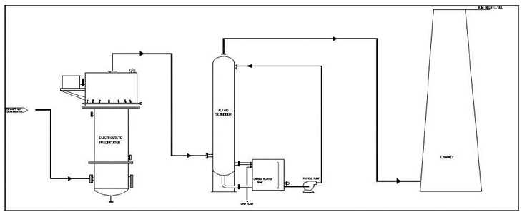
COMPLIANCE OF TOR
COMPLIANCE OF TOR
Effluent Gas Treatment System

Slide 47
COMPLIANCE OF TOR
COMPLIANCE OF TOR
ToR-3(VII): Requirement of water, power, with source of supply, status of approval, water balance diagram man-power requirement (regular and contract).
Compliance: Total fresh water requirement: 203 KLD.
Source: State approved water tanker suppliers will be used. Refer slide-27
Power Requirement: 1000 KW sourced through WBSEDCL.
S. No. | Equipment | Capacity
1. | DG Set | 910 KVA
2. | DG Set | 500 KVA
Manpower requirement: 200 {operational phase-40(permanent) & construction phase-160(temporary)}
ToR-3(VIII):Process description along with major equipments and machineries, process flow sheet (quantative) from raw material to products to be provided.
Compliance: The process flow sheet in the next slide.

Slide 48
COMPLIANCE OF TOR
COMPLIANCE OF TOR

Slide 49
COMPLIANCE OF TOR
COMPLIANCE OF TOR
List of Equipment
S. No. | Description | Quantity | Capacity
1. | Sulfur Trioxide Gas Generation Plant | 1 | 1250 kg/hr
2. | Air Drying Unit | 1 | 9000 CMPH
3. | Film Sulphonation/Sulphation Reactor | 1 | 5000 kg/hr
4. | Neutralization Unit | 1 | 5000 kg/hr
5. | Water Purification Plant | 1 | 10 kl/hr
6. | Cooling Tower | 3 | 700 m3/hr (Total)
7. | Vent Gas Treatment System with ESP | 1 | 6000 CMPH
8. | Screw Chiller | 2 | 100 TR
9. | Waste Heat Recovery Boiler | 1 | 850 kg/hr
10. | Electricity Generator | 1 | 1000KW
11. | Weigh Bridge | 1 | 100 MT
12. | Pumps | As Per Requirements
13. | Water Hydrants System | As Per Requirements
14. | LABSA 90% Batch Reactor | 1 | 35 KL
15. | LABSA 90% Seperator | 1 | 35 KL
16. | Reactors with Agitators | 4 | 15 KL
17. | Flaker | 1 | 1500 kg/hr
18. | Nitrogen Generator | 1 | 200 Nm3
19. | Oil Based Boiler | 1 | 2000 kg/hr

Slide 50
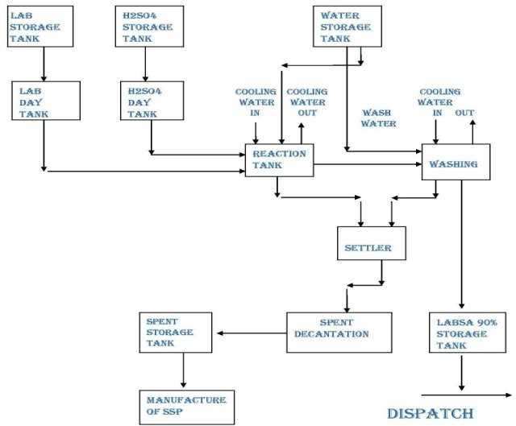
COMPLIANCE OF TOR
COMPLIANCE OF TOR
Line Diagram of Continuous Sulphonation Plant

Slide 51
COMPLIANCE OF TOR
COMPLIANCE OF TOR
ToR-3(IX): Hazard identification and details of proposed safety systems.
Compliance: Classification of Major Hazardous Units: Hazardous substances may be classified into three main classes namely Flammable substances, unstable substances and toxic substances.
S. No. | Product | No of Tanks | Classification | Design Capacity
1 | HSD | 1 | Flammable | 20 KL
2 | H₂SO₄ | 1 | Corrosive | 420 MT
Substance Stored | Safe Guard
Sulphuric Acid | Dyke wall of height - 1.0 m and thickness-230 mm will be constructed around the storage tank for acid spillage containment. Also the provision for automatic emergency shower will be provided.
High Speed Diesel (HSD) | Following Fire Fighting measures will be provided: DCP (Dry Chemical Powder) Extinguisher; AFFF (Aqueous Film Forming Foam) Extinguisher; Water cum Foam Monitor; and d) Sand Bucket.

Slide 52
COMPLIANCE OF TOR
COMPLIANCE OF TOR
Hazard Identification for Tank Farm (cont.)
S. No. | Causes | Consequences | Safeguards
1 | Leakage from unloading hose, Damaged hose, Improper hose connection, Flange gasket leak, Movement of tanker during unloading. | Exposure to toxic chemical Fire/explosion hazard due to flammable liquid release Loss of chemical Soil/Water contamination | Regular inspection & replacement of chemical hoses. Maintenance system for gaskets, flange & hose connections including leak check. Procedure to immobilize tanker before start of unloading. Paved area for tanker unloading with berm for spill containment. Unloading checklist and display board in local language. Use of PPE for unloading.
2 | Leakage from pump seal | Exposure to toxic chemical Fire/explosion hazard due to flammable liquid release. Loss of chemical Soil/water contamination | Reliable type of mechanical seal for pump. Stand-by pump Regular maintenance of pumps
3 | Overflow from storage tank by excess filling due to malfunction of tank level instrument. | Exposure to toxic chemical Fire/explosion hazard due to flammable liquid release Loss of chemical Soil/water contamination | Reliable type tank level instrumentation Multiple level instruments to provide overfill protection for tank Regular monitoring of tank inventory
4 | Leakage from flange joint in piping connected to tank bottom | Exposure to toxic chemical. Fire/explosion hazard due to flammable liquid release Loss of chemicals Soil/water contamination | Remote operated shut off valve in tank bottom connection with push button in control room and safe location outside the dyke.

Slide 53
COMPLIANCE OF TOR
COMPLIANCE OF TOR
ToR-3(X): Expansion/modernization proposals:
Compliance: N/A as this is a green field project.
ToR-3(Xa): Copy of all the Environmental Clearance(s) including Amendments thereto obtained for the project from MOEF/SEIAA shall be attached as an Annexure. A certified copy of the latest Monitoring Report of the Regional Office of the Ministry of Environment and Forests as per circular dated 30th May, 2012 on the status of compliance of conditions stipulated in all the existing environmental clearances including Amendments shall be provided. In addition, status of compliance of Consent to Operate for the ongoing Iexisting operation of the project from SPCB shall be attached with the EIA-EMP report.:
Compliance: N/A
ToR-3(Xb): In case the existing project has not obtained environmental clearance, reasons for not taking EC under the provisions of the EIA Notification 1994 and/or EIA Notification 2006 shall be provided. Copies of Consent to Establish/No Objection Certificate and Consent to Operate (in case of units operating prior to EIA Notification 2006, CTE and CTO of FY 2005-2006) obtained from the SPCB shall be submitted. Further, compliance report to the conditions of consents from the SPCB shall be submitted.
Compliance: N/A as this is a green field project.
ToR-4(I): Location of the project site covering village, Taluka/Tehsil, District and State, Justification for selecting the site, whether other sites were considered.
Compliance: The Project location: DAG No. 42, 44, 45, 46, 52, 53, 54, 55, 131, 132, 138, 139,141, Mouza Kulepairi, P.S. Bagnan, Dist-Howrah, West Bengal".

Slide 54
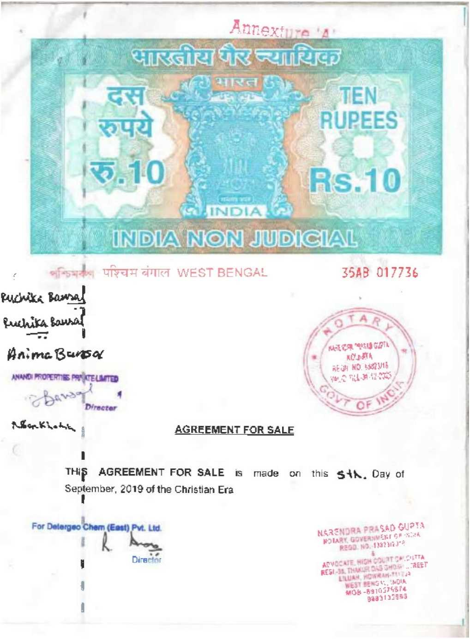
COMPLIANCE OF TOR
COMPLIANCE OF TOR
Proposed project shall be established over the purchased land and copy of land documents as follows.

Slide 55
COMPLIANCE OF TOR
COMPLIANCE OF TOR
ToR-4(II): A toposheet of the study area of radius of 10km and site location 1:50,000/1:25,000 scale on an A3/A2 sheet. (including all eco-sensitive areas and environmentally sensitive places)
Compliance:

Slide 56
COMPLIANCE OF TOR
COMPLIANCE OF TOR
ToR-4(III): Details w.r.t. option analysis for selection of site.
Compliance: The proposed Greenfield project shall be developed on the existing land, which is already owned by DCEPL, therefore no analysis for selection of site will considered.
ToR-4(IV): Co-ordinates (lat -long) of all four corners of the site.
Compliance:
Points | Latitude | Longitude
1 | 22°31'49.49"N | 87°55'44.51"E
2 | 22°31'47.21"N | 87°55'44.87"E
3 | 22°31'49.07"N | 87°55'51.13"E
4 | 22°31'50.64"N | 87°55'50.90"E
5 | 22°31'50.80"N | 87°55'52.29"E
6 | 22°31'51.20"N | 87°55'52.13"E
7 | 22°31'50.98"N | 87°55'50.85"E
8 | 22°31'51.30"N | 87°55'50.81"E
9 | 22°31'50.66"N | 87°55'48.60"E
10 | 22°31'50.46"N | 87°55'48.66"E
11 | 22°31'50.05"N | 87°55'47.22"E
12 | 22°31'50.25"N | 87°55'47.16"E

Slide 57
COMPLIANCE OF TOR
COMPLIANCE OF TOR
ToR-4(V): Google map-Earth downloaded of the project site.
Compliance: Google map of the Project site

Slide 58
COMPLIANCE OF TOR
COMPLIANCE OF TOR
ToR-4(VI): Layout maps indicating existing unit as well as proposed unit indicating storage area, plant area, greenbelt area, utilities etc. If located within an Industrial area/Estate/Complex, layout of Industrial Area indicating location of unit within the Industrial area/Estate.
Compliance:

Slide 59
COMPLIANCE OF TOR
COMPLIANCE OF TOR
ToR-4(VII): Photographs of the proposed and existing (if applicable) plant site. If existing, show photographs of plantation/greenbelt, in particular.
Compliance:
SITE PHOTOGRAPHS

Slide 60
COMPLIANCE OF TOR
COMPLIANCE OF TOR
ToR-4(VIII): Landuse break-up of total land of the project site (identified and acquired), government/ private - agricultural, forest, wasteland, water bodies, settlements, etc shall be included (not required for industrial area).
Compliance: Total land of 13,493.00 Sq.mt (1.3493 ha.) has been allotted in favour of M/s Detergeo Chem (EAST) Private Limited (DCEPL). The details of land requirement for the project are as follows:-
Details | Area (Sq. Mt.) | % Ratio
Production Shed | 1820 | 20%
Tank Farm | 1395 | 15%
DG Room | 60 | 1%
Electrical Room | 120 | 1%
UG Water Sump | 180 | 2%
ETP | 78 | 1%
Toilet | 36 | 0%
Workshop | 66 | 1%
Sulphur Yard | 285 | 3%
Barrel Warehouse | 120 | 1%
Office/Store/Canteen | 162 | 2%
Roads | 1741 | 19%
Green Belt | 3019 | 33%
Total Builtup Area | 9,082.00
Earmarked For Future Projects | 4,411.00
Total Land Area | 13,493.00

Slide 61
COMPLIANCE OF TOR
COMPLIANCE OF TOR
ToR-4(IX): A list of major industries with name and type within study area shall be incorporated. Land use details of the study area.
Compliance:
List of industries/ Project activities | M/s. Tandhan Cotton Mills Private Limited- Textile M/s. Tandhan biochemical Private Limited M/s Mohan Boards Pvt Ltd
Detail of Land use/Land cover:
S. No | Classes | Area (sq.km) | Area in %
1 | Settlement | 69.70 | 20.88
2 | Agriculture Land | 227.96 | 68.29
3 | Vegetation | 6.88 | 2.06
4 | Water Bodies | 25.23 | 7.56
5 | Waste Land | 4.06 | 1.22
Total |  | 333.83 | 100.00

Slide 62
COMPLIANCE OF TOR
COMPLIANCE OF TOR
ToR-4(X): Geological features and Geo-hydrological status of the study area shall be included.
Compliance: Complied.
ToR-4(XI): Details of Drainage of the project upto 5 km radius of study area. If the site is within 1 km radius of any major river, peak and lean season river discharge as well as flood occurrence frequency based on peak rainfall data of the past 30 years. Details of Flood Level of the project site and maximum Flood Level of the river shall also be provided. (mega green field projects)
Compliance: Drainage Map of study area (10km area) is attached in EIA report.
The major rivers in the study area are mentioned below: -
Rupnarayan river- 3.6 Kms
Damodar kata Nadi (Hurhur khal)-2.7 Kms
Mendeshwari River-3.8 Kms
Kanashabat Nadi- 49 Kms
Damodar River- 4.0 Kms
Gaighata Khal -1.1 Km
ToR-4(XII): Status of acquisition of land. If acquisition is not complete, stage of the acquisition process and expected time of complete possession of the land.
Compliance: The land is already acquired by the project proponent and under the complete land is under the possession.

Slide 63
COMPLIANCE OF TOR
COMPLIANCE OF TOR
ToR-4(XIII): R&R details in respect of land in line with state Government policy.
Compliance: N/A.
ToR-5: Forest and wildlife related issues.
(I) Permission and approval for the use of forest land (forestry clearance), if any, and recommendations of the State Forest Department.
Compliance: N/A, as no forest land is involved in the proposed project site.
(II): Land use map based on High resolution satellite imagery (GPS) of the proposed site delineating the forest land (in case of projects involving forest land more than 40 ha)
Compliance: N/A.
(III): Status of Application submitted for obtaining the stage I forestry clearance along with latest status shall be submitted.
Compliance: N/A, as no forest land is involved in the proposed project site.
(IV): The projects to be located within 10 km of the National Parks, Sanctuaries, Biosphere Reserves, Migratory Corridors of Wild Animals, the project proponent shall submit the map duly authenticated by Chief Wildlife Warden showing these features vis-à-vis the project location and the recommendations or comments of the Chief Wildlife Warden-thereon.
Compliance: N/A, as no national parks, sanctuaries, biosphere reserves, migratory corridors of wild animals are present within 10 km radius of the proposed project site.

Slide 64
COMPLIANCE OF TOR
COMPLIANCE OF TOR
ToR-5(V): Wildlife Conservation Plan duly authenticated by the Chief Wildlife Warden of the State Government for conservation of Schedule I fauna, if any exists in the study area.
Compliance : N/A. Since, No schedule I fauna is present in the study area.
ToR-5(VI): Copy of application submitted for clearance under the Wildlife (Protection) Act, 1972, to the Standing Committee of the National Board for Wildlife.
Compliance : N/A.
ToR-6: Environmental Status:
Determination of atmospheric inversion level at the project site and site-specific micrometeorological data using temperature, relative humidity, hourly wind speed and direction and rainfall.
Compliance :
Months | Temp (°C) |  | Relative Humidity (%) | Average wind speed (Km/h) | Total Rainfall (mm)
 | Max | Min | Average | Average
Dec. 2023 | 27 | 18 | 46 | 9.5 | 10.63
Jan. 2024 | 28 | 16 | 40 | 8.8 | 7.77
Feb. 2024 | 31 | 19 | 46 | 10.5 | 6.05

Slide 65
COMPLIANCE OF TOR
COMPLIANCE OF TOR
ToR-6(II):AAQ data (except monsoon) at 8 locations for PM10, PM2.5, SO2, NOX, CO and other parameters relevant to the project shall be collected. The monitoring stations shall be based CPCB guidelines and take into account the pre-dominant wind direction, population zone and sensitive receptors including reserved forests.
Compliance: the monitoring has been done at 8 locations. The map and locations has been attached in slide no.13
ToR-6(III):Raw data of all AAQ measurement for 12 weeks of all stations as per frequency given in the NAQQM Notification of Nov. 2009 along with - min., max., average and 98% values for each of the AAQ parameters from data of all AAQ stations should be provided as an annexure to the EIA Report.
Compliance:
LOCATIONS | POLLUTANTS | PM₁₀ | PM_{2.5} | SO₂ | NO₂ | CO
 | NAAQS | 100 (µg/m3) | 60 (µg/m3) | 80 (µg/m3) | 80 (µg/m3) | 2 (mg/m3)
AQ1 | Max | 78 | 45 | 16 | 30 | 0.97
 | Min | 60 | 34 | 10 | 18 | 0.58
 | Avg | 70.42 | 40.25 | 12.21 | 24.04 | 0.77
 | 98 percentile | 78 | 45 | 15.54 | 30 | 0.93
AQ2 | Max | 72 | 42 | 14 | 27 | 0.94
 | Min | 52 | 30 | 9 | 17 | 0.58
 | Avg | 65.96 | 35.08 | 11.54 | 22.25 | 0.73
 | 98 percentile | 72 | 41.08 | 14 | 27 | 0.92

Slide 66
COMPLIANCE OF TOR
COMPLIANCE OF TOR
Cont.
LOCATIONS | POLLUTANTS | PM₁₀ | PM_{2.5} | SO₂ | NO₂ | CO
 | NAAQS | 100 (µg/m3) | 60 (µg/m3) | 80 (µg/m3) | 80 (µg/m3) | 2 (mg/m3)
AQ3 | Max | 76 | 44 | 15 | 30 | 0.85
 | Min | 58 | 28 | 9 | 17 | 0.58
 | Avg. | 66.75 | 35.46 | 11.21 | 22.54 | 0.73
 | 98 percentile | 76 | 43.08 | 14.54 | 29.08 | 0.84
AQ4 | Max | 78 | 45 | 16 | 32 | 0.86
 | Min | 66 | 34 | 10 | 18 | 0.54
 | Avg. | 72.46 | 39.13 | 13.08 | 25.58 | 0.72
 | 98 percentile | 78 | 44.54 | 15.54 | 31.08 | 0.86
AQ5 | Max | 76 | 42 | 16 | 32 | 0.91
 | Min | 58 | 31 | 10 | 21 | 0.65
 | Avg. | 67.58 | 35.67 | 12.54 | 24.96 | 0.78
 | 98 percentile | 76 | 41.08 | 15.54 | 31.54 | 0.89
AQ6 | Max | 79 | 46 | 16 | 26 | 0.94
 | Min | 58 | 28 | 10 | 15 | 0.63
 | Avg. | 65.71 | 35.71 | 12.25 | 19.67 | 0.78
 | 98 percentile | 77.16 | 44.16 | 16 | 26 | 0.94
AQ7 | Max | 74 | 42 | 16 | 30 | 0.94
 | Min | 56 | 28 | 10 | 18 | 0.57
 | Avg. | 64.83 | 34.75 | 12.25 | 24.13 | 0.76
 | 98 percentile | 74 | 42 | 15.54 | 30 | 0.94
AQ8 | Max | 72 | 42 | 16 | 32 | 0.89
 | Min | 54 | 25 | 10 | 20 | 0.57
 | Avg. | 64.83 | 33.38 | 12.88 | 25.21 | 0.72
 | 98 percentile | 72 | 41.08 | 15.54 | 31.08 | 0.87

Slide 67
COMPLIANCE OF TOR
COMPLIANCE OF TOR
ToR-6(IV):Surface water quality of nearby River (100m upstream and downstream of discharge point) and other surface drains at eight locations as per CPCB/MoEF&CC guidelines.
Compliance: Details of Surface Water Quality Location is given in Slide no. 18 and
Monitoring Location Map is given in Slide no. 16
BASELINE DATA OF SURFACE WATER QUALITY:
S. No. | Parameter | Units of Measurements | Roopnarayan River | Damodar Kata River | Mundeshwari River | Damodar River | Kanashabat River | Gaighata Khal
1 | Colour | Hazen Units | <5 | <5 | <5 | <5 | <5 | <5
2 | Odour | - | Agreeable | Agreeable | Agreeable | Agreeable | Agreeable | Agreeable
3 | Taste | - | Agreeable | Agreeable | Agreeable | Agreeable | Agreeable | Agreeable
4 | Turbidity | NTU | 2.3 | 2.5 | 3.2 | 2.6 | 1.9 | 2.2
5 | pH | - | 7.67 | 7.39 | 6.95 | 7.82 | 7.91 | 7.86
6 | Temperature | °C | 20 | 21 | 21 | 22 | 20 | 21
7 | Conductivity | µmhos/cm | 283 | 315 | 260 | 305 | 302 | 343
8 | Alkalinity as CaCO₃ | mg/l | 112 | 122 | 98 | 116 | 108 | 124
9 | Total Dissolved Solids | mg/l | 184 | 205 | 169 | 198 | 196 | 223
10 | Total Hardness as CaCO₃ | mg/l | 124 | 146 | 118 | 136 | 128 | 154

Slide 68
COMPLIANCE OF TOR
COMPLIANCE OF TOR
BASELINE DATA OF SURFACE WATER QUALITY (CONT.) :
S. No. | Parameter | Units of Measurements | Roopnarayan River | Damodar Kata River | Mundeshwari River | Damodar River | Kanashabat River | Gaighata Khal
11 | Calcium as CaCO₃ | mg/l | 92 | 110 | 86 | 98 | 94 | 122
12 | Magnesium as CaCO₃ | mg/l | 32 | 36 | 32 | 38 | 34 | 32
13 | Chloride as Cl | mg/l | 20 | 24 | 22 | 26 | 26 | 30
14 | Phosphate as PO₄ | mg/l | 0.33 | 0.45 | 0.42 | 0.41 | 0.44 | 0.39
15 | Nitrate as NO₃ | mg/l | 6.80 | 7.40 | 6.20 | 7.40 | 9.20 | 8.40
16 | Sulphate as SO₄ | mg/l | 16 | 18 | 14 | 16 | 18 | 20
17 | Fluoride as F | mg/l | 0.38 | 0.31 | 0.28 | 0.41 | 0.39 | 0.34
18 | Phenolic Compound | mg/l | <0.001 | <0.001 | <0.001 | <0.001 | <0.001 | <0.001
19 | Copper as Cu | mg/l | <0.005 | <0.005 | <0.005 | <0.005 | <0.005 | <0.005
20 | Cadmium | mg/l | <0.002 | 0.0021 | <0.002 | <0.002 | 0.0031 | <0.002
21 | Mercury as Hg | mg/l | <0.0005 | <0.0005 | <0.0005 | <0.0005 | <0.0005 | <0.0005
22 | Selenium as Se | mg/l | <0.005 | <0.005 | <0.005 | <0.005 | <0.005 | <0.005
23 | Total Arsenic as As | mg/l | 0.0054 | <0.005 | 0.006 | <0.005 | <0.005 | <0.005
24 | Lead as Pb | mg/l | <0.005 | <0.005 | <0.005 | <0.005 | <0.005 | <0.005
25 | Zinc as Zn, Max | mg/l | 0.024 | 0.029 | 0.034 | <0.02 | 0.03 | 0.05

Slide 69
COMPLIANCE OF TOR
COMPLIANCE OF TOR
BASELINE DATA OF SURFACE WATER QUALITY (CONT.) :
S. No. | Parameter | Units of Measurements | Roopnarayan River | Damodar Kata River | Mundeshwari River | Damodar River | Kanashabat River | Gaighata Khal
26 | Chromium as Cr⁺⁶ | mg/l | <0.01 | <0.01 | <0.01 | <0.01 | <0.01 | <0.01
27 | Aluminium as Al | mg/l | 0.018 | 0.045 | <0.005 | 0.028 | <0.005 | 0.015
28 | Manganese as Mn | mg/l | <0.005 | 0.007 | <0.005 | 0.0052 | <0.005 | <0.005
29 | Boron as B | mg/l | <0.1 | <0.1 | 0.564 | <0.1 | <0.1 | 0.91
30 | Iron as Fe | mg/l | 0.076 | 0.094 | <0.02 | 0.062 | <0.02 | 0.066
31 | Sodium as Na | mg/l | 14 | 12 | 10 | 14 | 15 | 14
32 | Potassium as K | mg/l | 2 | 2 | 3 | 2 | 3 | 3
33 | Dissolved Oxygen | mg/l | 6.3 | 6.5 | 5.8 | 6.9 | 6.6 | 6.2
34 | BOD | mg/l | 8 | 10 | 13 | 7 | 9 | 11
35 | COD | mg/l | 70 | 84 | 110 | 60 | 76 | 90
36 | Total Coliform | MPN/100ml | 1300 | 940 | 1090 | 1200 | 1480 | 1410
37 | Faecal Coliform | MPN/100ml | 790 | 460 | 490 | 700 | 840 | 630

Slide 70
COMPLIANCE OF TOR
COMPLIANCE OF TOR
ToR-6(V):Whether the site falls near to polluted stretch of river identified by the CPCB/MoEF&CC, if yes give details
Compliance: N/A.
ToR-6(VI):Ground water monitoring at minimum at 8 locations shall be included.
Compliance: Details of Ground Water Quality Location is given in Slide no. 17 and
Ground Water Monitoring Location Map is given in Slide no. 16
BASELINE DATA OF GROUND WATER QUALITY:
S. No. | Parameters | Units of Measurements | Project Site | Khalna | Malia West | Mankur | Kalyanpur | Bainan | Udang | Bangalipr
1 | Colour | Hazen Units | <5 | <5 | <5 | <5 | <5 | <5 | <5 | <5
2 | Odour | - | Agreeable | Agreeable | Agreeable | Agreeable | Agreeable | Agreeable | Agreeable | Agreeable
3 | Taste | - | Agreeable | Agreeable | Agreeable | Agreeable | Agreeable | Agreeable | Agreeable | Agreeable
4 | pH | - | 7.65 | 7.52 | 7.72 | 7.43 | 7.30 | 7.41 | 7.32 | 7.39
5 | Temperature | °C | 22 | 23 | 21 | 24 | 22 | 20 | 22 | 21
6 | Conductivity | µmhos/cm | 717 | 1039 | 866 | 762 | 756 | 793 | 739 | 758
7 | Alkalinity as CaCO₃ | mg/l | 246 | 374 | 298 | 254 | 276 | 284 | 266 | 272
8 | Total Dissolved Solids | mg/l | 466 | 675 | 563 | 495 | 492 | 516 | 480 | 492

Slide 71
COMPLIANCE OF TOR
COMPLIANCE OF TOR
BASELINE DATA OF GROUND WATER QUALITY (CONT.) :
S. No. | Parameters | Units of Measurements | Project Site | Khalna | Malia West | Mankur | Kalyan pur | Bainan | Udang | Bangalipur
9 | Total Hardness as CaCO₃ | mg/l | 354 | 510 | 428 | 360 | 368 | 388 | 352 | 378
10 | Calcium as Ca | mg/l | 96.8 | 144.8 | 120.0 | 100.8 | 101.6 | 104.0 | 95.2 | 104.8
11 | Magnesium as Mg | mg/l | 27.21 | 35.96 | 31.10 | 26.24 | 27.70 | 31.10 | 27.70 | 28.18
12 | Chloride as Cl | mg/l | 98 | 136 | 120 | 110 | 98 | 104 | 90 | 100
13 | Phosphate as PO₄ | mg/l | 0.47 | 0.62 | 0.56 | 0.38 | 0.53 | 0.61 | 0.55 | 0.52
14 | Nitrate as NO₃ | mg/l | 8.6 | 9.8 | 9.2 | 9 | 8.8 | 9.6 | 8.6 | 8.4
15 | Sulphate as SO₄ | mg/l | 30 | 38 | 34 | 28 | 26 | 30 | 34 | 28
16 | Fluoride as F | mg/l | 0.34 | 0.42 | 0.37 | 0.39 | 0.33 | 0.28 | 0.43 | 0.32
17 | Phenolic Compound | mg/l | <0.001 | <0.001 | <0.001 | <0.001 | <0.001 | <0.001 | <0.001 | <0.001
18 | Copper as Cu | mg/l | 0.0057 | <0.005 | <0.005 | 0.0061 | 0.0054 | 0.006 | <0.005 | <0.005
19 | Mercury as Hg | mg/l | <0.0005 | <0.0005 | <0.0005 | <0.0005 | <0.0005 | <0.0005 | <0.0005 | <0.0005
20 | Cadmium as Cd | mg/l | <0.002 | <0.002 | <0.002 | <0.002 | 0.0025 | <0.002 | <0.002 | 0.0029

Slide 72
COMPLIANCE OF TOR
COMPLIANCE OF TOR
BASELINE DATA OF GROUND WATER QUALITY (CONT.) :
S. No. | Parameters | Units of Measurements | Project Site | Khalna | Malia West | Mankur | Kalyanpur | Bainan | Udang | Bangalipur
21 | Total Arsenic as As | mg/l | 0.0052 | <0.005 | <0.005 | <0.005 | 0.0057 | 0.006 | 0.0055 | <0.005
22 | Lead as Pb | mg/l | <0.005 | 0.0067 | 0.0059 | <0.005 | <0.005 | <0.005 | 0.0062 | 0.0055
23 | Total Chromium as Cr | mg/l | <0.005 | <0.005 | <0.005 | 0.0051 | 0.0064 | <0.005 | <0.005 | <0.005
24 | Iron as Fe | mg/l | 0.026 | 0.037 | <0.02 | 0.03 | 0.045 | 0.038 | 0.052 | 0.029
25 | Sodium as Na | mg/l | 20 | 32 | 26 | 28 | 25 | 26 | 28 | 22
26 | Potassium as K | mg/l | 4 | 5 | 3 | 5 | 3 | 3 | 2 | 2
30 | Total Coliform | MPN/100ml | <2 | <2 | <2 | <2 | <2 | <2 | <2 | <2
31 | Faecal Coliform | MPN/100ml | <2 | <2 | <2 | <2 | <2 | <2 | <2 | <2

Slide 73
COMPLIANCE OF TOR
COMPLIANCE OF TOR
ToR-6(VII):Noise levels monitoring at 8 locations within the study area.
Compliance: Details of Noise Monitoring Location is given in Slide no. 15 and
Noise Monitoring Location Map is given in Slide no. 14
BASELINE DATA OF NOISE QUALITY MONITORING:
S. No. | Noise Location | DOS | Standards of Noise Level |  |  | Noise Level db(A)
 |  |  | Category of Area | Day dB (A) | Night dB (A) | Day (Ld) | Night (Ln)
1 | Project Site | 01.02.2024 | Industrial | 75 | 70 | 62.3 | 48.6
2 | Khalna | 04.02.2024 | Residential | 55 | 45 | 42.5 | 39.7
3 | Malia West | 08.02.2024 | Residential | 55 | 45 | 50.4 | 46.5
4 | Mankur | 02.02.2024 | Residential | 55 | 45 | 52.3 | 41.8
5 | Kalyanpur | 05.02.2024 | Residential | 55 | 45 | 46.7 | 38.2
6 | Bainan | 09.02.2024 | Residential | 55 | 45 | 52.8 | 42.6
7 | Udang | 03.02.2024 | Residential | 55 | 45 | 46.2 | 39.2
8 | Bangalipur | 06.02.2024 | Residential | 55 | 45 | 44.5 | 38.1

Slide 74
COMPLIANCE OF TOR
COMPLIANCE OF TOR
ToR-6(VII):Soil Characteristic as per CPCB guidelines.
Compliance: For studying the soil types and soil characteristics, 8 sampling locations were selected to assess the existing soil conditions representing various land use conditions and geological features and soil quality monitoring results. Soil samples collected from the 8 locations during February 2024.
Details of Soil Sampling Location is given in Slide no. 20 and
Soil Sampling Location Map is given in Slide no. 19
BASELINE DATA OF SOIL SAMPLING RESULTS :
 |  | Location | Project Site | Khalna | Malia West | Mankur | Kalyanpur | Bagnan | Udang | Bangalpur
S. No. | Parameters | Units | Value | Value | Value | Value | Value | Value | Value | Value
1 | pH | - | 7.31 | 7.25 | 7.48 | 7.32 | 7.61 | 7.42 | 7.38 | 7.56
2 | Bulk Density | gm/cm3 | 1.84 | 2.14 | 2.08 | 1.96 | 2.26 | 2.12 | 1.98 | 2.32
3 | Conductivity | Micro mhos/cm | 324 | 258 | 286 | 348 | 250 | 308 | 412 | 264
4 | Moisture | % | 6.2 | 5.4 | 6.3 | 5.6 | 6.1 | 5.8 | 6.4 | 5.2
5 | Texture | - | Sandy Loam | Sandy Loam | Sandy Loam | Sandy Loam | Sandy Loam | Sandy Loam | Sandy Loam | Sandy Loam
6 | Sand | % | 64 | 62 | 60 | 58 | 60 | 58 | 62 | 60
7 | Clay | % | 18 | 22 | 20 | 22 | 18 | 24 | 16 | 24
8 | Silt | % | 18 | 16 | 20 | 20 | 22 | 18 | 22 | 16

Slide 75
COMPLIANCE OF TOR
COMPLIANCE OF TOR
BASELINE DATA OF SOIL SAMPLING RESULTS (CONT.) :
 |  | Location | Project Site | Khalna | Malia West | Mankur | Kalyanpur | Bagnan | Udang | Bangalpur
S. No. | Parameters | Units | Value | Value | Value | Value | Value | Value | Value | Value
9 | CEC | meq/100gm | 13.88 | 15.76 | 14.36 | 16.34 | 12.92 | 17.64 | 13.08 | 17.52
10 | Nitrogen | mg/100gm | 14.49 | 14.36 | 14.62 | 13.91 | 14 | 14.22 | 14.4 | 14.58
11 | Phosphorous | mg/100gm | 0.8 | 0.76 | 0.93 | 0.67 | 0.84 | 0.71 | 0.8 | 0.93
12 | Potassium | mg/100gm | 9.81 | 9.72 | 10.16 | 9.63 | 9.9 | 9.99 | 10.07 | 10.21
13 | Sodium | mg/100gm | 3.8 | 4.2 | 3.6 | 4.6 | 4.3 | 4.5 | 3.7 | 4.1
14 | Organic Matter | % | 2.44 | 2.38 | 2.18 | 2.67 | 1.96 | 2.82 | 2.54 | 2.76
15 | Ca | meq/100gm | 3.1 | 2.8 | 2.7 | 3.6 | 3.1 | 3 | 3.4 | 3.2
16 | Mg | meq/100gm | 2.08 | 1.88 | 1.64 | 1.77 | 1.68 | 1.54 | 1.81 | 2.14
17 | SAR | - | 0.41 | 0.47 | 0.42 | 0.49 | 0.49 | 0.52 | 0.4 | 0.43

Slide 76
COMPLIANCE OF TOR
COMPLIANCE OF TOR
ToR-6(IX):Traffic study of the area, type of vehicles, frequency of vehicles for transportation of materials, additional traffic due to proposed project, parking arrangement etc.
Compliance: Traffic Study Data of project site is given as follows:
S. No. | Type of Vehicle | Additional Vehicle per day | PCU | Total Number of Vehicle in PCU/day | Total Number of Vehicle in PCU/hour
1. | Truck | 42 | 3 | 126 | 5.25
2 | 2 Wheeler | 24 | 0.5 | 12 | 0.5
3. | Bus | 4 | 3 | 12 | 0.5
4 | Car | 30 | 1 | 30 | 1.25
Total |  |  |  | 180 | 7.5 or say 8
ToR-6(X): Detailed description of flora and fauna (terrestrial and aquatic) existing in the study area shall be given with special reference to rare, endemic and endangered species.
Compliance: Based on the information gathered, an inventory of the terrestrial vasculars plants belonging to the area has been made that includes 132 species (32 trees, 26 shrubs, 17 climbers, 15 grasses and 42 herbs) under 55 families. On the basis of number of species and genera, most diverse families include Fabaceae, Asteraceae, Euphorbiaceae, Poaceae, Moraceae, Acanthaceae, Malvaceae, Rutaceae and Convolvulaceae etc.

Slide 77
COMPLIANCE OF TOR
COMPLIANCE OF TOR
ToR-6(XI): Socio-economic status of the study area.
Compliance: Socioeconomic status has been studied through secondary sources and by site visits. The social requirements identified such as Drinking water requirement, Promotion of Educational institutions and Medical facilities to the villagers (especially Senior Citizens and infants or pregnant ladies). Community centers, recreation facilities etc. will also be developed as part of social responsibility.
ToR-7: Impact and Environment Management Plan.
(I) Assessment of ground level concentration of pollutants from the stack emission based on site-specific meteorological features. Cumulative impact of all sources of emissions (including transportation) on the AAQ of the area shall be assessed. Details of the model used and the input data used for modeling shall also be provided. The air quality contours shall be plotted on a location map showing the location of project site, habitation nearby, sensitive receptors, if any.
Compliance: U.S. EPA AERMOD dispersion model, has been used for this report. Isopleths of Nox, Sox and PM10 are given in the next slide.

Slide 78
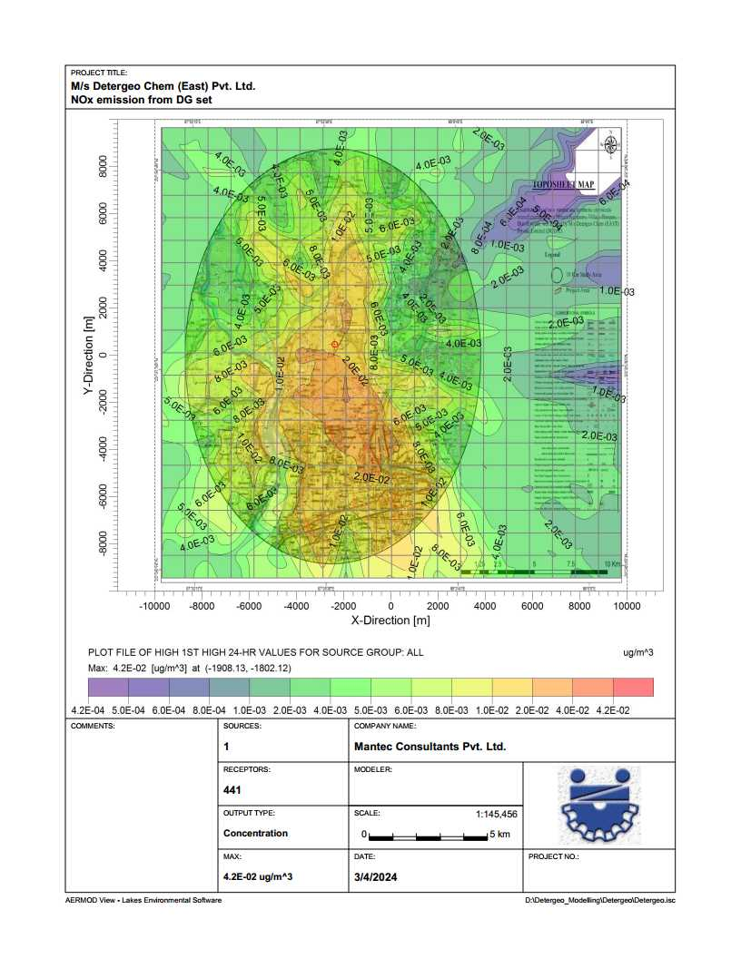
COMPLIANCE OF TOR
ISOPLETH OF NOX:

Slide 79
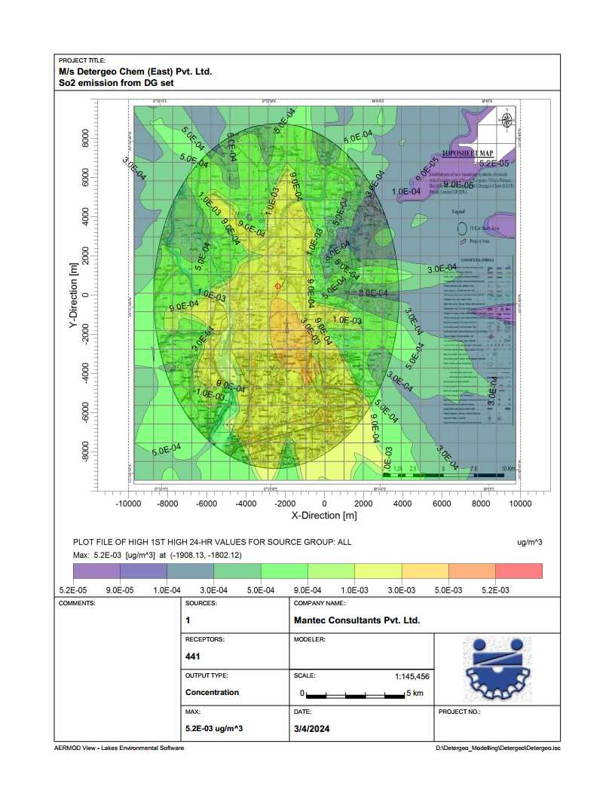
COMPLIANCE OF TOR
ISOPLETH OF SO2:

Slide 80
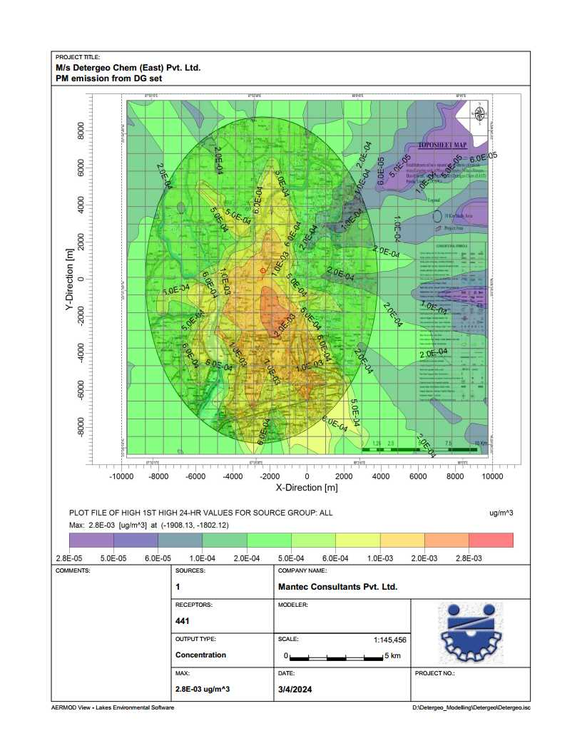
COMPLIANCE OF TOR
ISOPLETH OF PM:

Slide 81
COMPLIANCE OF TOR
COMPLIANCE OF TOR
ToR-7(II): Water Quality modeling-in case of discharge in water body.
Compliance: No Waste water or Treated water will be discharge in to water body.
ToR-7(III): Impact of the transport of the raw materials and end products on the surrounding environment hall be assessed and provided.
Compliance: The LOS value from the proposed project may be same as earlier value “Excellent” for NH-6 and ‘Very Good’ for SH-15. So the additional load on the carrying capacity of the concern roads is not likely to have any significant adverse effect.
ToR-7(IV): A note on treatment of wastewater from different plant operations, extent recycled and reused for different purposes shall be included.
Compliance: Details of ETP (Effluent Treatment Plant):
The raw effluent will be received at the inlet of the bar screen to trap any floating particles and debris. A belt type oil skimmer and grease trap will be provided to remove the floating oil and grease.
The oil free effluent will be pumped to the flash mixer where lime dolomite will be added to precipitate the dissolved solids, sulphates and other organic impurities present in the effluent. The effluent from the flash mixer overflows to the settling tank where poly will be added and the impurities are removed as sludge from the bottom of the tank.
The sludge will be sent to sludge drying beds. The clear supernatant overflows to the Clarified Water tank where Hypo will be dosed for disinfection. Filter Feed pumps transfer the clarified water to the downstream Pressure Media filter and Activated Carbon filter for removal of suspended solids and any traces of organics.

Slide 82
COMPLIANCE OF TOR
Pressure Sand Filter:
The system is provided with Gravels, Pebbles Sand Media Filter. The main purpose of the filter is to remove the Suspended Solids & reduce Turbidity. The Filter is provided within Inlet Distributor, Bottom collector & various Filtration Media like pebbles, gravels, sand to achieve effective filtration.
Externally, the filter has Mesh of Valve to assist in various service requirements like Filtration, Backwash & Rinse.
Activated Carbon Filter:
The system is provided with Activated Carbon Filter. The main purpose of the filter is to remove free Chlorine, balance organics, color etc. The Filter is provided with Inlet Distributor, Bottom Collector & filtration media like fine silex and activated Carbon.
Externally, the filter has Mesh of Valve to assist in various service requirements like Filtration, Backwash & Rinse.
The treated water is used for floor washing/process applications.
Design Capacity
Effluent treatment plant: 5 KLD Flow
Rate: 1m³/hr
Service Cycle: 5 hrs

Slide 83
COMPLIANCE OF TOR

Slide 84
COMPLIANCE OF TOR
ToR-7(V): Details of stack emission and action plan for control of emissions to meet standards.
Compliance: Stack specification:
S. No. | Stack Details | Stack Parameters | Values | Unit
1. | Sulphonation Plant (Vent Gas from ESP & Scrubber) | MOC | MS
 |  | Diameter | 600 | mm
 |  | Height | 30 | metre
 |  | Exit Gas Temperature | 30-40 | Celcius
2. | Oil Fired Boiler (Bag Filter) | MOC | MS
 |  | Diameter | 450 | mm
 |  | Height | 30 | metre
 |  | Exit Gas Temperature | 180 | Celcius
3. | Diesel Generator | MOC | MS
 | 1 x 910 Kva | Diameter | 250 | mm
 | 1 x 500 Kva | Height | 11 | metre
 |  | Exit Gas Temperature | As per DG Standards
The emission sources for the proposed project i.e. Boiler, DG set, Alkali Scrubber, Reactor will be designed with adequate stack heights and air pollution control measures to meet the standards set by the WBPCB/CPCB. Good housekeeping, providing adequate air pollution control measures and stack of adequate heights will be provided.
Online Air monitoring system for stack emission (for Particulate Matter) will be installed and transmission of online data to WBPCB and CPCB will be done.

Slide 85
COMPLIANCE OF TOR
ToR-7(VI): Measures for fugitive emission control.
Compliance: Measures for fugitive emission control:
The principal air pollution control systems proposed for the sulphonation plant are Electrostatic Precipitator (ESP) and Alkali Scrubber.
The SO₂ and Acid mist released during the sulphonation process would be cleaned by taking the gas through an ESP to remove the acid mist followed by alkali scrubber to remove the SO₂ gas.
The clean gas will be discharged into atmosphere through a stack of 30.0 m height.
ToR-7(VII): Details of hazardous waste generation and their storage, utilization and management. Copies of MOU regarding utilization of solid and hazardous waste in cement plant shall also be included.
Compliance: Details of hazardous waste generation and their storage: Refer slide-24.
Utilization and Management of hazardous waste generation : Refer slide-25.
ToR-7(VIII):Proper utilization of fly ash shall be ensured as per Fly Ash Notification, 2009. A detailed plan of action shall be provided.
Compliance: N/A
ToR-7(IX):Action plan for the green belt development plan in 33 % area. Giving details of species, width of plantation, planning schedule.
Compliance: 33% of total area as per MoEF&CC stipulated norms will be developed as the green belt. The plant density of 150 trees per hectare with local native species will be implemented. The greenbelt will be developed in an area of 3019 sq.m (33%) of the total land area of 13,493 sq.m.

Slide 86
COMPLIANCE OF TOR
ToR-7(X):Action plan for rainwater harvesting measures at plant site shall be submitted to harvest rainwater from the rooftops and storm water drains to recharge the ground water.
Compliance: The rainwater harvesting measures and quantity with regards to the various components of the project are as follows:
S. No. | Category | Area (sq.m) | Intensity of Rainfall mm/ hr. | Runoff Cofficient | Total vol. of water available for RWH (m³/hr) | Total vol. of water available for RWH (m³/15 min)
1. | Building area | 564 | 100 | 0.9 | 50.76 | 12.69
2. | Landscaped area (Green area, Vacant area | 7430 | 100 | 0.2 | 148.6 | 37.15
3. | Road/Paved area | 5499 | 100 | 0.6 | 329.94 | 82.48
Total |  | 13493 |  |  | 529.30 | 132.32
The total calculated peak run-off from landscaped areas, road and open area is 132.32 cu.m.
This run-off is proposed to be channelized through storm water drains to individual recharge pits and the rainwater will be recharged into underground aquifers.

Slide 87
COMPLIANCE OF TOR
ToR-7(XI): Total capital cost and recurring cost/annum for environmental pollution control measures shall be included.
Compliance: The total capital investment on environmental control measures is envisaged to be about Rs.150 Lakhs and Recurring Cost is envisaged to about Rs.17 Lakhs/yr. out of a total project cost of Rs.20 Crores.
ToR-7(XII): Action plan for post-project environmental monitoring shall be submitted.
Compliance: A detailed monitoring of emissions and effluent sources for different environmental parameters will be carried out as per the present norms and any further notification/direction from West Bengal State Pollution Control Board (WBPCB), Central Pollution Control Board (CPCB) and MoEF&CC. Monitoring methodologies will follow standard methods prescribed by Central Pollution Control Board (CPCB), Bureau of Indian Standards (BIS) etc.
ToR-7(XIII): Onsite and Offsite Disaster, Preparedness and Emergency Management Plan.
Compliance: Disaster management plan are prepared with an aim of taking precautionary step to control the hazard propagation, avert disaster, take action after the disaster, which limits the damage to the minimum, and follow the on-site & off-site emergency planning. DMP hyperlink.
ToR-8: Occupational health:
(I): Plan and fund allocation to ensure the occupational health & safety of all contract and casual workers.
Compliance: Rs.5.0 Lakhs/yr. will be kept for to ensure safety of all Employees including contract & casual workers.

Slide 88
COMPLIANCE OF TOR
(II): Details of exposure specific health status evaluation of worker. Compliance: Workers' health shall be evaluated by pre designed format, for chest x rays, Audiometry, Spirometry, Vision testing (Far & Near vision, colorvision and any other ocular defect) ECG, during pre placement and periodical examinations that will give the details of the same.
ToR-8(III): Details of existing Occupational & Safety Hazards. What are the exposure levels of above mentioned hazards and whether they are within Permissible Exposure level (PEL). Compliance: The main chemicals affecting the health will be VOC’s, CO. MSDS of all hazardous chemicals will be made available for concerned personnel. The following general measures will be taken:
Establishment of Safety Policy.
Compulsory use of PPE’s.
Regular monitoring of work place environment with respect to air, light, humidity, temperature.
Installation of fire extinguisher.
Separate area for container decontamination.
Provision of part time qualified M.O as per Factory Act.
Pre medical & periodic medical checkup of workers as per Factory Act.
Monitoring of Occupational hazardous like noise, vibration & chemical exposure.
Displaying various instruction boards, cautionary notices etc.

Slide 89
COMPLIANCE OF TOR
ToR-8(IV): Annual report of heath status of workers with special reference to Occupational Health and Safety.
Compliance: N/A
ToR-9: Corporate Environment Policy.
(I): Does the company have a well laid down Environment Policy approved by its Board of Directors? If so, it may be detailed in the EIA report.
Compliance: The company had a well laid environment policy and is detailed in the EIA Report.
(II): Does the Environment Policy prescribe for standard operating process / procedures to bring into focus any infringement / deviation / violation of the environmental or forest norms / conditions?
Compliance: Yes, All the Environmental policy is followed for SOPs and procedures so that any violation regarding environmental or forest norms will be avoided. For that scheduled internal audits and management review meeting shall be done.
(III):What is the hierarchical system or Administrative order of the company to deal with the environmental issues.
Compliance: Hierarchy of the company is well laid and its schematic representation is in the next slide.

Slide 90
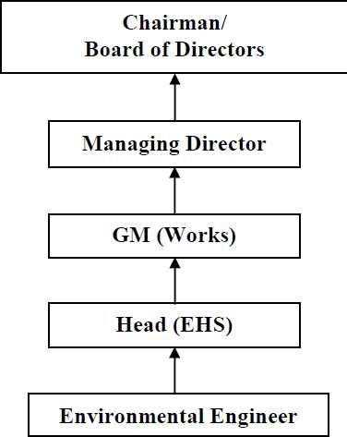
COMPLIANCE OF TOR
HIERARCHY SYSTEM:

Slide 91
COMPLIANCE OF TOR
ToR-9(IV): Does the company have system of reporting of non compliances / violations of environmental norms to the Board of Directors of the company and / or shareholders or stakeholders at large?
Compliance: The system of reporting of Non-conformances/ violation of any Environmental Law/Policy will be as per quality management system.
The internal audit will be conducted on periodic basis, and any Non-conformances/ violation to Environmental Law/Policy will be closed and discussed during Management Review Meetings of board of directors/partner.
ToR-10: Details regarding infrastructure facilities such as sanitation, fuel etc.
Compliance: Most of the labor force during construction and operation phase hired from the local areas. Sanitation and rest rooms will be provided for the casual workers and truck drivers.
ToR-11: Enterprise Social Commitment (ESC)
Compliance: The company has separately earmarked Rs. 40.00 lakhs (2% of Project cost) towards the Corporate Environment Responsibility (CER) Activities as per OM (CER) F. No. 22- 65/2017-IA.III dated 01.05.2018.
ToR-11(I): Adequate funds (at least 2.5 % of the project cost) shall be earmarked towards the Enterprise Social Commitment based on Public Hearing issues and item wise details along with time bound action plan shall be included. Socio-economic development activities need to be elaborated upon.
Compliance: A provision of Rs.3 lakhs has been made under Public Hearing Budget towards provision of scheme of Zero Liquid Discharge (ZLD) (1 lakhs) and for awareness and training programme for local employment (2 lakhs) based on the commitment made under Public hearing meeting held on 23.08.2021.

Slide 92
COMPLIANCE OF TOR
ToR-12: Any litigation pending against the project and/or any direction/order passed by any Court of Law against the project, if so, details thereof shall also be included. Has the unit received any notice under the Section 5 of Environment (Protection) Act, 1986 or relevant Sections of Air and Water Acts? If so, details thereof and compliance/ATR to the notice(s) and present status of the case.
Compliance: N/A.
ToR-13: A tabular chart with index for point wise compliance of above TOR.
Compliance: Complied.

Slide 93
SPECIAL ToR COMPLIANCE

Slide 94
COMPLIANCE OF SPECIAL ToR
SToR-(i): Details on solvents to be used, measures for solvent recovery and for emissions control.
Compliance: N/A.
SToR-(ii):Details of process emissions from the proposed unit and its arrangement to control.
Compliance: Details of process emissions:
Impact on air quality due to proposal project will be temporary rise in SPM and RSPM level likely to result from:
Fugitive dust emissions at the construction site.
Use of unpaved roads and trucks tracks by the construction activities.
SToR-(iii): Ambient air quality data should include VOC, other process-specific pollutants* like NH3*, chlorine*, HCl*, HBr*, H2S*, HF*,etc., (*as applicable).
Compliance: For AAQ data Refer slide no.-61
SToR-(iv): Work zone monitoring arrangements for hazardous chemicals
Compliance: Work place monitoring to be done regularly & Detectors will be installed. Hazardous chemicals will be stored separately.
SToR-(v): Detailed effluent treatment scheme including segregation of effluent streams for units adopting 'Zero' liquid discharge.
Compliance: Effluent Treatment plant followed By Tertiary treatment is proposed for the Unit to achieve the ‘Zero Liquid Discharge’. And for water balance refer slide-27.

Slide 95
COMPLIANCE OF SPECIAL ToR
SToR-(vi): Action plan for odour control to be submitted.
Compliance: Scrubber is installed for scrubbing the residual Formaldehyde from the main product stream which also controls the odour problem.
Green belt will be maintained to control the odour problem, About 33% of the total area is under the green cover. About 125 no of trees will be planted under GB development program.
SToR-(vii): A copy of the Memorandum of Understanding signed with cement manufacturers indicating clearly that they co-process organic solid/hazardous waste generated.
Compliance: N/A.
SToR-(viii): Authorization/Membership for the disposal of liquid effluent in CETP and solid/hazardous waste in TSDF, if any.
Compliance: Company will collect, store separately and dispose off solid/hazardous waste at TSDF site and will take the Authorization/Membership of TSDF facility after the grant of Environmental Clearance
SToR-(ix): Action plan for utilization of MEE/dryers salts.
Compliance: N/A.
SToR-(x): Material Safety Data Sheet for all the Chemicals are being used/will be used.
Compliance: Material safety data sheet for all the chemicals will be used.

Slide 96
COMPLIANCE OF SPECIAL ToR
SToR-(xi): Authorization/Membership for the disposal of solid/hazardous waste in TSDF.
Compliance: Company will take the Authorization/Membership of TSDF facility after the grant of EC.
SToR-(xii): Details of incinerator if to be installed.
Compliance: N/A.
SToR-(xiii): Risk assessment for storage and handling of hazardous chemicals/solvents. Action plan for handling & safety system to be incorporated.
Compliance: Risk for storage units depends not on the extent of the consequence, but also on the probability of the failure of the safety measures and provisions provided. The safety measures to be provided in storage facilities in the proposed plant are given below:
General Safety Measures for Chemicals Storage & Handling.
Following safety measures for chemicals storage and handling will be provided.
Availability of MSDS (Material Safety Data Sheets) information for all chemicals Proper layout of tank farm and other storage areas for chemicals
Proper segregation of chemicals storage taking into account compatibility Matrix Instrumentation and control system for tanks, Sulphonator etc. SO₂ and SO₃ Gas detection and fire protection systems
Periodic inspection and maintenance system Standard operating procedures and check lists Training of operation and maintenance personnel Safety work permit system.
Electrical hazardous area classification for process units and storage areas Incident investigation and implementation of recommendations.

Slide 97
COMPLIANCE OF SPECIAL ToR
SToR-(xiv): Arrangements for ensuring health and safety of workers engaged in handling of toxic materials.
Compliance:
Personnel especially contractor workers at the plant should be made aware about the hazardous substance stored at the plant and risk associated with them.
To overcome these hazards, in addition to arrangements to reduce it within TLV's, personal protective equipment should also be supplied to workers.

Slide 98
CONCLUSION
M/s DCEPL will generate a fair amount of direct, indirect and induced employment in the region.
The local economy will receive a boost due to employee spending and services generated by the company. Due to the implementation of the project activity there shall be improvement in the standard of living viz. better education, improved health, sanitation facilities etc. This is envisaged as a major positive benefit.
The company’s management will recruit semi-skilled and unskilled workers from the nearby villages due to availability of local labors. The employment provided due to the proposed project would rapidly increase the social status of the villagers.
Company commitment towards environment & using the latest technology, along with optimal usage of available resources will reduce the impact and makes the project viable.

Slide 99
COMPLIANCE OF SPECIAL ToR
THANK YOU

