Slide 1
File No. & Proposal No.: SIA/MH/IND2/68526/2017
WELCOME
Expert Appraisal Committee Members, MoEFCC; New Delhi
Environmental Clearance (EC) Presentation
On
Expansion of Molasses Based Distillery (30 to 105 KLPD) for Ethanol Production by Using C / B Heavy Molasses / Cane Juice Including Expansion of Cane Crushing Capacity (4,500 to 7,500 TCD) & Co-genertion Plant (15 to 22 MW)
(In Project Complex of 4,500 TCD Sugar Factory, 15 MW Cogeneration Plant & 30 KLPD Distillery)
(Cat. B2 Project as per MoEFCC Notification No. 980 (E) dt.02.03.2021)
By
Vishwasrao Naik Sahakari Sakhar Karkhana Ltd.
Yashwantnagar, Chikhali, Tal.: Shirala, Dist.: Sangli, Maharashtra.
Prepared By
Equinox Environments (I) Pvt. Ltd.
Environmental; Civil & Chemical Engineers, Consultants and Analysts, Kolhapur (MS)
QCI- NABET & ISO 9001 : 2015 Accredited Organization
Email : eia@equinoxenvi.com, projects@equinoxenvi.com

Slide 2
Vishwasrao Naik S.S.K.L., Yashwantnagar, Chikhali, Tal.: Shirala, Dist.: Sangli
1 | New Project / Expansion Project | Expansion Project
2 | Project Capacity | Expansion of Distillery (30 to 105 KLPD) by using Molasses / Cane Juice & Expansion of Cane Crusshing (4,500 to 7,500 TCD) & Co-genertion Plant (15 to 22 MW)
3 | Forest Area/ Wildlife/ ESZ if any | Not Applicable
4 | Name of EIA Coordinator, Consultant, NABET Registration No. & Validity | Dr. Sangram Ghugare, Equinox Environments (I) Pvt. Ltd., NABET/EIA/1821/RA 0135, 10.04.2022
5 | Monitoring Period | Not Applicable. Project to be appraised as B2 as per Notification S.O. 980 (E) 02.03.2021 under EBP program
6 | Date of Public Hearing (P.H.) conducted
7 | Status of FC; CRZ & CPA | Not Applicable
8 | Certified Compliance submitted | For 30 KLPD Molasses Distillery (EC dt. 29.09.2003)
9 | Ro; MoEFCC, Nagpur Visit & Report Dt. | 23.11.2021 & 17.02.2022
10 | Any Court Cases against the Project | No
Project Proponents
No. | Name | Designation
1 | Shri Mansingrao Fattesingrao Naik | Chairman
2 | Shri Babasaheb Yashwantrao Patil | Vice Chairman
3 | Shri Mansingrao Hambirrao Patil | Director
4 | Shri Dinkarrao Daulu Patil | Director
5 | Shri Suresh Pandurang Patil | Director
6 | Shri Babasaheb Dattajirao Pawar | Managing Director

Slide 3
Introduction
1 | Project Description | Vishwasrao Naik Sahakari Sakhar Karkhana Ltd., Tal.: Shirala, Dist.: Sangli, Maharashtra. Expansion of Distillery (30 to 105 KLPD) by using Molasses / Cane Juice & Expansion of Cane Crusshing (4,500 to 7,500 TCD) & Co-genertion Plant (15 to 22 MW); Cat.: B2, Item :5(g), 5(j), 1(d)
2 | Plot (Ha) | Plot : 52.52 [Built Up : 3.22 (Existing) + 0.18 (Proposed), Parking: 10.5 (20%), Roads: 2.68, OS : 10.49]
3 | GB (Ha) | Existing: 22.4 (42 % of TPA)
4 | LU change | Present Land use is Industrial only
5 | Air & Noise Pollution Sources | Sugar & Cogen : 80 TPH Proposed Boiler (ESP & 76 M Stack); Existing Boiler: 80 TPH (ESP & 76 M Stack), 700 KVA & 300 KVA (2 Nos.) D.G. Sets; Process Emissions : CO_{2,} Fugitive Emissions: Mills, Sugar Bagging, Bagasse; Pressmud & Ash Storage Yards, Bagasse Conveyor.
6 | Project Cost | Existing : Rs. 231.12 Cr., Expansion : Rs. 182 Cr., Total after Expansion : Rs. 413.12 Cr.
7 | EMP Cost | Rs. 7.3 Cr. (Existing) & Rs. 20.30 Cr. (Proposed); Total: Rs. 27.6 Cr. (After Expansion)
8 | CSR Cost | Rs. 0.5 Cr.(Exist.). Rs. 1.4 Cr. (Prop.); Manpower– Existing: 911, Under Expansion : 125
9 | EMC Details | 8 Members, M.E. (Env.), M.Sc. (Env. Sc.), B.Sc. (Chem.), PGDISHE. MD, Chief Chemist, Chief Engineer, Civil Engineer, Co-gen Plant Incharge, Labour Officer, Environmental Officer
1 | Water Use | Sugar Factory & Co-gen Plant : 4,737 (25 Fresh + 882 ETP, STP Treated & RWH + 3,830 Excess Cane Condensate Reuse) Distillery: 994 (78 Fresh + 916 CPU Treated Effluent Reuse); 98% Recycle Overall
2 | Source | Mangale Savarde Bandhara of River Warana (Permission granted from Irrigation Dept.; MS)
3 | Energy | Power requirement - 5.7 MW (Existing); 9.0 MW (After Expansion)
4 | Fuels (TPD) | Sugar & Co-gen : Proposed 80 TPH Boiler (Bagasse -810); Existing 80 TPH Boiler (Bagasse- 810),
5 | Effluent; CMD | Sugar Factory & Co-gen: 577, Distillery: Raw Sp.wash: 840 (Conc. Sp.wash: 215); Other Effluents (MEE Condensate, Cooling & Boiler B/d , Washing) : 935
6 | Treatment & Disposal | Sugar & Co-gen : Existing ETP : 577 CMD Distillery : Spentwash : MEE - Dried to form Powder; CPU Treated Effluent : 100% Recycled in Process - ZLD.

Slide 4
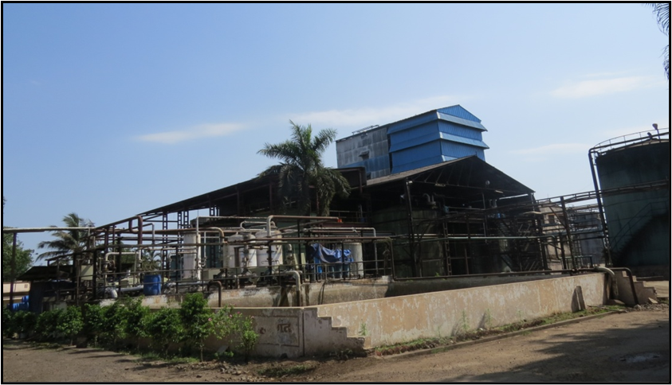
About the Project & Allied Developments
Year 1967 : Industry Registration as – Vishwarao Naik S.S.K. Ltd.
Year 1973 : First Crushing Season with 1250 TCD Capacity
Year 2003 : Establishment of 30 KLPD Molasses based Distillery Unit (EC Procured)
Year 2012 : Establishment of 15 MW Cogeneration Plant
Year 2004 : Expansion of Sugar Factory from 1250 to 4500 TCD
Year 2022 : Expansion Distillery (30 to 105 KLPD), Sugar Factory (4,500 to 7,500 TCD) & Co-gen Plant (15 to 22 MW)

Slide 5
Salient Features of Integrated Project Complex
Distillery -
100% Biofuel Ethanol Manufacturing and Participation in National Bio-Fuel Program.
100% Fresh Water Saving for Cane Juice Distillery (Requirement : 0 KL/KL, Norm : 10 KL/KL)
93% Less Water for Molasses Distillery (Norm : 10 KL/KL; Requirement : 0.7 KL/KL)
90% (Cane Juice) Lesser Spentwash to Disposal (Generation : 0.8 KL/KL, Norm : 8 KL/KL)
74% (Molasses) Lesser Spentwash to Disposal (Norm : 8 KL/KL, Generation : 2.4 KL/KL)
No New Boiler in DIstillery
ZLD tho’ Spentwash Powder (98% Solids); High Organics (50%); Good N (2%), P (1%) & K (5%), Powder has value as Organic Fertilizer – Value Addition.
CO₂ from Fermenters to be Cleaned, Compressed & Bottled.
Substantial Investment in EMP Infrastructure : Existing Rs. 7.3 Cr; Proposed: Rs. 20.30 Cr.
Handsome Provisions for CSR: Existing Rs. 0.5 Cr; Proposed: Rs. 1.4 Cr.
Rs. 1.56 Cr / Yr. to be spent on O & M of ETP, APC & Other Infrastructure.
42% of TPA Green Belt already developed.
Sugar Factory -
100 % Saving in Process Fresh Water.
62% Reduction in Effluent w.r.t. Norm (Generation: 77 Lit/MT; Norm:200 Lit/M)
40% Increase in ETP Efficiency (Exist. BOD : 100 mg/lit; Prop. BOD : 60 mg/lit)
ZLD for Sugar Factory tho’ Reduce- Reuse- Recycle
ESP & 76 M Stack as APC to Sugar & Cogen Boiler (ESP Efficiency : 99%); OCMS Provided.

Slide 6
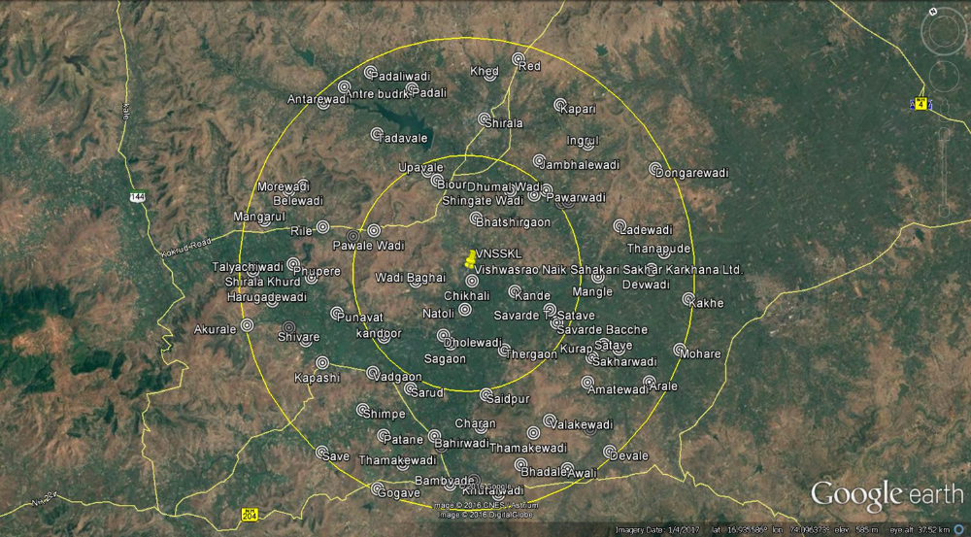
Location of Project & its Connectivity
15 Km
10 Km
5 Km
Accessibility | Connectivity
Highway / Road | NH-4 (19 Km)
Railway Station | Kolhapur (31 Km)
Airport | Kolhapur (36 Km)
Latitude | 16°56’12.93"N
Longitude | 74°05’18.06“E
Elevation | 560 M above MSL

Slide 7
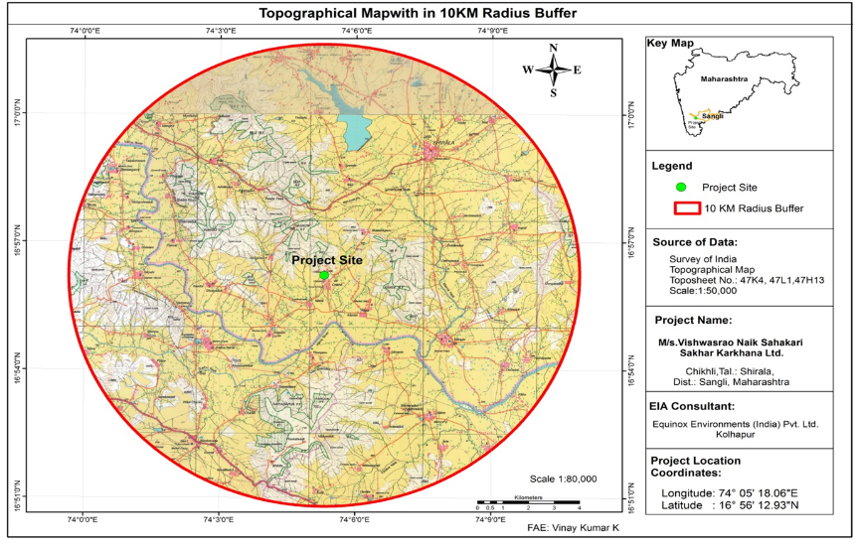
Topographical Map
Particulars | Distance & Directions
Water Bodies | Warna River at 2.5 Km (S), Morna 4.5 Km (N) & Morna Dam 7 Km (N)
Forest | No
Nearest Habitation | Chikhali Village (0.5 Km)

Slide 8
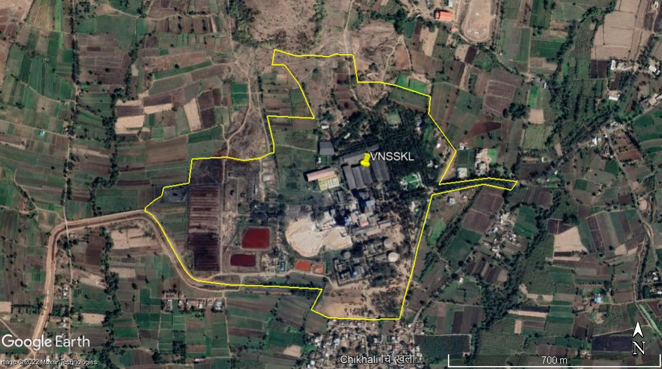
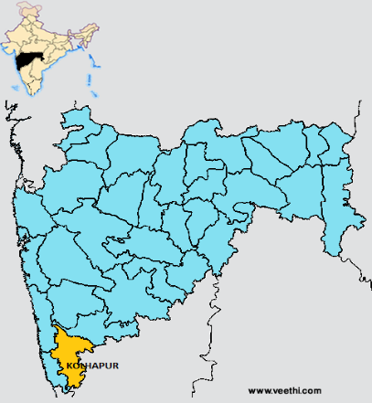
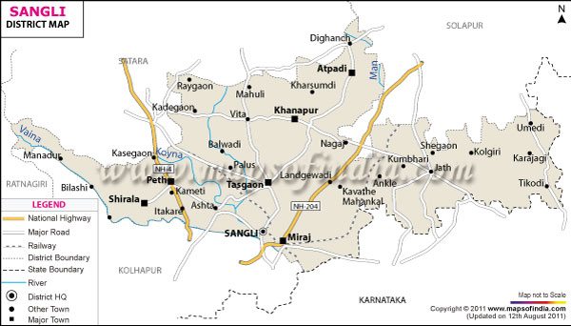
Project Site
Location - Industrial Site is at 53 Km on West of Kolhapur City & at 270 Km on South East of Mumbai
The Maps are Purely Graphical & not to Scale.
Latitude ¹ 16°56’12.93"N,Longitude ¹ 74 0518.06“E.

Slide 9
Integrated Project Complex Process Flow Diagram
Sugar Factory
Weighment & Cane Preparation
Cogeneration Plant
To Grid
Cane Milling/ Crushing
Bagasse
30%
Boiler
Turbines
Steam
Power
Boiler Ash
brick/ cement manufacturers/ manure
To Factory
Juice Extraction & Clarification
Press Mud
4%
Sale
Distillery Unit
Juice Sulphitation
ATFD
Powder As Manure
Syrup Boiling
Conc. Spent Wash
MEE
Condensate to Recycle
Molasses (4%)
Raw Spentwash
Centrifuging
Alcohol Storage
Fermentation
Distillation
Alcohol
Storage of Sugar

Slide 10
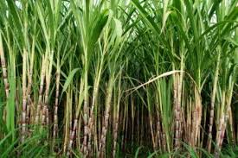
Products, By-products & Value Addition
Sugarcane in Farm
Sugar Factory
7500 TCD
Sugar
(12-13% on Cane Crushed)
Manure
Bagasses
(30%)
Pressmud
(4%)
Molasses
(4%)
Powder As Manure
Low Pressure Steam
Cogen Boiler
ATFD
Steam
High Pressure Steam
Conc.
Spentwash
Spentwash
Distillery
105 KLPD
Turbine
MEE
CO₂
Alcohol
CO₂ Bottling Plant
Electricity

Slide 11
Product & Raw Materials
A. Products: Expansion: Distillery (20 to 105 KLPD), Sugar Factory (4500 to 7500 TCD), Co-gen Plant (15 to 22 MW)
Industrial unit | Product & By-product | Quantity
 |  | Existing | Expansion | Total
Distillery | Products
 | RS/ ENA | 900 KL/M | 0 | 900 KL/M
 | Ethanol (B & C Heavy Molasses) | 600 KL/M | 2550 KL/M | 3150 KL/M
 | Ethanol (Sugarcane Syrup) | 0 | 3150 KLPD | 3150 KL/M
 | By-Products
 | Carbon Di-oxide | 690 T/M | 1920 T/M | 2610 T/M
Sugar Factory | Products
 | Sugar (12%) | 16,872 T/M | 10,128 T/M | 27,000 T/M
 | By-products
 | Molasses (4.%) | 5400 T/M | 3600 T/M | 9000 T/M
 | Bagasse (30%) | 40,500 T/M | 27,000 T/M | 67,500 T/M
 | Press Mud (4%) | 5400 T/M | 3600 T/M | 9000 T/M
Co-Gen | Electricity (MW) | 15 MW/H | 7 MW/H | 22 MW/H
B. Raw Materials: Expansion: Distillery (30 to 105 KLPD), Sugar Factory (4500 to 7500 TCD), Co-gen Plant (15 to 22 MW)
Industrial unit | Name of Raw Material | Quantity (T/Month) |  |  | Source
 |  | Existing | Expansion | Total
Distillery | Molasses | 3330 | 315 | 11,670 | Own Sugar Factory/ Outside Purchase
 | Sugarcane for juice | 0 | 4,95,000 | 4,95,000
 | Yeast | 3 | 5 | 8 | Local Vendor
 | Urea | 36 | 84 | 120
 | De-foaming Oil | 105 | 255 | 360
Sugar Factory | Sugarcane | 1,35,000 | 90,000 | 2,25,000 | Near By Farms
 | Lime | 243 | 162 | 405 | Nearby Market
 | Sulphur | 81 | 54 | 135
 | Lubricants | 19 | 13 | 32
Co-gen | Bagasse | 24,300 | 24,300 | 48,600 | Own Sugar Factory

Slide 12
Molasses & Cane Juice / Syrup based Operations for 105 KLPD Distillery
No. | Description | Quantity
1 | Sugar cane crushing capacity | 7500 TCD
2 | Sugar factory operating days | 180 Days
3 | Total Cane Crushing | 13,50,000 T/Season
4 | Cane Juice / Syrup based Operations (Crushing Season); 180 Days | 13,50,000 T Cane
5 | Molasses based Operations; 330 Days | 1,28,370 T Molasses
Raw Material Transportation Details
No. | Type of Vehicle | Avg. wt. (T) / Vehicle | Daily No. of Vehicles | Quantity of Cane (T) | %
1 | Bullock Carts | 2 | 175 | 350 | 5
2 | Mini Tractor | 13 | 88 | 1150 | 15
3 | Tractor Trolleys | 15 | 300 | 4500 | 60
4 | Trucks | 15 | 100 | 1500 | 20
Total |  | 45 | 982 | 7500 | 100
 | Molasses
 | Tankers | 18-20 | 19 | 389
Product & By-product Transportation Details
No. | Product | Type of Vehicles | Daily Frequency of Vehicle | Average Capacity of Vehicle | Quantity of Final Product Transported
1 | Sugar | Trucks | 60-65 | 15 MT | 1,68,840 MT / Season
2 | Pressmud | Trolleys | 75 | 4 MT | 54,000 MT/ Season
3 | Alcohol | Tankers | 5-6 | 18-20 KL | 34,650 KL/Season

Slide 13
Sugar Factory Process Flow Chart – 7,500 TCD
Imbibition - 1875 MT
Sugar Cane 7,500 MT
Milling Section
Bagasse; 2250 MT
Lime 11 MT
Juice 7136 MT
Heat Exchanger
Condensate 750 MT
Clarification
Sediment 750 MT
Filtrate
450 MT
Steam 3150 MT
6836 MT
Condensate 1275 MT
Vacuum Filter
1st Effect Vapours 750 MT
2nd effect
4th effect
1st effect
3rd effect
Steam condensate;
3150 MT
Pressmud 300 MT
2051 MT Vapours to Pan
Vacuum Pan; 2760 MT
Evaporation Loss 952MT
Pan Condensate 1875 MT
Condensate; 240 MT
Crystallizer; 885 MT
Molasses ; 300 MT
Centrifuge 1125 MT
Sugar 825 MT
Condensate
1275 MT
Condensate for Recycling
2025 Cu.M
Washing
7 CMD
Vacuum Pump
Sealing
146 CMD
Brushing & other
140 CMD
Mill Bearing
50 CMD
Ash Quenching
4 CMD
Turbine Cooling
468 CMD
Mill Turbine
300 CMD
Boiler
408 CMD
Green Belt/Gardening
90 CMD
As Raw Water
412 CMD

Slide 14
Existing Distillery Process Flow Chart - 30 KLPD (Molasses)
Sugar Factory
Molasses
Weighing of Molasses
Molasses (111 MT; 80 KL)
Molasses Dilution
Water 240 KL
(Fresh water)
Wash (320 KL)
Pre-Fermentation
Yeast Culture
As Manure
Yeast Sludge
(5 KL)
CO₂
(23 MT)
Bottling Section
Fermentation
Fermented Wash (315 KL)
Distillation
Alcohol (30 KL)
Storage Section
Raw Spentwash
(220 KL)
Spent Leese
(65 KL)
Reboiler
10-12% Solids
Spentwash
Tank
Existing ETP
(76 KL)
Other Effluents
(11KL);
(Lab .,Washings, Cool B/d)
Digested Spentwash
(216 KL; 8% Solids)
2 % Loss
Pressmud
86 MT
Composting
74 KL; For Green Belt
Compost
79 MT

Slide 15
Proposed Distillery Process Flow Chart - 105 KLPD (Molasses)
Sugar Factory
Weighing of Molasses
Spentwash Powder
(65 MT/Day)
(95% Solids)
Molasses (278 KL; 389 MT)
Molasses Dilution
CPU Treated Effluent
834 KL
Diluted Wash 1112 KL (834 + 278)
Pre-Fermentation
Yeast Culture
ATFD
Yeast Sludge
(19 KL)
Fermentation
CO₂
(87 MT)
Bottling Section
Conc. Spentwash (215 KL; 279 MT),
Fermented Wash (1093 KL)
Distillation
Alcohol (105 KL)
Storage Section
Spentwash
(840 KL)
10-12% Solids
Spent Leese
(148 KL)
Vol. 20%, Solids 50-55 %
Condensate from Dryer
(143 KL)
CPU
(1056 KL)
Spentwash
Tank
Other Effluents
(19 KL);
(Lab .,Washings, Cool B/d)
Spentwash
(840 KL)
Total Condensate (768 KL)
MEE
Condensate (625 KL)
Vol. 80%
Treated CPU Effluent 916 KL
(Process: 834KL + Cooling: 82 KL);
100% Reuse

Slide 16
Proposed Distillery Process Flow Chart - 105 KLPD (Sugarcane Juice)
Sugar Crushing : 1500 TCD
Bagasse;30% (450 MT)
Cane Juice; 70% (1050 KL)
Juice Boiling; Concentration & Syrup
Condensate (420 KL)
Cane Juice Syrup (630 KL)
Weighing of Syrup
Spentwash Powder
(33 MT/Day)
(95% Solids)
Juice Syrup (630 KL)
Pre-Fermentation
Yeast Culture
ATFD
Use as
Manure
Yeast Sludge
(8 KL)
Fermentation
CO₂
(52 MT)
Bottling Section
Fermented Wash (622 KL)
Condensate (420 KL)
Distillation
Alcohol (105 KL)
Storage Section
Conc. Spentwash
(84 KL; 95 MT)
30-35% solids
Spentwash
(420 KL)
6-8% Solids
Spent Leese
(97 KL)
Condensate from Dryer
(32 KL)
Spentwash
Tank
CPU
(484 KL)
Other Effluents (19 KL);
(Lab .,Washings, Cool B/d)
Spent Wash (420 KL)
MEE
Condensate
(336 KL) 80%
Total Condensate (368 KL)
Treated CPU Effluent
for Reuse 474 KL
Total Effluent for Reuse: 474 + 420= 894 KL
(152 KL for Cooling; Lab & wash)
Condensate (32 KL)

Slide 17
Environmental Aspects
A. Water Consumption in Distillery (M³/Day) :
No | Description | Existing (30 KLPD) | After Expansion (105 KLPD)
 |  |  | Molasses (Crushing) | Molasses (Non-Crush) | Cane Juice
1 | Domestic | #2 | #8 | #8 | #8
2 | Industrial
 | Process | #240 | ♣834 | ♣834 | --
 | Boiler Make up | -- | -- | -- | ⁻⁻
 | Cooling Make up | #75 | 147 (♣82 +*65) | 147 (♣82 +#65) | ♣147
 | Lab & Washing | # 6 | *5 | # 5 | ♣5
 | DM Plant | ⁻⁻ | -- | ⁻⁻ | ⁻⁻
 | Industrial Use F. Water (10 KL / KL) | #322 10.7 KL/KL | 986 (*70 +♣916) 100% Rec., 0.0 KL/KL | 986 (#70 + ♣916) 92% Rec., 0.7 KL/KL | ♣152 100% Rec., 0 KL/KL
 | Grand Total (1+2+3) | #325 | 994 (#8 + *70 + ♣916) | 994 (#78 +♣916) | 160 (#8 + ♣152)
B. Effluent Generation in Distillery (M³/Day)
No | Description | Existing 30 KLPD | After Expansion (105 KLPD) |  | Treatment
 |  |  | Molasses | Cane Syrup
1 | Domestic | 2 | 6 | 6 | Proposed STP
2 | Process | Raw Spwash : 240 | Raw Spentwash : 840 Conc. Spwash : 215 | Raw Spwash- 420 Conc. Spentwash- 84 | Sp.wash –MEE – Dried for powder formation
 |  | Spent Leese – 41 | MEE Cond. - 768; Spent Leese – 148 | MEE Cond. 368 Sp. Lees- 97 | Treatment : In Distillery CPU Treated Effluent : 100% Recycle. Total ZLD Project Sp.wash Storage Tank Capacity : 5 Days Note: # - Fresh water from Mangale Savarde Bandhara of river Warana, *- Excess Cane Condensate, ♣ - Distillery CPU Treated Effluent
 | Cooling b/d | 8 | 14 | 14
 | Boiler b/d | -- | -- | --
 | DM Plant | -- | -- | --
 | Lab & Wash | 3 | 5 | 5
 | Norm : 8 KL / KL | Conc. Sp wash: 240 Other Effluent: 637 | Conc. Sp wash: 215 Other Effluent: 935 Spwash: 2.0 KL/ KL | Conc. Sp wash: 88 Other Effluent : 484 Spwash : 0.8 KL/ KL

Slide 18
Environmental Aspects
A. Water Consumption in Sugar Factory & Co-gen Plant (M³/Day) :
No | Description | Existing (Sugar 4500 TCD & Co-gen 15 MW) | Total After Expansion (Sugar 7500 TCD & Co-gen 22 MW)
1 | Domestic | #25 | #25
2 | Industrial
 | a. Process | *1380 | *2362
 | b. Boiler Makeup | #195 | *384
 | c. Cooling Makeup | *855 | *696
 | d. DM Plant | #45 | *139
 | e. Lab & Washing | *5 | *8
 | f. Ash Quenching | *2 | *3
 | Industrial Use | 2482 (*2242 + #240) (96% Recycle) | *3592 (100% Recycle)
3 | Green Belt | ^{Ω}1120 | 1120 (*238 + ^{Ω}882)
 | Grand Total (1+2+3) | 3627 (*2242 +#265 + ^{Ω}1120) | 4737 (*3830 +#25 + ^{Ω}882)
 | Water Norm : 100 Lit / MT of Cane | 59 Lit / MT of Cane | 3.0 Lit / MT of Cane
Note : # - Fresh water from Mangale Savarde Bandhara of river Warana, *- Excess Cane Condensate, Ω- ETP, STP Treated water + RWH.
B. Effluent Generation in Sugar Factory & Co-gen Plant (M³/Day)
No | Description | Existing | After Expansion | Treatment
1 | Domestic | 20 | 20 | Proposed STP
2 | Industrial |  |  | Treated in ETP and used for Green Belt to Achieve ZLD.
 | a. Process | 180 | 283
 | b. Boiler b/d | 35 | 77
 | c. Cooling b/d | 55 | 70
 | d. Lab & Washing | 19 | 139
 | e. DM Plant | 9 | 8
 | Total Industrial | 298 | 577
 | Effluent Generation Rate | 66 | 77 | Norm: 200 Lit/ MT of Cane Crushed

Slide 19
Sugar Factory, Co-gen Plant & Distillery Integrated Project ZLD Plan
1 | Daily Sugarcane Crushing | 7,500 TCD
2 | Water Content of Cane Crop @ 68% by weight | 5,100 MT
3 | Actual Cane Condensate for reuse is to the tune of 52 % on Cane Wt. after losses as - (1) Moisture in Pressmud (70%) (2) Bagasse (50%), (3) Sugar (5%), (4) Molasses (60%) as well as (5) Losses during juice heating, concentration in pans etc. | 3,900 CMD
4 | Sugar & Cogen ETP Treated Effluent for Recycle 577 CMD after Primary & Sec. | 565 CMD
5 | Treated STP Effluent for Recycle; Sewage @ 26 CMD | 25 CMD
 | Total Recycle Availability (3+4+5) | 4,490 CMD
Water Consumption in Sugar Factory (7500 TCD) & Cogen Plant (22 MW) (M³/Day):
No | Sugar Factory | Water Quantity | Effluent Generation | Remarks
A | Domestic | #25 | 20 | Treated in STP
B | Process | 2362* | 283 | Industrial Effluent is being treated In existing ETP Fresh Water Norm : 100 Lit/ MT of Cane crushed- 0 Lit/ MT Note: Note : # - Fresh water from Mangale Savarde Bandhara of river Warana, *- Excess Cane Condensate, Ω- ETP, STP Treated water + RWH.
 | Boiler Makeup | 384* | 77
 | Cooling Makeup | 696* | 70
 | DM Backwash | 139* | 139
 | Lab & Washing | 8* | 8
 | Ash Quenching | 3* | --
 | Total | *3592 100% Recycle | 577
C | Green Belt | 1120 (*238 + ^{Ω}882) | --
D | Grand Total (A+B+C) | 4737 (*3830 +#25 + ^{Ω}882) | --
E | Cane Condensate Utilization in Sugar Factory | 3830
F | Total Cane Condensate Availability | 3900 |  | 590 CMD Treated Effluent from Sugar Factory ETP & Proposed STP to be used for Green Belt Purpose. 70 CMD Excess Cane Condensate to be reused in distillery during Crushing Season.
G | Condensate Remaining (F-E) | 3900-3830 = 70

Slide 20
Existing Sugar Factory ETP (Capacity: 750 M3/Day)
Inlet
577 CMD
Pri. Tube Settler
(8 X 6.5 X 2.35 M)
Equalization Tank
(21.5 X 15 X 3.5 M)
Neutralization Tank
(6 X 1.2 X 2.5 M)
Oil & Grease Tank
Flash Mixer Tank
(2.2 X 2 X 1 M)
Buffer Tank
(7.5 X 6.5 X 2.5 M)
Bio- Digester
(11 Ø X 13 M)
To SDB
Aeration Tank – II
(18 X 17 X 4 M)
Aeration Tank – I
(18 X 10 X 2.5 M)
Sec. Clarifier II
(8.5 Ø X 3 M)
Sec. Clarifier I
(8.5 Ø X 3 M)
Intermediate Tank
(8 X 5 X 2.5 M)
RAS
RAS
Excess Sludge
Excess Sludge
To SDB
SDB (2 Nos.)
(7.5 X 5 X 1.75 M)
To Greenbelt of Industry
PSF
ACF
Treated Water Tank
(15 X 5 X 3.5 M)
Note:
PSF : Pressure Sand Filter
ACF : Activated Carbon Filter
RAS : Returned Activated Sludge
SDB : Sludge Drying Bed
No | Param | Unit | Inlet | Outlet
1 | pH | --- | 5-6 | 7-8
2 | COD | mg/lit | 2000-3000 | 120-150
3 | BOD | mg/lit | 1200-1500 | 45-60
4 | SS | mg/lit | 400-500 | 80-90

Slide 21
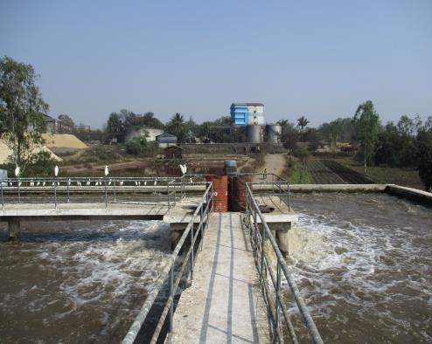
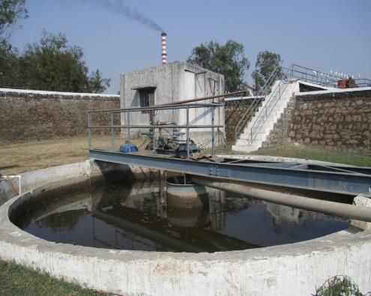
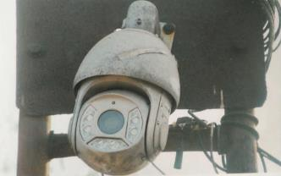
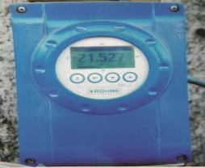
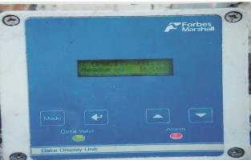
Existing Sugar Factory ETP
Aeration Tank
Secondary Clarifier
Flow Meters & Online Monitoring System

Slide 22
Flow Chart of Proposed Distillery CPU
Condensate &
Other Effluents
1056 CMD
Return Activated Sludge
Tube Settler
(4 X 4 X 3 M)
Reaction
Tank
UASBR
18 Ø X 6M Ht.
MBBR Reactor
25 X 18 x 4.5 M
Equalization
Tank
20 X18X3.5M
PTS
Pump
Buffer
Tank
(3 X3 X 3 M)
Sludge To SDB
Sludge to SDB
Treated Effluent Tank
15 X 15 X 4 M
Pump
SST
8Ø X 3M
RO Reject
TS
Flocculator
Flash Mixer
ACF
50 Cu.M / Hr
PSF
50 Cu.M / Hr
Intermediate Tank
(8 X8 X 3 M)
Tube Settler
(4 X 4 X 3 M)
Pump
Sludge
Sludge to Disposal
Sludge
RO
Plant
Sludge Dewatering Unit / SDB
Filtrate to Equalization Tank
No | Para. | Inlet | Outlet
1 | pH | 5-6 | 7 – 8
2 | COD | 3500-4000 | < 100
3 | BOD | 2000-2500 | < 50
4 | TDS | 2000-3000 | < 100
Permeate for Reuse in Process
916 CMD
Note:
PSF: Pressure Sand Filter
ACF : Activated carbon Filter
SST: Secondary Settling Tank
SDB: Sludge Drying Beds

Slide 23
Proposed STP (Capacity: 25 M3/Day)
Equalization Tank
(20 M³)
Anaerobic Contact Media Chamber
(6.450 M³)
Inlet
25 M³/Day
Sedimentation & Separation Chamber
(3.135 M³)
Bar Screen Chamber
(2.5 M³)
O & G
Chamber
(2.5 M³)
Pump
Recirculation Line
Treated Water Tank
(10 M³)
Moving Bed Chamber
(6.293 M³)
Disinfection Chamber
(0.380 M³)
Sedimentation Chamber
(2.247 M³)
To Reuse
No. | Parameter | Unit | Inlet | Outlet
1 | pH | --- | 6.0 – 8.5 | 6.0 – 8.5
2 | COD | mg/lit | 400 – 500 | < 50
3 | BOD | mg/lit | 250 – 300 | < 20
4 | TSS | mg/lit | 150 - 250 | < 30
5 | O & G | mg/lit | 20 - 30 | < 10

Slide 24
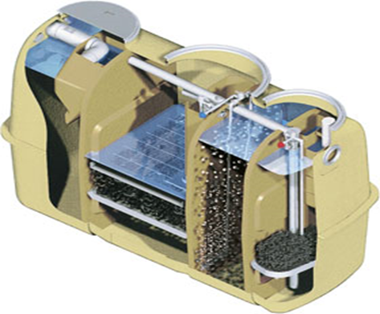
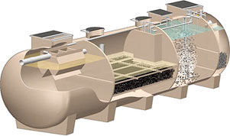
Daiki Axis Johkasou Technology – Packaged STP
Expeditious treatment; easy maintenance
Energy-saving
Most updated automated manufacturing technology
Stable high-quality FRP material
Capacities:
1 KLD to 50 KLD models
(further capacities can be increased in parallel arrangement)

Slide 25
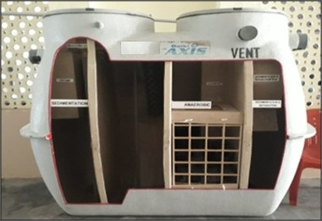
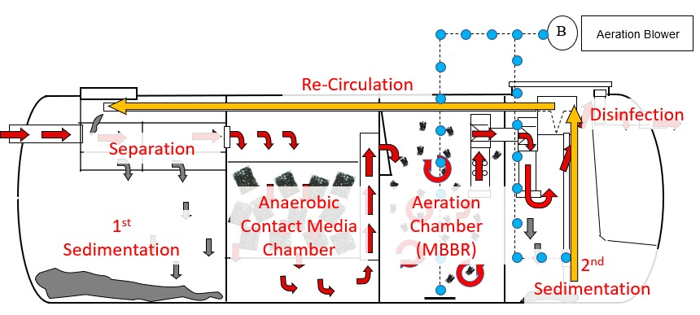
Johkasou STP Treatment Process
Unit | MOC | Process Description
Separation & Sedimentation Chamber | FRP | Suspended Solids (SS) are separated.
Anaerobic Chamber | FRP | Organic matters are anaerobically decomposed.
Moving Bed Chamber | FRP | BOD content reduced by continuous aeration.
Sedimentation Chamber | FRP | SS are settled and clear treated water is obtained.
Disinfection Chamber | FRP | Treated Water is disinfected by Disinfection agent.
Sludge Re-circulation Arrangement | - | Sludge from 2nd Sedimentation Chamber is recirculated to the 1st Sedimentation Chamber.
Technological Frame Work
Technology approved by National Jal Jeevan Mission.
Technology Approved by CII (Confederation of Indian Industry)
No COVID-19 Trace observed in outlet water

Slide 26
Environmental Aspects
Air Pollution Control
No | Description | Proposed Boiler | Existing Boilers & DG Set |  | Remarks
1 | Source | Boiler | Boiler | DG Set | D.G. Set only in power failure. OCMS Installed to Cogen Boiler
2 | Capacity (TPH) | 80 | 80 | 700 & 300 KVA
3 | Fuel | Bagasse | Bagasse | Diesel
4 | Quantity (MT/D) | 810 | 810 | 145 Lit./Hr.
5 | Stack Height | 76 M | 76 M | 200 mm
6 | APC Equi. | ESP | ESP | --
Hazardous Waste
No | Industrial Unit | Category | Quantity (MT/Yr.) |  | Storage & Disposal Method
 |  |  | Existing | After Expansion
1 | Sugar Factory, Co-gen Plant & Distillery | 5.1 Used Oil | 0.2 | 0.8 | Forwarded to authorized re-processor
 |  | 33.3 Contaminated Cotton Waste | 0.1 | 0.3
 |  | 33.1 Empty Containers | 10 Nos. | 35 Nos. | Forwarded to authorized re-seller
Solid Waste
No | Unit | Type | Quantity (MT/M) |  | Disposal
 |  |  | Existing | After Expansion
1 | Sugar Factory & Co-gen Plant | ETP Sludge | 10 | 17 | Used as Manure
 |  | Boiler Ash (Bagasse) | 600 | 1200 | Sale to brick/ cement manufacturers/ manure
2 | Distillery | Yeast Sludge | 150 | 570 | Used as Manure
 |  | CPU Sludge | -- | 28

Slide 27
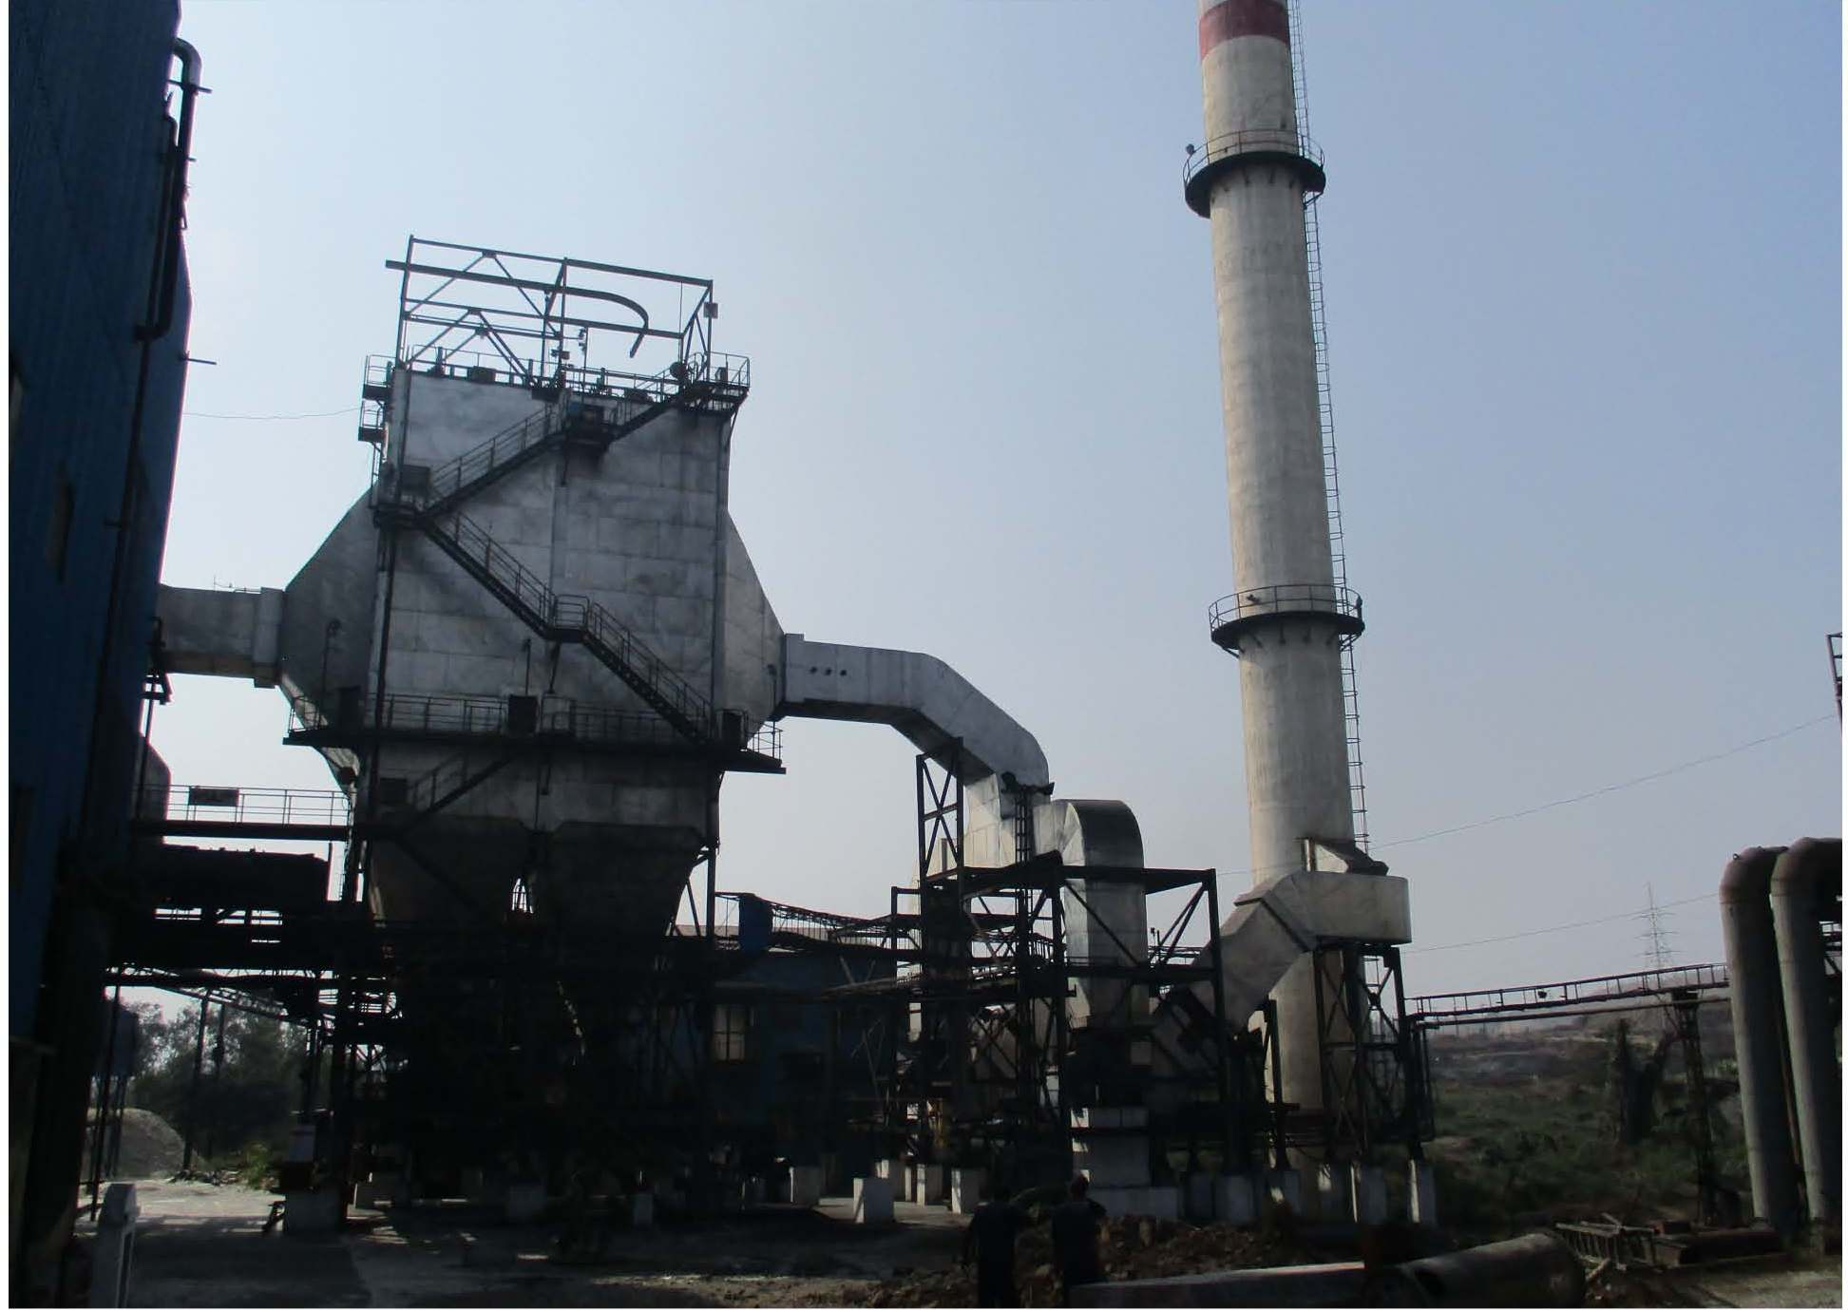
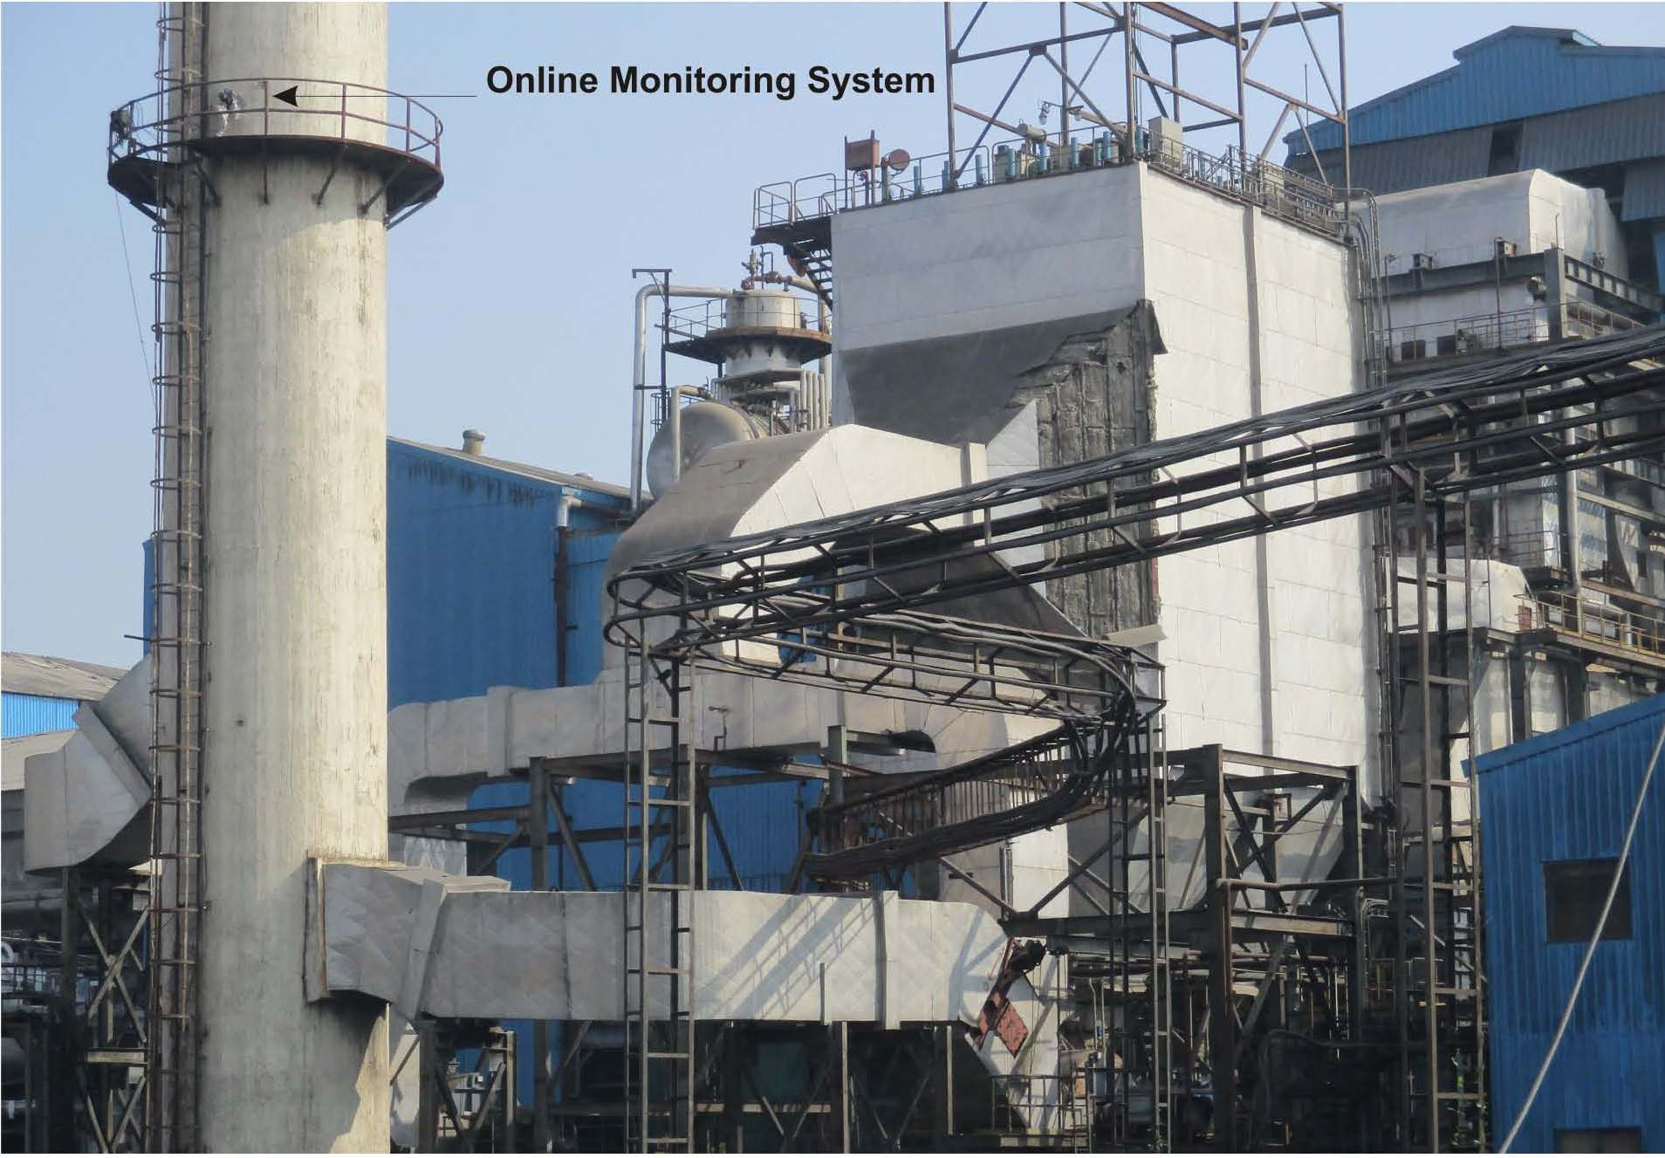
APC & Online Continuous Monitoring System (OCMS)

Slide 28
Environmental Aspects
Noise
Unit | Source | Control Measures
Distillery | Fermentation & Distillation Section | Isolation, Separation and Insulation techniques adopted PPE as Earmuffs, Earplugs provided to staff & workers.
Sugar Factory | Mills, Pumps Compressors & D. G Boiler Section & Turbine
Dust
Unit | Source | Control Measures
Sugar Factory | Mills, Sugar Bagging, Bagasse & Pressmud Storage Areas | Efficient Exhaust & Ventilation Systems, Efficiency Monitoring of APC & Dust Control Equipments, Regular Self Monitoring of Work Zone Dust Levels, PPE, Adequate Density & Type Green Belt Development, Proper Surfacing of Internal Roads, Yards, Water Sprays & Mist Arrangements.
Odour
Unit | Source | Control Measures
Distillery | Molasses Tanks, Fermentation Section, Yeast Sludge & Spentwash Storage Tanks | Proper House Keeping, Prompt Sludge Management in Biological Treatment units, GMPs Efficient handling, prompt & proper disposal of Pressmud, Yeast Sludge & Spentwash. Close Fermentation & Molasses Handling.
Sugar Factory | ETP, Molasses Tanks, Pressmud Yard, Bagasse Conveyor; Feeding Section, Ash Storage

Slide 29
Baseline Environmental Details
Risk Studies & Disaster Management
Project | Risk Area | Hazard | Mitigation Measures
Distillery | Molasses Storage Tanks | Rupture & Toxic Liquid Leakage | Dyke walls is constructed around the tank. In case of temp. beyond 30⁰C; external cooling system Mechanical Seals to Pump Gland to avoid leakages Hot work permit for maintenance to avoid direct contact with pressurized gases in tank.
 | Alcohol Storage | Fire (Worst case scenario) | All tanks in Dyke Walls (Std. design & construction norms). Guidelines in OISD 117 Std. is followed for fire fighting around alcohol storage area. Pump Motors & Electrical Fittings to be Flame Proof. On Site Emergency Control Plan : RA & DMP is implemented.
Sugar Factory | Bagasse Storage | Fire | Self & Auto-mode Fire Fighting System around Bagasse Yard. Hot Work, Welding, Gas Cutting avoided near Bagasse Storage Training of all Staff in Normal & Emergency Conditions. High Voltage Transmission Lines above Bagasse Yard Avoided. Firefighting Plan & Lightning Arrestors Provided
 | Sulphur Storage | Dust Explosion & Fire | Shed with Min. Horizontal Surfaces to avoid Dust Accumulation, All sources of Ignition excluded. Formation & Suspensions of Sulphur Dust in air avoided, Chemical Foam Fire Extinguishers provided. Bag Opening Device, PPE (mask, hand gloves) provided.
 | SO₂ Prod. | Toxic Gas Leakage | Installation of SO₂ Leak Detectors & Alarm Systems. Pressure & Thickness Tests of equipment & piping carrying SO₂ to avoid leakage.
Occupational Health & Safety Measures
Occupational Health Center., 24 X 7 Ambulance Facility available
Regular Medical Checkup of Employees & Records Keeping is followed .
SO₂ Production procedure has been prepared.
Workmen Compensation Policy, Mediclaim Health Policy (Temporary & Permanent)
Good Management Practices (GMPs) being followed.
Well Managed Process Operations, Automation of Production with Pollution Control Equipments done.
Health & Safety Awareness camps arranged. Posters & Boards displayed in Industry.
PPEs such as Shoes, Helmets, Goggles, Earmuffs, Ear Plugs are provided.
Housekeeping & Waste Handling : Training & Education to Workers, Good O & M Practices
Sanitary Facilities & Other Measures – Adequate Toilets, Changing Rooms, Rest Rooms Provided. Good Aesthetics maintained and BMPs adopted.

Slide 30
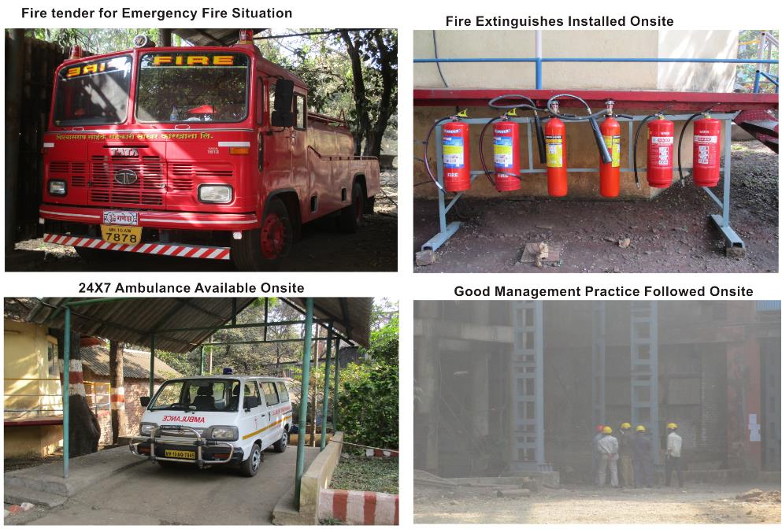
Photographs of Fire Fighting Arrangements

Slide 31
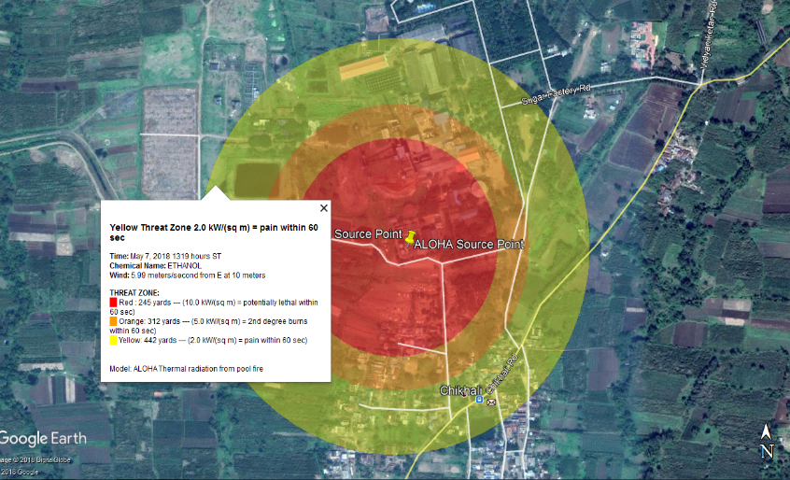
Aloha – Ethanol
Scenario : Fire in Ethanol Storage
Pipe Dia. : 150 mm; Length : 30 M; Pressure – 0.5 Kg/sq.cm
Release Duration : 18 min.; Qty. released : 5.57 Kg
Threat Zones :
Red : 245 M (10 KW/sq.m = Potential lethal within 60 sec.)
Orange : 312 M (5 KW/sq.m = 2nd deg. burns within 60 sec.)
Yellow : 442 M (10 KW/sq.m = pain within 60 sec.)
Mitigation Measures:
For Alcohol storage, tank layout, tank-farm layout, pump locations will be as per requirements of PESO latest rules and regulations.
Statutory approvals for the storage of Alcohol will be obtained, before the plant start up.
All tanks will be provided with Flame Arrestors, Moisture Traps & over head condensers with chilled water for prevention of Alcohol loss & environment protection.

Slide 32
Green Belt Development Plan
Total Land Acquired for VNSSKL Complex : 52.52 Ha
Existing Green Belt (42% of TPA) : 22.4 Ha; No. of Trees : 7472
Features of the GB Development Program:
Avenue Plantation : Internal Roads to various Units, Bagasse; Pressmud; Ash Yards
Shelter Belt Plantation: A thick barrier of trees to be created along periphery / fence.
Mass Plantation : Vicinity of Ash & Bagasse Storage, Trees controlling dust planted.
Plantation of Peculiar Tree Species - Noise Attenuation, Dust Suppression, Indigenous, Ever Green.
Rain Water Harvesting Details
Surface Harvesting : Runoff from Industrial Plot 52.52 Ha. to be harvested & stored in tanks excavated at suitable locations as per the Contour Levels.
Roof Top Harvesting Yield : 5128.5 M³ (From Area : 8125 M²)
Surface Harvesting Yield : 1,34,955 M³ (From Area: 4,61,196.85 M²)
Total RWH : 1,40,083 M³, 140 ML.
Provision of 2 Tanks (5128.5 M³) : 2,500 M³, 3,000 M³.
Utilization for Green Belt, Fugitive Dust control, Firefighting Demand Makeup, Washing & Cleaning
Excess rain water will be diverted offsite the plot through storage tanks outlets
Description | Area (M²) | Total Area (M²) | Rainfall (M) | Runoff Coeff. | Yield (M³)
Roof Top Harvesting | 8125 | 5,25,280 | 0.789 | 0.8 | 5128.5
Surface Harvesting
Green Belt | 2,24,000 | 5,25,280 | 0.789 | 0.3 | 53,020.8
Road | 58,831 |  | 0.789 | 0.5 | 23,208.8
Open space | 73,009.85 |  | 0.789 | 0.3 | 17,281
Parking Area | 1,05,056.0 |  | 0.789 | 0.5 | 41,445
Total |  |  |  |  | 1,40,083

Slide 33
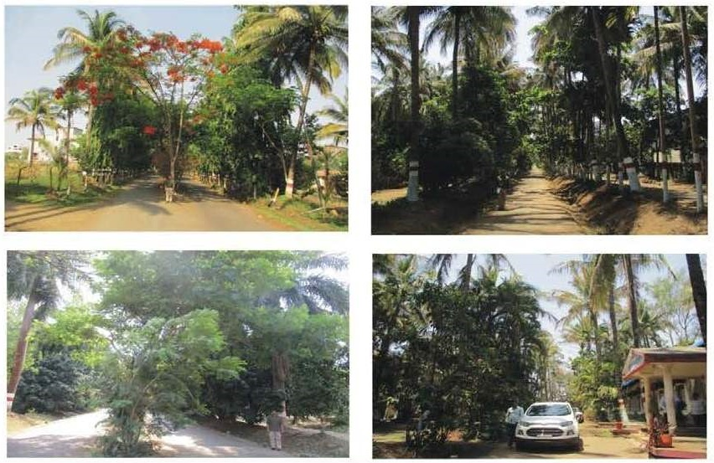
Photographs of Green Belt
Roadside Plantation

Slide 34
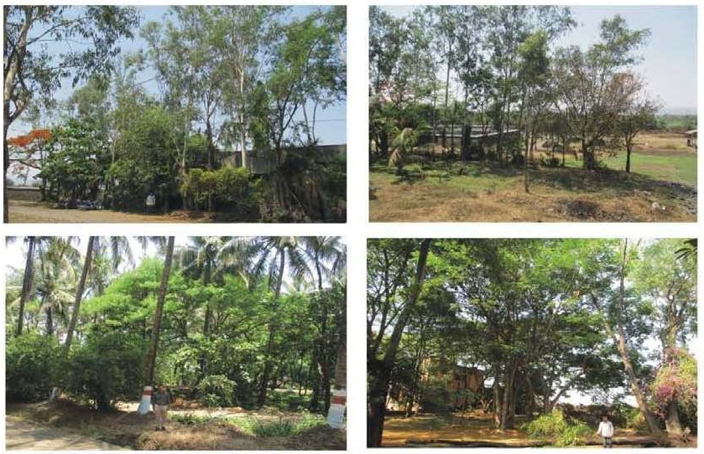
Photographs of Green Belt
Shelter Belt Plantation

Slide 35
Green Belt (GB) Design Details
Type of Plantation | Location on Plot | GB Length (M) | GB Width (M) | GB Area (Sq. M) | No. of Tree Rows | Trees / Row | Total Trees | Trees | Characteristics
 |  | A | B | C = A*B | D = B/2 (2 = Dist. Bet. 2 Rows) | E = A/2 (2= Dist. Bet. 2 trees) | F = D*E
Shelter Belt along Compound Wall | North | 1476 | 10 | 14760 | 5 | 738 | 3690 | Neem, Shisav, Karanj, Umbar, Wilayati Chinch, Saptaparni, Apta, Mahogani, Bel, Ran Bibba, Nandruk, Kadamb, Limbara | Trees with round & oblong canopy, native, evergreen, pollution resistant, fast growing, high dust settling index
 | East | 448 | 10 | 4480 | 5 | 224 | 1120
 | South | 1841 | 10 | 18410 | 5 | 920.5 | 4602.5
 | West | 200 | 10 | 2000 | 5 | 100 | 500
Mass Plantation | Open Areas | Areas with uneven shapes |  | 190722 | 4 sqm area for each tree species |  | 47681 | Khair, Saag, Bel, Bahava, Shivan, Nandruk, Umbar, Limbara, Kadamb | Tree with round & oblong canopy, native, evergreen, pollution resistance
Avenue Plantation | Along Roadside | 4640 | 2 | 9280 | 1 | 2320 | 2320 | Bakul, Bahava, Tamhan, Ashoka, Saptaparni | Tree species with conical, columnar canopy, ornamental, fast growing, pollution resistance will be planted as avenue plantation
Total |  |  |  | 2,39,652 |  |  | 59,913
 |  |  |  |  |  | Existing | 34,735
 |  |  |  |  |  | Proposed | 25,178

Slide 36
Existing Tree List
Names; Numbers & Types of Trees in Green Belt
No. | Common Name | Scientific Names | No. of trees
Plantation in Sugar Factory Premises:-
1 | Coconut | Cocos Nucifera | 40
2 | Chikku | Manilkara Zapota | 40
3 | Suru | Casuarina equisetifolia | 1500
4 | Nilgiri | Eucalyptus Globulus | 1000
5 | Ashoka | Polyalthialongifolia | 60
6 | Amba | Mangifera Indica | 40
7 | Morpankhi | Platycladusorientalis | 40
8 | Peru | Psidiumguajava | 12
9 | Palmtree | Areca catechu | 670
10 | Gulmohar | Delonixregia | 30
11 | Booganvel | Bougainvillea glabra | 50
Plantation in ‘C’and‘D’ type Colony Area :-
1 | Coconut | Cocos Nucifera | 10
2 | Rain tree | Samaneasaman | 40
3 | Nilgiri | Eucalyptus Globulus | 20
Plantation in Garden:-
1 | Coconut | Cocos Nucifera | 660
2 | Chikku | Manilkara Zapota | 50
3 | Peru | Psidiumguajava | 40
4 | Shevaga | Moringa oleifera | 10
5 | Palm | Areca catechu | 10
6 | Suru | Casuarina equisetifolia | 50
7 | Ashoka | Polyalthialongifolia | 8
Plantation in Sugar Factory ETP Premises:-
1 | Suru | Casuarina equisetifolia | 1000
2 | Chikku | Manilkara Zapota | 80
3 | Nilgiri | Eucalyptus Globulus | 2000
4 | Coconut | Cocos Nucifera | 12
Total |  |  | 7472

Slide 37
Proposed CER Details
No. | CER Activity Details | Amount (Rs. Lakh)
1 | Solar Photovoltaic Electricity Generation System : 300 KW @ Rs. 40,000 per KW to be installed at grampanchayat, school building, PHC building. Cost: 300 KW x Rs. 40,000/- = Rs. 120 Lakhs | Rs. 120.0
 | Provision of Solar Street Lights (5 Villages) : With Gadget – 1 MS Pole, 18-20 W LED Lamp, Battery, Solar Panel, Wiring etc. complete 5 Villages X 20 Nos./Village = Total 100 Solar Street Lights X Rs. 20,000/- per No. = Rs. 20 Lakhs | Rs. 20.0
 | (0.76% of Capital Investment Rs. 182 Cr.)Total Amount | Rs. 140 Lakhs

Slide 38
Existing CSR Details
CER activities are administered and communicated via. a separate foundation, namely; “Fattesingrao Naik Endowment Trust”, Yashwantnagar. CER activities implemented through HR, Agriculture, and separate CER department. The details are as under-
No. | Description | Amount Incurred on CER (Rs. Lakhs)
 |  | 2018-19 | 2019-20 | 2020-21
1 | Supply of Educational Material | 4.0 | 5.0 | 5.0
2 | Funds for Sports and Competitions | 1.0 | -- | 0.5
3 | For Social Welfare & Medical Check - Up | 1.0 | 5.0 | 7.0
4 | Supply of Drinking Water to Villages | 2.0 | 2.0 | 2.0
5 | Promoting Self Employment | 1.0 | 1.0 | --
6 | Agricultural Training & Krishi Mela | 1.0 | 1.0 | 0.5
 |  | 10.0 | 14.0 | 15.0

Slide 39
Environment Management Plan (EMP)
EMC of 8 Members, Qualification : Qualification : M.E. (Env.), M.Sc. (Env. Sc.), B.Sc. (Chem.), PGDISHE.
MD, ETP Chemist, Sugar ETP Supervisor
The Capital as well as O & M Costs towards Environmental Management -
No. | Description | Cost Component (Rs. Lakhs)
 |  | Capital | Annual O & M
A | Existing
1 | APC Equipment : ESP, Stack (Ht. 76 M) & OCMS | 400 | 40
2 | Sugar Factory & Co-gen ETP | 150 | 50
3 | Noise Pollution Control | 15 | 3
4 | Solid & Hazardous Waste Management | 25 | 5
5 | Occupational Health & Safety | 30 | 5
6 | Environmental Monitoring & Management | 30 | 5
7 | Green Belt Development & Rain Water Harvesting | 80 | 20
 | Total (3% of Capital Investment of Rs. 231.12 Cr) | 730 | 128
B | After Expansion
1 | APC Equipment : ESP, Stack (Ht. 76 M) & OCMS for Co-gen Boiler | 400 | 40
2 | Water Pollution Control – Sugar & Distillery CPU, MEE, STP & ATFD | 1500 | 100
3 | Noise Pollution Control | 10 | 2
4 | Occupational Health & Safety | 20 | 2
5 | Green Belt Development & Rain Water Harvesting | 90 | 10
6 | Environmental Monitoring & Management | 10 | 2
 | Total (11% of Capital Investment of Rs. 182 Cr) | 2,030 | 156
 | Grand Total (A + B) | 2,760 | 284

Slide 40
Report by RO; MoEFCC; Nagpur (Visit dt.: 23.11.2021 & Compliance Observed vide Report dt. 17.02.2022)
Out of 22 General Conditions; 14 were Fully Complied, 3 were Partly Complied & only 5 was Not Complied
No | Comments in RO Report | Comment / Compliance done by PA
A | Condition was not Complied
1 | Condition No. V PP did not install any piezometer nearby to compost yard even after 18 years of grant of EC | Earlier during year 2007; two piezometers were installed near distillery & compost yard premises. They were simple manual reading & recording type WLR gadgets. Over a period of time; the instrument got non-functional as a result of frequent manual operations & corrosion. So industry decided to install new latest type of DWLR Piezometers working on automation and telemetry data recording and transmission principles. The order was already put with one reputed supplier in January 2020. However, due to COVID-19 Pandemic situation the supplier & installing agencies could not provide and commission the Piezometers Network Station. As a pre-requisite, Hydrogeological Survey required for identification of locations of the new Piezometers around spentwash storage and compost yard was conducted. Based on findings of this report, new bore wells are already drilled for installation of DWLR Piezometers sensors in them. Installation of Piezometers will be completed within next three months. Image showing locations identified for installation of Piezometers is enclosed at Annexure-I.
2 | Condition No. X PP did not provide any structure for rainwater harvesting/recharging of ground water even after 18 years of the grant of environmental clearance. | Roof top harvesting system is partly provided on site. Harvested water is used for green belt development in industrial premises. For surface water harvesting, two tanks will be provided by considering contours of project site; for which a detailed survey has already been conducted. Refer Annexure-II for Contour Plan & Rain Water Harvesting Arrangements & Structures. Implementation will be done within three months.

Slide 41
No | Comments in RO Report | Comment / Compliance done by PA
A | Condition was not Complied
3 | Condition No. XII PP did not provide any detail pertaining to the compliance of the stipulation. There is no clarity whether the stipulated funds were deposited with MPCB. PP did not submit any action plan for the Eco development and community welfare. PP did not take any step despite the EC was granted post-facto. | Industry is a Co-operative Sugar Factory. Implementation of Eco Development and Community Welfare activities under CSR are done through a separate foundation named - “Fattesingrao Naik Endowment Trust”. Through this foundation, activities have been done towards eco development and community welfare which included - Supply of Educational Material, Funds for Sports and Competitions, For Social Welfare & Medical Check – Up, Supply of Drinking Water to Villages, Promoting Self Employment & Agricultural Training & Krishi Mela, Plantation of trees in neighbouring villages etc. The details are as follows –
4 | Condition No. VIII PP did not submit the six monthly compliance reports regularly since the grant of environmental clearance. | The industry has submitted six monthly reports regularly since 2020. The latest Six monthly compliance report for period April 2021 to September 2021 was submitted to RO; MoEFCC, Nagpur on 22.11.2021 by mail. Industry hereby assures that henceforth, six monthly compliance report submission shall be done regularly. Acknowledgment of six monthly compliance report submitted is enclosed at Annexure – III.
5 | Condition No. IX PP did not make the newspaper advertisement as per the stipulation. The advertisement was made in the year 2021. | Industry had already advertised regarding grant of EC in local newspaper in year 2003. The record of newspaper cutting was not traceable due to very long period since grant of EC. Industry republished advertisement on 09.11.2021 in Marathi language (Jan Pravas) and English Newspaper (Times of India). Advertisement copy is enclosed at Annexure- IV

Slide 42
No | Comments in RO Report | Comment / Compliance done by PA
B | Conditions Partly Complied
6 | Condition No. III Spent wash generated in the distillery is treated in reboiler and utilised in compost preparation with press mud and yeast sludge. During the site inspection it was observed the spent was flowing in adjacent drains. No collection system was provided at the compost yard. | Leachate collection arrangement is provided on site. Separate drains are provided for leachate & leachate from compost yard is collected in a tank and then pumped to spent wash storage tank. Google image of leachate tank and composting area is enclosed at Annexure –V.
7 | Condition no. IV Spent was is stored in lagoon provided with HDPE liner. During the site inspection, it was observed that the storage capacity of spent wash was 35 days. | In fact the capacity of spent wash storage tank is 30-days only. While designing the tanks; certain allowance / volume has to be considered to accommodate sudden torrential rains and the direct precipitation on tank surface so that there will not be any overflow and runoff discharges on to nearby open lands.
8 | Condition no. VII During the site inspection, it was observed that one Environmental Officer was posted at the project. Environment quality monitoring was carried out through external laboratory. As per the information provided, Rs.730 lakhs were allocated for capital works and an amount of Rs. 128 lakhs were allocated annually for operation & maintenance of environmental infrastructure. However, the compliance levels were not observed to be satisfactory. | Industry is already having a EMC of 18 persons functioning under its existing sugar factory, co-gen plant and distillery projects. The EMC is responsible for all the activities, actions, outputs and management of entire infrastructure provided for control and abatement of pollution in the VNSSKL project complex. At the time of site inspection visit, work of compost yard & spent wash spraying infrastructure maintenance was going on. A report on performance of existing pollution control infrastructure will be submitted through next six monthly compliance report.

Slide 43
THANK YOU

