Slide 1
PRESENTATION
TO
HON’BLE EXPERT APPRAISAL COMMITTEE OF MoEF & CC
(THERMAL POWER PROJECTS)
FOR
EXTENSION OF VALIDITY OF ENVIRONMENTAL CLEARANCE
(J-13012/ 73/2011-IA.II (T) dated 05.12.2011)
OF
EXPANSION BY ADDITION OF 1 x 350 MW COAL BASED THERMAL POWER PLANT (PHASE-II)
M/s GMR KAMALANGA ENERGY LTD.
AT VILLAGE-KAMALANGA, DISTRICT -DHENKANAL, ODISHA
Date of EAC Meeting:

Slide 2
ABOUT THE COMPANY
GMR Kamalanga Energy Ltd. (GKEL) is a flagship company of GMR Group specifically in Power Sector.
GMR is a global infrastructure Group specialized in Airports, Energy, Highways and Urban Infrastructure. The Group is also actively engaged in the areas of Education, Health and Community Services through its Foundation, reaffirming its presence as an agency for a change from the grass root of the society, in the field of Corporate Social Responsibility.
GMR Energy has 3015 MW capacity under operation and around 1775 MW capacity under development at various locations. Under Operation includes 29.35 MW of Green Energy, 300 MW of Hydro.
GKEL has already obtained environmental clearance for existing 3x350 MW Thermal Power Plant (under operation) and additional 1x350 MW (under implementation) at Village - Kamalanga, District – Dhenkanal, Odisha.
GKEL has implemented the best management practice like ISO 9001(QMS), ISO 14001(EMS), ISO – 45001 (OHSMS), ISO-50001 (EnMS), ISO – 27001 (ASM) and ISO – 55001 (ISMS) and also 5S system Certification through NPC.

Slide 3
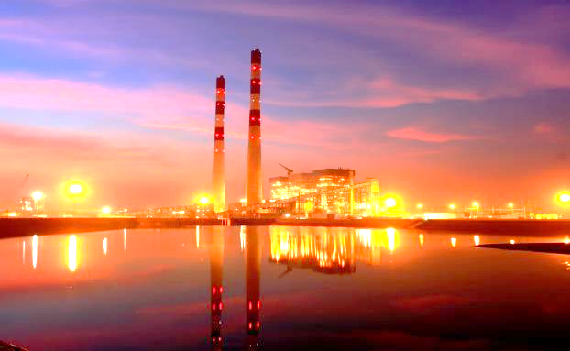
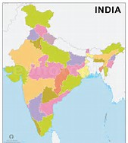
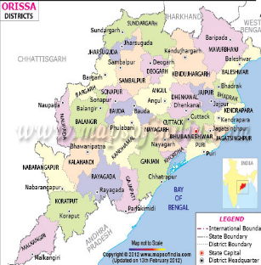
GMR KAMALANGA ENERGY LIMITED
GKEL
Plant Site
Geographic Location | Latitude : 20⁰ 52’ 00” N Longitude : 85⁰ 16’ 18“ E
Nearest Airport | Bhubaneswar -140 Km
Nearest Seaport | Paradeep - 180 Km
National Highway | NH-55 – 05 Km
Nearest Railway Station | Budhapank - 03 Km

Slide 4
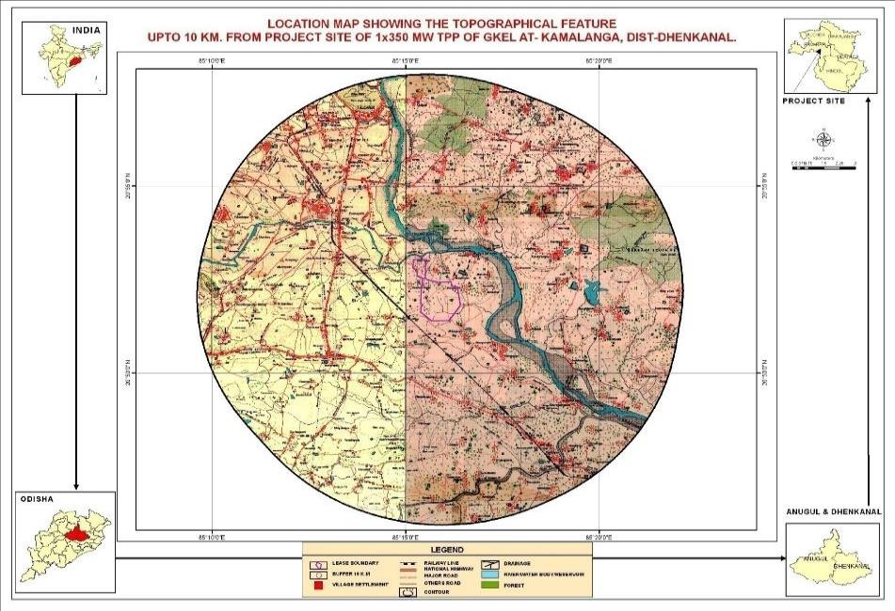
LOCATION OF THE PROJECT

Slide 5
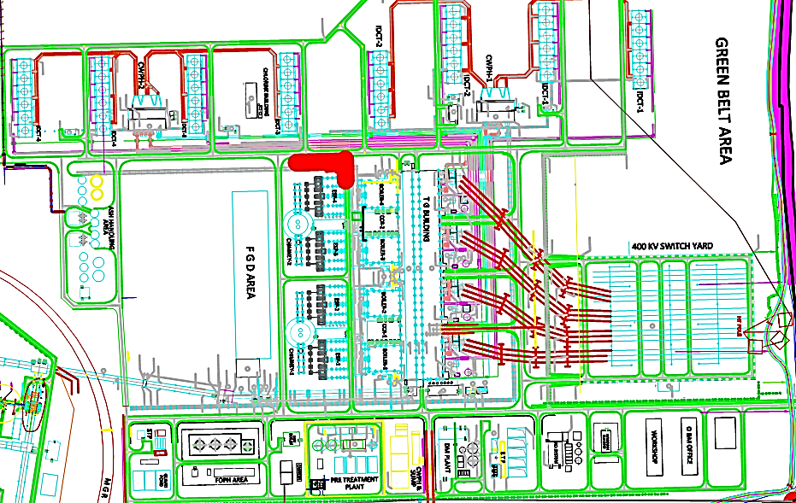
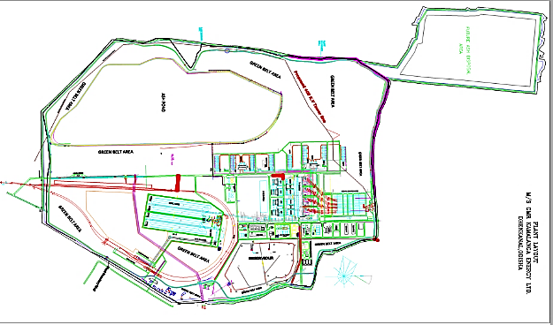
PROJECT LAYOUT
Unit IV BTG Area

Slide 6
STATUS OF APPROVALS
Sl. | Description |  | Approvals
1. | Environmental Clearance | EC for 3 x 350 MW Thermal Power Plant (Phase-I) | Granted by MoEF&CC vide letter No. J-13011/ 64/2007-IA.II(T) dated 05.02.2008
 |  | EC for 1 x 350 MW Thermal Power Plant (Phase-II) | Granted by MoEF&CC vide letter No. J-13012/73/2011-IA.II (T) dated 05.12.2011, Amendment dated 11.01.2019 & Validity Extension dated 11.04.2019
2. | Present status | Phase-I | 1050 MW under operation
 |  | Phase-II | 350 MW under implementation
3. | Consent to Establish | Phase-I | Granted by OSPCB vide letter no. 10298/Ind-II-NOC-4469 dtd.30.04.2008
 |  | Phase-II | Granted by OSPCB vide letter no. 7260/Ind-II-NOC-5312 dated 12.04.2012 & its validity extend till 11.04.2027
4. | Consent to Operate | Phase-I | Granted by OSPCB vide letter no. 5396/IND-I-CON 6218 dated 31.03.2022
 |  | Phase-II | --

Slide 7
PRESENT PROPOSAL
Sl. | Present Proposal
1 | Extension of Validity of EC obtained from MoEF&CC vide letter no. J-13011/64/2007-IA.II(T) dated 05.12.2011, for another five years i.e. up to 04.12.2027
The Environment Clearance was granted for Expansion of existing 3 x 350 MW Thermal power project by addition of 1 x 350 MW Coal based Thermal Power Plant by MoEF&CC vide F. No. J-13012/73/2011-IA.II (T) on dated 05.12.2011 and its revalidation dated 11.04.2019 and is valid up to 04.12.2022 considering general extension of 1 year vide MoEF&CC Gazette Notification No. 201 dated 18th January, 2021.

Slide 8
REASON & NECESSITY OF VALIDITY EXTENSION
Reason for Delay –
No project work due to the Covid 19 pandemic from April 2020 to April 2022
Non-availability of Power purchase agreement
The coal supply was hit because of Hon’ble Supreme Court’s decision on Coal Mining allocation, and ultimately which hit the Power Sector
The price of coal in international market was very high
Delay in offshore material supply
Necessity of Validity Extension –
As GKEL has set up common infrastructure facilities like MGR, Direct Road, Switch Yard, Transmission line, Coal Handling Plant, Ash Handling Plant, Coal Yard & Water System, STP, ETP in line with 4 x 350 MW (including 1 x 350MW) and we have already implemented more than 63% of the overall Project Works. 90% of Civil work including chimney construction is completed. Adequate land is also available for installation of FGD & Future Ash pond of this project, so further validity extension of EC is required for getting the Power Purchase Agreement (PPA), Fuel supply Agreement (FSA) and their by getting the finance and achieving financial closure and completion of the Project activities.
Completion of the project will definitely benefit to meet the ever-increasing power demand of the state and country, and also will be help in increase of the Socio-economic development of the locality.

Slide 9
IMPLEMENTATION STATUS of the Expansion Proposal by adding 1 x 350 MW
Sl. | Plant Facilities | Status of Implementation | Completion by
1 | Boiler, Turbine, Generator & Accessories and TG Building | Major Civil work completed, Coal Bunkers erected, rest to be done. | 30.06.2025
2. | ESP & FGD, Ash Conveying | ESP Control Room Building completed, Rest of jobs to be done. Space available for FGD. | 30.11.2025
3 | Chimney with Flue can | Completed | --
4 | Switch Yard | Completed | --
5 | Cooling Towers & CW Pump house | Civil & building work of pump house completed, Cooling Tower work to be done. | 30.03.2025
6 | River Water Pump House, Pipelines, Reservoir & Raw water Pump House | Completed – Common facility | --
7 | Water treatment plant system & ETP/STP/RO system | Completed-Common facility | --
8 | Ash Pond | Completed Present ash pond will be used, as ash utilization more that 100 % since last 5 yrs. | --
7 | Coal Handling, Fuel Handling and Ash Handling Plant with silo. | Completed -Common facility | --
8 | Greenbelt | 358 Acres with 3,93,816 nos. of Saplings planted. | --
9 | Road and infrastructure | Completed | --

Slide 10
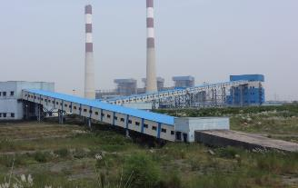
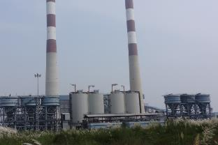
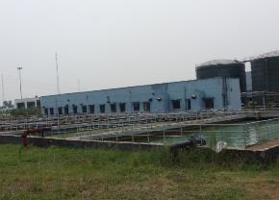
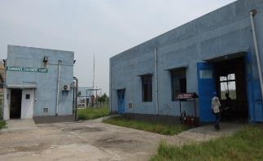
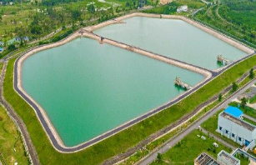
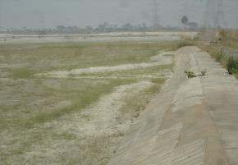
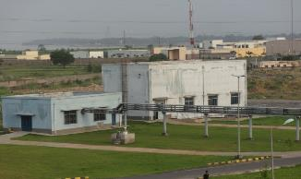
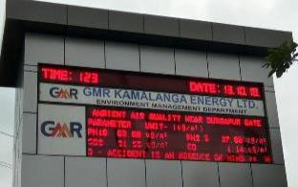
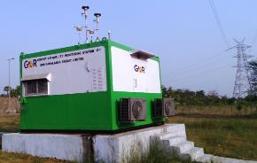
VIEW OF PLANT FACILITY
COMMON FOR 3 x 350MW + 1 x 350 MW

Slide 11
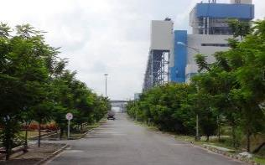
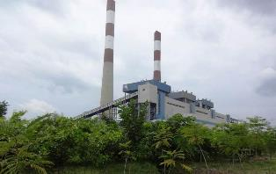
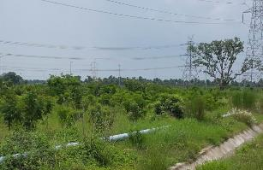
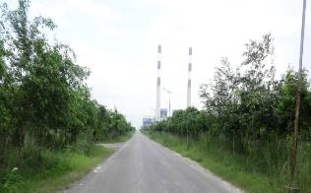
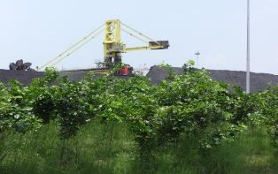
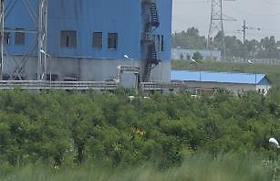
STATUS OF GREEN BELT & PLANTATION
Plantation in around plant & township - 393816 nos. of Saplings
Area Covered - 358 Acres
Survival rate - > 90%
Saplings distribution to near by community - 13417 nos.
Outside plantation in village & Dhenkanal - 22050 Sapling
Medicinal Plants near Sogar of Dhenkanal - 4800 Sapling at 3 Ha.

Slide 12
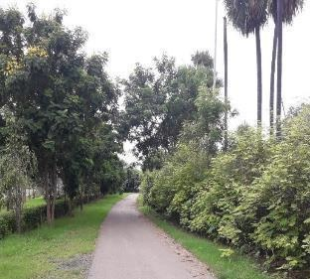
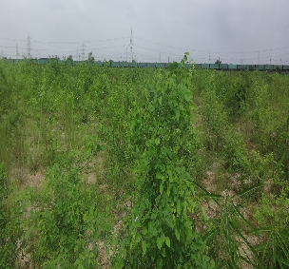
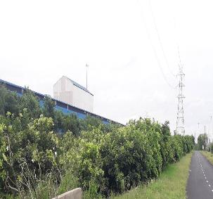
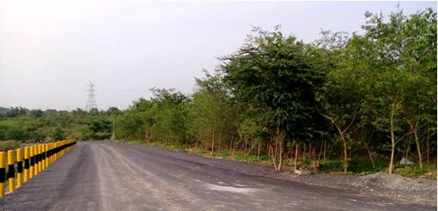
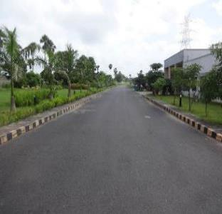
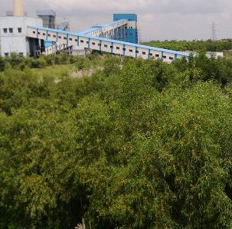
STATUS OF GREEN BELT & PLANTATION

Slide 13
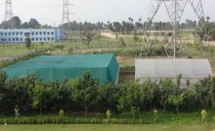
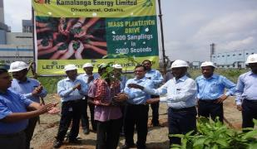
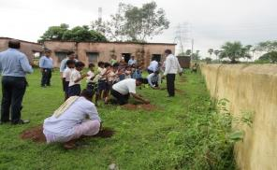
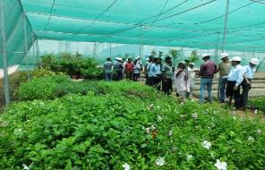
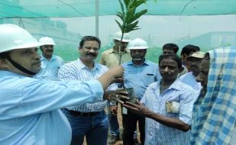
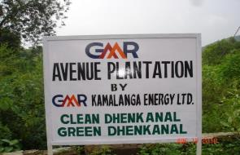
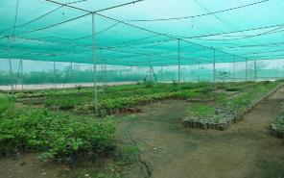
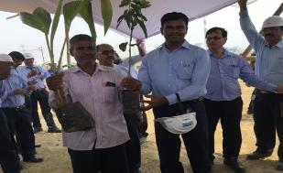
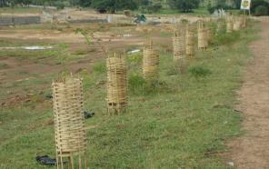
VIEW OF NURSERY & PLANTATION
In-house Nursery | Sapling Distribution | Outside Plantation

Slide 14
FLY ASH UTILISATION –EXISTING UNITS
GKEL have utilised fly ash more than 100 % in last five years (till September 2022)
Sl. No | Year | Coal Consumption (MT) | Total Ash Generated (MT) | Total Ash Utilized (MT) | % of ash utilization
1 | 2018-19 | 4801570.51 | 1786716.48 | 1788724.90 | 100.11
2 | 2019-20 | 4338089.50 | 1704859.21 | 1820567.69 | 106.79
3 | 2020-21 | 5166811.11 | 2060592.32 | 2382150.99 | 115.61
4 | 2021-22 | 5457810.00 | 2324000.33 | 3101815.83 | 133.47
5 | 2022-23 (YTD-Sep’22) | 2460288.00 | 1086586.97 | 1259123.24 | 115.88
Total (last 5 Years) |  | 22224569.12 | 8962755.31 | 10352382.65 | 115.50

Slide 15
FLY ASH UTILISATION – ACTION PLAN
Combine Action Plan for Generation & Utilisation of Fly Ash (including Pond Ash) (Quantity in MT)
Planning Year | 2024-25 | 25-26 | 26-27 | 27-28 | 28-29 | Remark
Current Generation | 18.35 | 18.35 | 18.35 | 18.35 | 18.35
Unutilized pond ash | - | - | - | - | -
Unit-4th to be commission |  |  | 3.00 | 6.17 | 6.17 | Daily 2000-2100MT of Ash is being sent to brick making unit situated in the district of Angul, Dhenkanal, Cuttack, Bhubaneswar outside plant One brick making unit is in operation. Average daily consumption is 20.00 MT AAC Block manufacturing unit will be installed by March 2025
Total to be utilised in LMT | 18.35 | 18.35 | 21.35 | 24.52 | 24.52
To Brick Manufacturer | 8.40 | 8.40 | 9.60 | 9.60 | 9.60
For Road making (NHAI) | 6.00 | 3.00 | 3.00 | 3.00 | 2.00 | NH-16, 23 & 200 connecting Talcher to Chandikhole NH-55 connecting Manguli to Sambalpur
Filling abandoned Laterite quarries/Land reclamation | 0.35 | 2.75 | 3.95 | 6.52 | 6.92 | CTE & CTO obtained for three location in Dhenkanal District with a potential of 3.00 LMT. Process for identification and obtaining approval from MCL for filling abandoned coal mines of MCL.
Ash Dyke raising & Developing new Ash pond | - | - | - | - | -
For Cement | 3.60 | 4.20 | 4.80 | 5.40 | 6.00 | Supply to cement plants within radius of 150KM. Installation of cement grinding unit
Total to be utilised | 18.35 | 18.35 | 21.35 | 24.52 | 24.52

Slide 16
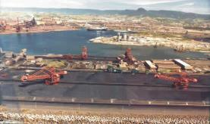
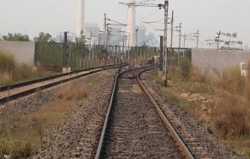
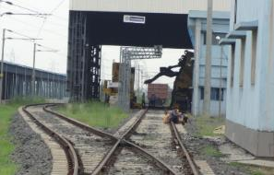
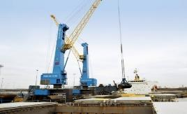
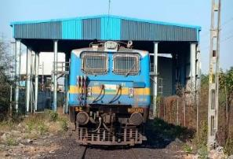
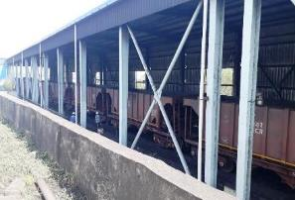
MODE OF COAL TRANSPORTATION
Domestic Coal - Coal is being transported from Mahanadi Coal Fields – Talcher area to plant site by Rail for the existing units and also to be transported for Unit - 4 in same way.
Imported Coal - Coal will be sourced from Indonesia through Port and then by rail to project site and unloaded through existing track hopper / wagon tippler. The coal will be imported through bulk carriers/vessels through at Paradeep port (180 km) or Dhamra port (250 km).

Slide 17
CSR ACTIVITIES
GMR Kamalanga Energy Ltd. performs its corporate social responsibility in collaboration with GMR Varalakshmi Foundation (GMRVF), the CSR arm of GMR Group, in Kamalanga & Mangalpur G.P. of Odapada block in Dhenkanal district of Odisha. GKEL as part of GMR Group’s policy, is committed towards inclusive growth and has undertaken CSR activities since 2007.
CSR Unit undertakes projects mainly on Education, Health, Hygiene & Sanitation, Empowerment & Livelihoods and Community Development.
Company has established DAV Public School – Given fee concession to children of PAP
A 15 bedded Hospital for the communities.
Pipe water supply started to 7 villages in collaboration with RWSS dept. of Govt. of Odisha
A Special Livelihood Restoration Program (LRP) started in 2016-17 with an objective of livelihood improvement of about 1500 families in 6 years. We provide support for farming, livestock rearing, skill training and enterprise development for increase income & provide alternative livelihood option.
Concession in school fees to the children from land loser families at GMR DAV Public School.
Construction of Village roads, renovation of temples, ponds in the Panchayats.
Implementation of Social Volunteering Programs (an group initiative) for the benefit of community people by GKEL employees every year.
DAAN UTSAV week is being observed every year with identified activities. After the Covid pandemic in FY 2021-22 & 2022-23 various supports provided to more than 1400 needy people with an expenditure of around Rs 32.00 lakhs contributed by Employees, Agencies and other stake holders of GKEL.

Slide 18
CSR ACTIVITIES
Engaging 15 Extra teachers(Vidya volunteers) in Govt. schools
Supporting 16 Anganwadi centres
Providing scholarship to 14 students every month
Running Computer education for girls.
Test papers provided to 300 students of class 9th and 10th in FY 22-23
Telemedicine program for specialised diseases covering about 100 patients every month.
Average 800 patients treated through Mobile medical Unit every month
1179 persons took booster dose of vaccine against COVID in FY 22-23
45 persons received 4.3 lakhs as reimbursement of health treatment expenses.
55 pregnant and lactating mothers receive nutritious food in 5 village centres.
48 old and poor persons receive monthly dry food ration
45 girls are engaged in 2 tailoring centres for stitching various garments, fancy bags etc.
92 fish farmers received fish yearlings and other inputs in FY 22-23
25 farmers started doing Kuber variety of paddy and 4 has taken up sugar free paddy
Expenses in CSR activities in last five years and this financial year (till September) is given below
Year | Expenses (Rs. In lakhs) | Year | Expenses (Rs. In lakhs)
FY 2019 | 379.09 | FY 2022 | 202.60
FY 2020 | 279.79 | FY 2023 (till September) | 106.30
FY 2021 | 163.60

Slide 19
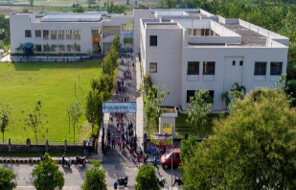
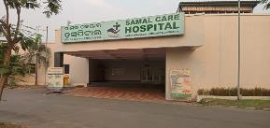
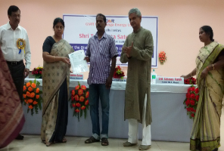
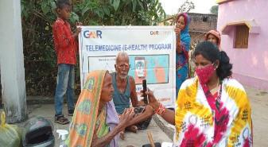
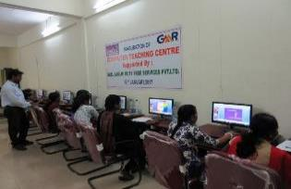
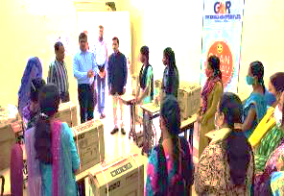
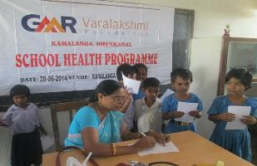
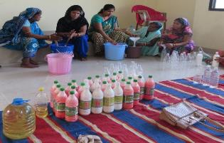

CSR ACTIVITIES

Slide 20








CSR ACTIVITIES
Black top road from Maniabeda to Durgapur village
400mtrs CC Road- Bhagamunda Village
Restoration of Pond of Maniabeda Village
Water Supply facility for community
Rain water harvesting in Kamalanga School
Yagna Mandap in Village Temple - Kamalanga

Slide 21
SUBMISSION
In light of the above discussion, GKEL request the Hon’ble EAC (Thermal power projects) to grant extension of validity of Environmental Clearance (Phase-II) obtained from MoEF&CC vide letter no. J-13011/64/2007-IA.II(T) dated 05.12.2011 for the period of five years i.e. up to 04.12.2027. (Five years)

Slide 22
Thank You

